Slide 1
Stay tuned for our next webinar!
Webinar: AI & Transportation
1:00-1:45 pm ET
The webinar recording and slides will be emailed to all registrants within a day.
@Enotrans

Slide 2
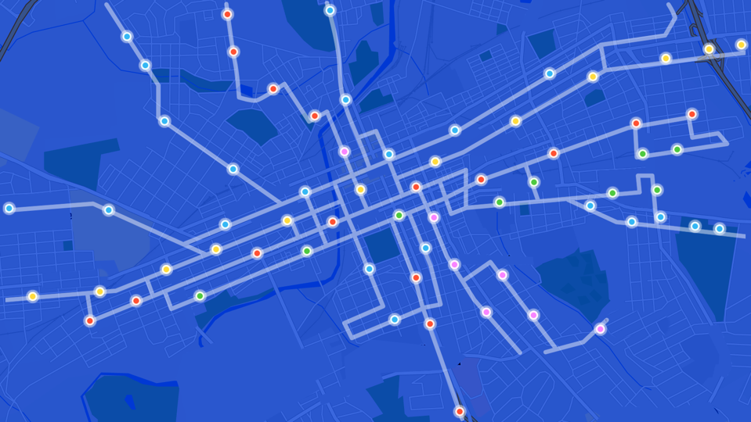
AI & Transportation
October 12, 2023

Slide 3
Renee Autumn Ray, Senior Director of Transportation Policy at Hayden AI
Sameer Sharma, Eno Board of Directors, Eno Center for Transportation
Robert Puentes, CEO,
Eno Center for Transportation

Slide 4
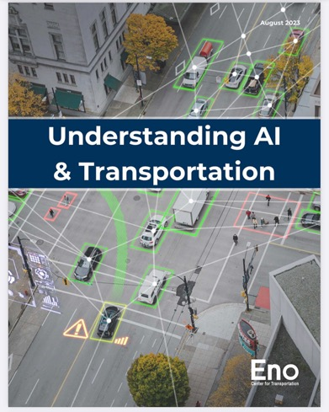
https://enotrans.org/eno-resources/ai-and-transportation/

Slide 5
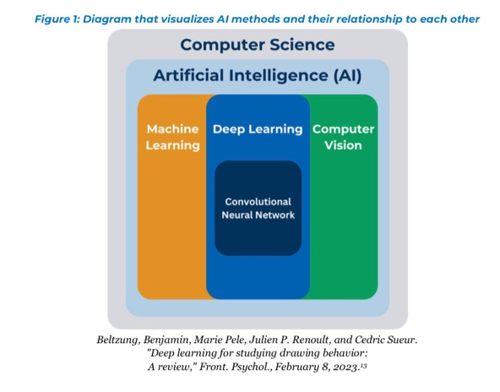

Slide 6
AI Applications in Transportation
Computer vision | Driver assistance safety technology that uses object detection to interpret images from cameras on a vehicle. Roadway and curb obstruction and anomaly detection to trigger proactive mitigation measures.
Convolutional neural network | Apply a convolutional neural network (CNN) to data sources such as satellite images, weather radar, and historic weather patterns to improve the accuracy of the location and intensity of weather patterns for aviation operations. Apply a CNN to precisely locate and identify illegally parked vehicles to enforce traffic laws [note: the author works for a company that does this work]
Deep learning | Create an anomaly detection tool to identify variances in the Federal Aviation Administration remote monitoring and logging system. Train ADAS or ADS systems to identify and classify objects such as traffic-control devices and to respond appropriately.
Machine learning | Forecast demand for public micro transit vehicles by location, day, and time of day. Create a usable outdoor wayfinding system to help people with disabilities navigate to exact transit pick up locations, which GPS technology often fails to do.
Natural language processing (NLP) | Map compliance with international Standards and Recommended Practices for aviation that are scattered across thousands of pages of text. Deploy a chatbot to deliver personalized wayfinding or route options.
Neural networks | Identify various pieces of roadway infrastructure from images as a vehicle travels down a street. Identify anomalies on railroad right-of-way to mitigate safety hazards and find potential maintenance needs or debris that needs to be removed.
Reinforcement learning | Allocate scarce resources by scheduling and routing commercial ships to optimize the number of ships that can access a canal or port in a specific time frame. Improve performance of traffic signal control, especially for multi-intersections or across large systems.
SLAM | Navigate a drone to a precise landing spot. Vehicles can use SLAM to identify and avoid objects in the roadway.
Semi-supervised learning | Use a large dataset to identify mode choice by labeling a small fraction of the data and then applying rules from the labeled data to the unlabeled data.
Supervised learning | Use road, time, weather, and demographic data in a supervised learning model to create predictions for when and where crashes are likely to occur. Improve ADAS capabilities by mapping images from a human driver's steering and throttle and adjusting the AI model to fit them more closely.
Unsupervised learning | Train an AI model to take unlabeled geospatial data and identify the mode of transportation used so that location-based services could provide users with accurate, personalized information based on their location and how they are traveling.

