Slide 1
Metro Overview
EnoMax
Lynn Bowersox
August 2019

Slide 2
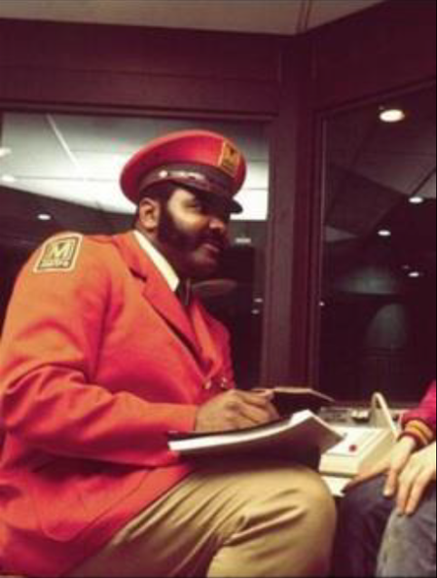
What is Metro
What is Metro?
Bus, Paratransit and Rail System
Built in the 70’s and 80’s
Regional agency – governed and funded by MD, VA, DC and local counties
50/50 taxpayer dollars and fares for every $1 to operate

Slide 3
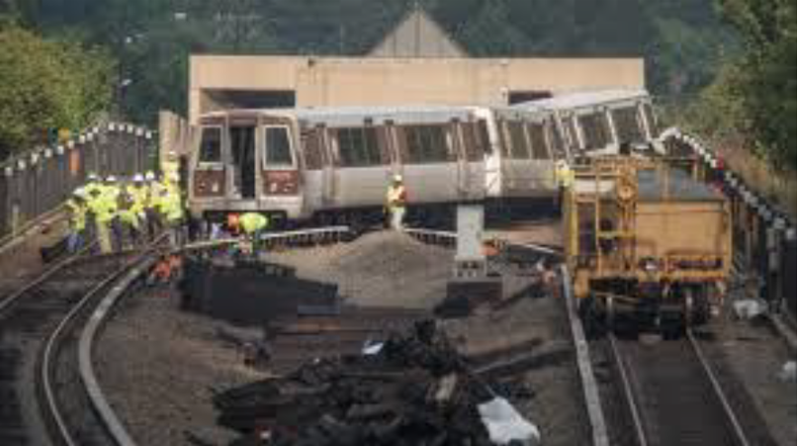
Bad Old Days
Previous view of Metro
Government funded the construction but not the maintenance of new system
Decades of underfunding and infrastructure neglect
Plagued by derailments, track fires, delays
Negative financial reports
Lack of public confidence

Slide 4
Neutral Activity

Slide 5
SafeTrack Communications

Slide 6
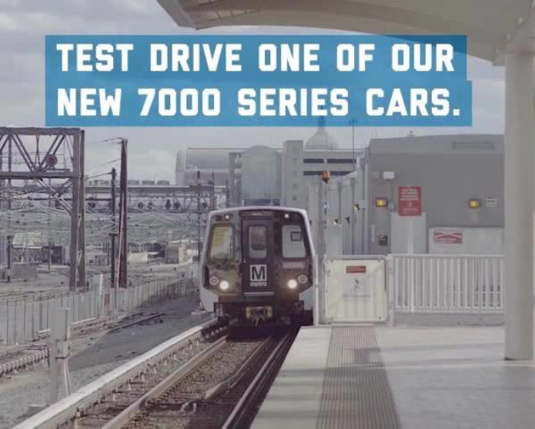
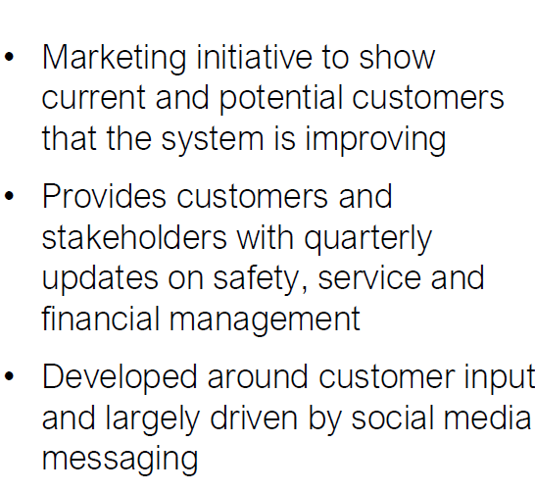
Back 2 Good Campaign

Slide 7
Back 2 Good Results

Slide 8
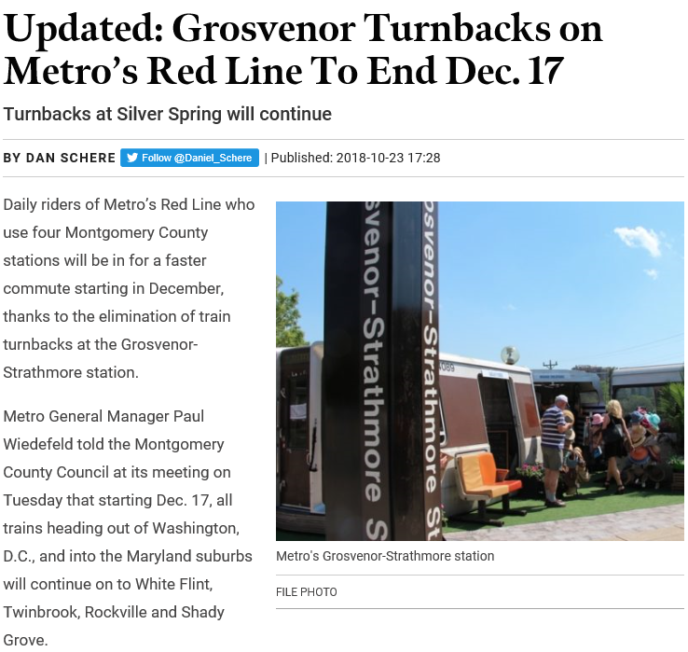
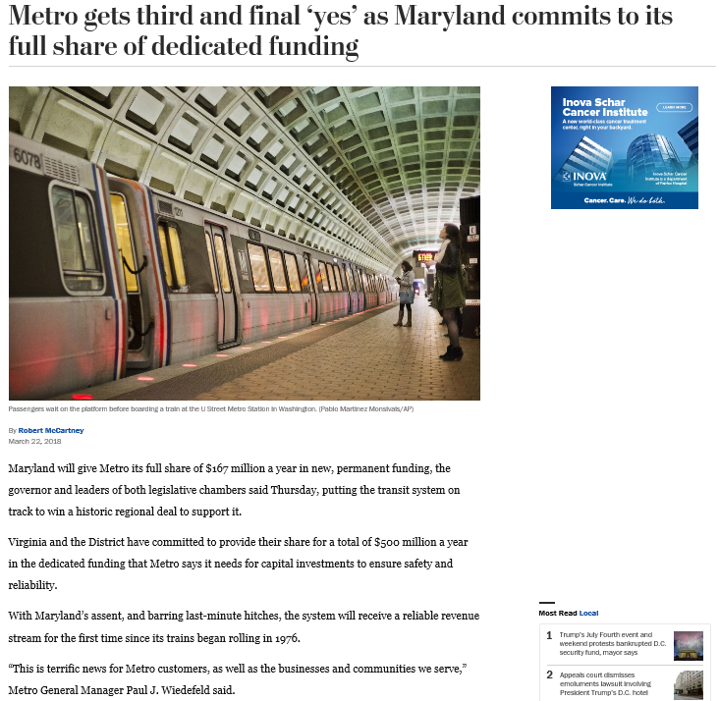
Signs of Turnaround and Dedicated Funding

Slide 9
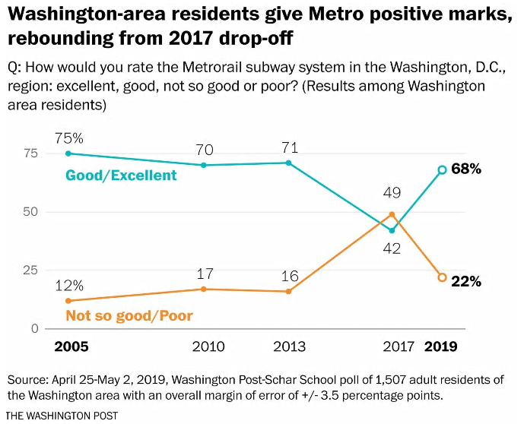
Washington Post Poll

Slide 10
Ridership Numbers up by 3%
Ridership Numbers for February – May

Slide 11
Operating Model

Slide 12
Refresh Metro brand? Uber/Lyft survival? Worldclass service possible?
Next Challenges

