Slide 1
Transit Route Planning & Remix Transit Planning Tool
Rob Smith
AVP, Service Planning & Scheduling, DART
MAX Dallas Visit
May 2, 2019

Slide 2
Transit Planning Overview
Transit planning involves the development of plans and proposals for future service development
Over the years, the planning field has split into two separate tracks: long-range capital planning and shorter-range service planning
At DART, the capital planning and service planning functions have separate staff and focus, though we work cooperatively
This presentation is focused on the service planning side of the equation

Slide 3
Capital and Service Planning
CAPITAL PLANNING
Longer-range focus – more than five years
Tending to address major capital investments like rail and bus rapid transit
Computing tools tend to focus on travel demand forecasting and other activities tied to longer-term analysis
SERVICE PLANNING
Shorter-range focus – usually less than five years
Tending to address bus service changes and items that will happen in the next few service changes
Computing tools tend to focus on ridership analysis, schedule development, geographic information systems (GIS), and other spatial analysis tools

Slide 4
Service Planning & Scheduling at DART
Staff of 21 positions, most currently filled
Four key focus areas:
Service planning – management of the service change process and development of plans and proposals for service changes, also manages bus stop program
Scheduling – scheduling of buses and trains, including development of service timetables and operator work assignments
Service analysis – analysis of ridership, geospatial data, and other topics that support DART activities
Innovative services – management of our vanpool program and other contracted service arrangements with a series of partners (as a part of our Site-Specific Shuttle program)

Slide 5
Service Planning at DART
Other staff within the Service Planning group manage miscellaneous construction contracts, on-street facilities, traffic signal priority programs, and other projects

Slide 6
Service Planning Process
Policies: Service Standards and other Board-determined policies that guide planning and evaluation of DART services
Data & Analysis: Detailed collection and analysis of data on ridership, service performance, schedule performance, and other issues
Feedback: Communication with external and internal customers on service-related issues, some ongoing, others as a part of specialized meetings

Slide 7
Service Planning Process
Plans: Development of 5-year Service Plans and other planning efforts to direct future service changes
Service Changes: Development of proposals for service changes several times per year, along with management of the process
Implementation: Schedule service, prepare information for other internal customers, etc.
Evaluation: Review of implemented service plans to see if they meet ridership and performance goals

Slide 8
Data & Analysis: Key to All Efforts
Because of the inherent complexity of transit service and ridership, transit service planning is a data-driven endeavor
Collection and analysis of data are core parts of the process
Specialized geospatial analysis is more frequently used now to support planning efforts, and specialized tools have evolved to support planning efforts
The rest of today’s presentation will look at this issue in greater detail

Slide 9
Evolution of Data Analysis for Service Planning
My transit career started in April 1982, and a lot has changed in the past 37 years
Capabilities for data collection and analysis have grown dramatically over that time…

Slide 10
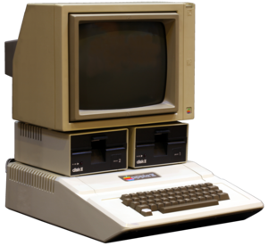
Computing
1982
Apple IIe computers were just starting to be used in transit environments
64k RAM
Floppy disc drives for programs and storage
Primitive monochrome screens with minimal graphical capability
Planners rarely had desktop use of computers
2019
Advanced desktop and laptop PC systems with cloud computing support
8+ Gb RAM
Fast SSD and/or hard disk storage with cloud elements
Advanced graphics capabilities for mapping, GIS, and other functions
Computers are a normal desk tool for Planners (and everyone)

Slide 11
Mapping/Geospatial Analysis
1982
Hand-drawn maps traced from city maps using a light table
Colored city maps to show demographics and other characteristics, again with hand-drawn routes
2019
Full GIS capabilities for map drawing, geospatial analysis, and many other uses
Specialized tools like Remix, Urban Footprint, and a number of others to support geospatial analysis and planning activities

Slide 12
Data Collection
1982
Ridership counts by bus operators
Manual ride and point check data collection by surveyors in the field
2019
Automatic passenger counters on buses and trains
Detailed on time performance data through automatic vehicle location systems and other means
Real-time review and playback of actual bus/train operations
Customer interviews collected and processed using tablets

Slide 13
Presentations
1982
If done, slide presentations were prepared on film slides by graphics companies and shown on carousel slide projectors
Hand-drawn maps, occasionally supplemented by more professional work done by graphic artists
2019
Has PowerPoint really improved anything?
Items are much easier and quicker to produce

Slide 14
Remix: An Example of the Evolution
Remix is specialized, cloud-based software that supports service planning functions, including:
Drawing and creating routes
Rudimentary scheduling capabilities
Costing of service proposals
Geospatial analysis of demographic and other data vis-à-vis current and proposed routes
Quick review of travel time access over the network
New features have been added on a regular basis

Slide 15
What Does Remix Offer?
The ability to quickly develop and analyze different service alternatives – much more quickly than through other tools of the past
Detailed demographic, job access, and other information is available for routes and networks under consideration
Quick costing of service alternatives

Slide 16
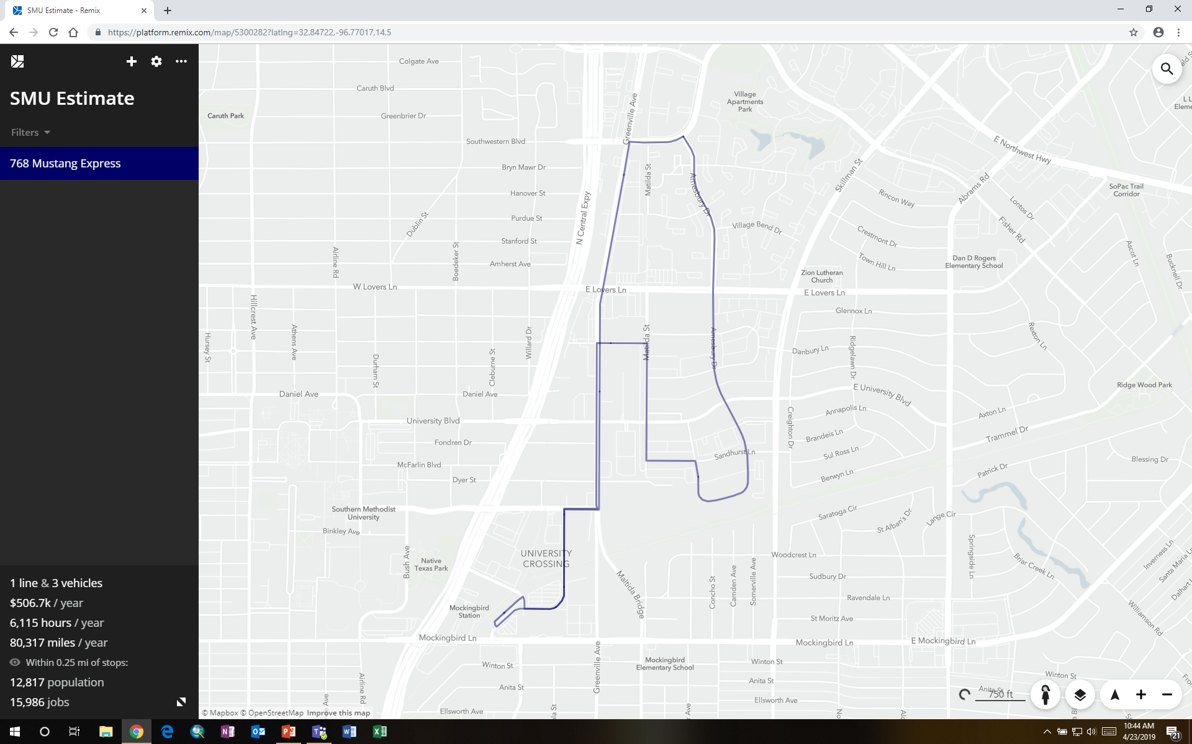
This is a simple example I used to cost out a route. It took less than 10 minutes to draw and calculate cost and basic impacts

Slide 17
More Complex Example: Grid System Analysis
We have had a lot of questions about development of a grid system for DART service
The City of Dallas passed a resolution asking DART to develop a high-frequency grid bus route network
Remix gave us a way to draw and analyze the potential impact of a grid system relatively quickly
Results were exportable into GIS for even more analysis of impacts

Slide 18
DART Grid Network Concept: Financial Implications
Frequency improvements have a significant impact on costs
604 peak local buses required vs. 484 now (not including spares)
Fleet expansion would require a new operating facility
65% increase in revenue hours over existing service levels
$72m in additional operating costs over current service

Slide 19
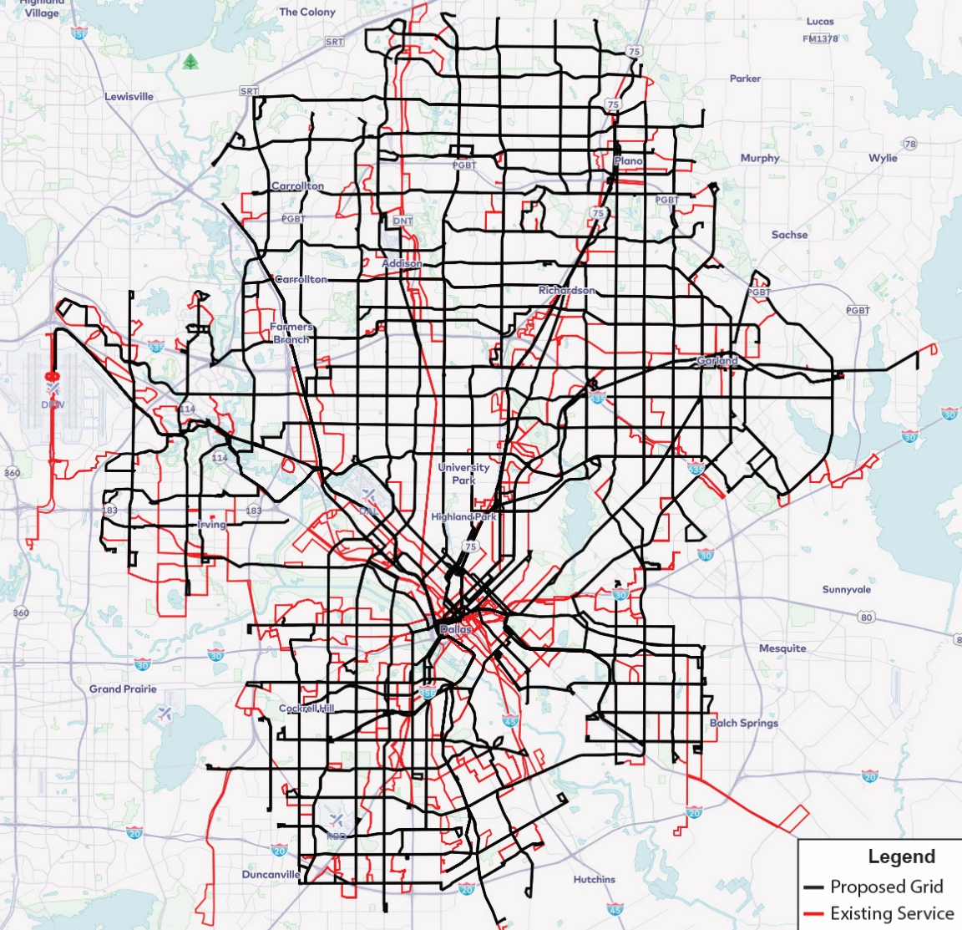
DART Grid Network Issues
Significant difference in coverage – existing route network shown in red
Some low income areas with high transit dependency do not have grid arterials, and would lose significant service coverage
Trinity River and lakes break grid street network, with impacts on connectivity (e.g. Pleasant Grove to Oak Cliff)

Slide 20
Analyzing Impact of Changes: Job Access
Our newest Service Standards include a goal of improving job access for service changes
Remix allows quick analysis for different locations in the service area through something called the “Jane” tool

Slide 21
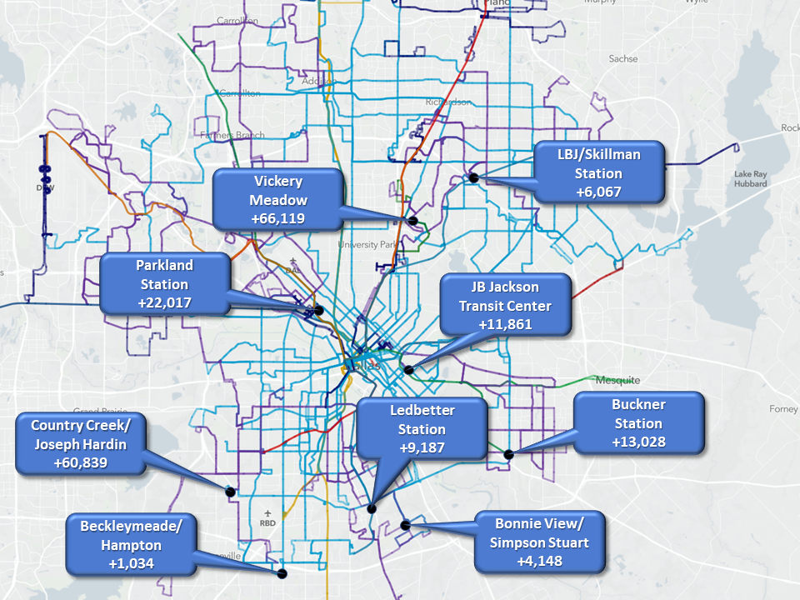
Additional Jobs Accessible Within 60 Minutes: August Service Changes
Data: U.S. Census Longitudinal Employer Household Dynamics (LEHD) 2015
Average increase for these locations: 6.1%

Slide 22
Remix Demo

Slide 23
Remix Limitations
It is not currently structured to deal with demand-responsive services, and DART is looking for that capability
Service costing does not fully work the way transit agencies typically calculate costs, but we have found that the differences are not great enough to worry

Slide 25
DART GoLink Service
Rob Smith
AVP, Service Planning & Scheduling, DART
MAX Dallas Visit
May 2, 2019

Slide 26
DART’s Mobility as a Service Framework
Mobility Services
P3 Agreements
CUSTOMER
Transit
Paratransit
Microtransit
Scooters
TNCs
Multimodal Services
Data Hubs
Car
Companies
Bike Sharing
System Integrations
Communications
Dynamic Car Pooling
Analytics
Taxi
Air Taxi
Car Sharing
Interactive Kiosk
Traffic Management
Dynamic Parking
WiFi
Smart Payments
Currently in process
Real-Time Information
Not currently in process
Trip Planning
Connected Traveler
Rewards + Incentives
APPS + Services
Automated Vehicles
Connected Services

Slide 27
Mobility on Demand/GoLink
The Mobility on Demand (MoD) pilot project builds upon a federal “Sandbox” grant, providing integration of public and third-party mobility providers
Zoned service accommodates ”last mile” access to/from other DART services and within-zone circulation
All zones will include a mix of dedicated vehicles under the GoLink brand, private carriers, and DART subsidy and management

Slide 28
GoLink Service

Slide 29
GoLink Service
The primary first mile/last mile service has been branded as GoLink service
GoLink replaces and expands upon our older On Call demand-responsive service program
GoLink service has been expanded to 6 additional zones
Several of these areas had limited or no service
13 GoLink zones are in operation
We are actively looking at 9 to 11 other candidate zones for future expansion

Slide 30
GoLink Functions
FIRST/LAST MILE OPERATION
All zones connect to DART rail or express bus service for access to the rest of the system
INTERNAL CIRCULATION
Offering circulation service for shopping, school, medical appointments, or other needs

Slide 31
Transition: On Call to GoLink
ON CALL SERVICE
7 zones, replaced low-performing fixed-route services
1 dedicated, assigned vehicle in most zones (2 if needed)
Peak service restricted to trips to/from the anchor point
Circulation trips within the zone midday and early evening only
In order to allow for the single vehicle operation, most zones were 6 square miles per less
Telephone reservations one hour in advance
GOLINK SERVICE
6 new ones added in areas without fixed-route coverage
Mix of dedicated vehicles and TNC support through UberPool
No travel restrictions within zones or to/from anchor point
Some zones are much larger and use multiple vehicles – up to 23 mi.²
App users do not have to book trips in advance – our goal is to pick up customers 10-12 minutes after their booking

Slide 32
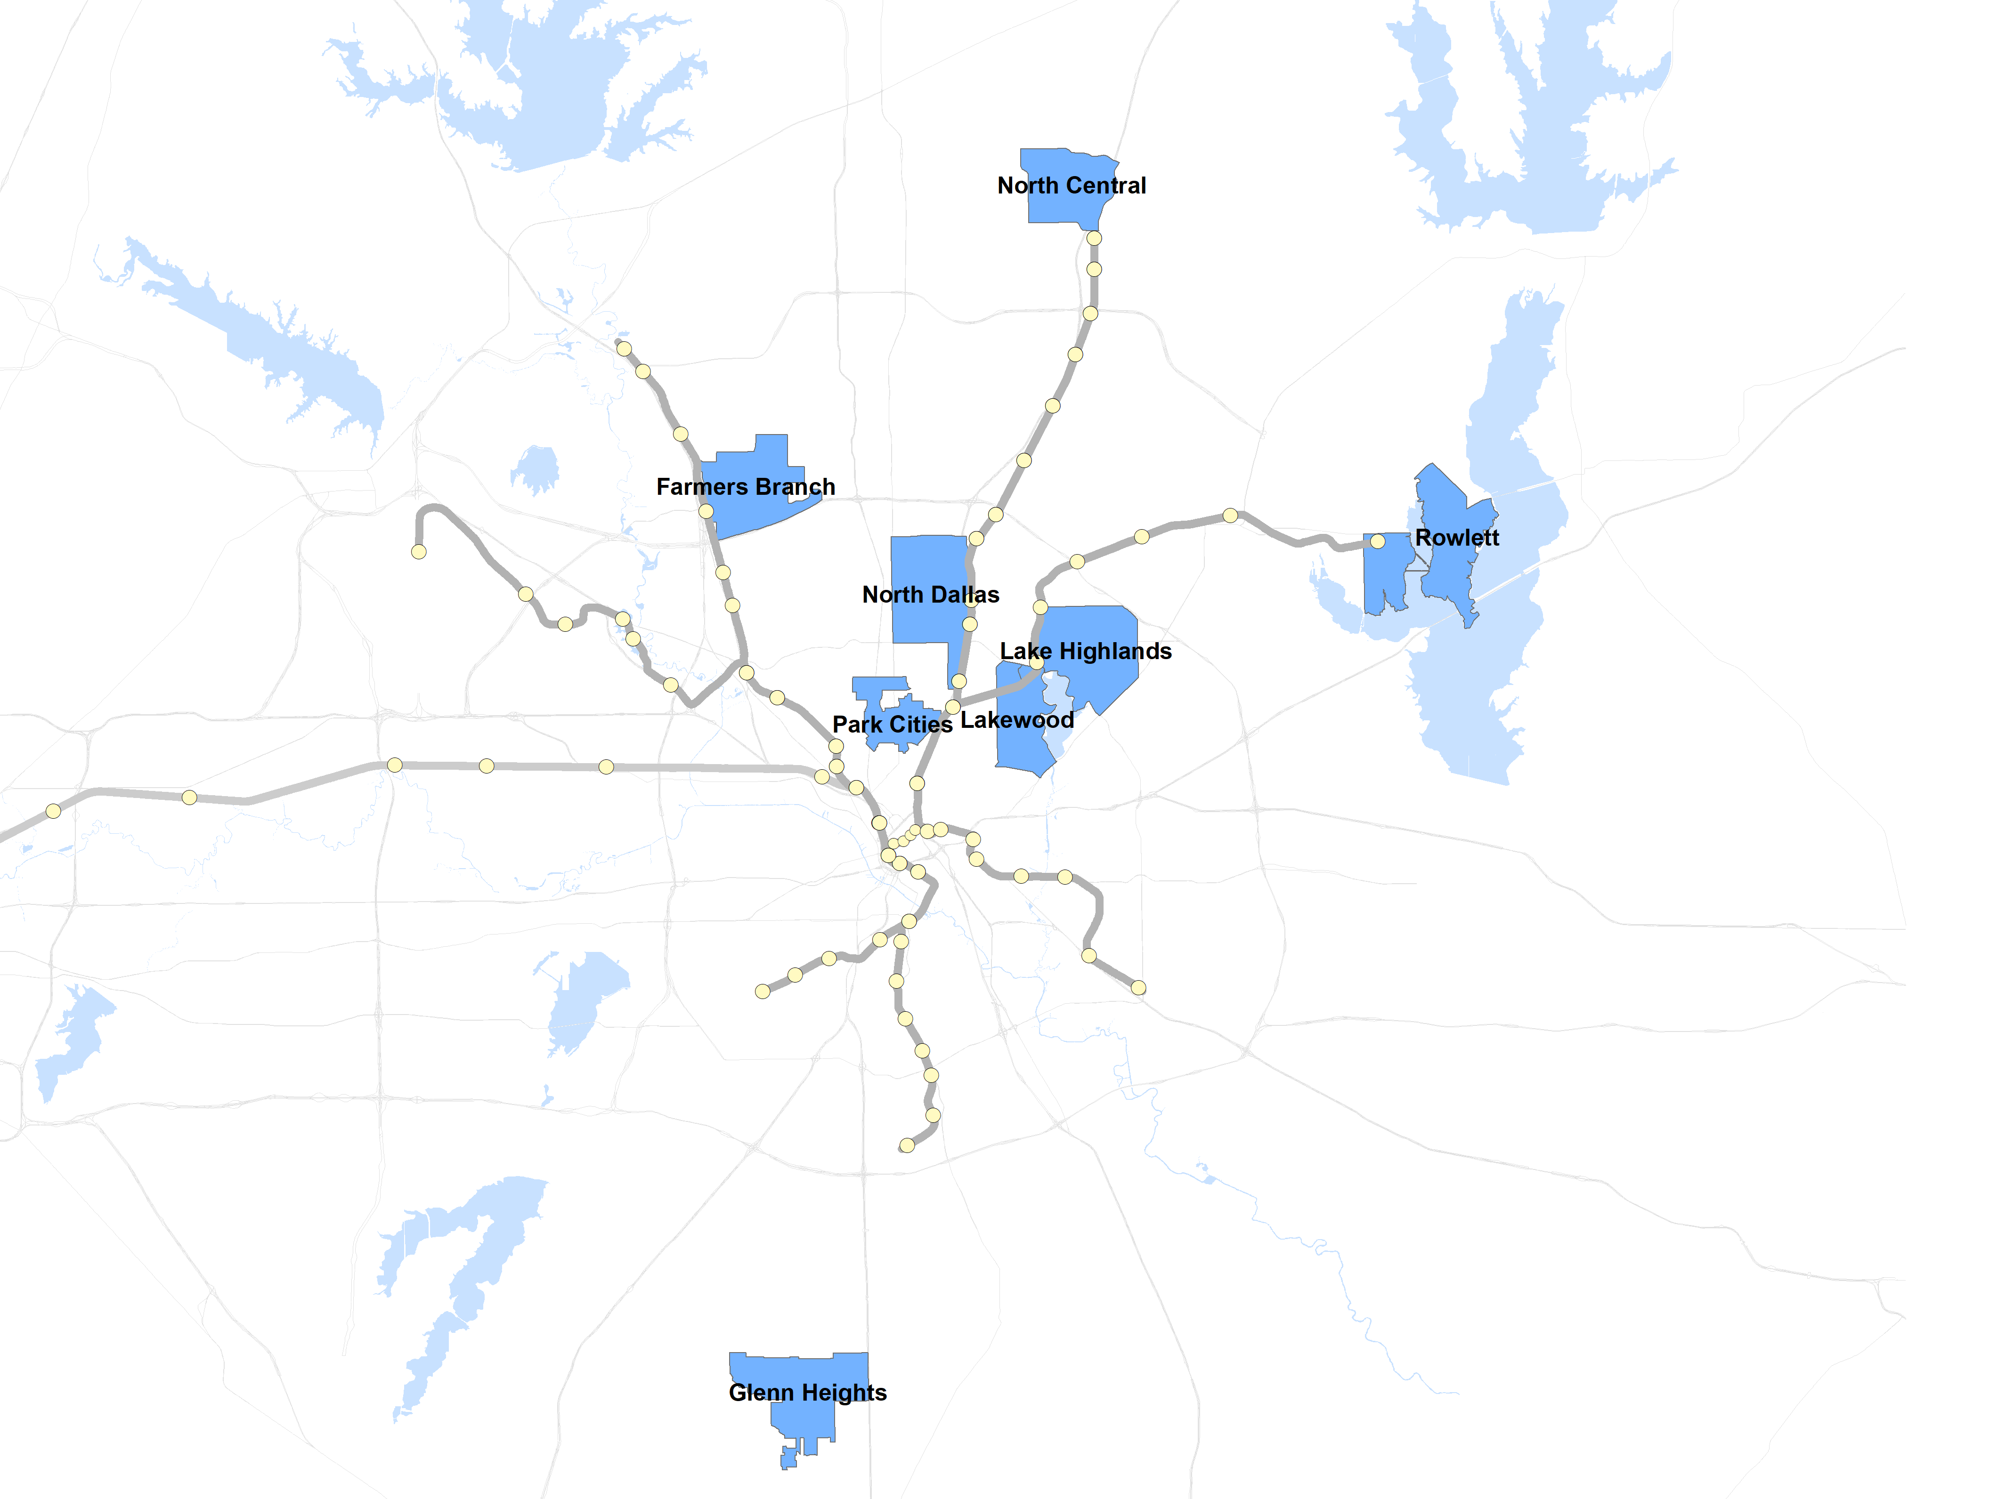
On Call Program
OnCall program included 7 zones
Service available where local fixed-route service did not perform to standards

Slide 33
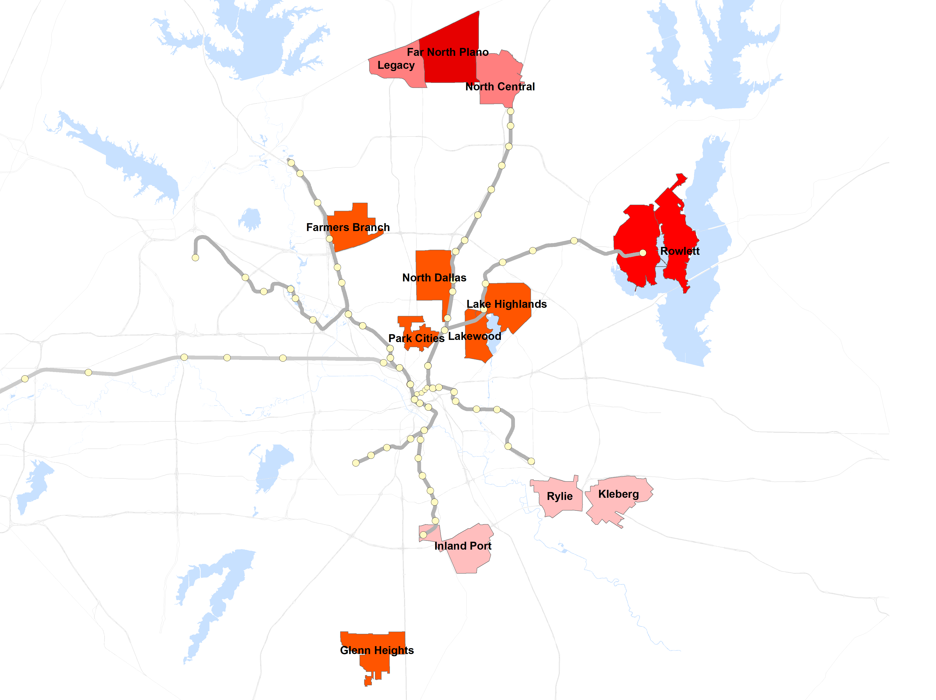
GoLink Final:
March 2019
13 zones now in full GoLink operation

Slide 34
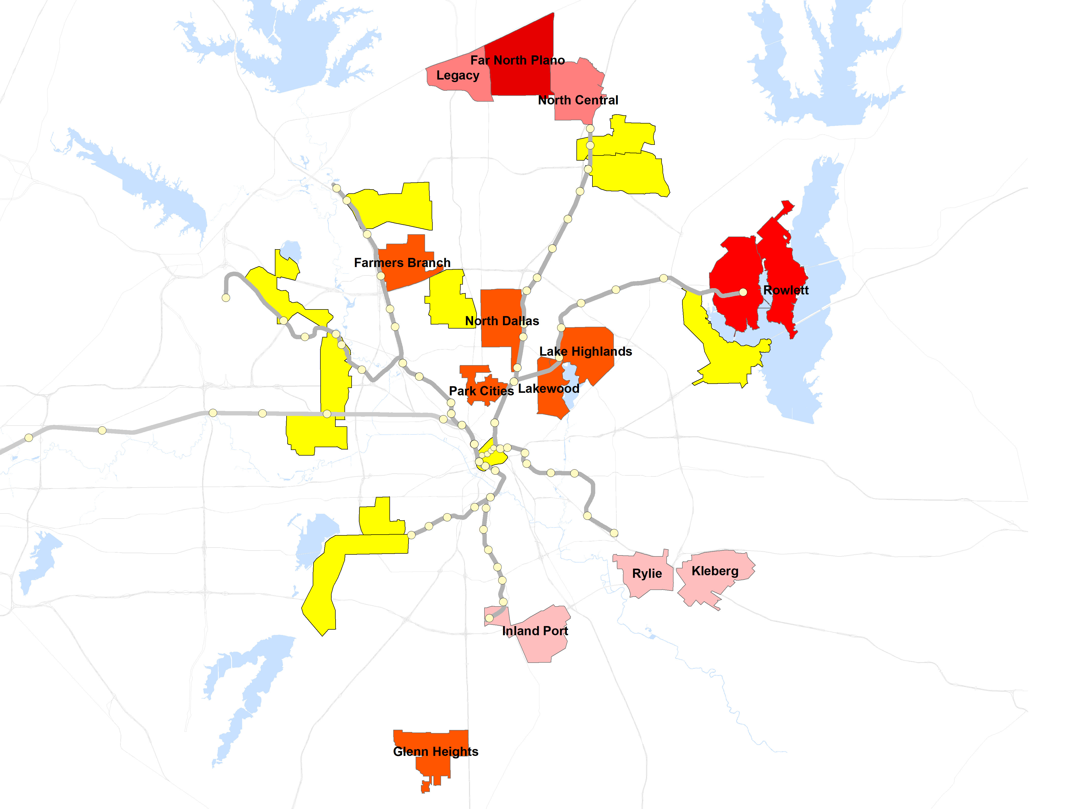
Opportunities
Service Planning staff are looking at potential expansion of the program
New zones target low productivity fixed route and/or FLEX services

Slide 35
Role of TNC’s
We have traditionally operated On Call using dedicated vehicles assigned to each zone
Our goal with GoLink service is to integrate TNC’s to keep per passenger costs down and to expand capacity
UberPool is our first TNC partner for GoLink, and we have started a pilot project in 6 zones
Right now the experience is somewhat limited until UberPool trips can be directly scheduled in our app – customers who wish to use it must go to the Uber app to book trips
Our new operating contract will allow us to move away from having some of the dedicated vehicles we have been operating

Slide 36
Rider Response
Overall ridership levels are very dependent upon activities and characteristics of each zone
Where On Call service has transitioned to GoLink, we have generally seen significant ridership growth

Slide 37
GoLink Ridership: Plano/Rowlett
Legacy West: 131
F.N Plano: 39
N.C. Plano: 121
Rowlett: 125

Slide 38
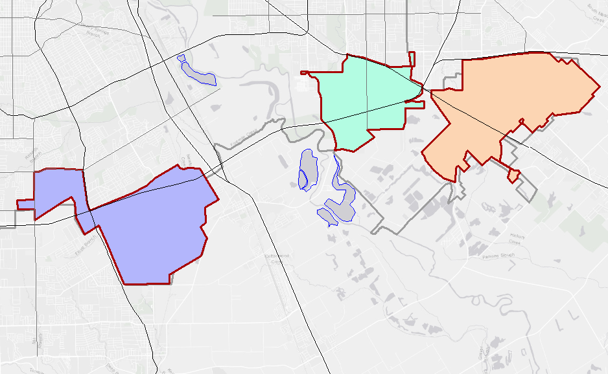
GoLink Ridership: Southern Sector
Rylie: 24
Kleberg: 76
Inland Port: 47

Slide 39
GoLink Transition: Rylie/Kleberg
33.4% Increase

Slide 40
GoLink Transition: NC Plano
63.0% Increase

Slide 41
GoLink Transition: Rowlett
204.4% Increase

Slide 42
UberPool Weekly Ridership Trends

Slide 43
Customer Satisfaction Survey Results

Slide 44
Key Program Goal: Cost Effectiveness
We are working to keep program costs at a reasonable level – targeting $12.00-12.50 per passenger as our goal
Mixed operation of dedicated vehicles and TNC’s will be crucial in reaching that goal

Slide 45
GoLink Trends Subsidy/Rider, No UberPool

Slide 46
UberPool Weekly Subsidy/Rider

Slide 47
Conclusion
We are very encouraged with what we have seen so far
Work remains to fully integrate TNC operations and maintain good performance (e.g. wait times)
Expansion expected in the future

