Slide 1
Mobility as a Service
Tina Mörch-Pierre
Assistant Vice President
Payment Systems & Statistical Reporting
April 29, 2019

Slide 2

Agenda
Define MaaS
Trends & Industry Outlook
DFW Region
Questions to Consider
MaaS Framework
MaaS Development Cycle
Short Term Initiatives

Slide 3
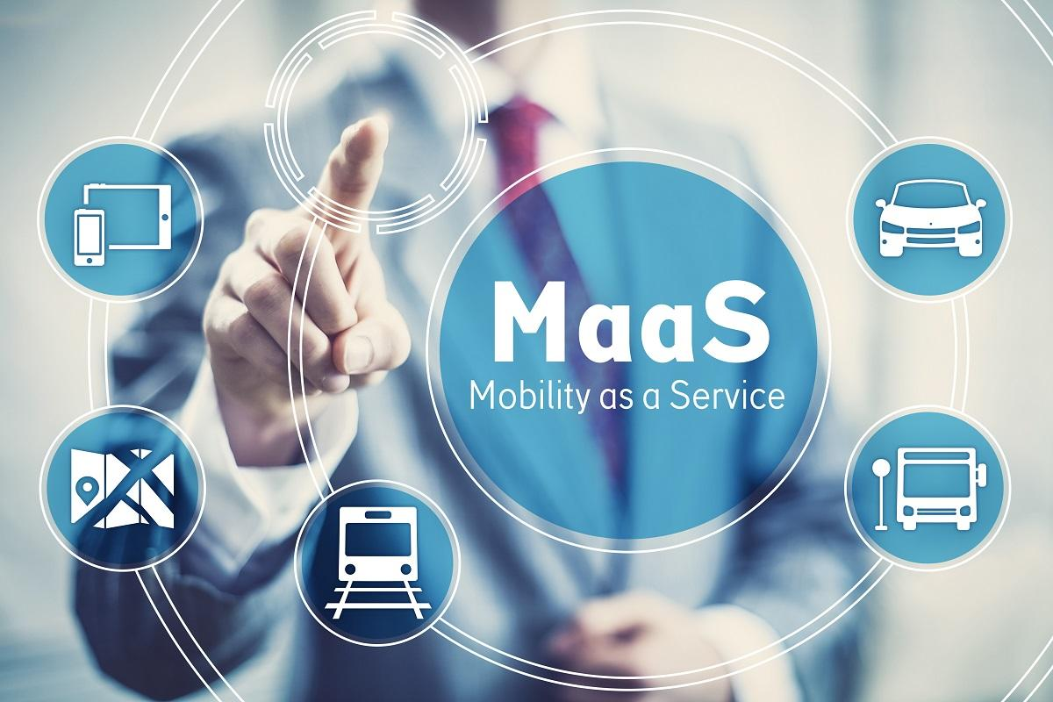
What is Mobility as a Service (MaaS)?

Slide 4
/’mahs/ - maas
MaaS
(1) Personalized journey planning and management; (2) Hassle-free digital payment and ticketing; (3) First/Last mile transportation combining public transit, on-demand and shared mobility services (4) Optimization of data exchange to expand services
RELATED WORDS
Journey planning; multimodal; autonomous vehicles; scooters; ride-sharing; choice; single payment; subscription services

Slide 5
Trends & Industry Outlook

Slide 6
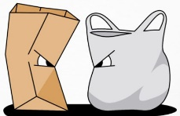
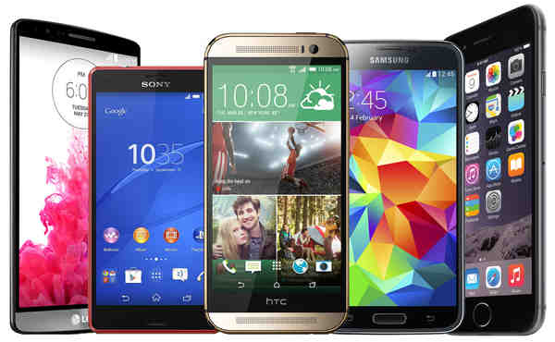
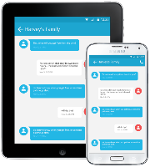





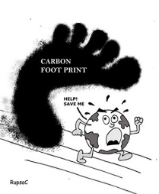

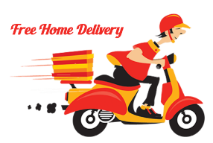


Top Cultural Trends
Consumer trends are impacting how DART engages with the community
Personalized Technology
Social Networking
Profiles
Personalized Products
Paper over Plastic
Carbon Footprint
Smart Phones
App Driven
Instant Text/Chat
Home Delivery
Personalization and Individualization
Civic and Environmentally Friendly
Techno Savvy and Connected 24/7
Demanding and Impatient
Source: Frost & Sullivan Top 20 Global Mega Trends and Their Impact on Business, Cultures and Society
Notes:
This slide helps to summarize social changes which will influence how DART will deliver various services in the future.
Impacts on ridership:
Riders will want transportation options that they can choose from to match their lifestyle
Connected living (home, work, and city) is an ecosystem which riders are using an array of integrated devices to gain access and ubiquitous connectivity anytime and anywhere.
Convergence of industries is driving unconventional players in to new markets i.e. Google and Nest, Facebook and Oculus

Slide 7

Sample 3
Global Payment Trends
Bi
Mobile Payment Platform
Contactless Payments
Number of Smartphones
PayPal
250M
Alipay
1B+
91%
66.7%
WeChatPay
1B+
Chinese competitors WeChatPay and Alipay state they have over 1 billion daily active users.
Merchant Savvy
Public Transit is reaping the benefits of contactless technology where 91% of all payments are contactless.
Merchant Machine
The number of smartphone users will continue to grow exponentially.
WorldoMeters U.N. data,.
World Population - 2019
Mobile Wallet Users
Mobile Apps
Japanese Market
7,699,900,870
2.1B
31%
70%
World population has doubled (100% increase) in 40 years from 1959 (3 billion) to 1999 (6 billion). It is now estimated that it will take another nearly 40 years to increase by another 50% to become 9 billion by 2037. Worldometers
Consumers worldwide will make payments or send money in 2019. 30% increase compared to 2017.
businesswire.com
Mobile apps accounted for global digital commerce volumes in 2017.
GCI Analytics
Consumers still prefer to use cash, mainly due to security concerns with mobile payments.
McKinsey & Company.
Prefer Cash
Notes:
WeChatPay and Alipay are closed loop products – QR Codes
Japan remains a largely untapped market. Research has found that close to 70 percent of Japanese consumers across all age groups still prefer to use cash when making in-store purchases, mainly due to security concerns with mobile payments.

Slide 8
MaaS
Industry Outlook
Automated vehicle technology is gaining momentum with tech giants, auto manufacturers and ride-share platforms
5G Internet connection provides more devices to be connected in faster, more reliable networks to include smart vehicles and smartphones
Scooters and the electric bike markets continue to grow exponentially
Greater focus on interoperability and big data
2019 - the year of pilots in many regions
Smart cities delivering infrastructure which is more responsive and flexible for future needs
Source: https://skedgo.com/5-maas-trends-to-look-out-for-in-2019/
Notes:
The industry outlook provides a high-level overview of considerations that DART will need to further examine during calendar 2019. Some of these changes will have a direct impact on DART services in the near term.
What makes a smart city:
The modern smart city is usually a city that has partnered with private and public enterprises and businesses to leverage technology to:
Enhance energy usage efficiency
Implement better waste management
Improve public transportation
Use data to make informed building and planning decisions
Make public communication like public Wi-Fi available
Improve public safety
Examples include San Francisco, Boston, Atlanta, Columbus, Ohio, DC, LA and New York. Dallas and Austin are becoming smart cities.

Slide 9
DFW Region

Slide 10
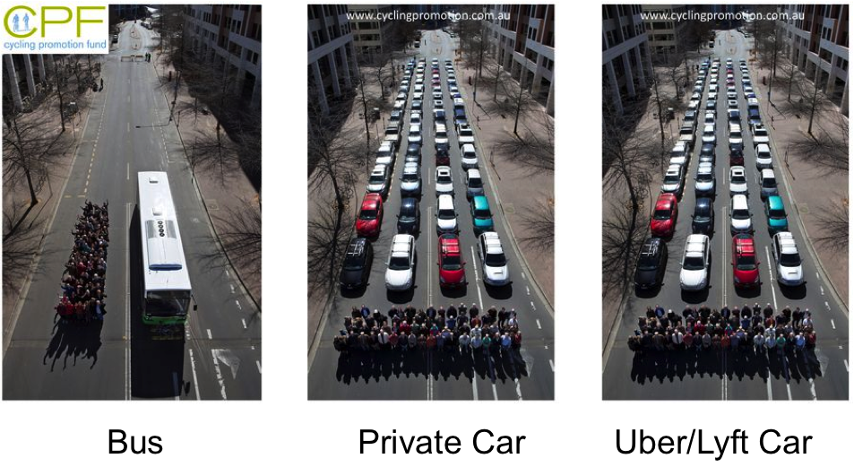
Synopsis
Whether transporting people by car, TNC or automated vehicle, they still cannot move as many people as bus or rail
It takes the same number of automated and Uber/Lyft/private vehicles to move the same number of people
Space required to transport 48 people
AUTOMATED VEHICLE
PRIVATE VEHICLE
Uber/LYFT
BUS

Slide 11
Source: The Metropolitan Transportation Plan For North Central Texas Executive Summary, NTCOG Staff,2017
Notes:
Changes in the DFW area population will largely impact the types of services offered to riders.

Slide 12

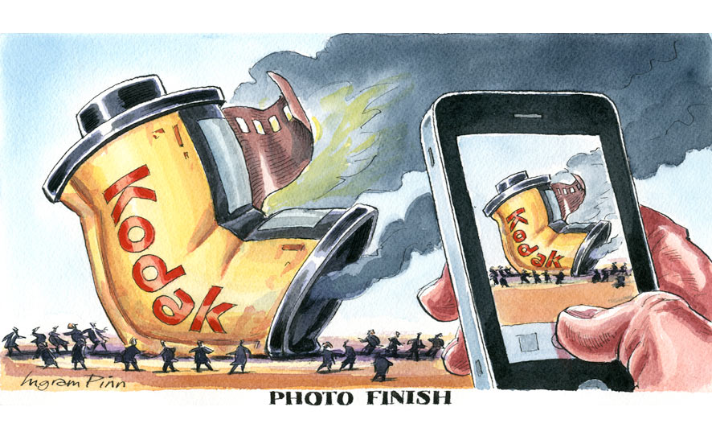

Slide 13
Questions to Consider

Slide 14


Questions to Consider
How can we leverage core competencies to differentiate or lead mobility as a service in the market place?
How can new transport modes complement and not cannibalize the existing offering?
How might we have to restructure to be successful in this venture?
What does success look like?
Who can be relevant partners for implementing and operating new modes of services?
How can we anticipate any competitive threats when planning?
What advantages does we have and how can we retain existing riders while attracting new customers?
Notes:
What does success look like:
Minimizing traffic congestion in the region and reducing the overwhelming dependency on the single occupancy vehicles during peak travel times.
Find a scalable plan that enables DART to add more coverage within North Texas with a cheaper cost structure
Reducing the overwhelming dependency on the single occupancy vehicles.
Improving the customer experience by integrating equitable mobility on demand options to DART’s portfolio of public transit options.
Initiating pilots to start the journey and realizing some quite wins for the agency.

Slide 15
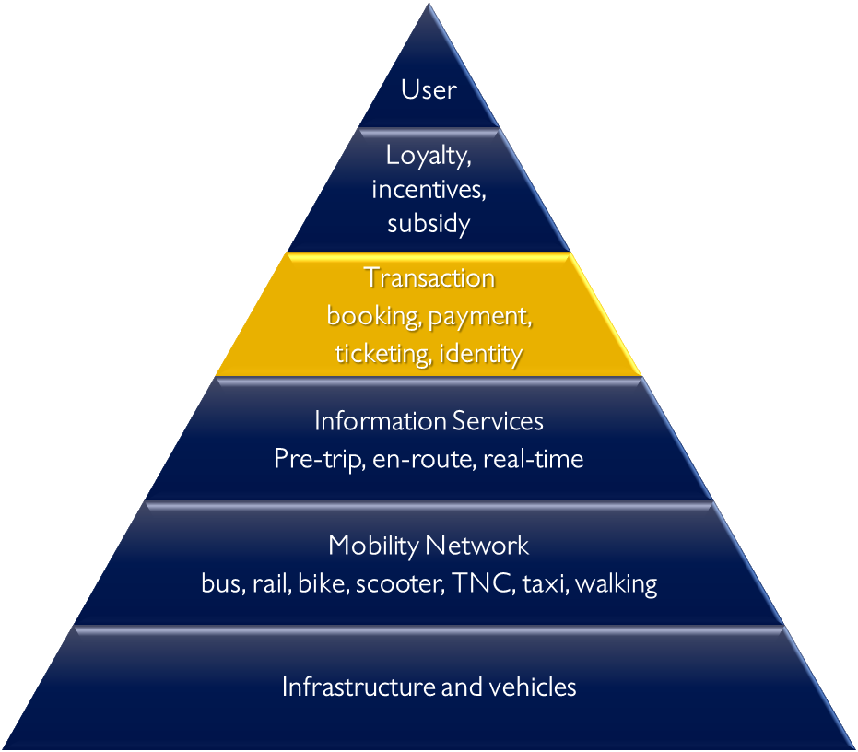
Mobility
Network
JOURNEY TO MOBILITY AS A SERVICE
While technology will connect vehicles, infrastructure and various modes of service, single payment transactions and identity are the nexus for any digital transformation of transportation. Payments must be routed to all participating parties to cover the cost of the service while providing a frictionless experience for the end user.

Slide 16
Challenges Not Yet Addressed
“Unbanked” or customers who choose not to use a credit accounts, may not be able to access new MaaS services
Accessibility and inclusivity
Customers who do not have smartphones need to interact with MaaS
Commuter Benefits in the U.S. (3M commuters receive this benefit) IRS rules complicate multimodal payments
Integrating with legacy technologies
Regulations, policies and standards for payment acceptance
Notes:
the opportunities and challenges in the technology and policy areas can be used to begin to implement solutions for disabled, low-income and elderly travelers.

Slide 17
MaaS Framework

Slide 18









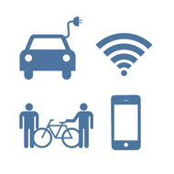















DART’s Mobility as a Service Framework
Mobility Services
P3 Agreements
CUSTOMER
Transit
Paratransit
Microtransit
Scooters
TNCs
Multimodal Services
Data Hubs
Car
Companies
Bike Sharing
System Integrations
Communications
Dynamic Car Pooling
Analytics
Taxi
Air Taxi
Car Sharing
Interactive Kiosk
Traffic Management
Dynamic Parking
WiFi
Smart Payments
Currently in process
Real-Time Information
Not currently in process
Trip Planning
Connected Traveler
Rewards + Incentives
APPS + Services
Automated Vehicles
Connected Services

Slide 19
DART’s Mobility as a Service Development Cycle
MaaS Definition
Personalized journey planning and management
Hassle-free digital payment and ticketing
First/Last mile transportation combining public transit, on-demand and shared mobility services
Optimization of data exchange to expand services
“Mobility as a Service”
Phase II
(Emphasis on automated driving)
High
Resource Planning
Mobility Behavior
Infrastructure
Automated Vehicles
Phase I
(Emphasis on sharing, integrations and evaluations)
Business Modeling
Level of value
Piloting Programs
Shared Intermodal Mobility
P3 Agreements
Payment
Integrations
Intermodal Integrations
Ride Hailing, Bike, Scooter & Carsharing
2014
2021+
2030+
Low
Point of Entry
Source: Roland Berger – Global Strategy Consulting Firm
Notes:
Business Modeling – To include evaluating regulation, policy and funding source requirements
Mobility Behavior – Understanding innovation and riding patterns is the basis for designing customized transportation solutions

Slide 20
Short Term Initiatives
Integrating a range of services
Identifying new mobility opportunities
Assessing pilot programs to determine viability in the DART platform of services
Aligning with cities to adopt mobility as a service framework
Improving current and exploring new technologies to enhance the rider experience

Slide 21
Questions

