Slide 1
Providing Mobility as a Service Options with the
GoPass App
Tina Mörch-Pierre
Assistant Vice President
Payment Systems & Statistical Reporting
April 29, 2019

Slide 2
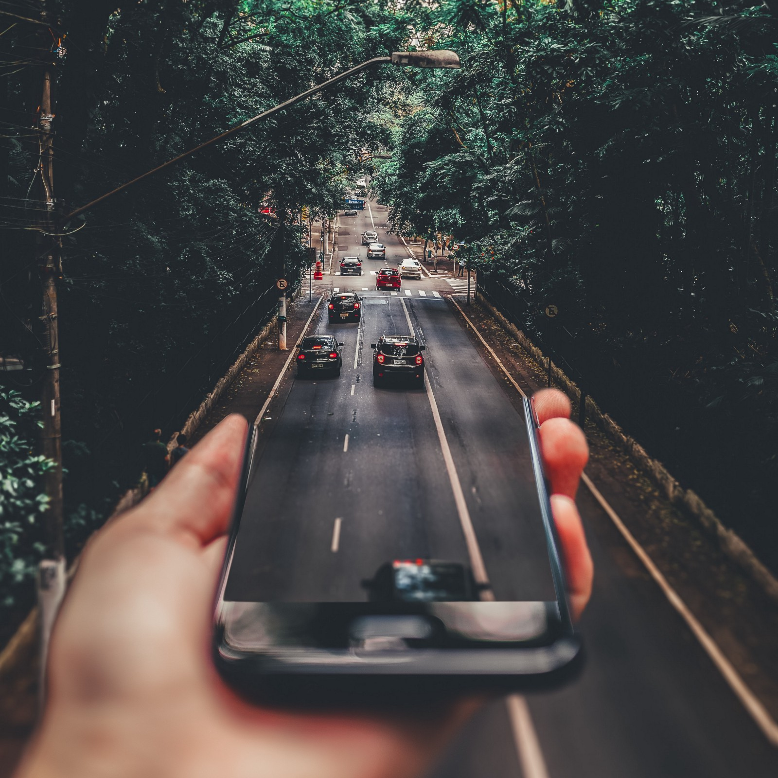
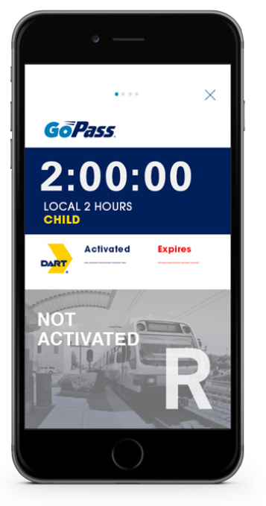
Agenda
App History
App Stats
App Features
App Roadmap

Slide 3
The App Journey

Slide 4
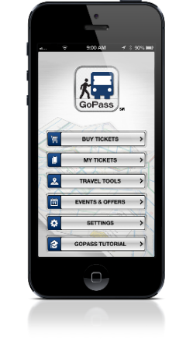
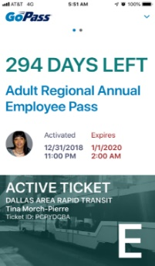
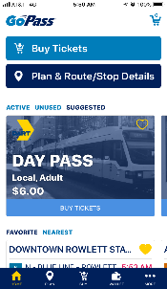



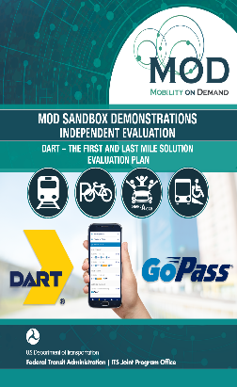

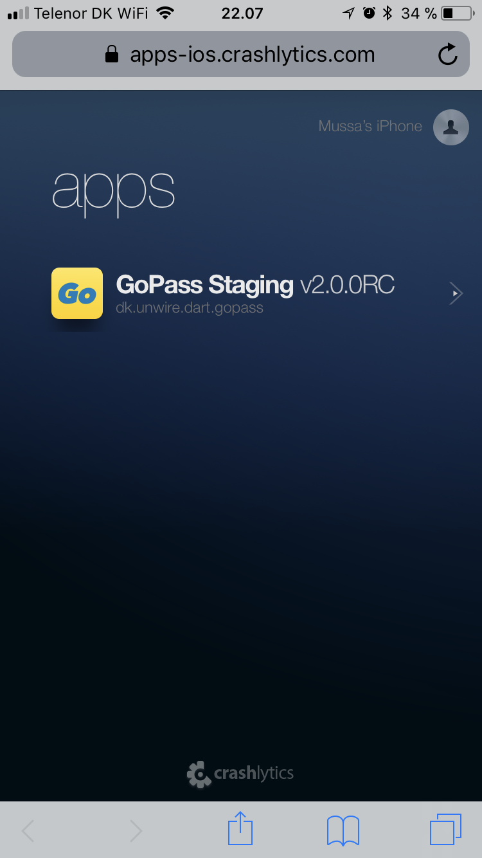

GoPass Journey
GoPass 1.0
Ticketing
Trip planning
Special events and offers
Regional app
Deep Linking
Uber
Lyft
Zipcar
GoPass 3.0
Multimodal
Microtransit
UberPool
Bird
Rideshare choices
FTA Grant Recipient
2013
2014
2015
2016
2017
2018
2019
Admission tickets
State Fair of Texas
Zoo
CFC
NCAA
Introduced Corporate and University passes
GoPass 2.0
Real time
Cash to mobile
Fare capping
Apple Pay
GoPass Wallet

Slide 5
Stats

Slide 6


GoPass App Stats
App Downloads
Device Usage
1.1M
56%
# of downloads since Sept 2013. There are 528 average daily downloads
(DART/Trinity Metro/ DCTA;2/28/19)
Device usage by operating system has been consistent since the inception of the app
Android
Loyalty Programs
790
Average Fare
Tickets Sold
Began Sep 2018, allows riders to earn up to a monthly pass during a calendar month period
2017
$5.81
8.7M
2018
$5.84
2019 (2/28/19)
$5.63
Various types of tickets are sold through the app to include time specific and period passes
Avg cost of tickets sold. Avgs. will fluctuate with fare changes
Notes:
Around 100 million U.S. consumers own tablets
Over 230 million U.S. consumers own smartphones
Those who do carry paper money around have less than $50 in their wallets. (CNBC Pew Research Survey)
Lower-income adults were about four times as likely as higher-income adults to say they make all or almost all of their purchases with cash.

Slide 7
GoPass 2.0

Slide 8


Slide 9
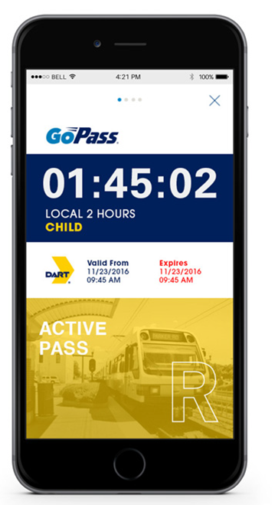
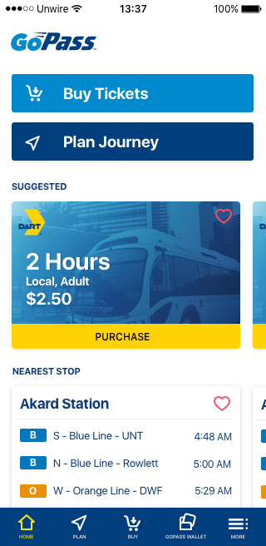
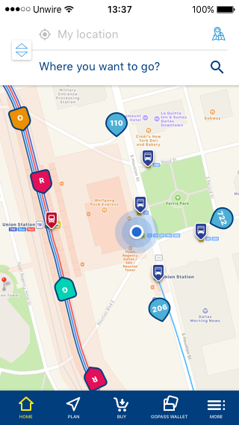
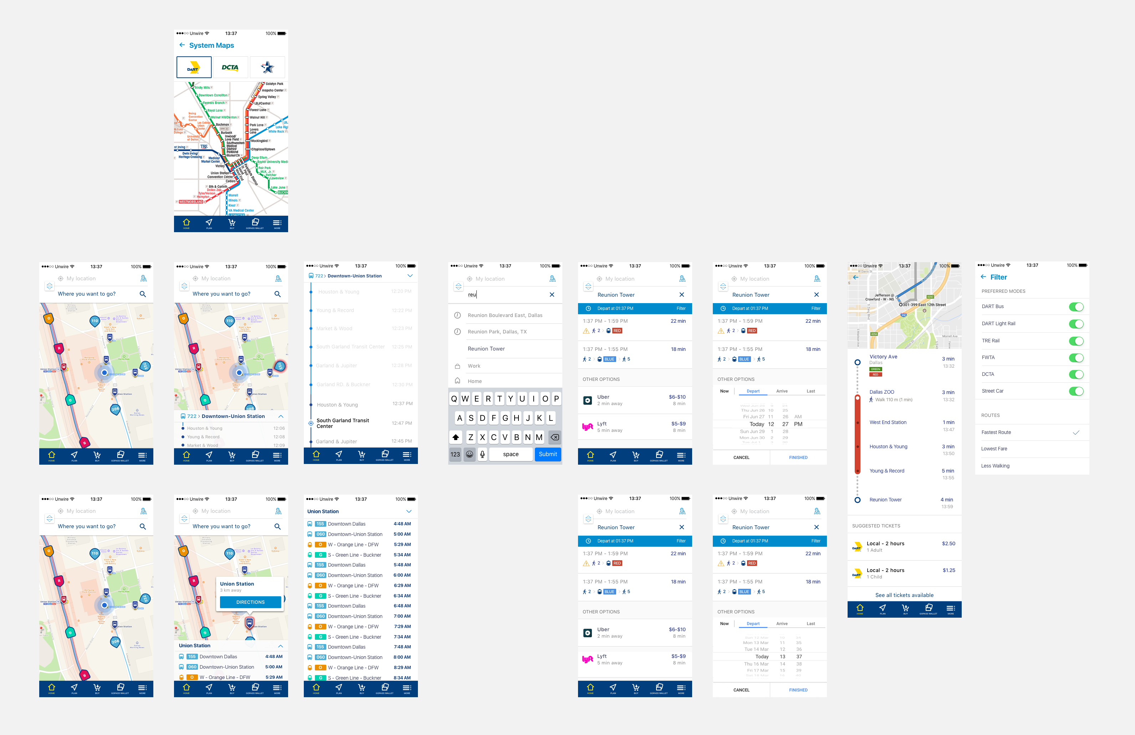
GoPass 2.0

Slide 10
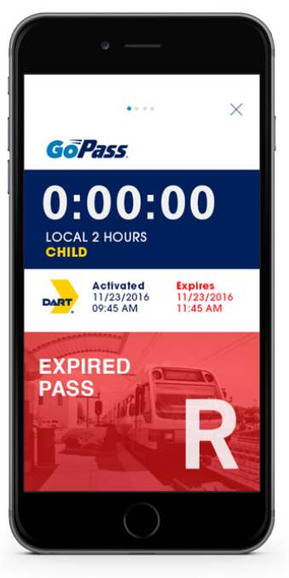
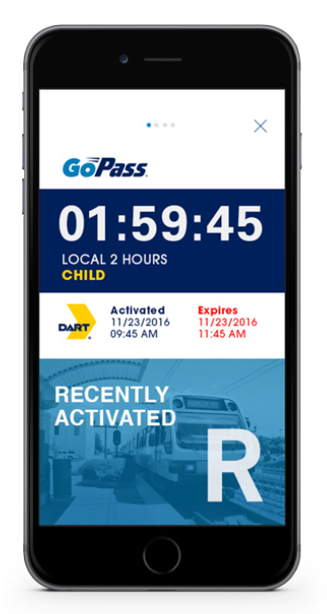
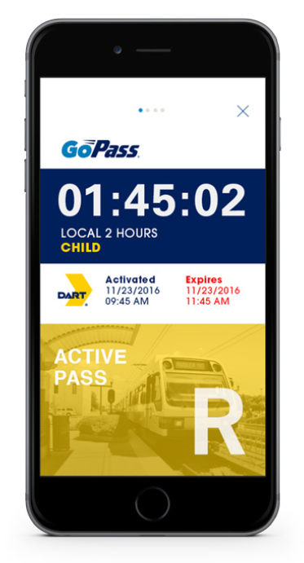
GoPass 2.0
Ticket Samples

Slide 11
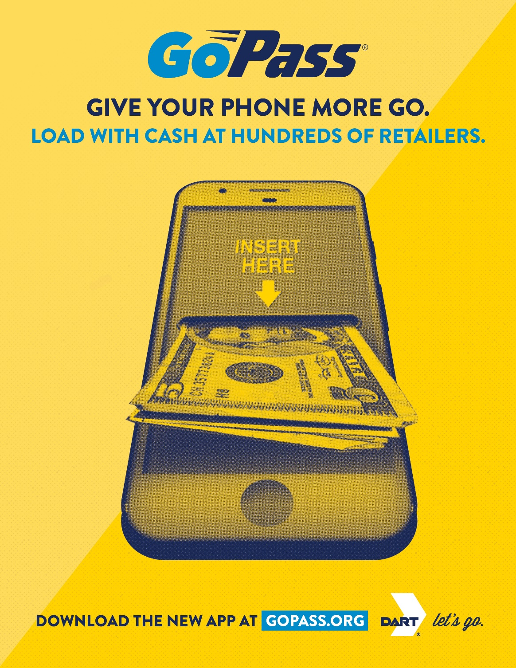

Slide 12

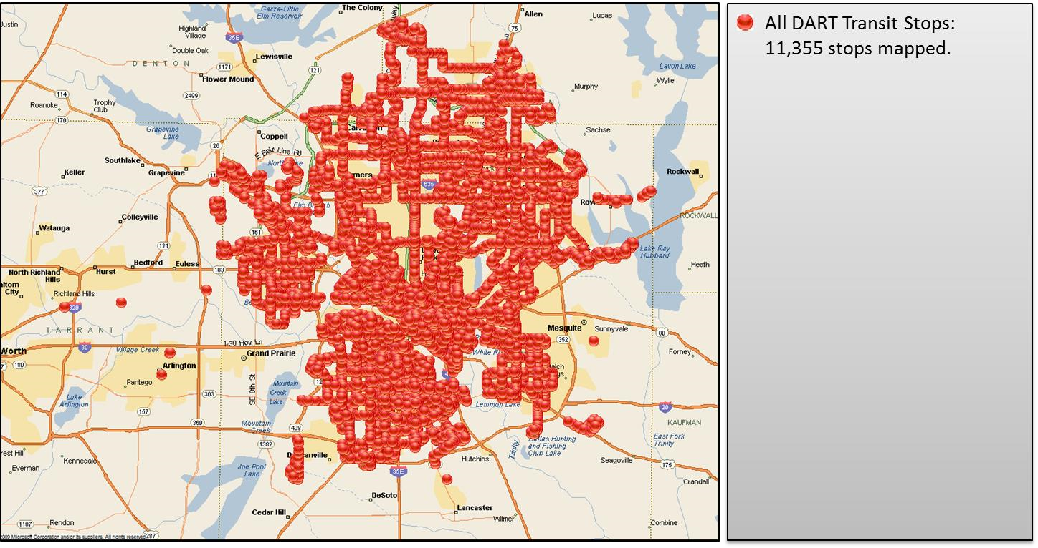
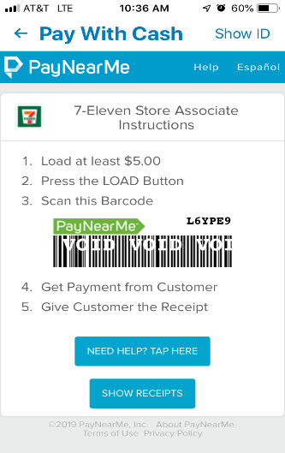
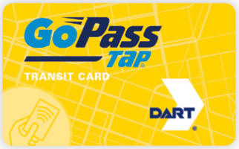




Payment and
Media Acceptance
These retailers and many more:

Slide 13
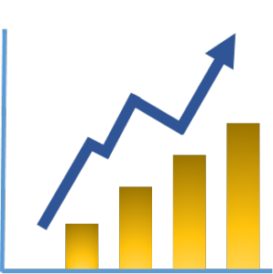
Positive Impacts for
Low Income Riders
  Provides cash to mobile options within the app
  Gets customers to areas that they don’t otherwise travel for jobs in high density locations
  Creates tailor made mobility solutions which are flexible

Slide 14
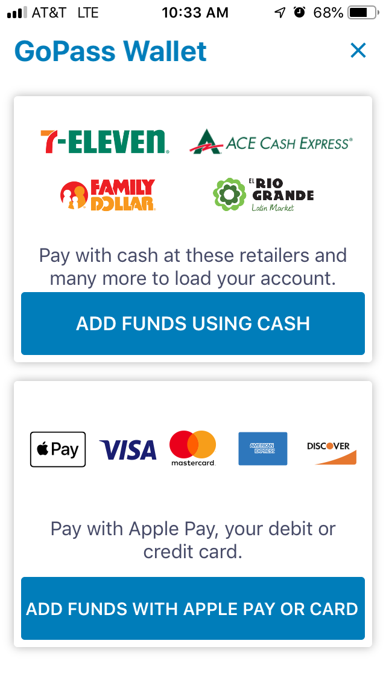
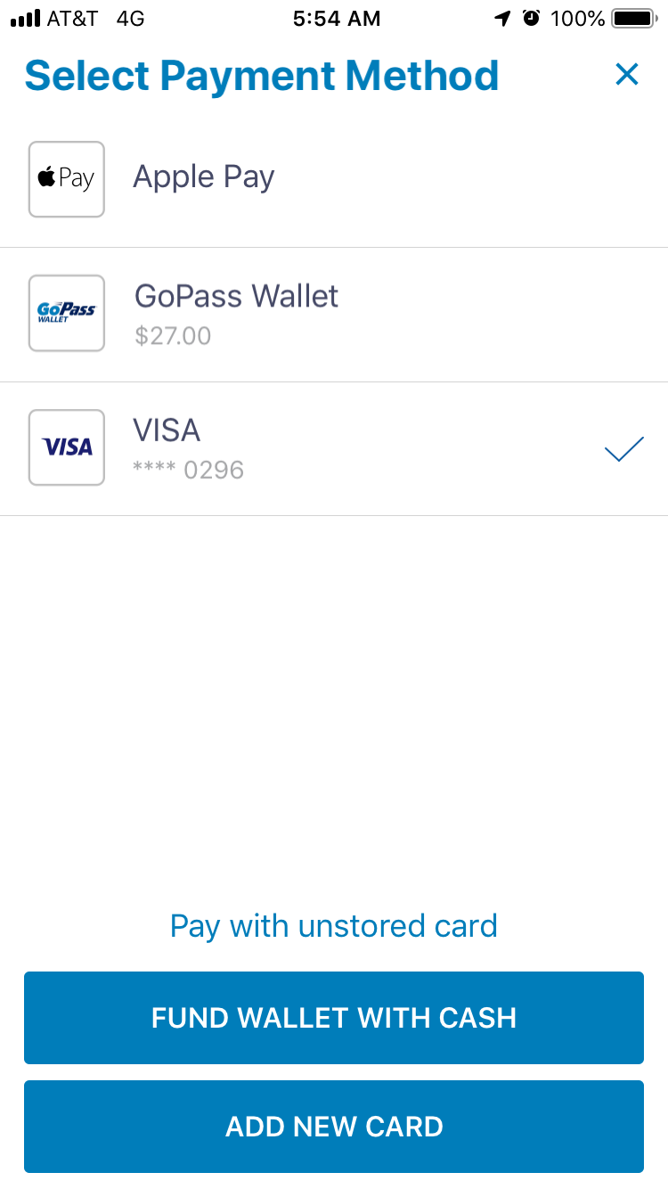
Other Payment
Acceptance

Slide 15
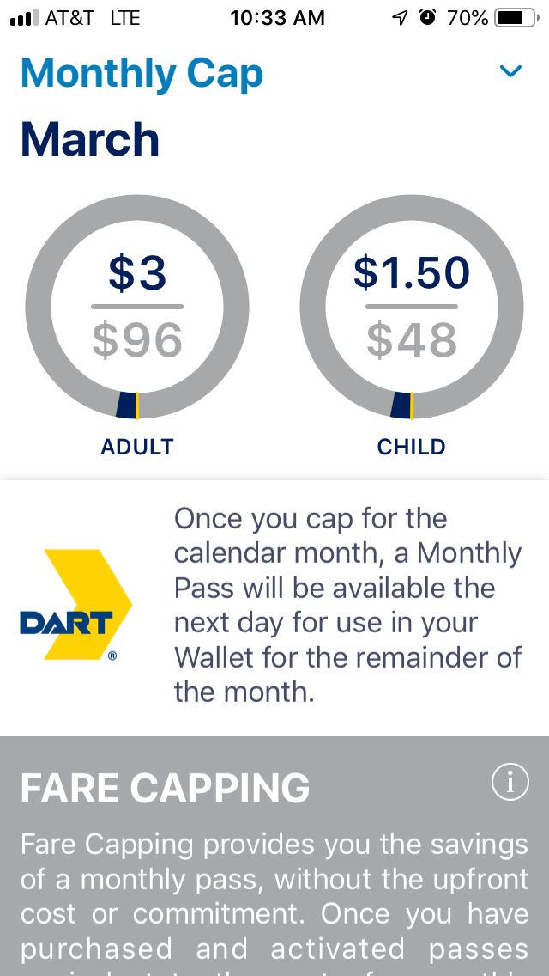
Loyalty
Customers that activate passes equaling $96 in a calendar month will get an equivalent of a monthly pass for the remainder of the month in the app:
  Local customers will pay no more than $96.00 in a calendar month
  Reduced customers will pay no more than $48.00 in a calendar month

Slide 16
GoPass App
Monthly Fare Capping

Slide 17
GoPass 3.0

Slide 18
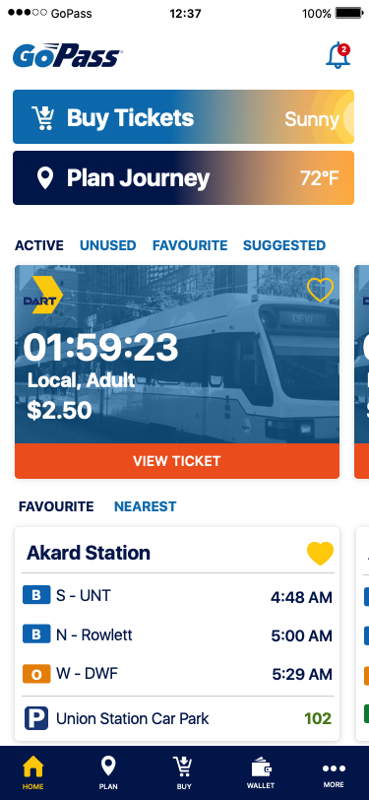

Enhanced Real-Time Trip Planning

Slide 19
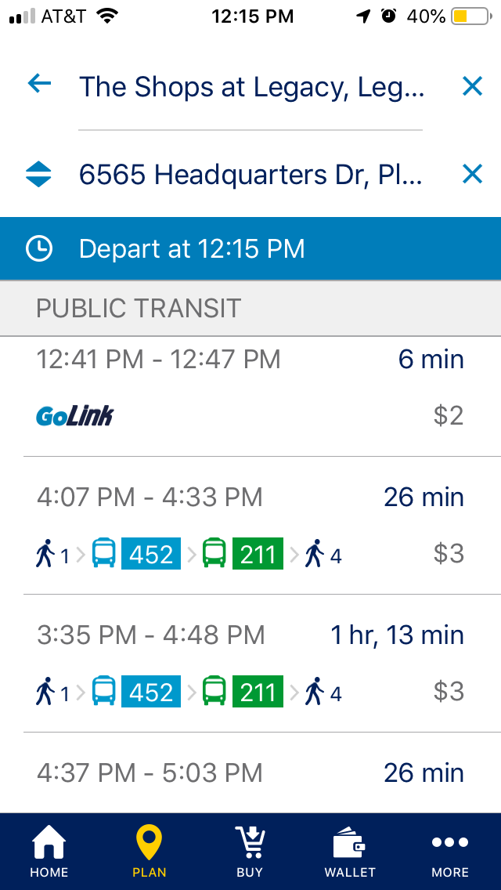
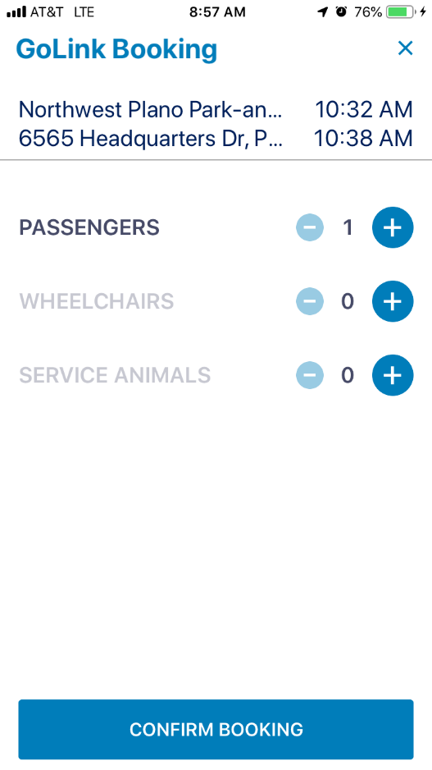
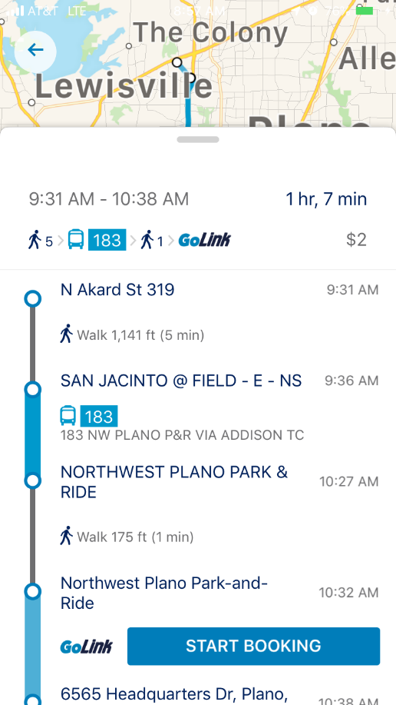
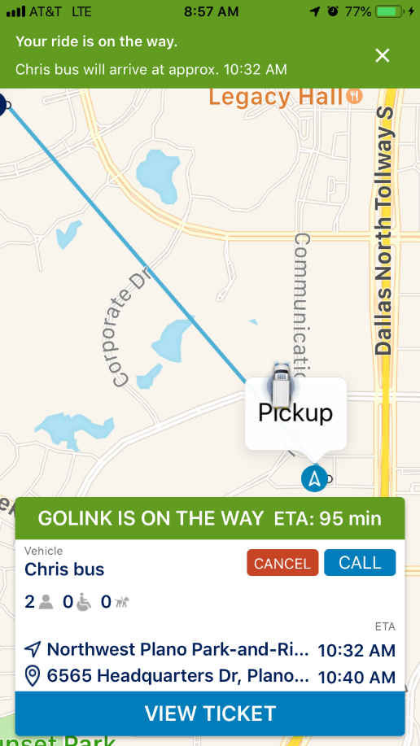
Return Points
First/Last Mile Planning
Journey Tracking
On Demand
Multimodal
Booking

Slide 20
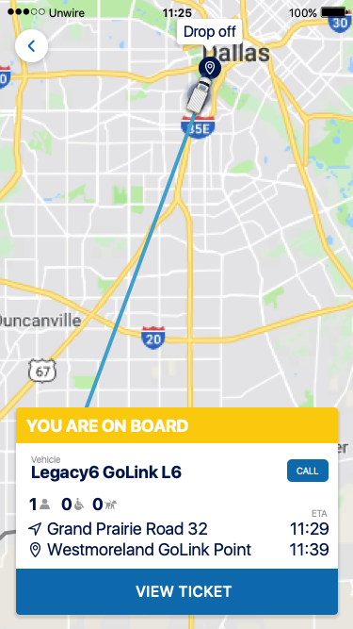
First/Last Mile Completion
Journey Tracking
Feedback

Slide 21
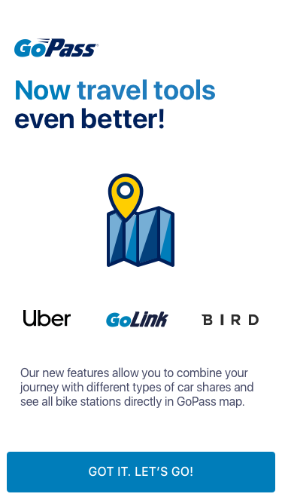
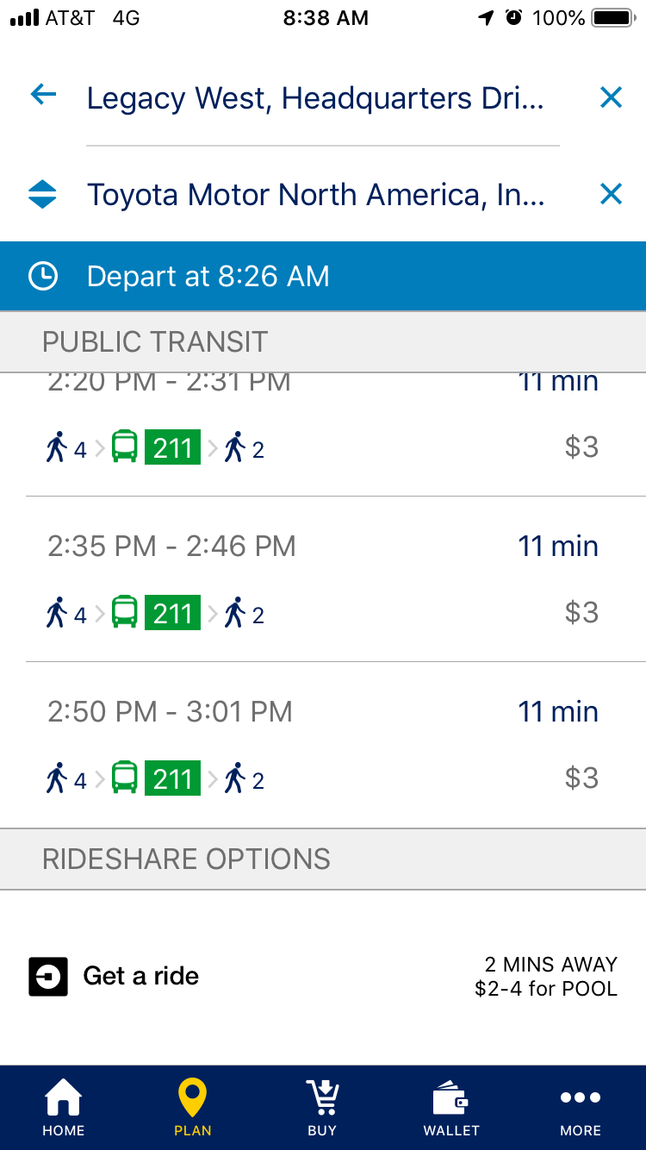
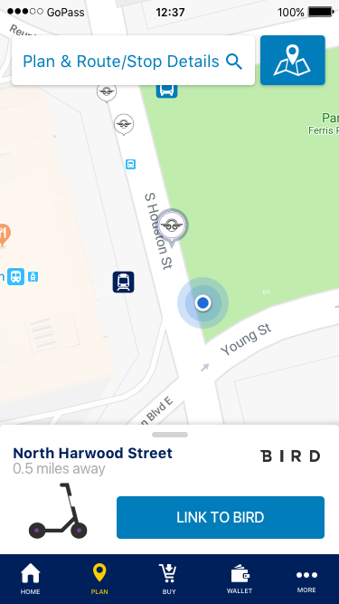
Other Modes of Service
Intro Screen
Rideshare
Scooter

Slide 22
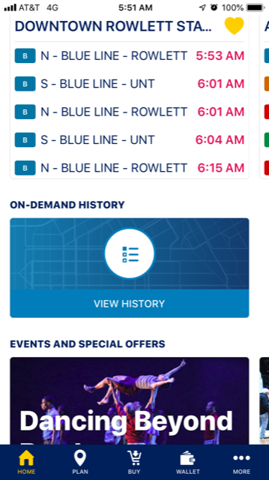
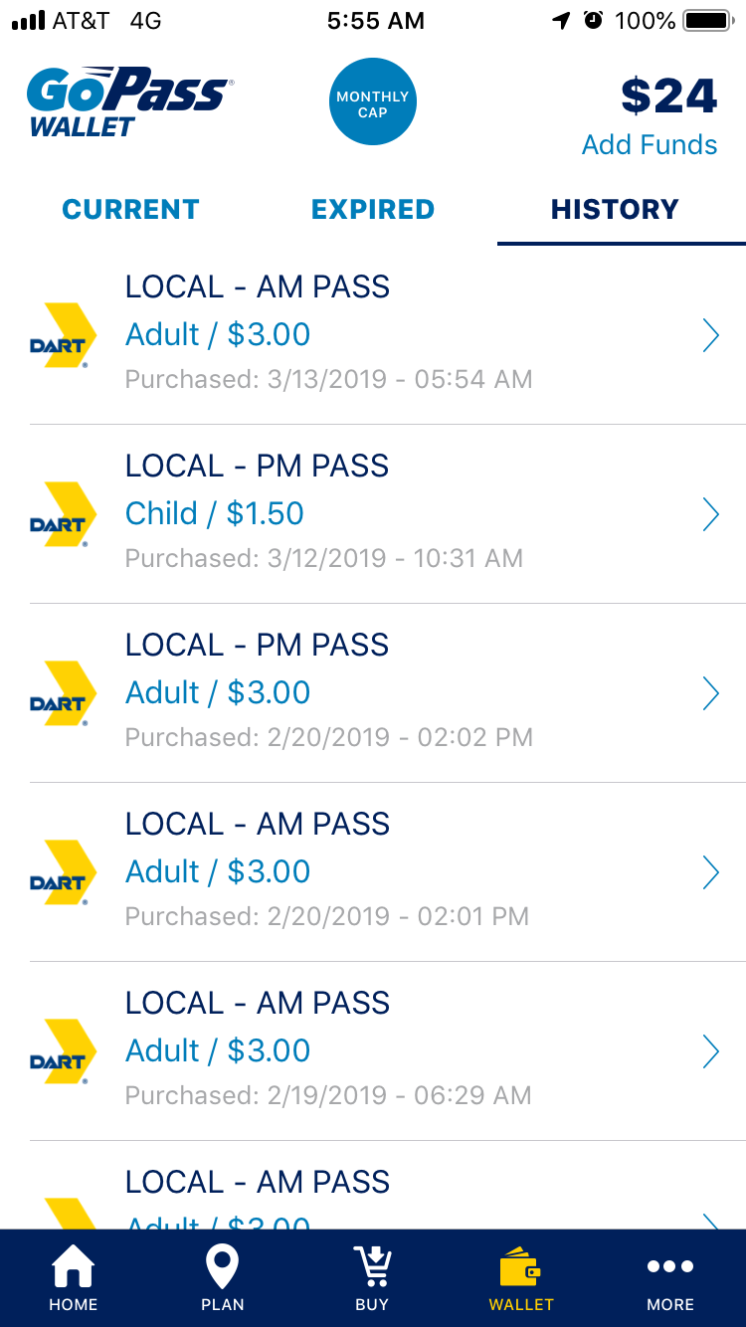
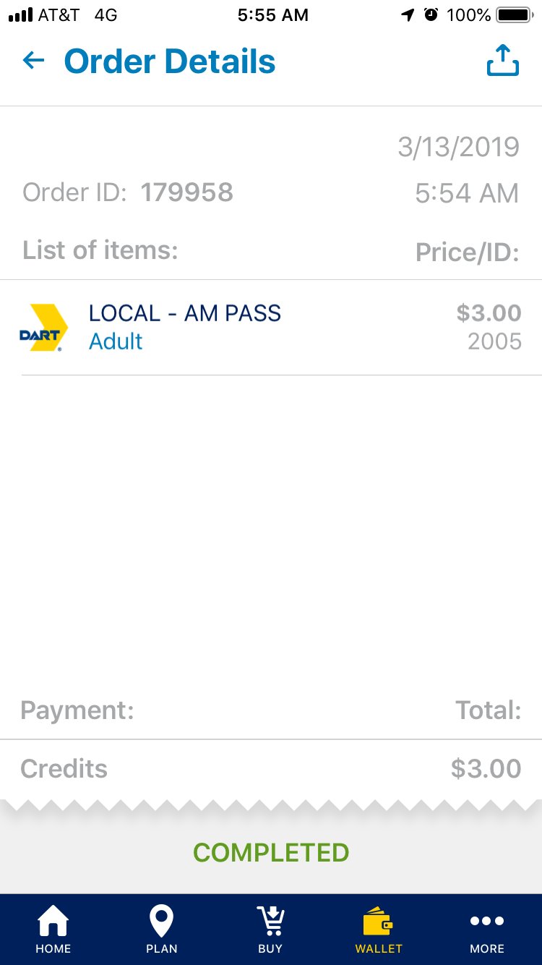
Other Features
Events & Offers
Wallet
Receipting

Slide 23
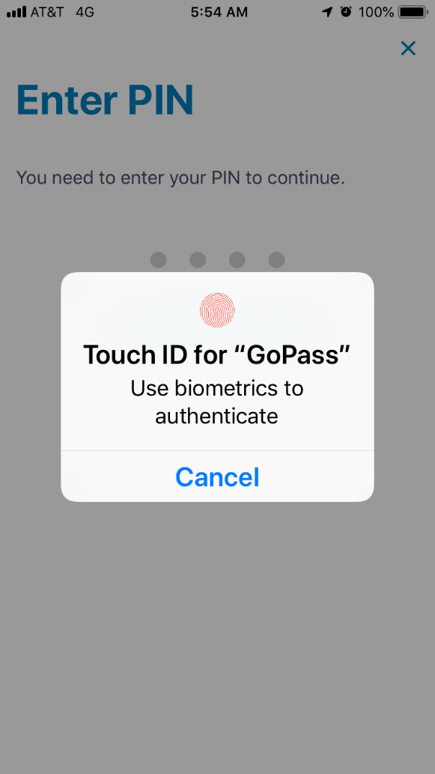
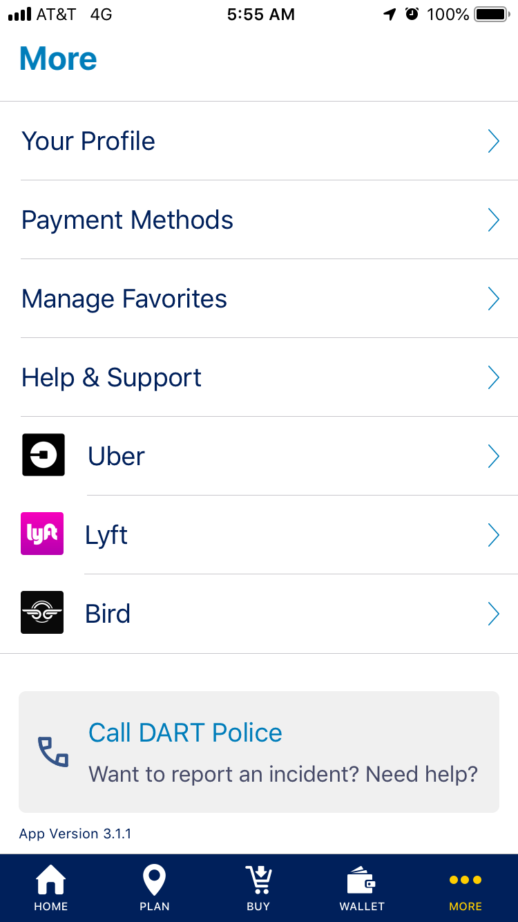
Other Features
Biometrics
“More”

Slide 24
GoPass
Roadmap
Continue with full integration of mobility options to include Paratransit, micromobility and ride-hailing services
Incorporate AI/AR intelligence which will empower persons with disabilities to use smartphones
Develop web-based journey planner for non-smartphone users to plan and book trips without needing an app
Provide real-time traffic information to encourage public transit to alleviate congestion in the region
Enrich app platform through continued redesign and modernization

Slide 25
Questions

