Slide 1
Challenge of Transit Bus Maintenance
Life of a Bus at Metro
David Michels, Vice President
Bus Maintenance
METRO INTERNAL USE ONLY

Slide 2
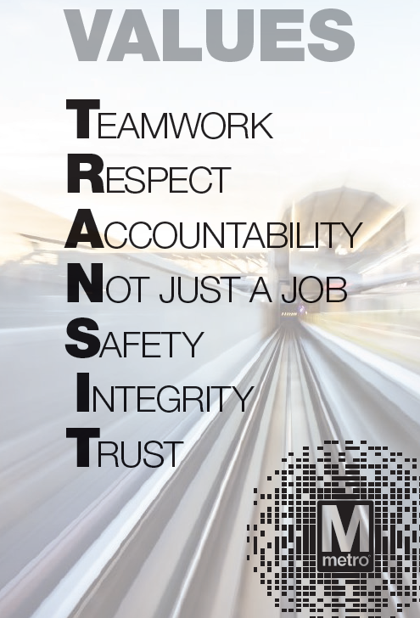
COO Mission, Vision, Values
MISSION
Move the region through safe, reliable and cost-effective public transportation.
VISION
Be the best transportation system in North America because we are consistently on-time with the cleanest
vehicles and stations. Ridership is at full capacity, with optimized networks that offer fast, frequent service to connect communities. All customers feel appreciated, have their needs met, and would rather ride metro than other forms of transportation because it is a seamless, safe, and secure experience with the lowest crime rate in North America. We have minimized the need for paratransit services because our systems are sufficiently ADA accessible and friendly to customers with limited mobility. Our assets are in good condition and are maintained using reliability-centered practices that maximize availability at the lowest cost. No part of our system is beyond its useful life. COO is well-managed with low turnover: communication flows up, down, across and our priorities are clear. All employees are fully engaged, feel valued and take pride that they are making a significant contribution in public service.

Slide 3
Bus Maintenance Organization
Challenge of Transit Bus Maintenance

Slide 4
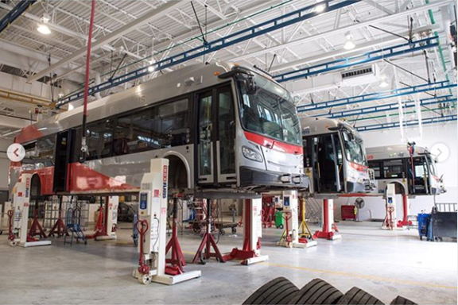
Life of a Bus
Challenge of Transit Bus Maintenance
Active Fleet (as of 8/1/19) 1525 buses
Fleet Average Age as of 8/1/19) 7.02 years
Actual Annual Miles (FY18) 48,576,705
Board directive is to own a bus for 15 years
Purchase 100 replacement buses per year

Slide 5
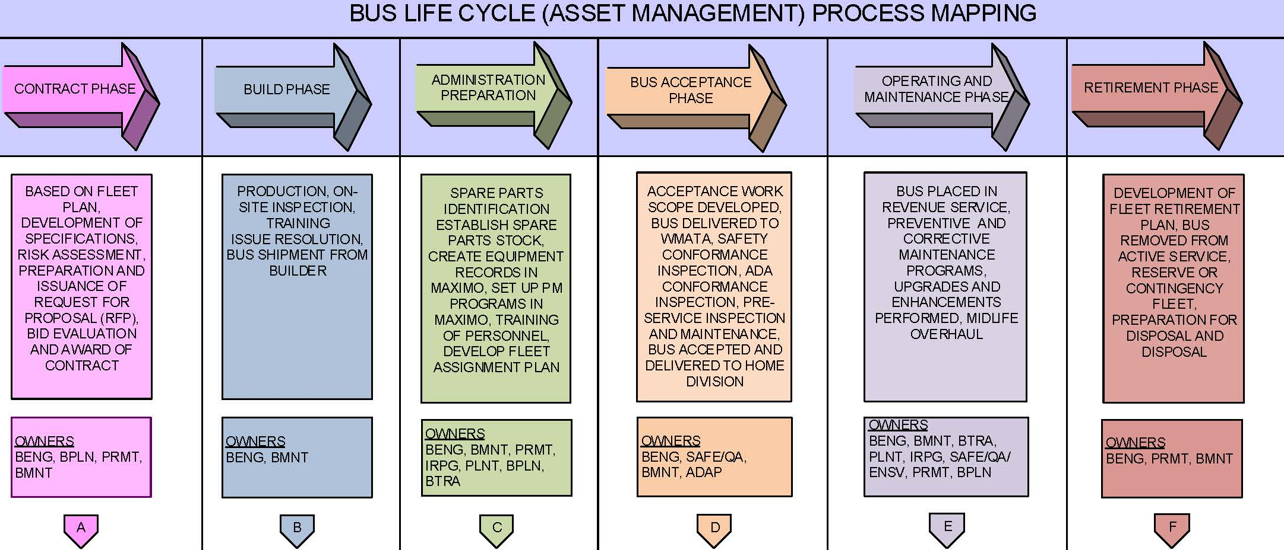
Life of a Bus – How we Manage the Fleet
Challenge of Transit Bus Maintenance
Established policy to manage bus fleet in life stages
Procurement phase
Plan …plan … plan …
Adjust as needed
Operating and Maintenance phase
Manage warranty
Manage resources / technology
Retirement phase
Today is about what buses we can keep
Increasing needs with limited resources

Slide 6
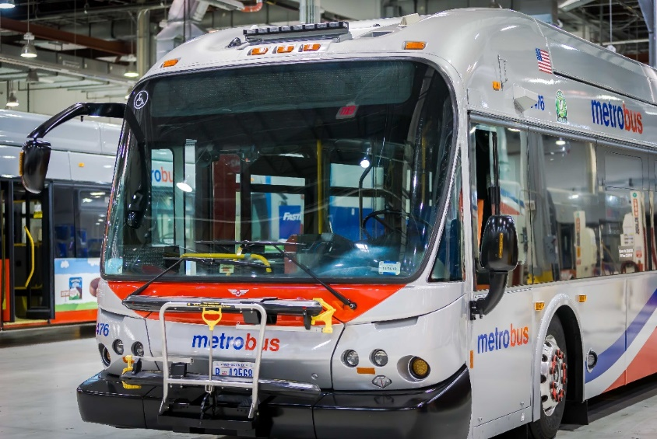
Resources
Challenge of Transit Bus Maintenance
Becoming more challenging to recruit workforce
Workforce looking past mechanic type work
Working closely with local schools to prepare students
Community colleges
Vocational schools
Made it easier for Military personnel to qualify
Continue to review what work we do ourselves versus contracting out

Slide 7
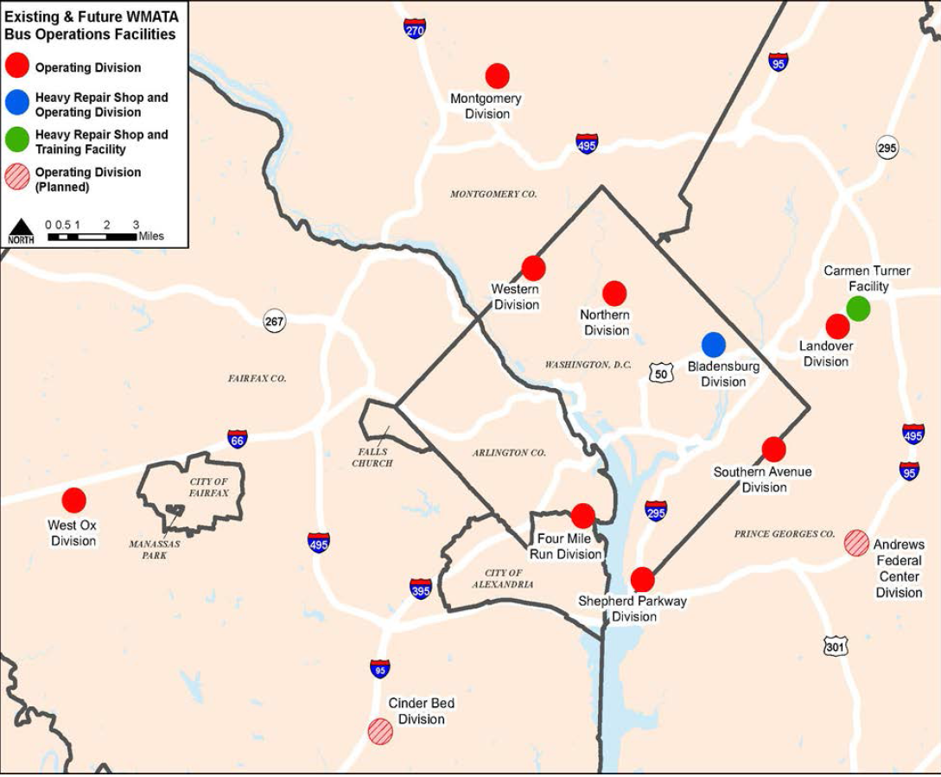
Core Services
Challenge of Transit Bus Maintenance
Bus Maintenance Core Services Provided are:
Division Operations
Service Lane Activities
Preventative Maintenance
Corrective Maintenance
Bus Engineering:
New Bus Procurement
Engineer Configuration Control
Fleet Reliability Analysis
Support Shop Services
Major Accident Repairs
Midlife Overhaul Program
Component Overhaul

Slide 8
Contract Maintenance
Challenge of Transit Bus Maintenance
Contracted services help fill the staffing void
High tech
Destination Signs
Fire Suppression
Automated Vehicle Location (AVL)
CCTV
Low tech
Bi-weekly cleaning
Pest control
Seat repair

Slide 9
What are the contracted services in BMNT?
Contracted Services for Bus Maintenance
# | Service | Service Description | Contractor | # of FTEs or Serivce Model | OPR / CIP | WMATA Responsibilities
1 | Bus Tire Leasing | Provides leased tires for the bus fleet, which WMATA pays for by mileage. | Goodyear | (1) Supervisor on-site (14) Technicians | OPR | This service is turnkey to provide WMATA a supply of tires for WMATA installation.
2 | Interior Bus Cleaning | Performs interior cleaning every 16 days for each bus, providing labor & materials to perform service. | Hands-On | (30) FTEs | OPR | This service is turnkey to WMATA, very limited involvement.
3 | Heavy Duty Transit Bus CCTV Preventative & Corrective Maintenance | Performs the preventative & corrective maintenance associated with bus fleet CCTV system, providing labor & materials to perform service. | Apollo | (11) Technicians | OPR | This service is turnkey to WMATA, only project management oversight.
4 | Heavy Duty Transit Bus CCTV Lifecycle Replacement Program | Completes the removal and replacement of new CCTV systems for camera systems beyond lifecycle. This includes labor & materials to perform this service. | Apollo | (2) Technicians | CIP | This service is turnkey to WMATA, only project management oversight.
5 | Heavy Duty Transit Bus Fire Suppression Preventative & Corrective Maintenance | Performs the preventative & corrective maintenance associated with the bus fleet fire suppression & gas detection systems, providing labor & materials to perform service. | Fireline | (4) Technicians | OPR | This service is turnkey to WMATA, very limited involvement.

Slide 10
What are the contracted services in BMNT?
Contracted Services for Bus Maintenance
# | Service | Service Description | Contractor | # of FTEs or Serivce Model | OPR / CIP | WMATA Responsibilities
6 | Driver Behavior Recognition System (Drive Cam) | Provides a driver behavior video system to reduce accidents, provide vehicle operator training, also used as an investigative tool incase of incidents and injury claims and general customer complaints. | Lytx (Drive Cam) | (5) Technicians pending on maintenance Off-Site Analytic and Reporting Service | OPR | This service is turnkey to WMATA, only project management oversight.
7 | Heavy Duty Transit Bus Designation Signs Preventative & Corrective Maintenance | Performs preventative & corrective maintenance for the Luminator designation signs installed on the entire Metrobus fleet. This includes all labor & materials to perform this service. | Luminator | (5) Technicians | OPR | This service is turnkey to WMATA, very limited involvement.
8 | Bus Seat Upholstery Service | Requirements contract for contractor to repair and re-upholster bus seats. This includes all labor & materials to perform this service. | Needles Eye | (1) Transportation Specialist (6) Technicians | OPR / CIP | This service is turnkey to WMATA.
9 | Pest Control | Performs the quarterly preventative maintenance & on-call services for pest control for the fleet. This includes all labor & materials necessary to perform the service. | N & N Pest Control | On-call Technicians | OPR | This service is turnkey to WMATA.

Slide 11
What are the contracted services in BMNT?
Contracted Services for Bus Maintenance
# | Service | Service Description | Contractor | # of FTEs or Serivce Model | OPR / CIP | WMATA Responsibilities
10 | On-Board Technology Preventative & Corrective Maintenance | Performs the preventative and corrective maintenance associated with the Comprehensive Transit Bus Intelligent Transportation System (ITS). This service covers all labor & materials to perform this service for on-board equipment, backend equipment, and facility infrastructure. | Clever Devices | All the necessary labor & materials required to support the deliverables of the contract | OPR | This service is turnkey to WMATA, with project management oversight.
11 | Professional Engineer Services | Perform professional engineering and technical consultancy services in support of programs associated with the procurement, rehabilitation, repair and maintenance of rolling stock for WMATA. | CH2M Hill (Jacobs) | Various labor categories Contingent upon the Task Order | CIP | This service is turnkey to WMATA, very limited involvement.
12 | First Aid Services | Responsible for ensuring the availability of first aid supplies and equipment within the bus garages. This includes labor and materials to perform this service. | Stat First Aid & Safety | (1) Technician | OPR | This service is turnkey to WMATA, only provide escort services for contractor.

Slide 12
What are the contracted services in BMNT?
Contracted Services for Bus Maintenance
# | Service | Service Description | Contractor | # of FTEs or Serivce Model | OPR / CIP | WMATA Responsibilities
13 | Dual Power Inverter Module (DPIM) Maintenance Service for Hybrid Buses | Performs the corrective maintenance associated with dual power inverter module (DPIM). This service covers all labor, materials, and towing to perform this service. | Johnson & Towers | (2 – 8) Technicians WMATA pays for labor, towing, materials | OPR | This service is turnkey to WMATA, very limited involvement.
14 | Energy Storage System Lifecycle Replacement Service for Hybrid Buses | Performs the removal of old energy storage system and installation of a new energy storage system for the hybrid buses. This service covers all labor, materials, and towing to perform this service. | Johnson & Towers | (2-3) Technicians WMATA pays for the unit (fixed cost) | CIP | This service is turnkey to WMATA, very limited involvement.
15 | Non-Warranty Repairs for Allison Systems | Responsible for completing repairs to the Allison systems for the transmission and hybrid drive units. This service covers all labor, materials, and towing to perform this service. | Johnson & Towers | (2 – 3) Technicians WMATA pays for labor, towing, materials | OPR | This service is turnkey to WMATA, very limited involvement.

Slide 13
What are the contracted services in BMNT?
Contracted Services for Bus Maintenance
# | Service | Service Description | Contractor | # of FTEs or Serivce Model | OPR / CIP | WMATA Responsibilities
16 | Non-Warranty Repairs for Cummins Engines | Responsible for completing repairs to the Cummins engines. This service covers all labor, materials, and towing to perform this service. | Cummins | WMATA pays for labor, towing, materials | OPR | This service is turnkey to WMATA, very limited involvement.
17 | Repair Stator Housing for Hybrid Buses | Responsible for testing and repairing stator houses. This service covers all labor, materials, and transportation to perform this service. | RAM Industrial Services | WMATA pays for the unit (fixed cost) | CIP | This service is turnkey to WMATA, very limited involvement.
18 | MRO Vending and Fastenal Supplier for Shop Supplies | Responsible for ensuring the availability of consumable MRO products and equipment within the bus garages through a vending and bin stock vendor managed inventory. This includes labor and materials to perform this service. | Fastenal | (1) Account Manager (2-5) Order Fulfillment Specialists | OPR | This service is turnkey to WMATA, with project management oversight.

Slide 14
What are the contracted services in BMNT?
Contracted Services for Bus Maintenance
# | Service | Service Description | Contractor | # of FTEs or Serivce Model | OPR / CIP | WMATA Responsibilities
19 | Supplemental Towing Services for DC, MD, and VA | Responsible for performing towing services as needed to supplemental WMATA requirements. | M&M Towing (DC/MD) Willow Springs (VA) | WMATA pays for towing based on distance | OPR | This service is turnkey to WMATA, very limited involvement.
20 | Car Wash Services for Service Vehicle Fleet | Responsible for keeping the service vehicle fleet cleaned. | Sam’s Car Wash Mr. Wash Kenilworth Seabrook | WMATA pays for the unit (fixed cost) | CIP | This service is turnkey to WMATA, very limited involvement.
21 | Lubricants, Fuel, Coolant, and Fluids | Provides the necessary transportation and delivery of various lubricants, fuel, coolant, and fluids. | Mansfield James River Petro Choice Cummins Tilley | (1) Account Manager (2-5) Order Fulfillment Specialists | OPR | This service is turnkey to WMATA, very limited involvement.

Slide 15
What are the contracted services in BMNT?
Contracted Services for Bus Maintenance
# | Service | Service Description | Contractor | # of FTEs or Serivce Model | OPR / CIP | WMATA Responsibilities
22 | Real time Bus Customer Information System | Acquire bus stop-level schedule data from WMATA's existing scheduling system in Trapeze. Acquire real-time bus locations from WMATA's existing automatic vehicle location (AVL) data from Clever Cad. Use a predictive algorithm to calculate estimated times of arrivals (ETAs) and departures (ETDs) of buses at bus stops and bus terminals. | Cambridge Systematics | WMATA pays for the Service | OPR | This service is turnkey to WMATA, with project management oversight.
23 | Driver Protection System (DPS) Retrofit of the bus fleet. | Perform the design, installation, quality control, warranty, and coordination of the installation of the Arow Global driver protection system for the entire bus fleet. | New Flyer Arow Global Midwest Bus | WMATA pays for the unit and labor(fixed cost) | CIP | This service is turnkey to WMATA, with project management oversight.

Slide 16
Questions & Answers
Challenge of Transit Bus Maintenance

