Slide 1
Strategic Initiatives at Washington DC Metro
Jayme Johnson Director, Strategic Initiatives
Aug 12, 2019

Slide 2
Organization Position of STIN
Chief Operating Officer Joe Leader
Strategic Initiatives Jayme Johnson
Design and Construction John Thomas
MetroAccess Christiaan Blake
Support Services Rodolfo Bitar
Bus Robert Potts
MTPD Ronald Pavlik
Operations Budget, Performance, & Planning Andrea Burnside
Rail Lisa Woodruff
Engineering and Architecture
Infrastructure Renewal Program Group
Major Capital Projects
Dulles
Capital Support
Rail Transportation
Rail (CMOR)
Rail Infrastructure Maintenance and Engineering
Reliability Centered Maintenance Planning
Silver Line O&M
ADA Policy
Eligibility Cert. and Outreach
MetroAccess Service
Systems Maintenance
Plant
Supply Chain
Elevator and Escalator
Transportation
Maintenance
Patrol Operations
Homeland Security
Emergency Management
Professional Responsibilities and Inspections
Intermodal Strategic Planning
Chief Performance Officer
OPMS
Supply Chain Management Stephen Spulik
BUS Supply Chain Management
Facilities and Warehousing
RAIL Supply Chain Management
Planning and Analytics
We are here!

Slide 3
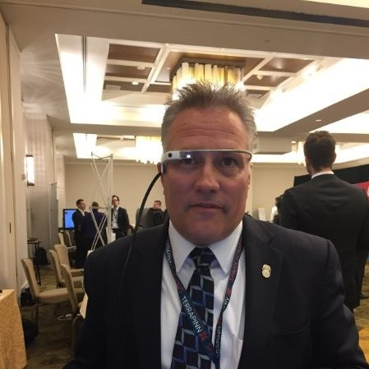
Strategic Initiatives at Washington DC Metro
In 2016 Joe Leader was appointed Chief Operating Officer at the DC Metro (after running the subway system in New York)
He appointed a Director to launch the ‘Strategic Initiatives’ team in 2017, modeling it on New York City Transit’s namesake
Strategic Initiatives works with operations departments to change the way we do business and improve operations
We carefully select projects based on two criteria:
Potential to substantially improve operations at WMATA (safety, service, efficiency)
Commitment from internal partners to collaborate throughout the process and own the solution if successful

Slide 4
Current Programs and Projects
Track Access
3% Challenge
Leadership
MetroDocs
Capital Risks
Safety
Performance and Clearing
Employee Train
Trailing Project
Tagging Relay
Non-Revenue Fleet Program
BTRA Systems Improvement
Maintenance Review
Program Management
Project Management Standardization
Crew Support
Delay Claims
Leadership
MetroDocs
Job Hazard Assessments
Resourcing Missing Work Instructions
Employee System of Record
Bus Operator Victimization

Slide 5
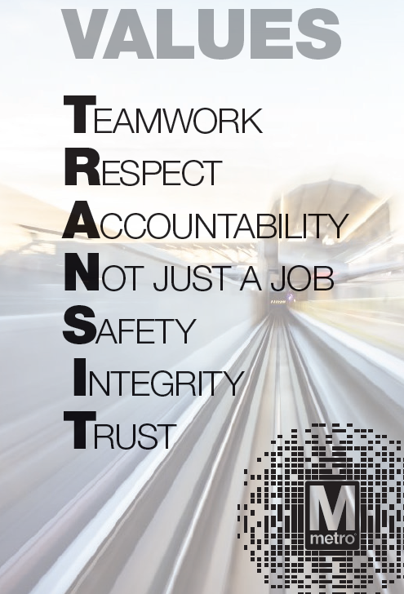
Mission and Values of COO
MISSION
Move the region through safe, reliable and cost-effective public transportation.
VISION
Be the best transportation system in North America because we are consistently on-time with the cleanest
vehicles and stations. Ridership is at full capacity, with optimized networks that offer fast, frequent service to connect communities. All customers feel appreciated, have their needs met, and would rather ride metro than other forms of transportation because it is a seamless, safe, and secure experience with the lowest crime rate in North America. We have minimized the need for paratransit services because our systems are sufficiently ADA accessible and friendly to customers with limited mobility. Our assets are in good condition and are maintained using reliability-centered practices that maximize availability at the lowest cost. No part of our system is beyond its useful life. COO is well-managed with low turnover: communication flows up, down, across and our priorities are clear. All employees are fully engaged, feel valued and take pride that they are making a significant contribution in public service.

Slide 7
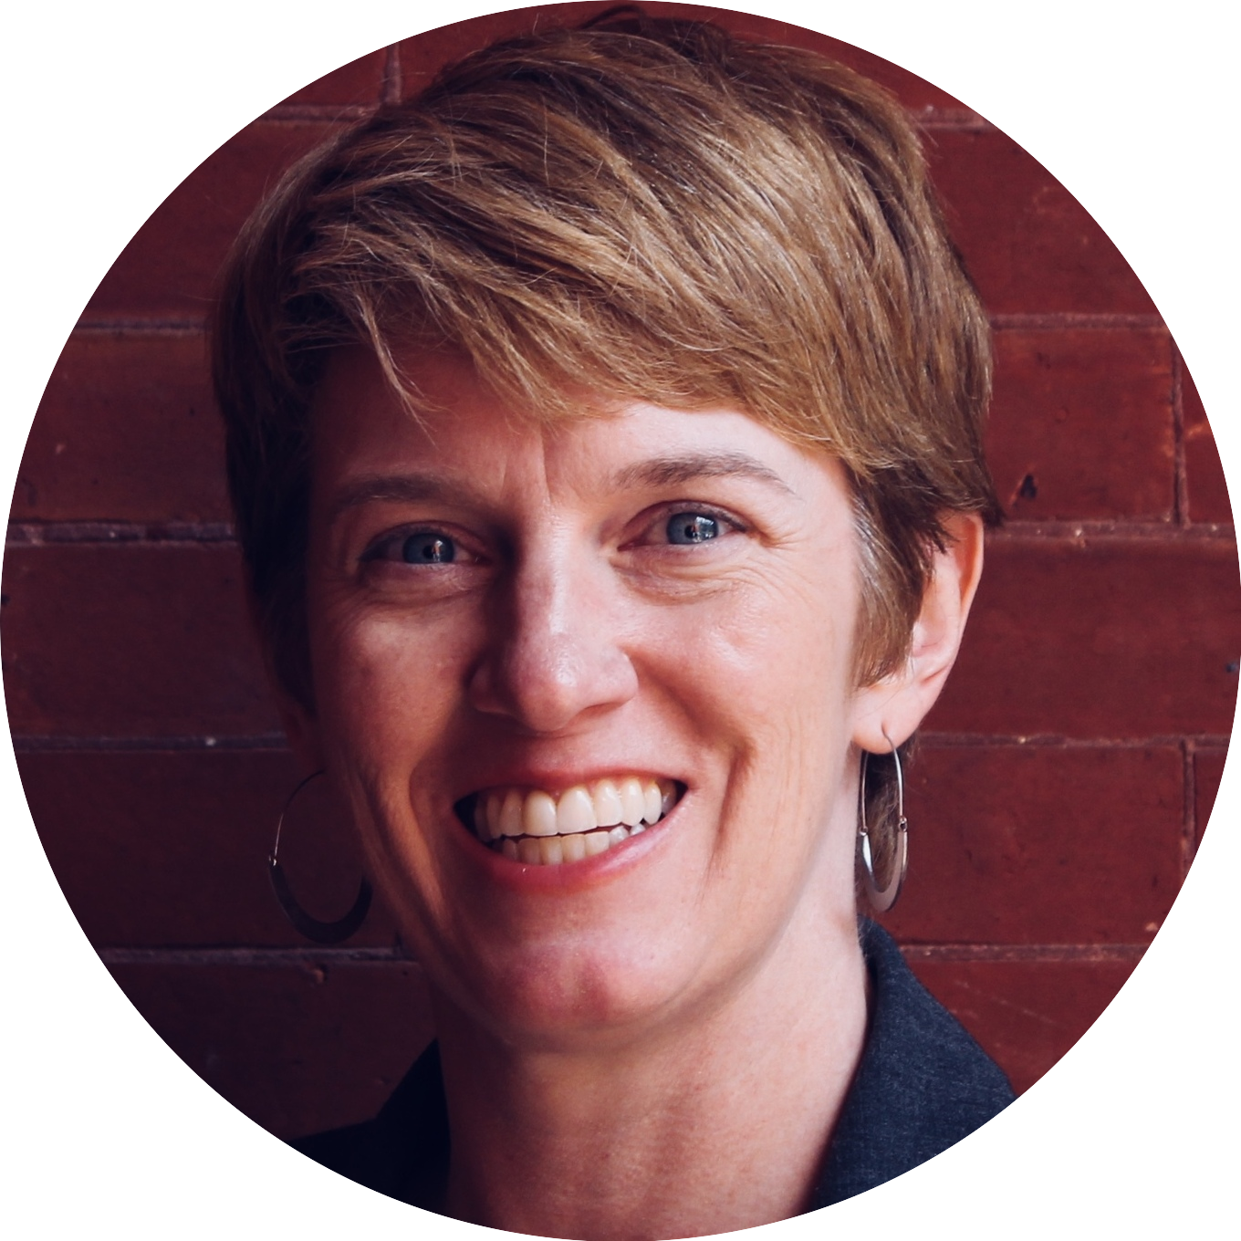
Importance of Diverse Experience
(not necessarily transit)
Jayme Johnson
Director, Strategic Initiatives
Kevin Coyne
Senior Program Advisor
Elissa McDade
Senior Program Manager

Slide 8
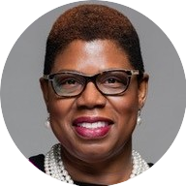
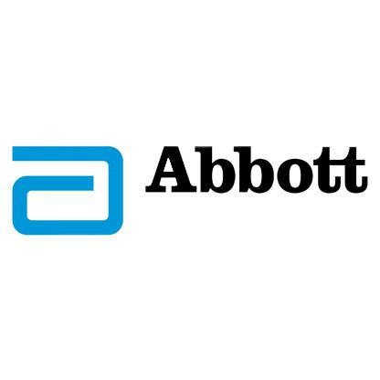
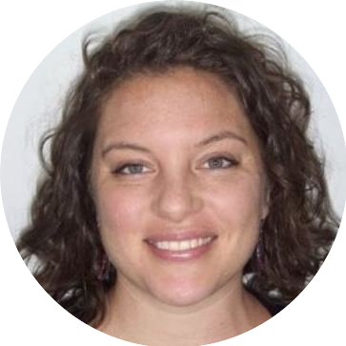
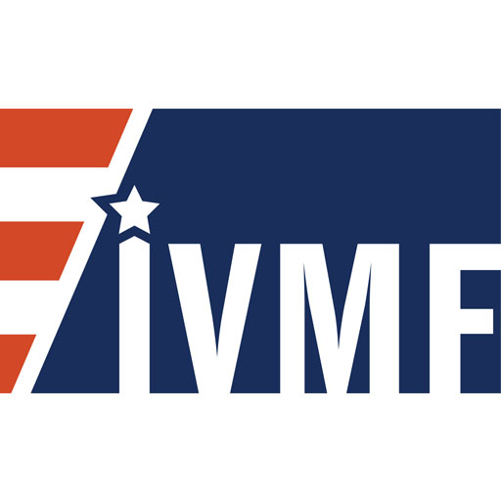
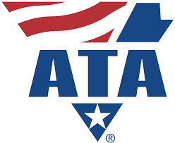
Importance of Diverse Experience
(not necessarily transit)
Adalena Ahmad
Manager
Amanda Barnett Manager
Ryan Platner
Operations Research Analyst

Slide 9
Our Skills (the highlights)
Project
and Program Management
Business Process and Systems Analysis
Cost Benefit Analysis and Tracking
Change Management in Operations
Business Data
Analysis
Culture Change and Communication
Risk Analysis
Cross-functional
Coordination

Slide 10
A Design Thinking Approach to Design our Approach

Slide 11
Key Requirements to Success
Implement solutions and monitor results – don’t put reports on shelves
Weaving change management practices (ADKAR) throughout the process – ownership of the solution is critical.
Design with users, not for them
Viewing + treating WMATA employees as part of the team—not a client
Building + nurturing trusting and productive relationships from day 1
Back-seat
Driving
Human Centered
Embody the role of changemaker
Shine a light on the people making things happen
Optimize for results, not optics
Understanding the problem space is more than half the battle
Take an evidence-based approach to decision-making
Track the dollars
Empower
Colleagues
Data Driven

Slide 12
Questions and Thoughts
Thank you
jmjohnson@wmata.com
202-962-5988 24/7

