Slide 1
Navigating Multiple Jurisdiction
Regina A. Sullivan
08/12/2019
METRO INTERNAL USE ONLY

Slide 2
WMATA BACKGROUND
WMATA was created in 1967 by a tri-state Interstate Compact between VA, D.C. & MD, which was then ratified by Congress.
Mandate:
To plan, finance, construct and operate a comprehensive mass transit system for the National Capital Region
Board of Directors:
8 voting members and 8 alternates with equal representation from each compact jurisdiction and the federal government.

Slide 3
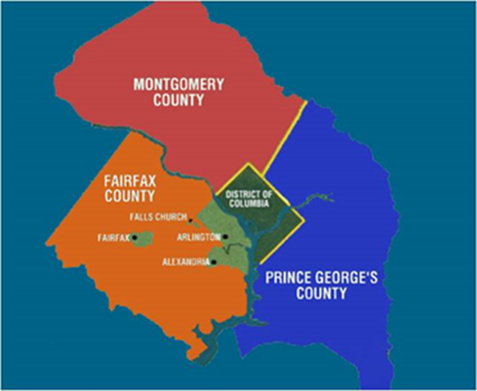
It’s complicated…
Virginia
Commonwealth
Fairfax County
Arlington County
City of Alexandria
City of Fairfax
City of Falls Church
District of Columbia
Maryland
Montgomery County Council
Prince George’s County Council
Notes:
Let me take a few minutes to describe the complexities of the multiple jurisdictions that oversee WMATA. Most transit agencies deal with their local, county and state government elected officials and staff which is challenging in it’s own way but is limited to one state’s oversight. Given our governance model we deal with two states, the District of Columbia, seven city and county entities.

Slide 4
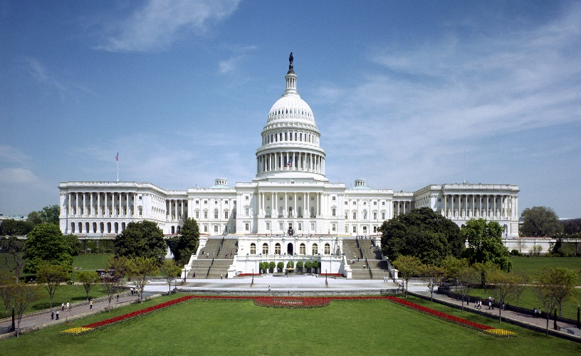
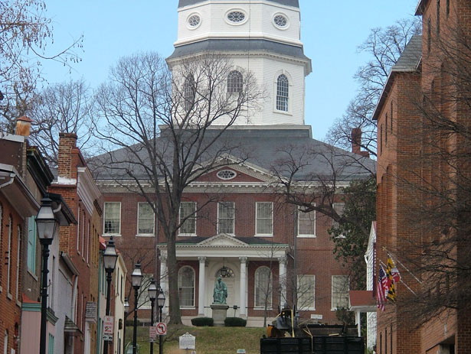
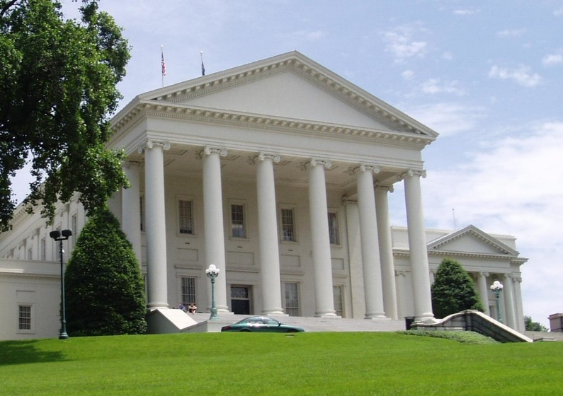
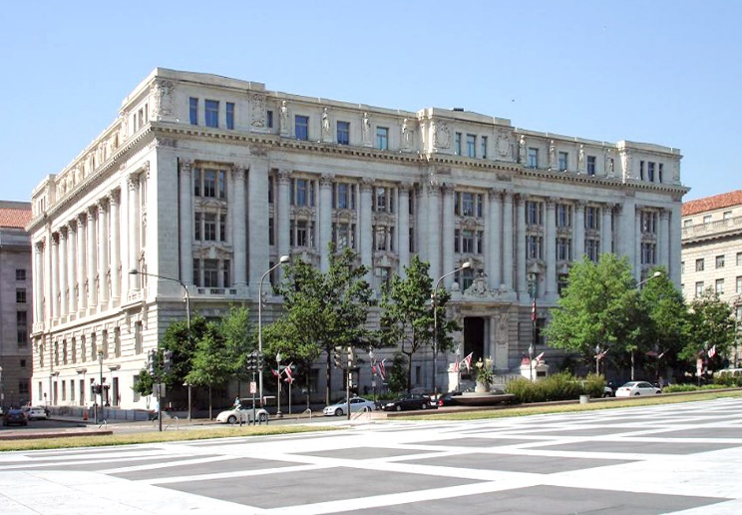
More complications……
Annapolis
Richmond
Wilson building
United States Capitol

Slide 5
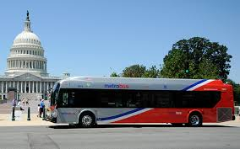
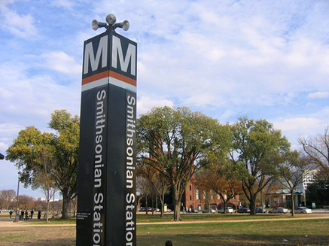
Federal Relationship
WMATA Benefits
More than half of Metrorail stations serve federal facilities
Approximately 1/3 of Metrorail’s peak period commuters are federal employees
Metro moves visitors to the capital and for national events such as presidential inaugurations, state funerals, celebrations and festivals on or near the National Mall
Metro also serves a unique vital security role for the federal government and is essential for public safety and emergency preparedness
Notes:
Metro also has a strong and unique federal relationship
More than half of Metrorail stations serve federal facilities
In addition to moving visitors to the nation’s capital, Metro also provides transportation for thousands of U.S. government employees – moving employees of 277 federal agencies (federal employees are ~1/3 peak A.M. commuters) - including those traveling to and from defense agencies, such as the Pentagon and the Department of Homeland Security.
Further, Metro has proven essential in a time of crisis, including evacuation for weather events and national emergencies (such as 9/11). Metrorail can enable the evacuation of more than 120,000 people per hour.

Slide 6
Federal oversight
US DOT
US DHS
OMB
White House
Congressional committees:
Appropriations
Transportation committees
Homeland Security
House and Senate Oversight committees
Administration committees
Judiciary Committees
Notes:
While all transit agencies in the U.S. have a relationship with their Congressional delegation and are subject to oversight ours is unique.
In addition to the obvious transportation and funding committees on Capitol Hill with jurisdiction over transit. Because of the governance structure that was set up when the agency was created we are subject to oversight by the House and Senate Oversight committees and the Judiciary committee. Both committees have been a little busy so far this session but are still paying careful attention to issues here at Metro.
We also deal with the Administration committees in the House and Senate on a variety of issues including things like the historic preservation sensitivities of putting a canopy up over the entrance at our Capitol South station. While permitting and sighting of structures a rail stations are complicated at all transit agencies, having the Architect for the Capitol involved in that project creates some very interesting dynamics.

Slide 7
Government relations
Notes:
I have described some of the complexities we are navigating. Now let me turn to some of the ways we manage to ensure WMATA’s priorities are addressed by all of our jurisdictional partners. First, the government relations department at WAMTA is structured as you can see from the org chart is there is a government relations officer assigned to cover each jurisdiction – DC, VA, MD , Capitol Hill and federal government. What’s not obvious by looking at the org chart is the deliberate collaboration that takes place between the government relations team to ensure that elected officials and staff focus on the regional needs of our system.

Slide 8
Structure and strategies
Joint Coordinating committee
Focusing on key leaders
Communication with elected officials/staff
“One issue” stakeholder groups
Notes:
I have described some of the complexities we are navigating. Now let me turn some of the ways we manage those complexities. We use multiple avenues to ensure we are covering the hundreds of staff and elected officials involved in WMATA oversight.

Slide 9
External stakeholders are critical
Business community
Non-profits
Think tanks
Unions

Slide 10
QUESTIONS ?

