Slide 1
Mobile Data Collection for Rail Operations Field Personnel
MAXX Program Presentation
May 3, 2019
Presented by: Michael Holbrook,
Vice President, Rail Operations,
and
Gail Cook,
Operations Analyst, Rail Operations

Slide 2
Rail Operations
214 Operators
23 hours of service (revenue and non-revenue) 365 days a year.
164 LRV’s
4 StreetCars
200 Miles of track
34 Rail Supervisors
98% of time spent in field

Slide 3
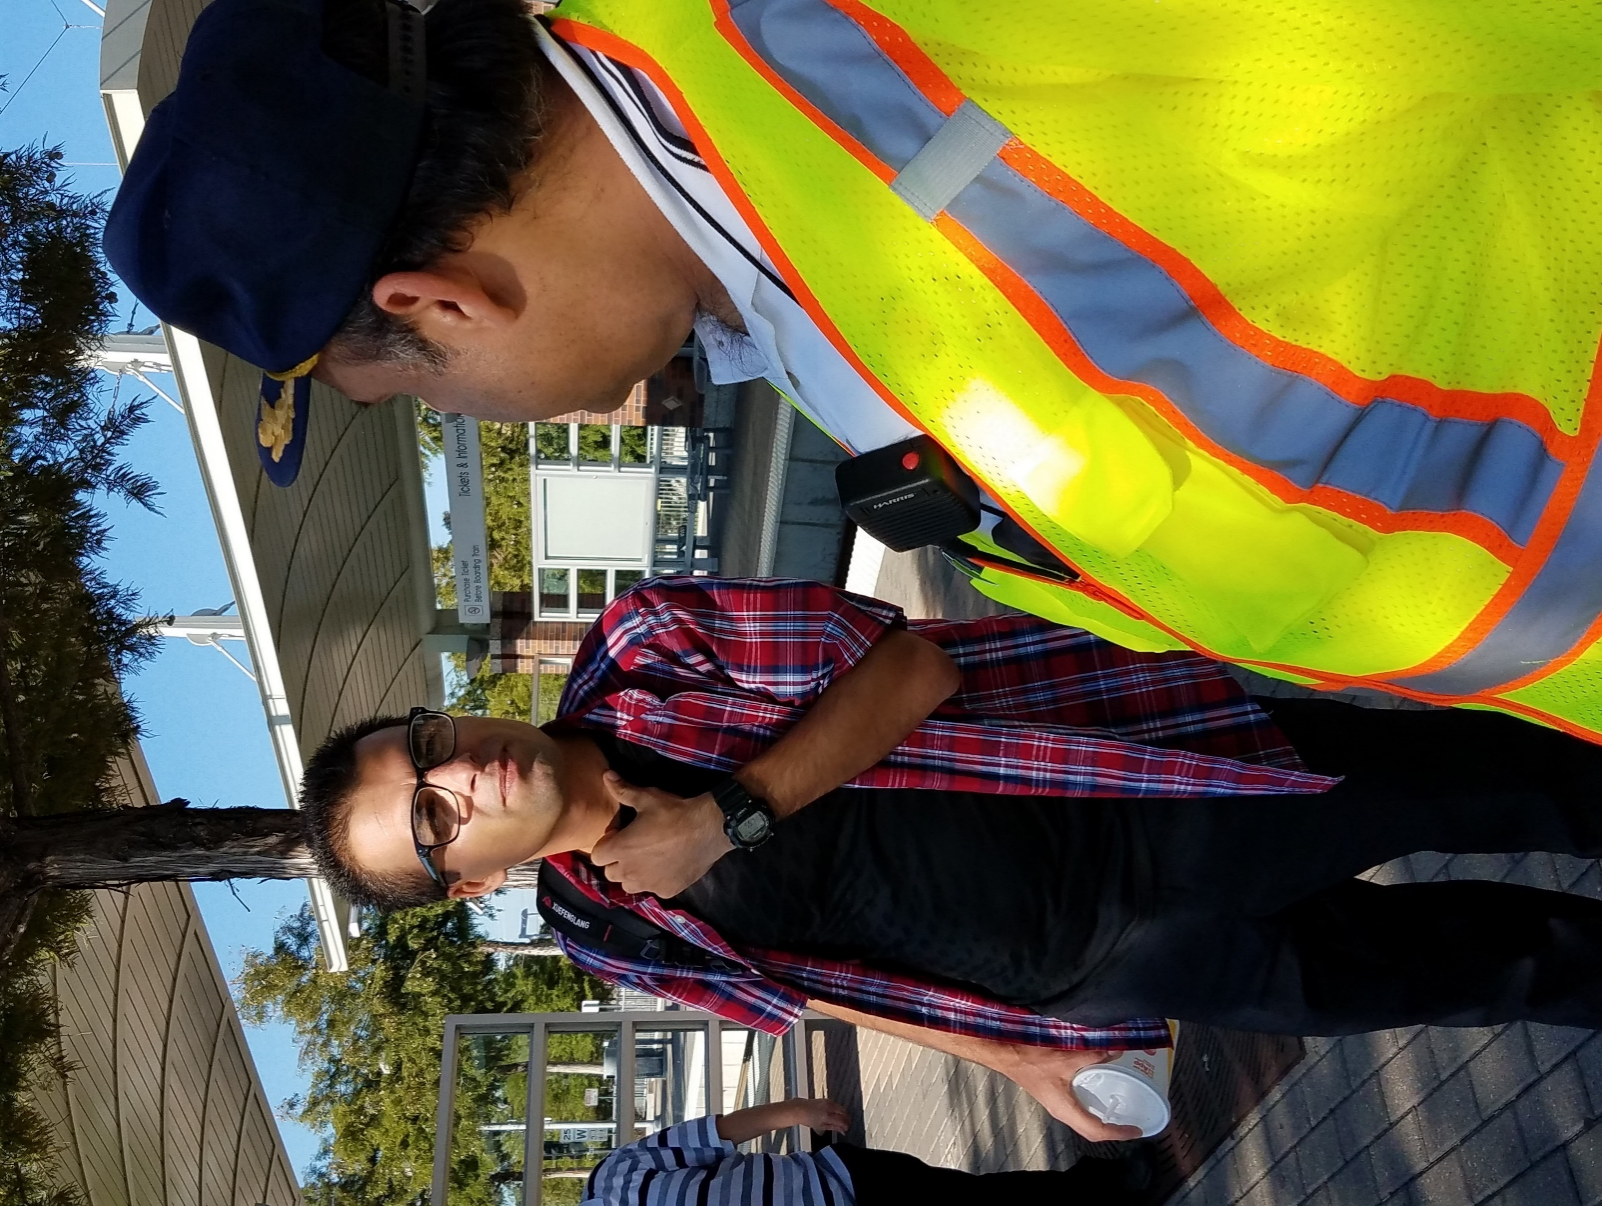
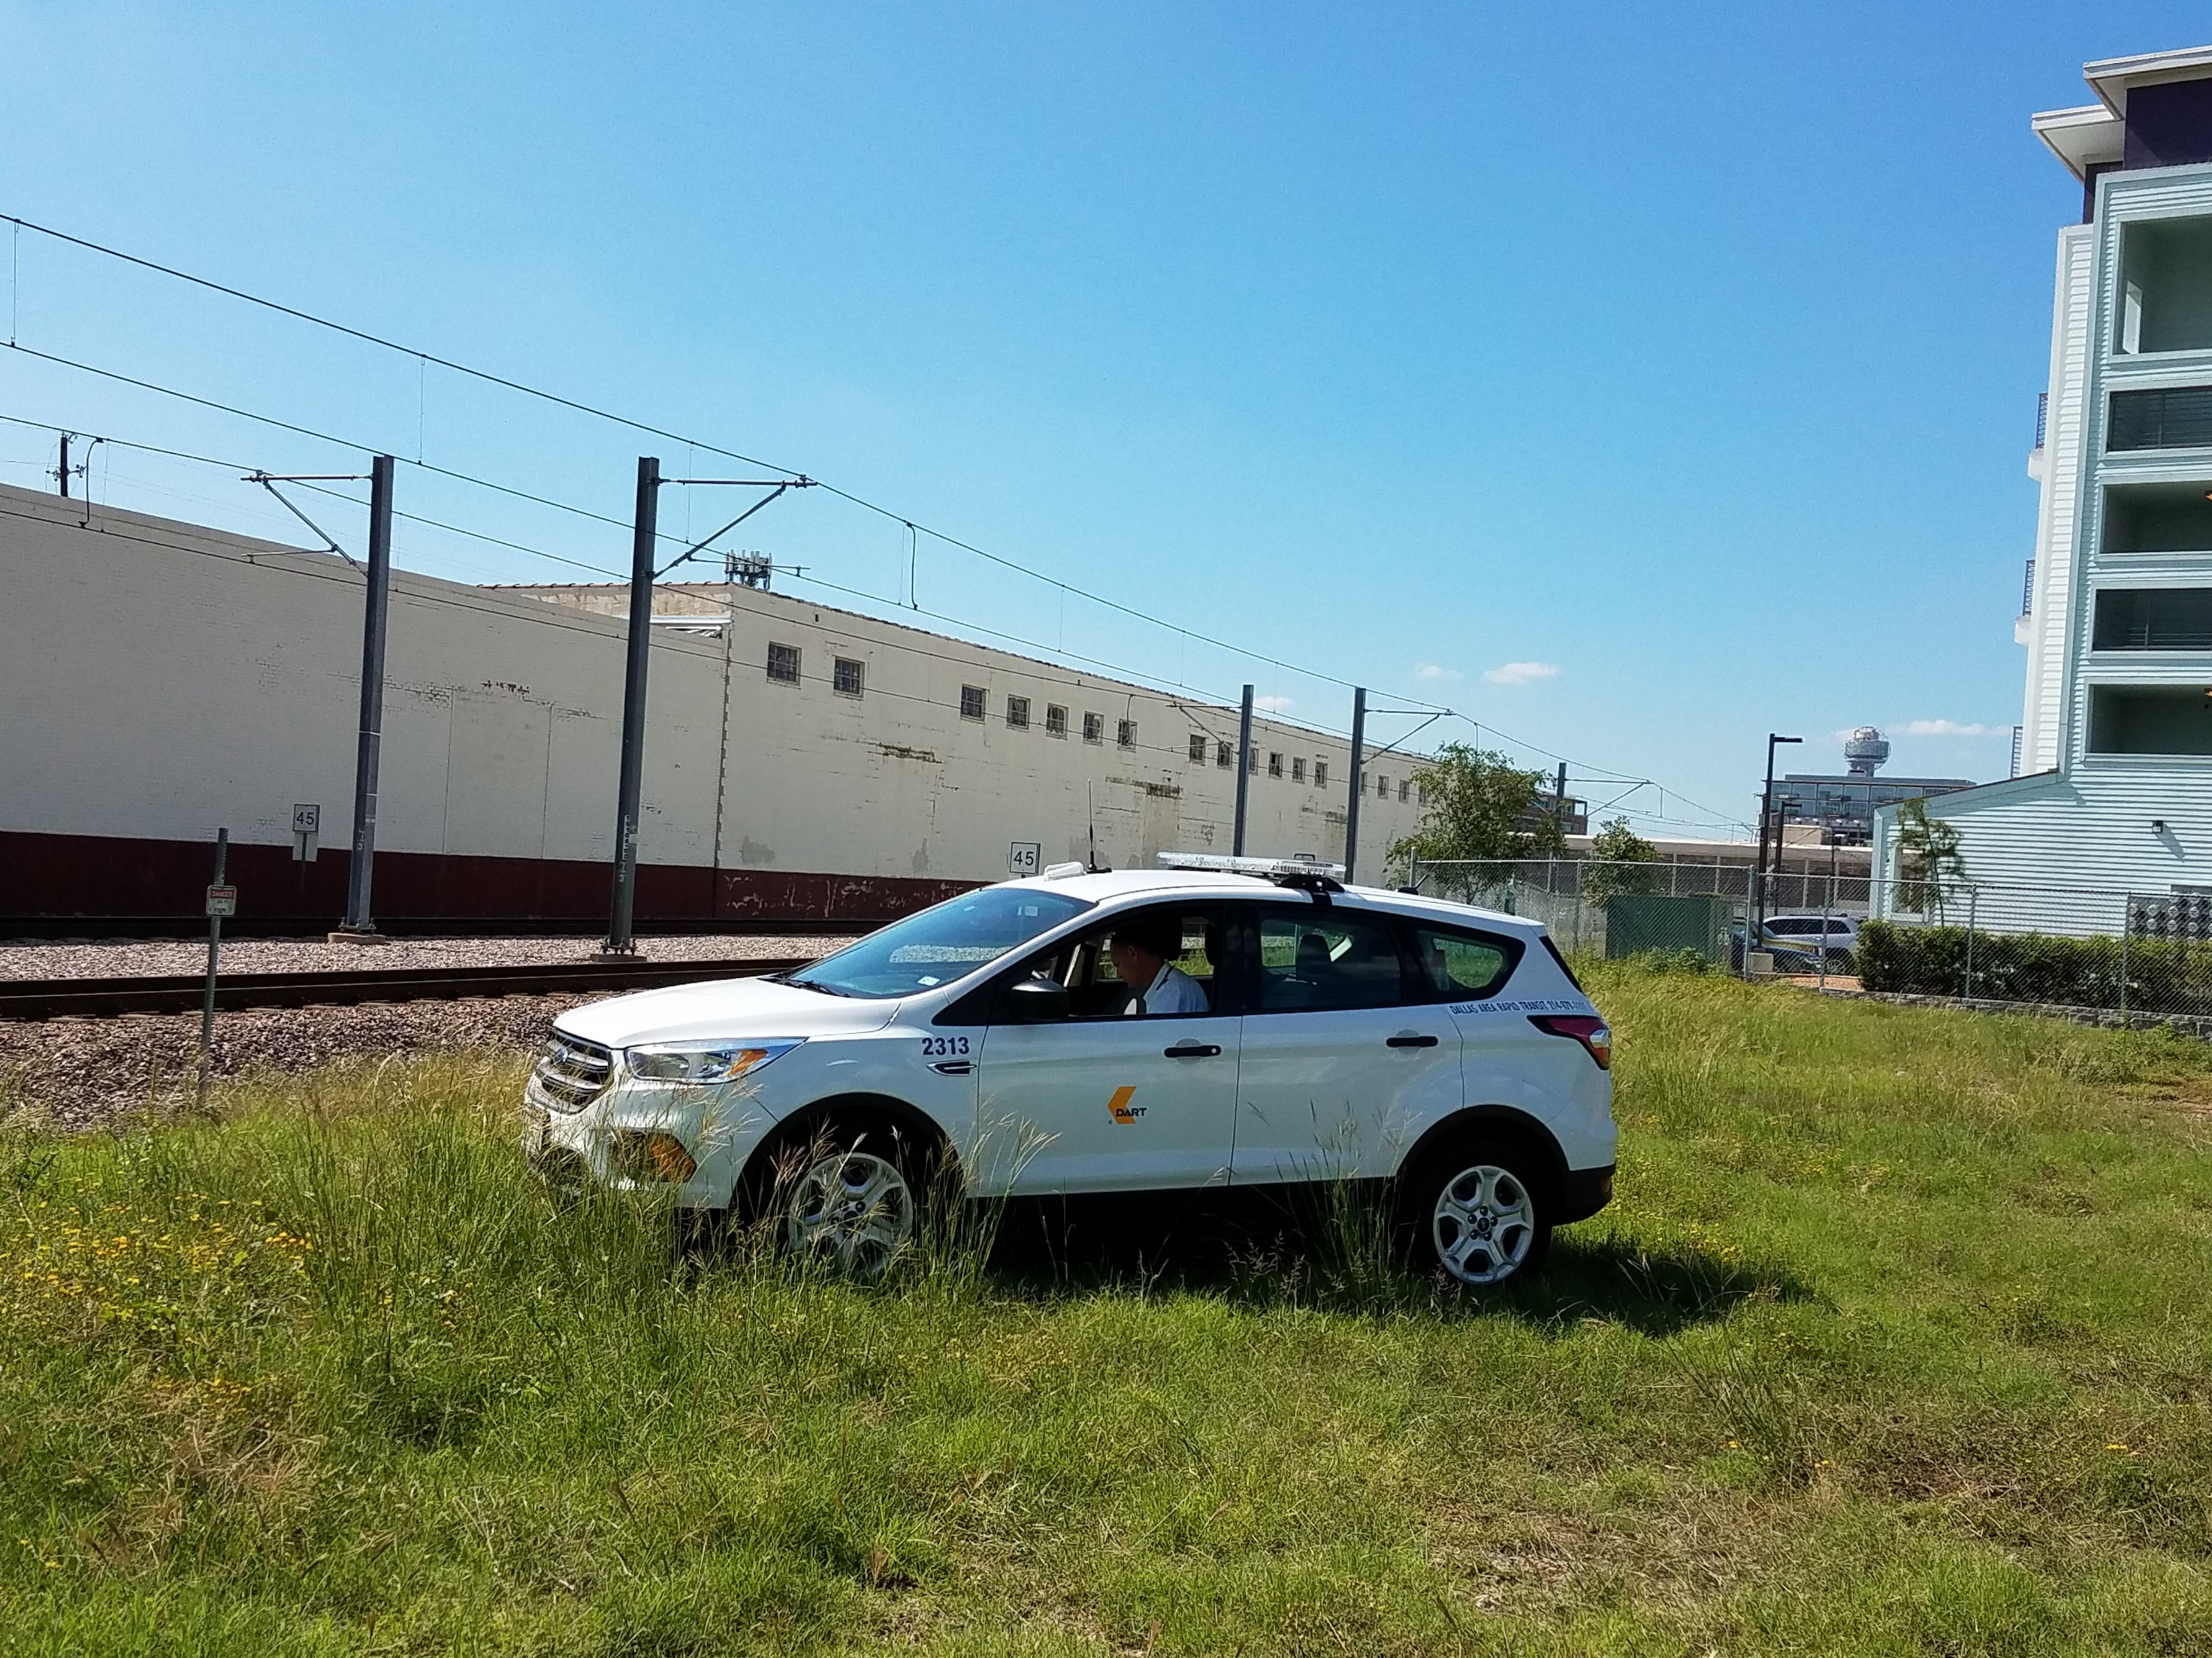
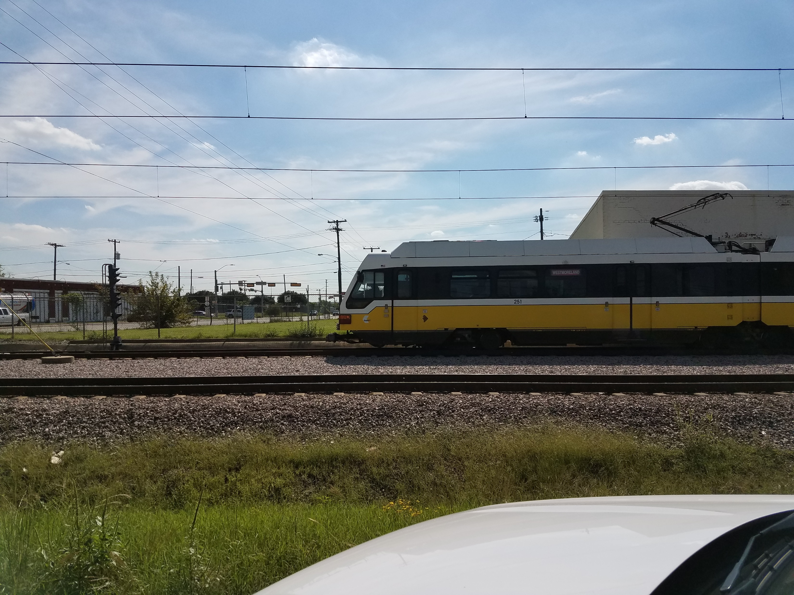
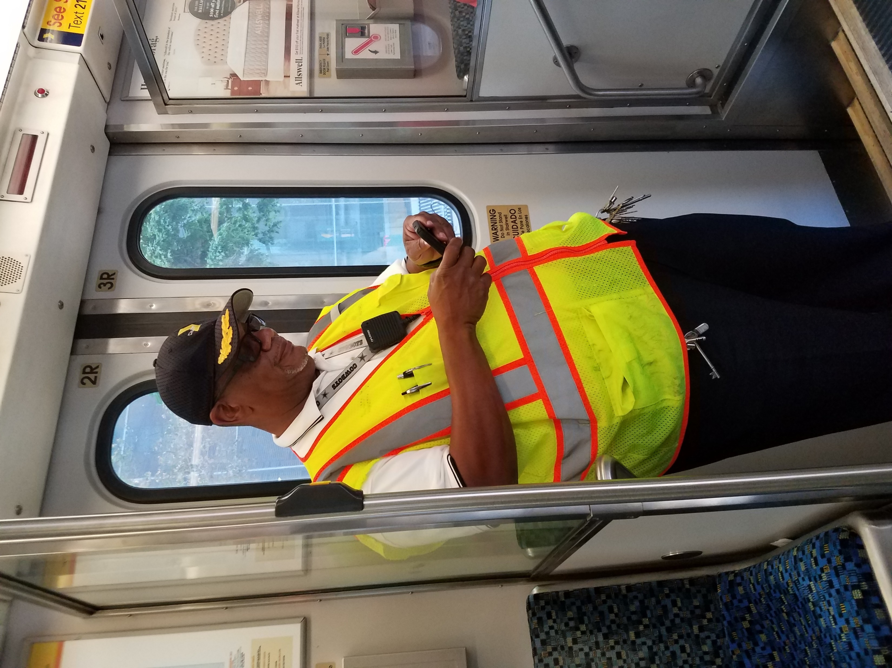
Background
Rail Operation Field Supervisors – Primary Purpose
Ensure rail operators operate light rail vehicles and street cars in a safe and efficient manner. Perform in-person assessment of operator performance. Record and report results of field assessments.
Rail Operation Field Supervisors – Secondary Purposes
Respond to incidents/accidents on train or right of way. Serve as single point of contact for all communications during service disruptions lasting more than 10 minutes. Provide relief to Operators Interact and provide assistance to customers.

Slide 4
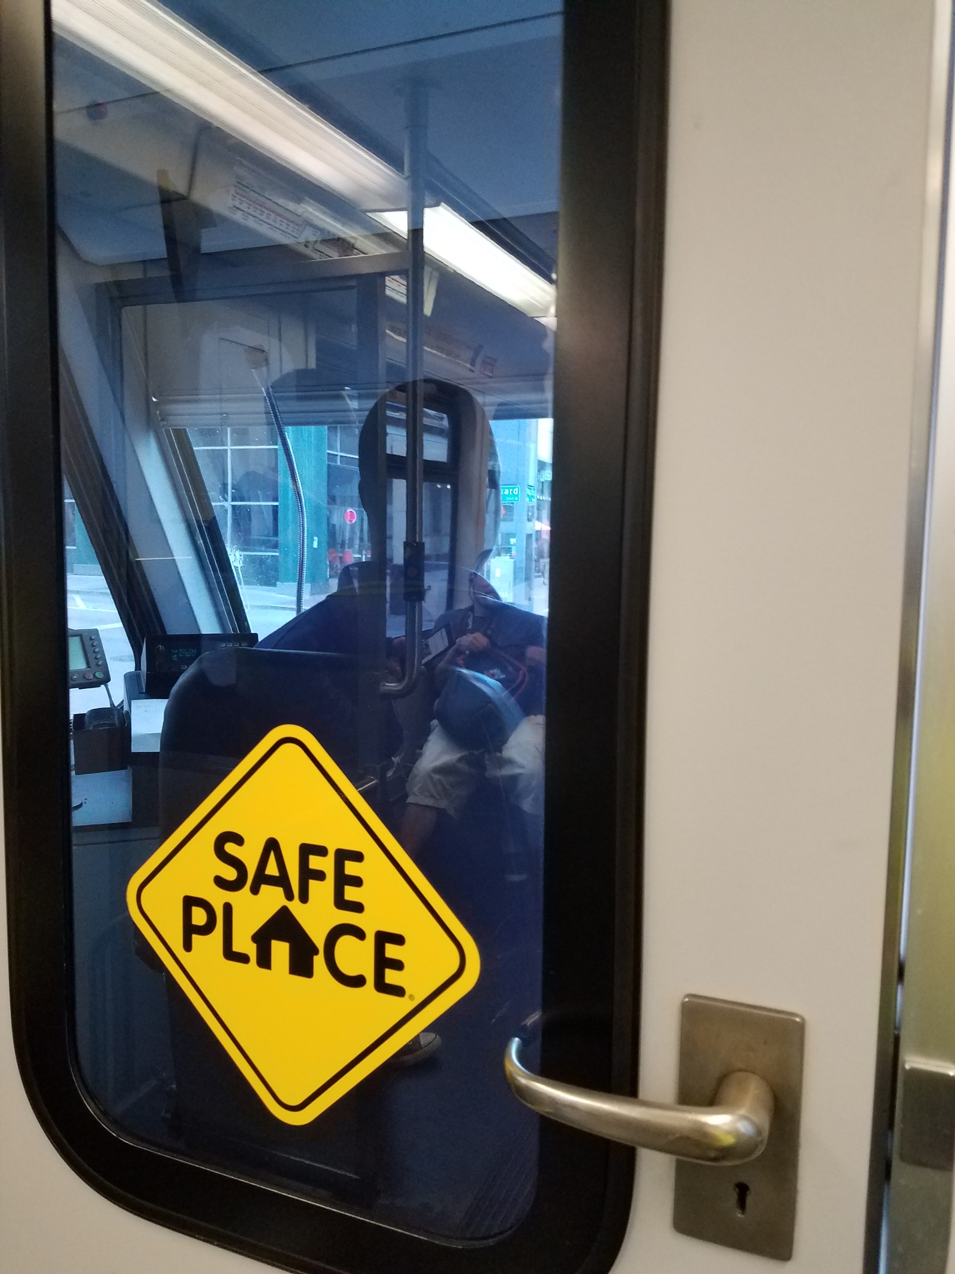
Challenges
No way to fairly assess Supervisors performance.
No easy way to communicate changing conditions and situations (i.e.; service disruptions).
No way to locate Rail Supervisors in real time.
No easy way to change the Rail Supervisors priorities according to the needs of management.
No way for management to easily assess – based on facts - the challenges and problems the Supervisors (and Operators) are facing in the field.

Slide 5
Evaluation and Analysis
Capitalize on “Smart Phones.”
Ensures on-scene live reporting.
Eliminates paper forms.
Employ easy to use software.
Use field intelligence to analyze existing or developing trends that may impact on-time performance.
Proactive management.
Supervisors and immediate managers can access individual performance at any time from a proactive platform.
Real time access to critical data collected from Field Supervisors.
An efficient tool to collect critical field intelligence data to be used to improve the customer experience.

Slide 6
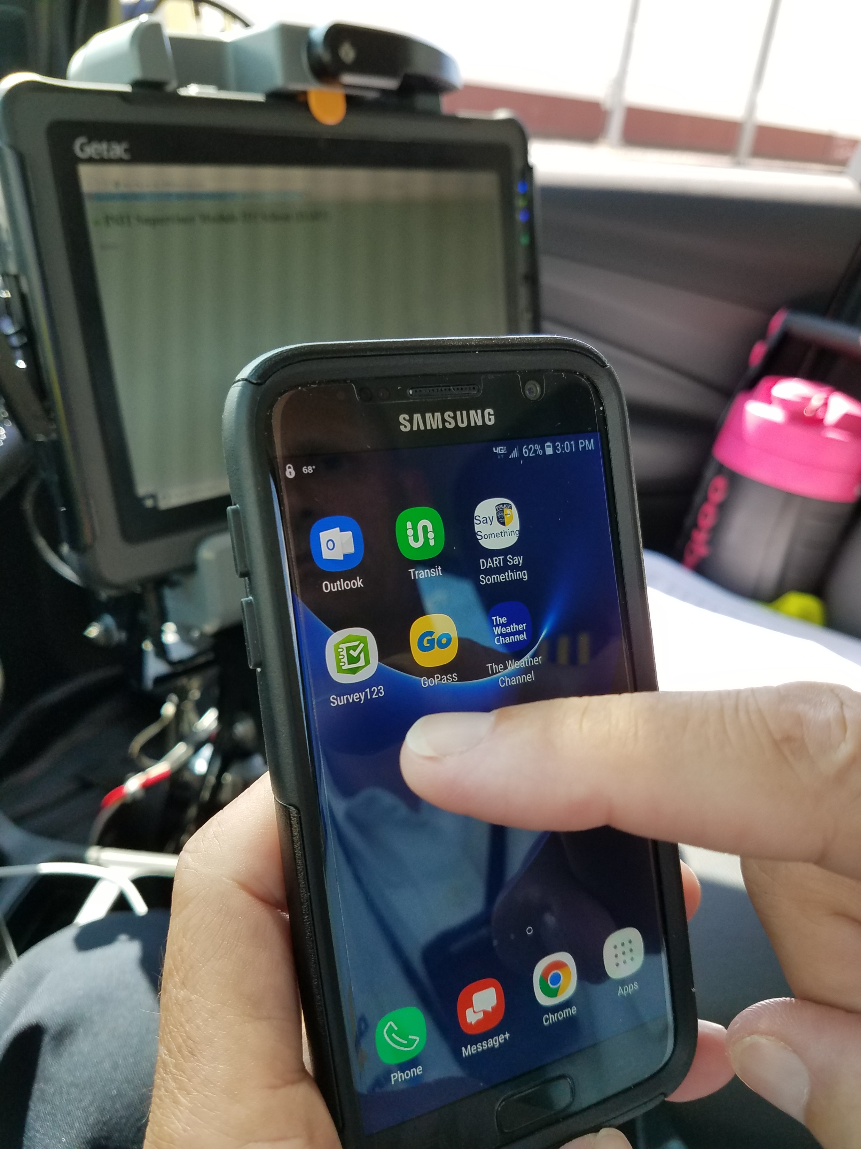
Deployment
All Rail Supervisors equipped with Samsung cellular devices
Total 34 devices
ArcGIS Survey 123 application selected as data collection tool.
Application was configured by DART Technology
In May 2018, Supervisors provided training on using Samsung devices and Survey 123 application
Live data collection began May 14th, 2018

Slide 7
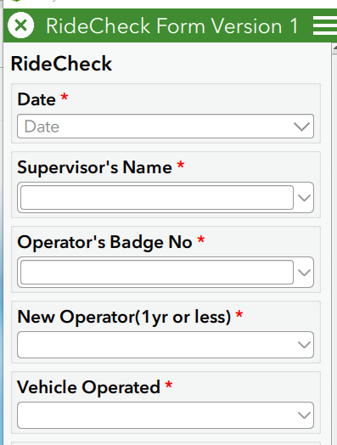
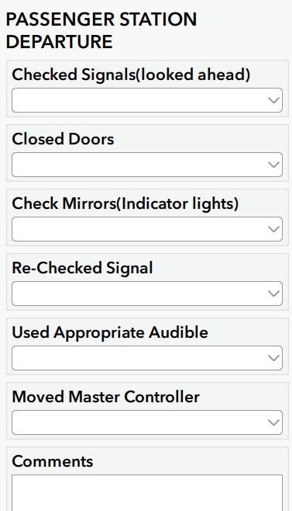
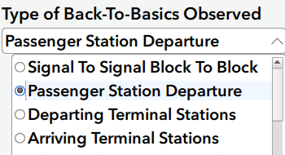
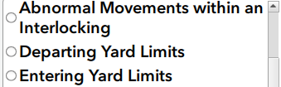
Information Obtained

Slide 8
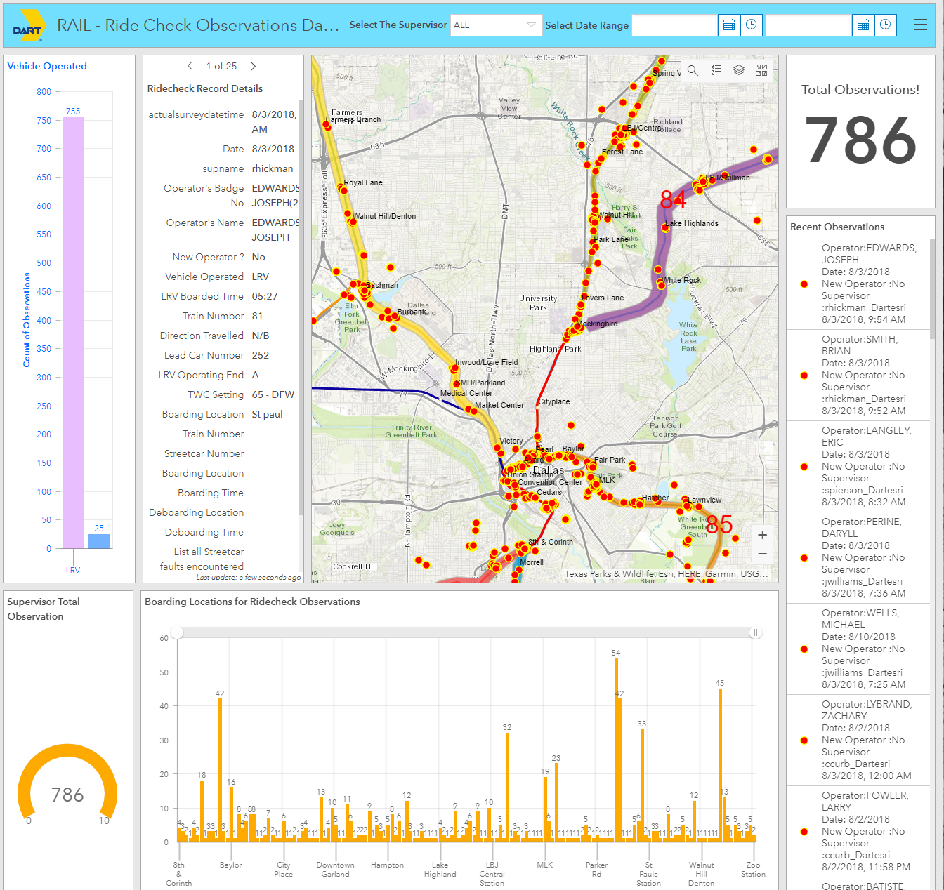
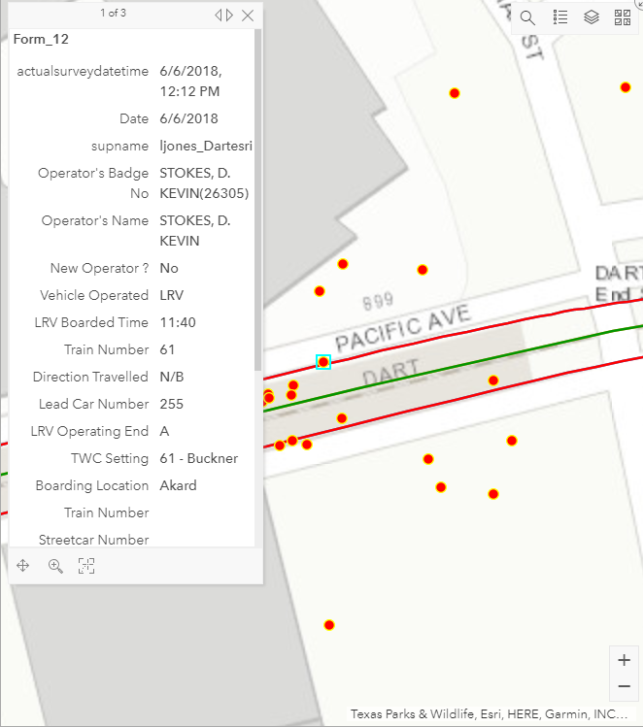
Tracking Information

Slide 9
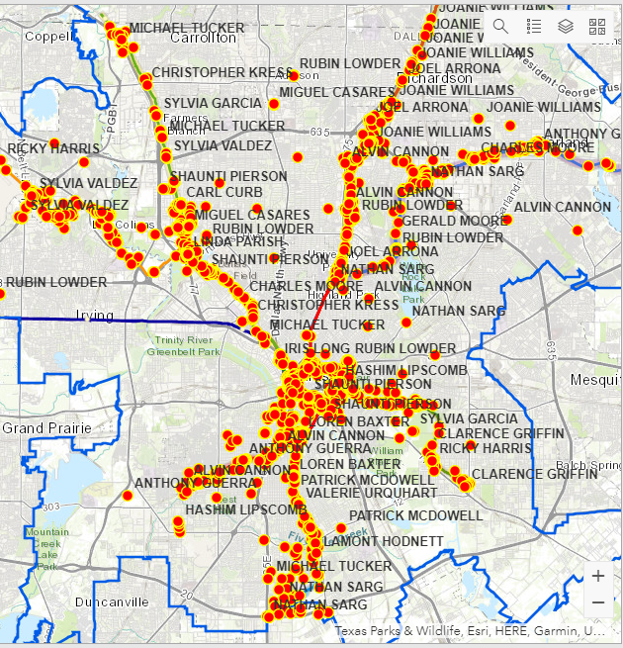
Results
Since January 1st, 2019
1,828 Ride Checks
1,408 Passenger Interactions
1,032 (60.49%) Positive
“Convenient” #1
387 (22.68%) Negative
“INconvenient” #1
500 On-Time Performance observations
3,408 Safety Efficiency Tests Performed
3,168 Audible at Grade Crossing
240 Monthly
Different rule tested each month
98.85% Pass Ratio

Slide 10
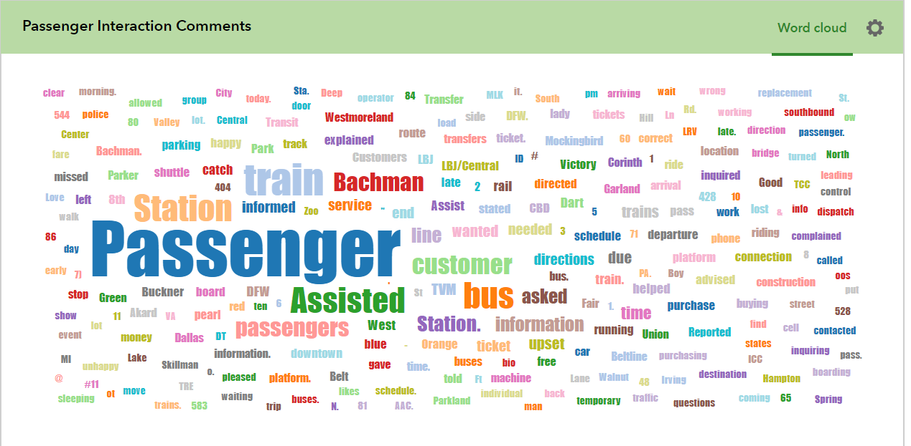

Slide 11
If time permits, follow link to show live data
ArcGIS.com

Slide 12
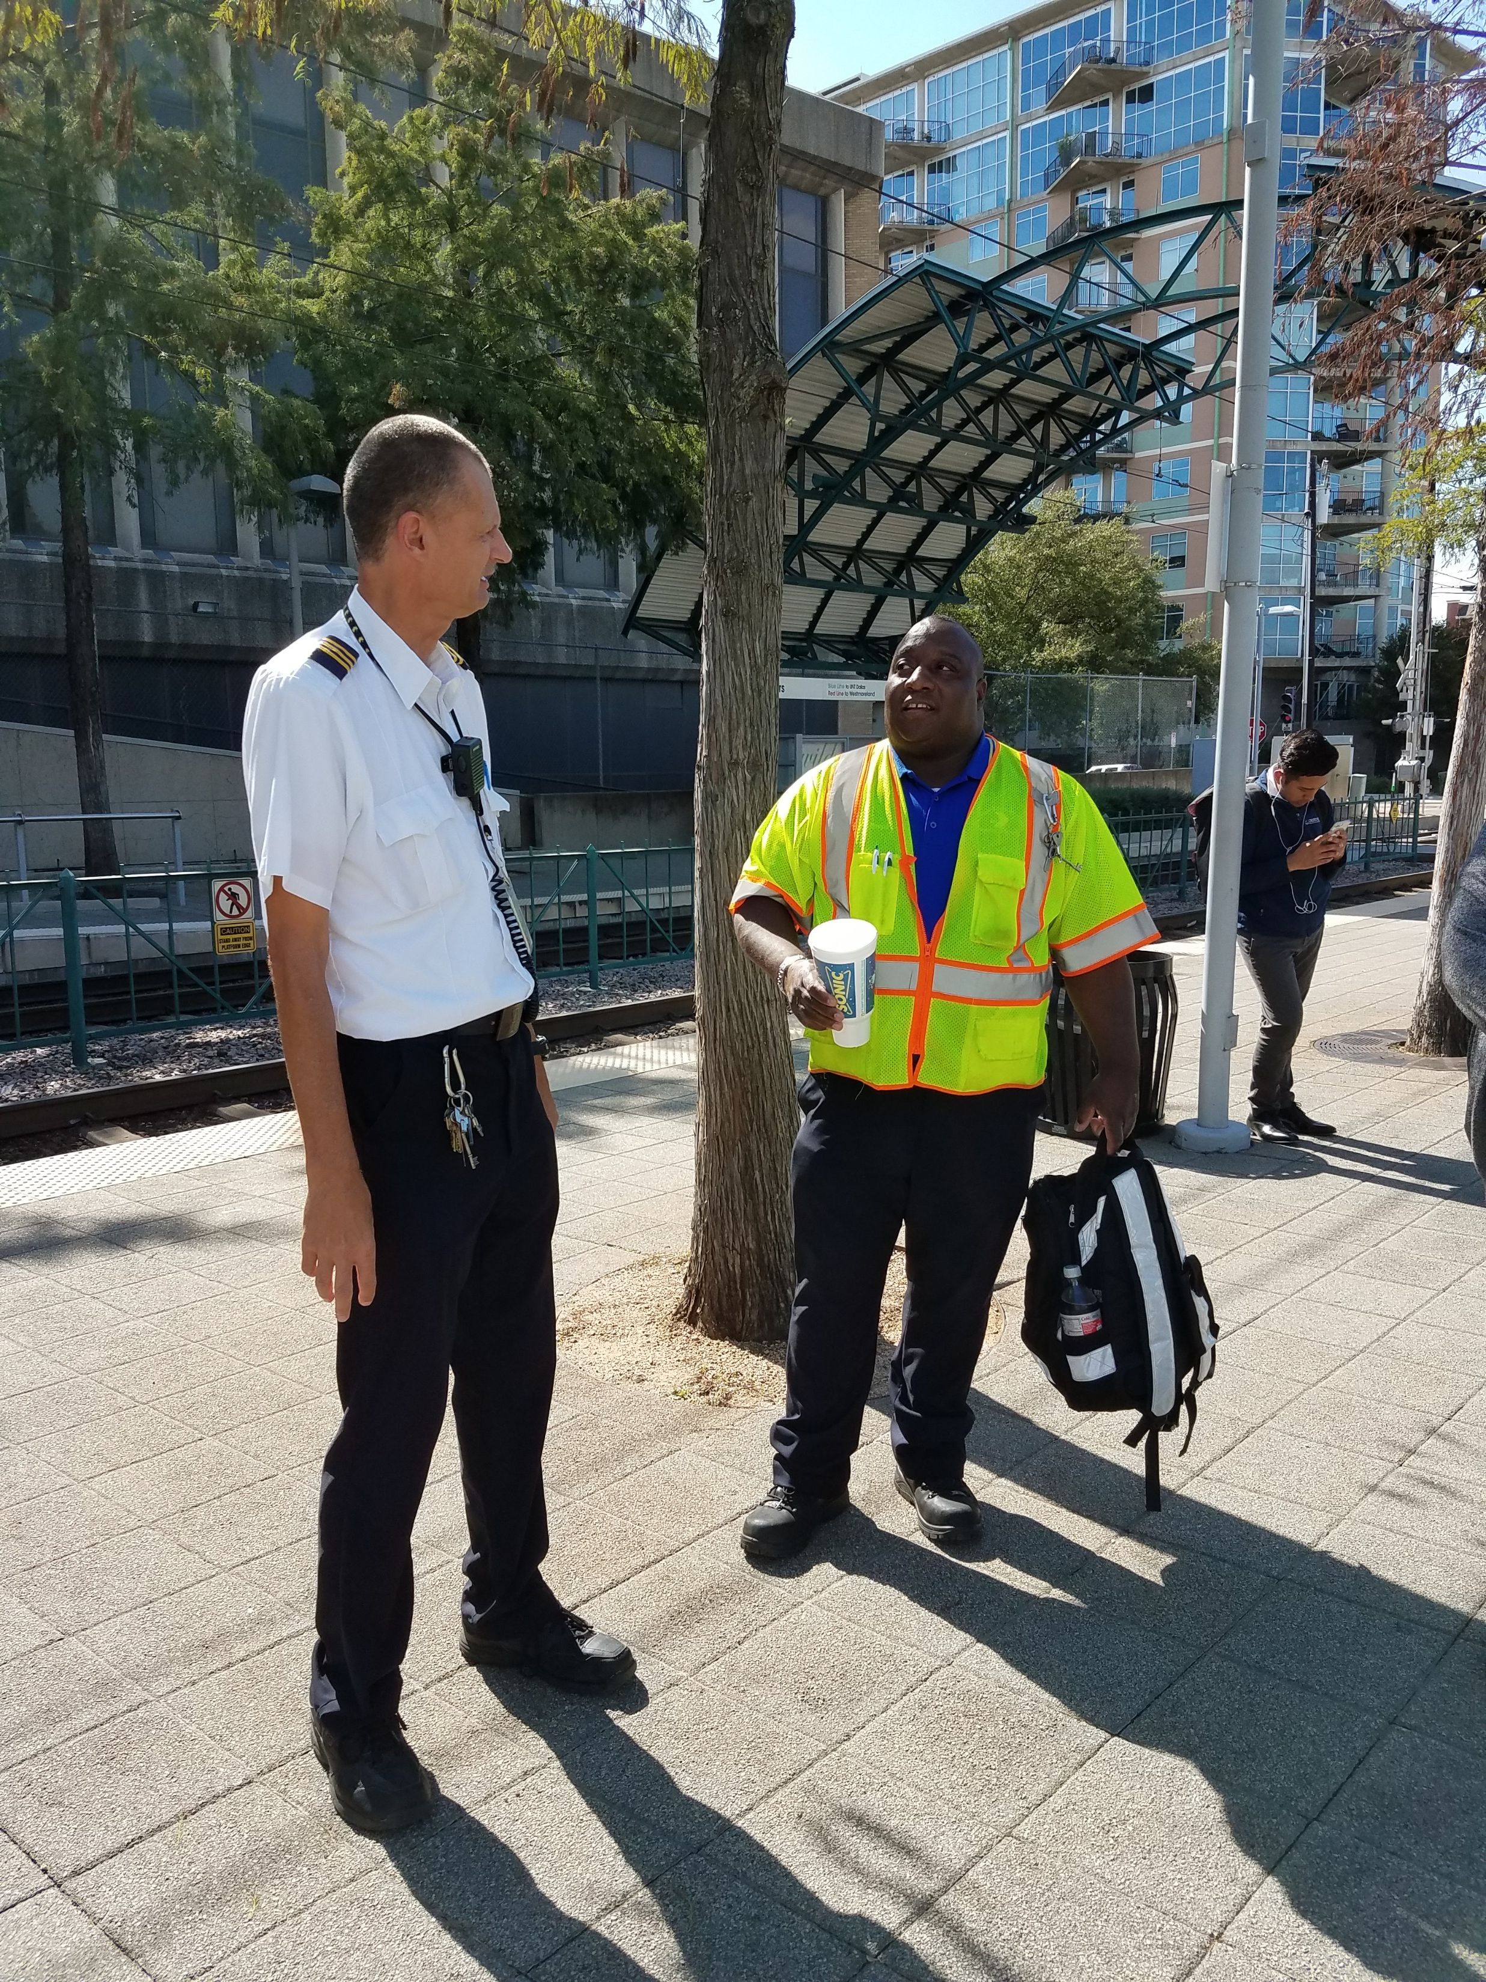
Questions?

