Slide 1


Bus Transformation Project
A better way to get there
Allison Davis
August 13, 2019

Slide 2

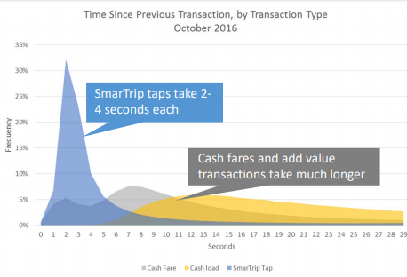
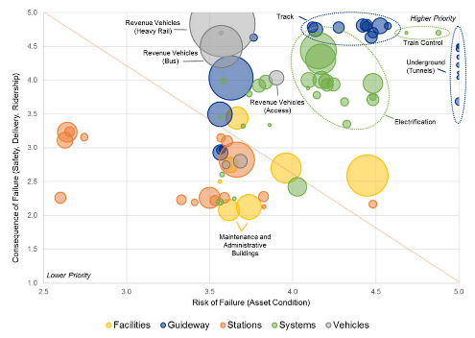
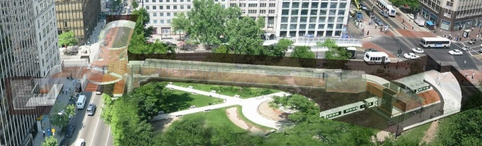



Allison Davis and WMATA’s Office of Planning
Strategic Planning
Applied Planning
Intelligence
Station Planning
Transit Asset Management
Long-range/ Regional Planning
Corridor Planning/NEPA
Title VI and Equity Analysis
Bike/Ped Access Planning
Ridership Forecasting
Fare Policy
Customer Impact Analysis
Big Data Analysis
Research and Development
Capacity Improvements
Vertical Circulation
New Station Entrances
Asset Management Business Systems
Asset Inventory and Condition Assessment
Asset Policy, Strategies, Training
Capacity and Reliability Study

Slide 3
Four problems driving need for bus transformation…
Bus Transformation Project
Bus speeds declining
Business model pressures
Bus traveling slower today than 10 years ago – causing $30M increase in expenses annually
Rising operating costs + declining ridership revenues = operating loss increases
Bus ridership decreasing
Fragmented system
13% decline in bus ridership across the region over the past five years
9 different providers with different fares, policies, decision-making, interests, etc.

Slide 4
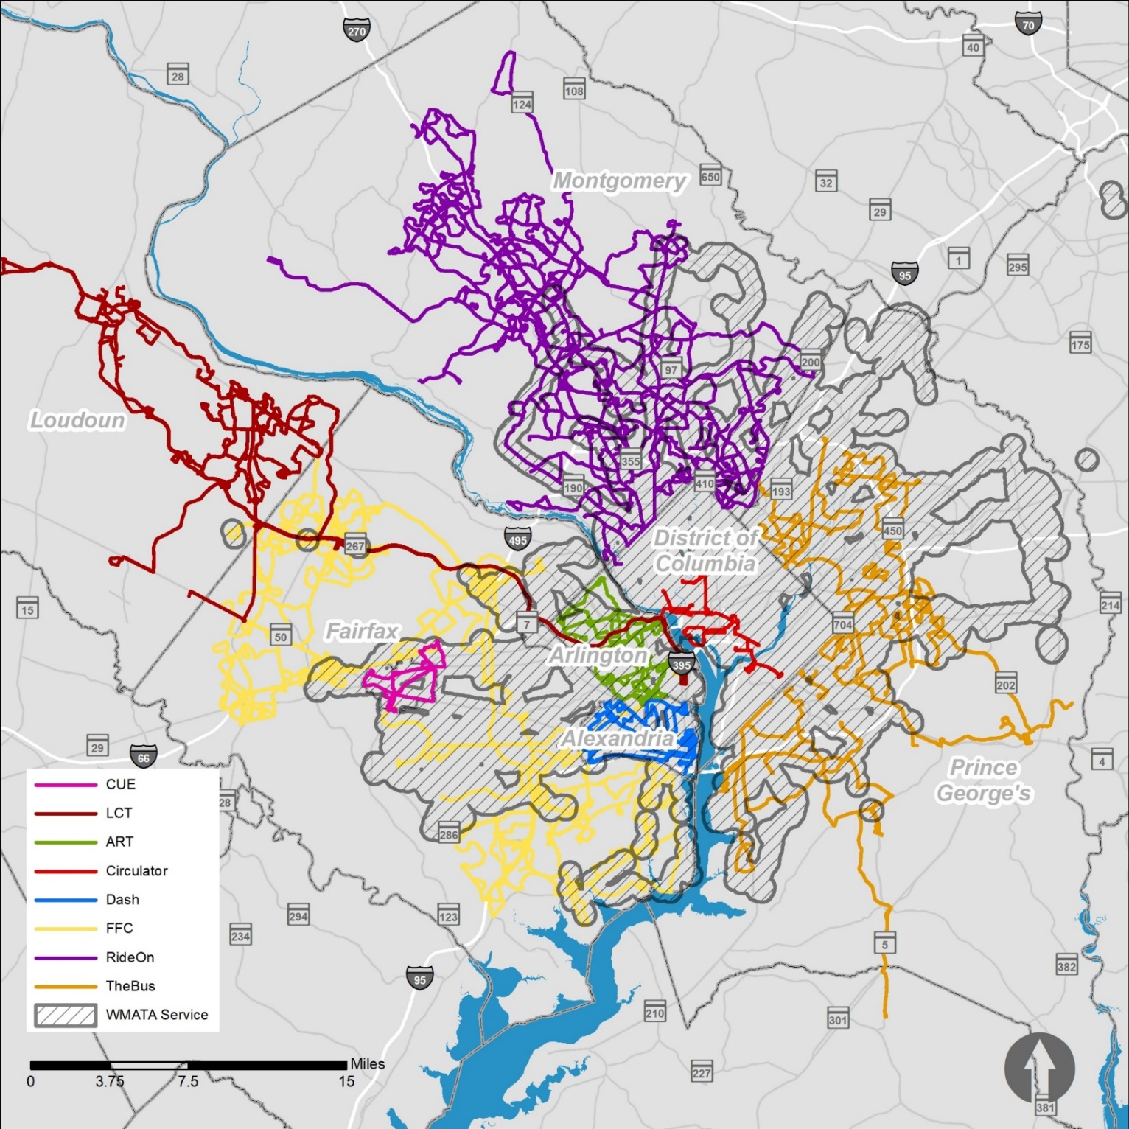
The Washington DC Region Local Bus System is Complicated
There are currently nine providers across the WMATA Compact area:
Metrobus
Loudoun County Transit
The Bus
Fairfax County Connector
Ride On
ART
DASH
CUE
DC Circulator
+ 9 local and state road operators
+ 4 “regional” transportation organizations
+ 1 state, 1 commonwealth, 1 district
All Bus Routes
Notes:
619,000 trips per day on these bus services. (*Source: National Transit Database, 2015)
81% of people have access to bus
94% of transit-dependent residents have access to bus
Allude to the fact that there is Regional and Non-Regional (one is funded by all joint partners; one is “contract service” that WMATA provides where requested)

Slide 5

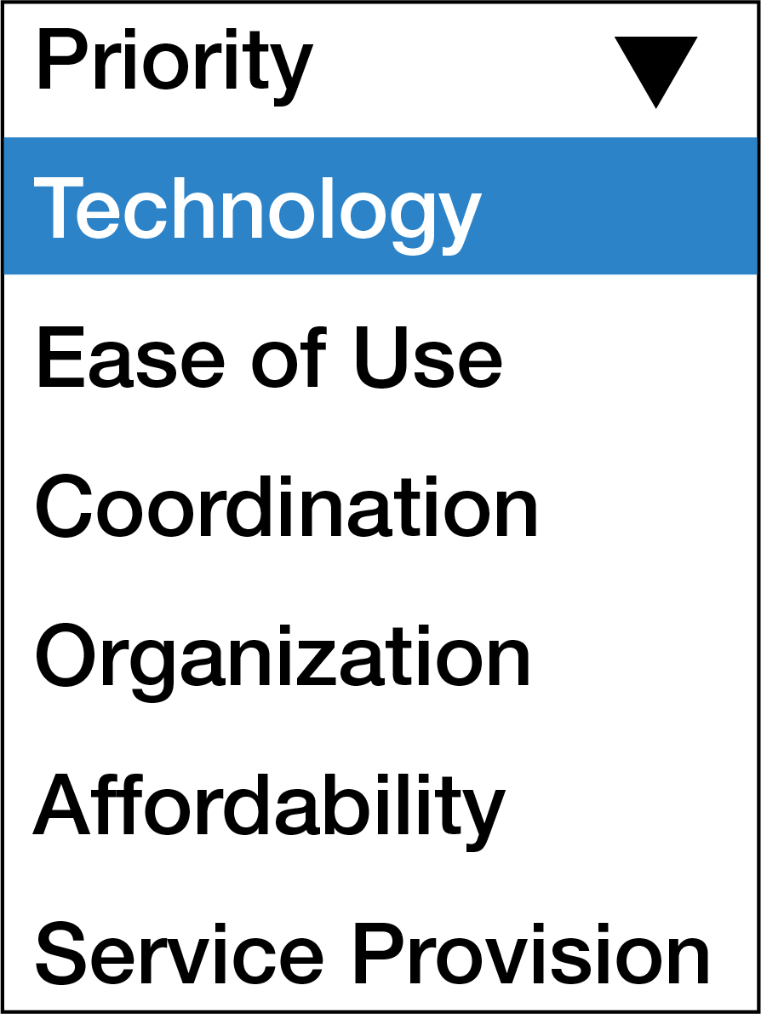
For bus to be the mode of choice on the region’s roads by 2030, the region must transform its approach to bus

Slide 6
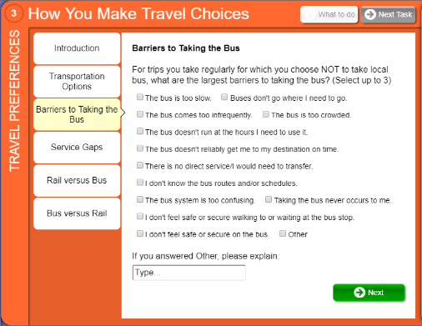
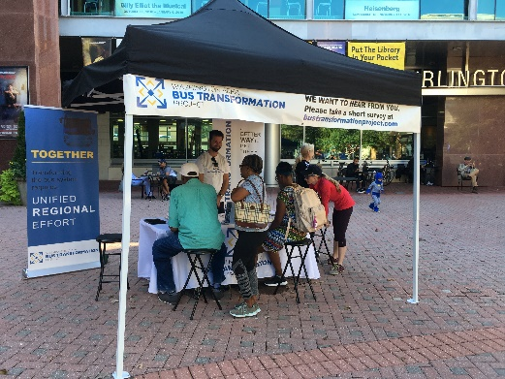
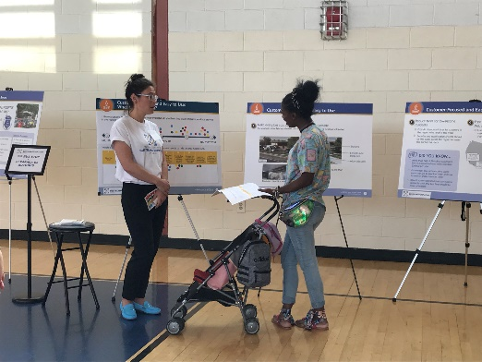
Stakeholder & Public Engagement
Executive Steering Committee
Strategic Advisory Panel
Stakeholders
Recognized leaders that are closely involved with strategy development and manage political risks and benefits to the region
Senior staff and appointed members that review major work products and advise consultant team
WMATA Leadership Team
Technical Team
Decision-makers within Metro that manage and evaluate actions that affect the organization and its operations
Recognized discipline leaders within Metro and senior jurisdiction transit staff that review technical and financial analyses
Public
Online Surveys
Pop-Up Events
Open Houses
Notes:
Since the project began in September 2018, elected officials, transit agencies, transit advocates, bus operators, bus riders, and many other stakeholders helped to develop the recommendations in the Draft Strategy.
8,500+ public survey responses
140 participants in September 2018 Kickoff Summit
33 regional pop-up events
3 Focus Groups
3 Public Open House events
31 project committee meetings
13 Metrobus operator listening sessions
40 interviews with local jurisdictions and transit agencies
35 project briefings/meetings with elected officials
15,365 people reached by the project Facebook page

Slide 7






The strategy to achieve the vision and goals is built around six elements – with a set of recommendations underlying each:
Draft Strategy Elements
1 | Customer Focused | The bus system should be customer-focused and an easy-to-use option that people want to ride
2 | Priority to Buses on Major Roads | Prioritizing buses on major roads is the fiscally responsible way to move the most people quickly and reliably
3 | Convenient Bus Service | Frequent and convenient bus service is fundamental to accessing opportunity, building an equitable region, and ensuring high quality of life
4 | Balanced local and regional provider responsibilities | Balance local and regional provider responsibilities by positioning local bus systems to meet their jurisdictional needs and the regional bus system to meet regional needs and deliver regional benefits
5 | Streamline Back-Office Functions and Share Innovation | Optimize back-office functions through sharing, streamlining and shared innovation by consolidating regional resources and devoting more resources to operating bus service
6 | Regional Steward to Transform the Bus System | Customers in a region with multiple bus providers need a regional steward to transform the bus system

Slide 8
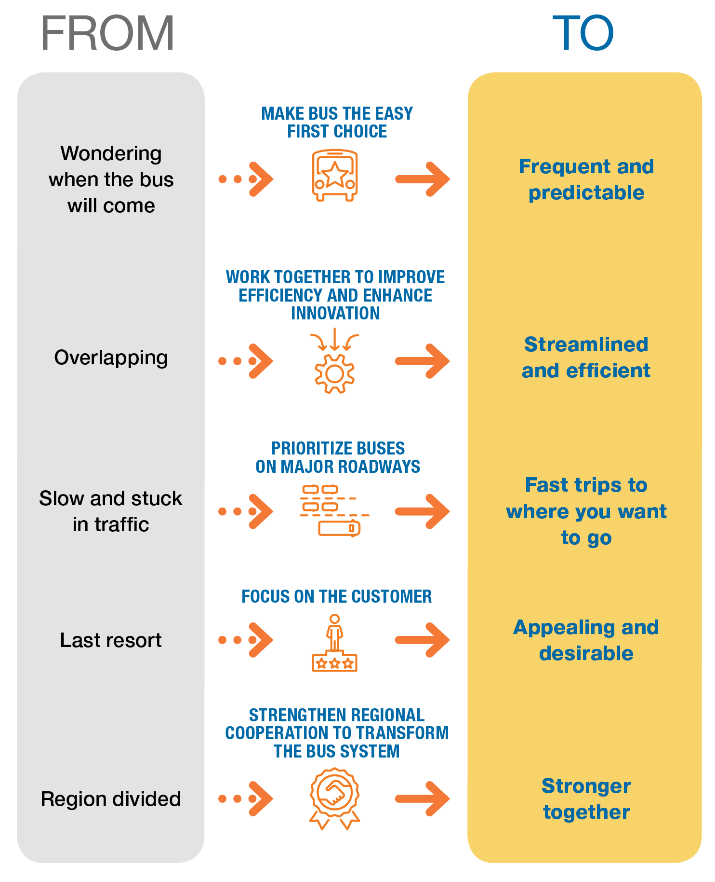

Strategy Outcomes
  Focus on what customers want - fast, frequent, reliable, affordable, bus service that is easy to use
  Maximize the benefits of buses by providing the right type of service in the right places at the right times
  Prioritize buses on major roads, making buses more cost effective and delivering fast, reliable, and frequent service.
  Create a bus system that feels unified to the customer while empowering multiple bus providers to address unique challenges
  Ensure immediate and sustained action by government entities to implement the changes that will make buses the mode of choice on the region’s roads

Slide 9
With Six Months to Go…
Working Well
Challenges
Raising the profile and value of bus in the region
Executive Steering Committee(ESC) ownership of strategy
Independent assessment of all local bus providers, including Metrobus
Big tent of stakeholders
Pop-ups and public outreach
Quickly arriving at strategy’s five main questions
Extensive consultant support with trusted and knowledgeable team
Wide range of stakeholder knowledge of the bus system
General public desires vs provider interests
Gaining consensus from the ESC
Engaging in governance reform
Notes:
What is the role of bus in the region
What is the level of regional commitment to speeding up the bus
What is the regional governance or delivery model for bus
What business should Metrobus be in
What services should Metrobus operate

Slide 10
www.bustransformationproject.com
Allison Davis
Director, Strategic Planning
adavis5@wmata.com
202.962.2056

Slide 11

Appendix
www.BusTransformationProject.com

Slide 12
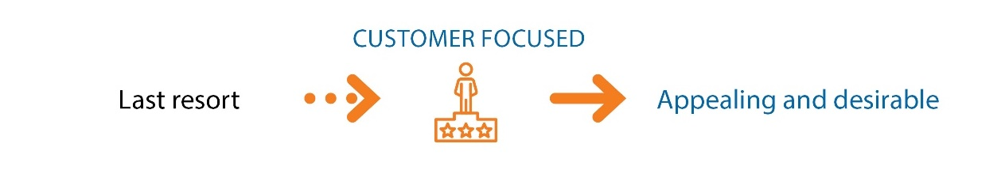

Element: The bus system should be customer-focused and an easy-to-use option that people want to ride
DRAFT
1
      Recommendations to drive strategy:
      What the strategy will achieve:
  Expand marketing efforts related to bus to enhance visibility of bus options and benefits
  Make buses easy to understand with legible maps and consistent route naming conventions
  Create a mobile solution that allows riders to plan and pay for trips and access real-time service information
  Make bus fares clear and consistent across the region
  Introduce pass products that work across all bus systems
  Enhance reduced fare products for low-income residents
  Allow customers to transfer for free between bus and rail
  Incentivize more employers to offer transit benefits
  Make bus stops safe, convenient, and accessible across the region
  Modernize the region’s bus fleet with advanced technologies that improve the environment, safety, and the rider experience
If bus agencies deliver outstanding end-to-end trip experiences for all riders, the region will see:
  Increased customer satisfaction
  Reduced safety incident rates at bus stops and on buses
  Reduced environmental impact of transportation
  Increased transit ridership
  More affordable transportation for residents that need it most
  Less congestion on our region’s roads
A
B
C
  Goal 2a: Provide clear, accurate, integrated customer information across all regional operators
  Goal 2b: Make it easy to plan, pay, and ride all modes
  Goal 2c: Provide a safe, comfortable experience for passengers while waiting, riding, and transferring
  Goal 3a: Maximize the value delivered by the bus system to the public and taxpayers
  Goal 4c: Realize the positive environmental potential of bus
  Goal 5a: Ensure equitable transit service for those who most depend on it
  Goal 5b: Provide riders with affordable end-to-end transportation
  Goal 5c: Enhance mobility options for people with disabilities
D
E
F
G
H
I
J
www.BusTransformationProject.com

Slide 13

Element: Prioritizing buses on major roads is the fiscally responsible way to move the most people quickly and reliably.
DRAFT
2
      What the strategy will achieve:
      Recommendations to drive strategy:
If the region commits to priority treatment of bus, it will experience:
  Reduced journey time for bus riders
  Increased ridership
  Greater on-time performance for bus
  Decreased bus operating costs
  Improved traffic conditions across modes
  Improved regional productivity and competitiveness
A
Obtain commitments from each local and state jurisdiction to prioritize bus on major corridors within their boundaries
Adopt consistent priority guidelines for corridors across the region
Develop enforcement programs that maximize the effectiveness of bus priority efforts
Offer incentives to jurisdictions to encourage implementation of the regional priority guidelines
Coordinate with regional congestion mitigation efforts, including congestion pricing, curb access management, and parking limitations to move more people more efficiently
B
  Links to goals
  Goal 1d: Invest in transit facilities and assets that support transit speed, reliability and efficiency
  Goal 1b: Mitigate congestion by increasing transit usage
  Goal 3a: Maximize the value delivered by the bus system to the public and taxpayers
  Goal 3b: Use available funding efficiently by lowering costs where possible
  Goal 3e: Optimize operating costs related to capital investments
  Goal 4c: Realize the positive environmental potential of bus
C
D
E
www.BusTransformationProject.com
Notes:
Increased ridership – all case studies in white paper #2 showed an increase in ridership, but didn’t think it would be good to average or quantify.

Slide 14

Element: Frequent and convenient bus service is fundamental to accessing opportunity, building an equitable region, and ensuring high quality of life
DRAFT
3
      Recommendations to drive strategy:
      What the strategy will achieve:
A
  Develop a regional bus network plan that realigns routes to create the most efficient and customer focused bus system
  Adopt consistent guidelines across the region to provide customers with the right amount of bus service by location and time of day
  Provide flexible, on-demand transit services to markets where customers are not well-served by conventional bus service
Strategic investment in enhancing access to bus will result in:
  Increased responsiveness to customer demand for service
  Increased access to transit (frequency, schedule, span)
  Increased bus ridership
  More efficient use of resources
Proximity
Destination
Elements of convenient bus service
B
Schedule/Span
Frequency
C
www.BusTransformationProject.com

Slide 15

Element: Balance local and regional provider responsibilities by positioning local bus systems to meet their jurisdictional needs and the regional bus system to meet regional needs and deliver regional benefits
DRAFT
4
      What the strategy will achieve:
      Recommendations to drive strategy:
Balancing local and regional provider responsibilities will:
  Better align bus service with regional needs
  Reduce cost of bus service regionally
  Improve regional coordination of bus service delivery
  Improve responsiveness of bus service to rider needs
A
Position the regional bus system to provide the services that meet regional needs
Revise the cost local jurisdictions pay WMATA for local service to better match the actual cost to provide service
Develop a 10-year plan to optimally allocate services between bus systems for applicable routes
B
C
DRAFT
www.BusTransformationProject.com
Notes:
Speaker note: Discuss remaining services with each jurisdiction (Those that the local jurisdictions want Metrobus to operate would be contracted outside the 3 percent subsidy cap)

Slide 16

Element: Streamline back-office functions and share innovation by consolidating regional resources and devoting more resources to operating bus service
DRAFT
5
      What the strategy will achieve:
      Recommendations to drive strategy:
If the region pursues centralization of select business functions and shared innovation across bus operators, it will experience:
  Annual Cost saving potential of ~$11.7 million due to economies of scale, which can be redirected into improving service
  Greater consistency in service for customers
  Greater understanding of bus system usage, which will enable additional cost savings and efficiencies
  Improved customer experience, leading to ridership growth
A
Consolidate back-office support functions to realize shared benefits of scale for bus systems that choose to participate
  Establish a Regional Mobility Innovation Lab to drive continuous improvement in customer experience
Develop regional standards for bus data collection, formatting, sharing, and analysis
B
C
www.BusTransformationProject.com

Slide 17

Element: Customers in a region with multiple bus providers need a regional steward to transform the bus system
DRAFT
6
      Action recommendations to drive strategy:
      What the strategy will achieve:
A
Form a task force responsible for Bus Transformation Project execution; after a three-year period, transfer responsibilities to a formal Coalition of jurisdictional representatives with authority for implementation
Hold transportation and transit agencies accountable for prioritizing bus as a primary mode of transportation within their organizations
Publish an annual Bus Transformation and bus performance scorecard to drive accountability for results
If the region commits to strengthening coordination and governance, it will experience:
  Increased customer focused decision making
  More cost efficient use of resources
  Improved coordination among bus operators and across mobility modes
Links to all goals in the Bus Transformation Project, with emphasis on three:
  Goal 1c: Enhance integration of bus systems and integration of bus with other transportation modes
  Goal 2a: Provide clear, accurate, integrated customer information across all regional operators
  Goal 3e: Optimize operating costs related to capital investments
B
C
www.BusTransformationProject.com

