Slide 1
Technology Department
MAX Program 2019
Presentations by:
Alan Gorman, BI Sr. Analyst/Practice Manager
Elisa Cunningham, Interim AVP
Massimo Scicali, Enterprise Platform Leader

Slide 2
MAX Program 2019
Information Management and Analytics Team (IMA)
Presenter:
Alan Gorman, BI Sr Analyst/Practice Manager

Slide 3
Information Management and Analytics
What does the IMA group do?
  Agency Database Management
  Data Warehousing and Data Management
  Reporting, Data Visualization and Analytics
  Geographic Information Systems
  Data Transformation and Systems Integration

Slide 4

GoPass
Data Integration

Slide 5
General Transit Feed
Real Time feed GTFS-R
Static feed GTFS-Static
Bus | Rail
Every 60 seconds | Every 25 seconds
Location and Schedule Adherence

Slide 6
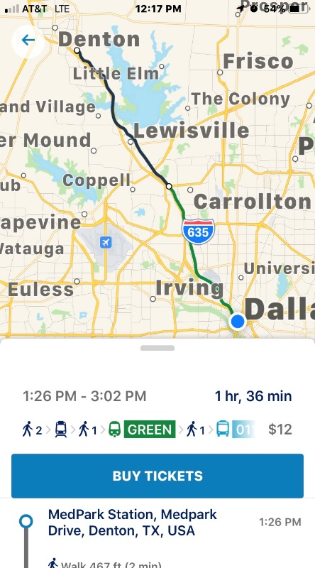
Real Time
Trip Planning

Slide 7
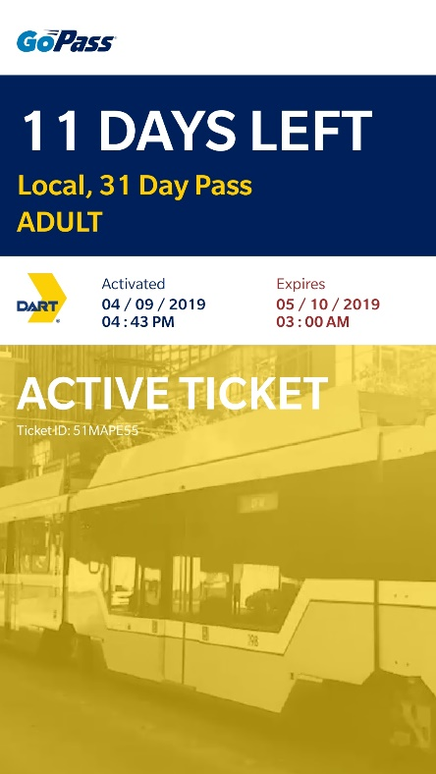
Fare
Management

Slide 9
Questions?

Slide 10
MAX Program 2019
Enterprise Applications Customer Care Team
Presenter:
Elisa Evans Cunningham, Interim AVP

Slide 11
Agenda
Team Overview
EAM Project Introduction
EAM Project Objectives
Phase 0 – Pilot for Signals
Phase 1 – Full Rollout
EAM: System of record for all assets maintained by DART
IBM Maximo Functionality
High Level Schedule

Slide 12
Enterprise Applications Customer Care Team
Customer Relationship Management (All Operations Divisions)
Web and Mobile Application Development
SPEAR Application Development
Routematch Application Support
Enterprise Asset Management (Maximo)
Trapeze Application Maintenance and Support
Business Intelligence/Analytics
Database Management
Geographical Information Solutions (GIS)
GTFS-R Feed
Fleetwatch Support
Notes:
Elisa

Slide 13
Enterprise asset management project

Slide 14

EAM Leadership Project Team
Elisa Evans Cunningham, Interim AVP/EAM Project Director
Darryl Spencer, Senior AVP Engineering
Greg Hoile, Interloc EAM Project Manager
Notes:
Elisa

Slide 15



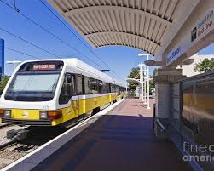
EAM Project Objectives
Business Process Management Improvement
Improved enhanced reporting to support
TAM and NTD
Improved maintenance, tracking and accountability of DART assets
Increased flexibility via mobile enabled platform
Notes:
Elisa

Slide 16
Maximo Functionality
Phase 0 – Pilot for Signals
Business Areas:
Signals
Asset Management
Work Management
Materials Planning and Issuing
Mobile Work Management
Mobile Condition Assessments
Integrations – Lawson, Kronos
Reporting – Reports, Start Centers, Queries, KPI’s
Data Migration from SPEAR and Others
Notes:
Greg

Slide 17
Maximo Functionality
Phase 1 – Full Rollout
Business Areas:
Signals, Rolling Stock, Rail and Track, Engineering, Warranty, Materials Management, Facilities, IT, Real Estate, TRE
Maximo Asset Configuration Management (ACM)
Maximo Transportation
Maximo Linear
Electronic Parts Catalog (EPC) – Documoto
SCADA/Internet of Things (IoT)
GIS References and Integration
Graphical Scheduling
Additional Integrations
Additional Analytical Capabilities
Mobile Enhancements
Notes:
Greg

Slide 18
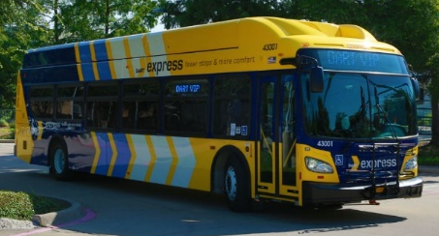
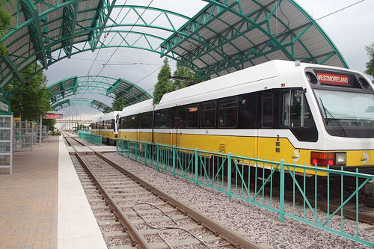
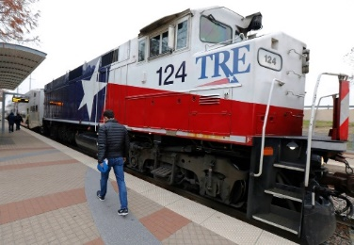

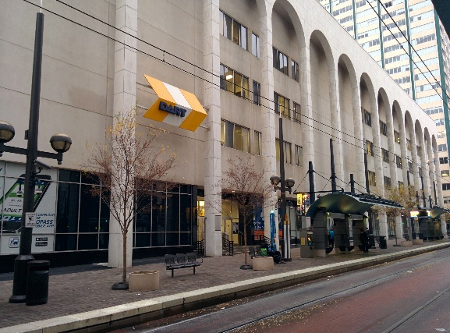



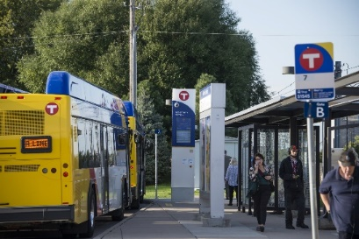
EAM: System of record for all assets maintained by DART

Slide 19
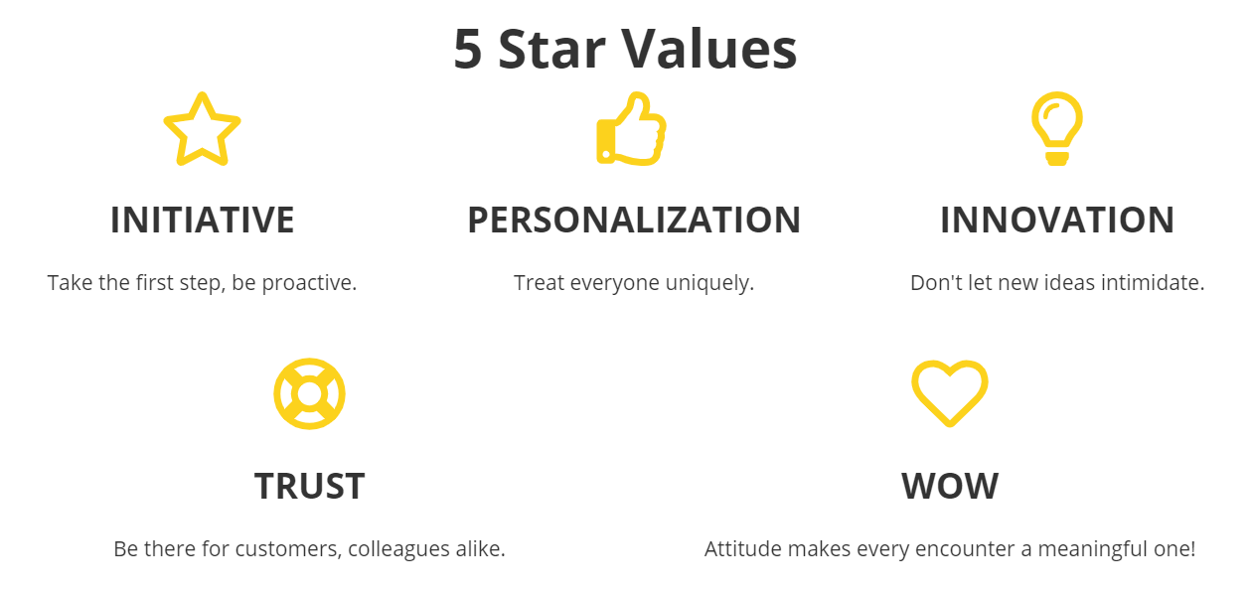
EAM supports DART’s Values
Business Process Management Improvement
Improved, enhanced reporting to support
TAM and NTD
Improved maintenance, tracking and accountability of DART assets
Increased flexibility via mobile enabled platform
Notes:
Provides ability to build workflows with limited development capability, resulting in quicker workflow development

Slide 20

Enterprise Asset Management
Asset Management
Inventory Management
Work Management
Asset Registry
Life Cycle Information
Condition Assessment
Planning and Scheduling Resources
Work Orders
  Preventive Maintenance
  Corrective Maintenance
  Inspections
Inventory Catalog
Storeroom Transactions
Replenishment

Slide 21
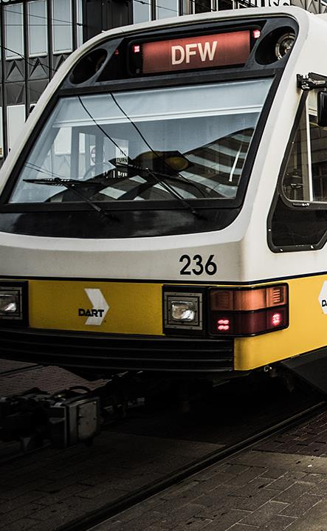

Maximo delivers comprehensive suite of EAM functionality
Base Maximo Functionality
Asset Management
Work Management
Supply Chain Management
DART Incremental Functionality
Maximo Transportation solution
Asset Configuration Management
Linear assets functionality
GIS spatial references
Mobile functionality

Slide 22

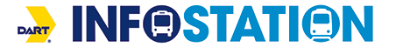





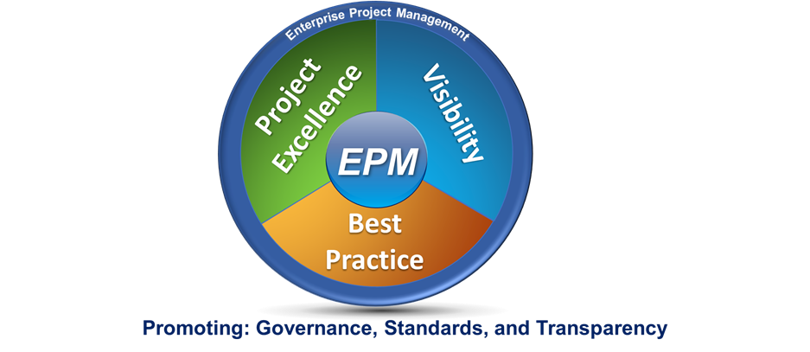
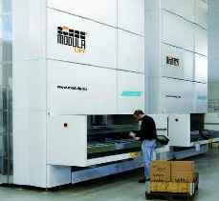
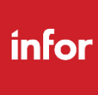
Maximo will be integrated with multiple DART systems
Bus and Rail Operator Scheduling
Fleet Management
Kronos
Enterprise Data Warehouse
ESRI (GIS)
Lawson
Vertical Lift Module

Slide 23
Project Timeline – High Level
Enterprise Asset Maintenance Software Implementation
Notice to Proceed
Pilot Phase
Agency Wide Implementation
November 2018
to
September 2019
October 2019
to
June 2021
October 2018
31 Month Project Duration
Notes:
Total project duration is ~31 months
Mobilization – 1 month
Pilot Phase - 10 months and will implement within the DART Light Rail Signals Maintenance group
Agency Wide Phase - 20 months implementation across all other business units including Maintenance, Growth & Regional Development and Technology

Slide 24
Key Dates – Phase 0

Slide 25
Key Dates – Phase 1, 2019

Slide 26
Key Dates – Phase 1, 2020/21

Slide 27

Questions and Answers
Notes:
Elisa

Slide 28
MAX Program 2019
Enterprise Applications Delivery & Customer Care
Presenter:
Massimo Scicali
Enterprise Applications Delivery Leader

Slide 29
Agenda
Project Introduction
Project Scope
Aurigo’s Masterworks Implementation Approach
Project Adoption
Project Success Criteria

Slide 30
EPM Introduction
Project Objective
To significantly advance the methods of planning, managing, and delivering programs and projects by increasing transparency, standardizing business language, and improving stakeholder efficiencies with the use of technology and process improvement
Mission
To collaboratively streamline project management strategies and practices with industry best practices to meet DART's future needs
Vision
DART’s Enterprise Project Management technology enables world class business practices

Slide 31
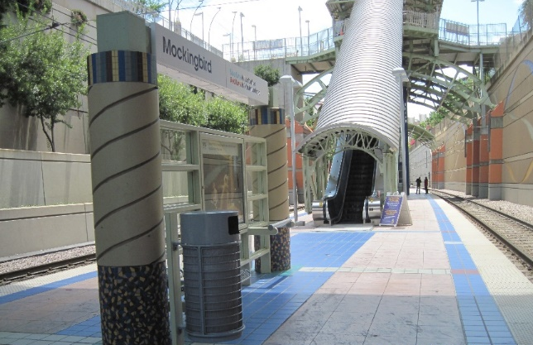

EPM Project Scope
Masterworks System Implementation
  18-month implementation
  Off the shelf solution configured based on business rules and workflows, interfaces and data migration.
  End-to-end project planning, execution, implementation and maintenance of DART assets
  Discovery sessions, to perform gap analysis, and business process re-engineering efforts.
  End-to-End solution that will address agency capital planning along with and project execution
Notes:
Masterworks Full System Implementation
18 month implementation
Core Product Out-of-Box with Configuration and Integration
For use by the agency for end-to-end project planning, execution, implementation and maintenance of DART assets
Preconfigured version based on best practices and standards to jump-start discovery sessions, perform gap analysis, support sprint planning and complete through implementation
Configure all business rules and workflows, activate APIs, set up interfaces for ERP, EAM up to 10 interfaces to support the agencies planning and forecasting of all major projects
Documents and necessary project artifacts will be loaded to populate Masterworks with key data
End-to-End solution that will address agency capital planning and project execution

Slide 32
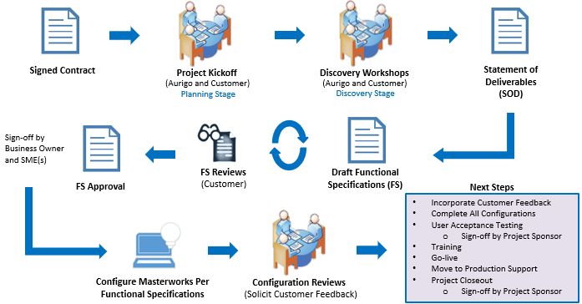
Masterworks Implementation Process

Slide 33
Aurigo Delivery: Discovery Process
Kickoff (Joint)
Document business goals for functional area
Discovery Workshop (Joint)
Demonstrate out of the Box capabilities of Masterworks
Key Business Rules
Review (Joint)
Fit-Gap Analysis
Aurigo Reviews and Recommends Best Practices
Make key strategic decisions
Statement of Deliverables
Aurigo performs detailed functional mapping
Creates preliminary Statement of Deliverables
Signoff
Customer Signs off on Requirement section
Documents functional specifications
Functional Specifications (FS)
DART PM will sign off on all FS Documentation
Aurigo BA will create Specification Documents inline with the Proposed needs in the Statement of Deliverables
Multiple Discovery sessions will take place with individual sessions ranging anywhere from one to three days
Each session has specific goals and outcomes
Functional Specification Documents will be developed as an output of these sessions.
Notes:
Multiple Discovery sessions will take place with individual sessions ranging anywhere from one to three days
Each session has specific goals and outcomes
Project Managers facilitate the discovery sessions
Business Analyst for Aurigo will guide onsite discovery sessions
Business Analyst from Aurigo will draft all Functional Specification Documents

Slide 34
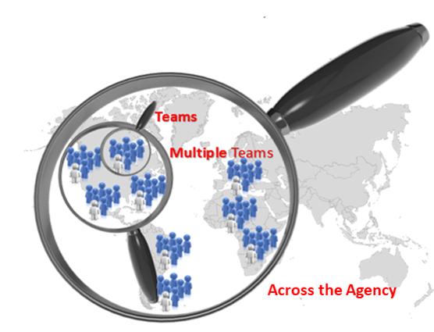
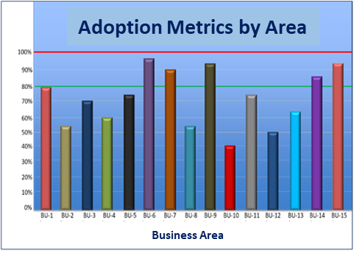
Adoption Metrics
The Simple Truth
Benefits are not realized, unless the people adopt the change
The percent of adoption directly correlates to the level of project success
Allows leadership to hold key stakeholders accountable for expected adoption levels and benefit realization
Intra-organizational measures provide a visible competitive motivator and an actionable leadership metric
Inspect what you expect

Slide 35
EPM Success Criteria
Establish strong project governance model and project management structures/processes
Implement the standard out-of-the-box functionality of the Masterworks software within 18 months to support the planning, delivery, monitoring and control of DART’s projects
Define a new To-Be business model based on the Masterworks software for the full project lifecycle
Plan and deliver a robust organizational change management program to facilitate a successful transition to the Masterworks product and DART’s new To-Be business model
Design and implement a system support model with appropriate Aurigo and internal DART resources
Conduct formal lessons learned processes at key milestone points and at project completion
Notes:
Establish strong project governance model and project management structures/processes
Deliver full project scope on-time and on-budget per revised project schedule
Ensure transparency and clear communications throughout the project
Implement the standard out-of-the-box functionality of the Masterworks software within 18 months to support the planning, delivery, monitoring and control of DART’s projects; product is intended to be used “As-Is” with any customizations/extensions requiring a clear business case and executive sponsor approval
Define a new To-Be business model based on the Masterworks software for the full project lifecycle from project identification to programming, initiation, execution and closure
Conduct business process re-engineering activities to define To-Be business processes that optimize the capabilities of the Masterworks software to the extent possible
Define enterprise-wide/standard business processes to be used across all types of projects and functional areas to the extent possible
Exhibit H – Page 28

Slide 36
Questions ?

