Slide 1
Service Delivery and Customer Care
OVERVIEW
MAX PROGRAM
2019

Slide 2
Service Delivery/Customer Care
Organization
Bus Operations
Rail Operations
Engineering
Materials Management
Mobility Management
Police Department
Human Trafficking Initiative
5 Star Service Program

Slide 4
Bus Operations

Slide 5
Bus Operations
184 Million Annual Budget
Operate 158 Bus Routes
Average 122,300 passenger trips per day
1,797 employees in Bus Operations
Service 11,270 Bus Stops
Perform maintenance on all Buses and Non-Revenue fleet of vehicles

Slide 6
Bus Operations
Administration
Dispatch, Field Supervision, Bus Operator Training
Transit Center Services (Concierge's)
Bus Maintenance (Body Shop, Rebuilds, Facility Maintenance)
CareerLink
Non-Revenue Vehicle Maintenance
Employee Engagement (Efficiency Awards, Honor Guard)

Slide 7
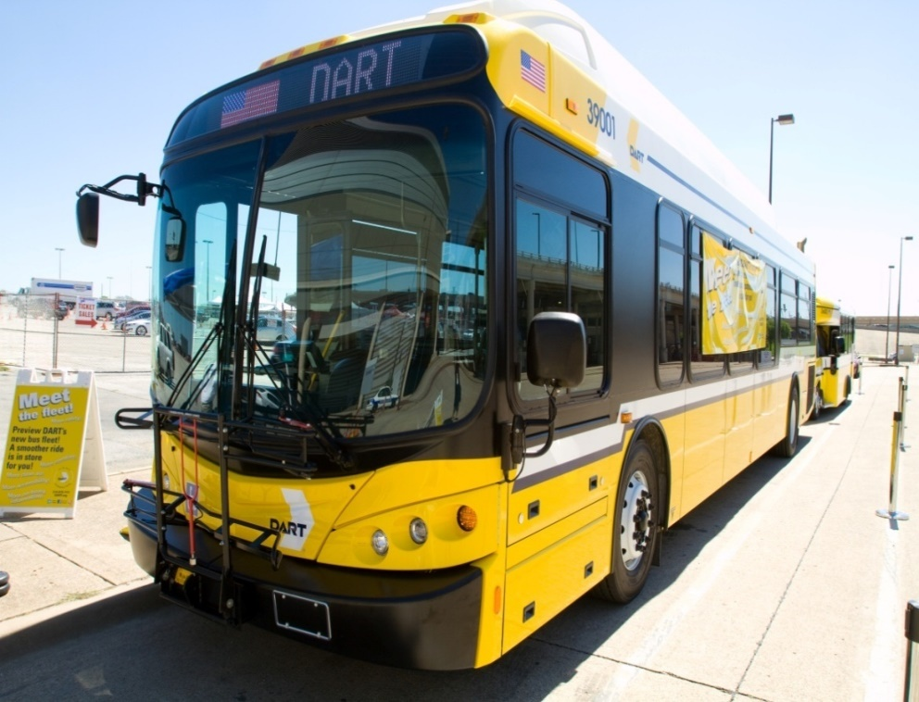

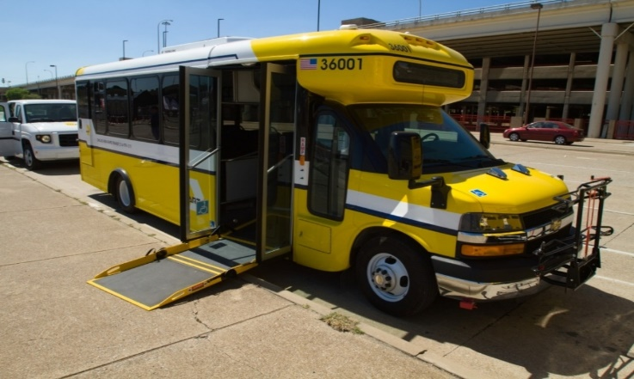
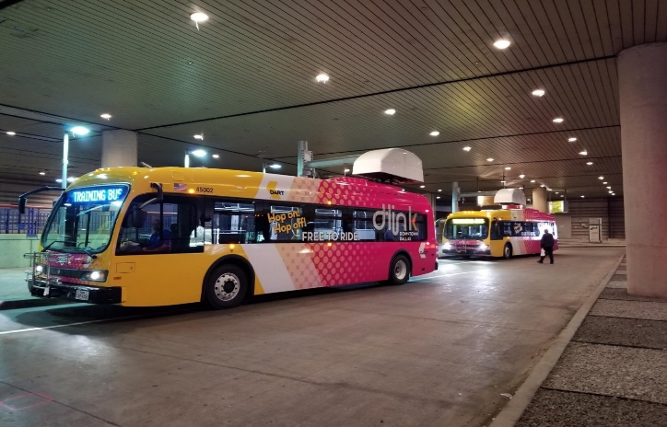
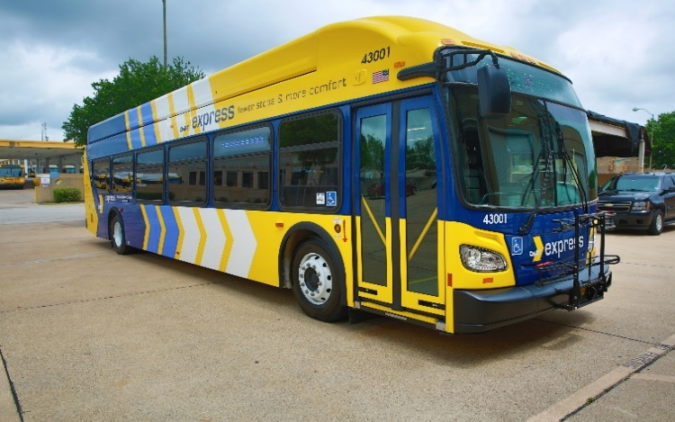
Bus Operation Vehicles
New 40’ and 30’ Buses
26’ Vehicles
New 35’ Lo-No Electric 7 Buses
Suburban Bus

Slide 8
New 40’ and 30’ Buses
26’ Vehicles
NABI Features
Level Boarding – Ramp
CNG Powered
Larger Windows
Light Rail Style Interior
Multi-Colored Destination Signs
Audio & Visual Customer Information Monitors (INFOtransit)
5 Real Time Security Cameras
2-Position Bike Rack
Electric HVAC
Automatic Passenger Counters
Go Pass Farebox Validators (Tap and Go)
ARBOC Features
Smaller – 26’ L x 96” W
Level Boarding - Ramp
CNG Powered
1-Position Bike Rack
Audio & Visual Customer Information
4 Real Time Security Cameras
Automatic Passenger Counters
Go Pass Farebox Validators (Tap and Go)
Suburban Bus Configuration
Single Door
Reading Lights and Vents
Level Boarding – Ramp
Multi-Colored Destination Signs
Single Entrance Door
5 Real Time Security Cameras
New 35’ Lo-No Electric 7 Buses
Proterra Bus Features
Level Boarding – Ramp
Fully Battery-Electric Powered Bus
Standard Transit Bus Seating
Two Charging Stations
Real Time Security Cameras

Slide 9
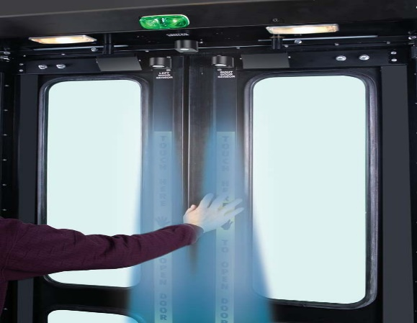
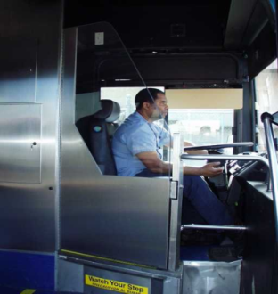
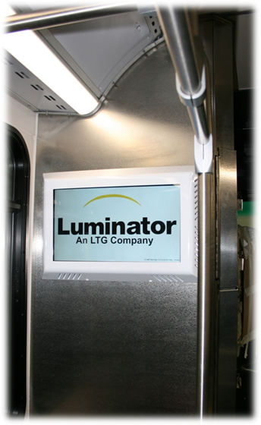
Bus Features
Touchless Rear Door Sensors
Operator Security Barrier
INFOtaiment System

Slide 10
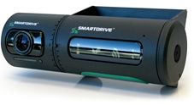
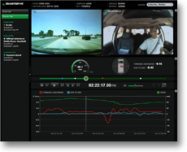
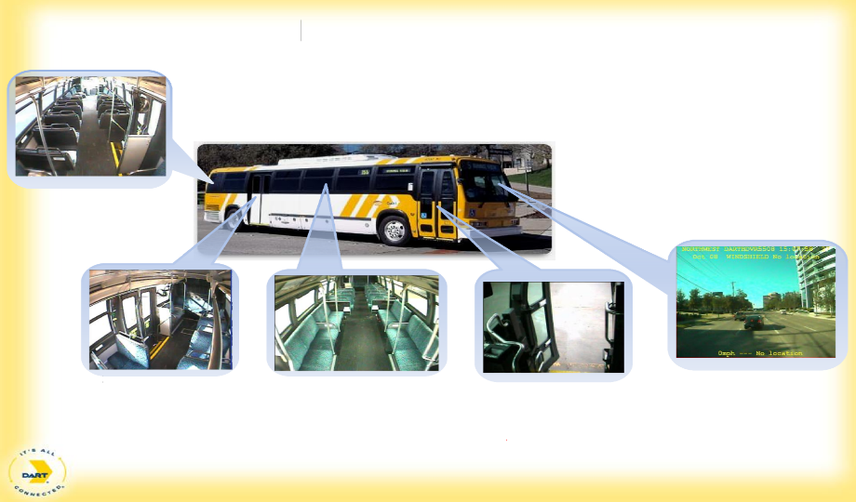
Safety/Security
SmartDrive Event Recorder
Remote viewing
Incident/Accident history

Slide 11
Bus Operations
2019 – 2020 OTP Initiative
  On Time Performance
  Collect detailed running time information that enables service planning staff to adjust bus schedules to better reflect actual run times, improve the timing of system connections, and provide for adequate recovery times.
  Improve the monitoring and real-time service management of bus on-time performance.
  Provide real-time feedback to the operator on schedule adherence.
  Collect detailed on-time performance reporting at the route, vehicle, and operator level.
  Deploy new reports and reporting tools to Bus Field Supervisors to improve on-time performance and reduce customer complaints.

Slide 12
Bus Operations – 2019 Key Performance Indicators
  On Time Performance: 83%
  Complaints per 100,000 riders: 57
  Mean Distance Between Service Calls: 12,220
  Vehicle Accidents per 100,000 miles: 2.30

Slide 13
Bus Operations – CareerLink
  The goal of CareerLink is to create soft skill learning opportunities that support employee talents and meet individual needs and interests.
  The CareerLink Training Program was established to help employees expand on what they know and develop and strengthen new skills.
  The CareerLink Program has four (4) full-time employees dedicated to this training
  initiative.
  This program also has the support of volunteer facilitators, who provide training to employees for CareerLink.
Succession Programs offered at DART through Careerlink
  Bus Operator Succession to Supervision (BOSS)
  Rail Operator Succession to Supervision (ROSS)
  Transportation Supervisor Career Ladder
  Career Development Programs
  E-Learning Program Development

Slide 14
Fleet Delivery Schedule 2018/2019
7 Electric Transit Buses – July 2, 2018
112 Arboc Small Buses – July 2018
3 Arboc (Go-Link) – November 2018
41 - 40’ Transit Buses – May 2019
By 2019 approximately 700 new vehicles will have been replaced since 2012.

Slide 15
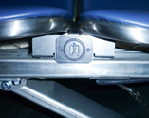
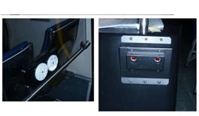
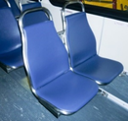
Coming in 2019
2019 New Flyer XN-40 Bus
Automatic Passenger Counters
(Infrared APCs at Doors)
USB Ports
(at Passenger Seats)
Vinyl Passenger Seats

Slide 16
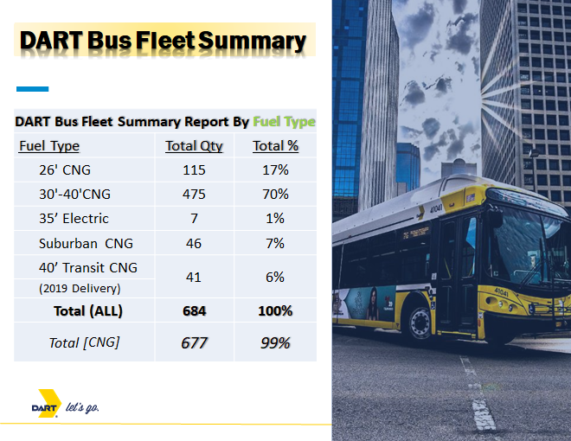
Reduced future fuels cost – 60%

Slide 17
Rail Operations

Slide 18
Rail Operations
LRV Fleet – 162 Vehicles
Dallas Street Car – 4 Vehicles
76 Rail Stations
136 Grade Crossings
11,500 Signal components
52 Communications Bungalow
1800 Radios
76 Traction Power Substations
Passenger Amenities

Slide 19
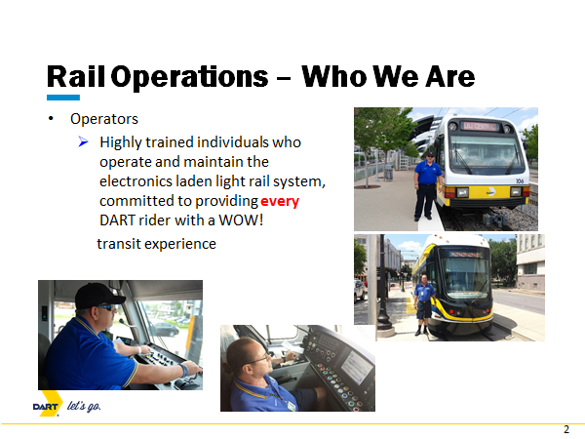
Click to add txt

Slide 20
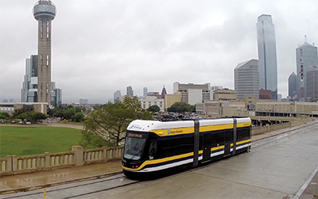
Dallas Streetcar
Revenue Operation since April 2015
4 Vehicles
Street Level Boarding
Off Wire Operation On Houston Street Viaduct

Slide 21
Major Initiatives: 2019 – 2020
Fleet:
  Complete installation of remaining CCTV units in Light Rail Vehicles (2019)
  Mid-Life Rehab of 95 LRV Vehicles
Rail Operations:
  Enhanced Operator Training Program including LRV Simulator
  Consolidated Control Center
Ways, Structures, and Amenities:
  CBD Rail Replacement Project
  Platform Extension Project
  Carpenter Ranch Station Project
  D-2 Alignment
  Asset Management
    Sustainability
    State of Good Repair

Slide 22
Key Performance Indicators
Complaints per 100,000 Riders
Goal: 2.29
Percentage to Goal Achieved: 96.4%
On-Time Performance
Goal: 93%
Achieved to Target: 93.1%
Accidents Per 100,000 Miles
Goal: 2.30
Achieved to Target: 99.0%

Slide 23
Engineering Department

Slide 24
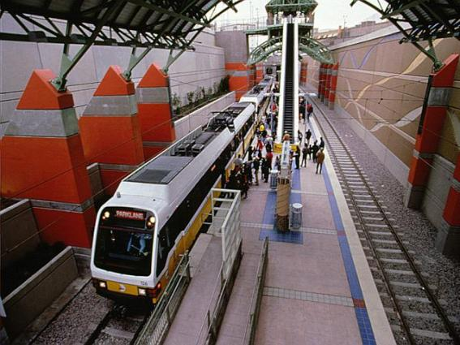
TAM/SGR Project Scope
Develop agency future needs for processes, organizational structure, supporting tools and software
  Asset maintenance
  Asset management
  Supply chain management
  Project management
  Financial capacity analysis
Guide agency in selection of new software(s) to replace aging enterprise systems

Slide 25

Transit Asset Management
National Perspective
>$83B SGR Backlog
Substantial Service Cuts
Restricted System Growth
FTA Roundtables
MAP-21 Legislation
FTA Regulations
  Transit Asset Management (TAM)
  State of Good Repair (SGR)
  Safety Oversight

Slide 26
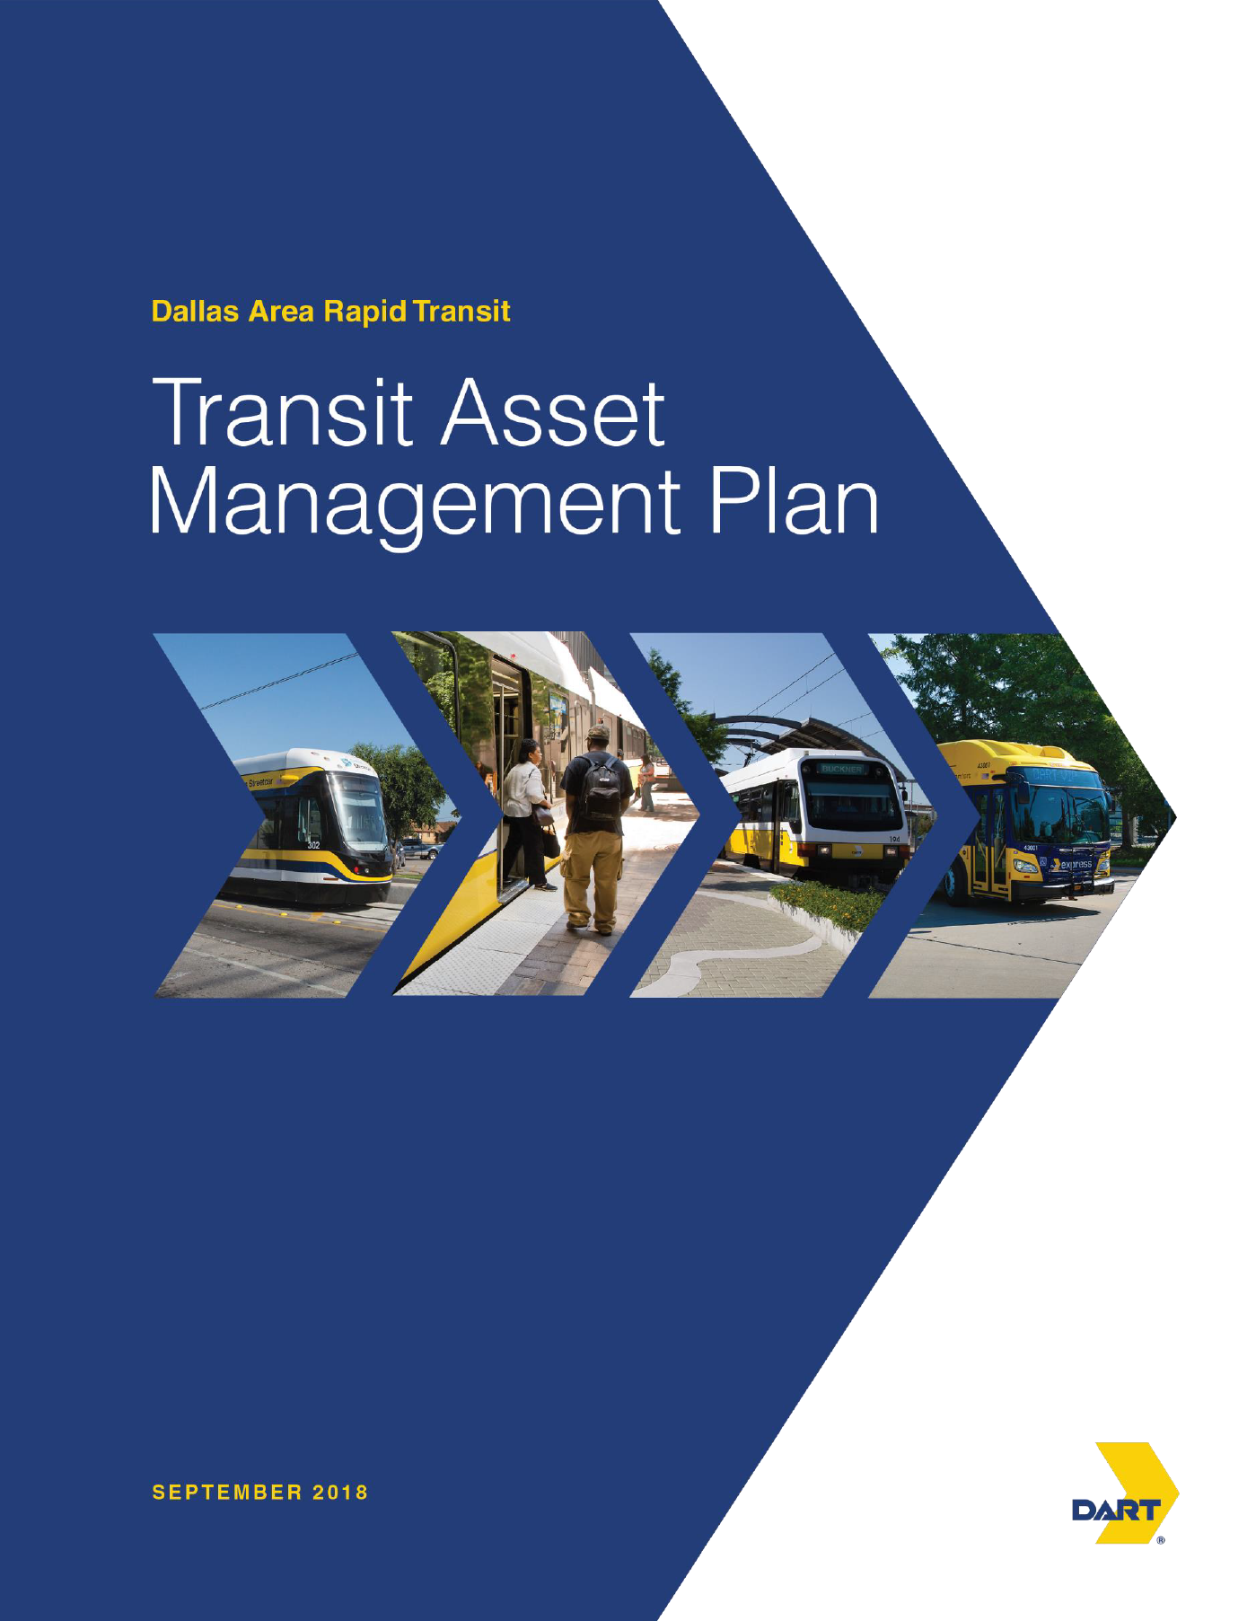
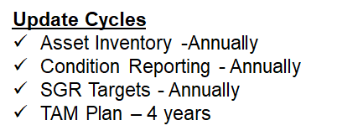
TAM/SGR Project Scope
Develop transit asset management plan & asset hierarchy
Oversee installation of selected software system(s)

Slide 27
Engineering Initiatives
41 New Low Floor Bus Procurement
LRV & Bus Passenger Seat Retrofit
LRV Replacement Plan
Energy Cost Saving Pilot
Transit Signal Priority
Mystery Rider Pilot –Quality Assurance

Slide 28
Materials Managementy

Slide 29
Materials Management
The Materials Management department has the primary responsibility of managing the ordering, receiving, distribution, and disposal of materials and equipment for the agency. Materials Management manages an inventory of over 14,300 various parts valued at over $40 million.
Materials Management is organized into three Sections: Materials Management and Planning, Receiving and Distribution, and Warehousing and Distribution.

Slide 30
Materials Management
Automation of Warehouses – As part of the Asset Management Program, we are working to update the warehouses and take advantage of available technology. To increase the accuracy and efficiently of our inventory and increase our storage capacity, Materials Management has acquired Vertical Lift Machines (VLMs) which were installed in FY 2018 in the main warehouse and in one of our satellite locations.
Improving relations with vendors – We have been visiting with vendors to better understand how they are set up and how their ordering processes work. Our goals are to better understand their processes and to make sure they understand our processes.

Slide 31
Materials Management
Materials Management Scorecard – Key Performance Indicators
Indicators | FY15 | FY16 | FY17 | FY18 Qtr. 3
Buses Down for Parts (Stocked) - Average Per Day | 100.0% | 78.4% | 100% | 100%
LRV's Down for Parts (Stocked) - Average Per Day | 100.0% | 100.0% | 100% | 100%
Parts Availability % | 100.0% | 100.0% | 100% | 99.9%
Inventory Accuracy % | 99.9% | 99.9% | 99.7% | 99.8%

Slide 32
Mobility Management Services

Slide 33
Mobility Management Services
Contractor – MV Transportation, Inc.
Currently in year 7 of 7 year contract
Total Contract Value: $186 million
Contract and model change yielded $90 million savings
MV subcontracts service to Irving Holdings (Yellow Taxicab)
80 lift-equipped vans
116 ramp-equipped minivans
MV – reservations, scheduling, dispatching, vehicle operation and maintenance
New contract awarded to MV Transportation in February 2019.
Three year, three month base contract with two, two year options.
Three year, three month base value: $105 million
MV acts as broker, does not provide any service directly
Providers include Irving Holdings, Big Star, Logisticorp, MyCity, and Lyft
42 lift-equipped vans
154 ramp-equipped minivans
13 Toyota Prius sedans
MV continues to perform reservations, scheduling, dispatching, and vehicle maintenance

Slide 34
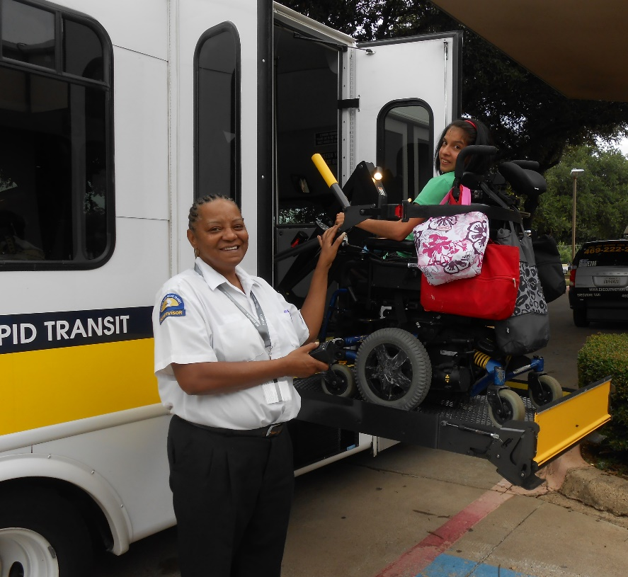
ADA (Americans with Disabilities Act) Paratransit eligible riders can travel anywhere within DART Service Area
  Just over 12,000 eligible riders take 2,500 to 3,000 trips/weekday
  Riders must book trips one to three days in advance
Seniors / Older Adults
General Population

Slide 35

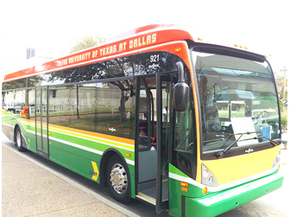

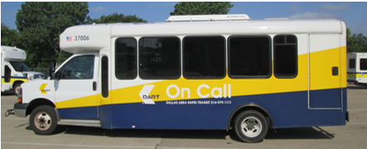
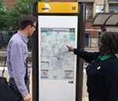
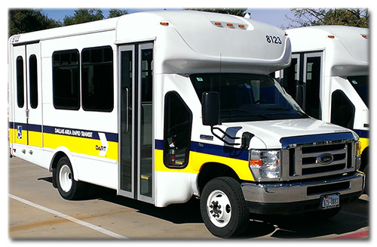
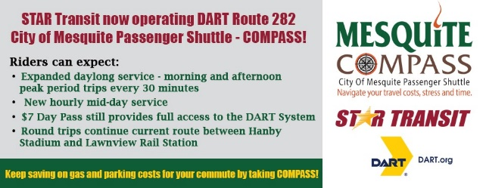
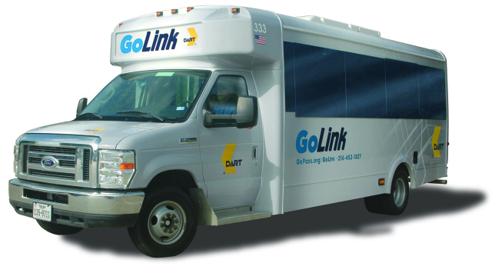
ADA Paratransit
Plano Rides
Collin County Rides
DART On Call
DART GoLink
Mesquite
UTD
Travel Ambassadors

Slide 36
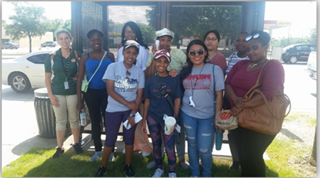
Travel Ambassadors
DART’s Travel Ambassador Program provides FREE Travel Orientation to anyone who needs a little extra help using public transit. (DART’s bus and rail service)
Travel Orientation:
  Teaches the skills necessary to navigate public transit in a safe and independent manner;
  Is personalized and taught with the customer’s needs, abilities, and specific travel plans in mind; and
  Consists of 1-3 outings in which a DART Travel Ambassador instructs an individual or group on how to prepare a trip plan, pay fare, and travel safely between their origin and destination.
As a part of a 5-Star Continuous Improvement Team initiative in 2015, the program has grown from 426 customers trained in FY15, to 925 in FY16, 986 in FY17, and 1,519 in FY18.
“Thank you so much for such a wonderful and most productive day! I so enjoyed your company / your guidance / training… I feel rejuvenated and ready to start getting out. Have felt like I have been sequestered in my home and now I will get out each weekend and head somewhere on the red line and other lines to enjoy the sites.” Jan K.
(Travel Orientation from Parker Road to the Dallas Farmers Market)

Slide 37
Major Initiatives 2019
Contract Award: $105 million, 3 year & 3 month contract with MV Transportation.
  Approved by OSS Committee 12/12/2018 and by
  Approved by COTW/Board on 01/22/2019.
Customer outreach – new model and contract.
Soft Start: Perform a gradual ramp up of service under the new model starting July 1, using the new technology platform (RouteMatch). Between July 1 – September 30, perform an estimated 20,545 Paratransit trips, 48,750 Microtransit trips, and 90 Assistance Program trips under new model.
Full Model Implementation: The new contract model is scheduled to be implemented fully on October 1.

Slide 38
Key Performance Indicators
Current Contract (FY13-FY19): Liquidated Damages only
  Complaints per 100,000 riders: 3
  On time performance: 95%
  Accidents per 100,000 miles: 2
  7 others, total of 10 KPIs
Future Contract (starting FY20): Liquidated Damages and Incentives
  Driver Rating (3.5/5 or higher)
  On time performance: 92%
  Accidents per 100,000 miles: 2.0
  11 others, total of 14 KPIs across Paratransit, Microtransit, Assistance Programs

Slide 39
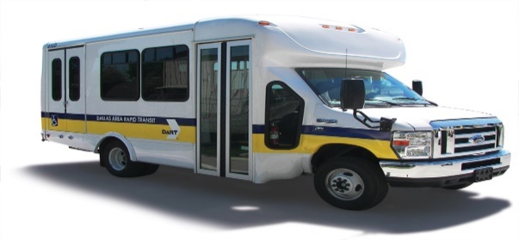
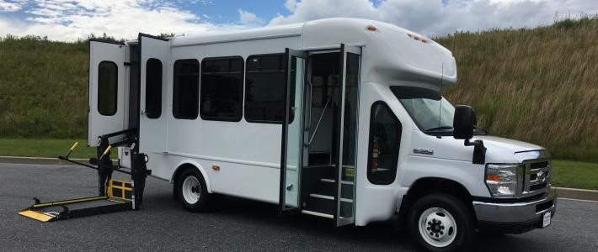
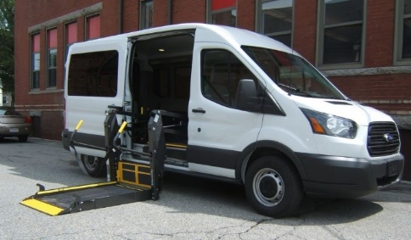
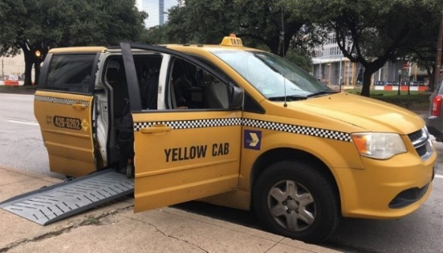


Paratransit Vehicles
Present
Future

Slide 40
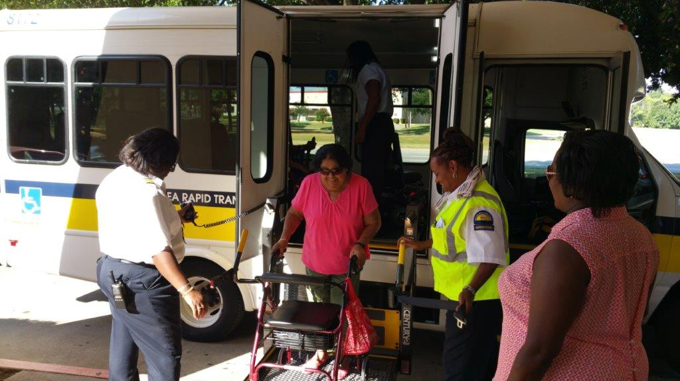
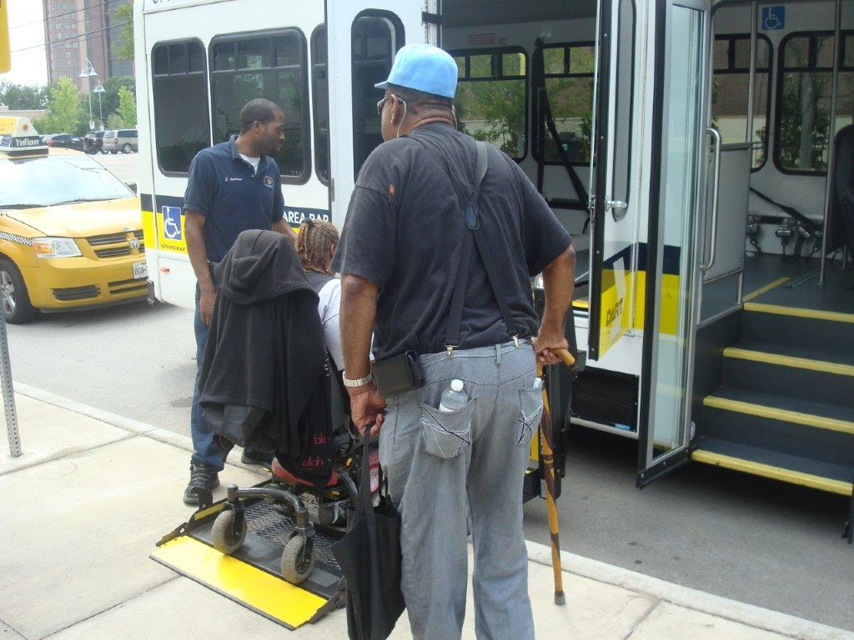
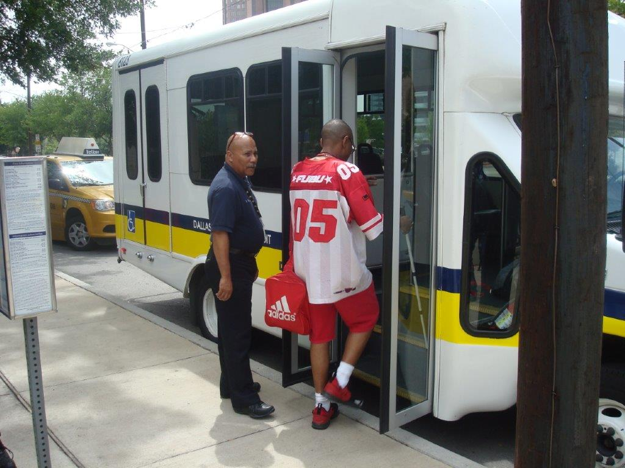
Paratransit Customers

Slide 41
Police Department

Slide 42

Police Department Operations
Rail Operations – Uniformed Police and Fare Enforcement Officers
Patrol Operations – Uniformed Police and Undercover Operations
Criminal Investigations – Investigate crimes against persons and property and intelligence analysis
Emergency Preparedness – emergency and disaster planning

Slide 43
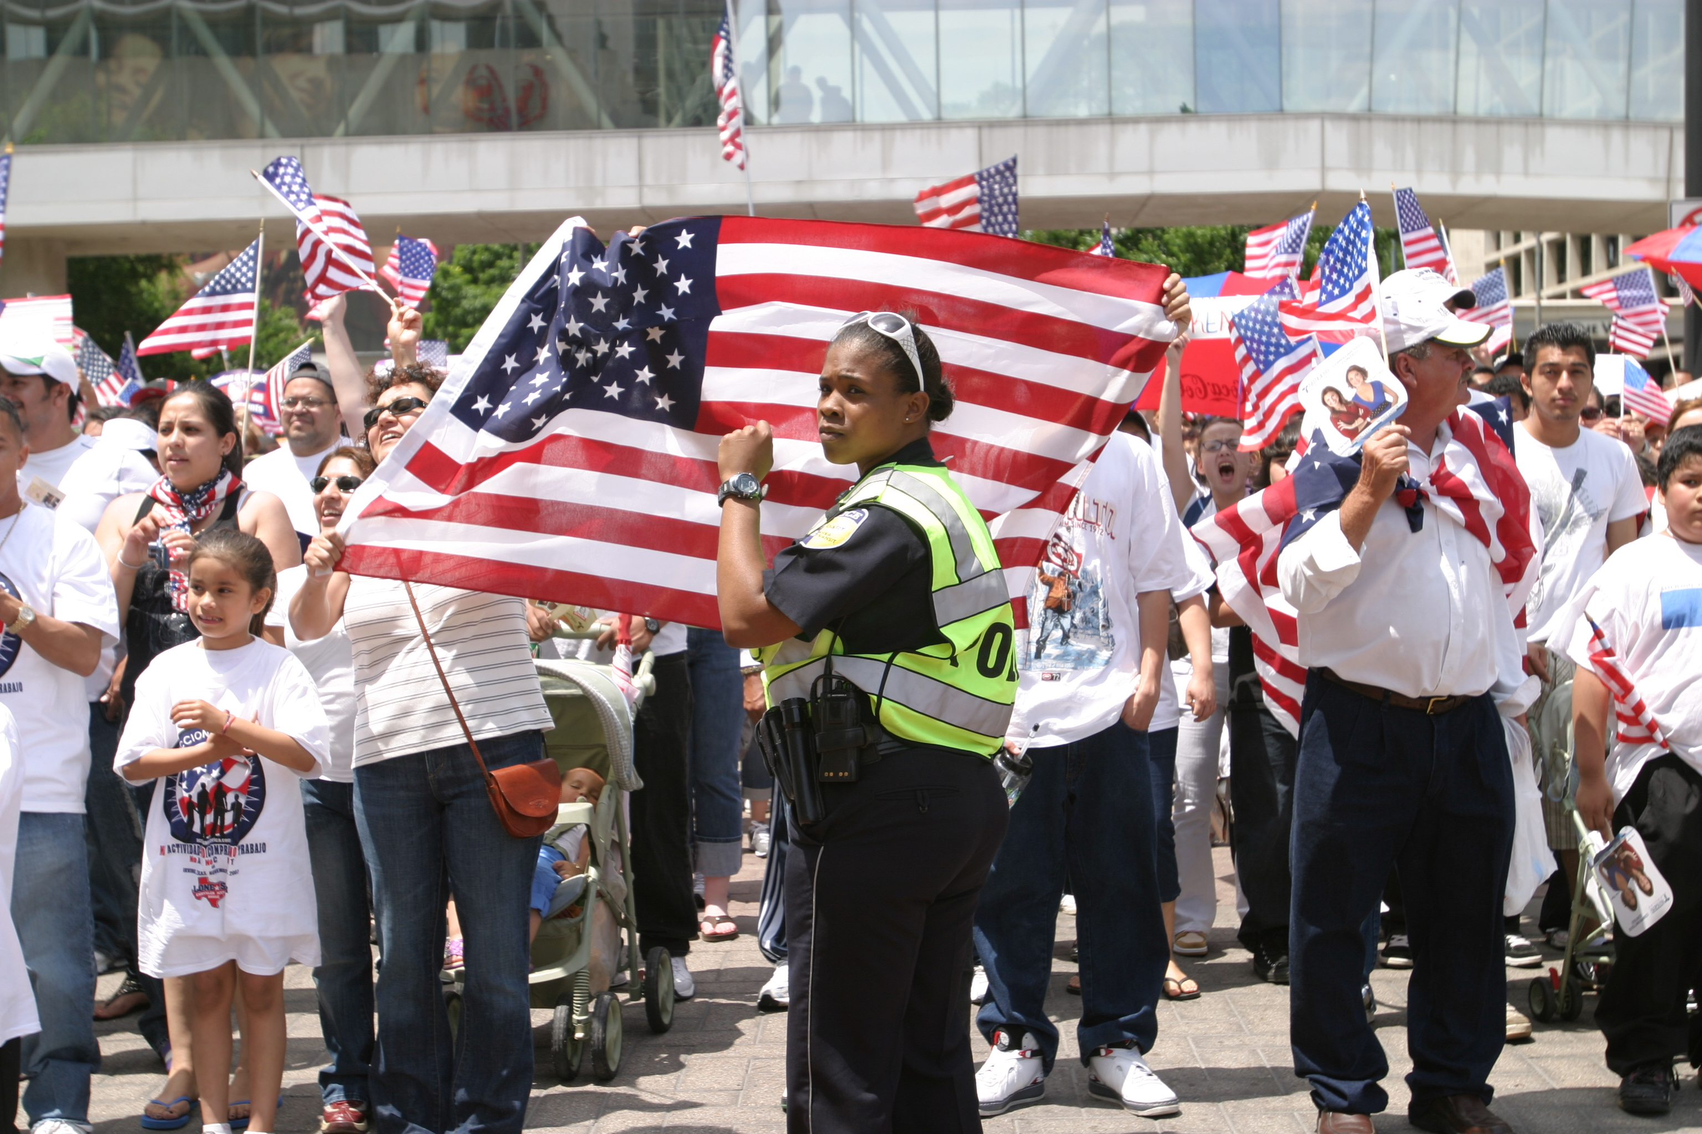
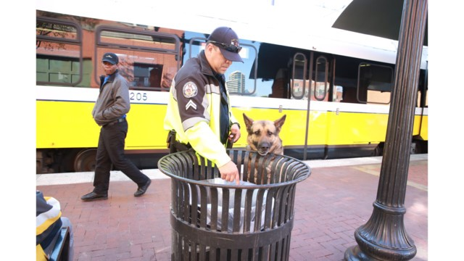
Police Department Operations
Explosive Detection Canine and Motorcycle Officers
Community Policing
Visible Intermodal Protection Response(VIPR) Teams
Security Cameras at Rail Stations and on buses
Customer Service Events

Slide 44
Police Department
Security Goals 2018 - 2019
Assign officers to West End and adjacent areas within CBD
Hired 35 Security Guards for presence on DART trains for visible deterrence to crime and increased presence
Deployed 100% coverage on trains by March 2018
Provided additional security cameras to high activity locations by May 2018
Installation of security cameras on 139 of 163 trains as of February 15, 2019 (Complete installation of security cameras 2020)
Increased coordination with municipal police departments within service area
Implemented communication protocol to inform Board members of serious incidents involving DART or its passengers
Evaluate bus routes and transit facilities to enhance security
Implement environmental design improvements to enhance security
Implement a communication and messaging strategy on security initiatives

Slide 45
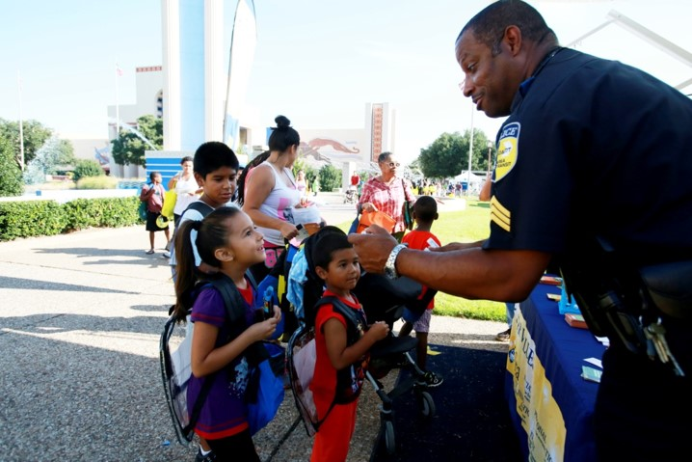
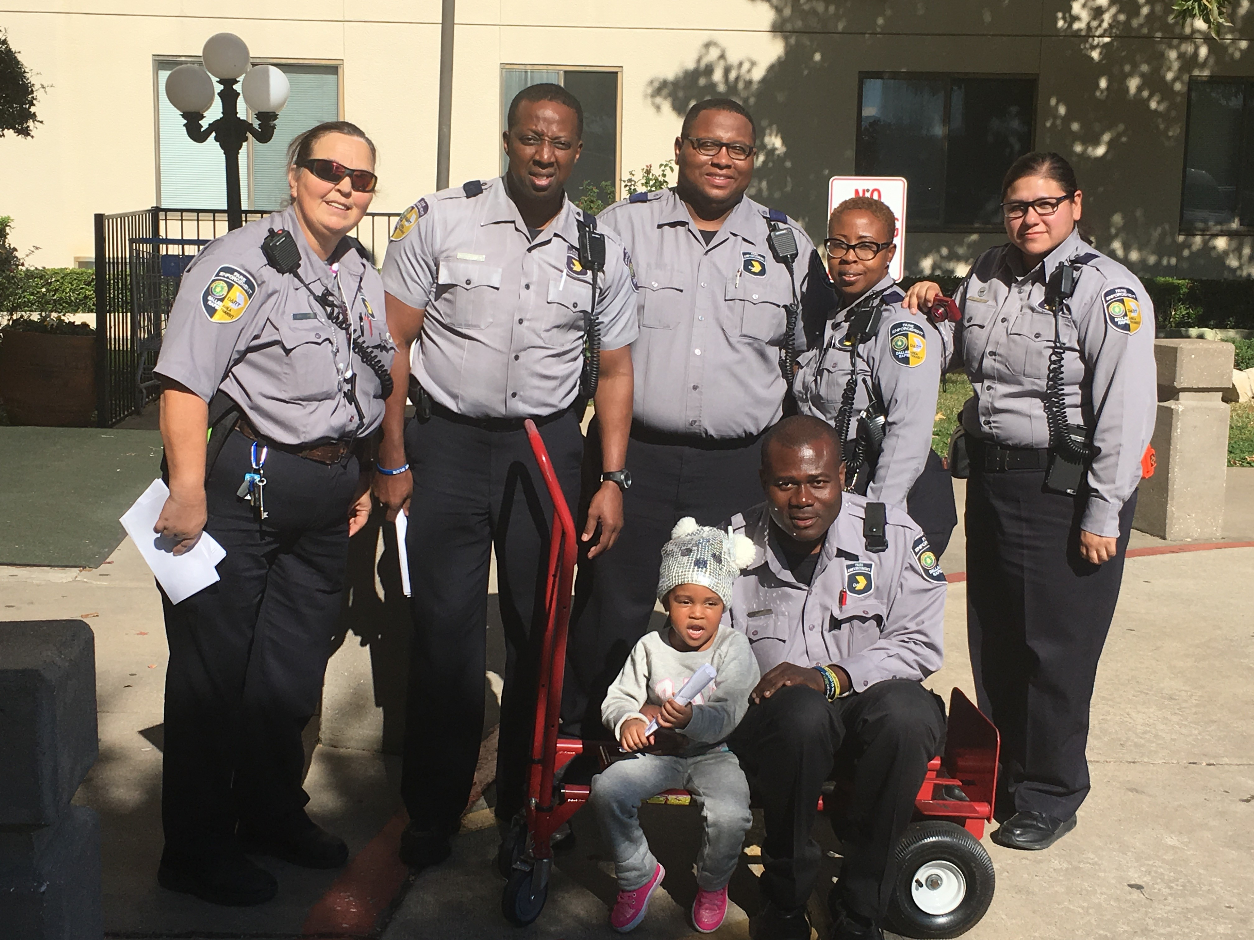
Service in the Community

Slide 46
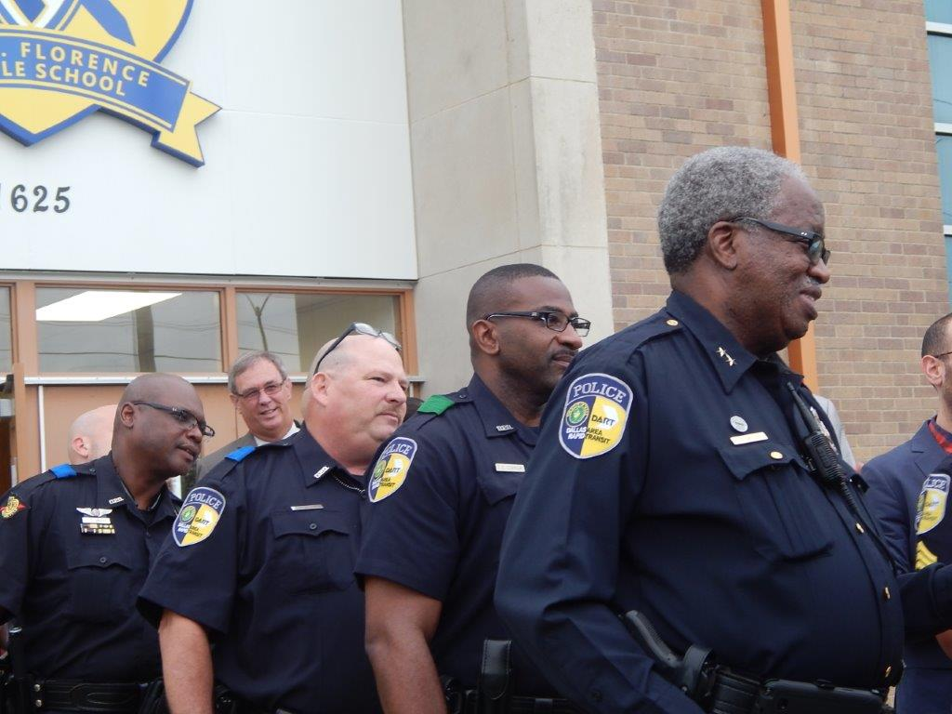
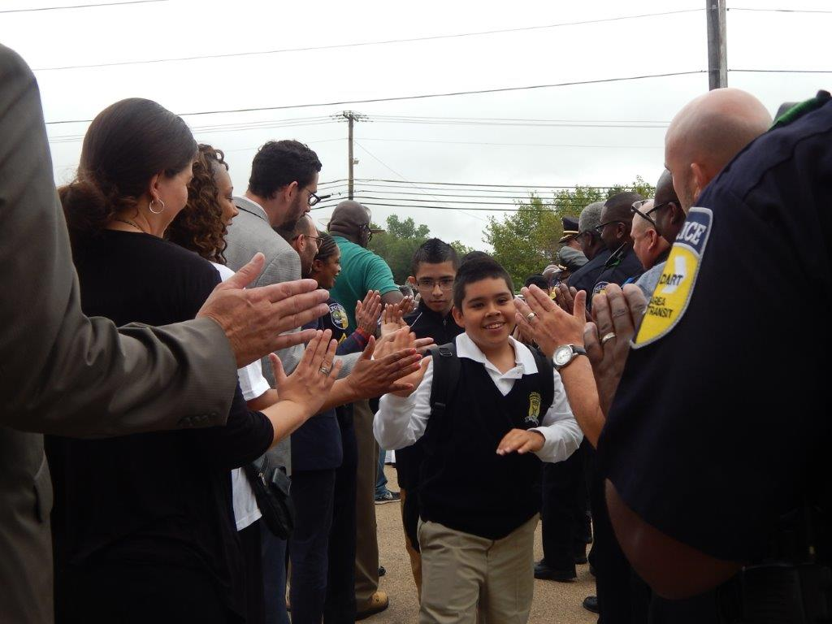
Service in the Community
First day of school at the Young Men’s Leadership Academy at Florence Middle School. DART Chief of Police and Officers participate in welcoming students back to school.

Slide 47
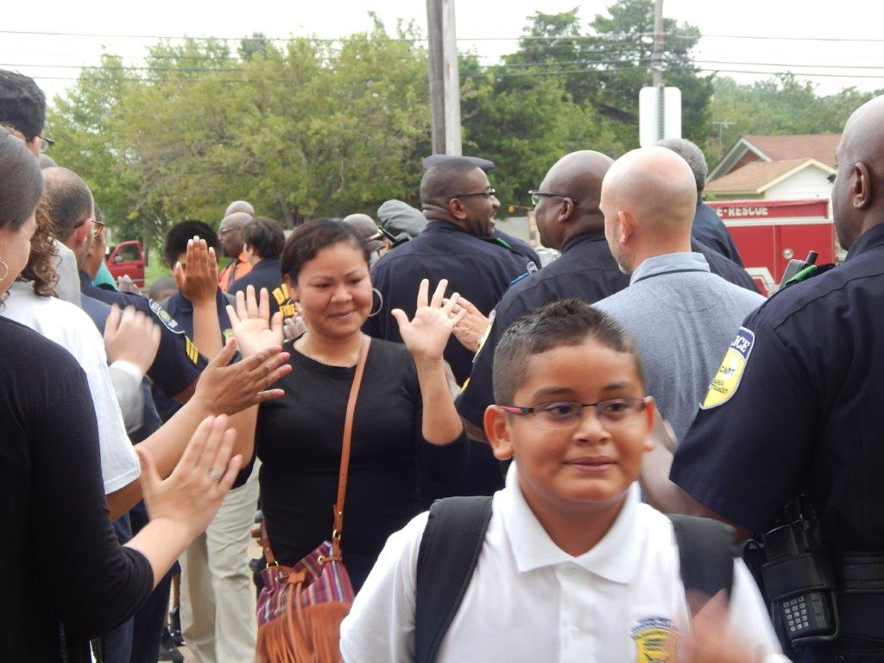
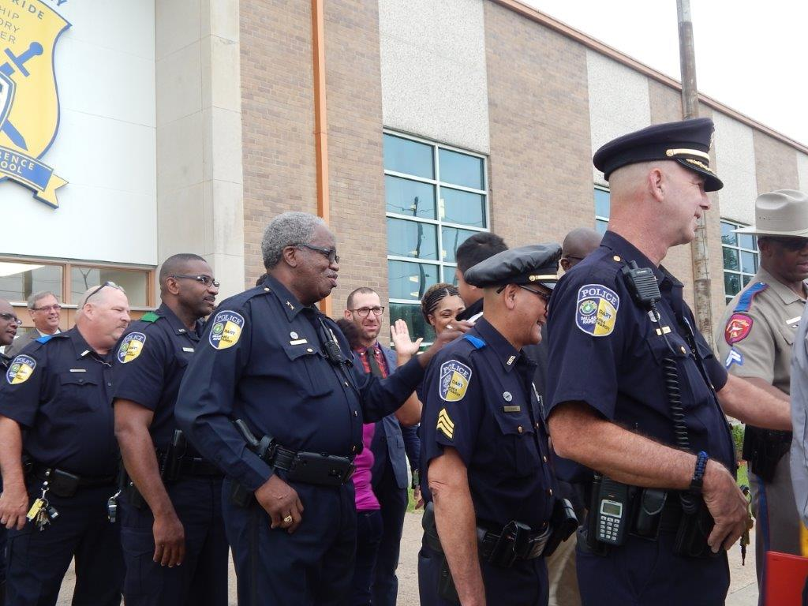
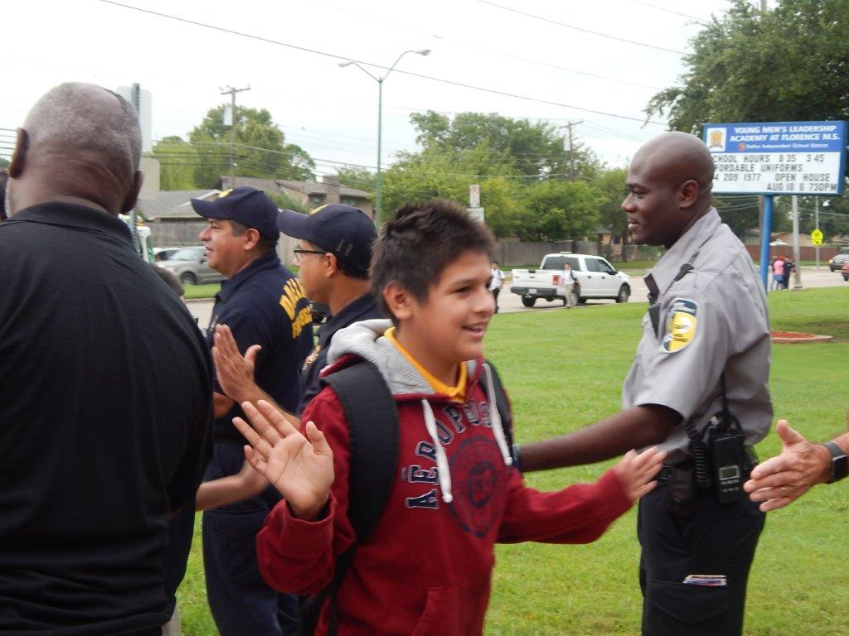

Slide 48
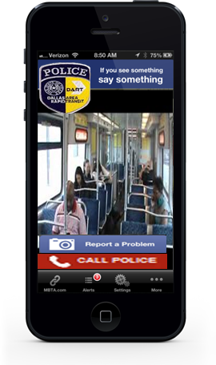
Police Department Operations
E-Alerts App Rollout 2017

Slide 49
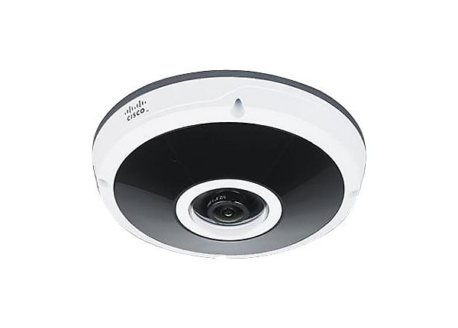
Security on Light Rail Vehicles
  Phase I installation of cameras on the first 48 Light Rail Vehicles completed February 2018. Phases II and III to be completed in 2019 and 2020.
  New camera system will interface with the current video system at stations. Camera features include 180° panoramic views and 360° surround views.

Slide 50
Police Department Operations
Police Communication with Customers
  Twitter (only used by Media Relations)
  Facebook (only used by Media Relations)
  Customer Interaction on trains, bus and platforms
  www.dart.org
  You Tube
  Texting
Communication to Community Partners
  Weekly/monthly meetings
  Representatives to Service Area cities police
  Task Force meetings
  Peer and supervisor meetings

Slide 51
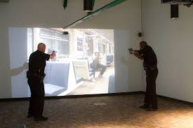
Simulator Use of Force
Police Training
Purchased in November 2014
Scenario-based training in controlled environment
  Immediate critique of officers’ actions after the scenario.
  Builds officer confidence in stressful scenarios
Sworn DART police officer attends this training annually
Future scenarios will include videos produced on DART property to enhance realism

Slide 52
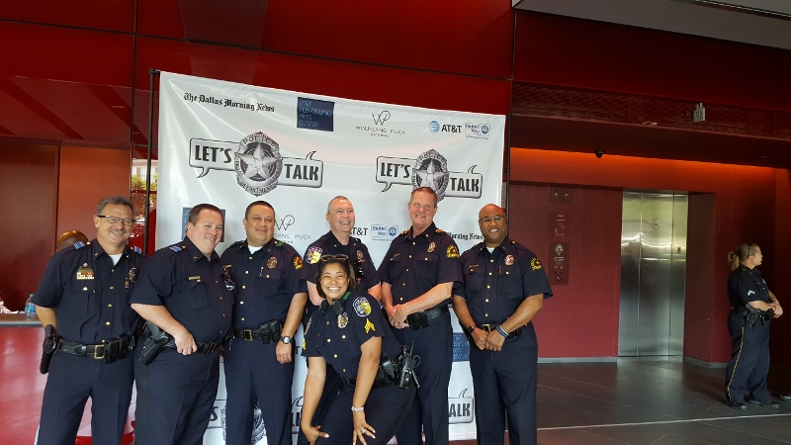
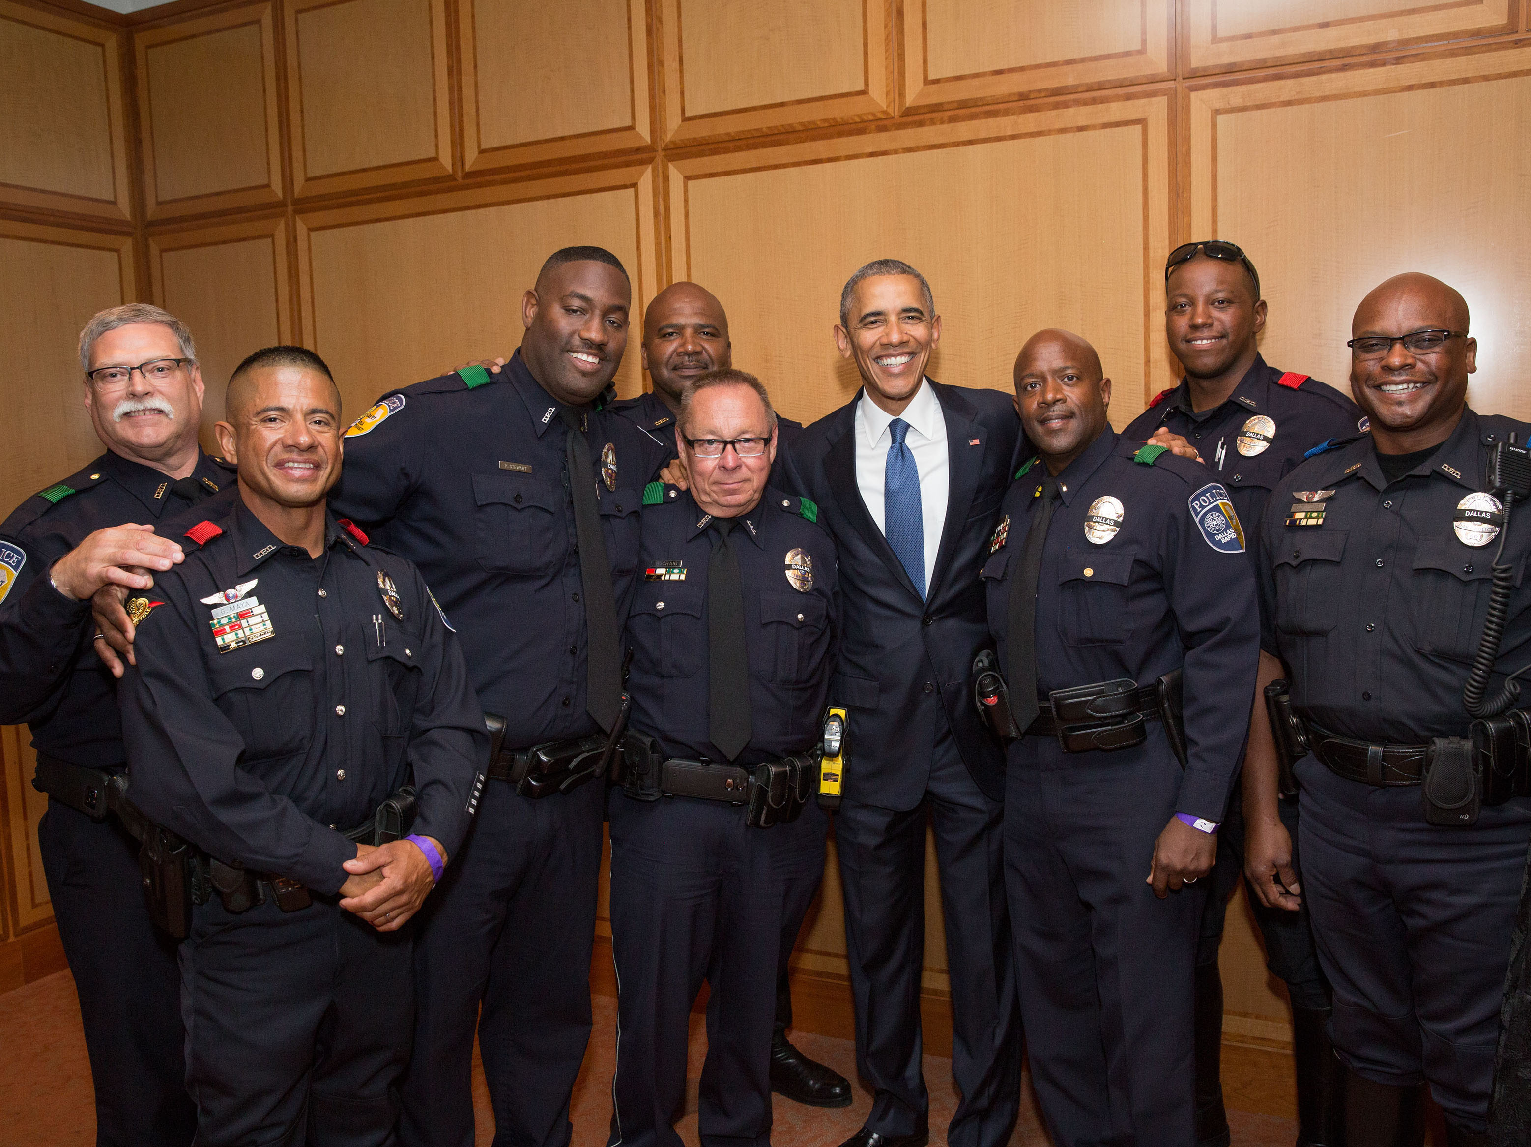
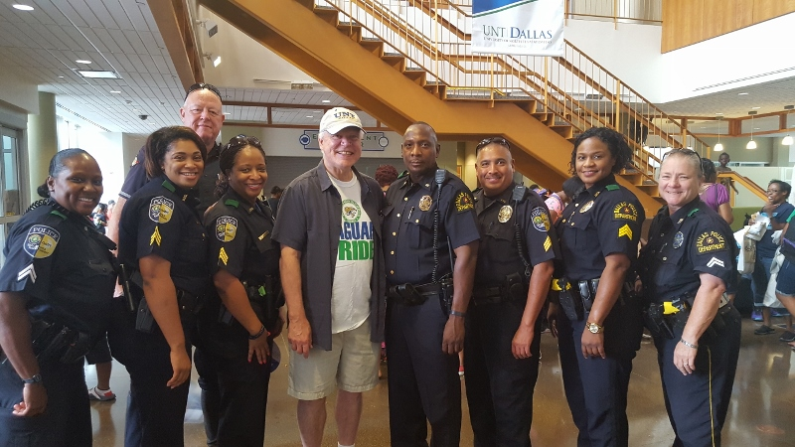
Honor and Service

Slide 53
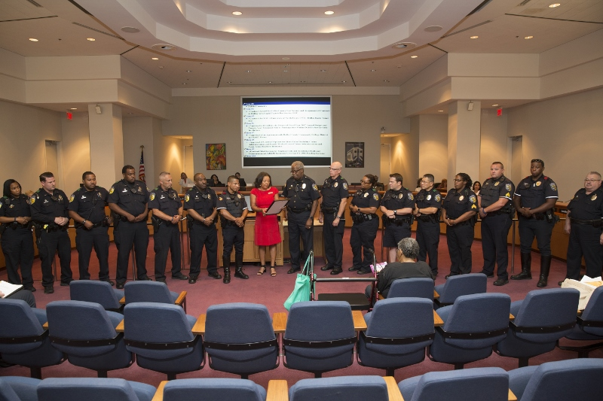
Honor and Recognition

Slide 54
Dallas Area Rapid Transit
Human Trafficking Initiative

Slide 55
DART signs the Department of Transportation
Leaders Against Human Trafficking Pledge
Take a Stand Against Human Trafficking
Educate Employees
Raise Awareness among traveling public
Measure impact by tracking and sharing data

Slide 56
PARTNERS
Transit
DCTA, Fort Worth (T), El Paso, SWATA, Greyhound, Amtrak, MV, Irving Holdings, Inc. (Taxicab)
Social Service Agencies
Mosaic, Children at Risk, New Friends New Life, Dallas Women's Foundation, Missing Kids Traffic 911,
Traffic Stop, Dallas Police Department

Slide 57


  DART and Human Trafficking Partners
DART and Greyhound Distribute Human Trafficking Materials
in the West End

Slide 58




DART's Human Trafficking
Awareness Campaign

Slide 59




Slide 60
On-going Initiatives
National Human Trafficking Month – Schedule Program in January
On-going Outreach to agencies
DART Employee Human Trafficking Training
On-going employee engagement

Slide 61
5 Star Service Program

