Slide 2
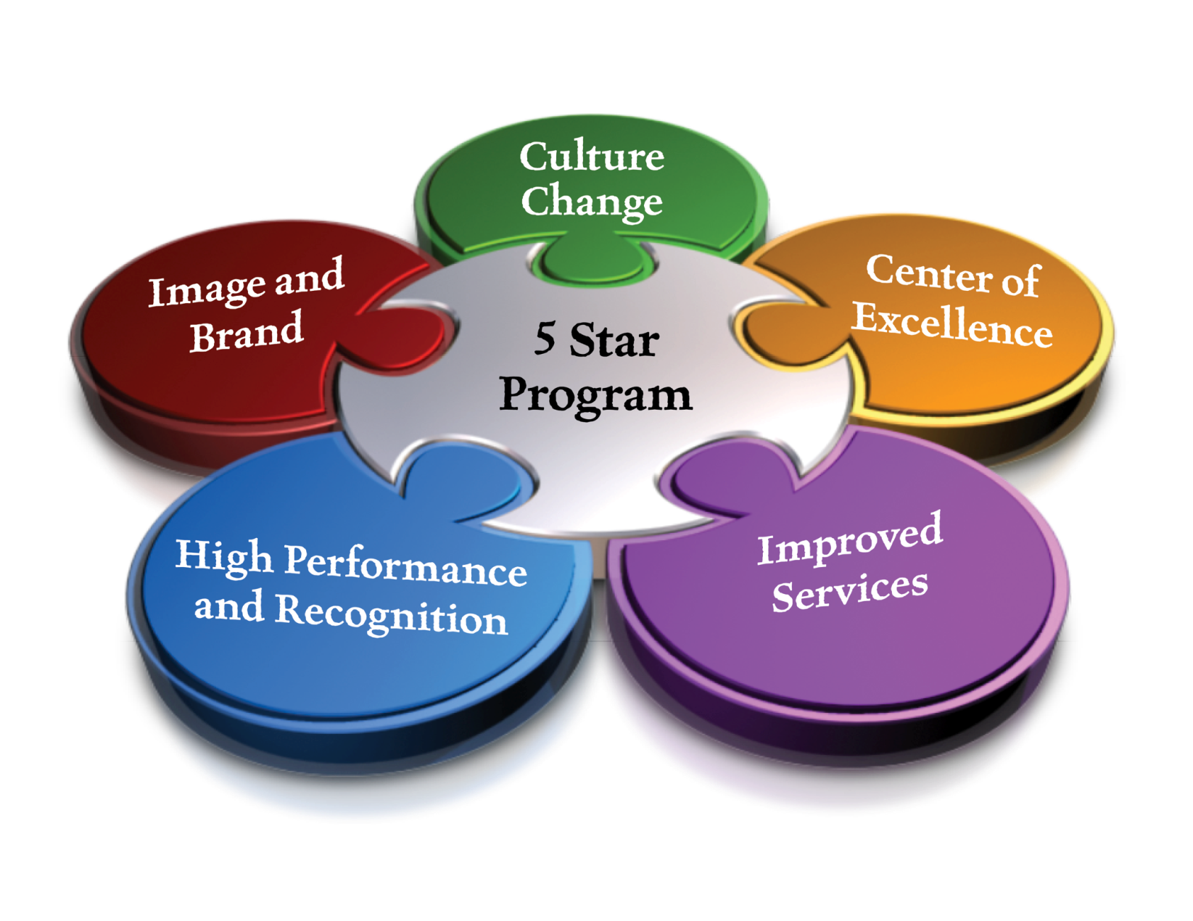
5 Star Pillars

Slide 3
5 Star Vision
Each member of DART’s team strives every day to create an extraordinary customer experience when interacting with colleagues, riders, partners and the community.

Slide 4
5 Star Values
INITIATIVE Take the first step, be proactive.
PERSONALIZATION Treat everyone uniquely.
INNOVATION Don’t let new ideas intimidate.
TRUST Be there for customers, colleagues alike.
WOW Attitude makes every encounter a meaningful one.

Slide 5
5 Star Levels
5 Spectacular
4 High Quality
3 Above Average
2 Routine
1 Embarrassing

Slide 6
SPECTACULAR
EVERY CUSTOMER IS A VIP. WE ANTICIPATE NEEDS AND LOOK FOR WAYS TO SAY “YES”
INNOVATION AND CREATIVITY MAKE US DISTINCTIVE AND MEMORABLE SO THAT BRAND IS TOP OF MIND AND HELD IN HIGH REGARD
EMPLOYEES HOLD THEMSELVES ACCOUNTABLE FOR THE CUSTOMER EXPERIENCE, REGARDLESS OF THEIR ROLE. THEIR KNOWLEDGE MAKES THEM TRUSTED ADVISERS OF OUR PRODUCTS AND SERVICES
DELIVER “WOW” SERVICE AS OUR TRADEMARK

Slide 7
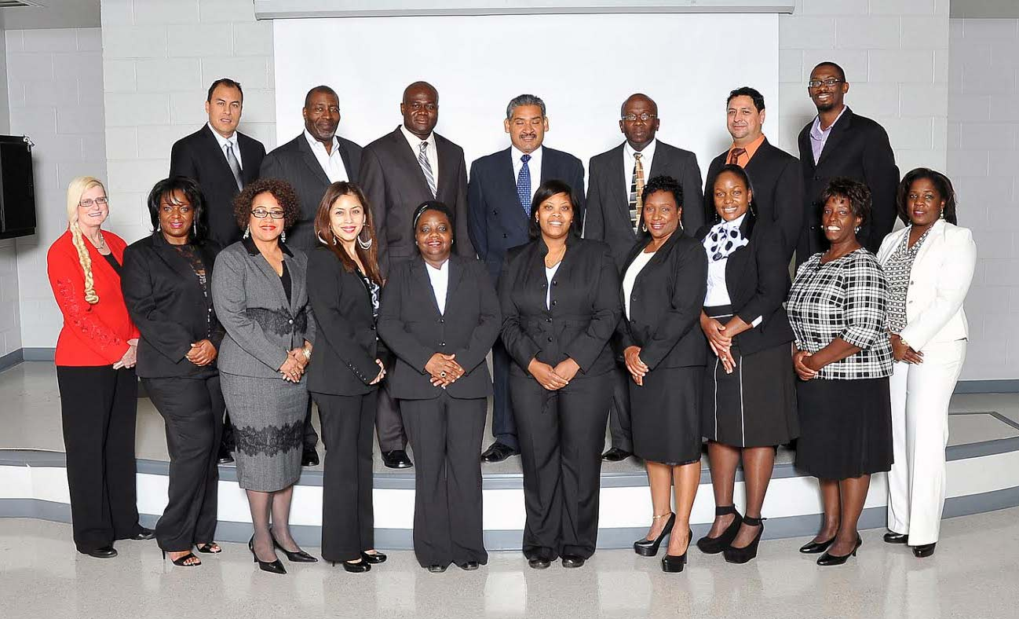
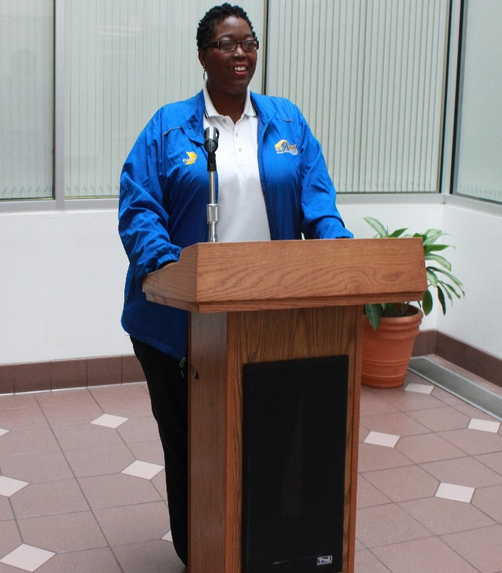
Employees Lead the Way
Customer Experience Officers (CEO)

Slide 8
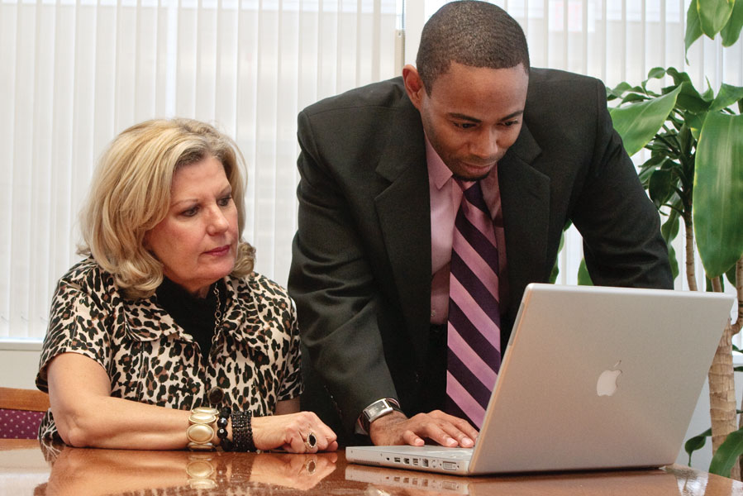
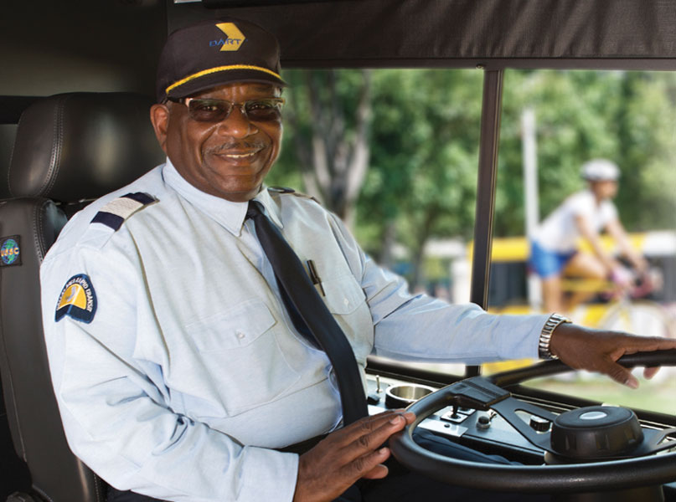
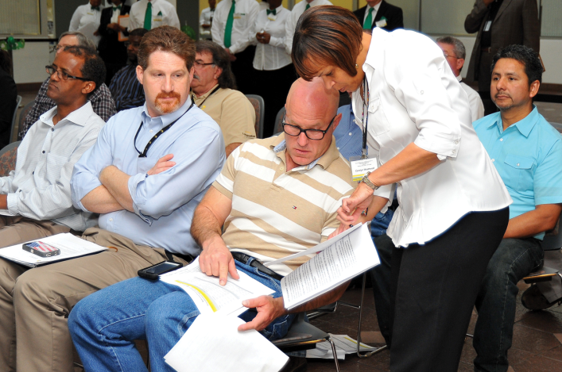
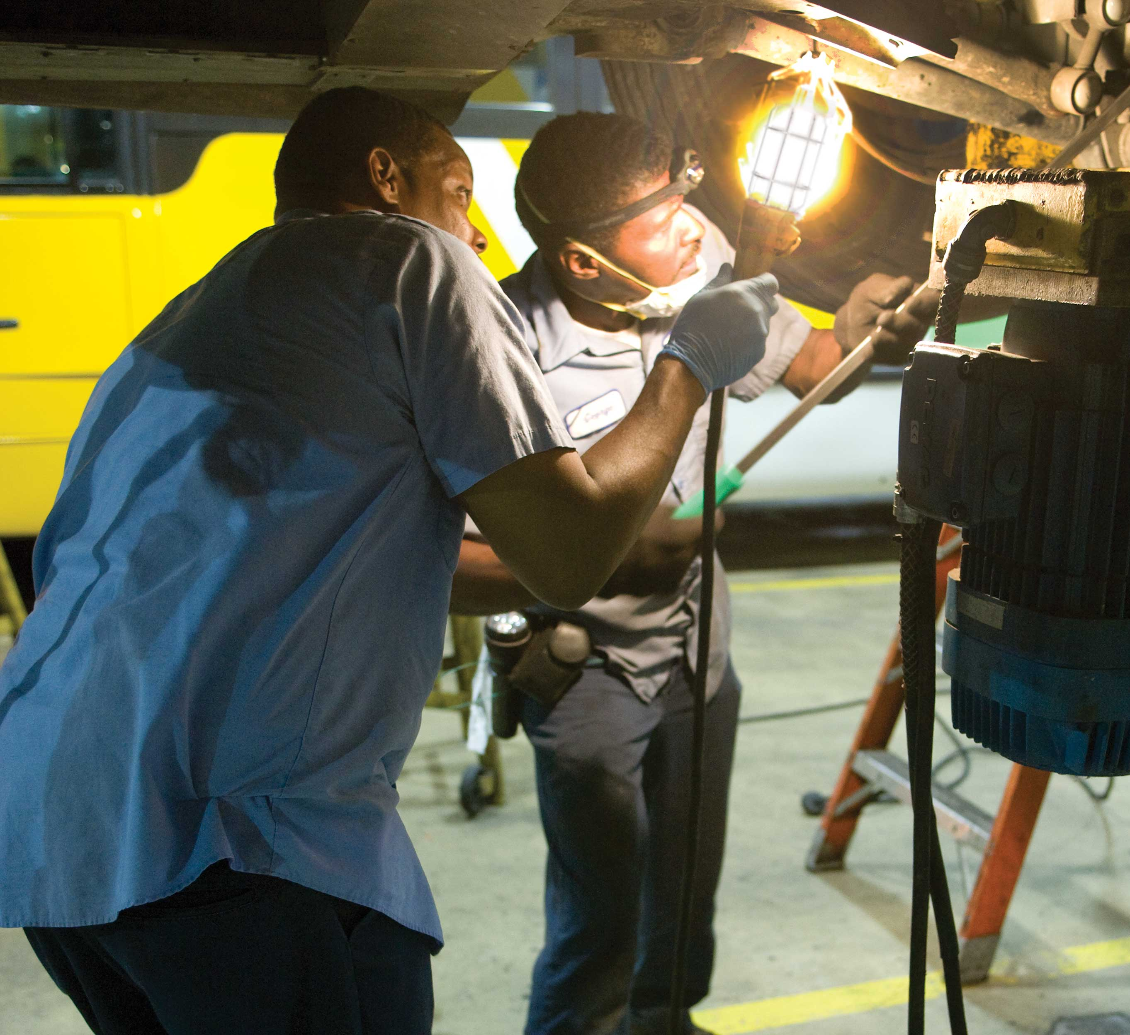
Who We Serve

Slide 9
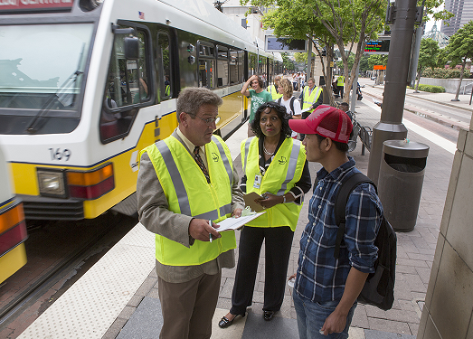
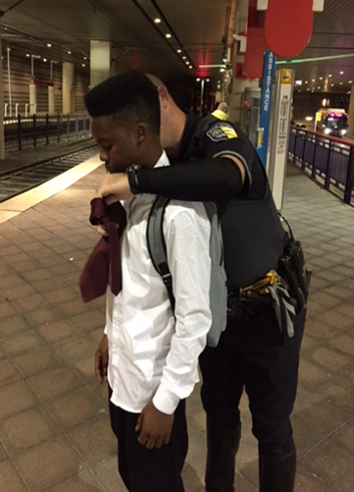
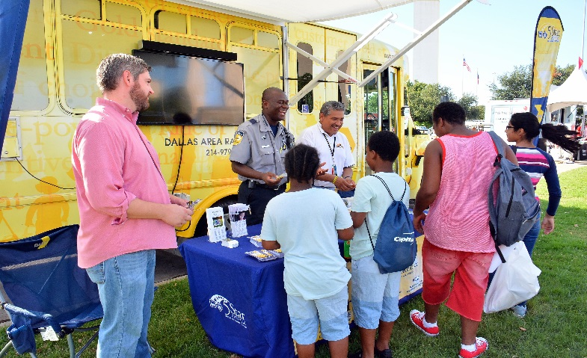
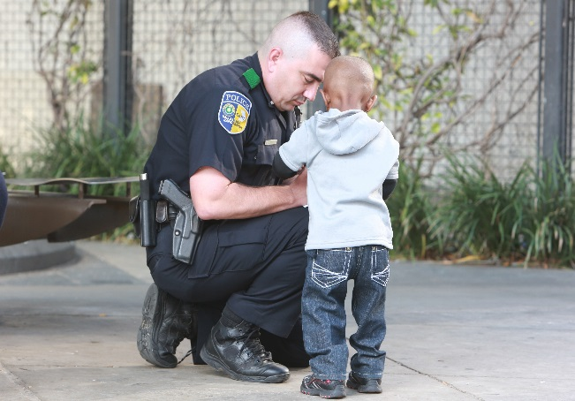
How We Serve

Slide 10
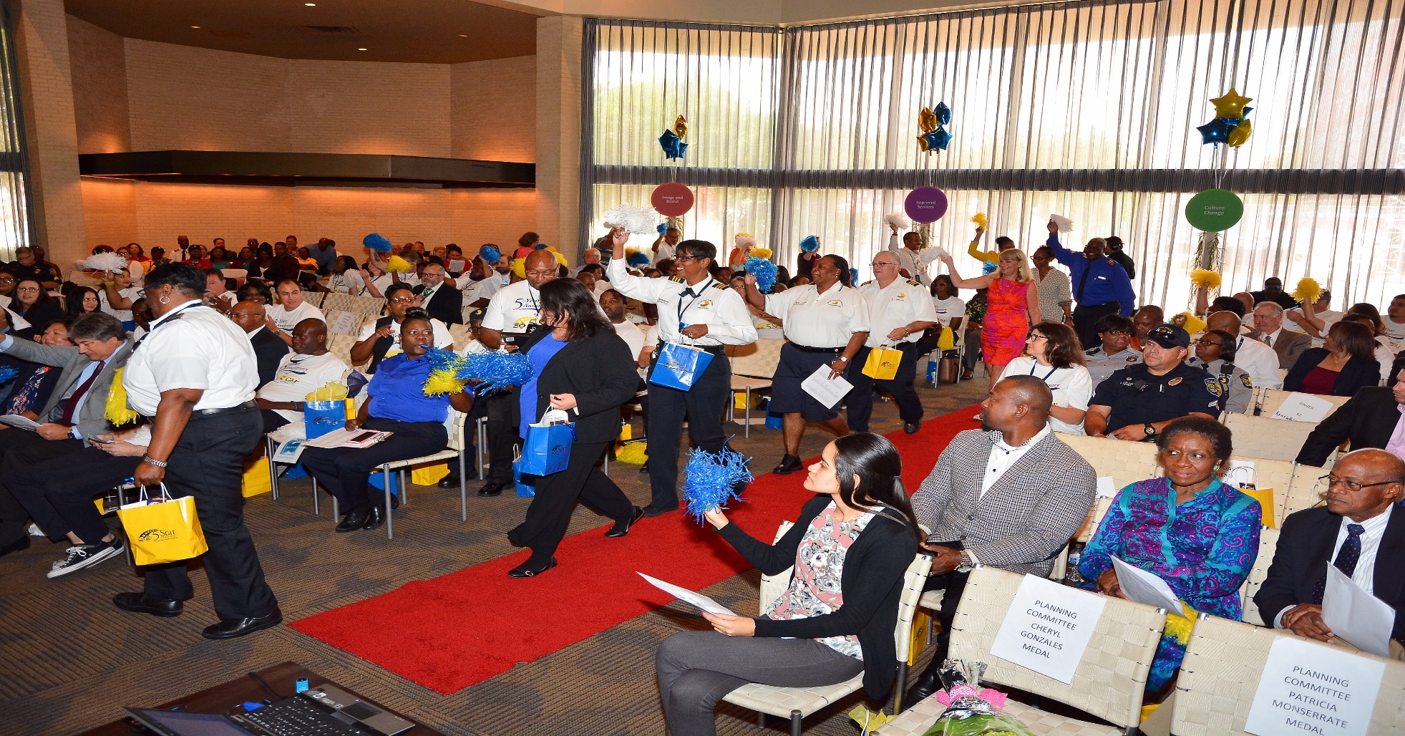
WOW Recognition

Slide 11
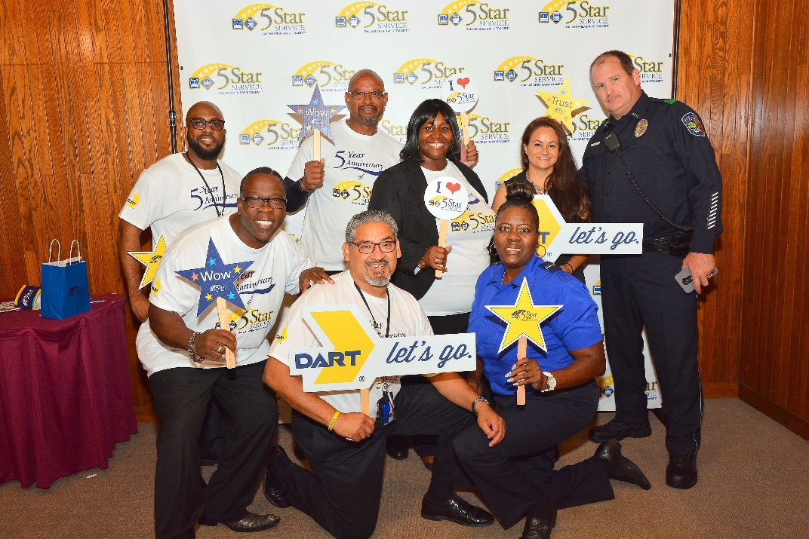
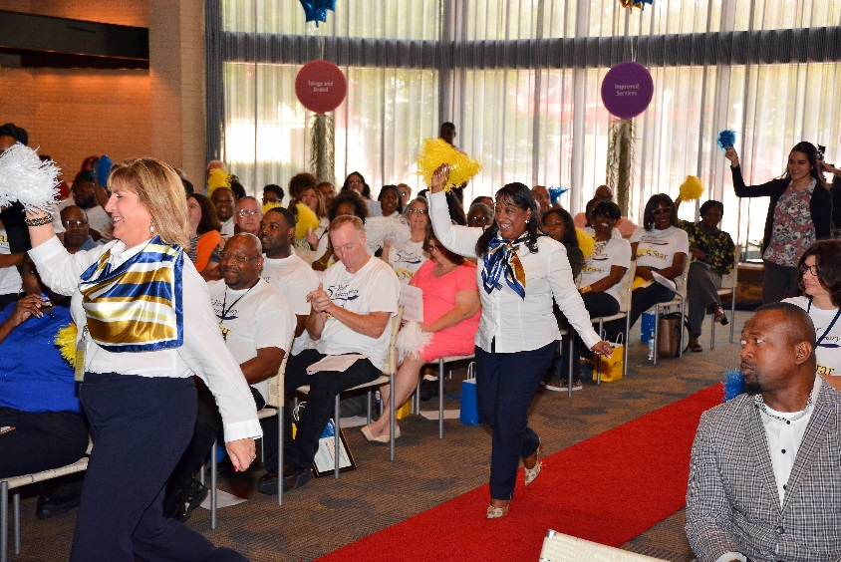
WOW Recognition

Slide 12
5 Star Results
Culture Change of Organization in Progress
New Training and 5 Star Orientation Programs
Key Performance Indicators Improved
Recognitions and Incentives
Customer engagements - Customer service events 10,000 contacts
Continuous Improvements Teams - 19 Successful Program Outcomes
DART Board includes Initiatives in President annual Goals
Departmental 5 Star assessments
Customer Service Events Meet and Greets 10,000 customers
New Training Programs
Improved Service Delays

Slide 14
“5 Star simply put is delivering
SPECTACULAR first class service with a WOW attitude.”
Carol Wise EVP/Chief Operating Officer

Slide 15
The Faces of DART

Slide 16
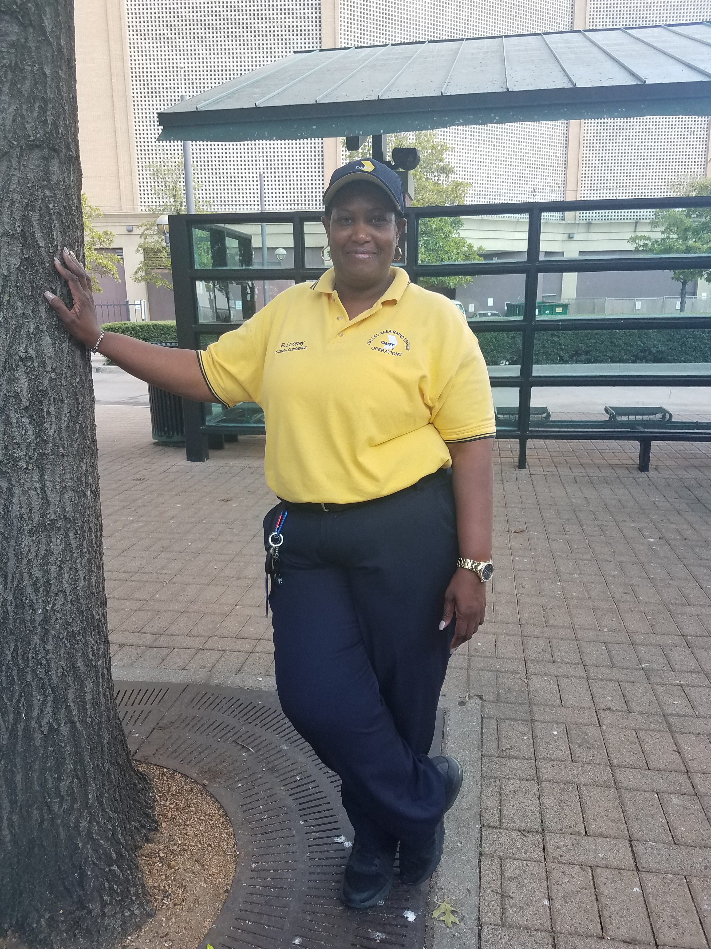
Rozetta Looney "WOWs” Out-of-Town Customer
Notes:
Sean Richardson, Victoria Sims and Carnelius Scott rescued a woman from a crashed vehicle. Won Gold Star Award

Slide 17
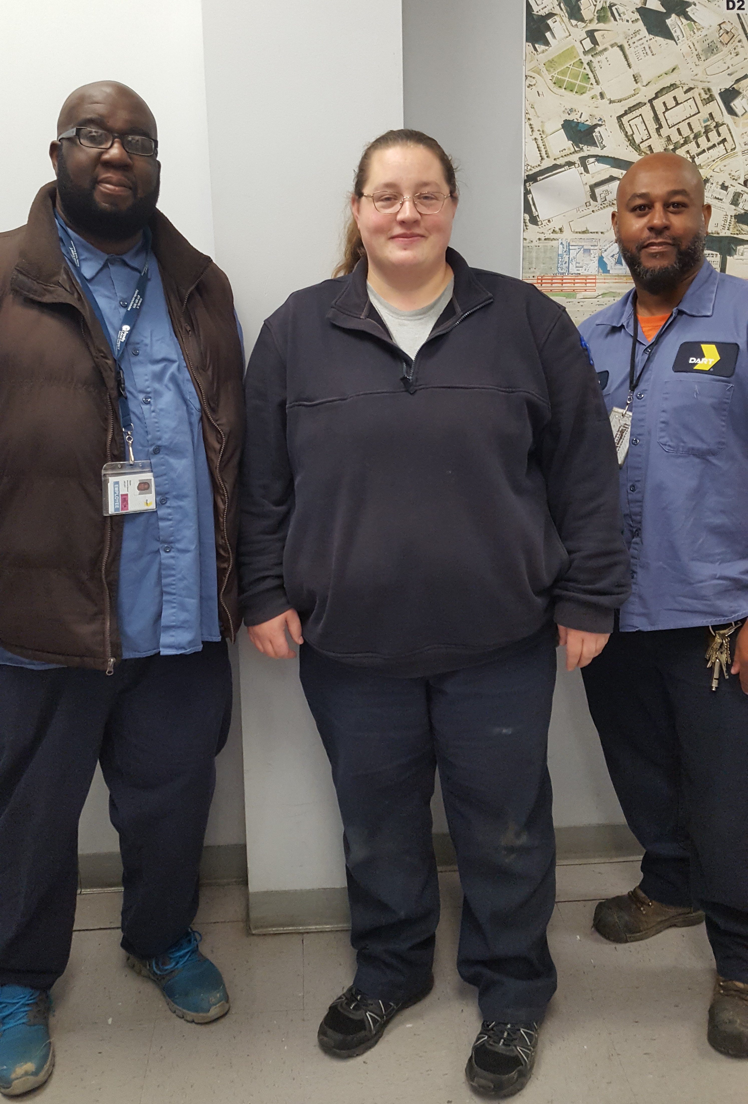
Rail Employees Save a Life
Sean Richardson, Victoria Sims and Carnelius Scott
Notes:
Sean Richardson, Victoria Sims and Carnelius Scott rescued a woman from a crashed vehicle. Won Gold Star Award

Slide 18
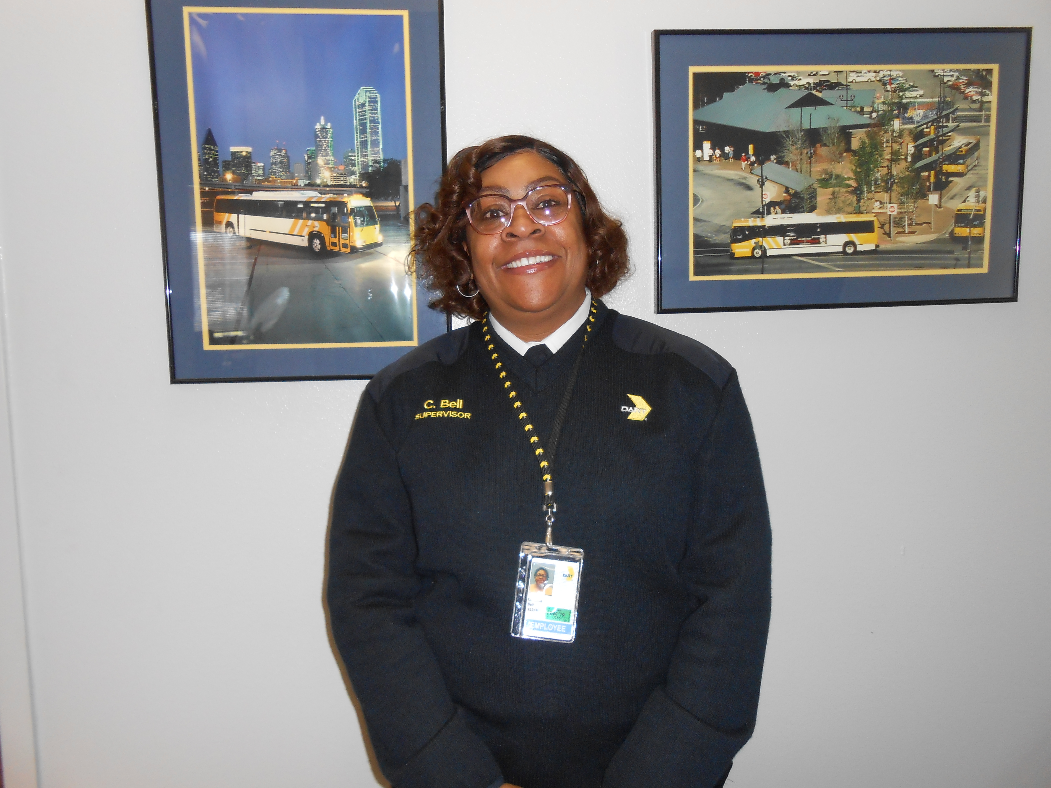
Cliftonia Bell Takes Lost Customer to Job Interview
Notes:
Sean Richardson, Victoria Sims and Carnelius Scott rescued a woman from a crashed vehicle. Won Gold Star Award

Slide 19
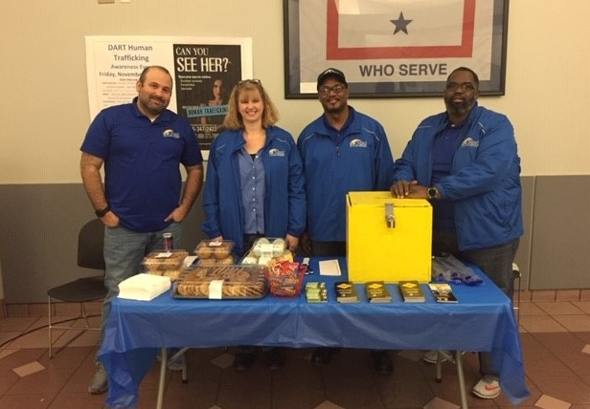
Serving Others
Human Trafficking Fundraiser
Christopher Rodriguez, Shannon Hergenrader, Mervin Anderson, Patrick Rose
Notes:
CEO raises over $1,500 for human trafficking victims

Slide 20
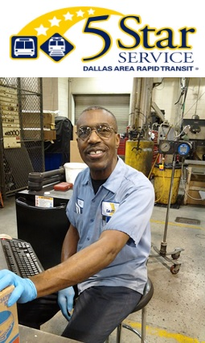
J.R. Steele Exemplifies Trust
Notes:
In the early A.M, J.R. Steele starts and warms up the buses for Operators

