Slide 1
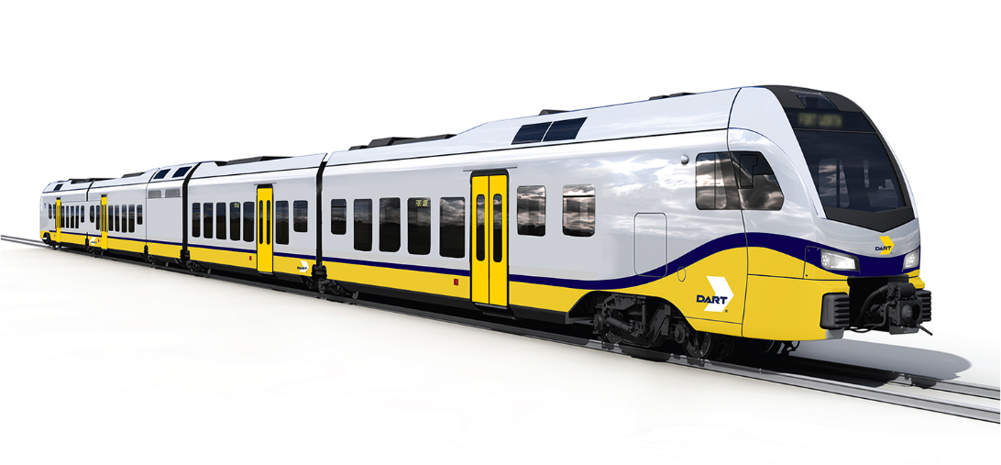
Dallas Area Rapid Transit (DART) Cotton Belt Regional Rail Project
MAX Program Workshop
May 2, 2019
John Rhone
VP Capital Design & Construction
Notes:
JLM first – introduces Tim
Tim opening remarks and introduces team
JR – Tonight we want you to meet the team points of contact; how you can stay informed; understand where we in the project life cycle; and what’s next and how you can be involved.

Slide 2
Project Status

Slide 3
Project Status
12/26/18, DART provided award of contract to Archer Western Herzog Joint Venture (AWH) for design and construction of the Cotton Belt
1/7/19, DART provided a Notice to Proceed to AWH
1/14/19, Kick-off meeting with AWH
2/12/19, the DART Board of Directors authorized a modification to the contract with the design-build contractor (AWH) to include double track for complete corridor
2/21/19, DART provided AWH with the right to access DART ROW for the purpose of preconstruction surveys and data collection to begin 30% design
March 2019 – August 2019, 30% Design
May 2019 – July 2022, Construction

Slide 4
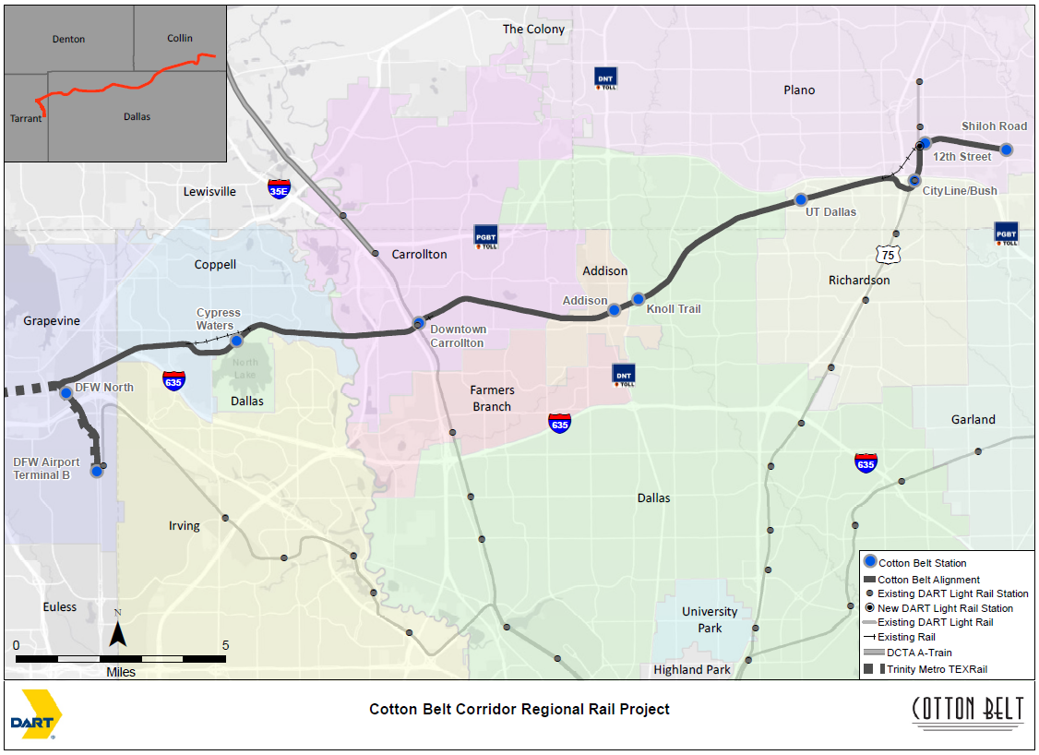
Notes:
26-mile double track, route from Plano to DFW Airport
Seven Cities: Addison, Carrollton, Coppell, Dallas, Grapevine, Plano, and Richardson
10 Stations, including 1 new LRT station at 12th Street
Freight will continue to operate in most of corridor except for North Dallas
Regional connectivity points – TexRail, Orange Line, Green Line, DCTA A-Train, Addison Transit Center, Red/Orange Line

Slide 5
City and Community Engagement

Slide 6
How to Stay Informed
Sign up for project alerts at www.DART.org/cottonbelt
Visit www.DART.org/cottonbelt
DART HOTLINE
972-833-2856
Email Cottonbelt@DART.org
Attend meetings regularly
Mail your Community Engagement Representative

Slide 7
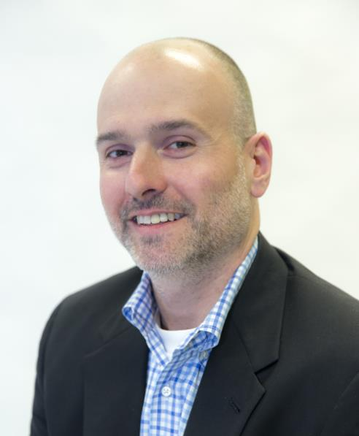
Community Engagement Representative
Chris Walters
cottonbelt@dart.org
214-749-3280

Slide 8
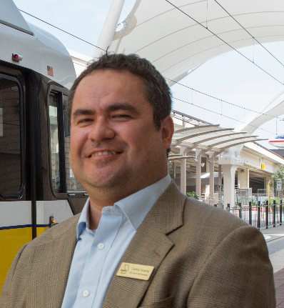
Community Engagement Representative
Carlos Huerta
cottonbelt@dart.org
214-749-2721
Notes:
Next slides are all hip pocket – vehicle slide is buffer in case go to far

Slide 9
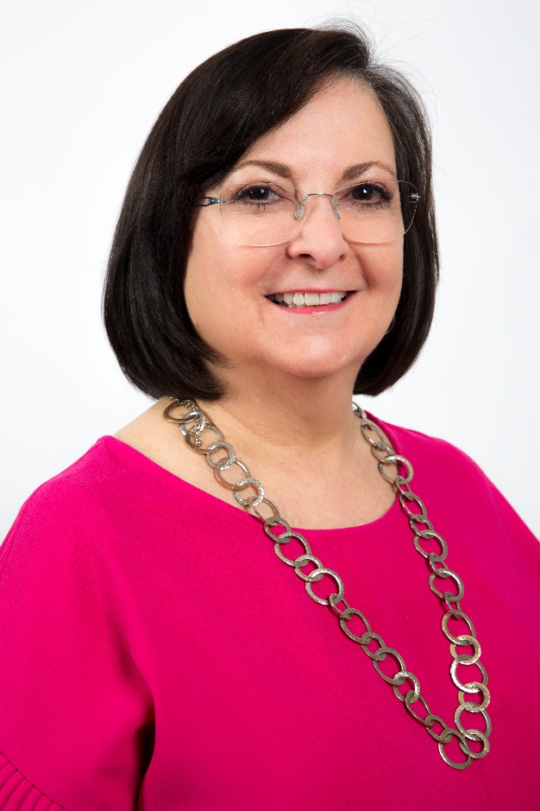
Community Engagement Representative
Rosa Rosteet
cottonbelt@dart.org
214-749-2522

Slide 10
City and Community Engagement
DART Art and Design Program
5 meetings per station
City Coordination
3 meetings with DART/City staff
Community Betterment Workshops
Kick-off meeting plus 3 meetings per neighborhood group
Design and Construction Updates
Monthly and web-based
Quarterly in large groups
Hotline

Slide 11
DART Art and Design Program
Station Meetings
Kick-off meeting
Site tour and key items identified
Artistic value statements and brainstorming (materials, colors, patterns)
Options and estimates presented with feedback and selection
Final presentation of station renderings

Slide 12
DART Art and Design Program Cont.
Predecessor Activities
DART recommendations for site-specific committee members for each station
Design-Builder recommendations for station artists for each station
Approvals of artists and site committee
30-day notice of Art and Design kick-off meetings

Slide 13
DART Art and Design Program Cont.
Station will have elements of continuity and varying elements
Opportunity for community input on varying elements during final design
Platform surface, column finish, pedestrian railing, coatings on steel
Use systematic workshop process to reach consensus within budget
Materials, colors, and patterns

Slide 14
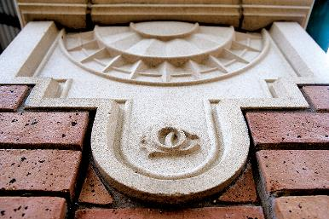
DART Art and Design Program Cont.
Tyler/Vernon Station
Hampton Station

Slide 15
City Coordination
Identify Coordination
City identifies their important items
DART Work With Design-Builder
DART presents on how to address
Report Back
All parties sign-off on coordination

Slide 16
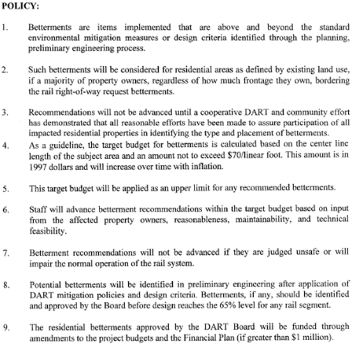
Community Betterments
DART Residential Betterment Policy
DART Board Resolution 970217, October 28, 1997
Residential areas must request betterments. Most requests in excess of budget per policy.
The Betterments Policy has been applied consistently to all corridors since its approval based on requests

Slide 17
Community Betterments Cont.
DART Cotton Belt Betterments
DART Board Resolution 180084, August 28, 2018
Betterments are items implemented that are above and beyond the standard environmental mitigation measures or design criteria identified through the planning, and preliminary engineering process
Walls
Enhanced Fencing
Landscaping

Slide 18
Kick-Off
Workshop #1
Community-wide meeting with all Communities to explain the 3-workshop process
Define betterments
What is important, if feasible
Workshop #2
Workshop #3
Presentation of betterments requested
Review options
Feedback and decisions
Report back to community
Confirm consensus

Slide 19
Community Betterments Cont.
Neighborhood Groupings
Grouped per size of neighborhood
Neighborhoods are considered as apartment complexes, condos, general neighborhoods, schools, etc.

Slide 20
Design and Construction Updates
Recurring Updates
Monthly and web-based
Quarterly with large group throughout the duration of the project
Hotline (coming soon) – for community use to report concerns
Cotton Belt email address: cottonbelt@dart.org
Website: https://www.dart.org/cottonbelt
Cotton Belt updates / alerts: www.DART.org/MyDARTUpdates

Slide 21
Interface with Others

Slide 22
Interface with Others
Dallas Garland Northeastern Railroad (DGNO)
Fort Worth & Western Railroad (FWRR)
Kansas City Southern (KCS)
Union Pacific Railroad (UPRR)
BNSF Railway Company (BNSF)
Trinity Metro / TEXRail

Slide 23
Interface with Others Cont.
North Texas Tollway Authority (NTTA)
Texas Department of Transportation (TxDOT)
North Central Texas Council of Governments (NCTCOG)
North Dallas Eruv
Dallas-Fort Worth International Airport (DFWIA)
Other Cities

Slide 24
Other Coordination
Hike & Bike Trail
Critical areas and funding
Other areas and funding
Quiet Zones Coordination
Application Process
Submitted by City
Supported by DART

Slide 25
Notes:
Buffer so hip pocket slides do not accidently show

