Slide 1
DART Station Art and Design Program
2019 MAX Program
May 2, 2019
David L. Ehrlicher, AIA
AVP, Capital Program Delivery

Slide 2
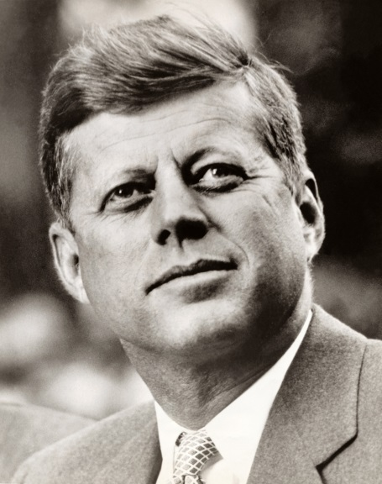
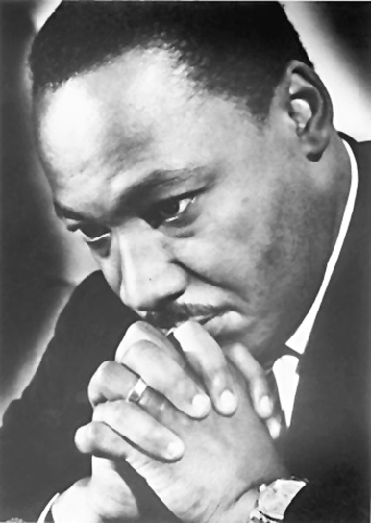
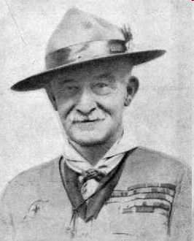
Vision “Nothing happens unless first a dream.” Carl Sandburg
Notes:
Part of your assignment before coming to this course was to think about your own VISION of future success, especially as it relates to Scouting.
Likewise, earlier today during the discussion of the Aims of Scouting, you were asked to think of young people who are currently involved with Scouting and to imagine them years in the future.
That's how VISION begins--thinking about what we can offer young people today through Scouting that will have a positive impact on their lives in 10, 20, or 30 years
That's a VISION that challenges each of us to do something of value for the future. Through Scouting, that vision encourages each of us to plant acorns.
Consider these VISIONS: John F. Kennedy; Martin Luther King, Jr.; Baden-Powell

Slide 3
Mission “Acting in accord with our beliefs and values is one of the greatest challenges each of us faces every day. “It’s true for individuals in all aspects of life . . . And equally true for organizations of every kind and size.” Eric Harvey and Alexander Lucia
Notes:
Part of your assignment before coming to this course was to think about your own VISION of future success, especially as it relates to Scouting.
Likewise, earlier today during the discussion of the Aims of Scouting, you were asked to think of young people who are currently involved with Scouting and to imagine them years in the future.
That's how VISION begins--thinking about what we can offer young people today through Scouting that will have a positive impact on their lives in 10, 20, or 30 years
That's a VISION that challenges each of us to do something of value for the future. Through Scouting, that vision encourages each of us to plant acorns.
Consider these VISIONS: John F. Kennedy; Martin Luther King, Jr.; Margaret Thatcher; Baden-Powell

Slide 4
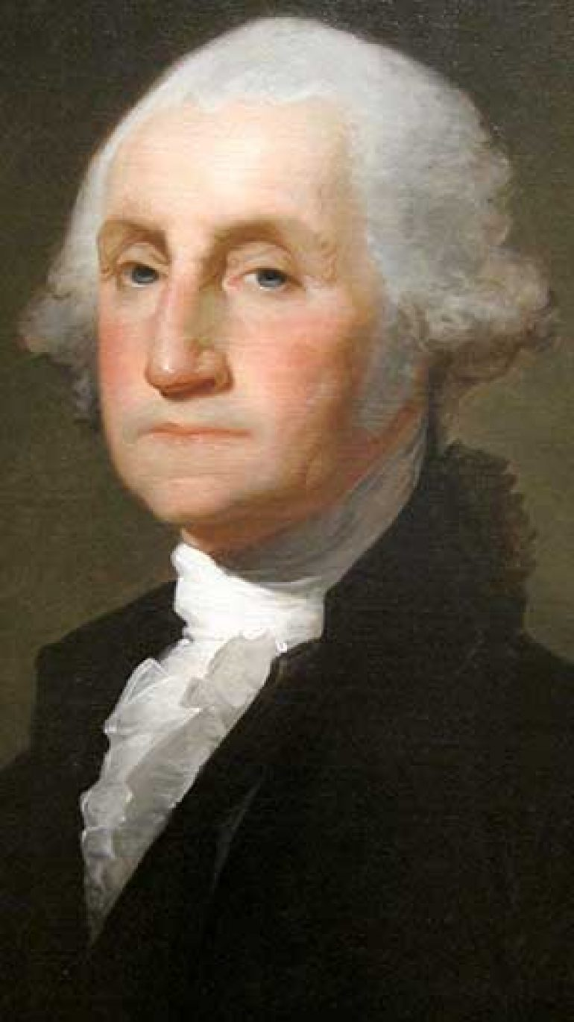
Values “Leadership turns on a sense of character and common purpose” Patrick Garrity and Matthew Spalding

Slide 5
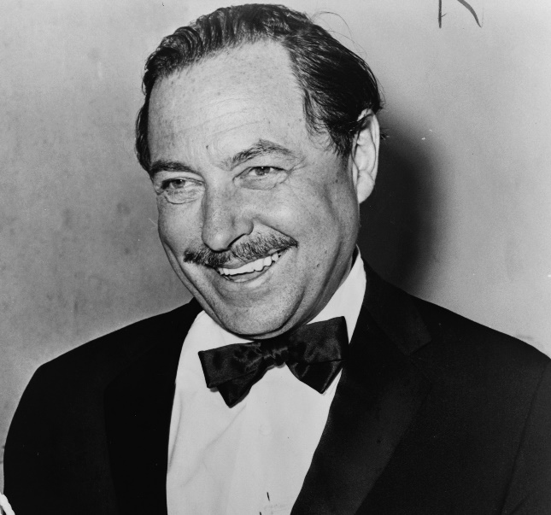
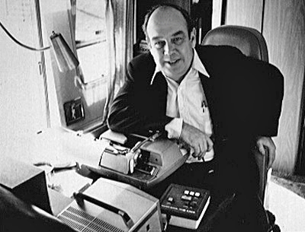
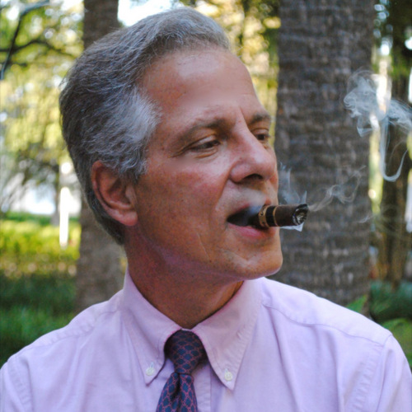

Slide 6
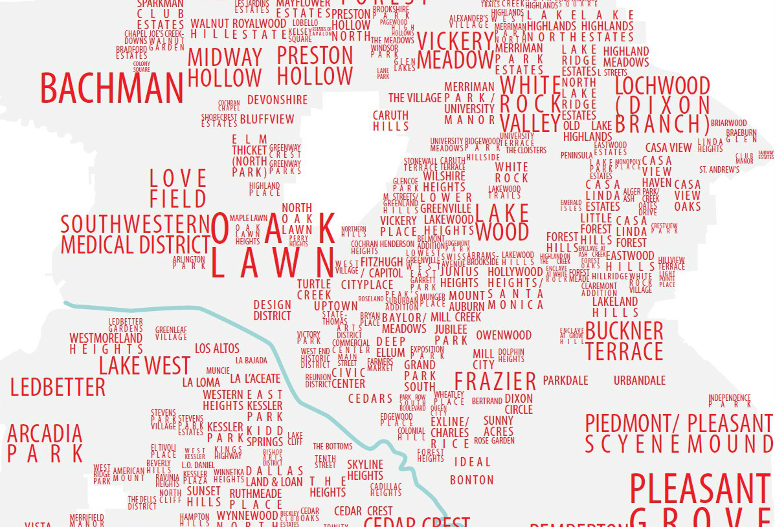

Slide 7
Connected
Divided
Re-connected

Slide 8
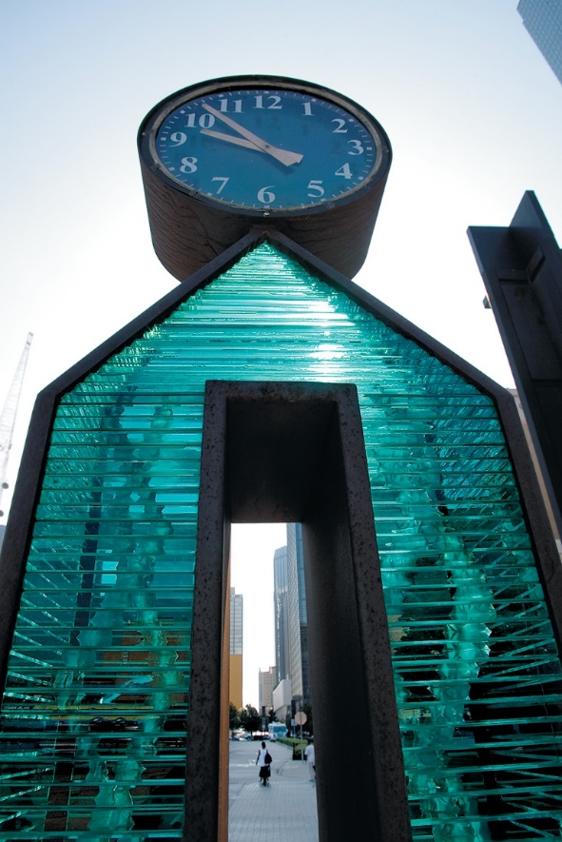
DART Station Art and Design Program
NEPA and FTA Funding
Involve the public at every phase of the project
DART Board Guiding Principle
Ensure maximum community participation

Slide 9
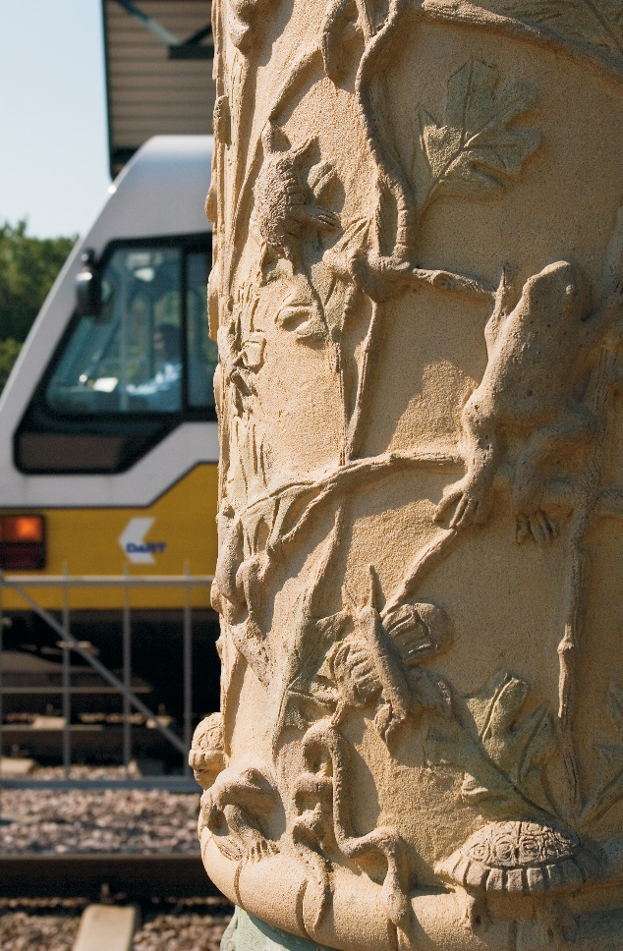
DART Station Art and Design Program
The DART Board established the Art & Design Program in 1987, recognizing art as an integral part of our society and our build environment.
DART is building a transit system to link communities of this region, and an effective public art program will enhance those linkages.

Slide 10
About the DART Art & Design Program
On December 8, 1987 (resolution No. 870103), the Board approved the DART Art and Design Program and authorized the President/Executive Director to take all actions necessary for its implementation.
On June 12, 1990 (resolution No. 900086), the Board approved the revised DART Art and Design Program and authorized the President/Executive Director or his designee to implement it.

Slide 11
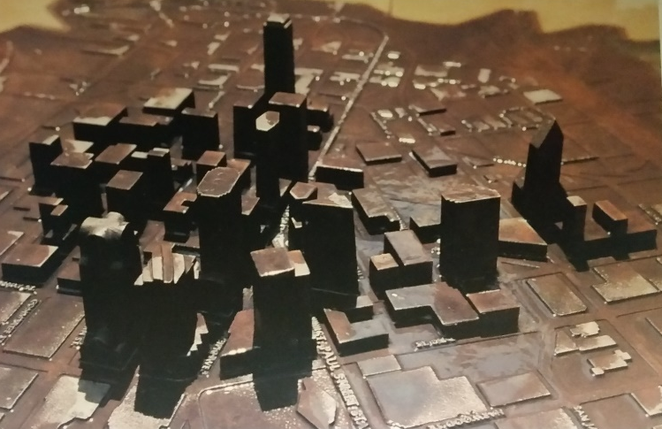
DART Station Art and Design Program
Program Process
Start at Beginning of Design
Systematic
Series of Workshops
Consensus-based
Collaborative

Slide 12
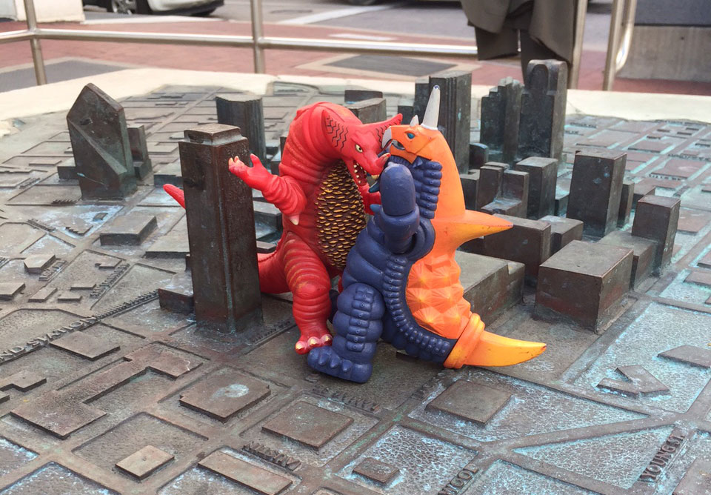
DART Station Art and Design Program
Cities in DART service area will provide input and approvals
Site Specific Committee
Station Artist
Participants collaborate with
Architect
Landscape Architect
DART Program Coordinator

Slide 13
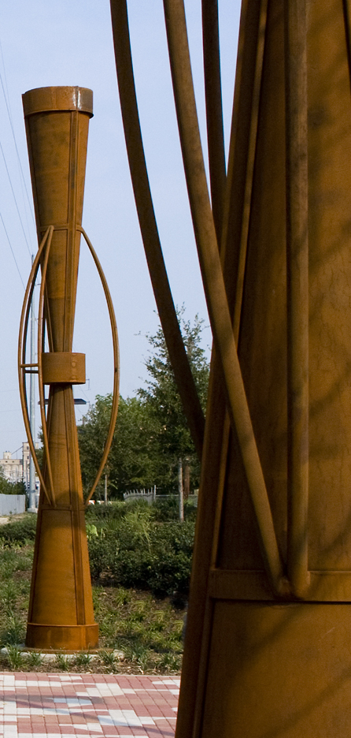
DART Station Art and Design Program
Orientation
Site Visit
Show and Tell What is Important
Workshop 1
Artistic Value Statement
Workshop 2
Select from Options
Report Back

Slide 14
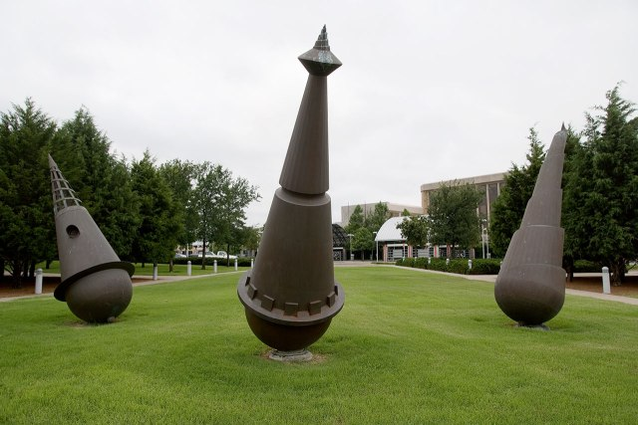
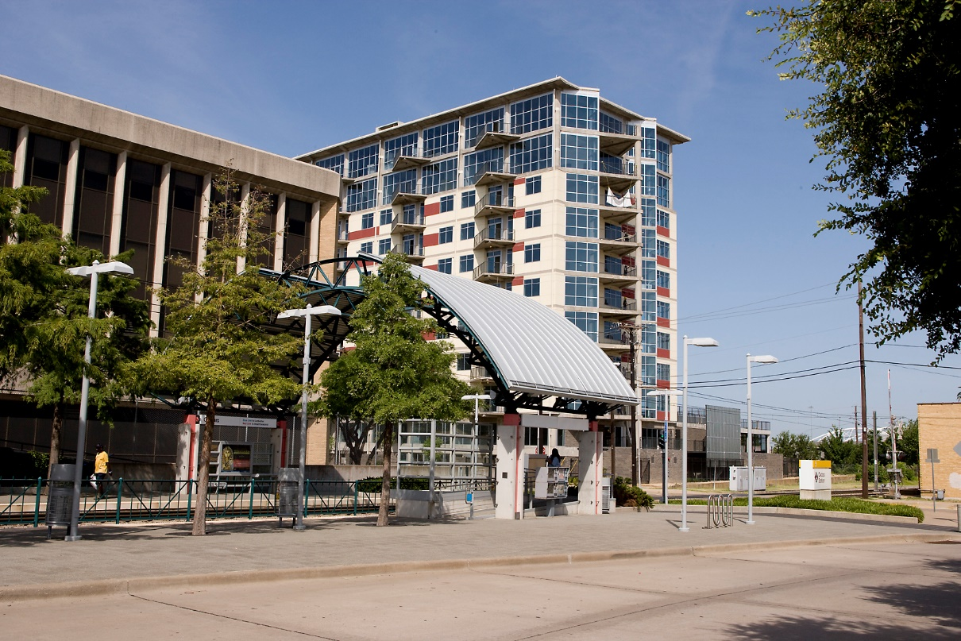
Cedars Station
Notes:
Cedar’s Station reflects the neighborhood’s urban and industrial character, station design incorporates the repeated use
of steel and concrete, featuring silver metallic canopies clad with polished architectural precast concrete and brightly
painted steel supports.
Carousel by Tom Stancliffe
Series of three freestanding forms fabricated in sheet bronze.
Ranges from 12’ – 13’ high and 4’ – 5’ in diameter at the base.
The abstract sculptures recall the conical form of cedar trees that once reigned in profusion around the community.
The cones feature a decorative design, a reference to the ornate sensibility of the Victorian era.
The sculptures deliberately use downtown Dallas as a backdrop, symbolically linking the neighborhood to a new
Partnership with the Central Business District.

Slide 15
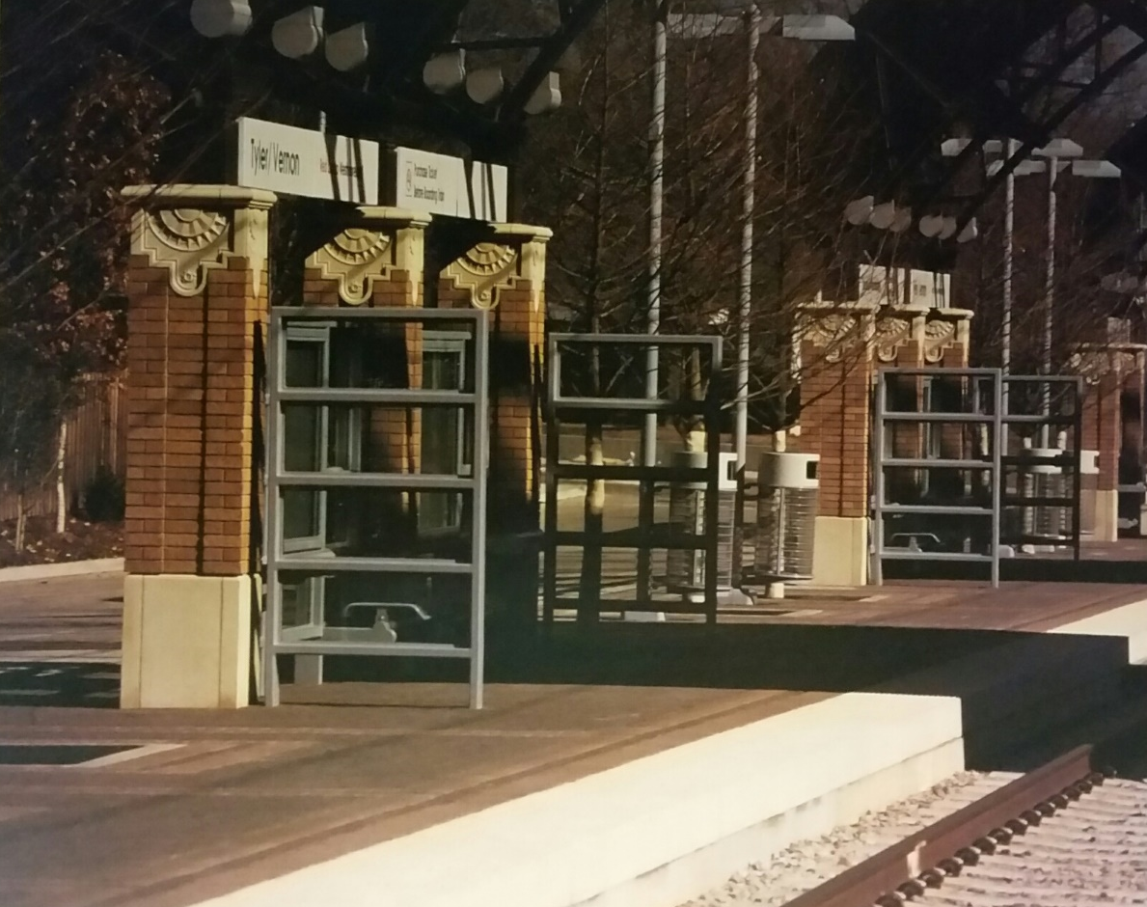
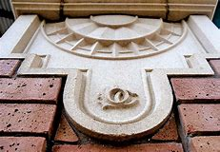
Tyler Vernon Station
Notes:
Tyler Vernon Station is located in a predominantly residential, culturally diverse community near the old
Oak Cliff “downtown” – an area historically designated because of its noteworthy architecture, dating
from the 1920s and 1930s.
The community committee and design team wanted the station to translate the historic district’s
architectural elements – notably its brickwork detailing – on a smaller scale, harmonizing with the neighborhood.
The station art embraces the concept of community – ranging from the development of rural Texas life to
the growth of a proud, mature neighborhood.
“A Community Honored” by Judith Inglese
Mural composed of four panels rendered in handmade, low-bas relief, terra-cotta ceramic tiles cut in free
form shapes … 140’ long x 4’6” high.
This is the 2nd mural section, which traces the state’s “confluence of cultures” – Native Americans, Hispanic
settlers, African American and Anglo pioneers, and European and Asian immigrants who settled Texas.

Slide 16
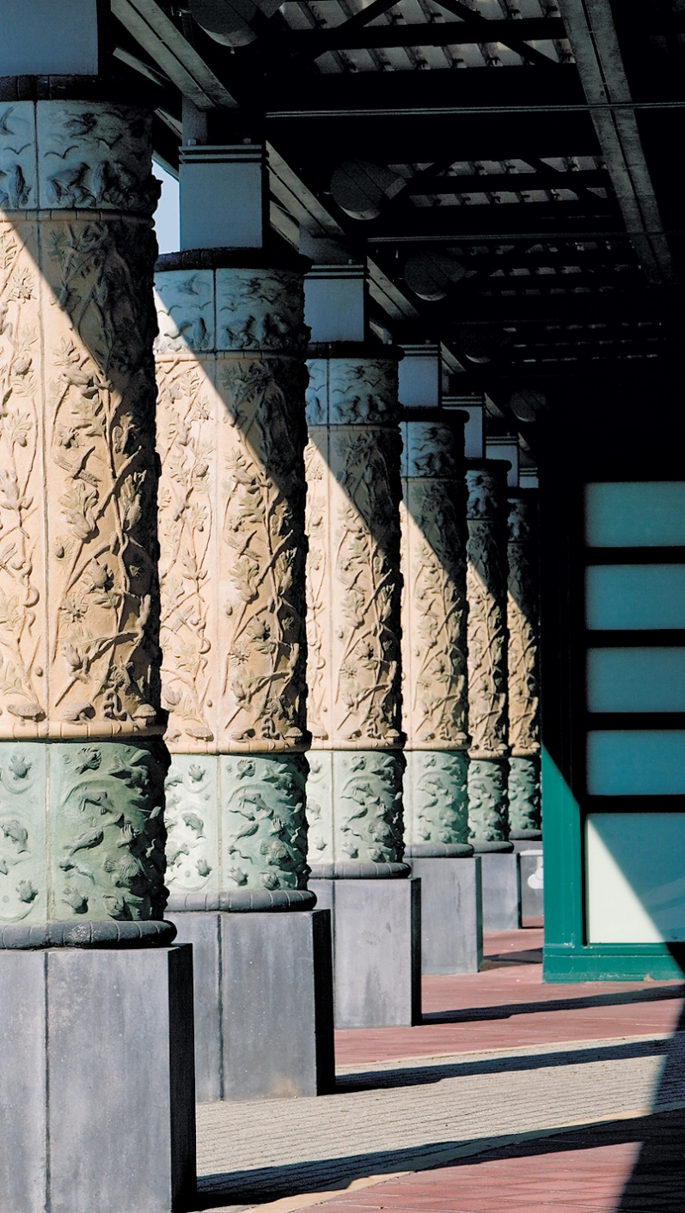
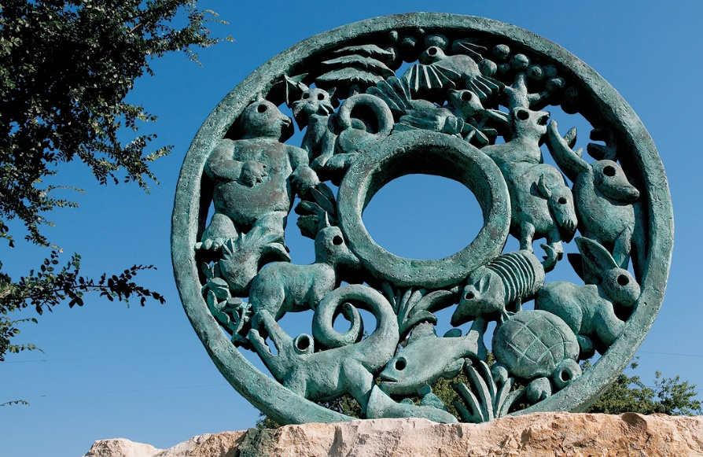
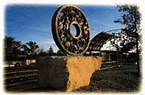
Hampton Station
Notes:
Hampton Station is located in a mature West Oak Cliff neighborhood, long known for its strong sense of community and family ties.
The creek concept, as suggested by landscaping design, begins at the station’s perimeter wall and continues across the parking lot
and station platform.
“United” by Edwin McGowin (round artwork)
Verdigris cast bronze circular form on a rough cut native stone pedestal 10’ high x 72” wide.
Sculpture incorporates stylized animals and vegetation native to the Elmwood Creek area,
Harmonizing with the arches of the station’s canopies and suggesting a “circle of life” in
Society as well as nature.

Slide 17
MLK, Jr. Station
Notes:
MLK, Jr. Station continues thematically where the adjacent J.B. Jackson, Jr. Transit Center leaves off:
telling the story of the community that surrounds it.
Symbols from African kuba cloths are used on both the walk and column cladding to symbolize such
concepts as unity, respect, wisdom and understanding.
The photos tell the story of the city’s African American community during the turbulent times of
Dallas’ civil rights era.
Sculptor Steve Teeters created two 17’ African “talking drums,” historically used for storytelling and
long-distance communication. Just as these drums helped to pass ideas in African culture, the ideas
of Martin Luther King, Jr. live on for present and future generations through this station’s artwork.

Slide 18
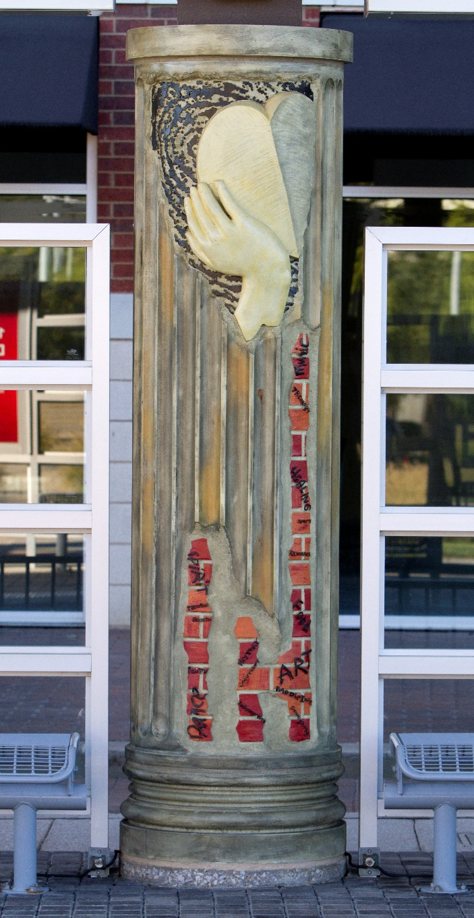
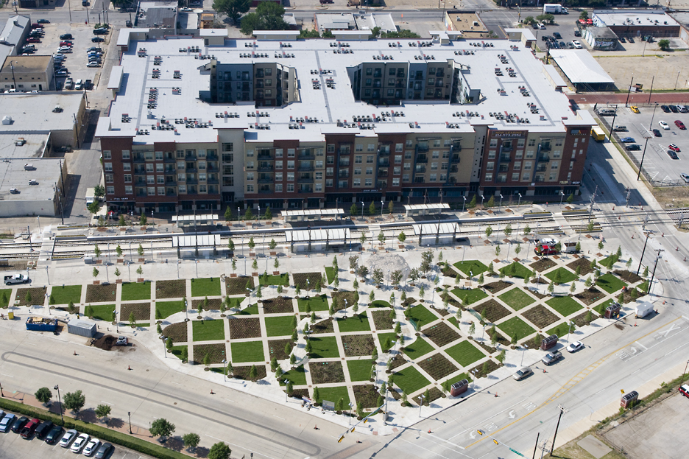
Baylor University Medical Center Station
Notes:
The concept at Baylor University Medical Center Station unites the century-old hospital campus with the
Equally historical Deep Ellum neighborhood. The station is conceived as a vibrant public space and includes
a two-acre plaza that can be many things to many people – a play area, a retreat for hospital visitors and
Employees or a respite for commuters.
The columns contain a collage of elements reflecting the architecture and character of Deep Ellum and
Baylor, including the image of a heart in hands and EKG. The basic fluted column shape is a reference to
The original Baylor Hospital columns, while the surface of the column erodes to reveal brick, much like
you might find on the façade of a building in Deep Ellum.
The paving of the area is quite unite, containing an imprint of a giant fingerprint, with five paths
radiating from it. Each of these paths represent one of the five senses.

Slide 19
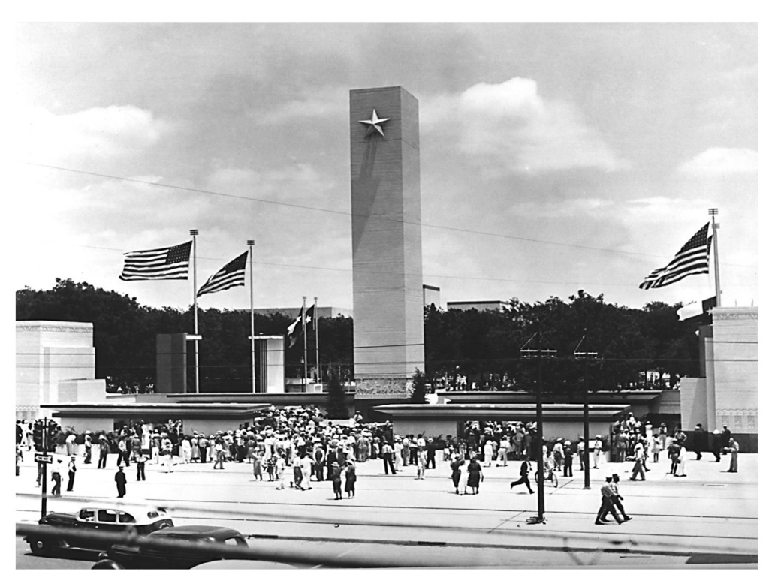
Fair Park Station
1936 - Ticket Booths at Entrance
Today -Station Canopy at Entrance
Notes:
Built for the 1936 Texas Centennial Exposition, the grand exhibit halls and esplanade of Fair Park constitute
the only intact and unaltered pre-1950s world fair site in the United States. Until 1956, trolleys served
the fairgrounds with a stop at the main entrance on Parry Ave. The Green Line’s Fair Park Station is
situated right where that original trolley stop was, more than half-century ago.

Slide 20
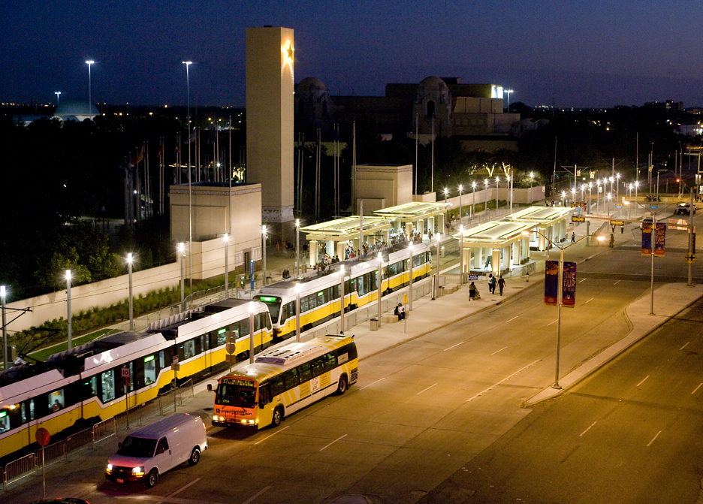
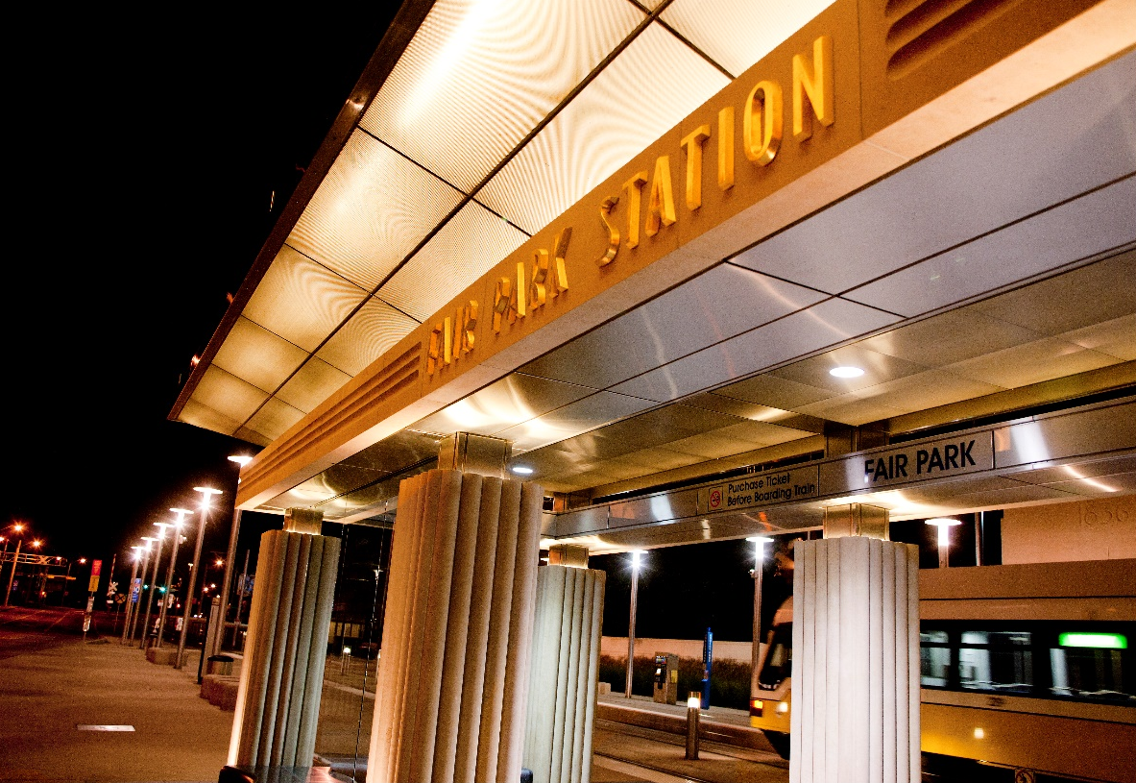
Fair Park Station
Notes:
Built for the 1936 Texas Centennial Exposition, the grand exhibit halls and esplanade of Fair Park constitute
the only intact and unaltered pre-1950s world fair site in the United States. Until 1956, trolleys served
the fairgrounds with a stop at the main entrance on Parry Ave. The Green Line’s Fair Park Station is
situated right where that original trolley stop was, more than half-century ago.

Slide 21
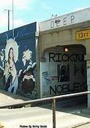
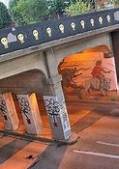
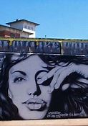
Deep Ellum Gateway
“Traveling Man”
Notes:
Dubbed “The Deep Ellum Gateway Project,” Brandon Oldenburg of Deep Ellum’s own Reel FX Creative
Studios and Brad Oldham of Dallas-based Brad Oldham, Inc., won the commission in 2007. The result,
a three-part stainless steel sculpture series called The Traveling Man, delivers spectacularly, guiding
the eye to Deep Ellum.

Slide 22
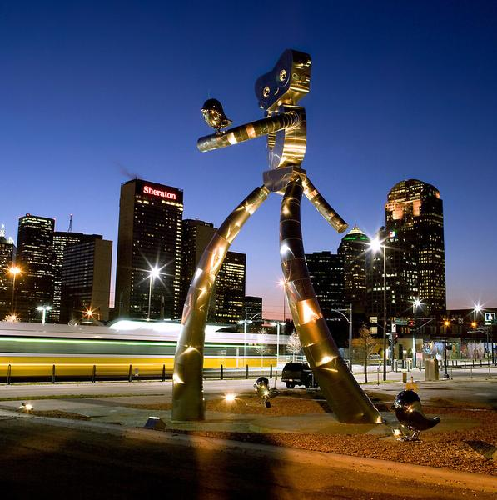
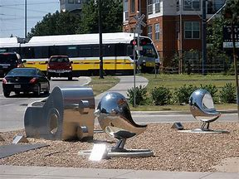
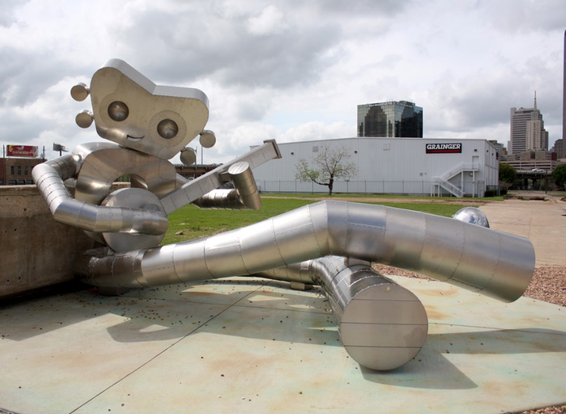
Deep Ellum Gateway
“Traveling Man”
Notes:
Dubbed “The Deep Ellum Gateway Project,” Brandon Oldenburg of Deep Ellum’s own Reel FX Creative
Studios and Brad Oldham of Dallas-based Brad Oldham, Inc., won the commission in 2007. The result,
a three-part stainless steel sculpture series called The Traveling Man, delivers spectacularly, guiding
the eye to Deep Ellum.

Slide 23
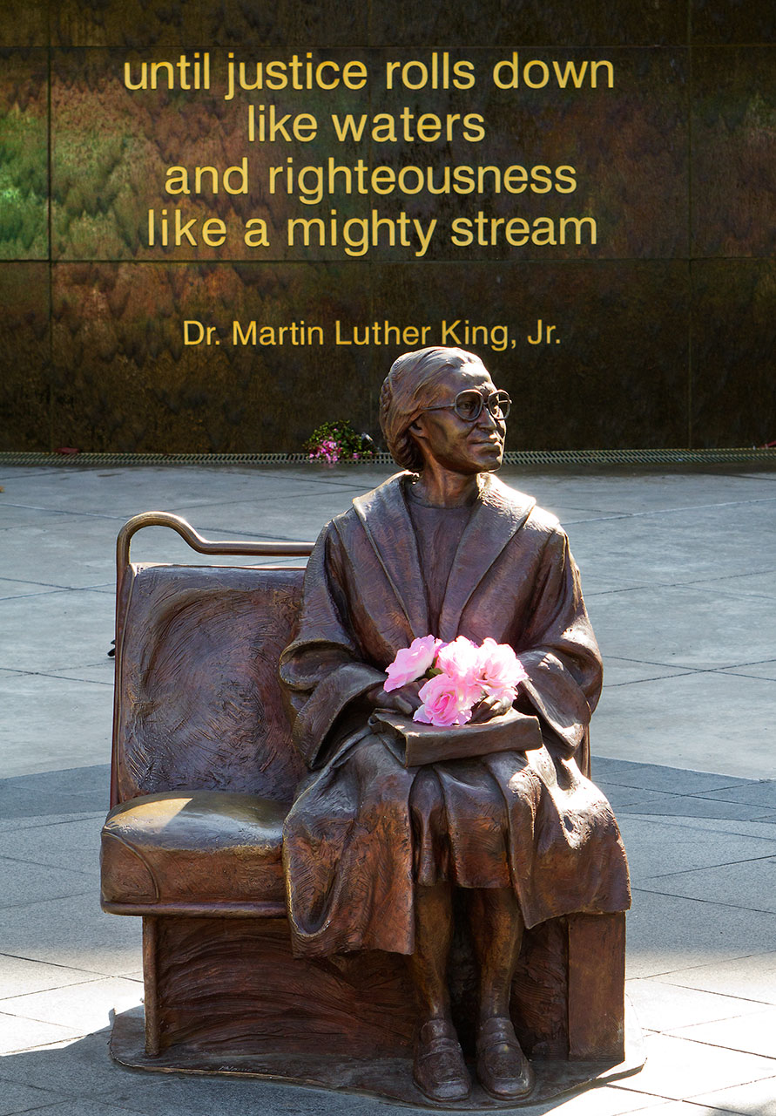
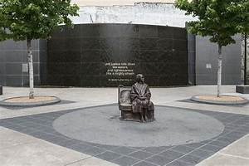
Rosa Parks Plaza

Slide 24
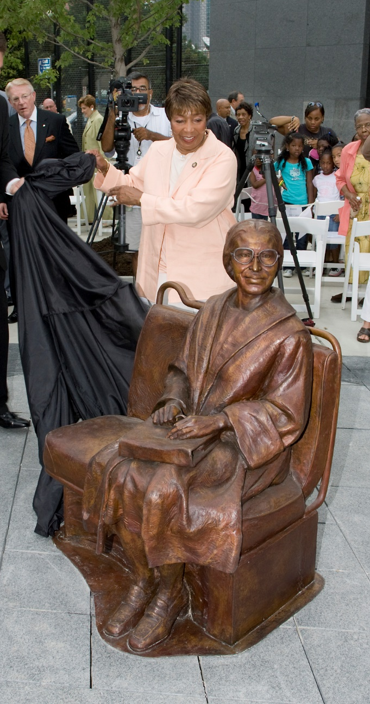
DART Station Art and Design
Go!
Ride!
See!

