Slide 1
Light Rail Vehicle [LRV]
Replacement / Rehab
Program Update
2019 MAX Program –
Engineering Briefing
Presented by:
Darryl E. Spencer, P.E.
Sr. AVP, Engineering
Updated: May 1, 2019

Slide 2
PRESENTATION OUTLINE
Executive Summary
Consultant’s Assessment Highlights
Program Budgetary Options Review
Projected Delivery Schedule
Staff Recommendation
LRV OEMs
ELT Charge & Amended Review

Slide 3
Executive Summary
WSP | Parsons Brinckerhoff Assessment (2016)
Assessment’s Scope
  Focus on the oldest three fleets (95 cars)
  Flt. 50, 51, & 52
  Approaching end-of-life
LRV Representative Sample
  Oldest vehicles within the Fleet
  Highest mileage vehicles within the Fleet
Assessment’s Purpose:
  Assess options available to DART:
    Purchase New
    Overhaul Vehicles (under EOLEP)
    Combination of 1 & 2
  All Options require competitive procurement.
LRV Sub-Fleets Reference Table
Fleet | Quantity | Year Entered Service | 30-Yr. Life Cycle
Fleet 50 | 40 | 1995 | 2025
Fleet 51 | 34 | 1997 | 2027
Fleet 52 | 21 | 1998 | 2028
Fleet 53 | 20 | 2008 | 2038
Fleet 54 | 48 | 2010 | 2040

Slide 4
Consultant’s Assessment Highlights

Slide 5
WSP | Parsons Brinckerhoff’s Report

Slide 6
PB Engineering Report Review
LRV Physical Inspections
Under Car
Roof
Interior
Exterior - Mechanical/Electrical/Structural
Non-Destructive Testing (NDT)
  Carbody Underframes (3)
  Bolsters (10)
  Trucks (10) / Journal Brg Housings
New and/or EOLEP Choices
  New Replacement by 2025/2027/2028
  EOLEP -- Extend the current useful life of the vehicles from 30 years to 45 years

Slide 7
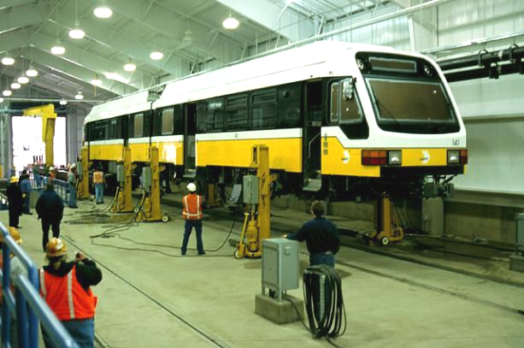
DART 12 LRVs Inspected

Slide 8
Exterior Body Condition Assessment
Exterior Sheet Corrosion & Coating Failure
Corrosion in Door Pocket Area
Thickness of Body Filler applied during Construction

Slide 9
Exterior Body Condition Assessment (cont.)
Corrosion at Base of
Passenger Window
Corrosion on Cab Roof Cap

Slide 10
Truck Frame NDT
(Insert:)
Truck Weldment NDT
Underbody & Truck Frame Structure
NOTE: Fully-compliant for EOLEP

Slide 11
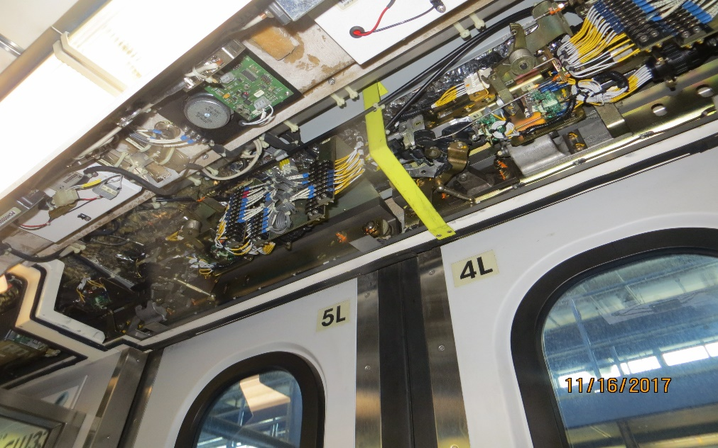
Doors Technology Upgrade
Recommendation DOOR-3
Additional indications should be added to door operation. Both visual and audible indications of door closing should be installed on a local per door basis. Such indicators should be active even on a reclose of the door after reopening due to sensitive edge activation. “Door Out of Service” should be indicated to passengers both externally and internally.
Additional door indications are not currently included in the DART Capital Works Program. This is not considered to be necessary to meet the requirements of the EOLEP.

Slide 12
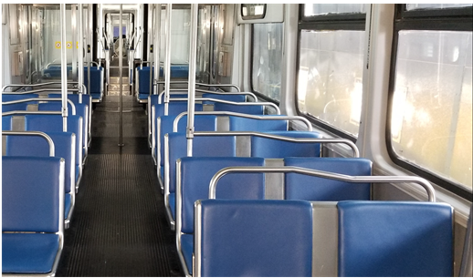
Technology Upgrades
LRV 190 Vinyl Seats – shop test
Interior Condition Assessment
LED Lighting System Upgrade
Route Destination Sign System Upgrade
NOTE: Front & Side Roller Curtain Destination Signs -to- New LED/LCD Electronic Signs.
Operator’s Cab

Slide 13
New Digital Line System Map Displays
NOTE: LED system Line maps or LCD map displays to enhance passenger communications and also meet the new ADA requirements.
Train Operator Display (TOD) Upgrade
NOTE: Eliminates most of the console switches and indicators.

Slide 14
WSP|PB Engineering Review [In Sum…]
LRV Physical Inspections
12 DART LRVs
Electrical / Mechanical / Structural / Vehicle Systems (Doors, Seats, Wheels, Motors, etc.)
Structurally above average
Non-Destructive Testing (NDT)
Critical Areas Inspected/Results
Carbody Underframes (3) / Bolsters (10)
Trucks (10) / Journal Brg Housings
No Apparent Fatigue / Cyclic Loading / Defects
New and/or EOLEP Choices
Replacing existing LRVs with NEW and/or Extending Life for another 15-yrs thru EOLEP, is a Sustainable Practice for Vehicle Long-term SGR.

Slide 15
Program Budgetary Options Review
  I. NEW (95 LRVs)
  II. EOLEP (Rehab)
  III. Combo/Mix (New/EOLEP)
  IV. New (85 LRVs)
  V. DO NOTHING”

Slide 16
  DART FP Snapshot
  Project Cost Model
  Projected Impact w/ Options/Scenarios Overlay

Slide 17
Scenario - I
[Purchase NEW – All 95 cars]
Item No. | Source Category | Description
1 | DART FP | Contact the Following for “$” values Darryl Spencer; dspencer@dart.org Marvin Hurt; mhurt@dart.org
2 | WSP | PB Cost Est. | $ For questions regarding detail entry, refer to the above DART contacts
3 | DART Support Cost Est. | $ For questions regarding detail entry, refer to the above DART contacts
4 | Delta (Deficit) | $ For questions regarding detail entry, refer to the above DART contacts
5 | Comments / Notes / Assumptions | Flt. 50 [New]: $X.XM Flt. 51 [New]: $X.XM Flt. 52 [New]: $X.XM Applicable CY: 2025 – 2028 PROS (Rewards) CONS (Risks) Enhanced Service Reliability ⇨ Project Schedule Adherence Components/Assets Life Extension ⇨ Removes Flt 52 IGBT ($6M) Investment Industry Support Alleviates Obsolescence Customer Satisfaction Quality Assurance FTA ADA Upgrades Parts Availability

Slide 18
Scenario - II
[EOLEP – All 95 cars]
Item No. | Source Category | Description
1 | DART FP | Contact the Following for “$” values Darryl Spencer; dspencer@dart.org Marvin Hurt; mhurt@dart.org
2 | WSP | PB Cost Est. | $ For questions regarding detail entry, refer to the above DART contacts
3 | DART Support Cost Est. | $ For questions regarding detail entry, refer to the above DART contacts
4 | Delta (Savings) | $ For questions regarding detail entry, refer to the above DART contacts
5 | Comments / Notes / Assumptions | Flt. 50 [EOLEP]: $X.XM Flt. 51 [EOLEP]: $X.XM Flt. 52 [EOLEP]: $X.XM ~ No IGBT scope. Applicable CY: 2020 – 2029 PROS (Rewards) | CONS (Risks) ⇨ Enhanced Service Reliability ⇨ Schedule Adherence ⇨ Components/Assets Life Extension ⇨ System Integration [EOLEP] Industry Support ⇨ Quality Assurance Alleviates Obsolescence ⇨ Configuration Mgmt. Customer Satisfaction ⇨ 6-Car Float Parts Availability FTA ADA Upgrades

Slide 19
Scenario – III [Combination]
Purchase NEW: Flt.50 (40 ea.) & Flt.51 (20 ea.)
EOLEP: Flt.51 (14 ea.) & Flt.52 (21 ea.)
Combination Total: NEW (60 ea.) / EOLEP (35 ea.)
Item No. | Source Category | Description
1 | DART FP | Contact the Following for “$” values Darryl Spencer; dspencer@dart.org Marvin Hurt; mhurt@dart.org
2 | WSP | PB Cost Est. | $ For questions regarding detail entry, refer to the above DART contacts
3 | DART Support Est. | $ For questions regarding detail entry, refer to the above DART contacts
4 | Delta (Savings) | $ For questions regarding detail entry, refer to the above DART contacts
5 | Comments / Notes / Assumptions | Flt. 50 [40 New]: $X.XM Flt. 51 [20 New]: $X.XM Flt. 51 [14 EOLEP]: $X.XM Flt. 52 [21 EOLEP]: $X.XM ~ No IGBT Scope on Flt. 52. Applicable CY: 2025 – 2029 3% Annual Inflation applied *¹_R-22 HVAC Conversion Cost Added PROS (Rewards) CONS (Risks) Enhanced Service Reliability ⇨ Project Schedule Adherence ⇨ Components/Assets Life Extension ⇨ System Integration [EOLEP] Industry Support ⇨ 6-Car Float Alleviates Obsolescence Customer Satisfaction Quality Assurance Parts Availability

Slide 20
Scenario – III [Combination]
[Purchase New (Flt.50 & 51) + EOLEP (Flts. 51 & 52)]
Project Timeline
Task Description | Type | Duration | Start | End
Fleet 50 & 51 “LRV Procurement [NEW]”
NTP #1 | FAI Vehicle | 18 mos. ~ | 01/04/2021 | 08/01/2022
Fleet 50 (NTP #2 ) | Production 39 LRVs | 29 mos. ~ (23 days / LRV) | 10/01/2022 | 03/30/2025
Fleet 51 (NTP #2 ) | Production 20 LRVs | 16 mos. ~ (23 days / LRV) | 09/01/2025 | 02/01/2027
Fleet 51 & 52 “LRV Rehab [EOLEP]”
NTP #1 | FAI Vehicle | 18 mos. ~ | 01/4/2023 | 06/30/2024
Fleet 51 (NTP #2 ) | Production 13 LRVs 6 Car Float | 15 mons. ~ (105 days / LRV) | 07/01/2025 | 10/01/2026
Fleet 52 (NTP #2 ) | Production 21 LRVs 6 Car Float | 23 mons. ~ (105 days / LRV) | 12/01/2026 | 11/01/2028

Slide 21
Scenario - IV
[Purchase NEW – 85 cars]
Item No. | Source Category | Description
1 | DART FP | Contact the Following for “$” values Darryl Spencer; dspencer@dart.org Marvin Hurt; mhurt@dart.org
2 | WSP | PB Cost Est. | $ For questions regarding detail entry, refer to the above DART contacts
3 | DART Support Cost Est. | $ For questions regarding detail entry, refer to the above DART contacts
4 | Delta (Savings/Deficit) | $ For questions regarding detail entry, refer to the above DART contacts
5 | Comments / Notes / Assumptions | Flt. 50 [40 New]: $X.XM Flt. 51 [34 New]: $X.XM Flt. 52 [11 New]: $X.XM Applicable CY: 2025 – 2028 PROS (Rewards) CONS (Risks) Enhanced Service Reliability ⇨ Project Schedule Adherence Components/Assets Life Extension ⇨ Removes Flt 52 IGBT ($6M) Investment ⇨ Removes 10 ea. Flt. 52 Vehicles Industry Support Alleviates Obsolescence Customer Satisfaction Quality Assurance FTA ADA Upgrades Parts Availability

Slide 22
Scenario – V [Do Nothing]
Item No. | Source Category | Description
1 | DART FP | Contact the Following for “$” values Darryl Spencer; dspencer@dart.org Marvin Hurt; mhurt@dart.org
2 | R-22 HVAC Conv | $ For questions regarding detail entry, refer to the above DART contacts
3 | CWP Est. thru 2036 | $ For questions regarding detail entry, refer to the above DART contacts
4 | Delta (Savings) | $ For questions regarding detail entry, refer to the above DART contacts
5 | Comments / Notes / Assumptions | Implement R-22 HVAC Conversion “115 LRVs” 3% Annual Inflation applied Request DART Support “$” to implement FAI for NEW LRVs in FY2024 PROs (Reward) FP Savings of $xxx CONs (Risk) ⇨ Increase Parts Cost ⇨ Increase Maintenance Cost (man-hours) ⇨ Parts Obsolesces ⇨ R-22 “Depleted” Stock ⇨ Decrease Service Reliability (MDBS) ⇨ Decreased Customer Satisfaction Existing (Old) Technology On-board / Lagging Industry SOGR Targets FTA ADA Upgrades Not Realized Ridership Impact

Slide 23
Scenario – V [Do Nothing]
[New / EOLEP 95 cars]
Project Timeline
Task Description | Type | Duration | Start | End
Retain Current Practice / No Change

Slide 24
Staff Recommendation

Slide 25
Scenario – IV [NEW (85) LRVs]
Total:
  NEW = 85 ea.
  EOLEP = 0 ea.
Fleet | Quantity | Year Entered Service | New Replacement | Rehab
Fleet 50 | 40 | 1996 | 40 | 0
Fleet 51 | 34 | 1998 | 34 | 0
Fleet 52 | 21 | 1998 | 11 | 0
Total |  |  | 85 | 0

Slide 26
  DART FP Snapshot
  Project Cost Model
  Projected Impact w/ Options/Scenarios Overlay

Slide 27
Projected
Delivery Schedule

Slide 28
Professional Services Contract Start:
Mar. 2019
Spec Development Finalized:
Nov. 2019
Procurement Process:
Nov. 2019 thru Feb. 2021
Pilot Car / FAI:
Mar. 2021 thru Sept 2022
Production Vehicles (6-car float):
Jun. 2022 thru Aug. 2029
Project Timeline Schedule

Slide 29
Project Timeline Schedule
Contingency [FM, Change Orders, etc.]
Feb. 2029 thru Aug. 2029
Warranty & Reliability [Last Car]
Feb. 2029 thru Aug. 2031

Slide 30
LRV OEMs

Slide 31
LRV OEM / Rebuilders
Manufacturer | LRV NEW Car Builder | LRV Rehab/ Car Rebuilder | International (HQ) | United States (HQ)
Kinkisharyo | Yes | Yes | Osaka, Japan | El Segundo, CA
Alstom | Yes | Yes | United Kingdom (UK) | Hornell, NY
Bombardier | Yes | Yes | Montreal / Quebec, Canada | Horsham, PA
Nippon Sharyo | Yes | Yes | Tokyo, Japan | Arlington Heights, IL
Siemens | Yes | Yes | Munich, Germany | Sacramento, CA
Kawasaki | Yes | Not in the U.S. | Hyogo, Japan | Yonkers, NY
Urban Transportation Development Corp (UTDC) | Yes | No | Ontario Canada | Detroit, MI
AnsaldoBreda | Yes | Yes | Naples/Pistoia, Italy | San Francisco, CA
CAF | Yes | Yes | Basque Country, Northern Spain | Elmira Heights, NY
CRRC Corp, Limited | Yes | Not in the U.S. | Haidian District, Beijing China | Springfield, MA

Slide 33
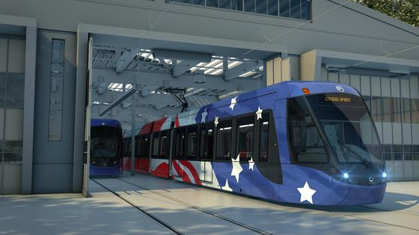

.
A range of capacities and operating modes
Spirit’s modular design means that extra cars can be added or trainsets operated in multiple units to reach the capacity of a light metro solution, thereby catering to the needs of a growing city. It can operate either in driven mode or in automatic control mode on dedicated tracks.
Enhanced passenger experience
The full low floor vehicle offers step-free access and passenger flow for fully compliant accessibility and a safer experience for riders of all walks. With a customisable interior – including wheelchair and/or bicycle berths – and passenger information system, operators can provide their customers with the most comfortable and enjoyable journey.

Slide 34
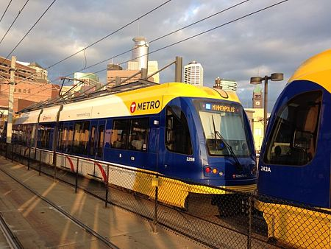
Bombardier Transportation
.
A range of capacities and operating modes
Spirit’s modular design means that extra cars can be added or trainsets operated in multiple units to reach the capacity of a light metro solution, thereby catering to the needs of a growing city. It can operate either in driven mode or in automatic control mode on dedicated tracks.
Smooth and sustainable mobility for cities around the world
As a market leader in the light rail vehicle (LRV) segment, Bombardier Transportation offers modern mobility solutions for the modern-day city, with FLEXITY trams. This comprehensive product portfolio includes 100 per cent low-floor trams, 70 per cent low-floor trams, as well as proven dual-system solutions.
Bombardier Transportation has been shaping urban mobility for decades, providing cities around the world with sustainable public transport. With our e-mobility solutions, passengers can rely on a safe and comfortable journey, with the lowest ecological footprint.
Bombardier’s global leadership in the light rail sector is built on innovative technology that has been tried and tested in numerous applications, resulting in best-in-class reliability. FLEXITY LRVs have a unique modular concept, providing operators with the opportunity to customize the tram to meet their specific requirements, from current infrastructure to operator branding.
Bombardier was the first manufacturer in the industry to combine 100 per cent low-floor technology with conventional wheel-set bogies. Over 5,000 FLEXITY trams have been ordered or are already in successful revenue service in cities around the world.

Slide 35
ELT Charge Summary
Amended Review
FTA rolling stock spare ratio policy
TCRP Synthesis 15 (spare vehicle ratio)

Slide 36
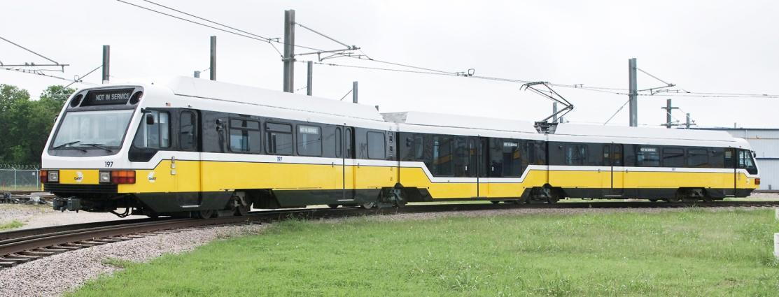
ELT Charge
Meet w/ Staff to develop Strategic Plan
  Maximize Usage of Vehicles
  Reduce Spare Ratio
  Factor-in Overhaul / Work Programs for Life Extension Model
  Reduce Services Disruptions via LRV Reliability
  Engage Rail Service Planning Dept.

Slide 37
  DART Total Peak Vehicle Requirement
  w/ Maintenance Assumptions
  [Spare Ratio Range: 54% (FY17) –to– 35% (FY35)]

Slide 38
Amended Review
  FTA Rolling Stock Spare Ratio Policy (FTA C 5010.1E/Mar 2017)
  TCRP Synthesis 15 [System-Specific Spare Rail Vehicle Ratios] (1995 publication)
FTA C 5010.1E (Page IV-29)
Rail Fleet: Because rail transit operations tend to be highly individualized, FTA has not established a specific number to serve as an acceptable spare ratio for rail transit operations. Nevertheless, rail operators should be aware that the recipient’s rail vehicle spare ratio and the rationale underlying that spare ratio will be examined during the triennial review whenever FTA assistance is used to purchase or rebuild rail vehicles. [No Maximum % imposed.]
TCRP Rpt. -- Based on data from the 1995 Report study showed LRT Spare Ratios ranged from 12% to 31% levels.

Slide 39
      Spare Ratio Reduction (Proposed):
Decrease Fleet Size by 10 LRVs
Achieved through real-world demonstration (April, 2019 thru Jan. 2020)
  Gradually drawdown DART oldest sub-fleet, to artificially create an environment with a lower spare ratio.
  Remove worst performing vehicles
  Fleet 50 preferred. Total of Ten (10) LRVs removed from service
  Validation Program start: April 2019
  Three (3) LRVs per quarter removed from service.
  Process will take place over a Four (4) Quarters.
  Do what’s required to ensure pull-out / emergency situations are met.
  Continue to drive reliability performance for in-service vehicles.

Slide 40
      Spare Ratio Reduction (Proposed):
Our fleet simulated reduction plan will be as follows:
  3Q FY2019: Remove 3 LRVs from service (two from CROF, one from NWROF)
  4Q FY2019: Remove 3 LRVs from service (one from CROF, two from NWROF)
  1Q FY2020: Remove 4 LRVs from service. (three from CROF, one from NWROF).
This will bring our total complement of downed LRVs to 10 by FY2020.
NOTE: DART is closely monitoring the number of spare vehicles we maintain to maximize efficiency and thereby reduce operating costs, as a strategic goal.
Fleet Spare Ratio Reduction Validation |  |  |  | Missed Service during Service Reliability Verification
Quarter | LRVs Removed from Service |  |  |  | Qtr | Date | Location | # of cars short | Comment
3rd Qtr FY19 (04/01/2019) | CROF | NWROF |  | 1
 | 101 | 107 |  | 2
 | 157 |  |  | 3
4th Qtr FY19 (07/01/2019) | CROF | NWROF |  | 4
 |  |  |  | 5
 |  |  |  | 6
1st Qtr FY20 (10/01/2019) | CROF | NWROF |  | 7
 |  |  |  | 8
 |  |  |  | 9
 |  |  |  | 10
Total LRVs out of service | 3
Goal of Total LRVs out of service: | 10

Slide 42
End of Presentation
Questions?

