Slide 1
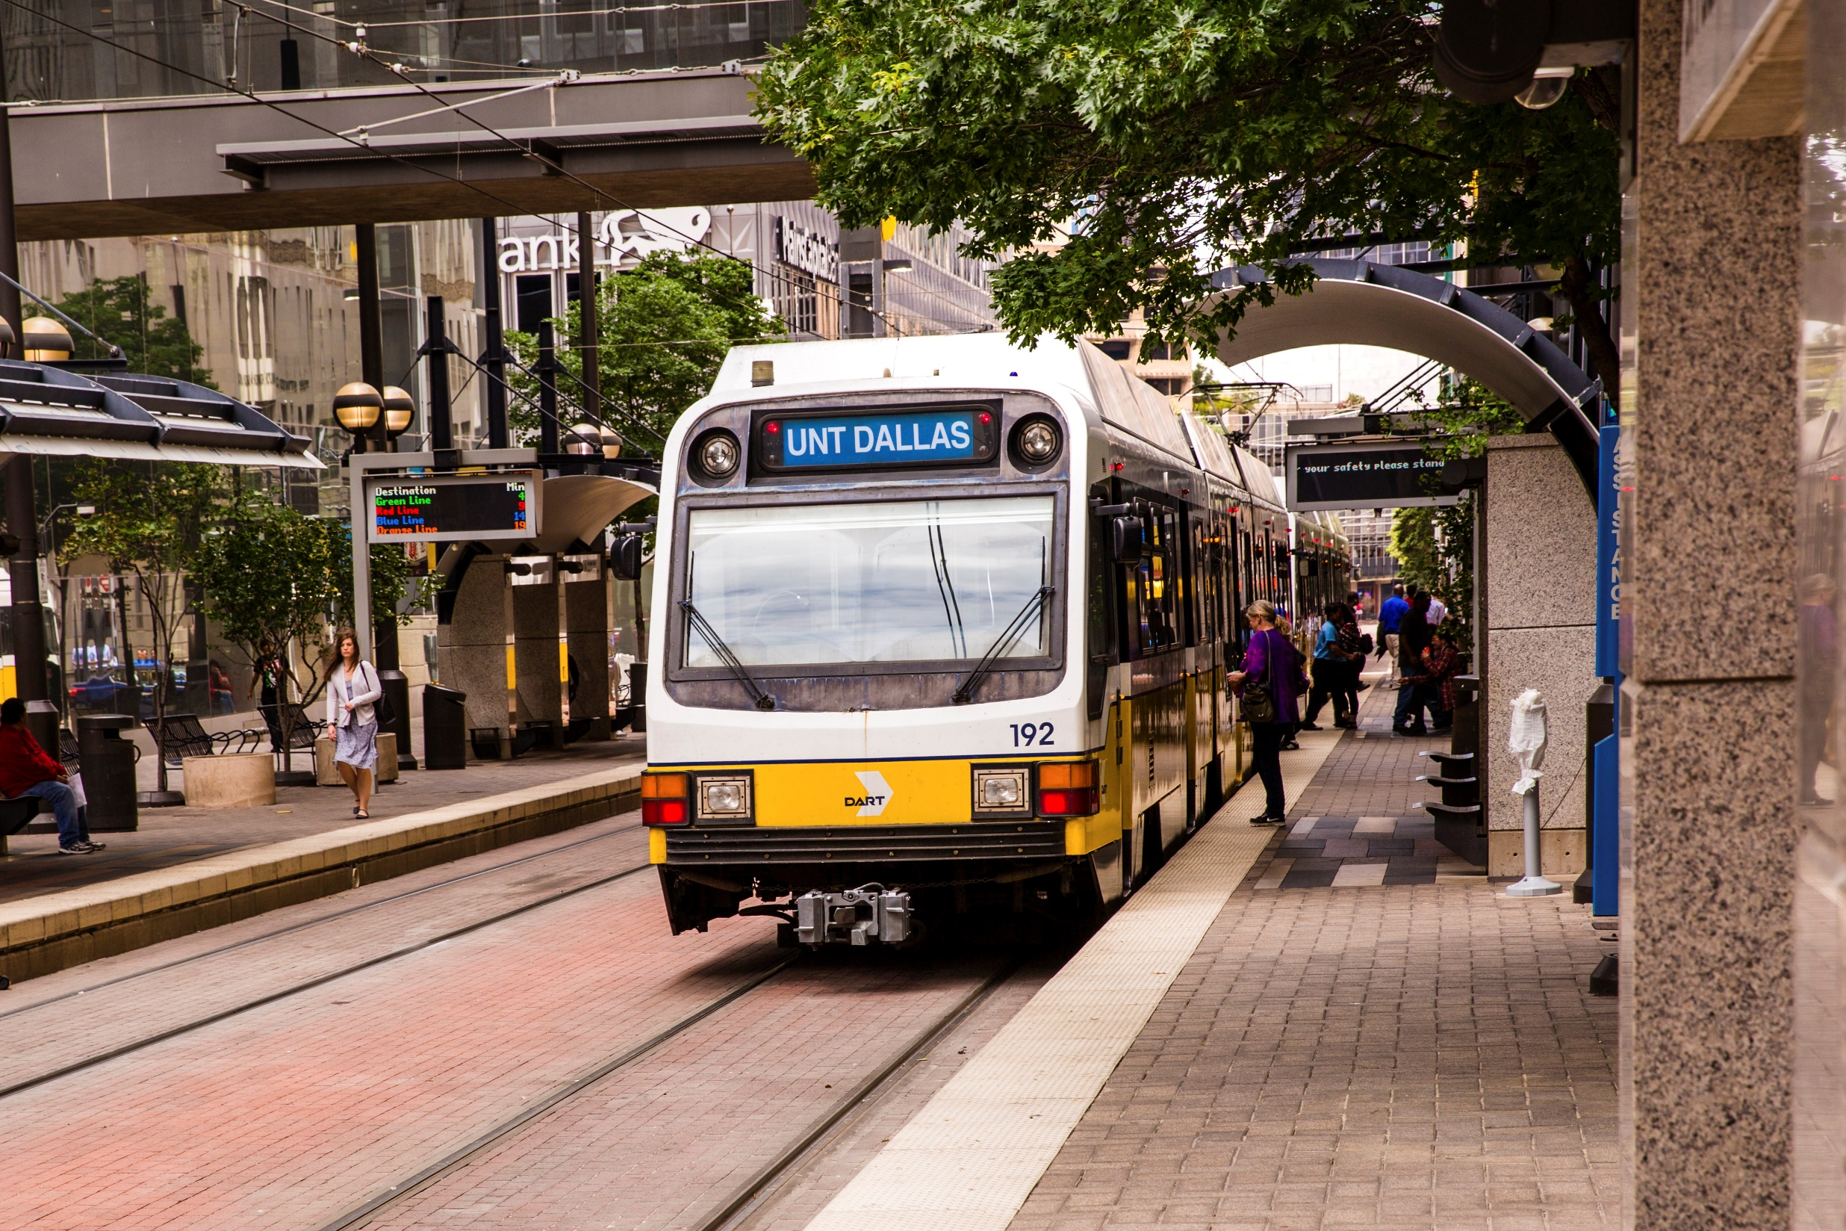
DELIVERING QUALITY HIGHER-ED TO NORTH TEXAS
Bob Mong, President – University of North Texas at Dallas

Slide 2
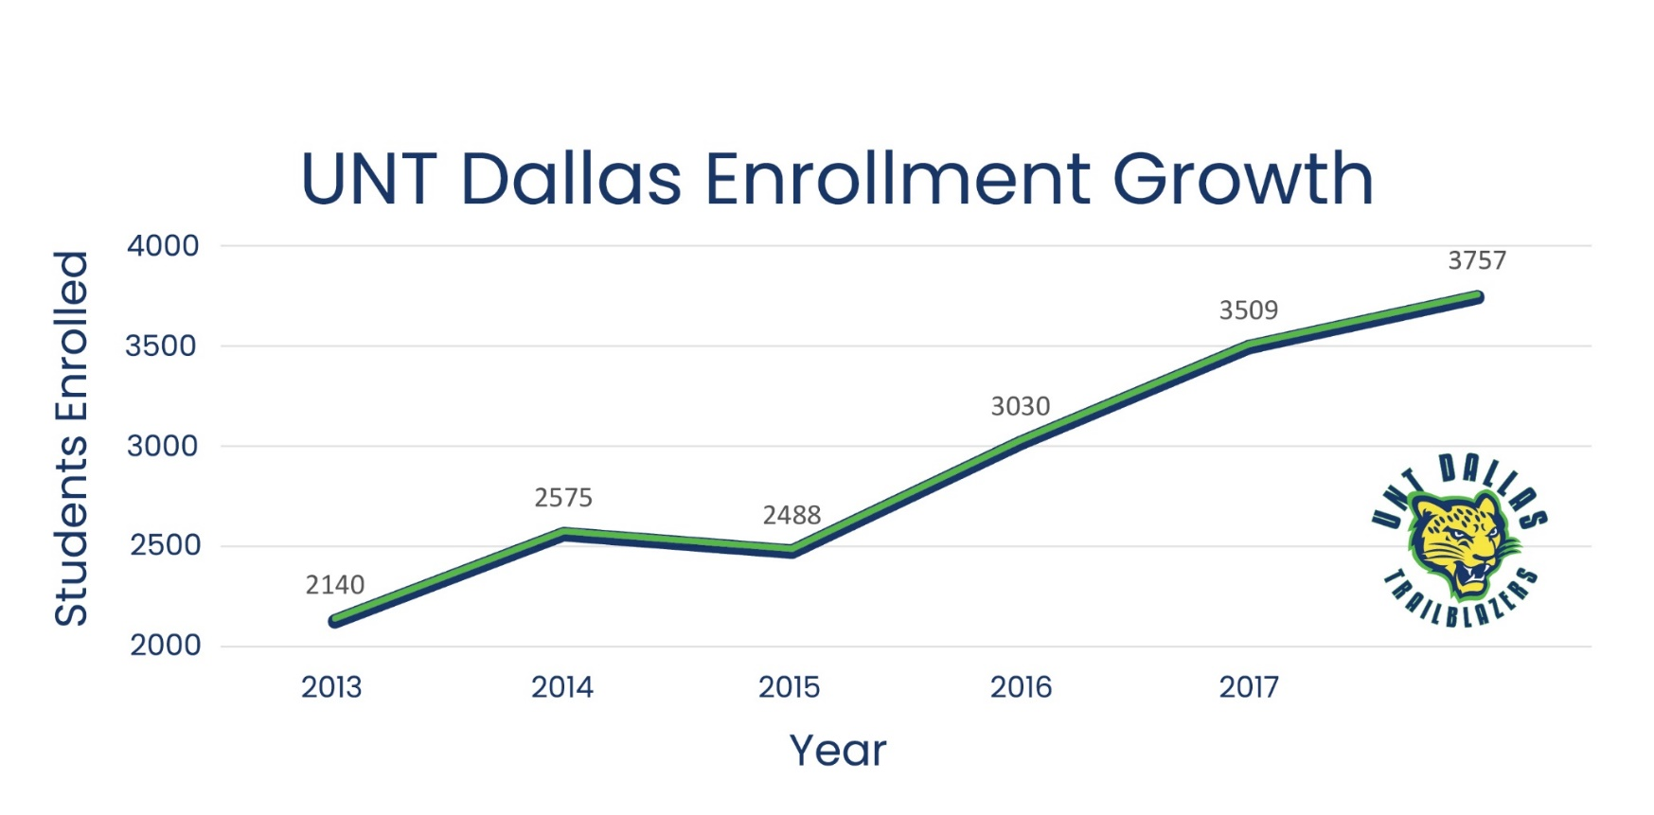
THE UNT DALLAS STORY
Record Enrollment
Fastest-Growing in Texas
Lowest Debt Upon Graduation in US
Top 20 Most Affordable
Enrollment, retention, graduation continue at record levels
Recognized as a minority-serving institution by U.S. Department of Education

Slide 3
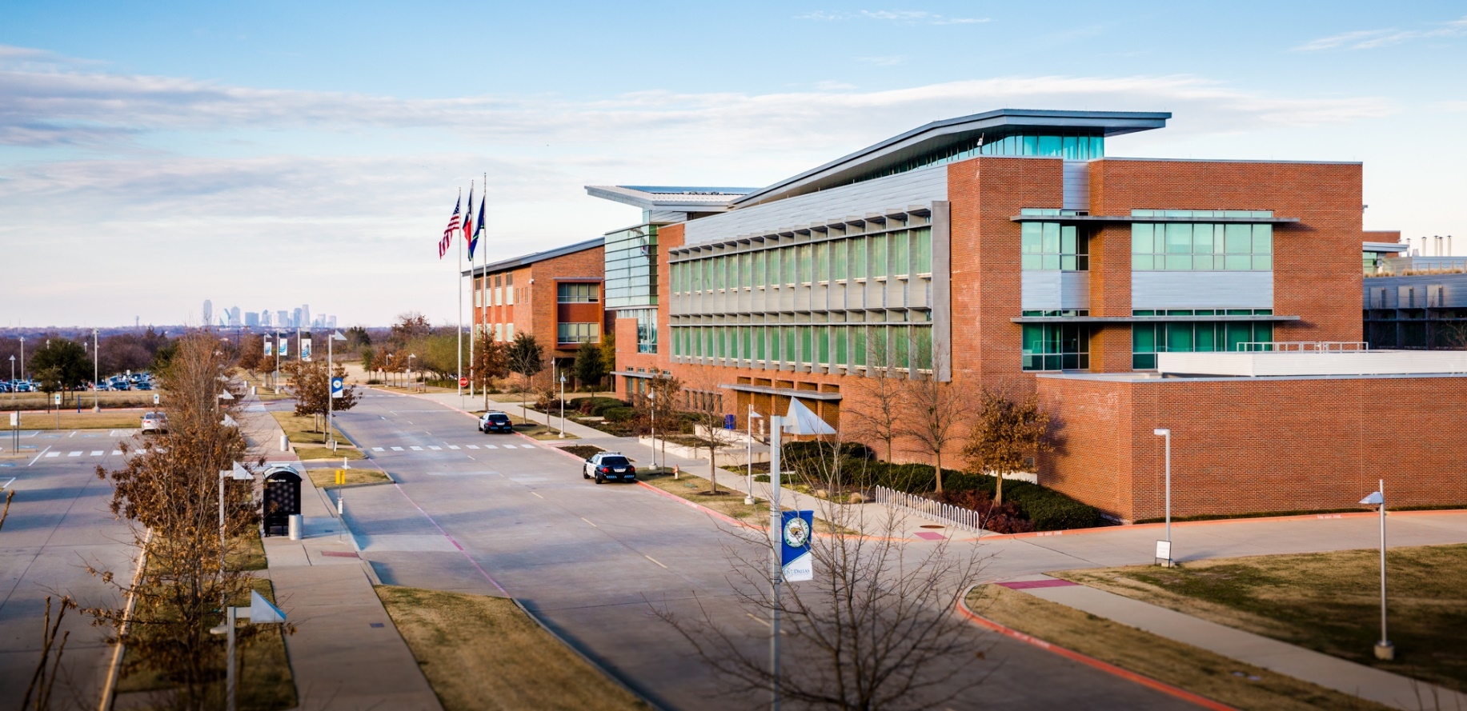
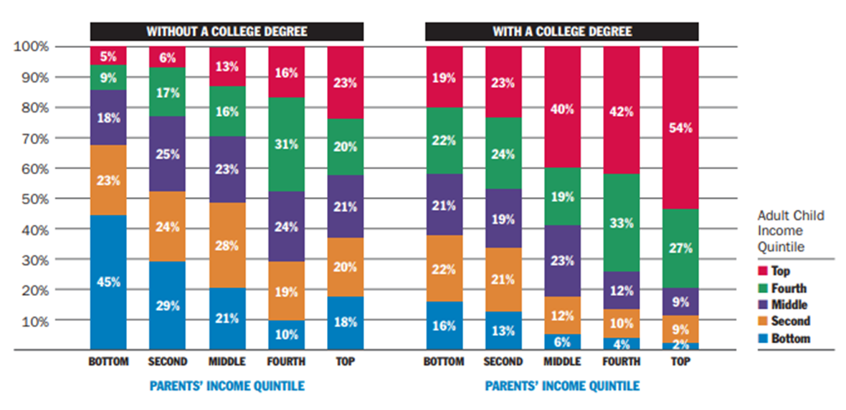
UNT DALLAS & THE EDUCATIONAL ECOSYSTEM
Metro Dallas is a paradox
Great wealth and great poverty
Educational attainment depends on household income
UNT Dallas focuses on urban metro Dallas

Slide 4
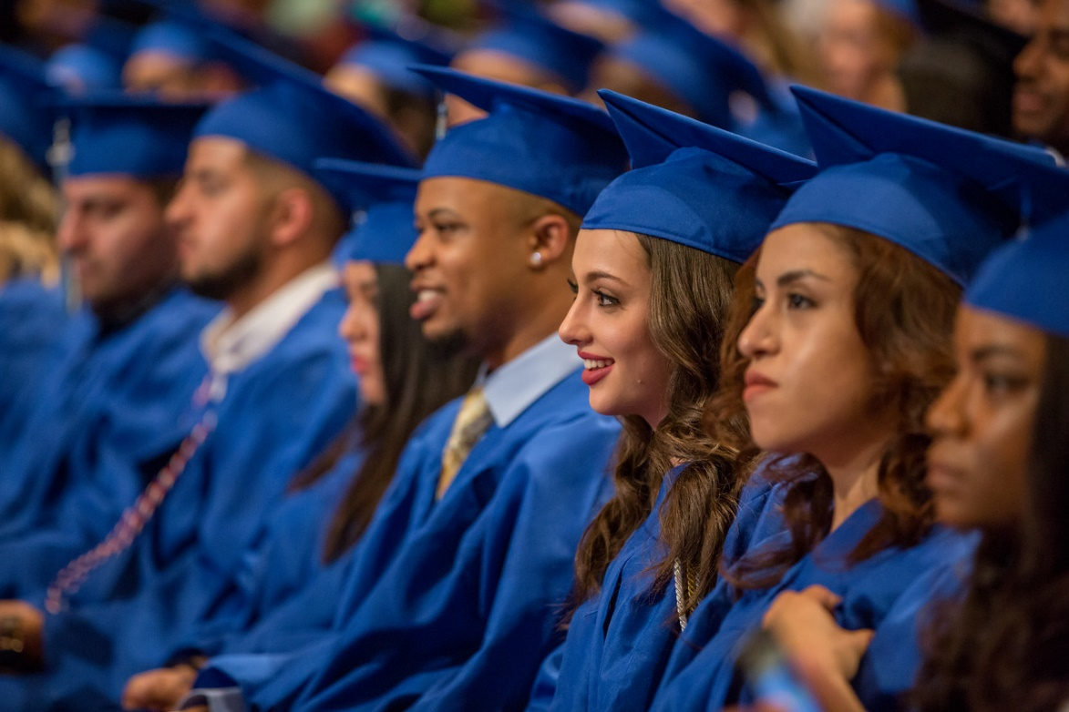
UNT DALLAS SERVES A HIGH-NEED POPULATION
Household income of $30k
70 % first generation
African-American and Latino blended diversity tops in Texas
Students balance childcare, transportation, finances
Traditional, transfer, non-traditional

Slide 5
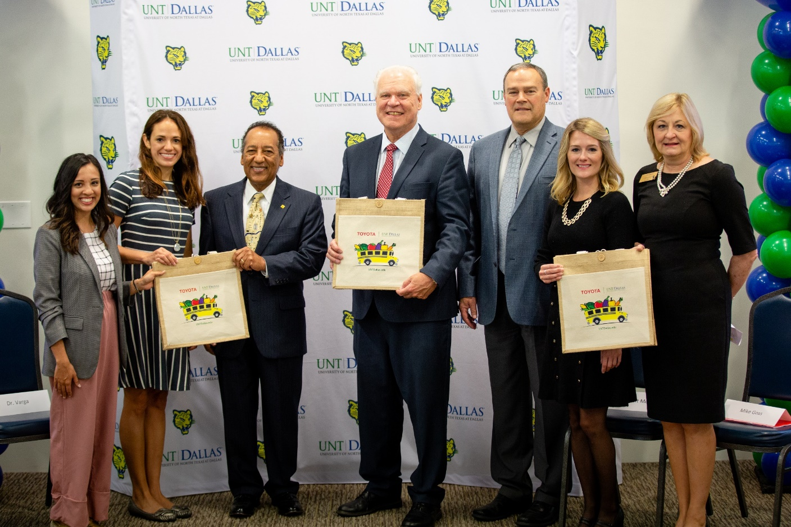
UNT DALLAS PARTNERSHIP MODEL
School Districts
DCCCD
Industry and Business
Foundations
DART

Slide 6
WHY PARTNER?
Growth will go on for many years
Recruiting is not a zero sum game
Too many students don’t see a way to higher-ed
Partnerships can foster closer communication
Partnerships can help us reach students at younger ages
Together we can encourage them to reach higher

Slide 7
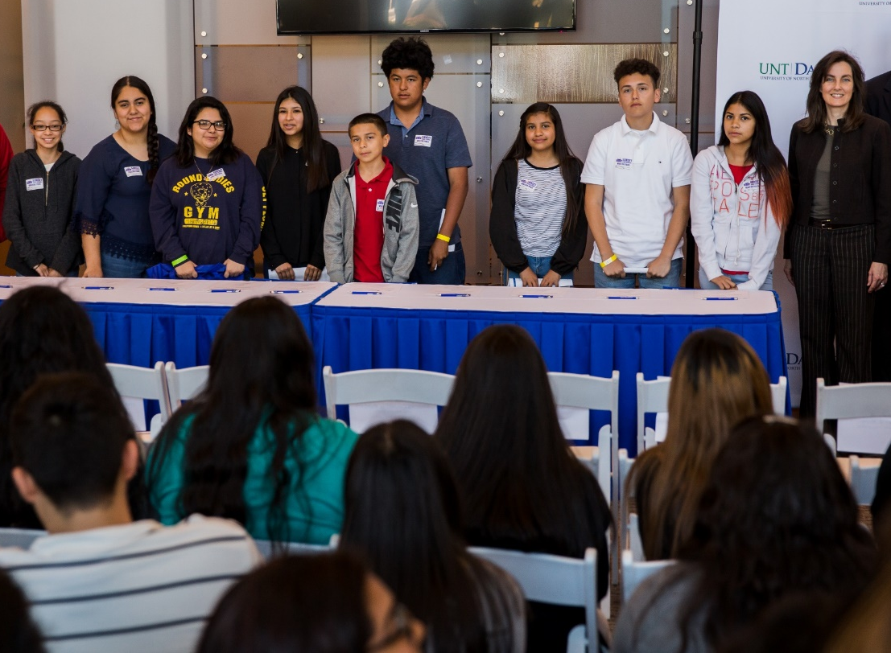
COLLEGIATE ACADEMIES
Districts, DCCCD, UNT Dallas
Capturing imaginations of high poverty families
Close partnerships with industry and business
UNT Dallas and Sunset and Lincoln high schools

Slide 8
DALLAS COUNTY PROMISE
Free community college for mostly high poverty students
UNT Dallas helped shape it
First Cohort = 9,300 students in 31 high schools

Slide 9
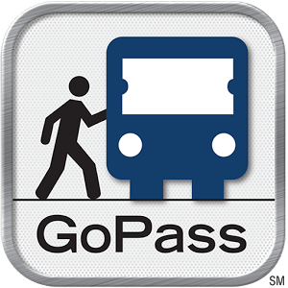
DEVELOPMENTAL APP
Tech, districts, DCCCD, UNT Dallas
Will assist students where they live – on their phones
Apply to Promise, access to financial aid
Send applications to employers, colleges
Why not GoPass?

Slide 10
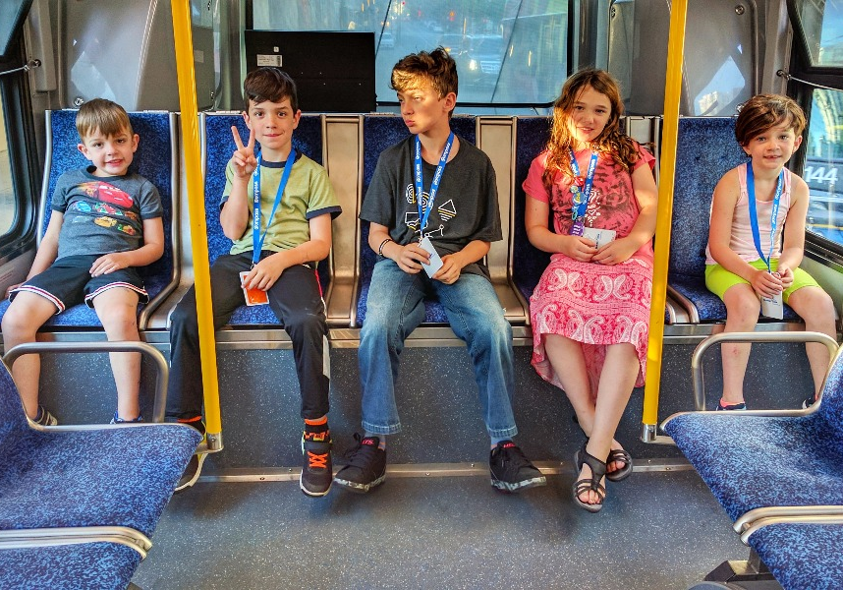
TRANSIT POTENTIAL TO ASSIST EDUCATIONAL ATTAINMENT
If DART serves them, potential high
Must learn to use DART
DART and UNT Dallas market transit
Dallas is still a car culture

Slide 11
DFW IS VAST AND NOT ALL AREAS VOTED FOR DART
Lone Star Transit Defeat
DART went with coalition of willing
Arlington!
Dallas southern suburbs opted out

Slide 12
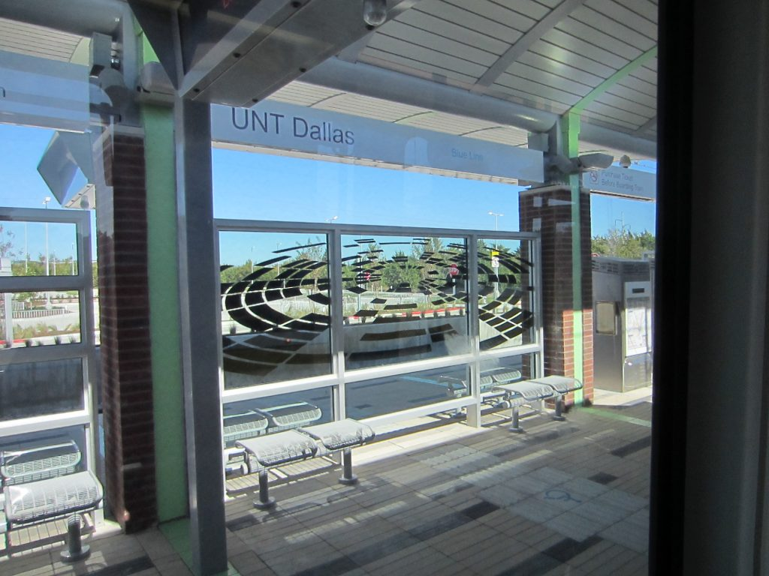
UNT DALLAS WELL SERVED BY DART
UNTD station on blue line
Bus service excellent
Potential for transit oriented development great

Slide 13
OUR PARTNERSHIPS INCLUDE DART
Toyota Green Mobility Grant
DART supplies low emission bus
DCCCD’s Cedar Valley campus retrofits bus
Toyota and UNT Dallas build business plan
By fall, bus will serve fresh fruits and vegetables

Slide 14
POTENTIAL FOR RAPID INCREASE IN GO PASS USAGE
Selling DART passes at retail outlets
Actively plug DART into our expanding partnerships
DCCCD provides free DART passes to all students
Increasing usage
Tarrant County Colleges following with bus passes

Slide 15
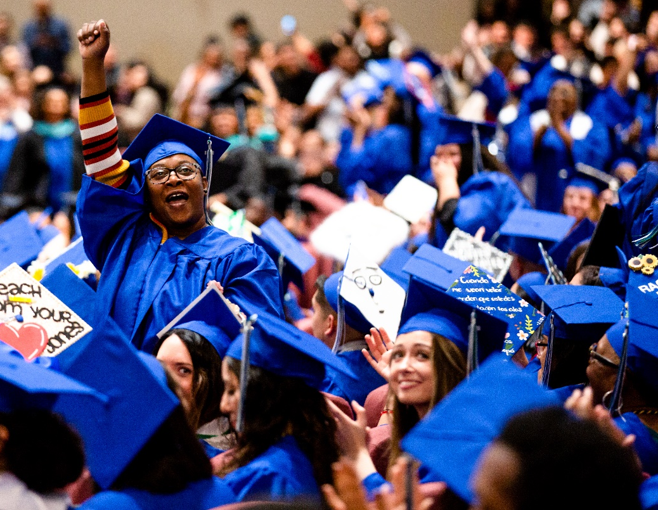
UNT DALLAS FOCUSES ON COMMUNITY PROBLEMS TO BE SOLVED
Increase educational attainment
Train bilingual teachers
Reduce behavioral health stresses
Help reduce teacher shortages
Diversify healthcare

Slide 16
Like UNT Dallas, DART is an essential part of the solution to the Dallas paradox.
DART AND UNT DALLAS HELP SHAPE THE FUTURE

