Slide 1
ENO Leadership Our Future is Bright Because of You
August 14, 2019

Slide 2
How Did I Get Here
Mid seventies
On the tracks
Worked my way up to president
Retired late 2015
Certified professional coach
Consulting Practice
Curiosity, Hard Work, Risk, Luck

Slide 3
NYCT Experience - 2009
$100M budget issue
Unprecedented layoff of 500 employees
“Signalgate”
Major reorganization
Death of an employee
Cultural challenges

Slide 4
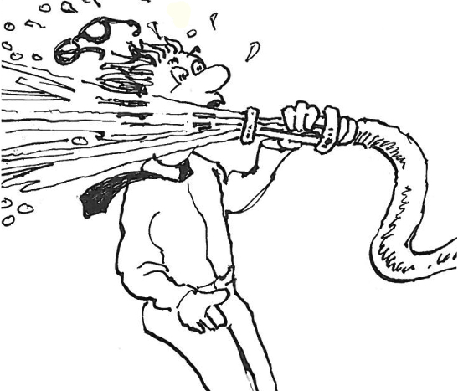

Slide 5
“LIFE IS NOT A MATTER OF HOLDING GOOD CARDS, BUT PLAYING A POOR HAND WELL.”
-Robert Louis Stevenson

Slide 6
Our world is changing
Public and political accountability
Email & social media are game changers
Face-to-face touch points are significantly down
Analytics, while powerful, overwhelms organizations
Technology & too much data can be distracting
Talent management & succession planning are critical
Are we meeting people’s basic needs?

Slide 7
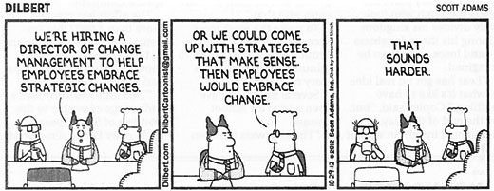

Slide 8
What is Organizational Culture
“A pattern of shared basic assumptions that the group learned as it solved its problems of external adaptation and internal integration, that has worked well enough to be considered valid and, therefore, to be taught to new members as the correct way you perceive, think, and feel in relation to those problems.”
- Edgar Schein
Simply Stated, “It’s the way we do things around here”

Slide 9
Who Own Organizational Culture
Leadership
What leaders pay attention to, measure, and control on a regular basis
How leaders react to critical incidents and organizational crises
Observed criteria by which leaders allocate scarce resources
Organizational rites and rituals

Slide 10
Leadership Priorities
Safety, Safety, Safety!!!
Profit, revenue growth & positioning the organization to be competitive for the future
Product, cyber and personnel security
Developing tomorrow’s leaders
Analytics: Using data to drive better performance
Moving the culture needle

Slide 11
So where do you fit in?
Balance between compliance & commitment
Partner & driving force in moving culture
Connecting people
Concentrating on behavioral reliability
Getting people to do the right thing, at the right time, the right way, for the right reason
Be a change agent

Slide 12
STRATEGY
BEHAVIORS
SYSTEMS AND PROCEDURES
GOALS
VALUES
SHARED ASSUMPTIONS
ATTITUDES & BELIEFS
LEADERSHIP STYLE

Slide 13
You Are Key Players
Make “behavioral reliability” a priority
Move the organization from compliance to commitment
Help the CEO connect leaders with values and behaviors
Increase your skills and abilities to “see around corners”
Do your job and 50% of the CEO’s

Slide 14
Ask Yourself…
What does our culture support?
Where and how do I fit in?
How do I touch the hearts & minds of every co-worker?
Where am I going?
Am I inspiring leaders to make a difference?
What is my legacy in this organization?

Slide 15
“I AM NOT A PRODUCT OF MY CIRCUMSTANCES. I AM A PRODUCT OF MY DECISIONS.
- Stephen Covey

Slide 16
Questions & Answers

Slide 17
“THE DAY SOLDIERS STOP BRINGING YOU THEIR PROBLEMS IS THE DAY YOU HAVE STOPPED LEADING THEM.
THEY HAVE EITHER LOST CONFIDENCE THAT YOU CAN HELP THEM OR CONCLUDED THAT YOU DO NOT CARE.
EITHER CASE IS A FAILURE OF LEADERSHIP.” - Colin Powell

