Slide 1
DART Reference Book
2019 MAX Program
Kay Shelton, Capital Planning

Slide 2
Agenda
Why?
What?
Who? How? When?

Slide 3
Why?
Have you attended or presented at a public meeting?
Have you briefed a City Council?
Do you ever get asked a question?
Did you know the answer?
Did anyone at the meeting know the answer?
Are people always asking you for answers?

Slide 4
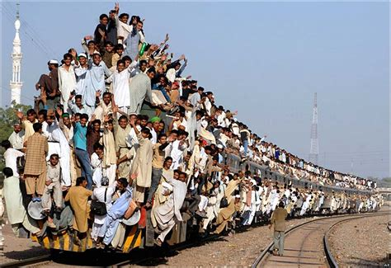
What is DART’s average weekday rail system ridership?
Not sure, but it’s the longest system in North America
Which system - LRT, TRE or Dallas Streetcar?
About 94,000 in FY18 for DART LRT
I don’t know, ask Steve
(If Steve doesn’t know, guess who he asks…)

Slide 5
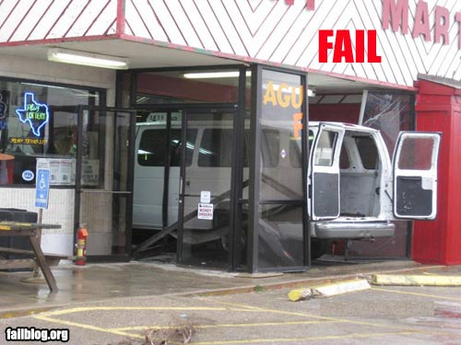
How many vanpools did we operate last year?
We operate vanpools?
101
171
145
I don’t know, ask Steve
(If Steve doesn’t know, guess who he asks…)

Slide 6
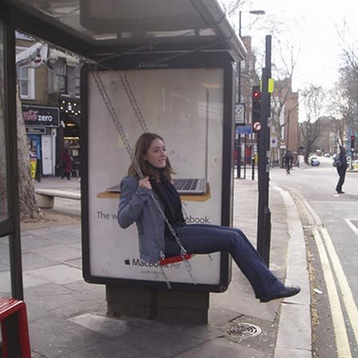
How many DART bus stops have shelters?
What is a shelter?
253
1,229
I don’t know, ask Steve
(If Steve doesn’t know, guess who he asks…)

Slide 7
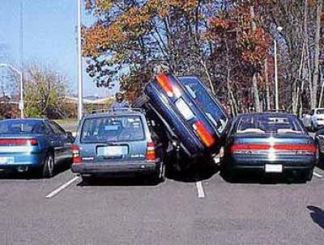
How many parking spaces are at LBJ/Central Station?
This is a trick question. It’s full, but I better check with Steve.
654 (no that’s LBJ/Skillman)
533
Gee, I wish we had a Reference Book.
(If Steve doesn’t know, guess who he asks…)

Slide 8
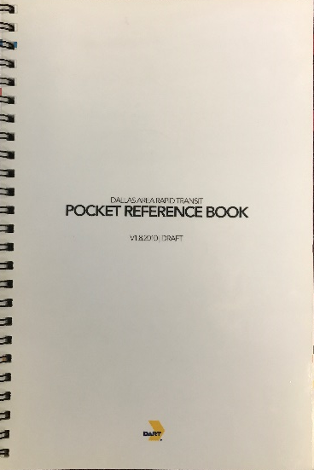
The Idea (it was Steve’s)
The Original
First version created in 2010
At first, not a management priority
Now it is
Key benefits:
Communication tool for senior staff
Handy reference material
Helps everyone stay on message
Consistent answers
(The real bonus? We get asked fewer questions)

Slide 9
Format
Sized to fit in a shirt pocket or handbag
Organized by section
Visuals – tables, charts
Version numbers
Metal spiral binding to easily flip pages or lay flat
Fold out maps

Slide 10
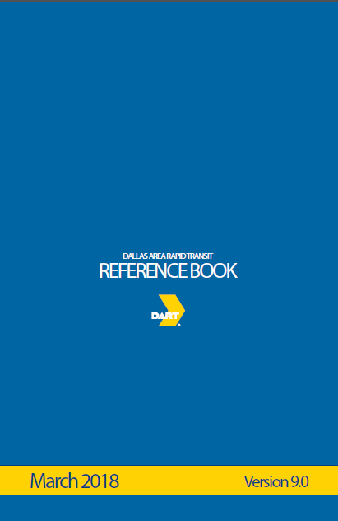
What’s in it?
Fast Facts
Agency Overview
Ridership and Service
Operations and Performance
Fleet Overview
Facilities
Infrastructure
Operating and Capital Budget
DART Rail System Expansion Program
Economic and Fiscal Impacts
And a series of maps

Slide 11
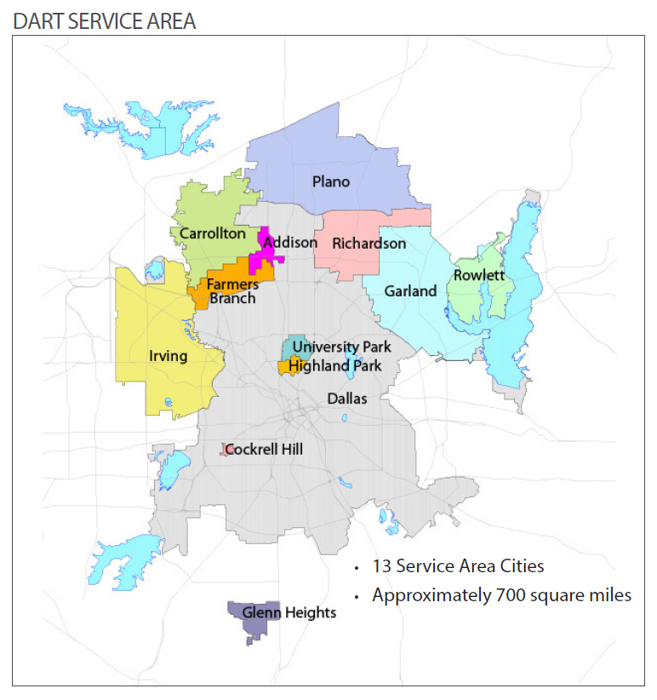
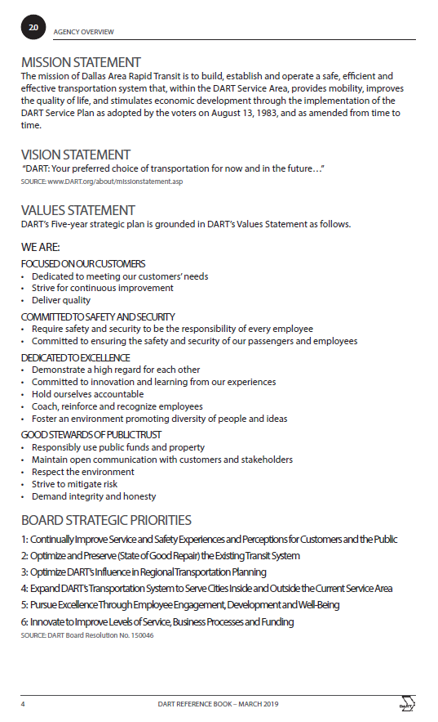
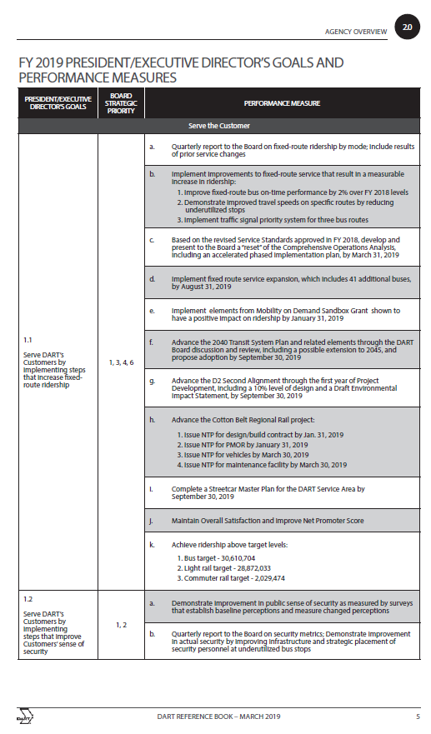
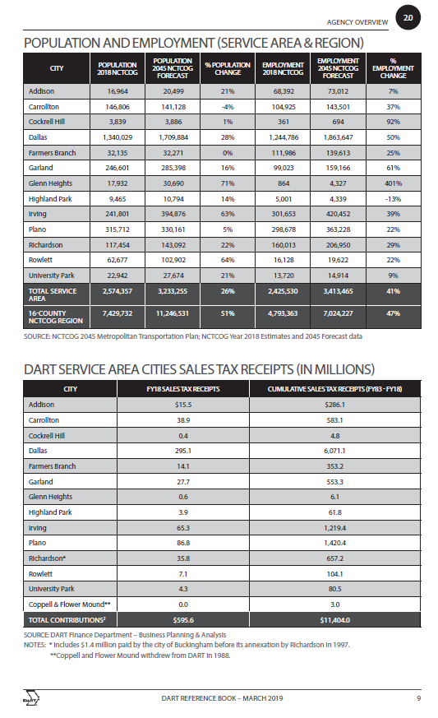
Agency Overview

Slide 12
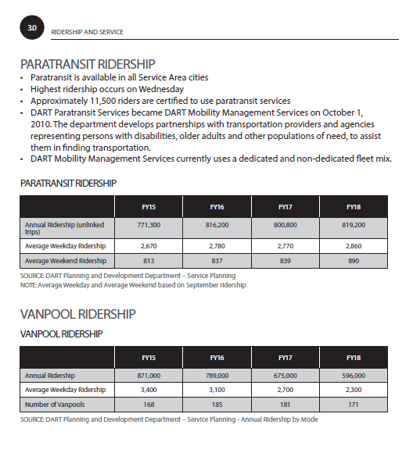
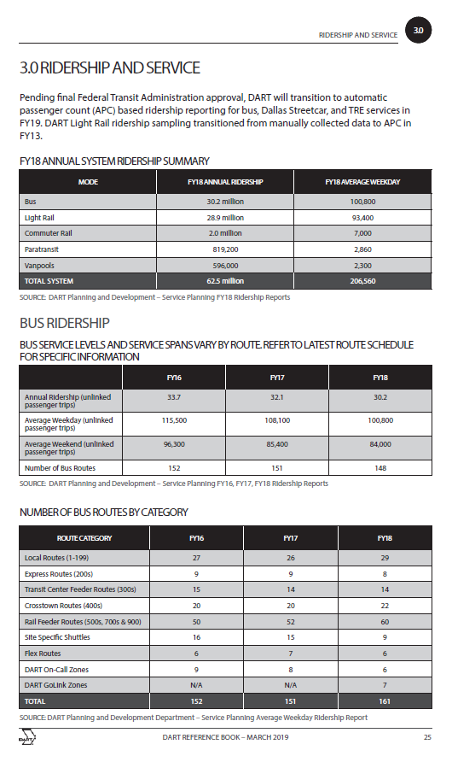
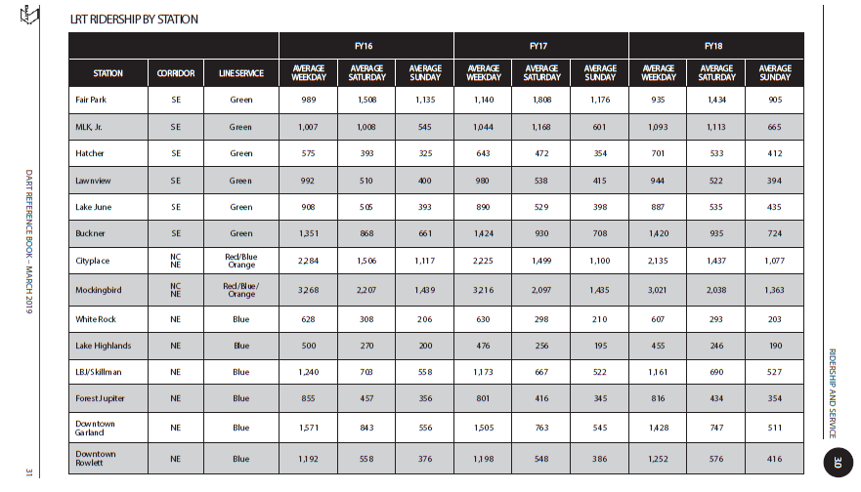
Ridership and Service

Slide 13
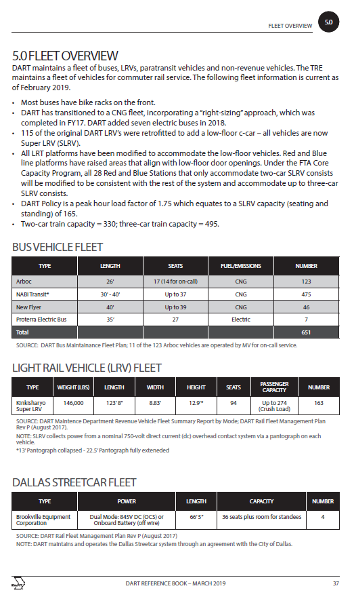
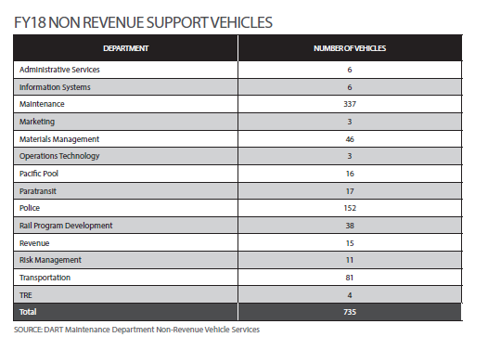
Fleet

Slide 14
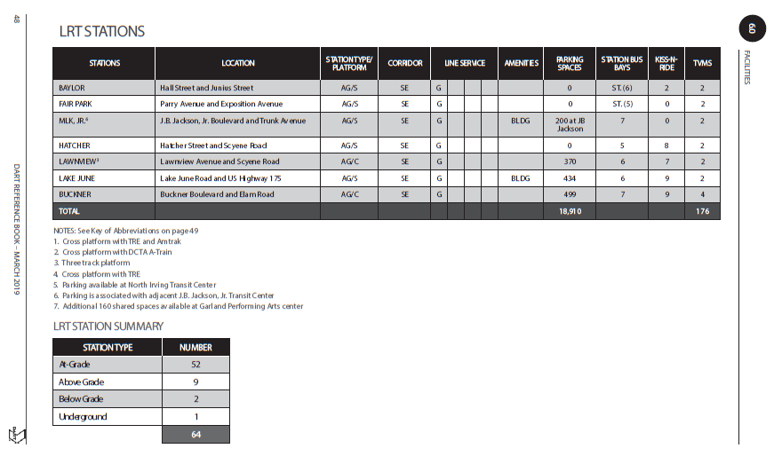
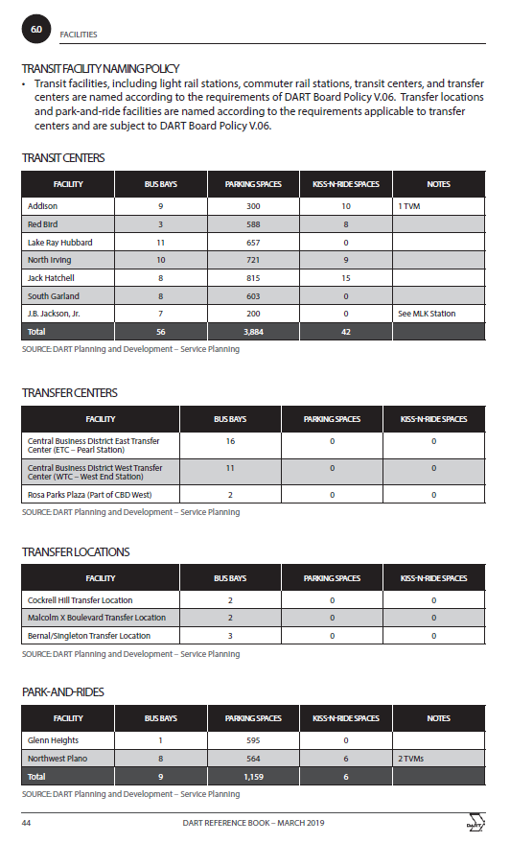
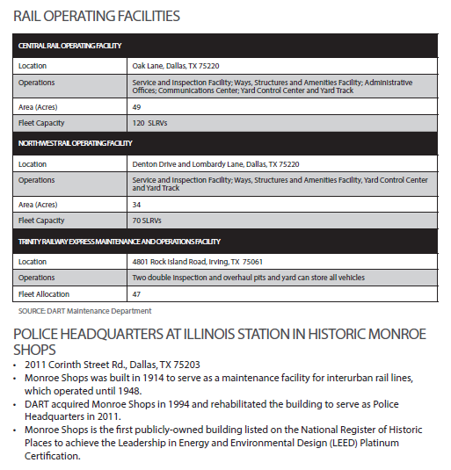
Facilities

Slide 15
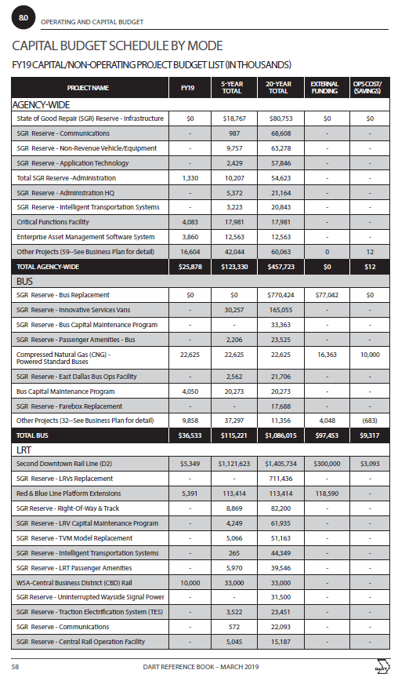
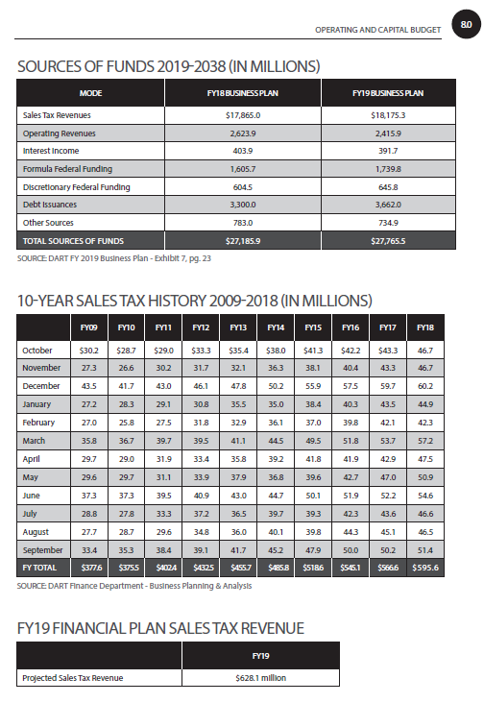
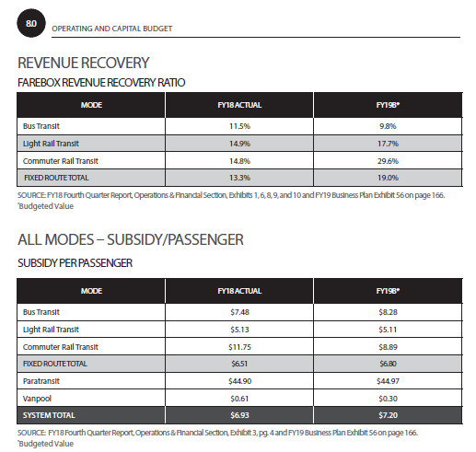
Capital and Operating Budget

Slide 16
Who, How, When?
Capital Planning collects data Jan-Feb each year from departments, reports, or Financial Plan
General Planning Consultant makes updates and coordinates with printer (250-300 copies)
Published every March to document prior FY actuals and current FY budget information
Distributed to Executive Management Team to share with key management staff
Posted on DART.org under “DART Facts”

Slide 17
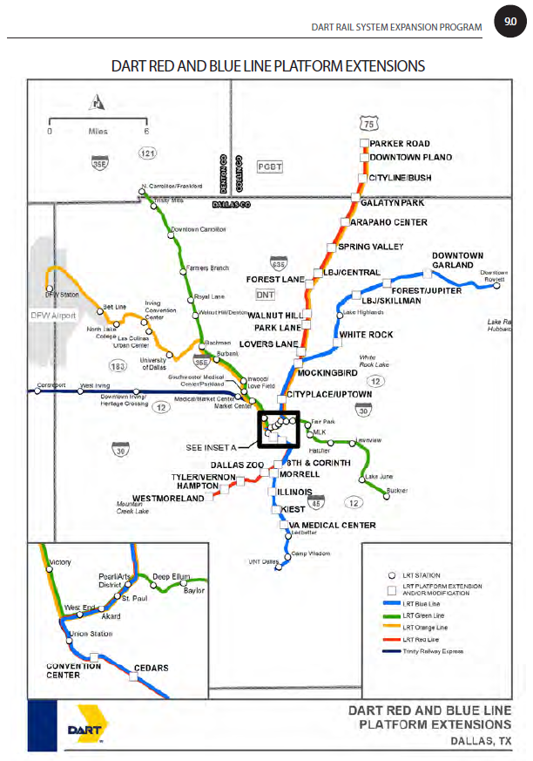
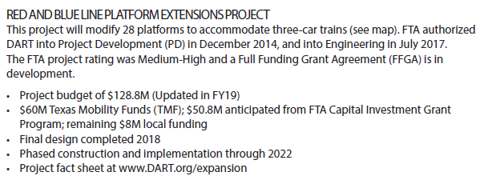
What is the status of the Red and Blue Platform Extension project?
Hmmm. I’m not involved in that project…
Wait! Let me look that up!
(I’m so glad we have a Reference Book!)

Slide 18
Questions?

