Slide 1

Introduction to the Metro Office of Planning
Shyam Kannan, VP Planning
8/15/2019
METRO INTERNAL USE ONLY

Slide 2
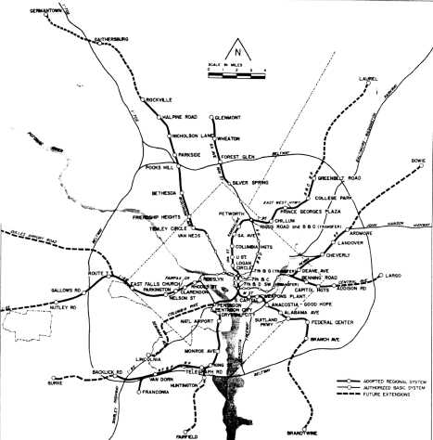
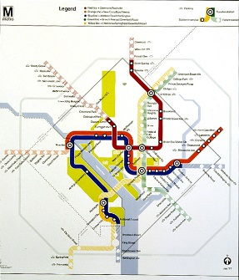
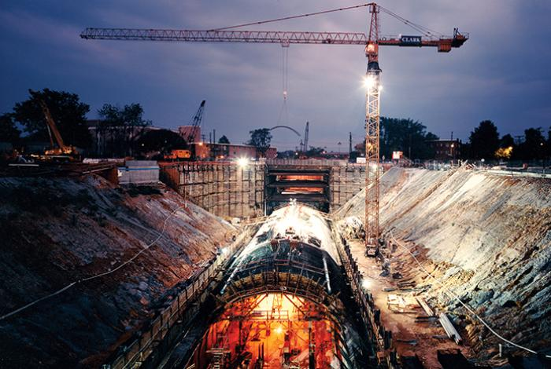
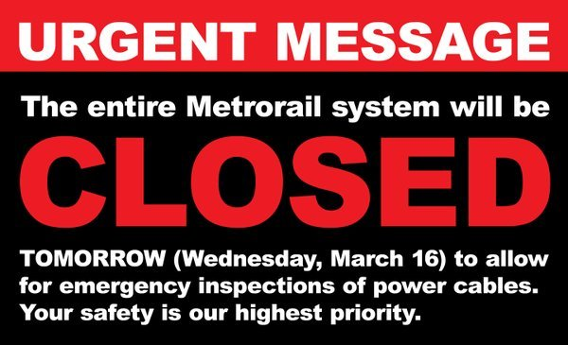

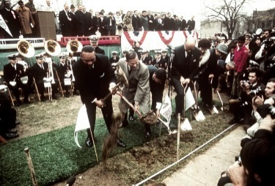
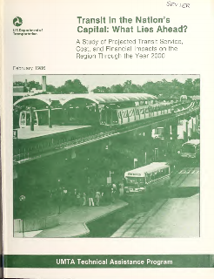
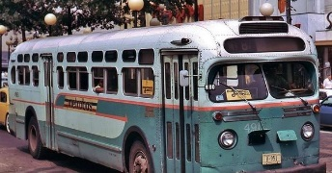
Decades of Underinvestment has Consequences
Planning in an Environment of Continuous Crisis
1968 ARS
1978
Alts. Analysis
2001
ARS Complete
2016
Metrorail Safety Shutdown
1960s
federal planning,
transit decline,
freeway revolts
1960s
1970s – 1990s
Major Construction
2000s – 2010s Operations/Maintenance
1967
WMATA created, assumes system planning
1969
Metrorail construction begins
1973
WMATA acquires private transit operators
1986
FCC Reinvestment Needs Report
2009
Fort Totten Crash

Slide 3
2012 – Want to be WMATA’s Planning Director?
Planning in an Environment of Continuous Crisis
Maturity
Downturn
Upturn
Recovery
Bottom
1970
1980
1990
2000
2010
2020
3
Notes:
CORE SERVICE ACTION PLAN SLIDE
HEADER:
Click on editable field to add Core Service #1
For the identified Core Service in the header, add the individual actions along with their owner, expected completion date
ACTIONS
An action describes the steps you will take to successfully deliver your core service and mitigate your risks.
Actions can be ongoing things that you do on a regular basis (e.g. daily, monthly, quarterly) or special projects that have a clear end date. They should reflect things that your are or will be doing within the budgeted resources that you have been allocated.
For each action, identify an owner and expected completion date. The owner is the point person for execution. It can be a specific individual or a position. For actions that you perform on a regular basis as part of your business processes, enter “ongoing” in the expected completion column. For actions with a clear end date, please enter the month or quarter that you expect it to be completed.
The date completed column can be updated throughout the year.
To add additional rows, LAYOUT > INSERT BELOW OR ABOVE
To delete rows, select row you wish to delete, LAYOUT > DELETE ROW
If you need additional pages for Core Service Actions, add an additional slide by clicking NEW SLIDE > DUPLICATE SELECTED SLIDE
FOOTER:
Edit Department Name in Footer

Slide 4








The Big Pivot – Planning for Near Term Survival
Planning in an Environment of Continuous Crisis
THE OFFICE OF PLANNING TOOK ON THESE PROBLEMATIC REALITIES
 | Ridership was falling and WMATA did not know when or if it will return |  | The transportation landscape is evolving dynamically, but WMATA was slow to process and adapt
 | Service and demand were mismatched |  | WMATA leaves money on the table that could close the capital funding gap
 | Operating costs were growing unsustainably |  | We were not maximizing the potential for Transit-Oriented Development
 | Capital and operating expense estimates were based on “rear-view mirror” approach |  | Our customers’ travel patterns change over time. In order to be effective, our Title VI practices should change as well.
4
Notes:
CORE SERVICE ACTION PLAN SLIDE
HEADER:
Click on editable field to add Core Service #1
For the identified Core Service in the header, add the individual actions along with their owner, expected completion date
ACTIONS
An action describes the steps you will take to successfully deliver your core service and mitigate your risks.
Actions can be ongoing things that you do on a regular basis (e.g. daily, monthly, quarterly) or special projects that have a clear end date. They should reflect things that your are or will be doing within the budgeted resources that you have been allocated.
For each action, identify an owner and expected completion date. The owner is the point person for execution. It can be a specific individual or a position. For actions that you perform on a regular basis as part of your business processes, enter “ongoing” in the expected completion column. For actions with a clear end date, please enter the month or quarter that you expect it to be completed.
The date completed column can be updated throughout the year.
To add additional rows, LAYOUT > INSERT BELOW OR ABOVE
To delete rows, select row you wish to delete, LAYOUT > DELETE ROW
If you need additional pages for Core Service Actions, add an additional slide by clicking NEW SLIDE > DUPLICATE SELECTED SLIDE
FOOTER:
Edit Department Name in Footer

Slide 5
Planning (PLAN) Core Services
The Big Pivot – Building Business Intelligence from Planning Core Competencies
1
Forecast future ridership and revenue
Forecasts and Impacts
PLAN delivers ridership and revenue estimates to operating and financial units
Quantify future expenses and recommend strategies to lower costs
2
3
Identify and solve capacity-related safety issues
Growing and Sustaining Ridership
Our clients depend on us for solutions to grow ridership/revenue as well as estimate customer and financial impacts of operating decisions
4
Secure funding for capital investments
Design improvements to grow ridership and better meet customers’ travel needs
5
Transit System Optimization
We identify unmet markets and potential efficiencies – and then underwrite the action plans
Recommend innovations and launch pilots that improve service and strengthen financial position
6
5
Notes:
DEPARTMENT CORE SERVICE SLIDE
HEADER:
Click on editable field to add your department’s name [Example: Office of Bus Maintenance Core Services]
CORE SERVICES:
Click on editable field to add your department’s Core Services
A core service is what you do to help WMATA achieve its mission and deliver on the GM’s priorities.
While each department contributes to Metro’s mission in unique ways, all departments are accountable for executing safe workplace practices, and for managing people & departmental budget wisely. Therefore, these areas (safety, people, & budget) will be included in all Business Plans this year, as well as up to four additional core services that are more specific to each department.
To help you get started, core services have been suggested drawing on your mission and information from your intranet page. Please edit as needed.
Tips:
Be concise
Start with your mission—in many cases the department mission is the core service that you provide; it is the reason that your department/office exists.
Think about your internal and external customers: what service do you provide them? Does it contribute to helping WMATA meet its mission?
Try to identify services that are unique to your department
Formatting Tip: To remove numbers you do not need, View > Slide Master > delete the number(s) you do not need, or align them if needed, then close out of the Master Slide View
PERFORMANCE MEASURES:
Click on editable field to add your identified Key Performance Measures aligned to the applicable Core Service
Populate this box last using the performance measures you included on the Core Service pages (5,7,9)
For measures that are reported on in Vital Signs, please note with an asterisk (*)
Formatting Tip: To align performance measures with the Core Service, Paragraph > Spacing – adjust before / after to align, better group measures
FOOTER:
Edit Department Name in Footer

Slide 6
Metro Office of Planning (PLAN)
The Big Pivot – Building Business Intelligence from Planning Core Competencies
GM/CEO
The Office of Planning prepares forecasts, strategies, and innovations to help Metrorail, Metrobus, and MetroAccess anticipate the Authority’s needs for tomorrow while identifying financially positive actions to improve service quality today.
CPPM
Office of Planning
Applied Planning Intelligence
Station Planning
Transit Asset
Management
(TAMO)
Strategic Planning
Cross-Functional
Working Groups
Capital Planning
6

Slide 7
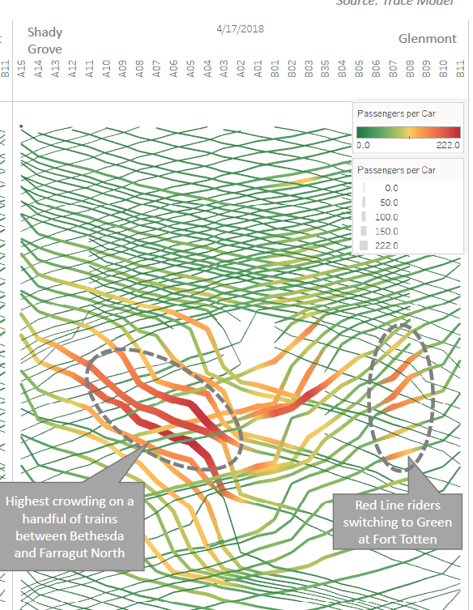
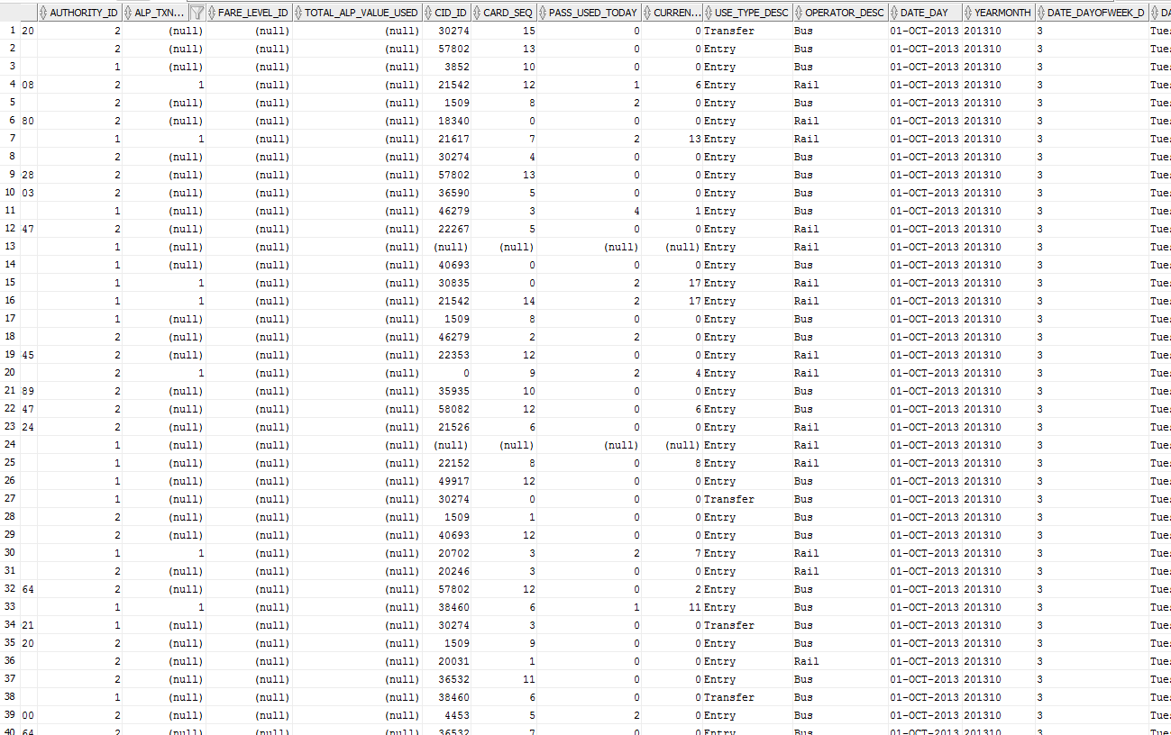
Business Need – Listen to Our Data
Applied Planning Intelligence
Metro is data rich, but information poor
We need transportation-oriented analysts who:
Listen to our data; and
Recommend changes and innovations
7

Slide 8
Applied Planning Intelligence
Applied Planning Intelligence
Ridership Smarts
Fare Policy
Customer Impact Analysis
Big Data Analytics
Research and Development
Mission
  Turn data into information
  Turn information into ideas
  Turn ideas into actions
Actions
Information
Ideas
Data
8

Slide 9
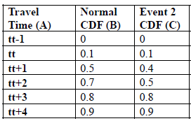

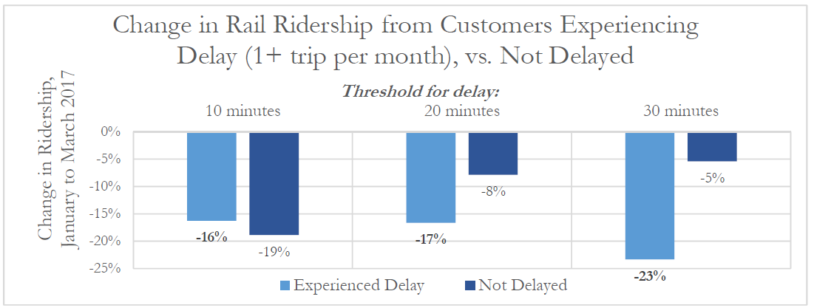
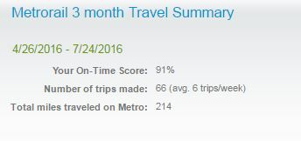
Case Study: Rush Hour Promise
Applied Planning Intelligence
Ideas
Actions
Data
Info
Greater Delay, Fewer Trips
9
Notes:
Data: Started researching customer travel time distributions under normal and disrupted conditions.
Information: Assessed SmarTrip card trip making for customers who did and did not experience delays: customers hit with 30 minute delay are more likely to reduce travel!
Ideas: Publicize individual customers’ on time performance, research method for a reliability refund program
Action: Implemented Rush Hour Promise in Jan 2018

Slide 10
API Accomplishments
Applied Planning Intelligence
Built a platform supporting major decisions and strategy:
  SafeTrack customer impact analysis
  Land use and ridership model (SWARM), fares and service modeling, short-term ridership forecast, CNEWS, vertical circulation model
  Trace model, yielding deep insights into travel behavior and crowding
Discovered and corrected flaw in the 2-hour bus transfer window, $4 million savings per year
Launched PlanItMetro and From Information to Intelligence
Underwrote major
Back2Good initiatives:
  Rail Customer OTP
  MyTripTime
  Rush Hour Promise
  SelectPass
  Gallery Place safety pilot
  Route 79 cash-free pilot
  Bus headway gauge pilot
  Fair Share program
10

Slide 11
Station Capacity Planning
Station Planning
Platforms & Mezzanines
Capacity Improvements
Vertical Circulation
New Station Entrances
Parking
Garages
& Lots
Cooling
Customer Information & Wayfinding
Restrooms & Worker Breakrooms
Elevators & Escalators
Kiosks
Entrances & Passageways
Bicycle & Pedestrian Facilities
Fare Collection
Lighting
Kiss & Rides
& Bus Loops
Stairs
Drainage & Flood Prevention
Canopies
&
Roofs
Metrorail stations encompass a variety of infrastructure elements; station capacity planning touches more than half
11

Slide 12
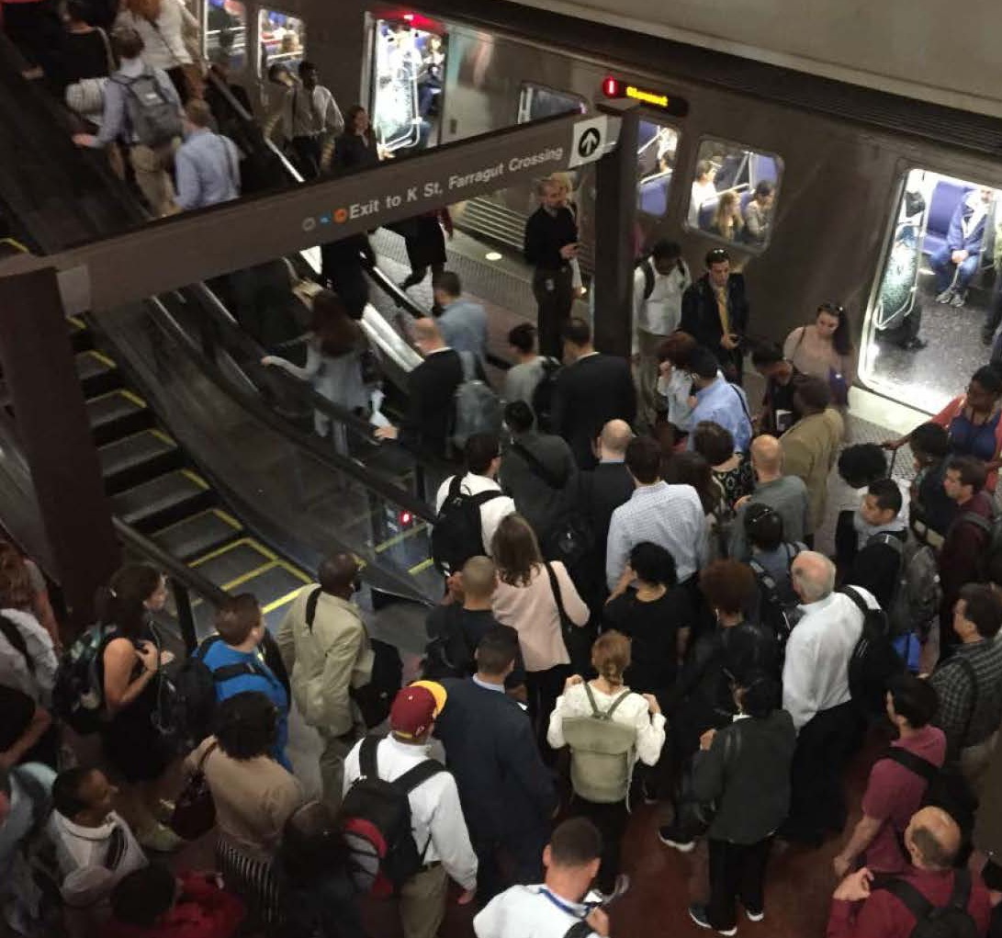
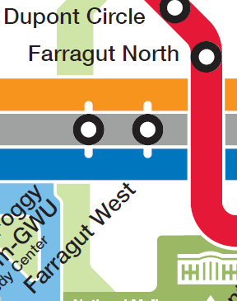
Case Study: Farragut North and West
Station Planning
Station Improvements and New Passageway
12

Slide 13
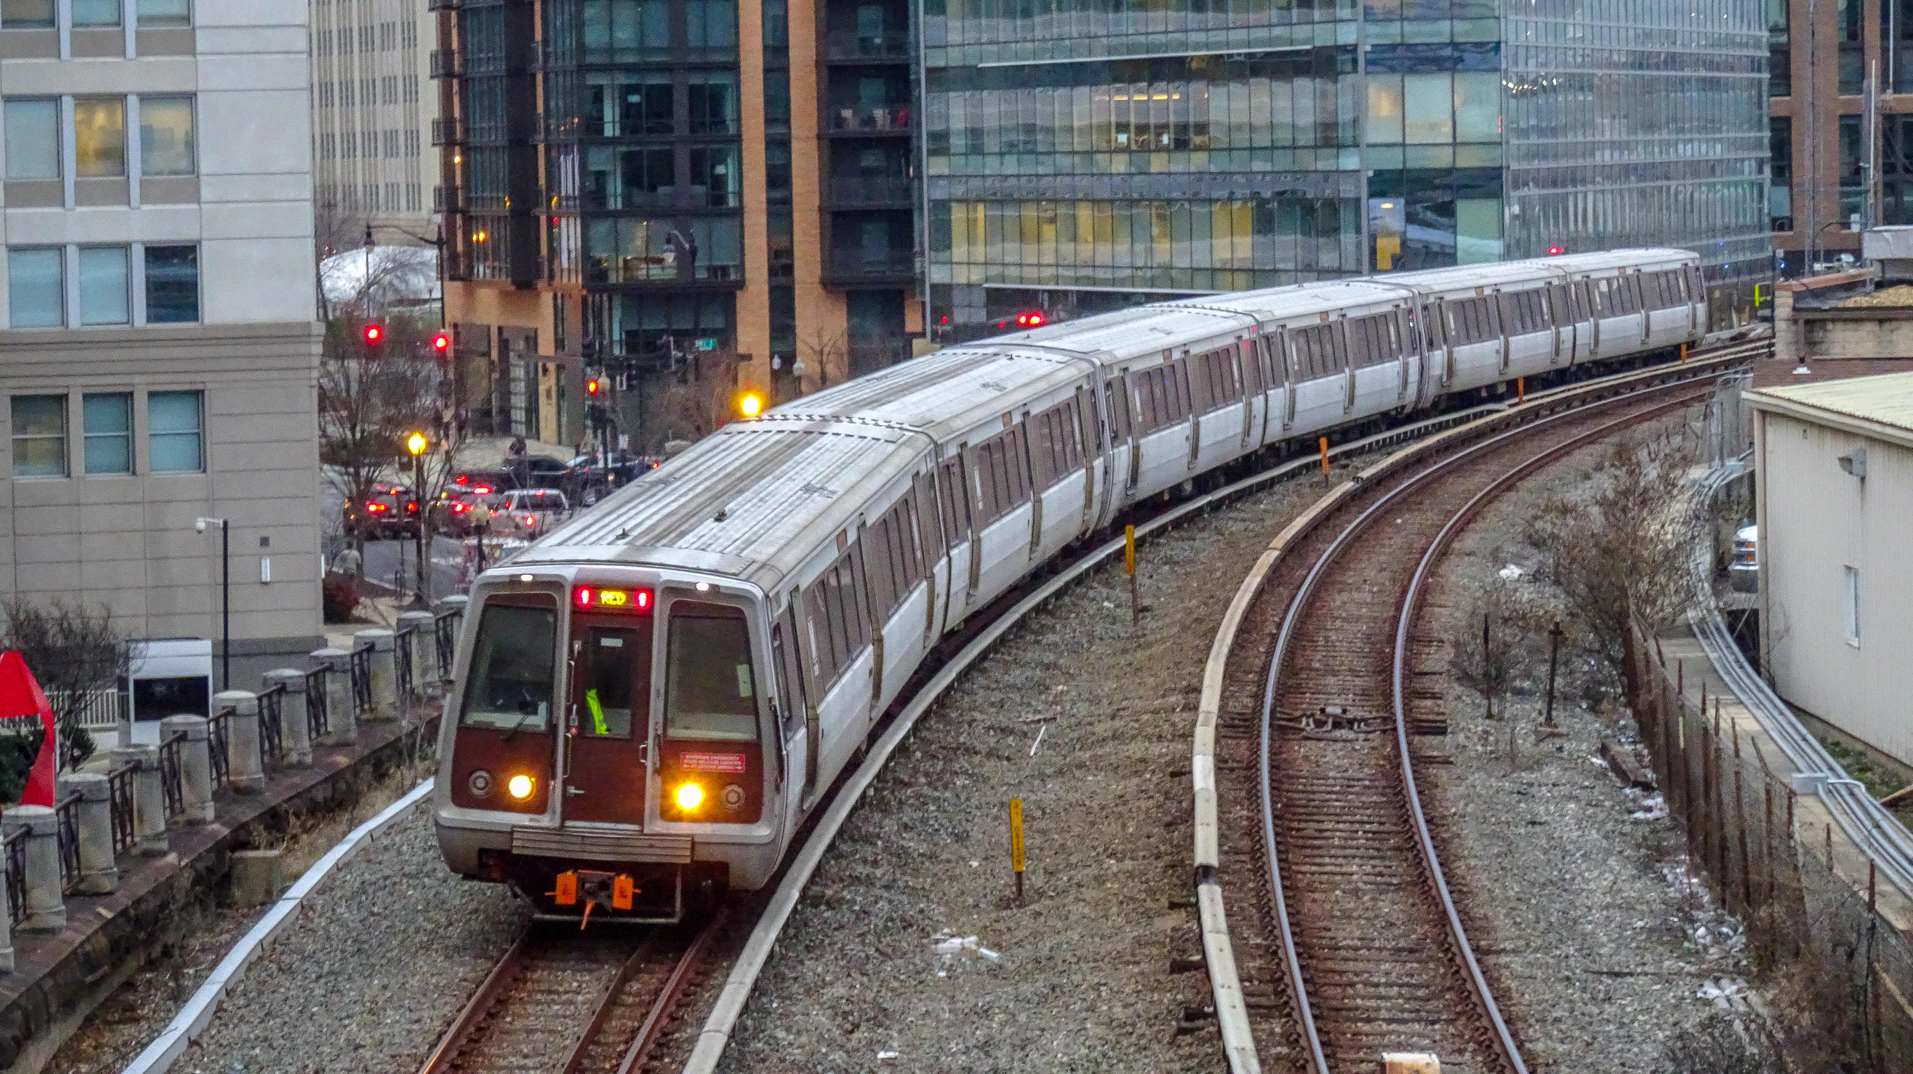
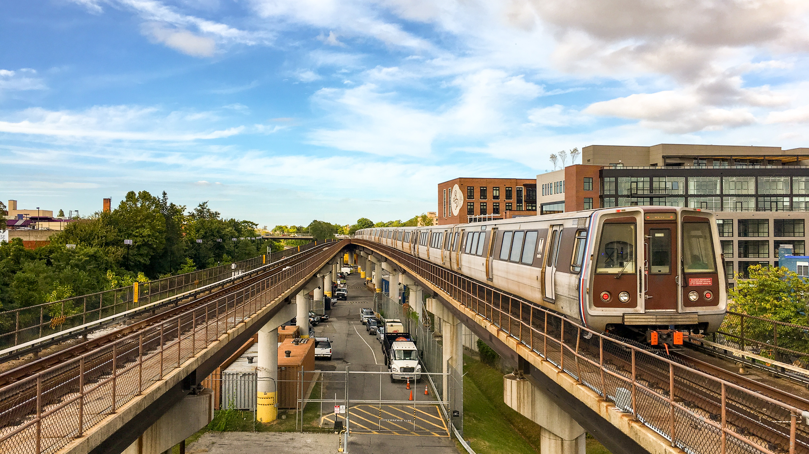
Capital Planning
Capital Planning
Develops WMATA’s Capital Needs Forecast and Capital Program
Delivers and reports/monitors on the Capital Program as it links to WMATA’s overall strategic goals and FTA’s required SGR targets
Establishes the polices, governance and business systems necessary for WMATA’s lifecycle management practices

Slide 14
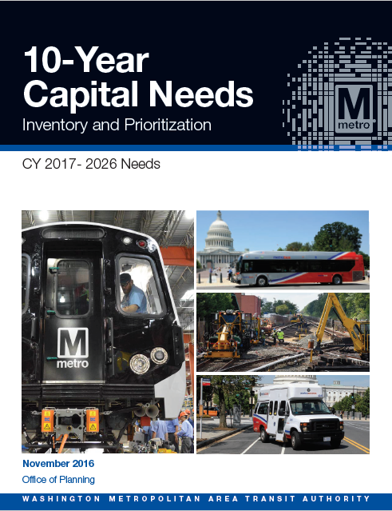
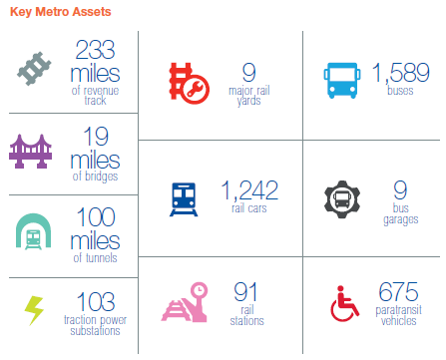
Capital Needs Forecast (2016)
Capital Planning
10 year prioritized summary of capital investment needs for CY2017 through 2026
Risk-based evaluation framework, with simple and transparent prioritization criteria
Delivered high-level investment needs as input to funding need discussions
Also identified critical safety or compliance needs and quantified magnitude
14

Slide 15















Improving the Capital Program
Capital Planning
Broad spectrum of customers with competing priorities
Effective coordination needed to:
  Strategically prioritize program and projects for greatest organizational impact
  Integrate capital program and project execution with focus on the customer
ROLLING STOCK
INFRASTRUCTURE
FACILITIES
BUS
SHELTER
TRACK
BUS
COMMUNICATIONS
RAILYARD
STATIONS
TUNNELS
PARKING
FARE COLLECTION
METRO
ACCESS
RAILCAR
VOLTAGE
15

Slide 16
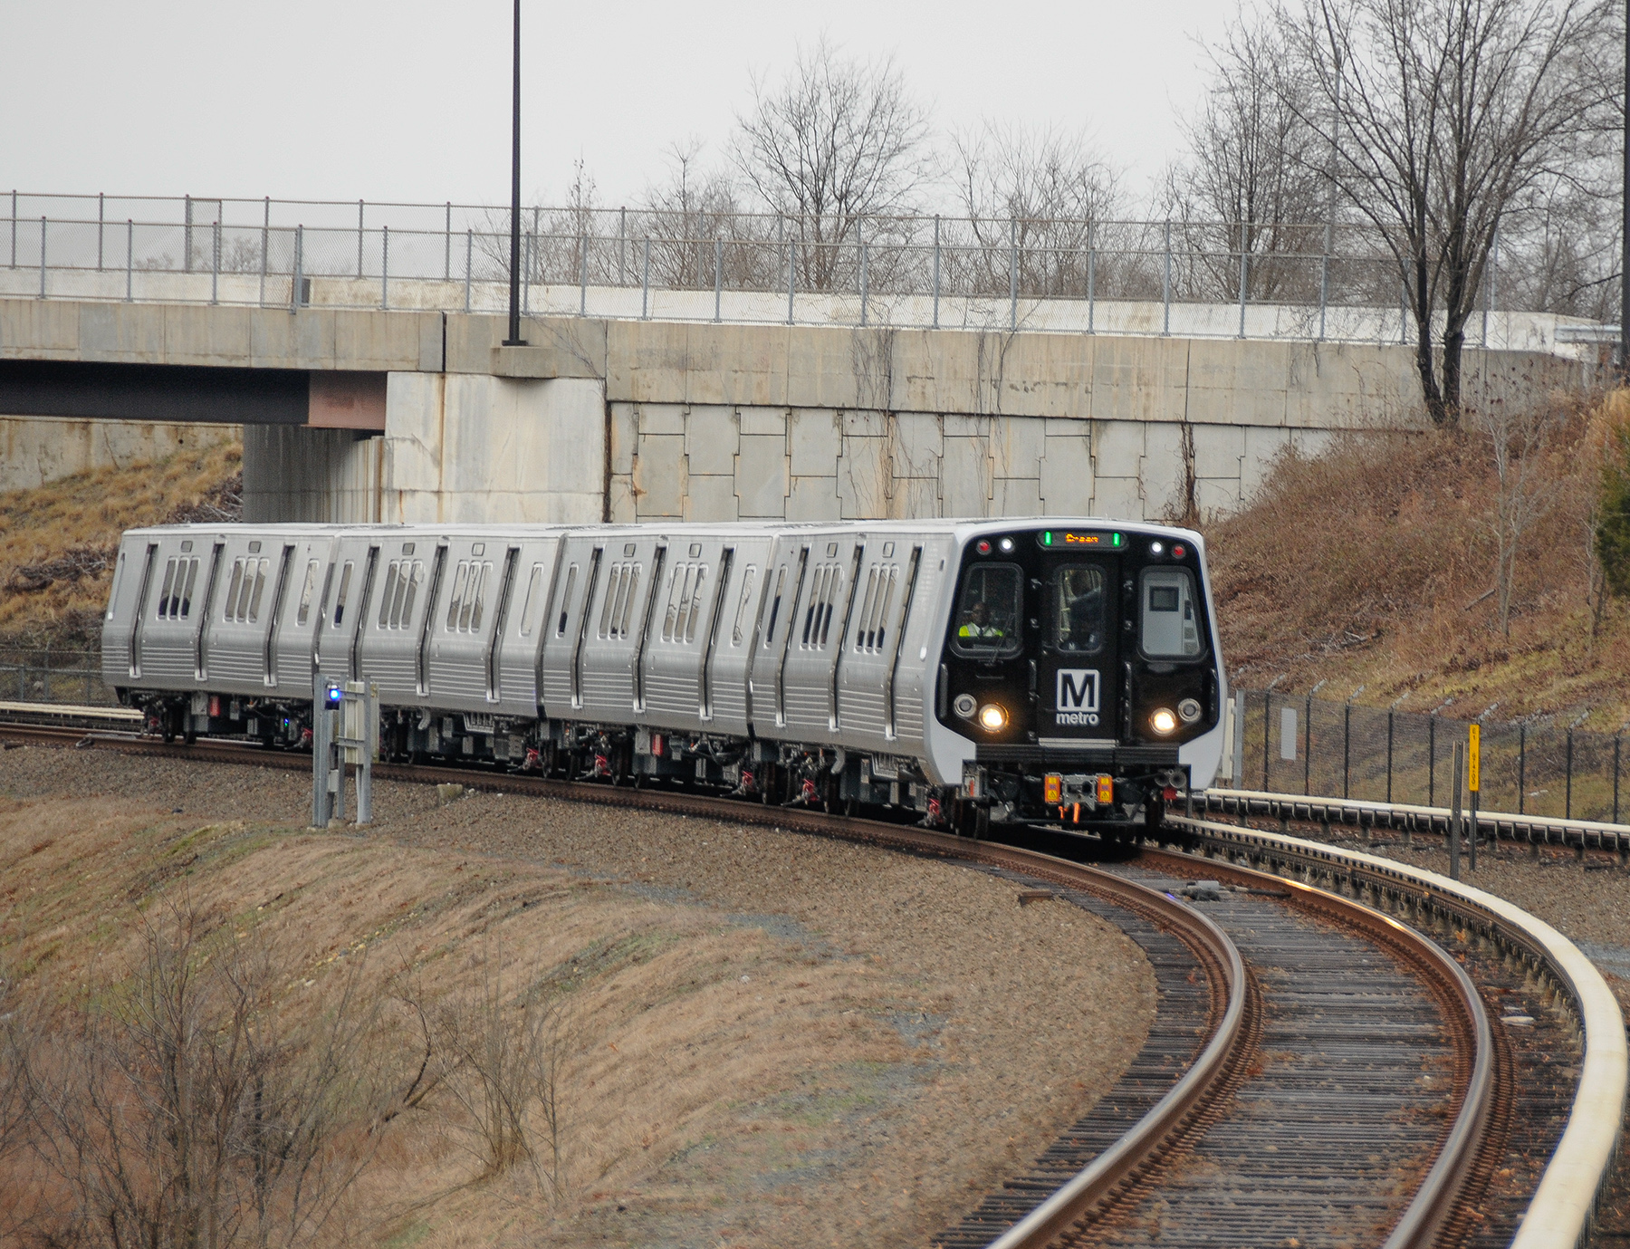
Transit Asset Management
Asset Management
Management Business Systems
Inventory and Condition Assessment
Policy, Strategies, Training
16

Slide 17
Enterprise Asset Management Implementation
Asset Management
Three-pronged effort to produce business-centric solutions, introduce the right technology enablers, achieve data quality and integrity, and train the company
Business Process Change
Policy and Procedures
Data Quality Initiative
Convening groups throughout the company to map their cradle-to-grave asset “touches”, business rules, SOPs, etc.
This intelligence will drive what the technology can and should do for us, and how the data will be codified, organized, managed, maintained, and used.
Definitions, classifications
Documented asset ownership(s)
Procurement guidelines
Induction SOPs
Decommissioning SOPs
Lifecyle plan support and guidance
Data governance policies
Contributions to capital planning
MAP-21 Reporting and Monitoring
42%
assets with conditions assessments
30%
assets with accurate Maximo records
17

Slide 18
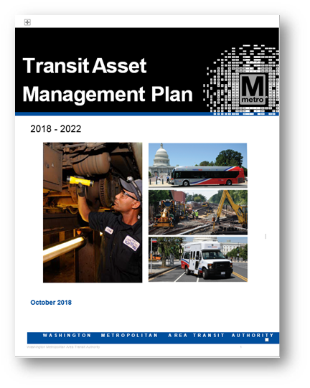
Transit Asset Management Plan
Asset Management
Signed and submitted on October 1, 2018
Sets vision and direction for Asset Management at Metro
Identifies 12 key avenues for improvement
Annual progress updates to FTA
Re-baselining in four years
Implementation Overview
Enterprise Asset Management (EAM) program (governance, framework, business processes)
EAM and AM training and certification programs
Confirm and develop PIs and SOPs that reflect departmental roles and responsibilities memorialized in plan
18

Slide 19
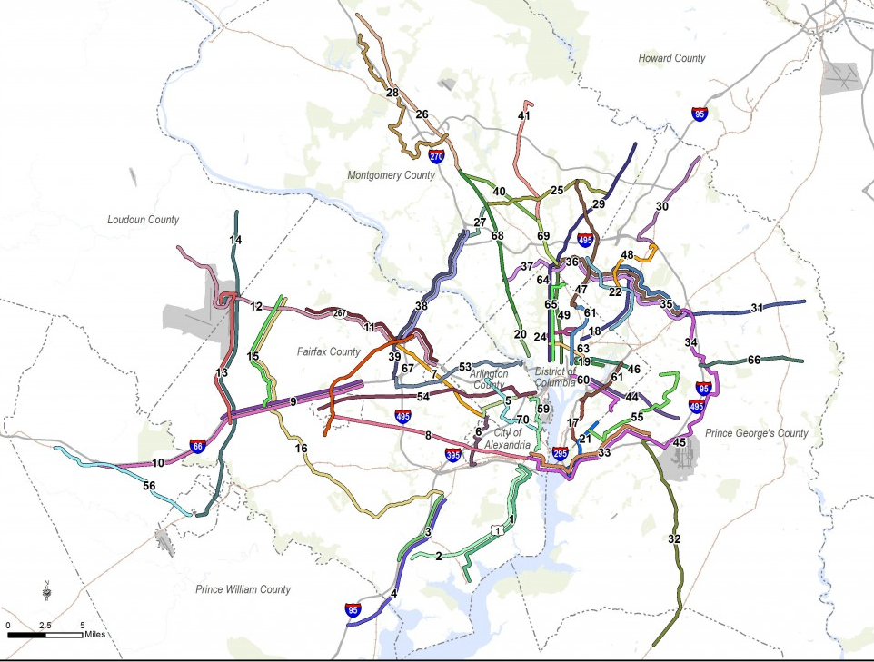



Strategic Planning
Strategic Planning
Long-range/ Regional Planning
Corridor Planning/NEPA
Title VI and Equity Analysis
Bike/Ped Access Planning
19

Slide 20
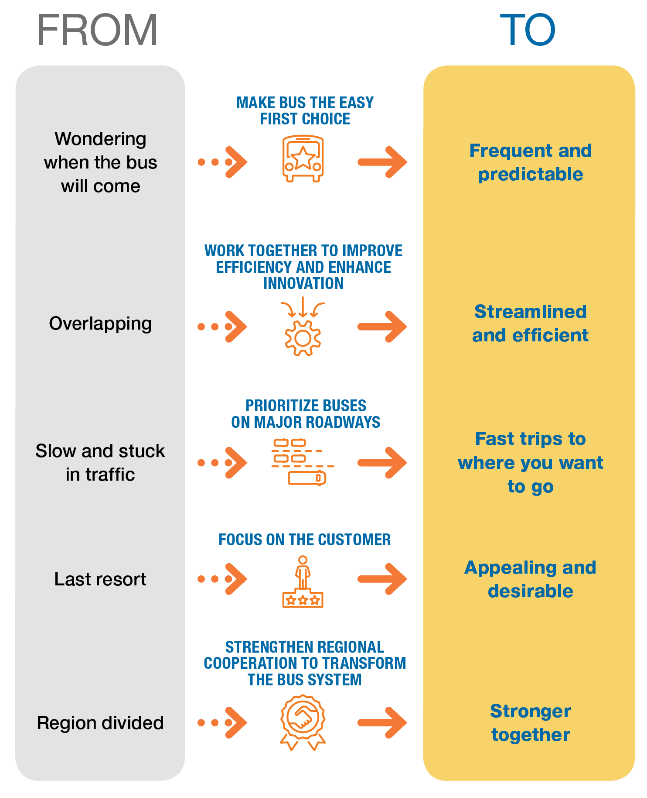

Case Study: Bus Transformation
Strategic Planning
  Strategy Outcomes:
  Focus on what customers want - fast, frequent, reliable, affordable, bus service that is easy to use
  Maximize the benefits of buses by providing the right type of service in the right places at the right times
  Prioritize buses on major roads, making buses more cost effective and delivering fast, reliable, and frequent service.
  Create a bus system that feels unified to the customer while empowering multiple bus providers to address unique challenges
  Ensure immediate and sustained action by government entities to implement the changes that will make buses the mode of choice on the region’s roads

Slide 21



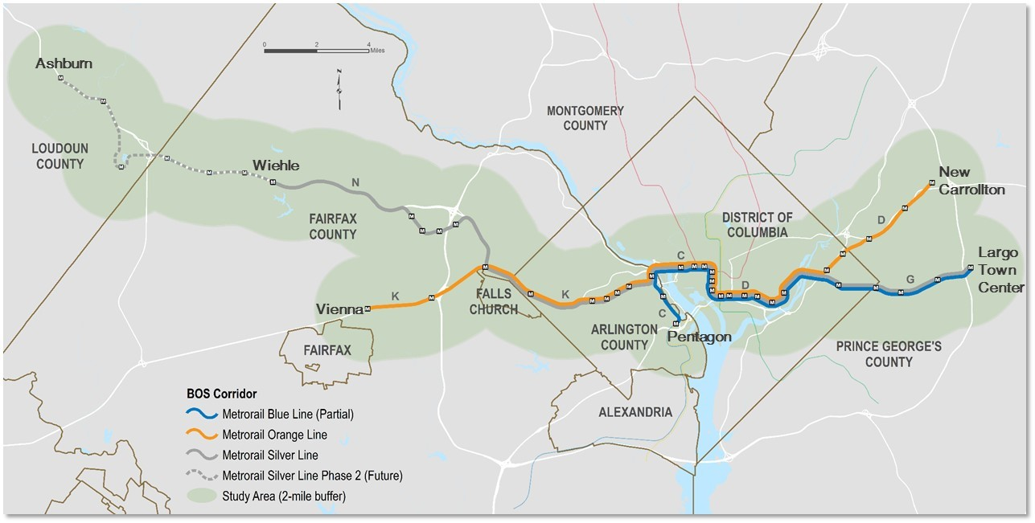




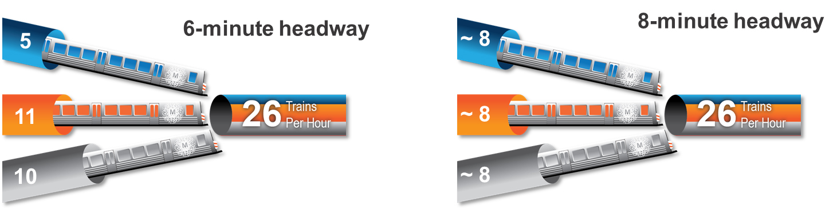

Case Study: Capacity and Reliability Study
Strategic Planning
Reduce impacts of
construction, disruption
Address urgent ridership and capacity needs
Maintain or improve reliability, customer-focused service
Build capacity for flexibility, lower costs
Leverage transit’s environmental benefits
21

Slide 22
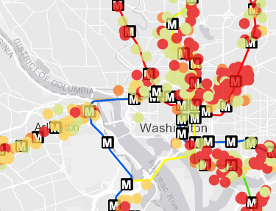
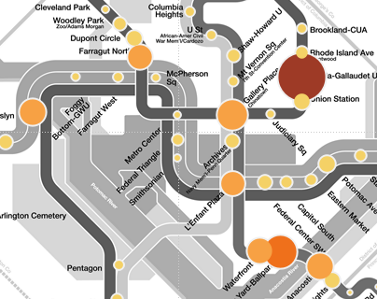
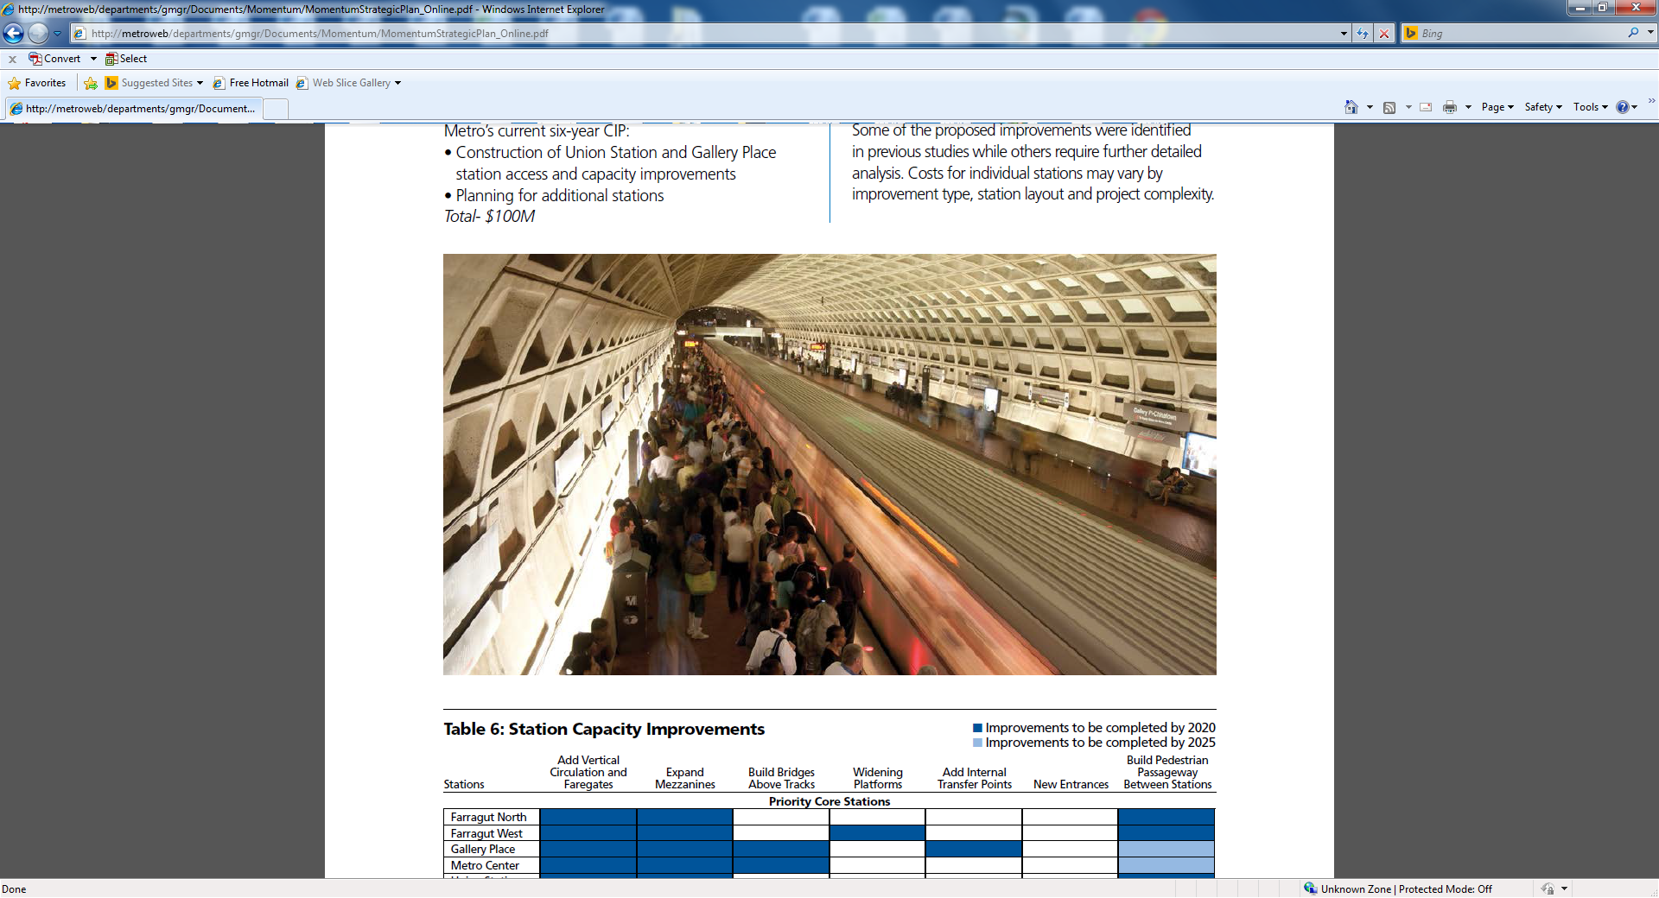
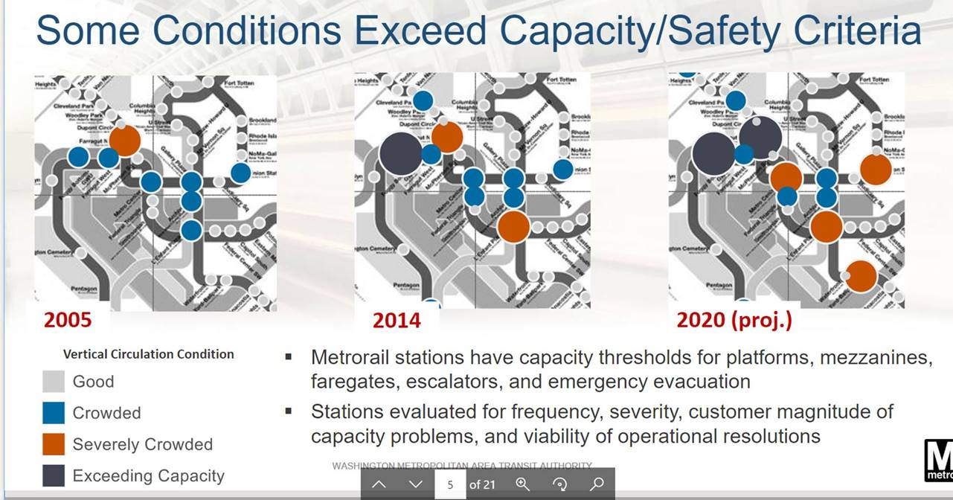
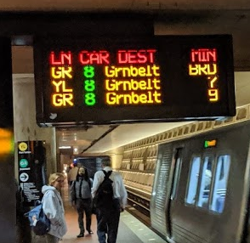
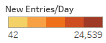
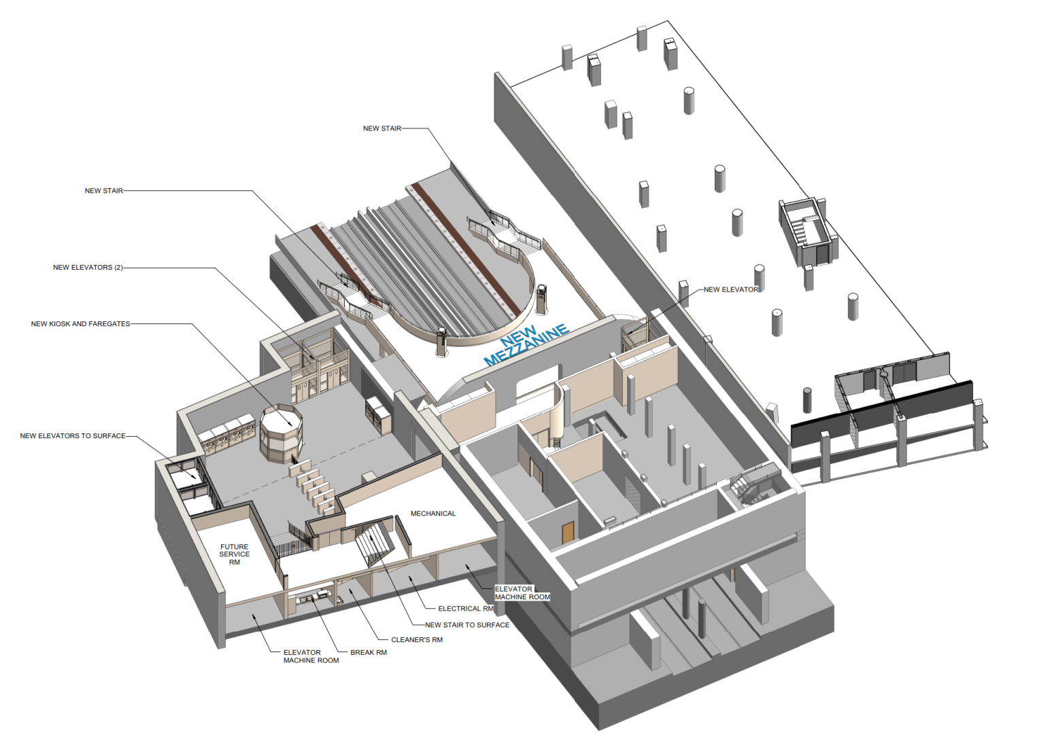
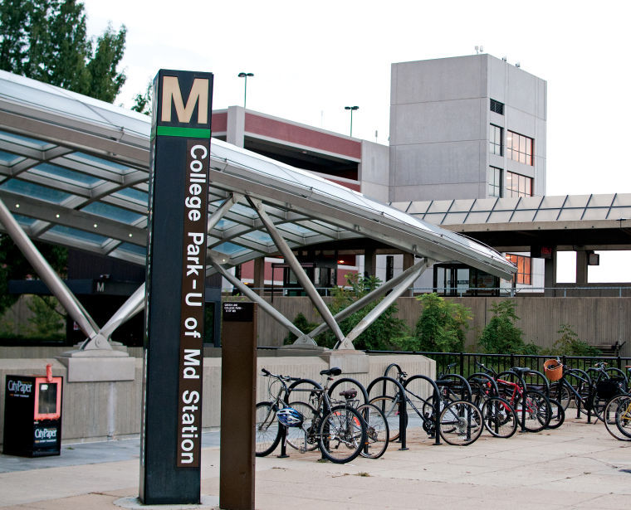
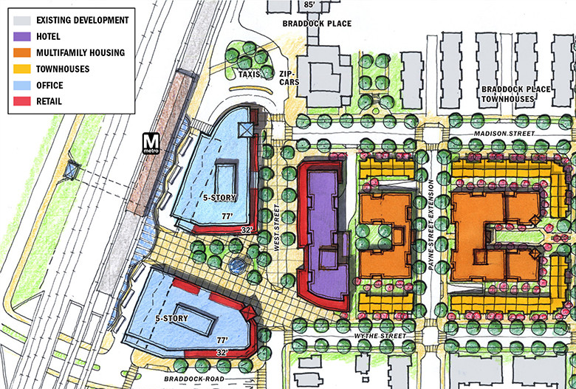
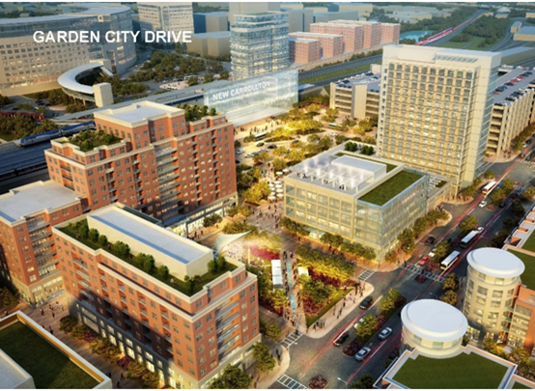
Case Study: Planning for Transit Oriented Development
Strategic Planning
662 projects, 221M sf
Tracking development pipeline
and land use data
Tools for estimating ridership
and revenue from TOD
Tools for estimating vehicle
and station crowding
Identify capital needs,
shape capital program
Formulate service changes,
rail fleet needs
We use planning tools to encourage TOD and maximize benefits
Station Capacity and Access Plans
Bike/Pedestrian Access Blueprint
Coordination on Station Area Plans
Joint Development

Slide 23
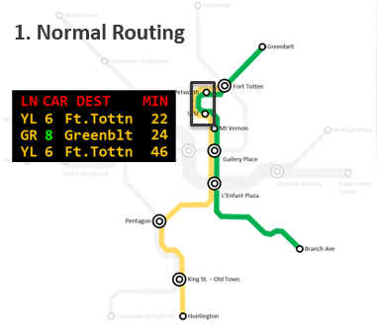
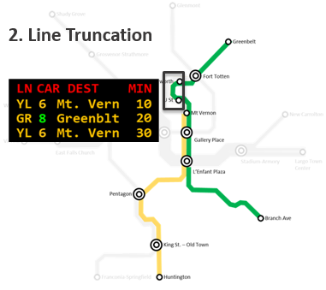
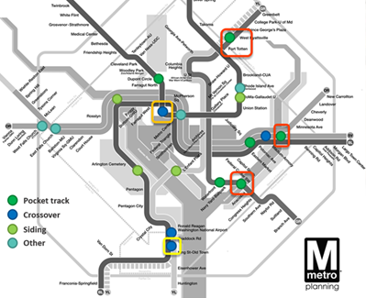

Case Study: Flexible Metrorail Operations Analysis
Strategic Planning
Leverage planning and operational best practices to optimize service under current conditions
Identify strategic locations for future infrastructure investment to improve operational flexibility
23

Slide 24
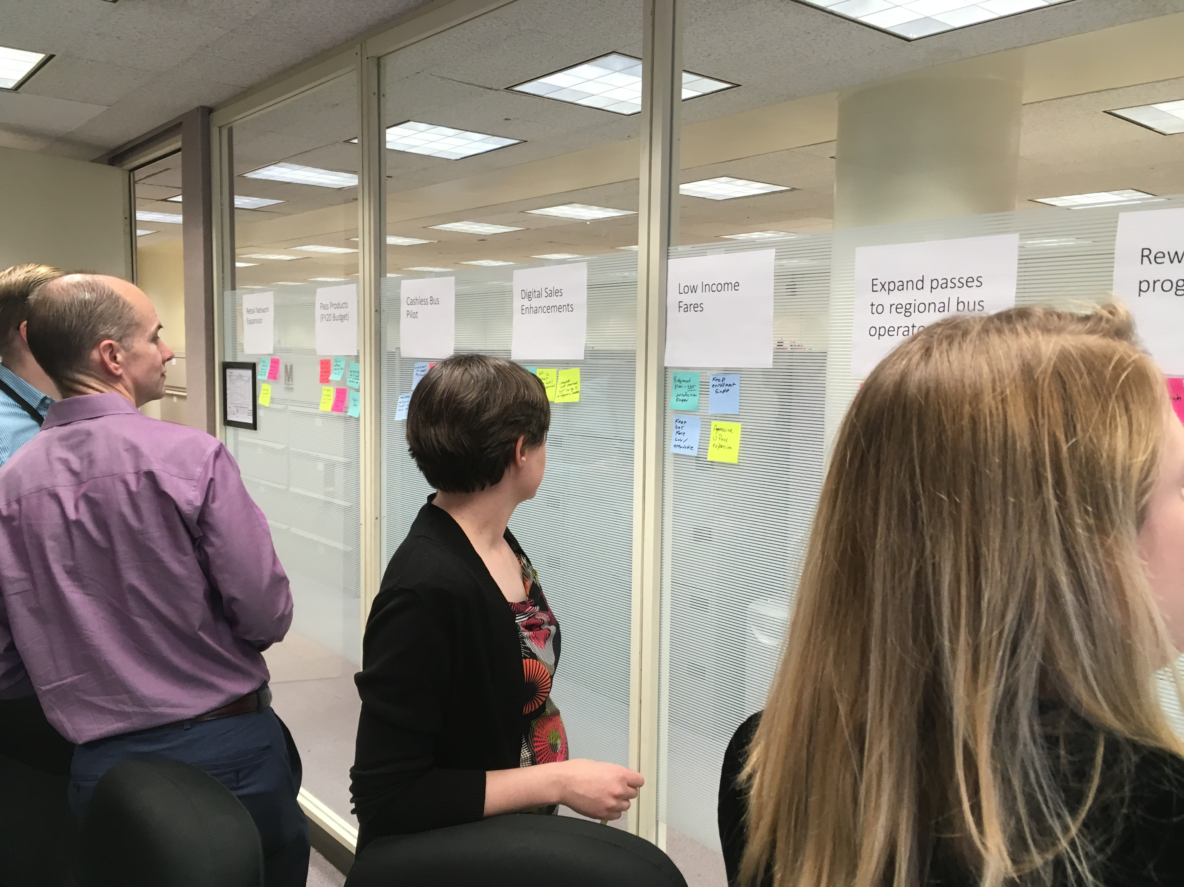
Cross-Functional Working Groups
Metro Office of Planning
Fare Strategy Working Group
  Fare policy, structure, and products
  Mobility as a Service
  Encouraging cost-effective fare payments
Equity Working Group
  Develop broad equity policies
  Focus on mobility, affordability, access of minority and low-income residents
CPO | FARE | GOVR | IPLN | MKTG | MREL | OMBS | RAIL | RESR | TRES
24

Slide 25
Introduction to the Metro Office of Planning
Preparing Metro for the Future
Shyam Kannan, VP Planning
8/15/2019
METRO INTERNAL USE ONLY

