Slide 1
Ethics Exercise
EnoMAX 2019 Exercise
Kevin Coyne
08/15/2019
METRO INTERNAL USE ONLY

Slide 2
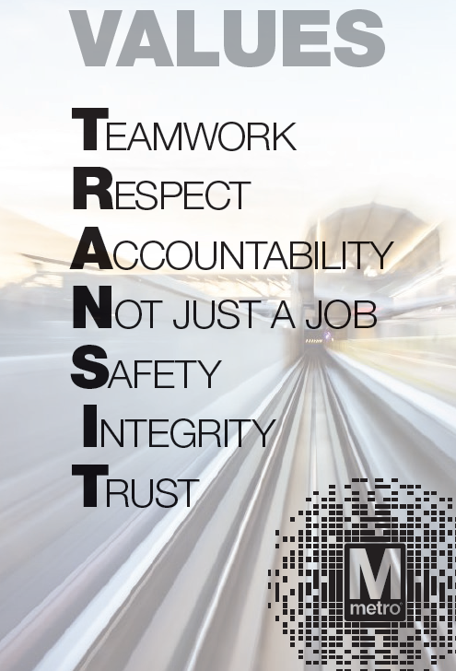
COO Mission, Vision, Values
MISSION
Move the region through safe, reliable and cost-effective public transportation.
VISION
Be the best transportation system in North America because we are consistently on-time with the cleanest
vehicles and stations. Ridership is at full capacity, with optimized networks that offer fast, frequent service to connect communities. All customers feel appreciated, have their needs met, and would rather ride metro than other forms of transportation because it is a seamless, safe, and secure experience with the lowest crime rate in North America. We have minimized the need for paratransit services because our systems are sufficiently ADA accessible and friendly to customers with limited mobility. Our assets are in good condition and are maintained using reliability-centered practices that maximize availability at the lowest cost. No part of our system is beyond its useful life. COO is well-managed with low turnover: communication flows up, down, across and our priorities are clear. All employees are fully engaged, feel valued and take pride that they are making a significant contribution in public service.

Slide 3
Purpose
EnoMAX 2019 – Ethics Exercise
To develop innovative strategic thinkers and change agents who can lead agile, effective organizations
Introduce one framework for resolving ethical dilemmas
Practice applying that framework to analyze ethical issues and resolve ethical dilemmas

Slide 4
What We’ve Heard
EnoMAX 2019 – Ethics Exercise
DART
It’s not the rule that’s written but the thing people see that will set the tone
The best behavior managers will get is the worst behavior managers will tolerate
MARTA
Integrity – know who you are, be truthful to yourself
Carmen Bianco
Values

Slide 5
First Questions
EnoMAX 2019 – Ethics Exercise
How are ethics and morality related?
Ethical standards or norms are generally built upon, or determined by what is considered right or wrong
Who determines right and wrong?
Context/culture is important. Right and wrong in a legal context are determined through legislation, regulations issued by an executive branch, and interpretations handed down by courts. Law expresses (or should express) the basic values of the community. Citizens must make values known through the public sphere and system of governance. In such a context, right and wrong are determined by prevailing shared values. In many areas of life, the law is the standard.

Slide 6
Developing … and Scanning
EnoMAX 2019 – Ethics Exercise
Do you agree with the ethical paradigms? Is one, or more, more important than the others in your understanding of ethical decision making?
Are there any of the ethical paradigms that you do not consider a difficult choice (or ethical dilemma) in making a decision?
Do you think that there are different ethics for different professions?
Do you consider public-life ethics different than individual ethics?

Slide 7
Context…
EnoMAX 2019 – Ethics Exercise
Adapted from LTG (r) Sattler
Moral World
Vague guidance
Do the right thing
But, how do I decide?
Regulatory World
What does the policy say? The instruction?
Often open to interpretation
Legal World
The minimum
Don’t break the law

Slide 8
4 Paradigms (A tool for analysis)
EnoMAX 2019 – Ethics Exercise
- From R. Kidder, How Good People Make Tough Choices (New York: Harper, 1995)
Right versus Right
Truth Loyalty
Individual Community
Short Term Long Term
Justice Mercy

Slide 9
3 Principles (A tool for decision-making)
EnoMAX 2019 – Ethics Exercise
- From R. Kidder, How Good People Make Tough Choices (New York: Harper, 1995)
Ends-based - Do what’s right for the greatest number of people
Requires we weigh the pros and cons in terms of future effects, intended and unintended
Rule-based - Follow the principle you want everyone else to follow
Act in a way that your actions could become a universal standard
Care-based - Do what you would wish others to do to you
The golden rule

Slide 10
Putting It Together
EnoMAX 2019 – Ethics Exercise
- From R. Kidder, How Good People Make Tough Choices (New York: Harper, 1995)
Framework
Truth Loyalty
Individual Community
Ends-based
Rule-based
Care-based
Ethical Issue
Decision
Short Term Long Term
Justice Mercy

Slide 11
Teams
EnoMAX 2019 – Ethics Exercise
- From R. Kidder, How Good People Make Tough Choices (New York: Harper, 1995)
A
B
C
D
E
F
G
H

Slide 12
Scenarios
EnoMAX 2019 – Ethics Exercise
Scenario 1 - TEAMS A and D
You’re leading a division that is going through a difficult period. Budget pressure is significant and growing. Resources are limited. Performance requirements are under a great deal of scrutiny. Everyone is feeling it, and no one is happy about it.
You learn that your recently hired direct report has used insider (not “classified”) information about Vendor A, where he was previously employed, to press for expedited processing of important deliverables. This will ultimately cut time to complete a large project by 35%, with positive financial and operational impacts.
Understanding that using insider information in this way can advantage and disadvantage parties involved, what do you as the leader do, now that you know this is happening?
Notes:
Scenario 2: ignore employment law/disparate treatment issues, focus on matters of fairness

Slide 13
Scenarios
EnoMAX 2019 – Ethics Exercise
Scenario 2 - TEAMS C and F
One of your very best employees, who works closely with you in the office has recently and consistently been late to work by 15-20 minutes.
You pulled your star employee aside and found out that he is dealing with a new and long term child care situation.
His ONLY affordable option will not enable him to come to work at the normal time for the foreseeable future.
What do you as the leader do?
Notes:
Scenario 2: ignore employment law/disparate treatment issues, focus on matters of fairness

Slide 14
Scenarios
EnoMAX 2019 – Ethics Exercise
Scenario 3 – TEAMS E and H
Andrea, the subject matter expert on the project and a meticulous analyst, drafted a brief for her boss Jaqueline. In it, she reported a quarterly drop of 20% in a KPI. Given the scrutiny this will surely invite, Andrea detailed for Jaqueline her methodology and the steps she took to verify the accuracy of her report.
Jacqueline, known to be a high achiever and a ferocious competitor, was never shy about conveying her intentions to “move the needle” for the agency and for her team. Jacqueline acknowledged Andrea’s brief and numbers and thanked her for the effort. Andrea was a bit surprised by this reaction, as it would reflect negatively on Jaqueline as department lead. Additionally, Andrea remains sensitive to recent remarks in counseling where Jacqueline conveyed, indirectly, that Andrea could do more to be a better, more loyal team player.
The next day, Jaqueline delivered the brief to the senior leadership. Oddly, she reported only a 5% drop in the KPI, not the researched and verified 20% number Andrea provided. 5% would not invite deep scrutiny. Andrea, in the room as this was unfolding, knew this was an error. What should Andrea do?
Notes:
Scenario 2: ignore employment law/disparate treatment issues, focus on matters of fairness

Slide 15
Scenarios
EnoMAX 2019 – Ethics Exercise
Scenario 4 – TEAMS G and B
John, who works for Assistant Director Stanley, gets things done. He provides a big boost to the bottom line at a time when the agency really needs it.
Lately, however, there have been a number of complaints about John making his team work late, routinely holding meetings that push the workday to 15 hours. There’s been one report about John and his temper. In this instance, he “lit up” a below average performer, one who is capable of much better but is known to not apply himself in certain tasks. Also, slips, trips, and falls, are showing an uptick on John’s area.
But John’s operational performance numbers have never looked better. What, if anything, should Stanley, the Assistant Director, do?
Notes:
Scenario 2: ignore employment law/disparate treatment issues, focus on matters of fairness

Slide 16
DEBRIEF

