Slide 1
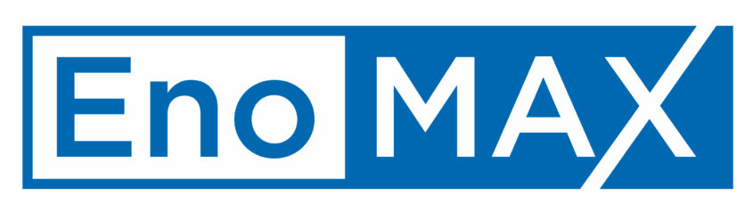
Enterprise Risk Management “Making it Work Every Day”
Elizabeth Sullivan
08/16/2019
METRO INTERNAL USE ONLY

Slide 2

Liz Sullivan
Vice President, Chief Risk and Audit Officer
Management Audits, Risk and Compliance (MARC)
Office of Management Audits, Risk and Compliance
Ms. Sullivan heads the Office of Management Audits, Risk and Compliance, and leads the internal audit function in providing assurance and advisory services that enable change for strong organizational governance, internal controls, and effective risk management. She has over 22 years of audit, risk management, and financial industry experience. In addition to internal audits and assurances services, her office has also taken on the responsibility of facilitating Enterprise Risk Management (ERM) across the organization.
Ms. Sullivan will be speaking on integrating risk management to improve performance and decision making.

Slide 3
MARC Supports Business Transformation
WMATA In Transition
MARC welcomes partnership opportunities to transform our transit business aiming the momentum toward meeting the relevant needs of our ridership community and achieving stakeholder goals and objectives. We strive to accomplish business transformation by:
Advising and supporting management in the three lines of defense (3LoD) model.
Management owns risk, and the responsibility for identifying, monitoring, and executing appropriate risk responses in business planning and performance results to achieve business objectives.
MARC supports management ownership of its risk by providing facilitated Risk Control Self Assessments (RCAS) to identify potential problems and in defining the appropriate strategies to mitigate risk impact on business objectives.
MARC provides independent audits and assurance by applying risk-based evaluations that inform management of high risk zones and opportunities to further improve processes and controls.

Slide 4
Risk Management is Everyone’s Responsibility
The Three Lines of Defense Model provides a simple and effective way to illustrate Metro’s cohesive and coordinated approach to managing
risks to the achievement of objectives.
The First Line of defense lies with the business
and process owners whose activities create and/or manage the risks that can facilitate
Metro’s objectives or prevent them from being achieved.
Board of Directors and Committees
Metro’s General Manager and CEO, Executive and Senior Management
The Second Line is put in place
by the GM/CEO to support management in ensuring that risks and controls are effectively managed.
1st Line of Defense
2nd Line of Defense
3rd Line of Defense
Management Functions
Metro Departments and Offices
Management owns and manages risks and internal controls
Safety Oversight
Quality Assurance
Information Security
Physical Security
Enterprise Risk Management
Internal Compliance and Monitoring Activities
Internal Audits
Management Audit and Assurance Services
Metro Office of Inspector General (OIG)
Independent audits and assurance services provided by MARC serves as the Third Line of defense, and MARC collaborates with OIG’s Office of Audits, which also provides independent assurance with a direct reporting relationship to the Board.

Slide 5
Enterprise Risk Management Program
What is Enterprise Risk Management?
The Premise
Every entity – whether for profit, not-for-profit, or governmental – exists to provide value for its stakeholders. All entities face risk in the pursuit of value.
Risk is the possibility that events will occur and affect the achievement of strategy and business objectives, which may be positive or negative.
Enterprise Risk Management
The process that allows organizations to identify, evaluate, and manage risks that could significantly disrupt the successful achievement of mission and objectives. (AFERM)
The culture, capabilities, and practices, integrated with strategy-setting and its performance, that organizations rely on to manage risk in creating, preserving, and realizing value. (COSO ERM)
Coordinate activities to direct and control an organization with regard to risk. (ISO 31000, International Standards Organization)

Slide 6

Enterprise Risk Management Program
Enterprise Risk Management – Why Important?
Successful organizations have a culture of risk management
Improves decision-making and supports the deployment of resources based on risk
Encourages open communications about significant risks and reduces gaps and inconsistencies with the management of process level objectives
Enhances knowledge management and workforce development
Mature transit agencies and other progressive organizations have an explicit risk management structure
Notes:
Transit Agencies

Slide 7


Enterprise Risk Management Program
Enterprise Risk Management Success Stories
Toronto Transit Commission –
Enterprise Risk Management Award of Distinction - RIMS 2017
U.S. Department of Education, Federal Student Aid – Reported to have a strong commitment to risk - GAO

Slide 8
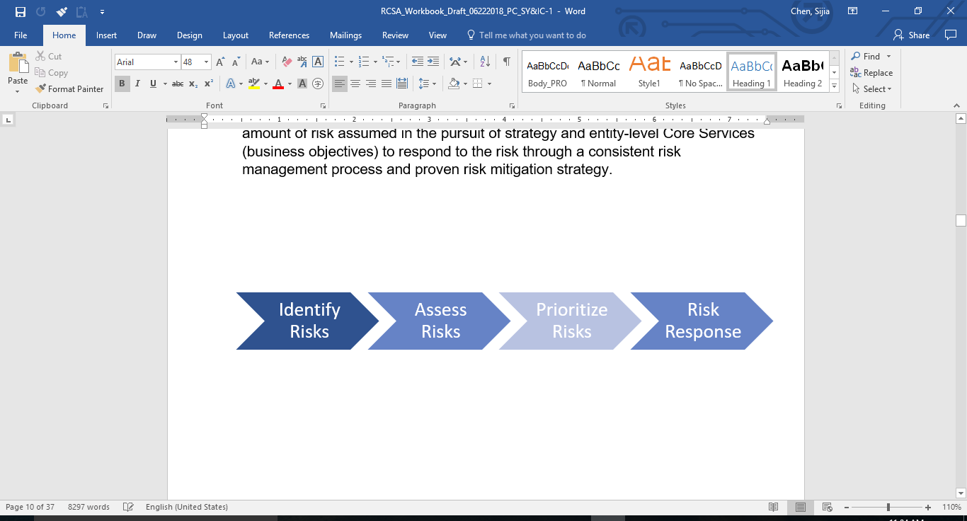
Enterprise Risk Management Program
Risk Assessment Process
Risk assessment is an iterative process that occurs enterprise-wide and considers risk across all levels of the organization.
Entity Level Process Level Special Focus Areas
  COSO Assess Risks Process Flow Diagram
Step 1 Risk Identification
Identification of the risk event is a critical step in the risk assessment process. If key risks are not accurately identified or fully understood through detailed analysis, they cannot be assessed, prioritized or managed effectively.
Step 2 Risk Assessment
Assessment of the risk event severity is determined through impact and probability analysis. The risk assessment may take many forms to focus on the key risks that are most relevant and significant to the Authority with the greatest consequences or potential opportunities for expected outcomes.
Step 3 Risk Prioritization
Prioritization of the risk event improves allocation of resources in response to the potential impact and probability of those risks occurring, and decision-making on risk responses.
Risk Response is required for risks identified, assessed, and prioritized with a risk level of High, Elevated, and Moderate. Often, any one of several risk responses will bring the residual risk in line with the tolerance, and sometimes a combination of responses provide the optimum results.

Slide 9
Risk Categories and Elements
Enterprise Risk Management Program
Service Delivery
Financial Management
Legal and Compliance
Asset Management
Business Interruption
Knowledge Management
Process Efficiency
Supply Chain
Training & Development
Workforce Competencies
Empowerment
Labor Management
Performance Incentives
Financial Management Controls
Budgeting
Cash Flow (AP & AR)
Grants Management
Legal, Illegal & Fraud Acts
Policies & Procedures
Political & Regulatory Changes
Third Party (Counterparty)
Safety
Strategic
Capacity
Innovations
New Projects & Programs
New Initiatives
Employee & Customer Safety
General Public Safety
Natural Disaster
Physical Security
Reputation
Brand/Image and Marketing
Communications (Internal & External)
Customer/Stakeholder
Employee Conduct
Public Relations
Information Technology
Information Management
Integrated Systems
IT System Reliability
Technological Innovation
Logical Security
Cyber Security
Access
Completeness & Accuracy
Data Integrity
Information Availability

Slide 10

Top-Ten Entity Level Risks
Enterprise Risk Management Program
INFRASTRUCTURE DISREPAIR
CYBERSECURITY AND INAPPROPRIATE ACCESS
LITIGATION AND FRAUD
WORKFORCE PLANNING AND TALENT MANAGEMENT
ASSET MANAGEMENT INFORMATION
POLICIES, PROCEDURES, AND COMPLIANCE
REPUTATION AND STAKEHOLDER PERCEPTION
CULTURE
IT INFRASTRUCTURE RELIABILITY AND TECHNOLOGY ADVANCES
MANAGEMENT AND LABOR UNION RELATIONSHIP
Top Ten Risks for calendar Year 2018 as assessed by Executive Management.
Top risk noted by other transit agencies and other organizations

Slide 11
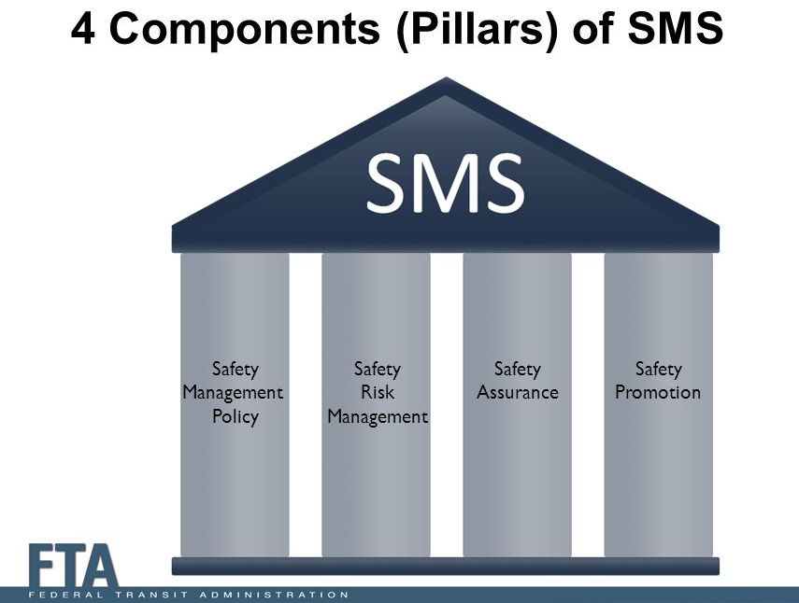
Safety Risk Management (SRM)
ERM Supports Compliance with Safety Risk Management Requirements of SMS
Safety Risk Management
FTA 49 CFR Part 673.25
Safety Hazard Identification
Safety risks are identified during the Process-Level Risk Assessments workshops.
2. Safety Risk Assessment
Safety risks are assessed and aggregated in the Risk Inventory.
3. Safety Risk Mitigation
Safety risks are mitigated through oversight of corrective action plans.

Slide 12
Enterprise Risk Management Program
Achievements
Opportunities
Metro ERM Program – About 100 facilitated risk workshop sessions.
Financial Management Controls – Control Validation Process.
GRC Archer – Automating Governance, Risk and Compliance monitoring process.
Silver Line Extension – Special focus risk assessment for RAIL operations.
Transit Security Grant Program – Completed pilot field test for DHS/FEMA.
Other ERM Activities – Partnership with Cybersecurity and Transit Asset Management.
Metro Transit Police Department – Leverage data results from threat and vulnerability assessment.
Continuity of Operations Plan – Conduct a risk assessment for business continuity and disaster recoveries as a special focus risk area.
3% Challenge – How ERM can support efforts to keep operating subsidy growth to 3% or less annually.
Cross Functional Areas Risks Assessments
Third Party Vendor Risk Assessment

Slide 13


“You Can’t Manage A Secret!”
Quote by: Alan Mulally, Former CEO of Ford Motor Company
The Ostridge's method of managing risk is hiding its head in the sand…
“Not the WMATA approach”
Notes:
Why ostrich hide their head in the sand?
The story that ostriches will stick their heads in the sand when they are frightened is a prevalent one. The idea is that the ostrich will feel perfectly safe and believe that they are completely hidden, so much so that a person can walk up to them and pluck a feather or even capture the bird very easily.

Slide 14
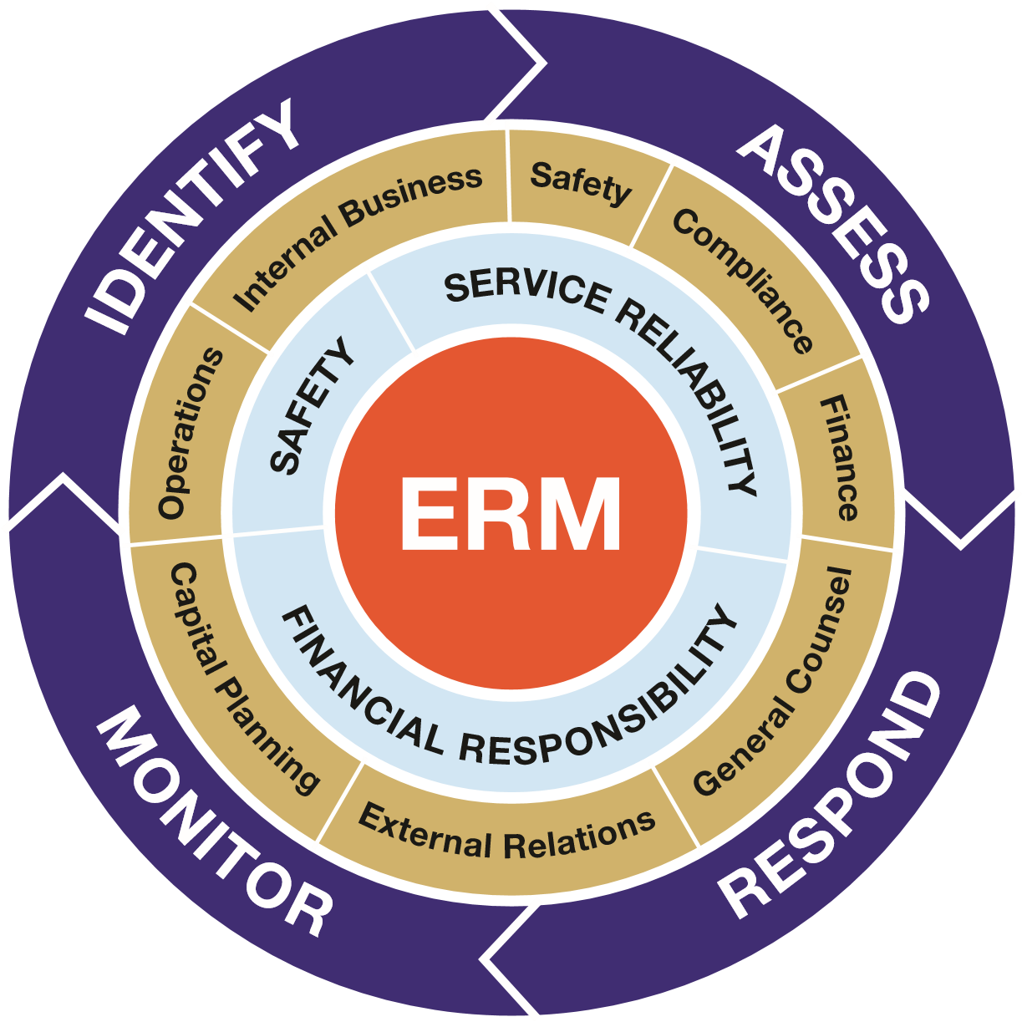
Questions?
Questions
Elizabeth Sullivan
Vice President, Chief Risk and Audit Officer
Management Audits, Risk and Compliance (MARC)
Washington Metropolitan Area Transit Authority
600 Fifth Street NW [7D-16]
Washington, DC 20001-1234
EOSullivan@WMATA.com

