Slide 1

Crime Strategy and Reduction
Metro Transit Police Department
Sergeant Maurice McKinney
August 12, 2019
METRO INTERNAL USE ONLY

Slide 2
Purpose
Crime Strategy and Reduction
Provide an overview on the process MTPD uses to address crime in the bus and rail system.

Slide 3

Organization Chart
Chief of Police
Office of Professional Responsibility
Assistant Chief
Strategic Executive Officer
Administrative Deputy Chief
Patrol Operations Deputy Chief
Homeland Security Deputy Chief
Emergency Management Director

Slide 4
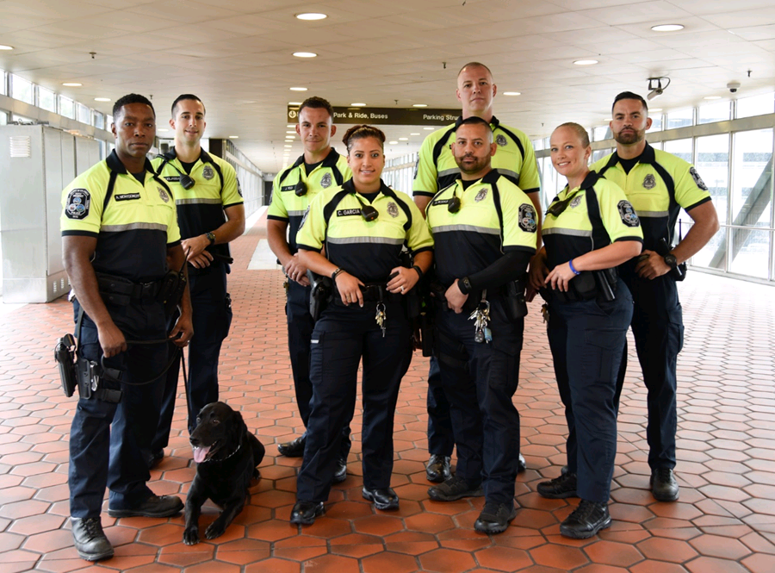
Manpower
  Established: June 4, 1976
  Function:
    Prevent crime
    Protect Metro’s customers, employees, facilities and revenue
    Enforce laws, ordinances, rules and regulations
Authorized strength:
  439 sworn officers
  141 security special police
  94 civilian personnel

Slide 5

Threats & Vulnerabilities
Public transportation systems are “open systems”
Must remain vigilant
  Mass transit is a soft target
  Large crowds
  Limited resources
  Proximity to public and federal places of interest
Voluntary national-level security audit (BASE Assessment)
  Conducted by TSA
  Scored “GOLD” rating

Slide 6
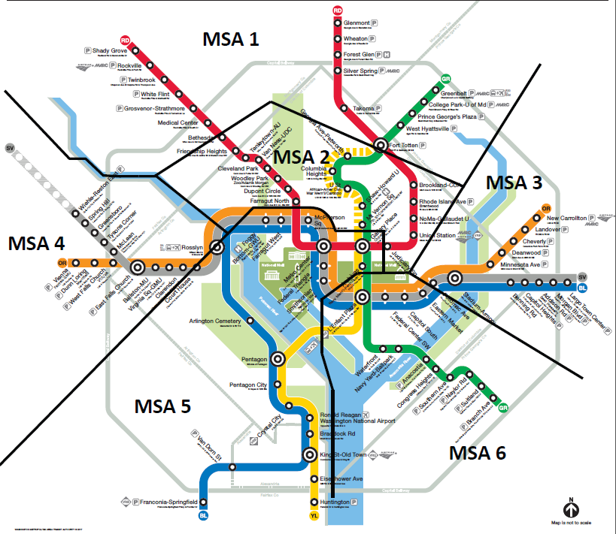
Metro
Service
Areas
Crime Strategy and Reduction

Slide 7
2018 Crime Stats Overview
Crime Strategy and Reduction
Part One Crime (2018)
Crime Type | #
Aggravated Assault | 106
Arson | 4
Burglary | 2
Homicide | 0
Theft Other | 474
Theft Snatch/Pickpocket | 217
Motor Vehicle Theft/attempt | 43
Rape | 5
Robbery | 257
TOTAL: | 1,108
There were 1,108 Part One crimes reported in 2018, reflecting a 14% decrease in crime compared to the prior year.
Nearly 80% of crime occurred within the Metro Rail system.
Over half of offenses occurred in the District of Columbia.
Nearly 13,000 citations/summonses were issued, the majority of which were for Fare Evasion offenses.
Enforcement Efforts | #
Arrests | 2,673
Citations/Summonses | 12,951
Written Warnings | 333
Calls for Service Count | 71,985
Traffic Violation Citations | 16,640

