Slide 1
A Capital Conundrum
Developed by WMATA for EnoMax 2019
Notes:
Today – instead of a panel discussion or lecture on Rail State of Good Repair challenges or capital programming, we are going to let you try your hand at running the railroad.
All of the issues, projects and events are based on reality.
Names and details have been changed, but represent real issues.
Numbers are scaled to be mostly accurate relative to each other, though simplified to enable you to speed through 5 years of decisions in less than 2 hours
ALL HYPOTETICAL for learning purposes
Where to begin…

Slide 2
Congratulations!
You are the new head of DC Metro!
Your agency has just secured $12.5B in funding over the next 5 years
After years of trouble and emergency rehab programs, safety and reliability are high and customer satisfaction is improving
However, stakeholder & customer expectations are rising along with increased competition from new modes of mobility
For the first time in recent memory, you have plenty of funding, so the question now is:
What are you going to do with all that money?

Slide 3
How to play the Game
Annual Budget planning
Year in Review
You will have 10 min to set your 2020 Budget. You can spend up to $2.5B
Each year thereafter, you will have 5 min with your team to do the next year’s plan
Decide what projects you want to fund, plus your annual operating budget: $2.5B
SOGR: Standard or Accelerated
Service/Capacity Improvement
Operational Investments
At the end of each year, we will review performance of the projects and impact to your key metrics
Highlight key events that happened. The consequences of these events – good and bad – depending on how you chose to allocate your resources.
Notes:
For clarity – all projects are “new” and at 0% complete.

Slide 4
State of Good Repair projects
Purpose
SOGR Projects
State of Good Repair (SOGR) is all about keeping your existing assets in good working order
No extra revenue
No new service
Key benefit: Improving SOGR improves reliability
OTP increases, which drives ridership
ATC System Renewal
Tunnel Ventilation
Platform Rehabilitation
Traction Power System
Tunnel Leak Mitigation
Floating Slab Elimination
Notes:
Be more even verbal project highlights (it signaled too much what projects were important)
Reference handout

Slide 5
Capacity Enhancements
Purpose
Capacity Projects
Projects enhance service provided by either increasing capacity, quality or customer experience
Expanded service and/or ridership means more revenue
No impact to OTP
Key benefit: Increased Revenue
More revenue means more money to spend next year, on other projects
Upgrade D&G interlocking
Farragut N/W Connection
Foggy Bottom Second entrance
Yellow Line Extension to National Harbor
Digital Communications Upgrade
Customer Experience Enhancements
Fleet Expansion for 100% 8-car Trains
Notes:
Be more even verbal project highlights (it signaled too much what projects were important)
Reference handout

Slide 6
Operational Investments
Purpose
Operations Investments
Annual Operating Expenses (OpEx):
The cost of delivering service every day, including train operators, station managers, inspection and maintenance teams, emergency response teams
Estimated at $1.0b/year
Projects to enhance employee experience and build the capacity of the DC Metro team
A better trained, equipped and motivated team will take better care of the customer and improve efficiency
Key benefit: Improved Customer Experience
Annual Operating Expenses
New Offices/Employee Facilities
Employee Learning & Development
Modernization & Efficiency projects
Notes:
Be more even verbal project highlights (it signaled too much what projects were important)
Reference handout

Slide 7
How to Win
2 Measures of Success
How to Win
Customer On-Time Performance (OTP)
OTP is the percent of customers who get to their destination on time. The higher the number, the better.
It is also an indicator for ridership: people only ride when it is safe and reliable
Starting point is 88% OTP.
Final score will be average OTP across the 5 years
State of Good Repair (SOGR) Backlog
To keep your funding, you need to reduce the backlog of SOGR projects
Starting point is $5.9B in SOGR needs.
[Note: any revenue impacts of final year will be applied against the ending SOGR balance.]
Stick to your core values and the details will work themselves out
Safety
Reliability
Fiscal Responsibility
Think about your team and how to work together to make these decisions

Slide 8
The Game Board
Step 1: Check Funding Avail.
Step 3: When ready, Submit Annual Budget
Step 2: Allocate funding in yellow boxes
Standard vs Accelerated
Enter any number for L&D, Mod/Eff and Op Budget

Slide 9
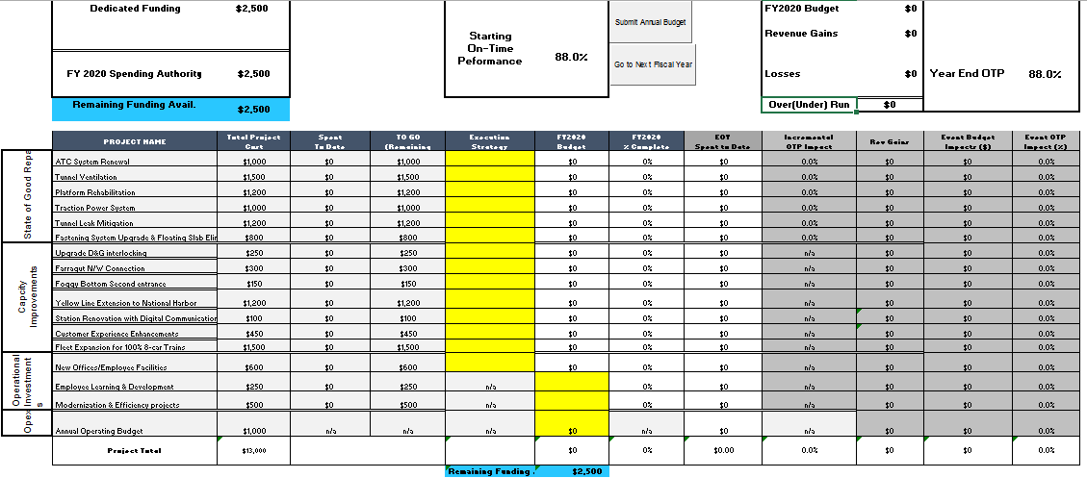
The Game Board
Step 4: Go to Next Year
Step 3: See Year End Results
Step 1: See Project Impacts
Step 2: Enter Event Impacts

Slide 10
Tracking progress

Slide 11
Let’s go!
15 min to set your 2020 Plan

Slide 12
2020 Year in Review

Slide 13
Signal Failure
Signaling failure at D&G snarled Orange, Blue and Silver lines for hours, leading to backups all the way to Virginia
If ATC project is Accelerated
Design had already been developed and you were able to direct the materials and contractor to D&G to resolve quickly
No impact to OTP or Budget
If ATC SOGR project is funded Standard
You had to accelerate design work for this location but were able to leverage existing contracts, resolving the issue within a month
OTP for 2020 Reduced by 0.5% [Enter -0.5 in cell O8… make sure it is negative!]
If ATC SOGR is not funded
Without a project in place, you had to issue emergency task order to your GEC to get a design a solution, followed by emergency procurements for the materials. It took 6 months to get service back to normal
OTP for 2020 reduced by 3% [Enter -0.5 in Cell L8 … make sure it is negative]

Slide 14
Foggy Bottom Development
New development announced at Foggy Bottom station, increasing demand at this station
If Foggy Bottom new entrance and vertical circulation was funded,
Great news for metro - you are able to capture the increase in demand and ridership and revenue increases. Increasing revenue effectively lowers your operating costs as you need less subsidy from the jurisdictions.
Annual Revenue increased by $20m for every year hereafter.
If Foggy Bottom wasn’t funded:
No impact. Station was so crowded that people found alternatives to metro.
Now with the added traffic and development in this area, it will be impossible to get construction permits until 2025. Project is no longer available.

Slide 15
5 minutes to Set & Submit your Budget for 2021

Slide 16
2021 Year in Review

Slide 17
3k car defect found
A defect was found in the 3k cars that enables cars to move with the doors open. All 200 cars must be immediately pulled from service
Impact:
If 100% 8-car project Spent to Date >=$1000m
No impact, new cars are used to replace the 3ks without impact
IF 100% 8-car project is not funded
3ks pulled from service, OTP reduced by 1% due to no cars available. [Enter -1%]
Note: you must start this project next year or continue to suffer 1% loss in OTP every year until the project spent to date exceeds $1000m

Slide 18
Power Outage in Northern Va
Cyber attack aimed at Pentagon takes out the power grid in Northern Virginia. No power to Pentagon station, Pentagon City & Crystal City.
Impact:
If 2021 OpEx > $850m (85%) and TPSS SOGR Spent to Date >=$300m
Teams activated contingency plans and minimized impact. Trains ran at reduced speed and normal headways until power grid was restored.
No impact to 2021 OTP or Budget
If OpEx >$850m (85%), but TPSS SOGR not funded (spent to date <$300m)
Teams activated contingency plans and minimized impact. Due to old infrastructure limiting the power capacity, trains ran at reduced speed and Yellow Line suspended to reduce load until power was restored.
Loss of revenue from reduced service hits Budget for $75m revenue loss
If OpEx < $850m (85%)
Response plan botched. Customers were stranded for hours and lost confidence in Metro, leading to steep decline in ridership
$200m revenue loss as customers are reluctant to return [Enter on Operating Budget line]

Slide 19
5 minutes to Set & Submit your Budget for 2022

Slide 20
2022 Year in Review

Slide 21
Fire @ Cleveland Park
Smoke/fire incident at Cleveland Park
Impact:
If Traction Power SOGR Spent to Date >= $675m (75%)
Fire was a damaged LV heat tape cable
No Impact
If Tunnel Ventilation Spent >= $450m
Fire was caused by deteriorated high voltage cables failing under peak service. However the new tunnel ventilation system performed well, controlling the smoke and enabling safe evacuation
Safety Regulators issued $75m fine for failing to comply with corrective action plans to address TP SOGR
Otherwise
Without an effective ventilation system, this event became catastrophic. People are calling for your resignation given that both the power SOGR and lack of sufficient ventilation issues have been known for years. FTA, NTSB and Congress are investigating
FTA mandates both Traction Power SOGR and Tunnel Ventilation must be accelerated immediately [fund @ Accelerated in 2023]
Fines & Damages add up to $250m in loses
Customers feeling unsafe and ridership drops – OTP down 10%

Slide 22
Customer Experience Improved
The new customer experience enhancements projects have been well received by the industry and the press. But have they really affected ridership and revenue as planned? At the end of the day, customers care most about whether or not the train was on time, if the climate conditioning was working on the train and in the station and that the escalators/elevators were working.
Impact:
If OpEx > $1,000m and OTP >= 90%
Customer improved paid off! If completed, Station Renovation w/ Digital increases revenue by $10m + Cust Service by $20m
If OpEx >$950m and OTP >= 87%
The new features helped attract riders, but frustrations about hot stations and down escalators muted the benefits. Ridership increase by only 50% of projections. Digital increases revenue by $5m + Customer Service by $10m
If either threshold violated
All the amenities don’t make up for inconsistent service. No increase in ridership or revenue
Note: these projects continue to be available; annual revenue earned by each project will be as described above every year.

Slide 23
5 minutes to Set & Submit your Budget for 2023

Slide 24
2023 Year in Review

Slide 25
Platform Collapse -
Platform Collapse Reported at Addison Road, inbound track. All service suspended!
Impact:
If Platform program is more than 50% complete, Spent to Date >$600m
False Alarm – Upon investigation the materials found in the track bed turned out to be some old formwork. No impact to service.
If D&G expansion project was completed [Spent to Date =$450m]
Extensive platform rehabilitation is required, however the impact of single tracking was minimized by turning Silver Line back at D&G. Some customer delays still experienced outbound of Addison Road.
2022 OTP reduced by 0.5%
Budget $50m revenue loss
If Platform program is active (at least $100m spent in 2023), but less than $600m to date
Extensive platform repairs are required but you are able to modify existing contract to redirect resources. Result is 1 month severe service reduction to Blue and range
2022 OTP reduced by 2%
Budget impact $150m revenue loss
Otherwise (Platform program not active in 2023)
3 month severe service reduction to Blue, Orange and Silver
2022 OTP reduced by 10%
Budget impact of $350m revenue loss

Slide 26
Service Hours Extended
Board votes to extend passenger service by 6 hours a week, closing at midnight and 2a on the weekends.
If modernization projects funded >$300m (cumulative to date)
Efficiencies gained when accessing the roadway and new Reliability Centered Maintenance (RCM) strategies have paid off, enabling this service extension to be made without negative impact
No impact to OTP
Otherwise,
Late night single tracking is increased to try to make up the time, but it isn’t enough to cover all the crews, especially not with the capital program still in full swing. Reliability will decline both from increased single-tracking and more frequent incidents
2024 OTP will be reduced by 3% [No need to enter anything, change will be automatic]

Slide 27
5 minutes to Set & Submit your Budget for 2024

Slide 28
2024 Year in Review

Slide 29
Coordination Fail @ Nat’l Harbor
The Yellow Line extension to National Harbor ran over budget due to coordination issues with Woodrow Wilson bridge. [Note – only applies if this project was funded]
Impact:
If L&D >$100m cumulative and OpEx >$1000m (100%) in 2022,
Those Project Management courses and new process paid off! The issue was caught early and managed well. The team was able to find an alternative solution minimize the impact.
No impact to OTP or OpEx
If OpEx >= $800m (80%)
The change was not well managed and resulted in significant delay claims. Net $200m impact to the budget
If OpEx <$800m (80%)
Massive delays lead to questions about the contract management and budgeting processes. Audit uncovers significant failures, resulting in Jurisdictions cutting capital funding.
Project is delayed AND next year’s funding is capped at $1.75B
Enter -$750m on Operating Budget line
Enter -$200m on Project line to pay out delay claims to contractor

Slide 30
Mass Retirement
The baby boomer generation is rapidly approaching retirement and more than a third of the DC Metro workforce is eligible for retirement! In order to slow the “brain drain” of decades of institutional knowledge leaving the authority and recruit new talent to backfill them smoothly, maintaining employee morale and working conditions is vitally important.
Impact:
If new Office/Breakroom project has been completed
Employees are excited about the new offices and stay past their eligibility date.
No impact: Staffing shortages effectively avoided
If Learning & Dev Spend >=$250m (cumulative)
While the people are frustrated about the employee facilities, the increased recruiting and training programs are helping offset the wave of retirements.
2024 OTP reduced by 0.5% due to key shortages in operations [enter on Office Project line]
Otherwise
Anger at management boils over that with over $12b in funding, none was spent on addressing employee concerns. Feeling unappreciated, employees retire and find better employment elsewhere. Compounding the problem, recruiting is struggling to attract new talent in the competitive labor market
2024 OTP drops by 10% as there are not enough people to cover service, even with overtime. [Enter on Office Project Line]

Slide 31
Game over
Please save with your team name

Slide 32
A Capital Conundrum DEbrief
Winners & Learnings
Notes:
Today – instead of a panel discussion or lecture on Rail State of Good Repair challenges or capital programming, we are going to let you try your hand at running the railroad.
All of the issues, projects and events are based on reality.
Names and details have been changed, but represent real issues.
Numbers are scaled to be mostly accurate relative to each other, though simplified to enable you to speed through 5 years of decisions in less than 2 hours
ALL HYPOTETICAL for learning purposes
Where to begin…

Slide 33
Take-aways– Life happens
Safety First means SOGR before Capacity Projects
Can’t ignore known issues even though the fix is painful
After safety, customers care most about reliability and the “basics” (train, escalators, HVAC)
Importance of funding OpEx
Perfect assets & new customer amenities don’t matter if operations can’t deliver safe, reliable service
OpEx is always needed to cover inspections, emergency responses, etc.
Some events are beyond your control, but you have to be able to take care of your people & the public
Invest in the future
Employee morale is important part of capital program → Unhappy employees = unhappy customers
Modernization is key to rising competition

Slide 34
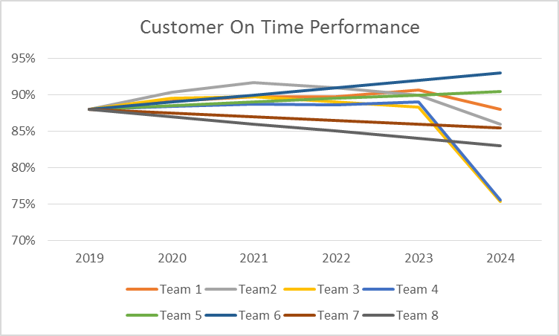
Customer on time Performance

Slide 35
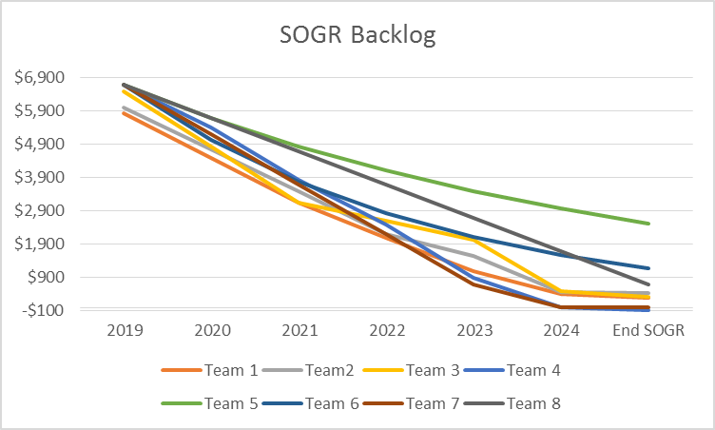
SOGR Backlog

Slide 36
Congratulations!
Team XXX had best OTP
Team YYY had lowest backlog
Team ZZZ had the combined best result

