Slide 1
DART Central Business District Rail Replacement
MAXX Program Presentation
May 3rd, 2019
Presented by: Mike Holbrook,
Vice President, Rail Operations

Slide 2
Project Technical Overview
Central Business District Transitway Mall Rail Replacement Project

Slide 3
Project Technical Overview Background

Slide 4
Project Technical Overview Background

Slide 5
Project Technical Overview Historical Background
Narrow gage
Train truck “hunting” in standard gage territory
Requires custom wheel profile to minimize hunting
Increases wear on rail & tire
Rail Grinding
Inability to grind girder rail until recently
Surface corrugation and profile
Rail Wear
Inability to measure rail profile until recently
Rail hardness too soft from single rolling during forging

Slide 6
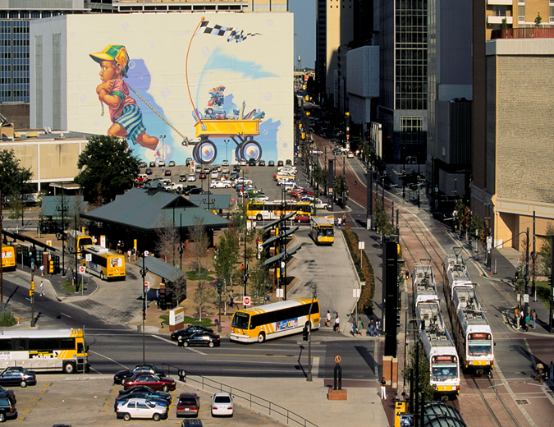
Project Technical Overview Recent Experiences

Slide 7
Project Technical Overview Inspection Results
Findings
No erosion of track bed
No major degradation of track drainage system
No degradation of icoset insulation material
Excessive rail wear in some locations: Curves, wheel flanges riding on rail guard
Girder rail severely worn

Slide 8
Project Technical Overview

Slide 9
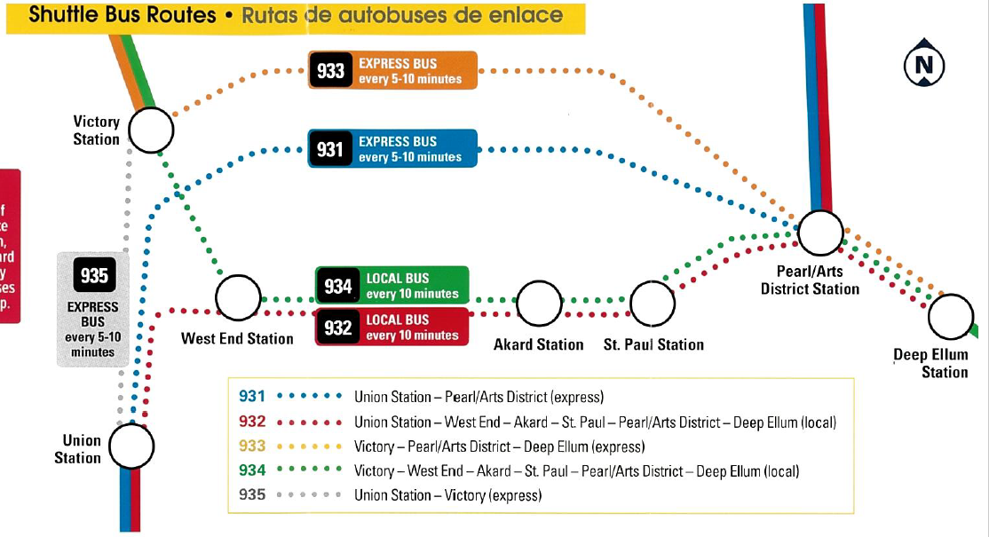
Customer Communications

Slide 10
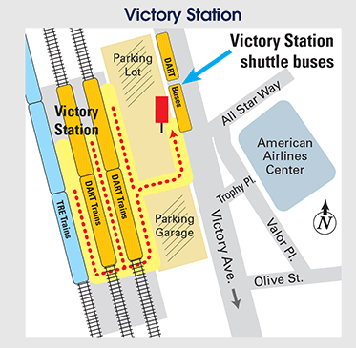
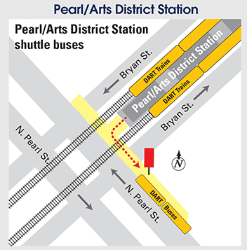
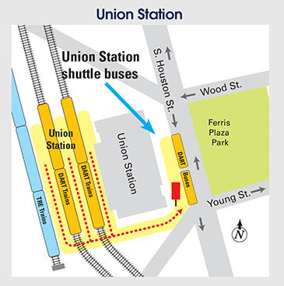
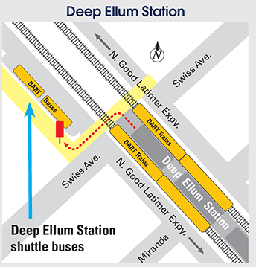
Customer Communications

Slide 11
Project Technical Overview Replacement
Phase 3 A, B and C – Bid Option 1 will include the following:
A – Rail Replacement and installation of two (2) 50-meter crossovers as specified in the contract documents.
B – Intersecting Street Crossing Headers and Drainage improvements.
C – Bid Option 1 – Rail Replacement for the remainder of the CBD segment of the DART Light Rail Transit System as specified in the contract documents.
You Tube of DART Rail Replacement Dec 20-21

Slide 12
Questions

