Slide 1
Week Highlights at a Glance
Evolving Today……Shaping Tomorrow
Sunday – Meet at Hotel lobby 5:00pm /Reception
Monday – CATS Overview /Streetcar Tour
Tuesday – Capital/Operations / Economic Dev Tour
Wednesday – Business Pitch/ Training /Art in Transit
Thursday – Technology/Business Project Simulation
Friday – GM Panel Discussion/Graduation

Slide 2
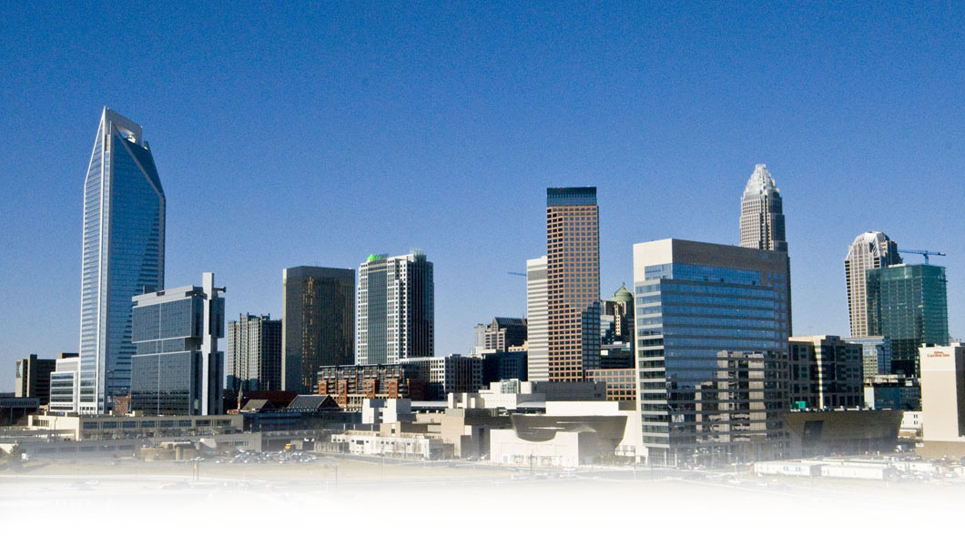
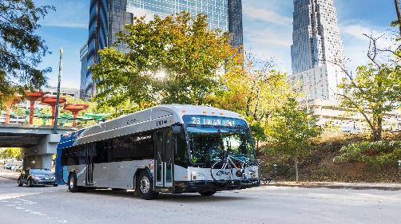
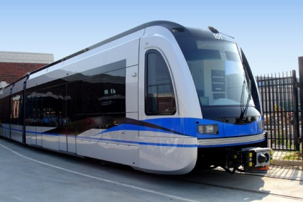
Questions?

