Slide 1

Business Case Training
EnoMAX2019
Throughout the program year, training and support will be provided to assist you in the development of your Business Case and complementary Business Pitch. There will also be informal opportunities for coaching and advice.

Slide 2
EnoMAX 2019 Cohort
Business case Timeline
Enrollment Stage
1st Class Visit
2nd Class Visit
3rd Class Visit
4th Class Visit
Post EnoMAX
Student identifies Problem or Opportunity
Submit Project Statement Description via online Enrollment Form
Refine Project Description online using the Max Business Project Form
Eno delivers a Welcome Session including an overview of Business Project process
Eno delivers Guidelines to a Successful Business Case Workshop
Host Agency schedules Business Project Information Exchange (BPIE) meeting for each visiting student
Eno Facilitator provides Business Coaching to Host Agency students
BPIE #2
Business Coaching (Host Agency)
Eno Staff checks in on progress and responds to questions during a Progress and FAQ
Eno Staff delivers a Public Speaking Workshop
BPIE #3
Business Coaching (Host Agency)
Eno Staff checks in on progress and responds to questions during a Progress and FAQ
Eno staff delivers Defining and Evaluating Options Workshop
BPIE #4
Business Coaching (Host Agency)
Eno Staff delivers Business Pitch Simulation Briefing
Eno Staff delivers Giving Feedback Tips
Eno staff facilitates Business Pitch Simulation Session
Graduates make Business Pitch to Executive Team
P
JAN
FEB
MAR
APR
MAY
JUN
JUL
AUG
SEP
OCT
NOV
DEC
Notes:
Briefly review each component of formal training provided throughout the program year. Highlight the progression of your development of your Business Case from session to session. Make sure you have completed all the steps in the Enrollment Stage.
Welcome Session
Guidelines to a Successful Business Case – Refine Problem Statement, Develop Research Plan and document the current situation
BPIE Meetings – Ask questions, identify best practices, develop options
Business Coaching for Host Property – Check on individual progress, clarify individual business case, receive feedback from peers and instructor
Progress and FAQ – opportunity to ask questions about what you have developed/discovered so far
Public Speaking Workshop – presentation of tips for CEO/Executive meeting, tips for Business Pitch Simulation
Defining and Evaluating Options – review techniques, provide critical requirements for this section
Business Pitch Guidelines – review process for the simulation pitch session and tips for designing your pitch
Giving Feedback Tips – provide tips for giving peer feedback

Slide 3
Overall Goals
Developing a Business Case is central to the EnoMAX program. The overall goals of this focus area are for students to;
Bring back solutions to problems at your agency or
  Take advantage of opportunities that exist for your agency
Deliver return on investment for your participation in MAX by implementing solutions to a business problem at your agency
Gain experience identifying business problems and developing implementable solutions
Expand your professional skills
Some Business Projects implemented by EnoMAX Alumni have included;
2013 - DART - Ambassador Program for Light Duty Employees; replicated LA Metro’s program using light duty employees to review and report equipment and infrastructure issues
2013 – RTD – Transit Watch App; worked with LA Metro’s IT department when developing App saving over $100K in development costs
2014 - MARTA – Customer Center Remapping; using best practices learned at LA Metro, RTD, and DART realized initial savings of over $1M in decreased staffing requirements
2017 - LA Metro - Drone use in Asset Management; developing proof of concept for technology observed at RTD
Notes:
Discuss why the Business Case is an important component of the EnoMAX program.
Talk about the accomplishments of students just like yourselves, who took a problem/opportunity and moved through this process to actually getting a greenlight from their Executive Team and implemented the recommended option.

Slide 4
Guidelines for a Successful Business Case

Slide 5
Why a Business Case
Business Case
A document or presentation compiled to educate and convince stakeholders (such as senior executives) that a recommendation should be implemented
Analysis of potential options, evidence of selected recommendation
Why a Business Case?
Logical progression of tasks
Consistent Approach
Clear and concise presentation of information
Inclusion of supporting documentation
Scalable
Executives familiar with process
Notes:
Why use this business case format
Focus on analysis of potential options. Make sure that you do not have the conclusion before you have completed the analysis.
Listen intently to what your peers at other agencies have to say about your business problem and related programs, projects and best practices they have implemented to address this problem. Observe tours and demonstrations to identify practices that may be implementable in your agency.

Slide 6

Expected Outcomes
At the end of this process each student will have;
A completed Business Project Worksheet
A draft Business Case (including Executive Summary)
A Business Pitch presentation
Recommendation(s)/Solution(s) to respond to problem
Expanded Skills

Slide 7
Business Project Worksheet
The Business Project Worksheet is a planning tool for organizing your information, it provides direction with standard actions to lead to solid recommendations. It is foundational to preparing your Business Case.
There are Five sections on the Worksheet
  Business Project Statement
  Current Situation Analysis
  Research Plan
  Evaluation of Alternatives (Options)
  Recommended Path Forward
You have both a blank Worksheet and a annotated Worksheet in your student package and electronically on the  Eno Website
Notes:
Review each section generally.
Note; The size of the sections is not indicative of importance. You can download the document on the Eno website and complete in WORD, the sections will size as you add information.

Slide 8
Business Project Worksheet
Business Problem Statement
1. Business Problem Statement
This is a clear statement summarizing your problem (or opportunity). It should include key issues as well as a brief description of your project
Key information to include;
  Exactly what is the Problem (or Opportunity)
  Brief description of the project
  Key issues
  What is the desired outcome of the project
Notes:
On this section of the worksheet, you should open with your problem statement . The problem statement should include the effect the problem is having on the business and the associated impact.
Following the 1-2 sentence problem statement is a brief description of the problem. The description should include any key issues and the desired outcome of the problem.

Slide 9
Business Project Worksheet
Business Problem Statement
What is the Problem?
____________________________________________________________________________________________________________________________________________________________________________________________________________________________________________________________
What is the Desired outcome? What are you hoping to impact?
____________________________________________________________________________________________________________________________________________________________________________________________________________________________________________________________
Notes:
Have the students read the example. Ask each of the two questions above and have students answer out loud.
In this example the problem is vehicle downtime causing reduced capacity. The cause of the problem is the inadequate training of maintenance personnel. The desired outcome is to improve vehicle availability by improving maintenance personnel skills through training.

Slide 10
Business Project Worksheet
Situation Analysis
2. Situation Analysis
This is the section of the worksheet where you analyze situation. Explain why your chosen project is a problem (or opportunity). Include in your analysis;
Background and history
Financial/Operational impacts
Perception of current state
  Are we at a stable state, is the problem growing/declining
Projections if current state continues
Work that may have already been done
Notes:
This section of the worksheet will answer the question; why am I working on this problem/opportunity?
Explain why or how this problem is creating challenges, Is it causing the agency to lose money, lose customers, violate regulatory requirements, generate overtime, etc.
How has the problem exhibited over time, just started, growing, getting better,
Are there contributing circumstances

Slide 11
Business Project Worksheet
Situation Analysis
What are we including in our Current Situation Analysis?
________________________________________________________________________________________________________________________________________________________________________________________________________________________________________________________________________________________________________________________________________________________________________________________________________________________________________________________________________________________________________________________________________________________________________________________________________________________________________________________________
Notes:
In this example, we want to give some data to support our claims. Ask students what kind of information should be included in this section for this example.
Vehicle downtime over five years, or ten months based on when problem started
Cars out of service (capacity) compare before and after problem presented
Fleet maintenance costs compare before and after problem presented
Training requirements prior to new equipment
Training requirements since new equipment

Slide 12
Business Project Worksheet
Research Plan
3. Research Plan
A successful Research Plan identifies what you will be investigating. Some thoughts;
  What are some types of questions you may ask?
  What are some reports you may be interested in?
  What documents will you need to paint a picture of current situation?
Notes:
This section of the Worksheet should be your roadmap during this MAX program to identify HOW you will be collecting all the information you need for your analysis. This section will grow as you conduct your research. One question will lead to another, one contact will direct you to another contact, information uncovered will direct you to more potential options. Follow all the leads to get a comprehensive picture of the problem and potential solutions.

Slide 13
Business Project Worksheet
Research Plan
3. Research Plan
At Agency Visit
  Interview and network with resources from BPIE Sessions
  Ask questions of relevant speakers/tour guides
  Collect relevant printed best practices information
  Visit relevant sites on tours or specially arranged visits
At your host property, host week
  Refine your project with Facilitators
At work
  Follow up with contacts
  Collect documents and data
  External research
  Discuss projects with facilitators and supervisors
Notes:
It’s your research, go wherever, not just within this year’s MAX program. It’s detective work, follow the clues, leads and hunches. Your research will keep evolving.
Here are some tips for your research.

Slide 14
Business Project Worksheet
Research Plan Activity
Developing a Research Plan
Take 10 minutes to draft your research plan. ________________________________________________________________________________________________________________________________________________________________________________________________________________________________________________________________________________________________________________________________________________________________________________________________________________________________________________________________
Considerations …
Research Plan
Interview Targets (Experts, Supervisors, Contractors, Operators, etc. )
Interview Questions
Data to collect
Industry Best Practices
Industry Standards
Regulatory Requirements
Documents to collect
You have a Research Plan page and a blank worksheet in your student package
Notes:
Have students take a few minutes to begin developing their research plan.
There will be a BPIE session later this week, that should be on your research plan, what types of questions are you going to ask this resource, what data may you ask to view, and what may you want to see in person or demonstrated.

Slide 15
Business Project Worksheet
Evaluation of Options
4. Evaluation of Options
This is the largest part of document answering most of the what, why and how questions.
As you are conducting your research you will begin to formulate potential solutions (options) to your problem. Begin listing these solutions (options) in this section of the worksheet. List all solutions (options) including No Action. Do not eliminate options during this listing process, even if they seem untenable.
Notes:
There will be a separate workshop on Defining and Evaluating Alternatives. In these next three slides we will go over basic information for this section of the worksheet, so that you may begin using this as you come across information. We will finetune it during visit three .
Evaluate all options
There is never just one solution to most problems. Depending on the circumstances, timeline, budget, personnel, or other incidentals; particular solutions will be more or less effective. The most effective solution may have the highest risk to the organization or the highest cost. There may be trade-offs It is important to list all of the solutions that you encounter, including a No Action.

Slide 16
Business Project Worksheet
Evaluation of Options
4. Evaluation of Options
I. List Options - Identify all potential options (solutions)
II. Define and Describe Options with sufficient detail including;
  Critical assumptions
  Required resources
  Organizational capability
  Key interdependencies
      completion of other projects, availability of key personnel, risks associated with failure of interdependencies
  Identify areas impacted
      own department, other internal departments, external entities
Notes:
List as much information as you can for all options that you encounter. You may not know all the assumptions when you start, Maybe a good question for your BPIE, your BPIE will be a good resource having possibly evaluated options to solve this problem in the past.
Critical assumptions are facts or characteristics that must be true in the real world for your case to be successful. Also consider constraints/limitations – budget resources, scope, quality, schedule, risk
Required resources include not just the resources once the recommended solution is implemented, but also the resources to implement the recommendation.
Organizational capability should clearly designate any obstacles to implementing or managing a particular solution.
Key interdependencies details whether there are other projects that must be completed before moving forward with your recommended solution. If you have to upgrade all computers before implementing a new database management system, there is a risk to expending funds on a new system if you can’t fund or schedule a hardware replacement.
Knowing the areas impacted is also a way of identifying key stakeholders, who might champion the project, who might block it
Document as much detail as you can obtain about the options

Slide 17
Business Project Worksheet
Evaluation of Options
4. Evaluation of Options
III. Evaluate and Compare Options – Consistent evaluation (decision) criteria used for all options
Identify Critical Assumptions, Constraints and limitations
Identify Key Decision Criteria, some considerations
    Cost
    Benefits
    Customer impacts
    Operational Impacts
    Technical Capability
There will be a separate workshop on tools to help define and evaluate options during Visit #3
Notes:
Be specific about the criteria being used. Just listing cost is not a criteria. Low cost is not a criteria. Cost not to exceed $1M is a criteria. Cost to include replacement parts for 1 year is a criteria.
You have to be able to evaluate all your options based on the decision criteria and the RISK of the solution. We will talk about RISK in the workshop in the 3rd visit

Slide 18
Business Project Worksheet
Evaluation of Options
What are some criteria you would use to evaluate your options?
________________________________________________________________________________________________________________________________________________________________________________________________________________________________________________
Are there any critical assumptions that would result in a NO GO decision immediately?
________________________________________________________________________________________________________________________________________________________________________________________________________________________________________________
Notes:
Have the students spend a few minutes listing criteria.
Share a few out loud.
For NO GO, ask yourself is there a mitigation that could allow the option to proceed.

Slide 19
Business Project Worksheet
Recommended Path FOrward
5. Recommended Path Forward
Summarize your preferred recommendation
Reasoning supporting recommendation
Identify next steps
  Who is responsible for project implementation
  Major schedule milestones
  Possible staging
Notes:
The final section of the Worksheet is the Recommended path forward. This summarizes your analysis and identifies which option is best and WHY.

Slide 20
Let’s Get to Work
For the next 15 minutes you will work on starting your Business Project Worksheet.

Slide 21
Business Project Worksheet
Activity
Refine your Business Problem/Opportunity Statement
A model for a basic Problem Statement
Problem of _________ has the effect of _________, with the impact of ___________.
What is your Problem/Opportunity?
____________________________________________________________________________________________________________________________________________________________________________________________________________________________________________________________
What is the Desired outcome? What are you hoping to impact?
____________________________________________________________________________________________________________________________________________________________________________________________________________________________________________________________
Notes:
Have students spend the next 15 minutes refining their Problem Statements and defining their Desired Outcomes.
.

Slide 22
Business Project Worksheet
Situation Analysis Activity
Begin Situation Analysis by describing your current situation…
________________________________________________________________________________________________________________________________________________________________________________________________________________________________________________________________________________________________________________________________________________________________________________________________________
Notes:
Have students spend a few minutes describing the current situation

Slide 23

Business Project Worksheet
Summary
This worksheet provides a structured process for you to investigate and document your research and analysis.
This worksheet will provide the foundation of your Business Case.
Notes:
Summarize Business Project worksheet and field any questions so far

Slide 24
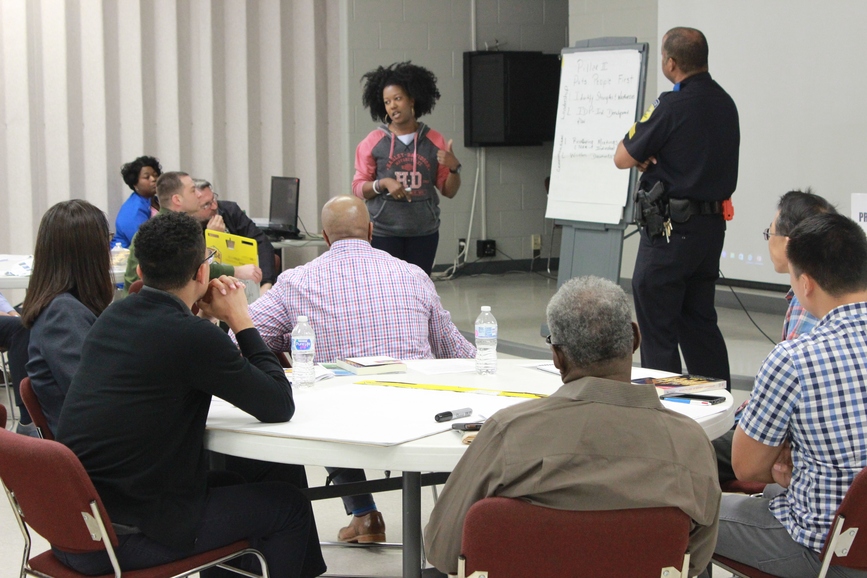
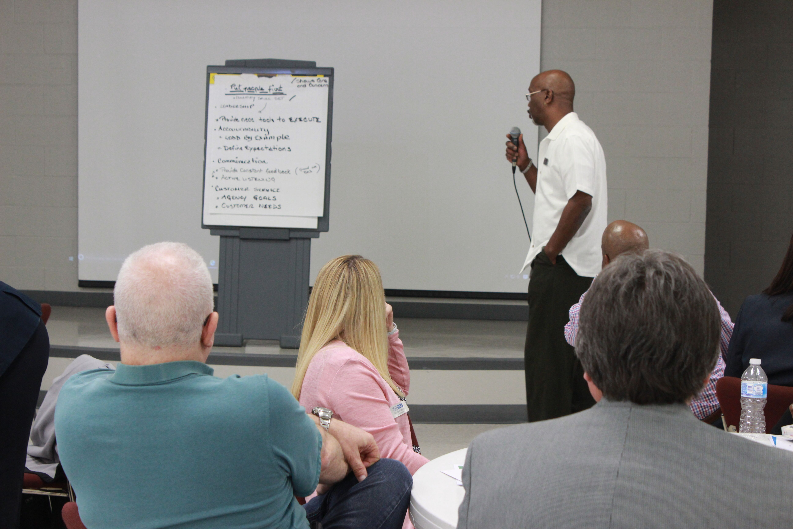
ALUMNI Business Pitch
Notes:
A DART Alumni from 2018’s EnoMAX cohort will share their Business Pitch and experience with you.
At DART after the MAX program year is over the students work on refining their Business Case and readying for their meeting with the CEO and Executive Team. Each of the agencies has a similar process.

Slide 25
Business Case
Business Case
Written or verbal presentation that is intended to educate a decision maker and convince them to take some kind of action.

Slide 26
Business case
Structure and Elements
Producing A Business Case Document
Remove the Research Plan
  Do include who you talked to and where you collected data in the Evaluation of Options and Recommended Path Forward sections
Add Implementation Plan Section
  Include the basic timeline, resources required, and costs of implementation
Add Executive Summary
  Typically written after the reminder of document is finished, sometimes is the only section an Executive reads, includes essential points in the same order as the full document
  Proposed project scope influences size and detail of document
Notes:
We’ve been working with our Business Project Worksheet. Now that we are ready to prepare our Business Case document,
We will take off the research plan, though it will be included in the narrative in the Evaluation of Options Section and the Recommended Path Forward Section.
We need to add an Executive Summary and an Implementation Plan.
All the information you have collected on your Business Project Wrksheet will be the heart of your Business Case.

Slide 27
Business Case
KEY POINTS
Business Case Description
the document should be brief and convey only essentials
make it interesting, clear and concise
eliminate conjecture and minimize jargon
demonstrate the value and benefits the project brings to the business
describe your vision of the future
ensure consistent style and readability
do not repeat information the audience is already familiar with

Slide 28
Business Pitch
The Business Pitch is an opportunity you may get to explain your business case, its benefits, overall costs and preferred recommendations
It can take many forms, including;
“Elevator Pitch” – a 5-7 minute quick synopsis of your project and reasons for implementing your preferred recommendation
Executive Briefing – short structured meeting with Executive(s), may or may not include handouts or visual presentation
Visual presentation – slide presentation
Executive Summary – section of Business Case that is shared with Executive(s) with or without a verbal presentation
During your 4th visit, you will be provided with Guidelines for a Business Pitch, which includes elements of 1, 2, and 4.
You will subsequently deliver this Business Pitch at a simulated CEO meeting

Slide 29
Putting it all Together
Business Case Research and Analysis
Prepare Business Case Document
Business Pitch
Executive Greenlight
Project Implementation
Research and Analysis – Business Project Worksheet
  The Business Project Worksheet provides structure and direction for your Research and Analysis
  Come up with many recommendations
  Provides the foundation for your Business Case materials
Prepare Business Case Document
  Uses the Business Project Worksheet as the foundation for developing your argument proving that your recommendation is viable
Business Pitch
  Presentation to decision makers
Notes:
In summary,
Business Project Research and Analysis
Beginning with your enrollment, you have identified a Problem/Opportunity and begun the work to fill out the Business Project Worksheet. At each of your Agency visits you will have A BPIE meeting with an identified resource (SME) who will provide you with information on their Agency as it relates to your project. You will also discuss with SME at your Home Agency. You will continue researching your project and begin identifying and analyzing options.
Business Case Document
Once you have selected your recommended path forward, you are ready to begin putting together your formal business case document. Include all sections from your Business Project Worksheet, Consolidate the Research Plan with the evaluation of options section, add an Implementation Plan and an Executive Summary. Pay careful attention to the magnitude of your project and make sure your Business Case is comparable.
Business Pitch
Develop your Business Pitch based on your Business Case document

Slide 30
Real World Applications
In your student Manual, you have an example of a completed real world Business Project Worksheets.

