Slide 1
Andrews Federal Center Bus Garage

Slide 2
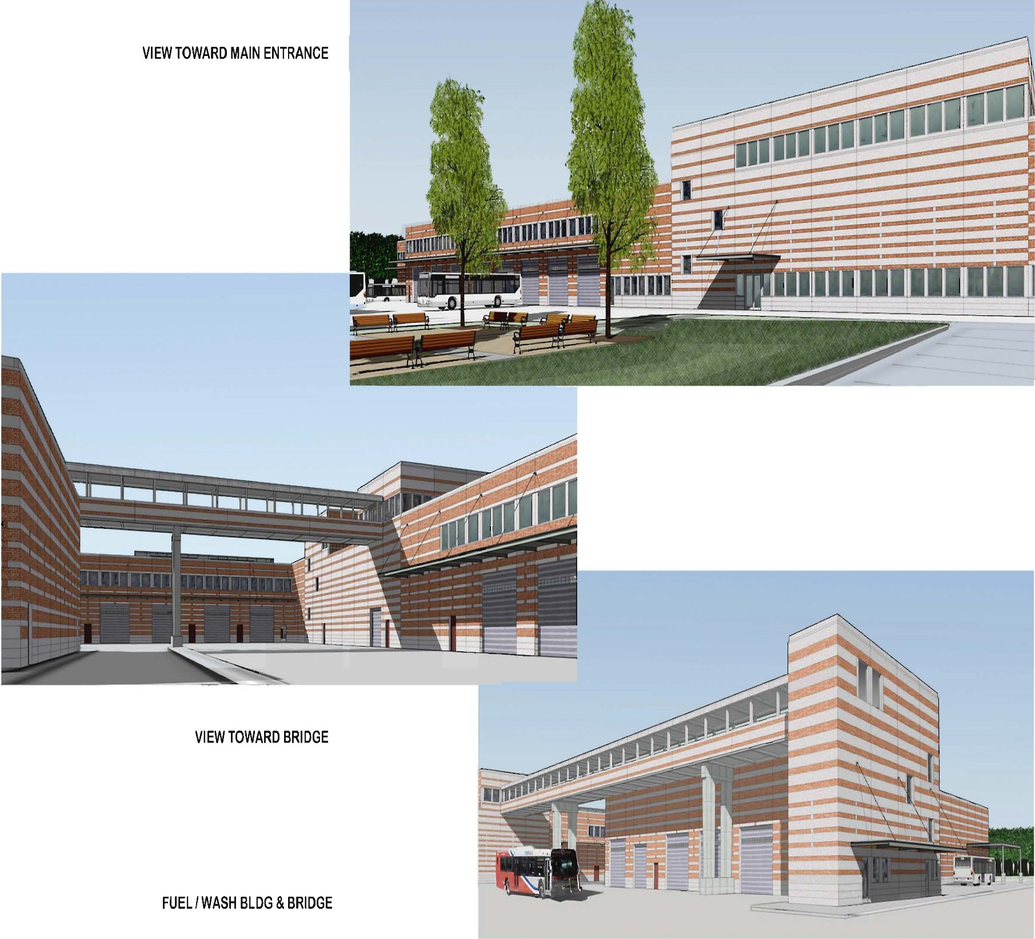
Andrews Federal Center Bus Garage
Andrews Federal Center Bus Garage
Andrews Federal Center Scope of Work
Scope of Work
Fact Sheet
Site Plan Rendering

Slide 3
Andrews Federal Center (AFC) Scope of Work
Andrews Federal Center Scope of Work
Andrews Federal Center Bus Garage:
Design and Construct: The Design-Builder (Contractor) will design and construct a new Andrews Federal Center Bus Operations and Maintenance and a Heavy Repair and Overhaul (HR&O) Facility on 35 acres of land in Prince George’s County, Maryland. WMATA has an Agreement in principal to purchase the land, the Contract will not be awarded until the acquisition of the property is finalized.
The Garage will support a 175 bus fleet (20% of which would be articulated buses) and include a fuel and wash building. The HR&O Facility will be designed to support the entire WMATA bus fleet. The Garage is to include maintenance, operations, fuel, wash, bus parking, and employee/visitor parking. The HR&O Facility is to include bus rehab bays and support spaces (including body repair and paint associated with bus rehabilitation), central warehouse, support vehicle (non-revenue vehicle) maintenance, bus engineering, and employee/visitor parking. As Option 1, the Design Builder shall provide a price for all furnishings, including furniture, appliances, fitness equipment and recreation equipment. The Garage will operate 24 hours a day, 7 days a week. The HR&O Facility will be designed to accommodate a fleet of 1,600 buses and typically operate 8 hours a day, 5 days a week.

Slide 4
Fact Sheet
Fact Sheet
Project Features
Sited on 35 acres
Gross Building Area approximately 317,000 SF
Primary Facility Functions:
Heavy Repair & Overhaul
Central Warehouse
Non-Revenue Vehicle Service
Bus Engineering
Signs & Shelters Shop
Operations and Maintenance
Fueling and Wash
Bus Storage
Employee Parking
Project Value and Start/Completion Dates
Base Contract Value $132.3M
Notice to Proceed – September 15, 2014
Project Final Completion – January 23, 2019
LEED Certification Goal – Silver
Design-Builder – Hensel Phelps Construction Company

Slide 5
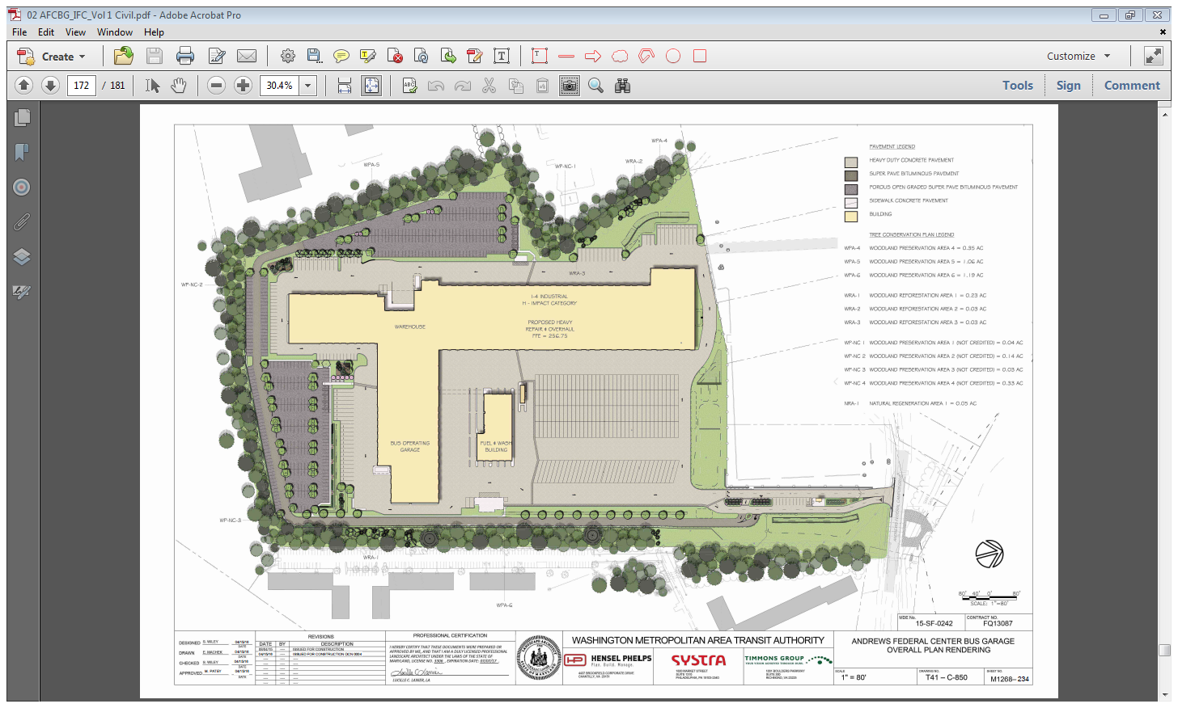

Slide 6
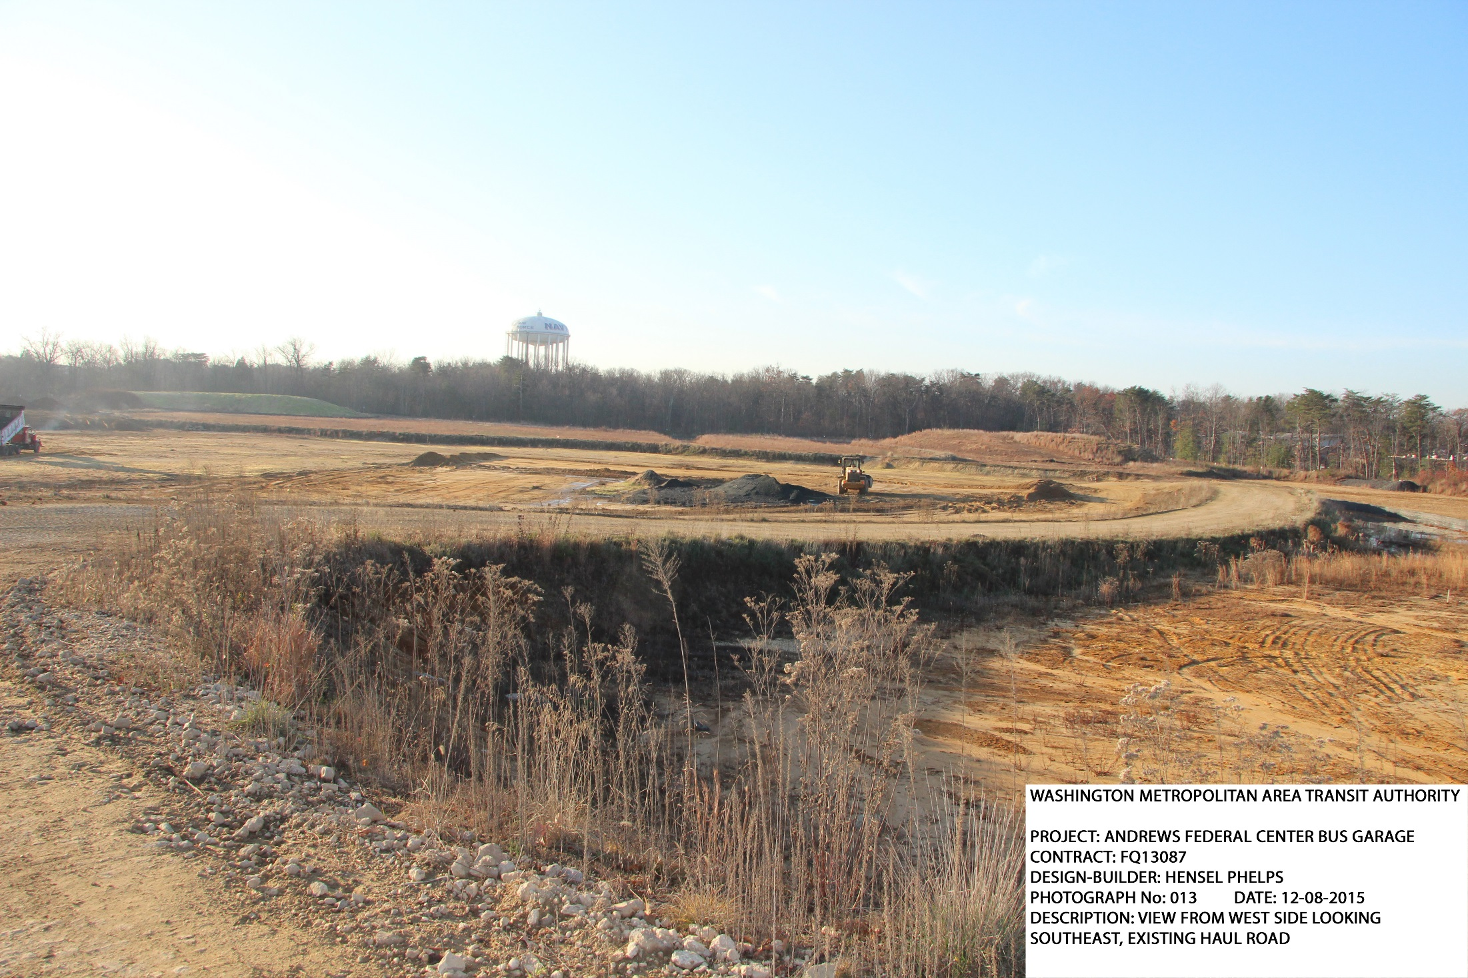
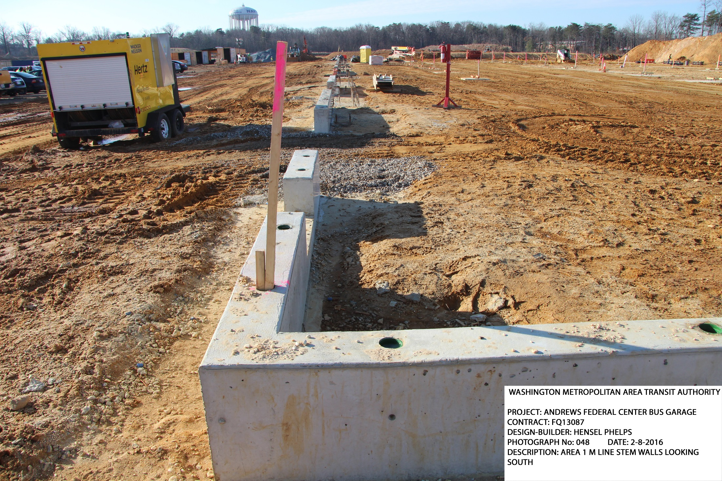

Slide 7
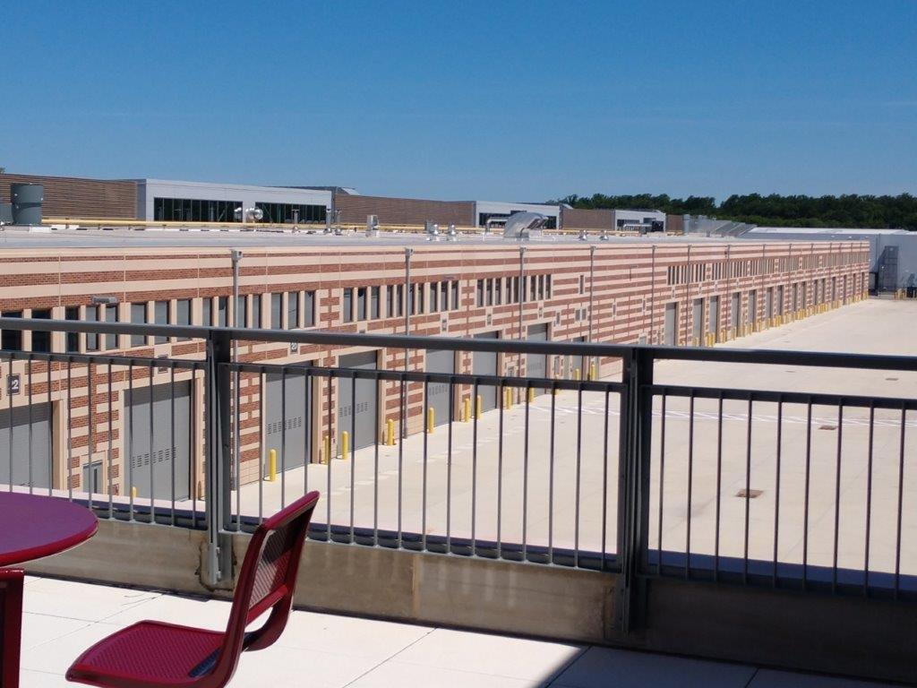

Slide 10
