Slide 1
Multi-Agency Exchange DART 2019
Dr. Julius Smith
Vice President & Chief Information Officer
30 April 2019

Slide 2
DART Technology Vision, Mission, and Guiding Principles
Own it
Get it right
Disagree without being disagreeable
Loyal opposition and unity of command
Beautiful systems*
User
Self-Service
Continuous learning and improvement
Teamwork
Vision
DART Technology, your trusted advisor for technology solutions.
Mission
To deliver beautiful systems*, reliable technology and innovative information solutions with extraordinary customer service.
*Tom Peters – “In Search of Excellence”

Slide 3
Information Technology Department
Julius Smith
VP/CIO
Business Intelligence
Customer Advocacy
Enterprise App. Development
Enterprise Architecture
Intelligent Transportation Systems
Cyber Security
Web and Mobile Development
Technology Team 79
Opex - $25M
Capex - $35.6M (active projects)
Budget FY 19
Technology Project Management Office
Infrastructure Platform Services

Slide 4
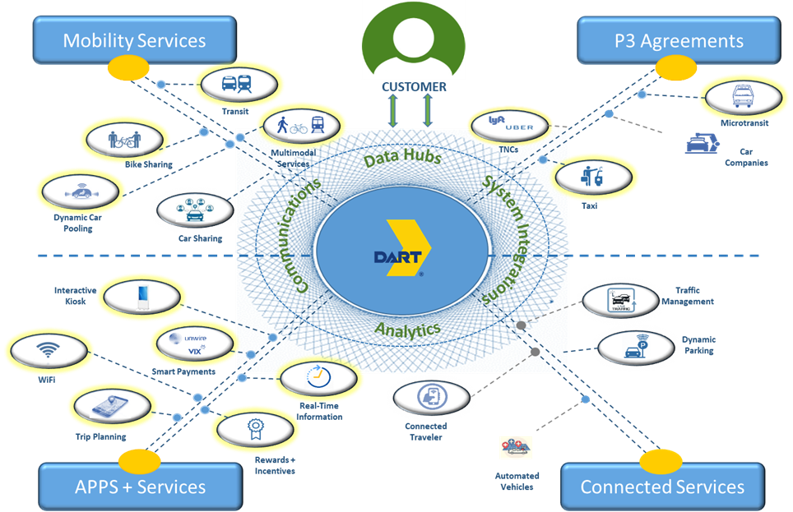
DART Maas Technology Support

Slide 5
DART - DFW’s Mobility Broker/Provider
Go Pass Go Pool
Bundled packages
Security
ITS
Improved rider experience
Community way finding

Slide 6
Questions

Slide 7
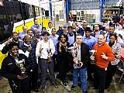
DART IoT Landscape
Digital Radio
Safety & Security
TPSS
Stakeholders
Signals Priority
PAVMB
Smart City
DART IoT
Geo- Spatial
PTC
Bus & Streetcar
Customers
CPS
CCTV
SCADA
Light Rail & TRE
Employees
Notes:
IoT (Align the agency to the customer expectations in real-time)

