Slide 1
What is Ethical Behavior?
And why does it matter?
David Schulze
VP Policy and Strategy
April 30, 2019

Slide 2
What is Ethical Behavior?
Learning objectives
Define ethics
Understanding ethical behavior
Setting an ethical tone
Challenges
Standards of behavior

Slide 3
Definitions
“Ethics” is the discipline of dealing with:
What is good and bad
Moral duty and obligation
“Ethics” is:
A set of moral principles
A theory or system of moral values
“Ethics” govern conduct of an individual or group:
A guiding philosophy
A consciousness of moral importance

Slide 4
Right or Wrong
Everyone knows right from wrong.
Right?

Slide 5
Right or Wrong
Everyone knows right from wrong.
Wrong!
People disagree about
the definition of right and wrong
all the time.

Slide 6
Right or Wrong
Ethical behavior is more
than knowing the difference between
right and wrong.

Slide 7
Ethical Standards
The rules of your organization
Written and unwritten principles and values that govern decisions and actions within an organization
Organizational culture sets standards for good decision making and individual behavior

Slide 8
Ethical Standards
Two ways an organization can approach ethical behavior
Shareholder focus
Stakeholder focus

Slide 9
Ethical Standards
Shareholder focus
Decisions made in the shareholders’ best interest
Guided by the need to maximize return
Ethical business practices are the ones that make the most money

Slide 10
Ethical Standards
Stakeholder focus
Decisions made in the interest of stakeholder groups
Interests other than profits and losses
Ethical business decisions work for the good of all affected parties

Slide 11
Ethical Standards
Who are Stakeholders?
Employees
Community residents
Vendors
Customers
Competitors
Governmental agencies
News media

Slide 12
Ethical Behavior
Who decides ethical behavior?
Different people have different beliefs
The law tells us what is legal or not
Lines between right and wrong are not always clear
Principles of ethics can guide decision making when other systems are inadequate

Slide 13
Ethical Behavior
Setting an ethical tone
Management’s role is very important
Management is responsible for setting standards of acceptable behavior
Management is responsible for creating a work environment that encourages and rewards ethical behavior

Slide 14
Ethical Behavior
Setting an ethical tone
Leading by example is the first step to creating a culture of ethical behavior
Employees are likely to act like management

Slide 15
Ethical Behavior
Setting an ethical tone
Leading by example is the first step to creating a culture of ethical behavior
Employees are likely to act like management
If employees see managers behaving ethically,
they will know the organization
wants them to behave ethically.

Slide 16
Ethics Challenges
Where you meet your challenges
Organizational culture
Acceptable standards of behavior
Formal and informal policies and procedures
Application of formal ethics rules

Slide 17
Ethics Challenges
Where you meet your challenges
Agency’s attitude toward employees
Managers’ attitude toward employees
Employees’ attitudes toward each other

Slide 18
Ethics Challenges
Where you meet your challenges
How employees are selected for hiring or promotion
How vendors are selected
How customers are treated
How we answer questions from the public
How we respond to critics
How we avoid conflicts of interest

Slide 19
Ethics Challenges
Tools to shape ethical behavior
System for recognizing and rewarding ethical behavior
Laws and regulations
Decision making processes
Attitudes and behaviors of leaders
Emphasis on professionalism and integrity

Slide 20
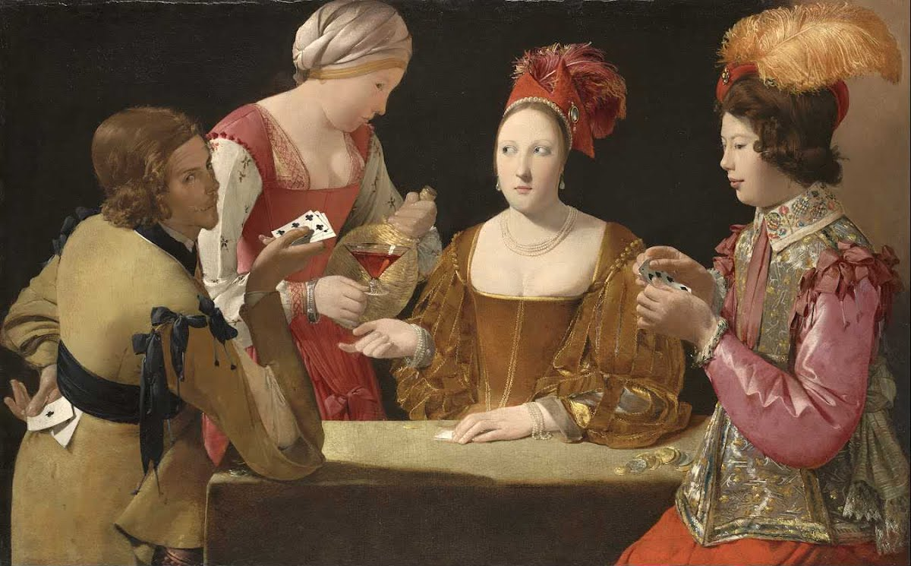

Slide 21
Standards of Conduct and Ethical Behavior

Slide 22
Common Standards
Conflict of Interest
Personal and organizational conflicts
Disclosure and reporting requirements
Training requirements

Slide 23
Common Standards
Unethical conduct prohibited
Improper influence or use of information
Acceptance of gratuity prohibited

Slide 24
Common Standards
Stewardship and public trust
Post-employment and representation
Participation in political activities
Solicitations and distribution of literature

Slide 25
Resources
Senior Management
Internal Audit
Office of Diversity and EEO
Legal Department

Slide 27
Georges de La Tour The Cheat with the Ace of Clubs, c. 1630-34 Kimbell Art Museum Collection, Fort Worth, TX

Slide 28
Georges de La Tour The Cheat with the Ace of Clubs, c. 1635-38 The Louvre Museum, Paris

