Slide 1
Contingency Planning and Execution – Bus Solutions
EnoMAX
Tuesday, August 13, 2019
James Hamre, Director
Office of Bus Planning and Scheduling

Slide 2

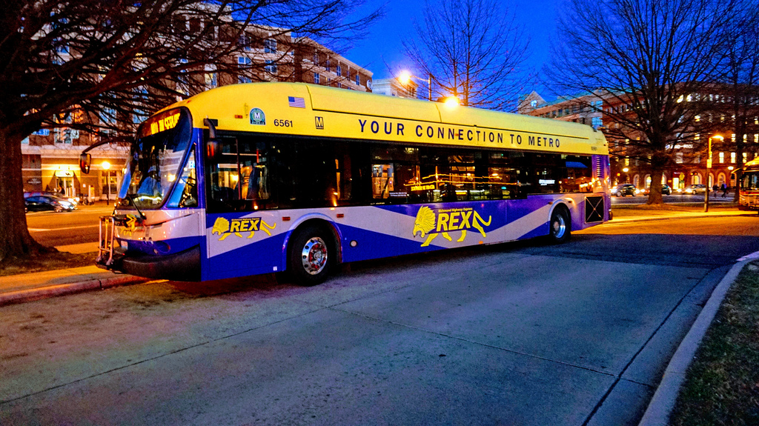
Reagan National Airport to Huntington/Franconia-Springfield – May 25 to Sept 02, 2019
South of National Airport (SoNa)
Stations Closed: National Airport, Braddock Road, King Street-Old Town, Van Dorn, Franconia-Springfield, Eisenhower Avenue, Huntington
Purpose: Achieve level boarding and structural concrete repairs at SoNa Stations. Additional work will be completed at Metrorail stations and bus bays.
Timeline:
  Bus Contractor RFP February 7, 2019
  Shuttle Operator Selected in March 2019
  Final Planning & Preparation in April 2019
  Mobilization in May 2019
  Program Launch: May 25, 2019
  Updated Project Schedule: June 15, 2019

Slide 3
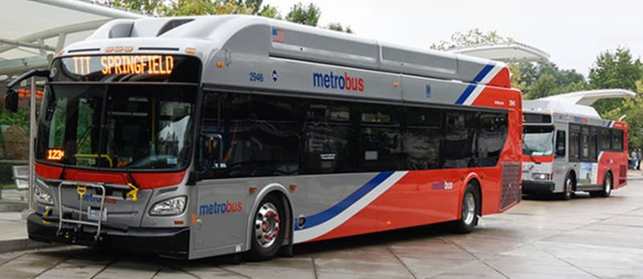
Reagan National Airport to Huntington/Franconia-Springfield – May 25 to Sept 02, 2019
South of National Airport (SoNa)
Operating Assignments:
Contract Provider(s) to operate ADA-accessible buses and supplementary WAV vans to operate 5-Weekday shuttle routes.
Contract Provider staffing to manage operators, support customers and augment WMATA staff
ATC DASH will operate the Blue Line Shuttle Weekdays and Weekends through Old Town Alexandria (MOU forthcoming).
Metrobus low-floor buses to operate Weekends on Yellow local shuttle and contract providers providing Express services
Transportation Management Services (TMS) firm was to supplement Metrobus Transit Field Supervisors and Ambassadors at each station.

Slide 4
A plan and schedule is essential (simple is better)

Slide 5
Define and prepare the “products” that will be needed to support implementation

Slide 6
Keep Track of New Stuff (audits will happen)

Slide 7

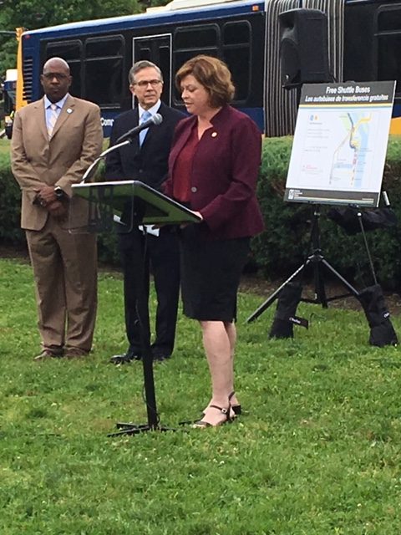
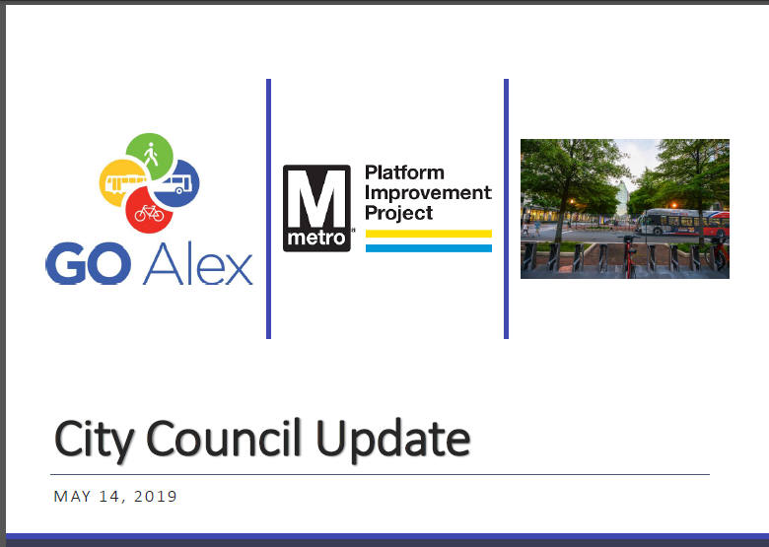
Story telling is an essential part of preparing and coordinating
Stakeholders have their own stories to tell that need to be accommodated
What you want known may not be what others want to tell
Be flexible and listen closely to what and how things are being said
Customize the message and delivery to the audience
Be prepared for many edits…

Slide 8
Be prepared to explain your approach, expectations and justification

Slide 9
Details matter when it comes to getting 300 people to work together to accomplish the same thing!

Slide 10
Meetings happen, and they should. Keep track and be prepared.
Meetings are for confirming actions, not designing them.
Keep the scope of discussions manageable.

Slide 11
Consistent outcomes require socializing information with implementers and reminding staff of what can & should be done

Slide 12
Prepare and plan for report outs upon start-up.
Important people want to know!

Slide 13
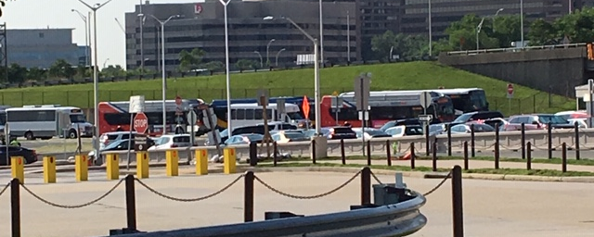
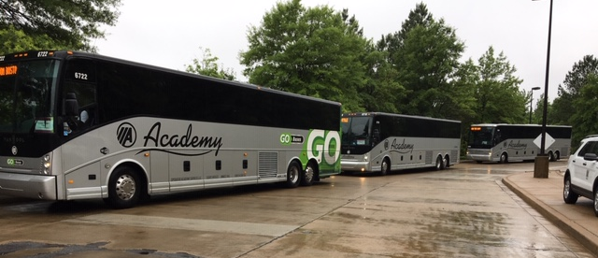
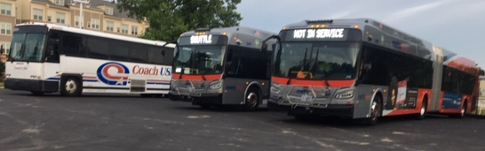
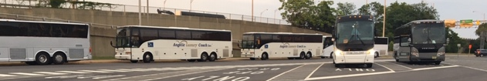
Buses are big and take up a lot of space. However, they are essential to the project and need to be accommodated. Traffic management matters!

Slide 14
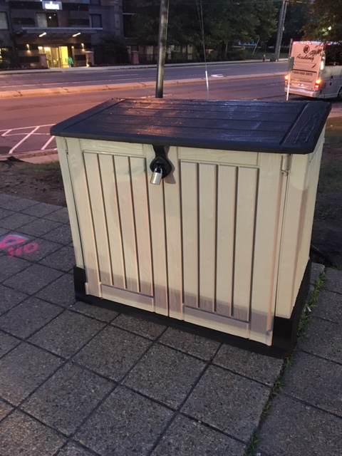
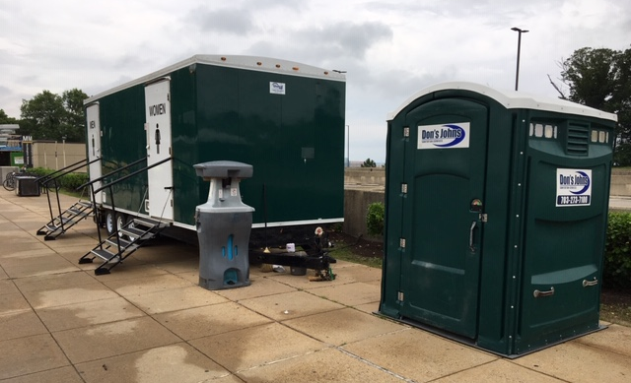
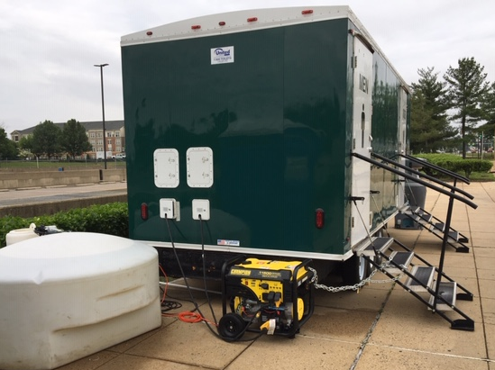
Logistical support features and function will rise to a level of importance not previously understood

Slide 15
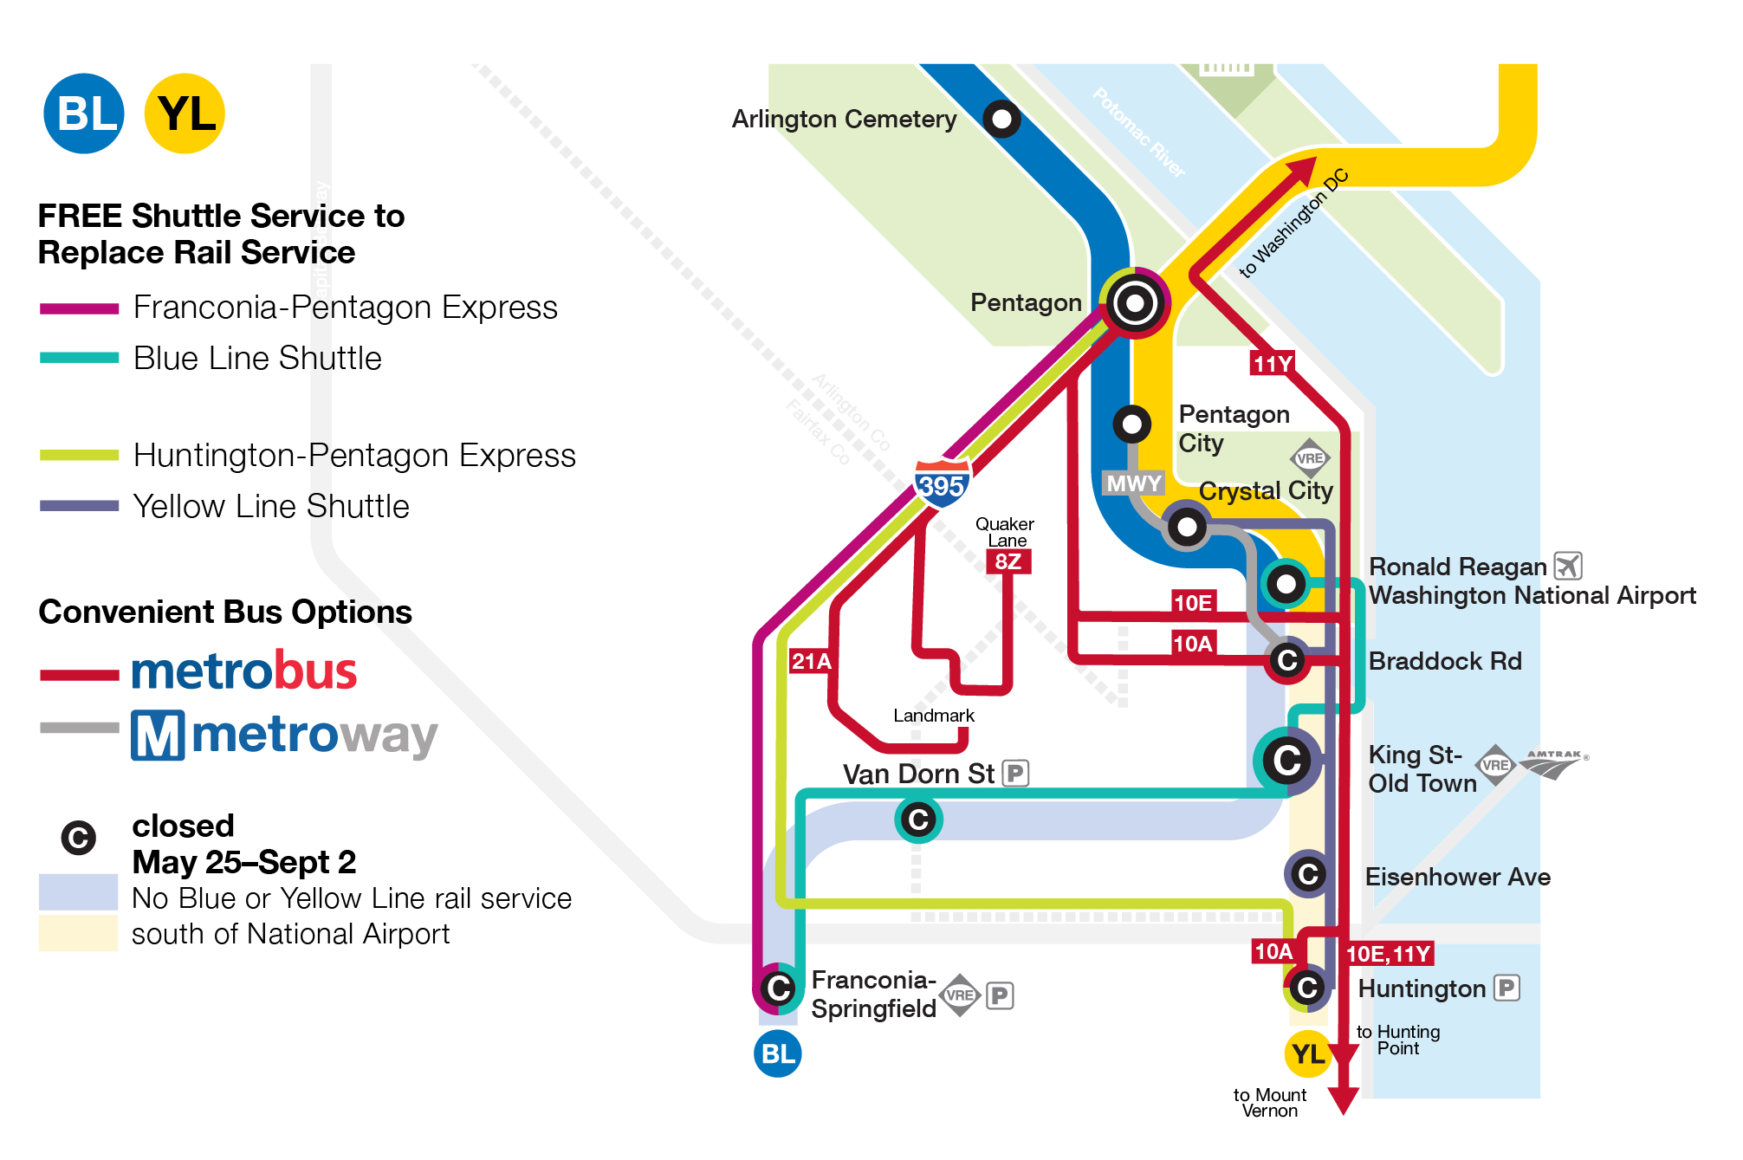
Practice Makes Perfect
South of National Airport (SoNa)
This shutdown is similar to the weekend project events on:
  January 26-27, 2019
  Marc 2-3, 2019
An additional event in advance of the SoNa Shutdown will take place
  April 20-21, 2019
Staff training begins May 1, 2019
May 4-5 will be a dress rehersal
Advance preparation is worth the investment

Slide 16
Prepare a summary of “readiness” to confirm to stakeholders that the planning and preparation have been successful and actions are pending.
All that is left is…GO!

Slide 17
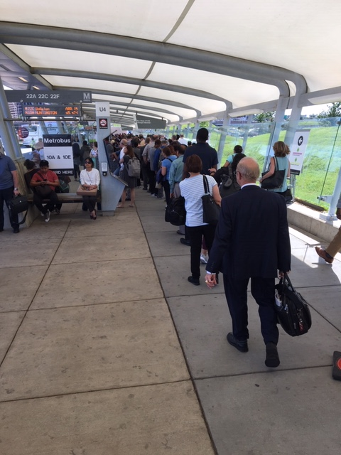
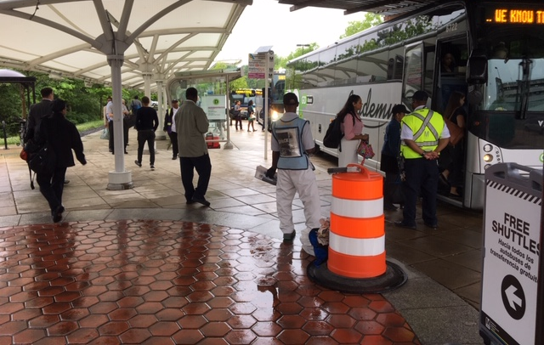
Of Course it will rain on the first day!

Slide 18
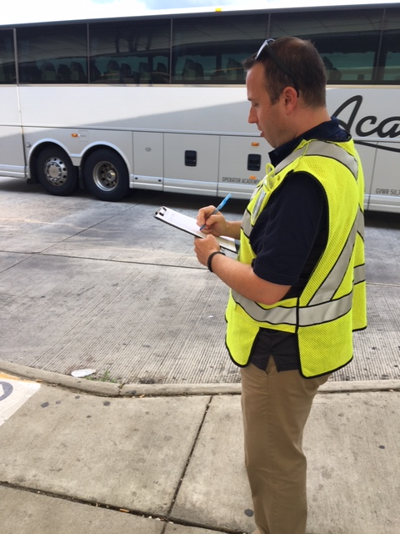
Be prepared to monitor the results

Slide 19
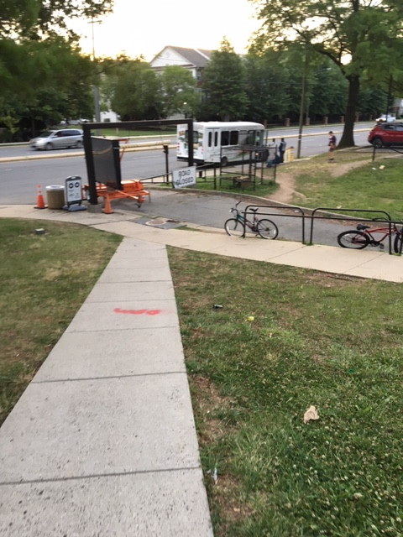
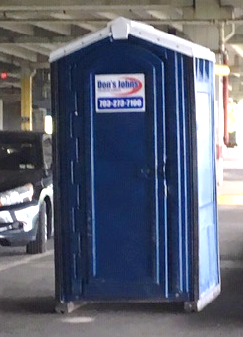
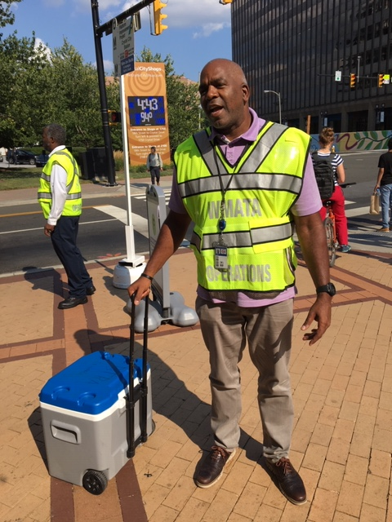
Confirm your infrastructure, delivery processes and hazards mitigation

Slide 20
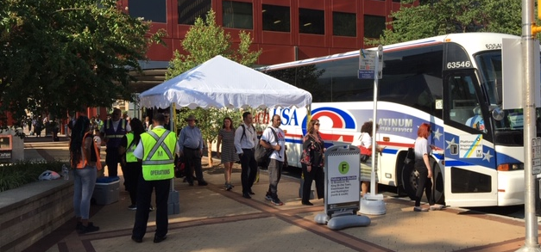
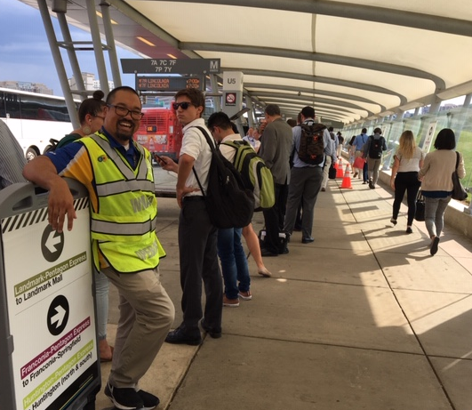
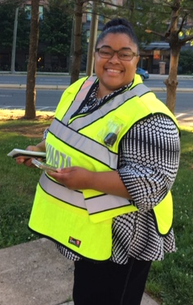
This work is all about people. Attitude matters!

Slide 21
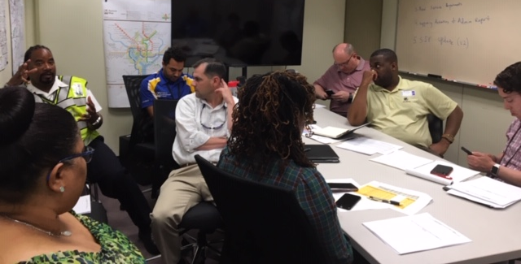
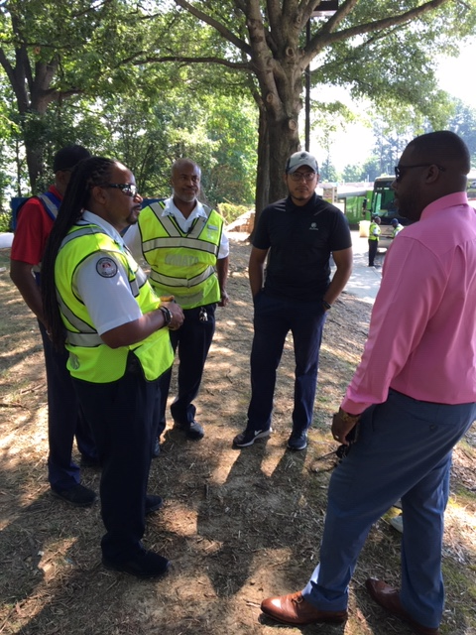
Talk is cheap, there is no substitute. Just Do it! Its Priceless! Keep it up as long as necessary.

Slide 22
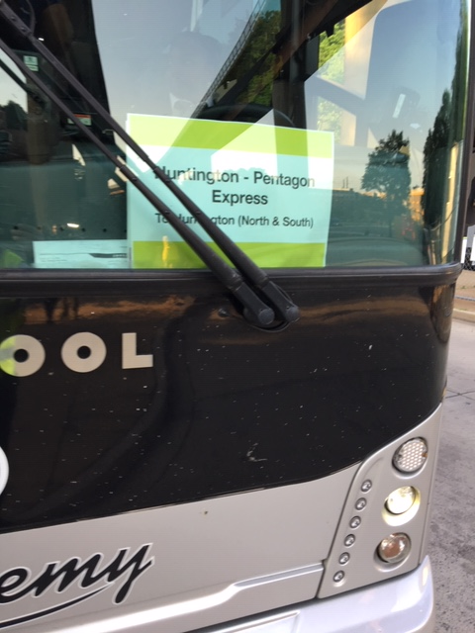
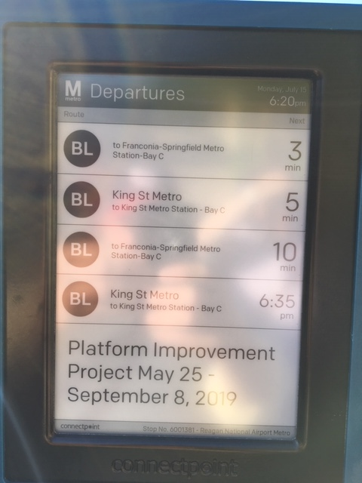
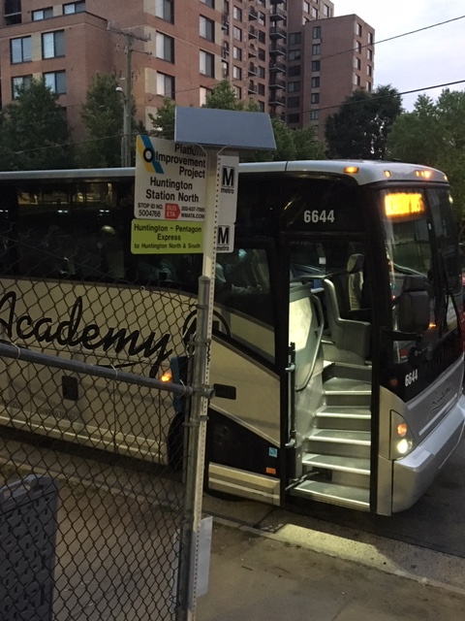
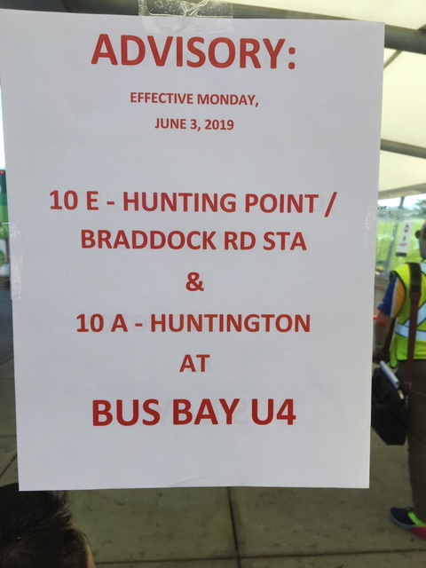
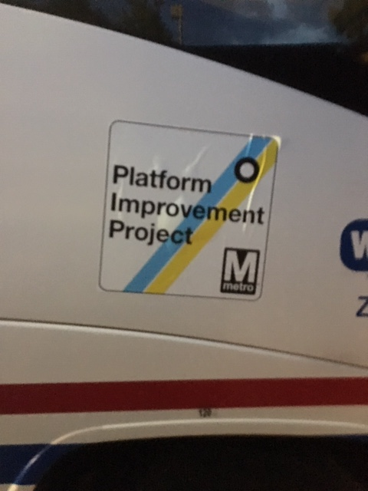
Communicate with customers by any means necessary

Slide 23
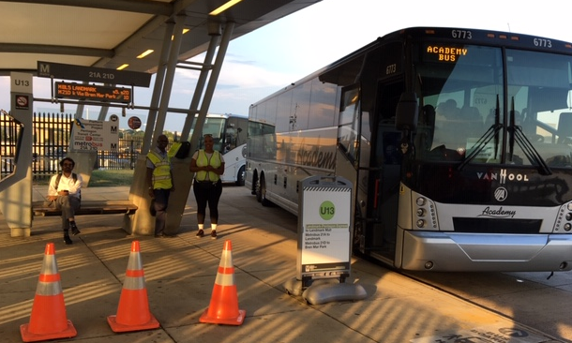
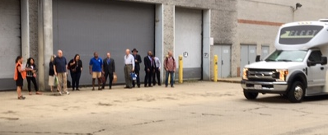
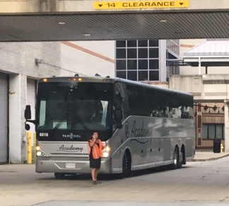
Keep an eye on both ends of the line, make sure they are communicating and resources are showing up!

Slide 24
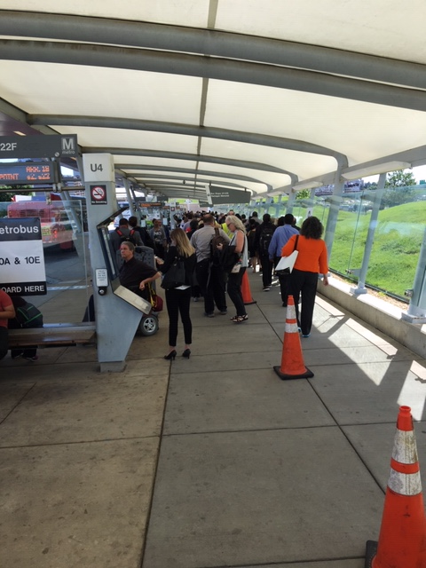
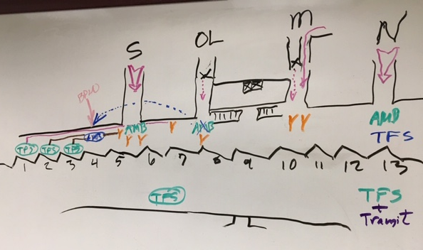
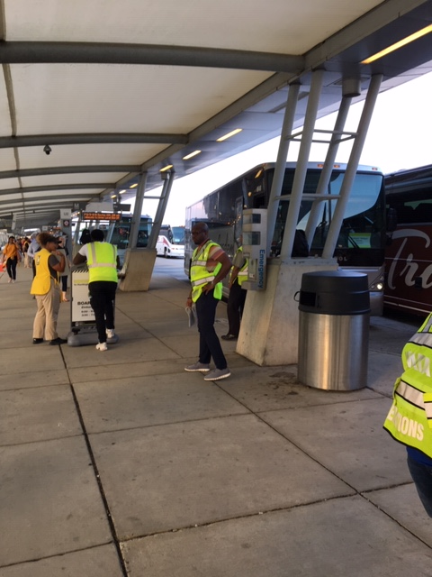
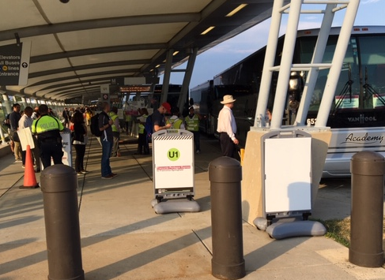
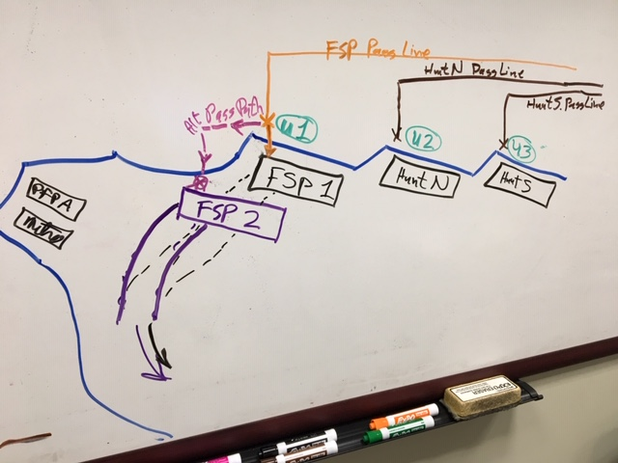
Managing crowds and loading is essential and requires technique, thoughtful planning and resources

Slide 25
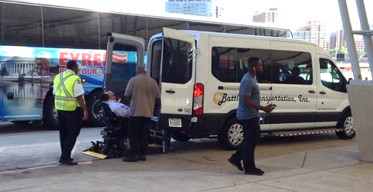
Take care of your ADA accommodation customers and they will take care of you!

Slide 26
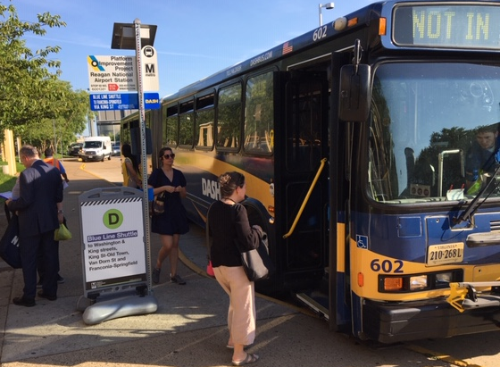
Partnerships can be challenging but also, of strategic value and very rewarding

Slide 27
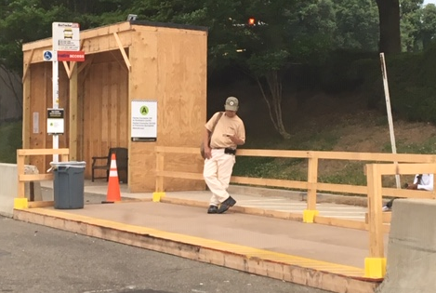
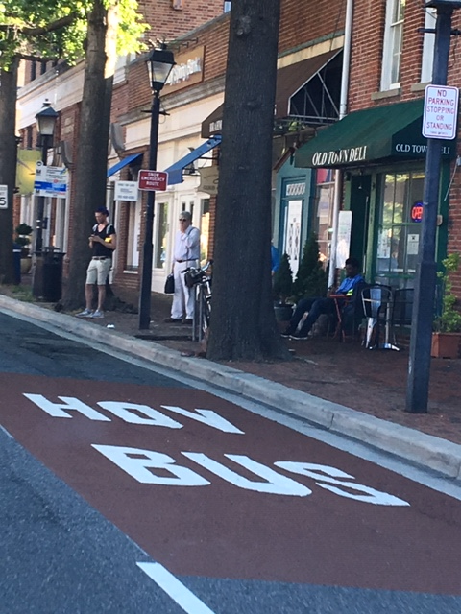
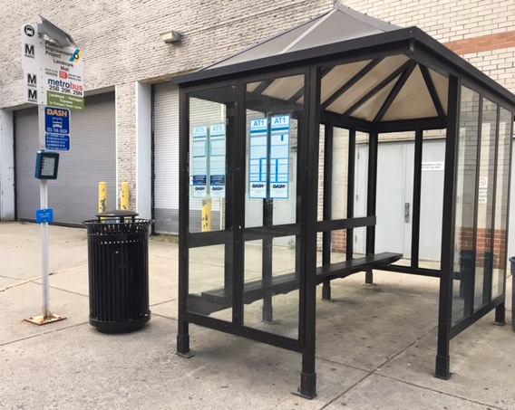
Timing of delivery physical assets and monitoring of condition is time consuming but, necessary

Slide 28
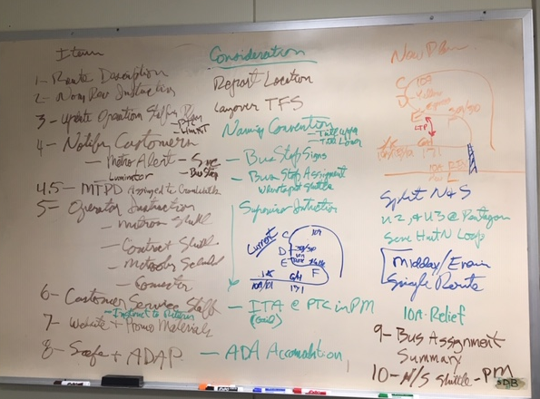
Track what needs fixing, make specific assignments and be clear about deadlines and coordination requirements

Slide 29
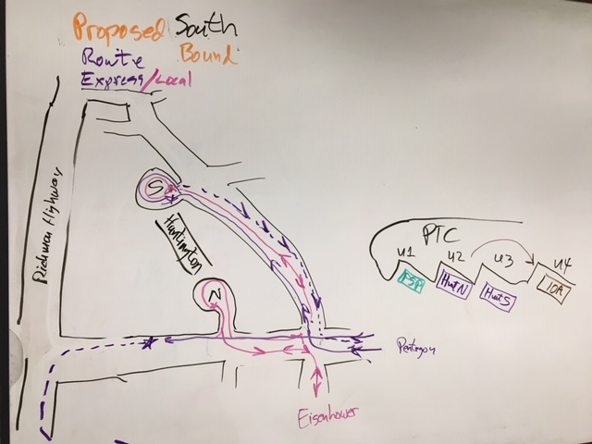
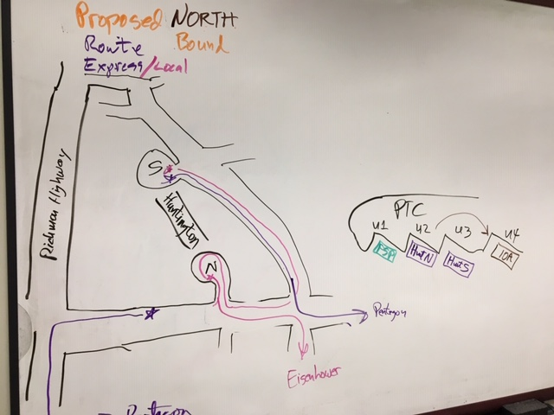
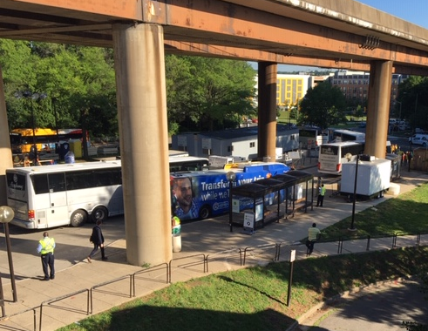
Solutions don’t have to wait for fancy graphics. If you know what needs doing, do it! Images help.

Slide 30
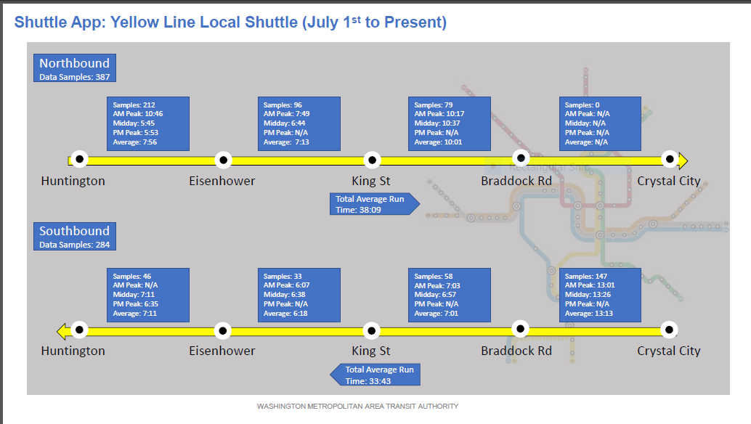
Quality information and data is essential to correcting the right problem.

Slide 31
Prepare in advance for project performance reporting and provide timely delivery. Highlight meaningful successes!

Slide 32
Thank You!
See you this summer South of National Airport ✈

