Slide 1
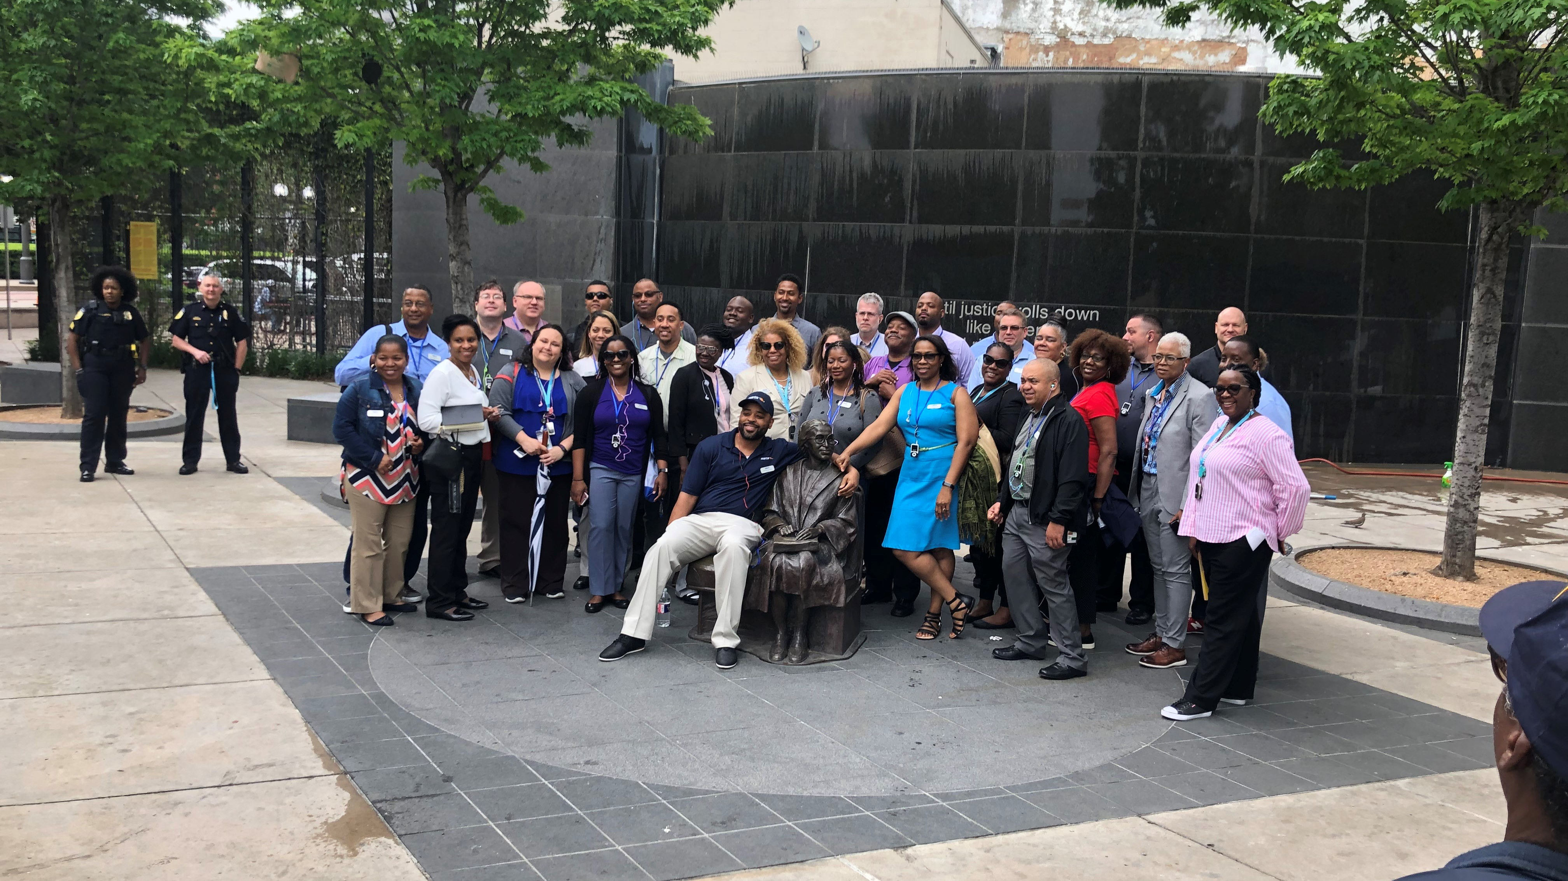

Slide 2
John M. Rhone
B.S. in Electrical Engineering, Prairie View A&M University
Vice President, Capital Design and Construction
Directs and oversees design, construction, utility coordination and dispute resolution functions associated with DART major capital projects.
Reports to the Executive Vice President, Growth/Regional Development Department.

Slide 3
Dwight D. Burns, Jr.
B.A. in Government, University of Texas at Austin Master of Public Affairs, University of Texas’ LBJ School
Treasurer
Provides investment fund management, debt administration, and grant management.

Slide 4
Welcome to DART

Slide 5
Joseph G. Costello
BS, Accounting, University of Illinois, Chicago, IL
MBA, University of Chicago – Graduate School of Management, Chicago, IL
Senior Vice President, Finance
Oversees DART’s budget process, financial planning, debt financing and management, treasury, funds management, revenue administration and collection, grants management, accounting, accounts payable, and business process reengineering.

Slide 6
Marcus Moore, Jr.
Assistant Vice President, Civil Rights
Marcus is responsible for the equitable and equal inclusion of transportation-dependent, underserved and minority populations in accessing DART programs, services and activities. He develop and manages activities to promote contracting opportunities to Disadvantaged, Minority and Women-Owned Business Enterprises (DMWBEs) and ensures compliance of DMWBEs participation on DART contracts.
He is charged with the responsibility of ensuring DART’s compliance with the Americans with Disabilities Act (ADA) and Title VI of the Civil Rights Act. In this capacity, he is involved with system-wide accessibility compliance, reasonable modification determinations and equitable participation of minority, low-income, and other protected category communities in all DART services, programs and activities.

Slide 7
David Ehrlicher
Graduated, Tulane University
Assistant Vice President, Capital Program
Before coming to DART, had a 19-year consulting career for clients including DART, DFW International Airport and Delta Airlines.
DART’s Chief Architect since 2002.

Slide 8
Welcome to DART

Slide 9
Rob Smith
Bachelors degree in Geography, University of Washington
Master degree in Regional Planning, University of North Carolina at Chapel Hill
Assistant Vice President, Service Planning
Responsible for service planning and scheduling for DART bus and rail services.
Oversees DART’s vanpool program, site-specific bus shuttle operations, service analysis efforts, and manages DART bus stop placements.

Slide 10
Herold Humphrey
Vice President, Bus Operations
Began his career in transportation in 1985 as a student worker in Jackson, Mississippi.
Moved into private side of the industry to pursue career.
Advanced into management quickly and has been able to live and work in multiple cities.
Employed in Atlanta before coming to DART.
Has deep operation, technical and safety knowledge of fixed route, paratransit, commuter service, shuttle and on demand transportation.
With DART since 2017.

