Slide 1
DART Financial Plan and Fare Structure
2019 Multi-Agency Exchange Program
May 2, 2019
  Joseph G. Costello
  Senior Vice President, Finance

Slide 2
Presentation Outline
Financial Standards
FY 2019 Twenty-Year Financial Plan
State of Good Repair
Strong Balance between Revenues and Expenses
New Low-Income Program
Finance Department

Slide 3
Financial Standards & FY 2019 Twenty-Year Financial Plan

Slide 4
Annual Financial Standards
Policy and Process
Financial Standards Policy (Res. No. 970083)
    Approve every year
    Requires a two-thirds vote (10 votes)
Staff reviews Standards; develops recommendations for changes
Present recommendations to the Board
Board approves Standards
Begins, and establishes framework for, budget development
Finance Department

Slide 5
Financial Standards
DART’s Financial Standards provide policy guidance for and ensure:
  Prudent management of financial affairs
  Establishment of appropriate cash reserves
  Compliance with legal/statutory/Board policy requirements
  Establishment and approval of a 20-year Financial Plan
  Framework for development of Budget and Financial Plan
  Establish future business targets
  Limit the level of debt incurred
  Debt assumptions based on market parameters
Finance Department

Slide 6
FY 2019 20-Year Financial Plan
Finance Department

Slide 7
FY 2019 Financial Plan:
Snapshots ($M)
Finance Department

Slide 8
Capital Spending by Year ($M)
Finance Department

Slide 9
Question
How to balance existing service versus new service?

Slide 10
State of Good Repair

Slide 11
State of Good Repair (SGR) Overview
DART has a comprehensive, long-term asset management, maintenance, and replacement plan (SGR) that is funded inside of a long-range Financial Plan
DART is among the leaders in the transit industry in state of good repair procedures
We are actively participating with the federal government in development of SGR guidelines
$3.3 billion of the $6.2 billion future capital spending in the Financial Plan is for SGR items
Finance Department

Slide 12
Federal SGR Program
DART Status
Practicing Key Elements since 1983
  Board Policies & Financial Planning Parameters
  20-year Financial Plan & Regular Reconciliation
  Asset Condition Assessments every 5 years
Federal Update
  In FY13 the BABS interest subsidy was reduced due to “sequestration”, reducing DART revenues by >$20 million over the life of the bonds
  In 2015 the FTA estimated >40% of buses and >20% of rail transit assets were in poor condition, and initiated an SGR program
  In July 2016, the FTA issued a final rule on Transit Asset Management (in essence, SGR)
Finance Department

Slide 13
Question
How to prioritize expansion and enhancement project.

Slide 14
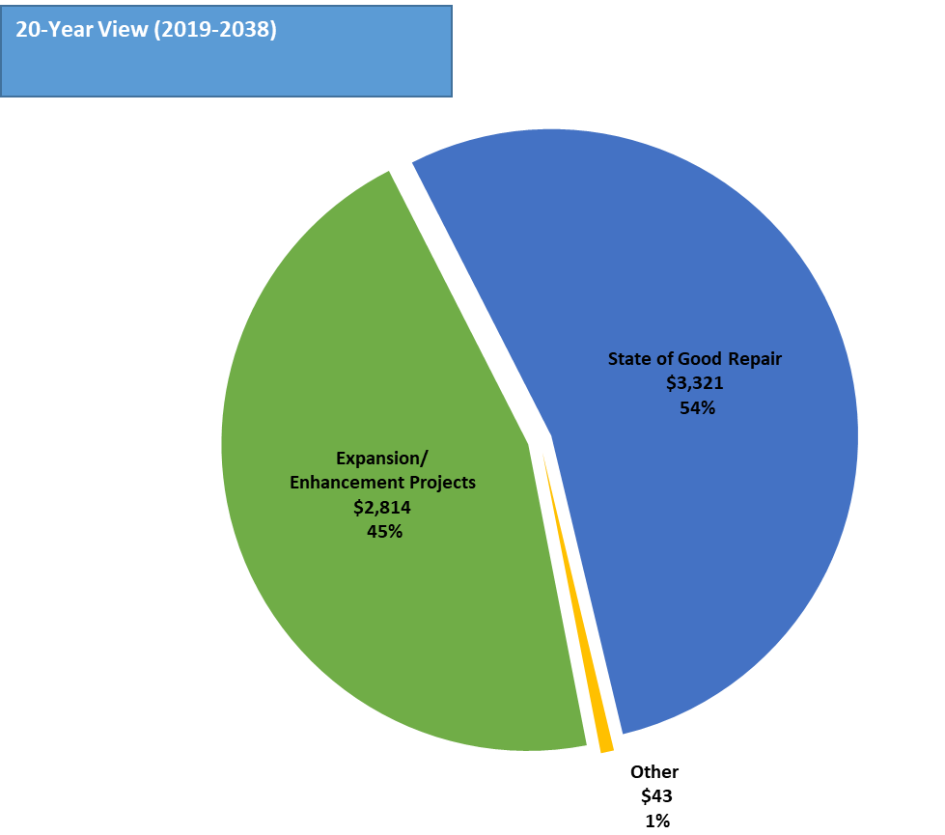
Capital Spending by Category ($M)
Finance Department

Slide 15
Strong Balance Between Revenues and Expenses

Slide 16
FY 2019
Structural Budget Balance ($M)
Finance Department

Slide 17
FY 2019 – FY 2022 Operating Expenses / Funding Sources ($M)
Finance Department

Slide 18
Expenses Actual vs Budget ($M)
Finance Department

Slide 19
Case Study
The great recession

Slide 20
Sales Tax Projections ($M)
Finance Department

Slide 21
Sales Tax Projections ($M)
Finance Department

Slide 22
Defined Benefit Pension Plan
Finance Department

Slide 23
Case Study
Financial Stability Requires Revenue Generation and Cost Containment
Fare increase

Slide 24
New Low-Income Program

Slide 25
Merits of Low-Income Program
Provides transportation options at a reduced cost for persons with low income.
Low income riders are more likely to ride in off-peak hours, which is where there are empty seats to fill.
Can reduce social and economic inequalities by making mobility financially feasible to more residents.
Discounted fares can help retain low income riders, and attract additional riders

Slide 26
DART Discount Fare Programs
Existing DART discount fare programs – cover 26.6% of DART riders and provide $11.8 million in discounts
  Seniors and non-paratransit disabled
  DART shuttle bus routes
  Children – elementary through middle school
  Students attending high schools within the DART service area
  Student whose schools are participating in the Higher Education Program
  Area residents in program administered by a social agency

Slide 27
Low-Income Program
  New program eligibility based
  Supplemental Nutrition Assistance Program (SNAP)
  Texas Temporary Assistance for Needy Families (TANF)
  Medicaid
  Comprehensive Energy Assistance Program (CEAP)

Slide 28
Supplemental Nutrition Assistance Program (SNAP)
Provides multiple benefits to needy families living in the state of Texas
Household gross income must be less than or equal to 130 percent of the federal poverty line
Benefits - one to six months before benefits need to be renewed
Program is state-administered

Slide 29
Texas Temporary Assistance for Needy Families - TANF
Provides financial and medical assistance to needy dependent children and the parents or relatives with whom they are living
Household income needs to be below 12 percent of the federal poverty line
Program is state-administered

Slide 30
Medicaid
Medicaid is the state and federal cooperative venture that provides medical coverage to eligible needy persons
Purpose - improve the health of people in Texas who might otherwise go without medical care for themselves and their children
Annual application must be done
Medicaid and the Children’s Health Insurance Program (CHIP) provide medical coverage for more than 4 million low-income Texans
Program is state-administered

Slide 31
Comprehensive Energy Assistance Program- CEAP
Designed to assist low income households in meeting their immediate energy needs and to encourage consumers to control energy costs
Participation in other benefit programs, such as the SNAP, SSI, or TANF
Program is state-administered

Slide 32
Ridership and Revenue Impact
Finance Department

Slide 33
Mobility Assistance and Innovation MA&I Fund
Interest Earnings on the Financial Plan
Change Pricing and Programs in the Fare Structure
Fare Increase Assumption in the Financial Plan

Slide 34
Question
Should federal law change from elderly and disabled to low-income?

Slide 35
Questions?

