Slide 1
Next Stop, Archives!
A Partnership to Preserve the
History of Dallas Area Rapid Transit

Slide 3
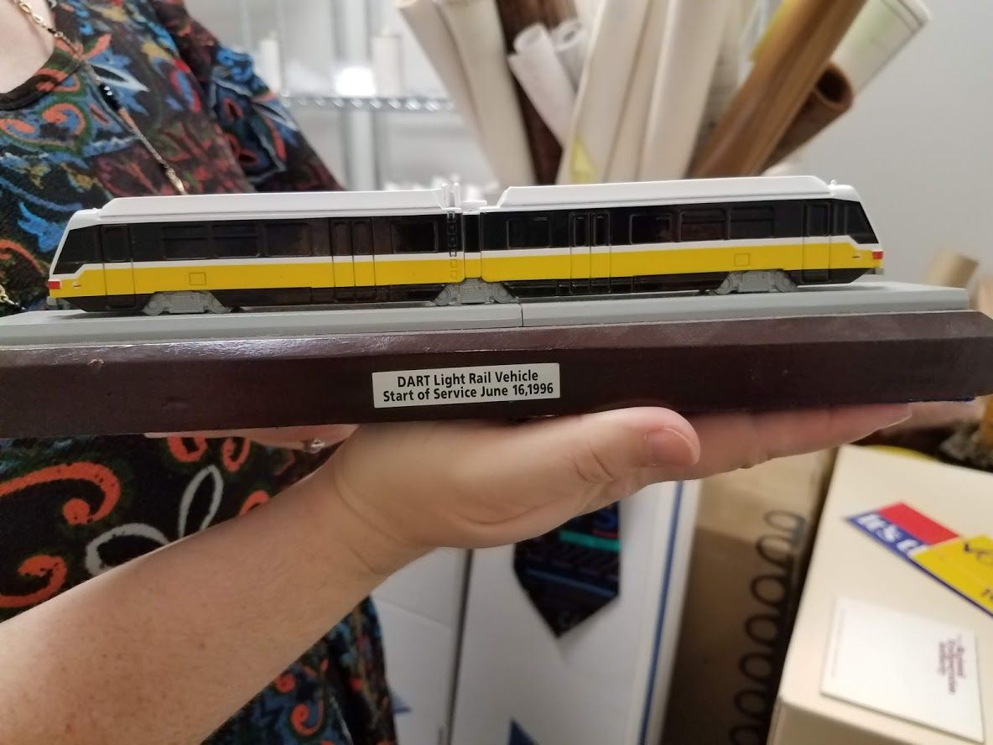
Why a DART Archive?
Recognize and preserve the history and legacy of DART
To serve as an educational resource
To expand the existing available body of knowledge
To support the information needs of federal, state and local decision makers

Slide 4
DART Historical Archive
DART has established the DART Historical Archive to document, preserve, and provide access to records about DART’s history, role and impact in North Texas, and legacy of innovation and leadership in the world-wide transit community.

Slide 5
Collection Development Strategy
Selection Criteria for development of the DART Archive:
Relationship of records to primary functions of DART as an agency, or to the functions of significant departments within DART
Records which document innovation and leadership in services, programming, engineering, and other areas related to transit
Records which were created by DART are of greatest interest.
Potential for ongoing research use of records outside the original business purpose for which they were created
Materials of all formats will be considered.

Slide 6
Creation of the DART Historical Archive
Collection Survey – Identify scope of archival holdings, both physical and digital
Processing Plan - Outline steps for creation of the archive, including timeline for project completion
Arrangement and Description – Create comprehensive collection Finding Aid, rehouse physical materials, add digital archival materials to Digital Library

Slide 7
Other considerations
Ownership of physical archive, digital archival, electronic Finding Aid and oral history recordings
Policies for internal and external access to archive
Space for archival processing and storage
Archival supplies
Security of archive
Digitization of physical materials
Oral histories

Slide 8
Benchmark Proposal
Phase 1: Planning and Development, part 1
Estimated processing time: 6 months
July 2018-December 2018
Capital Planning
Commuter Rail
Phase 2: Communications
Estimated processing time: 18 months
January 2019-June 2020
Phase 3: Governance and Administrative, part 1
Estimated processing time: 12 months
July 2020-June 2021
Phase 4: Planning and Development, part 2
Estimated processing time: 12 months
July 2021-June 2022
Phase 5: Operations
Estimated processing time: 6 months
July 2022-December 2022
Phase 6: Administrative, part 2; Pre-DART and External
Estimated processing time: 6 months
January 2023-June 2023

Slide 9
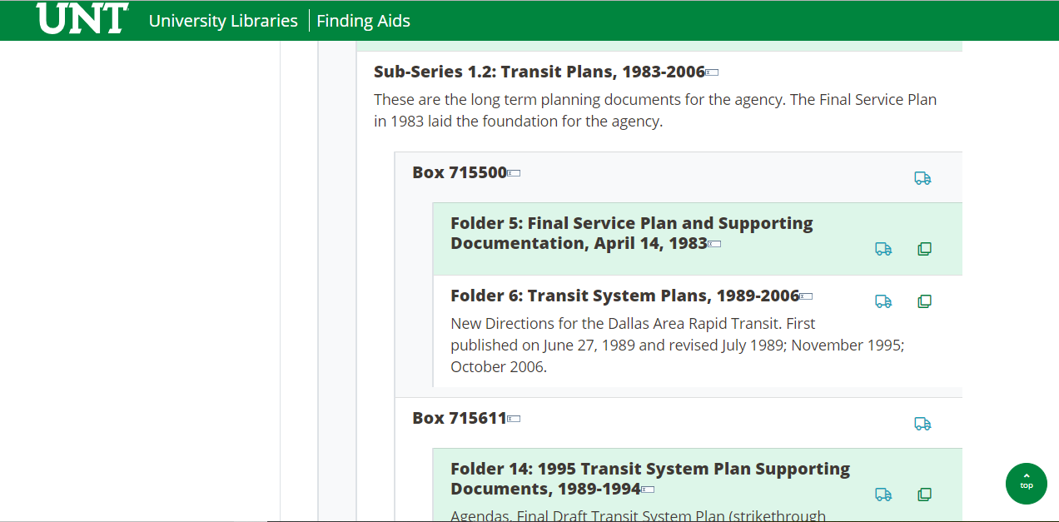
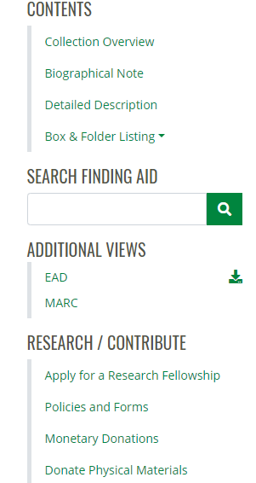

Slide 10
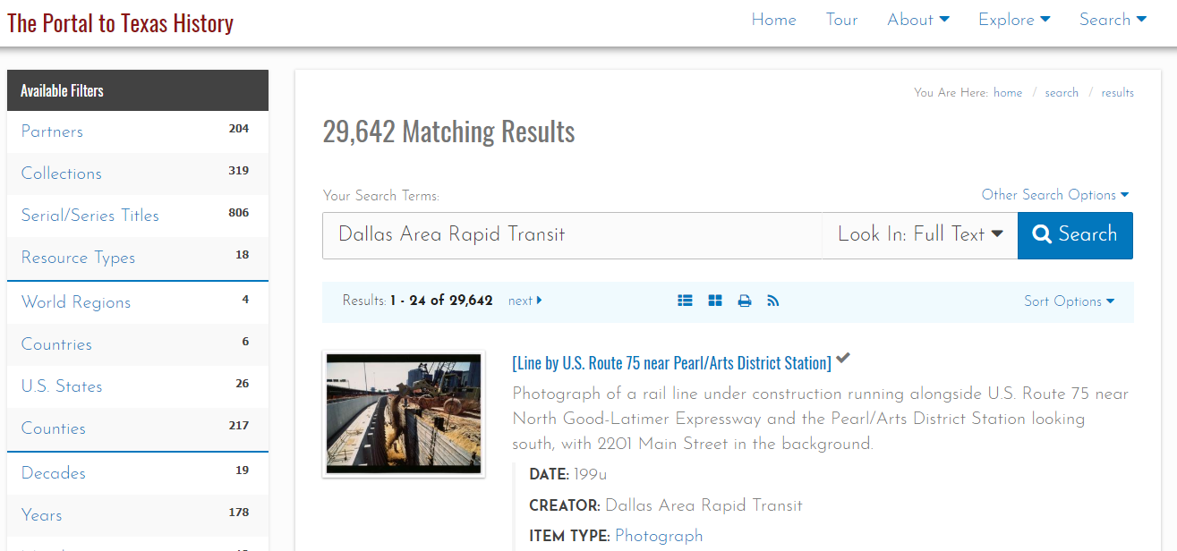

Slide 11
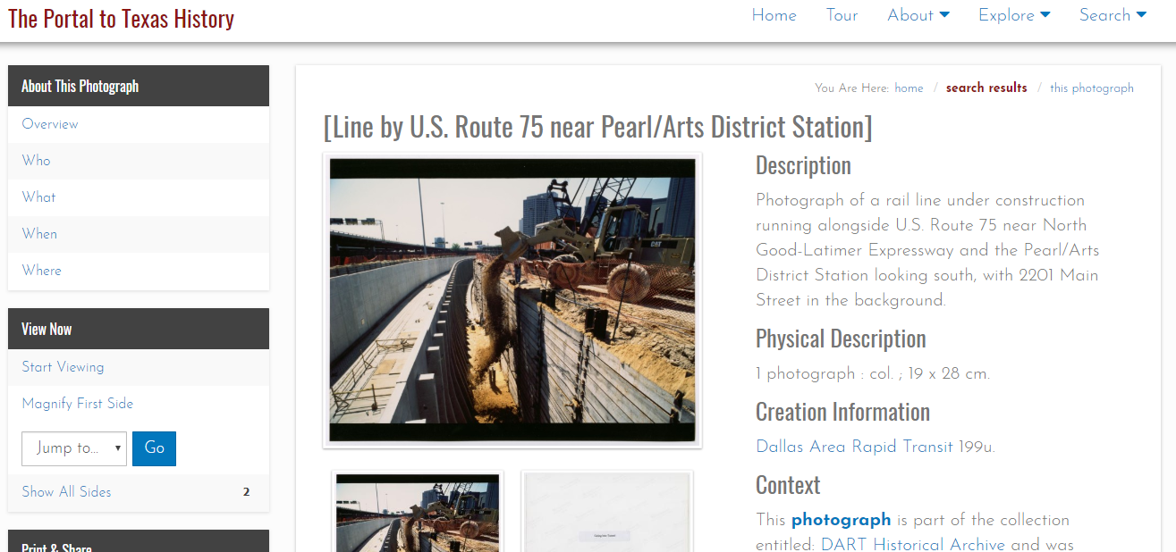

Slide 12
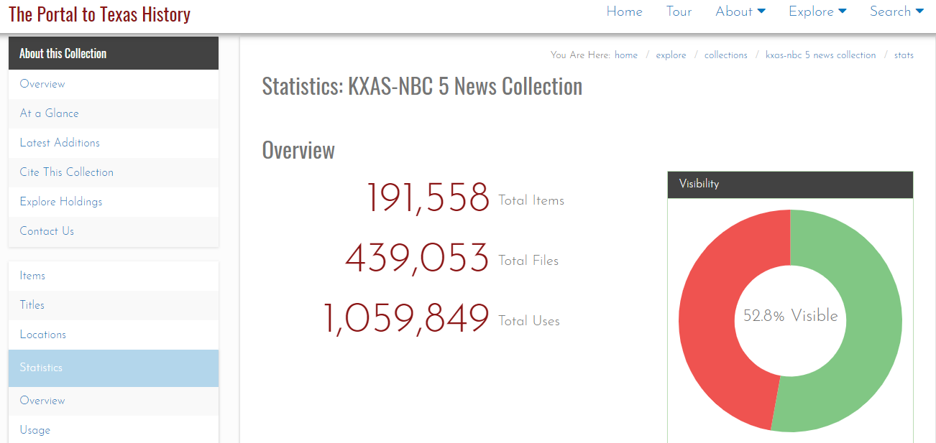

Slide 13
