Slide 1
DART Governance and
Strategic Plan
David Schulze
VP Policy and Strategy
June 19, 2017

Slide 2
DART Governance

Slide 3
Nature and Creation
DART is a governmental entity
Organized under State Law
Created by vote of the citizens

Slide 4
Board of Directors
15 members
Appointed by cities in proportion to population
Board uses a committee structure to facilitate decision-making

Slide 5
Open Government Laws
Open Meetings Act
Texas Public Information Act

Slide 6
Local Bylaws and Rules
DART Board Bylaws
DART Board Rules of Procedure
DART Board Policies
DART Procurement Rules
Code of Conduct for Persons on DART Vehicles, Facilities or Property

Slide 7
Board Functions
Set policy
Adopt budget
Adopt a long-term financial plan
Adopt a general System Plan and a specific Service Plan
Hire President/Executive Director, Attorneys, Secretary and Auditor

Slide 8
President/Executive Director
Administers daily operation
Employs and removes employees
Prescribes the duties, tenure, and compensation of employees

Slide 9
DART has Broad Powers
Acquire, construct, develop, plan, operate, and maintain a public transportation system
May acquire property by eminent domain
May employ police
May adopt and enforce rules
May issue bonds to fund authorized activities

Slide 10
Limited Liability
DART has governmental immunity
DART benefits from liability limits under state law

Slide 11
Public Involvement
Public Hearings are required for
  Major service changes
  Any fare change
  Rulemaking
  Receiving certain grant funds
Members of the public are allowed to speak at each Board meeting

Slide 12
Service Area
Current territory is defined by boundaries of cities that voted to participate in DART
Territory may be added by election

Slide 13
Funding Sources
Local sales tax: 1% collected within the service area
Fares
Federal government grants
Advertising and miscellaneous concessions

Slide 14
DART Strategic Plan

Slide 15
Nature and Creation
DART is a governmental entity
Organized under State Law
Created by vote of the citizens

Slide 16
DART’s Strategic Plan
Strategic Direction | Annual Elements | Long Range Elements
Mission Statement | Agency Goals | Transit System Plan
Vision Statement | Annual Budget | 20 Year Financial Plan
Employee Values | Business Plan (Annual Elements) | Business Plan (Long Range Elements)
Strategic Priorities | Department Work Plans
5 Star Service Program | President/Exec. Director Performance Measures
 | Employee Performance Measures

Slide 17
Strategic Priorities
How we accomplish our mission
  Broad and general statements
  Lay out the direction the organization needs to go
  Guides the development of Agency Goals and President/Executive Director Goals
  Results in progress toward meeting the Mission and Vision

Slide 18
Agency Goals
What we want to accomplish
  Set the priorities for the annual budget
  Guide development of annual work plans
  Basis for performance measures for President/Executive Director
  Basis for individual employee performance measures

Slide 19
Performance Measures
How we know if we accomplished the Goal
  Specific
  Measurable
  Objective

Slide 20
Dependency Initiatives
Prerequisite or significant sub-part necessary to meet the related Performance Measure
  Specific
  Measurable
  Objective

Slide 21
Strategic Plan Cycle
Board adopts Strategic Priorities
Board approves President/Executive Director Goals and Performance Measures
Management identifies Dependency Initiatives
Departments develop work plans
Board approves the annual budget

Slide 22
Strategic Plan Cycle
Departments establish objectives and performance measures
Managers create performance plans for individual employees
Regular reporting on progress toward meeting goals, objectives and performance measures
Annual review

Slide 23
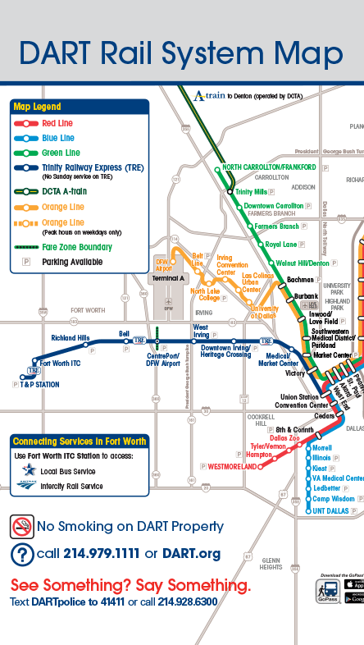
If you don’t know where you want to go
It doesn’t matter which path you take

