Slide 1
DART BOARD OF DIRECTORS
and
The Office of Board Support
Laneshia Hawkins
Board Support Specialist
June 19, 2017

Slide 2
Agenda
History of the DART Board
Function of the Board
Board Member Appointments
Board Meetings
Functions of the Office of Board Support

Slide 3
History of the DART Board of Directors
The Board’s structure was established by the Texas Legislature, which adopted the enabling statutes in 1983
The enabling statute is the law that gives DART authority to operate as a public transportation agency
The enabling statute is found in Chapter 452 of the Texas Transportation Code

Slide 4
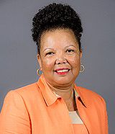
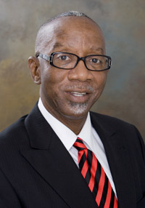
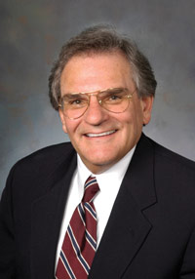
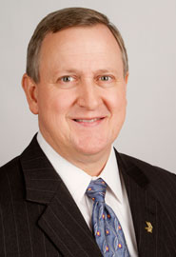
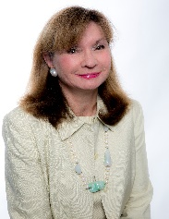
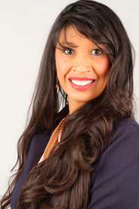
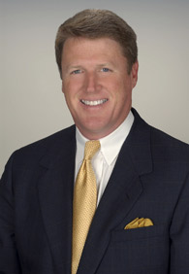
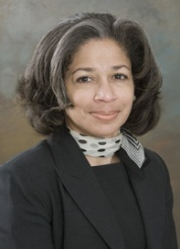
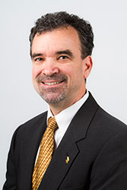
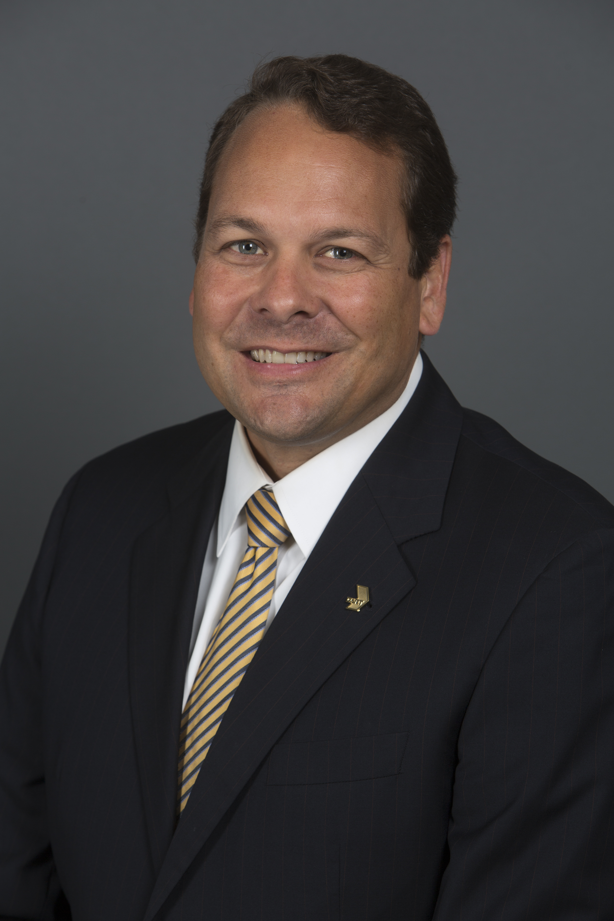
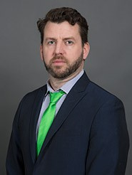
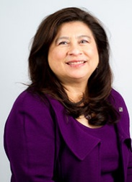
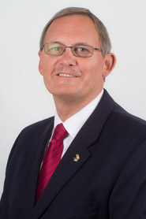
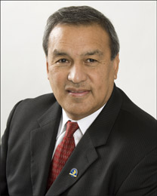
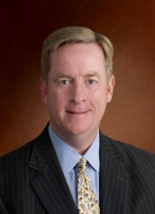
DART Board of Directors
LaFayette “Faye” Moses Wilkins
Chair
Cities of Farmers Branch and Plano
Jerry Christian
Vice Chairman
City of Dallas
Gary Slagel
Secretary
Cities of Richardson and Highland Park; Towns of Addison and University Park
Vacant
Assistant Secretary
City of Dallas
Jim Adams
City of Dallas
Sue S. Bauman
City of Dallas
Amanda Moreno Cross
City of Dallas
Mark C. Enoch
Cities of Garland, Glenn Heights and Rowlett
Pamela
Dunlop Gates
City of Dallas
Timothy A. Hayden
Cities of Carrollton
and Irving
Jonathan R. Kelly
City of Garland
Patrick Kennedy
City of Dallas
Michele Wong Krause
City of Dallas
Rick Stopfer
City of Irving
William Velasco, II
Cities of
Cockrell Hill and Dallas
Paul N. Wageman
City of Plano

Slide 5
Why Is The Board Important?
The Board is the governing body of DART
It sets overall Agency policies
It provides guidance in setting the Agency’s strategic goals
It oversees the operation and control of DART properties
It hires the President/Executive Director, Director of Board Support, Internal Auditor and General Counsel and determines their compensation
Board members serve as representatives of our customers and stakeholders

Slide 6
Difference Between the Role of the Board and the President/Executive Director
The Board sets the overall Agency policies
The President/Executive Director implements the policies set by the Board
The President/Executive Director is also responsible for the day-to-day operation of DART

Slide 7
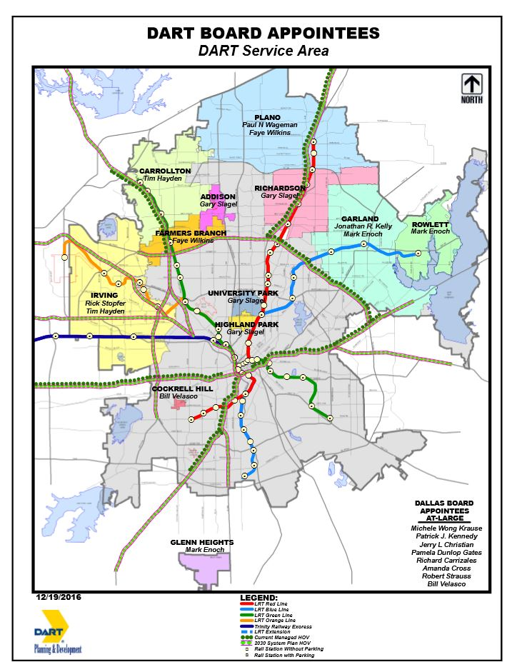
DART Service Area
Board members are
appointed by DART’s 13
Member Cities
City representation is based
on population Board
members are appointed for
two-year terms

Slide 8
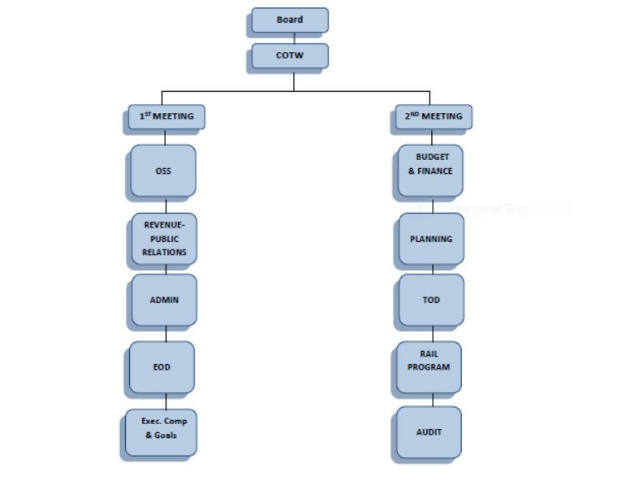
Committee Meeting Structure

Slide 9
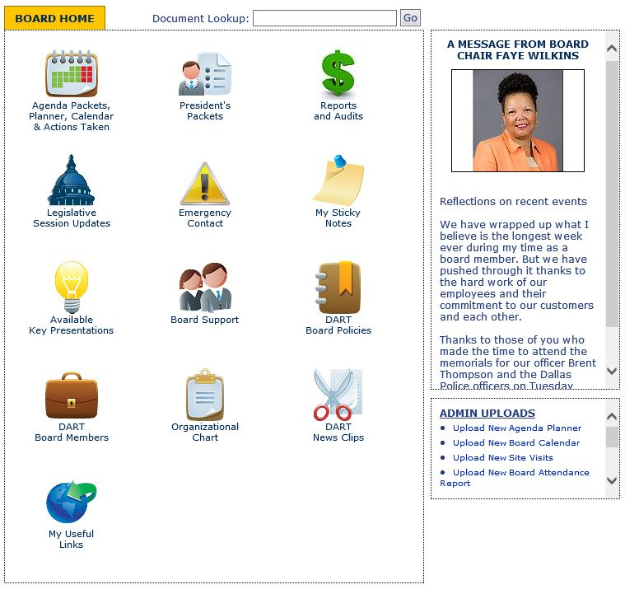
Board Portal
Volunteer Hours/Month:
Appx. 40 hrs – Board Members
Appx. 80 hrs – Board Chair

Slide 10
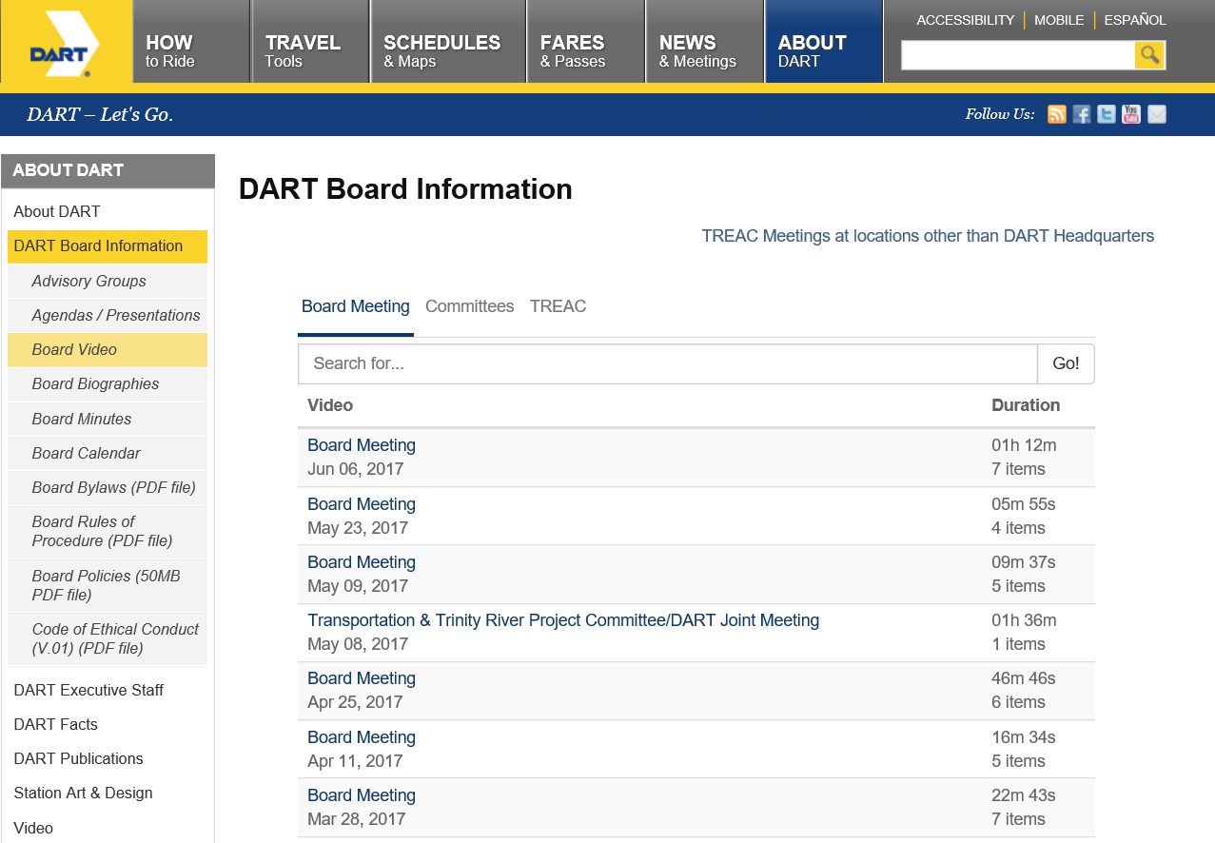
Video Recordings of Board Meetings

Slide 11
Primary Functions of Office of Board Support
Distribute information to board members
Assist in handling board members’ requests
Coordinate board and committee meeting materials
Coordinate meeting schedules for board members
Serve as secretary to the Trial Board
Serve as liaison to administrative law judges
Maintain official documents of all board and committee meetings

Slide 12
Office of Board Support Staff

Slide 13
Office of Board Support Staff (Director of Board Support)
Primary contact for board members, staff and the public (acts on behalf of the Board)
Secretary to Trial Board (involves employee grievances)
Administrative Law Secretary (involves contract disputes)

Slide 14
Office of Board Support Staff (Board Support Specialist)
Secondary contact for board members, staff and the public (acts on behalf of the Board, in absence of the Director of OBS)
Provide administrative support to Director of OBS and the Board
Handle board requests, department budget and procurement requests
Handle correspondence, public comment requests and codification of policies

Slide 15
Office of Board Support Staff (Board Committee Secretary)
Prepare meeting minutes for the committees, Committee-of-the-Whole and Board meetings
Assist with coordination of Board meeting materials
Responsible for agenda preparation and information distribution to Board
Post agendas with city/state agencies
Prepare attendance reports and actions taken by the Board during committee meetings

Slide 16
Office of Board Support Staff (Board Support Analyst)
Prepare meeting agendas and agenda planner
Handle records management for the department
Coordinate Video Recordings and Technology Assistance
Respond to Open Records Requests
Additional Duties:
Prepare meeting minutes for the committees, Committee-of-the-Whole and Board meetings
Assist with coordination of Board meeting materials
Responsible for agenda preparation and information distribution to Board

Slide 17
Office of Board Support Staff (Admin Law & Trial Board Representative)
Coordinate Trial Board grievances
Schedule Trial Board hearings
Coordinate Administrative Law contract disputes
Schedule Administrative Law hearings
Coordinate travel arrangements for the Board and the department

Slide 18
Questions?

