Slide 1
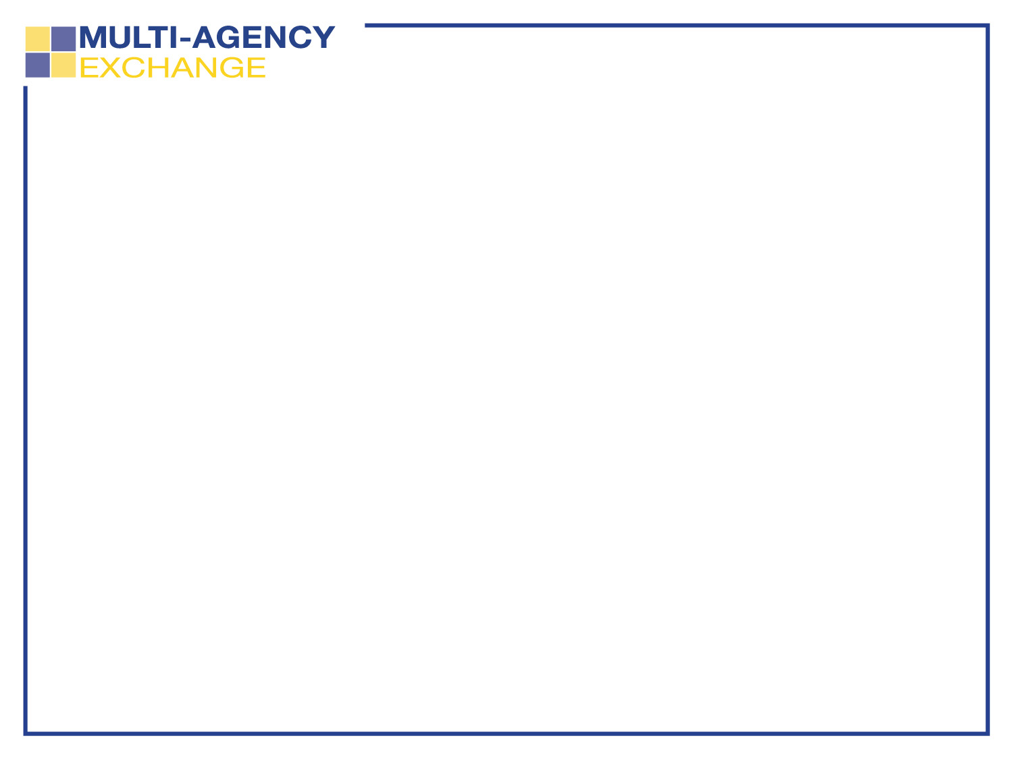
2017 Max Program
System Overview
Timothy H. McKay, P.E.
Executive Vice President, Growth/Regional Development
June 2017

Slide 2

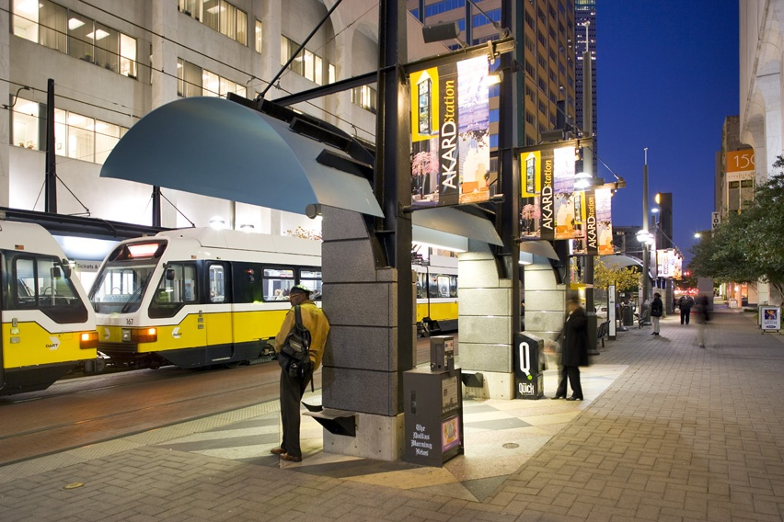
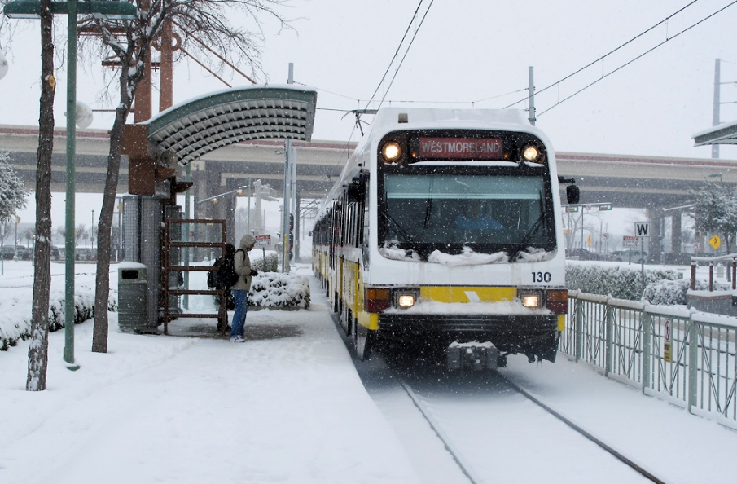
What is DART?
Dallas Area Rapid Transit
13 Service Area Cities
Services Provided:
  Light Rail
  Commuter Rail
  Bus
  Paratransit
  Streetcar
  Site Specific Services

Slide 3
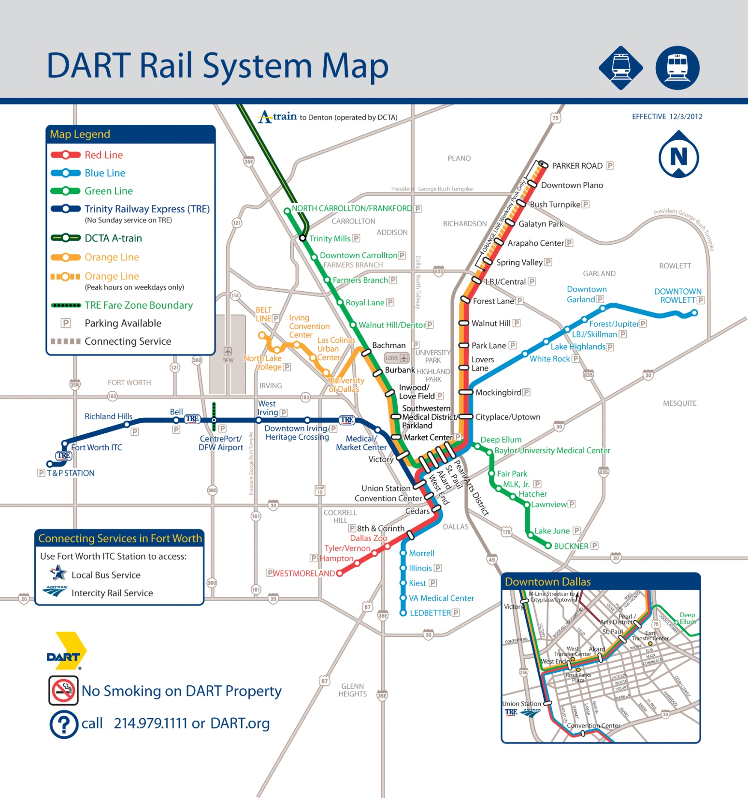
Rail Expansion Program
“Longest Light Rail System in North America”
DART’s expanding rail network serves more special events and has brought more riders to individual events

Slide 4
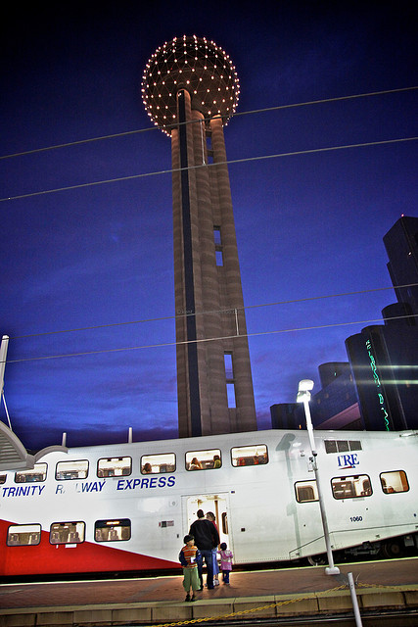
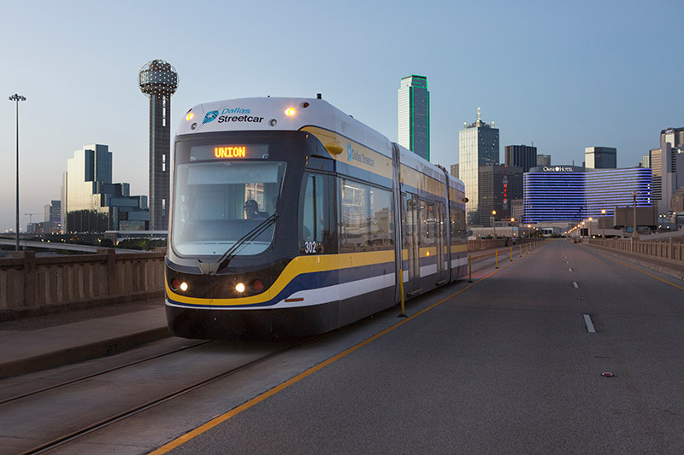
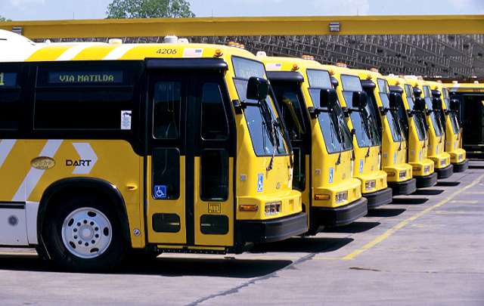
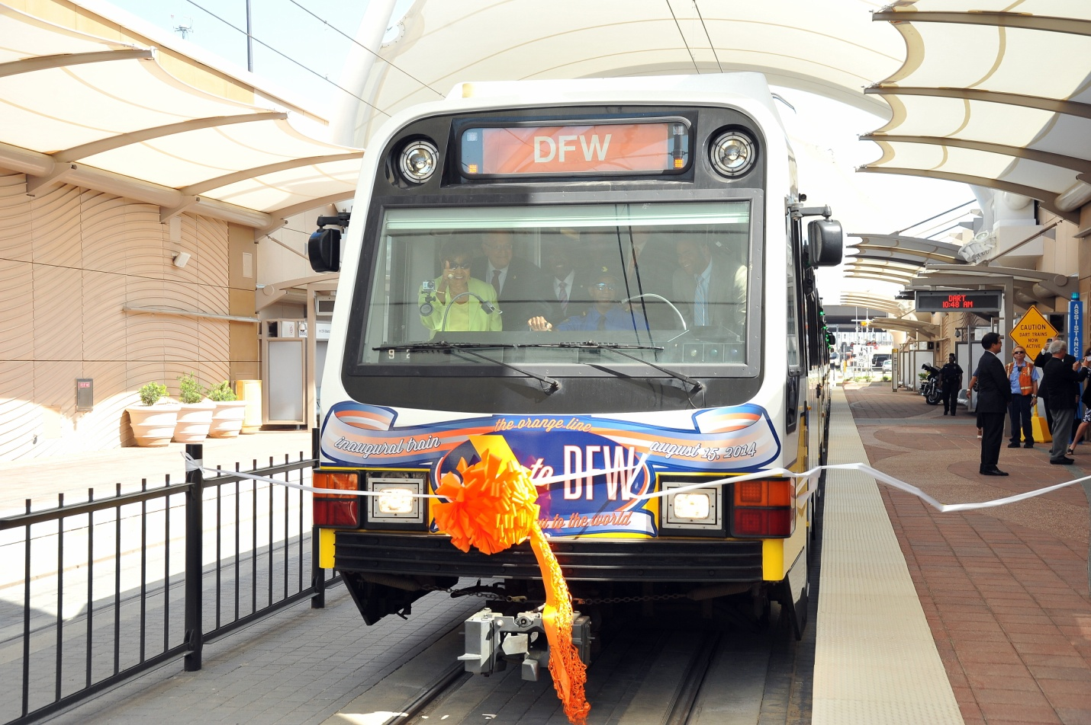
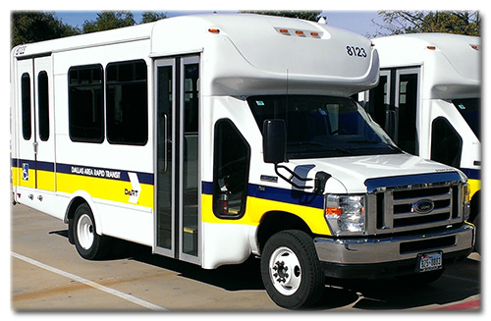
Overview of DART System
93 Miles of Light Rail
33.8 Miles of Commuter Rail
2.4 Miles Streetcar System
150 + Bus Routes
Paratransit & Vanpool
Site-Specific Services
67.1 Million Passenger Trips

Slide 5
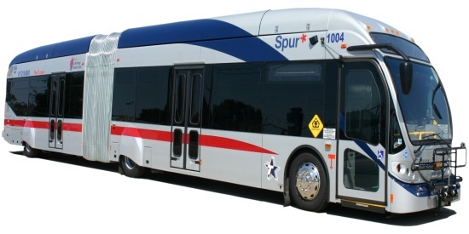
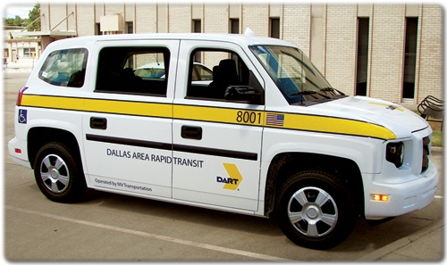
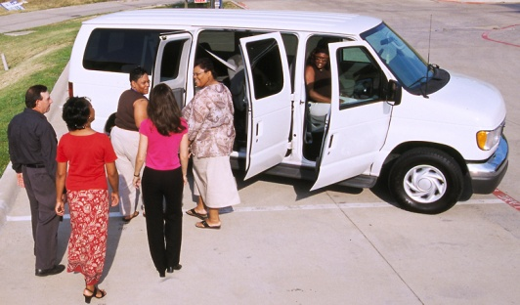
Services
Bus
  652 Buses
  Transitioned to CNG Fleet with 7 electric buses delivered later in 2017
  26’ ARBOC
  31’ and 40’ NABI Vehicles
Paratransit
  162 Vehicles
  200 Non-Dedicated Fleet
  Mobility Management Contract
Vanpool
  184 Vanpools

Slide 6
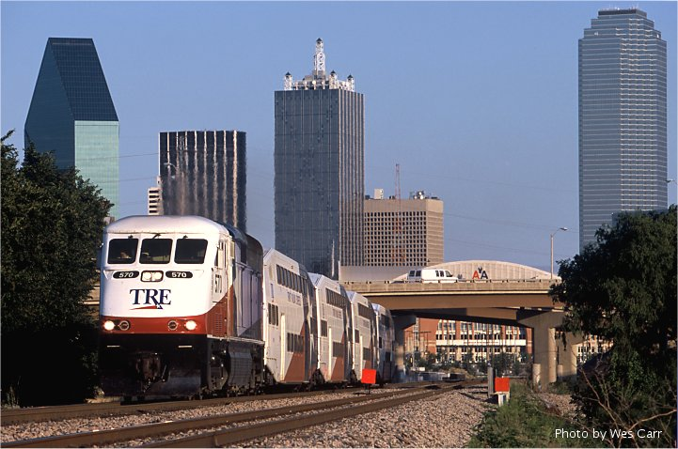
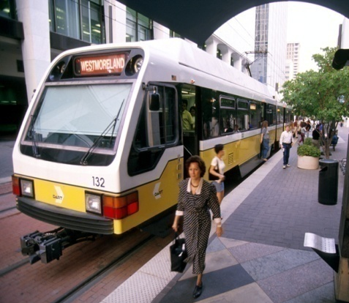
Services
Light Rail
  163 Vehicles
  62 Stations
Commuter Rail
  9 Locomotives
  17 Bi-Level Coaches
  10 Bi-Level Cab Cars

Slide 7
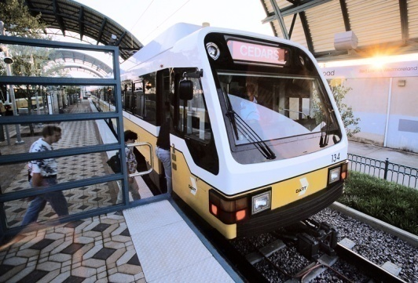
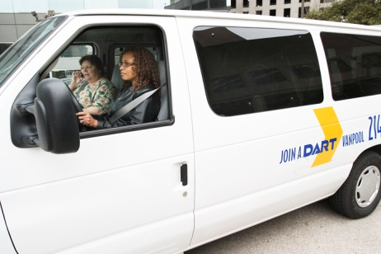
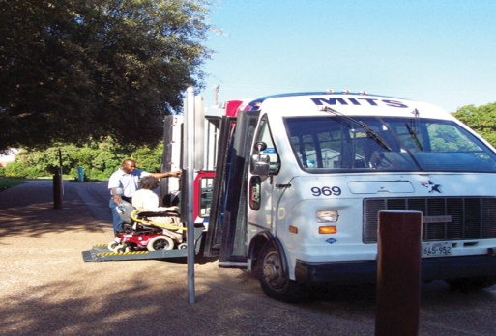
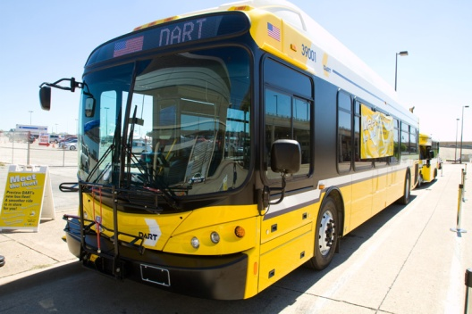
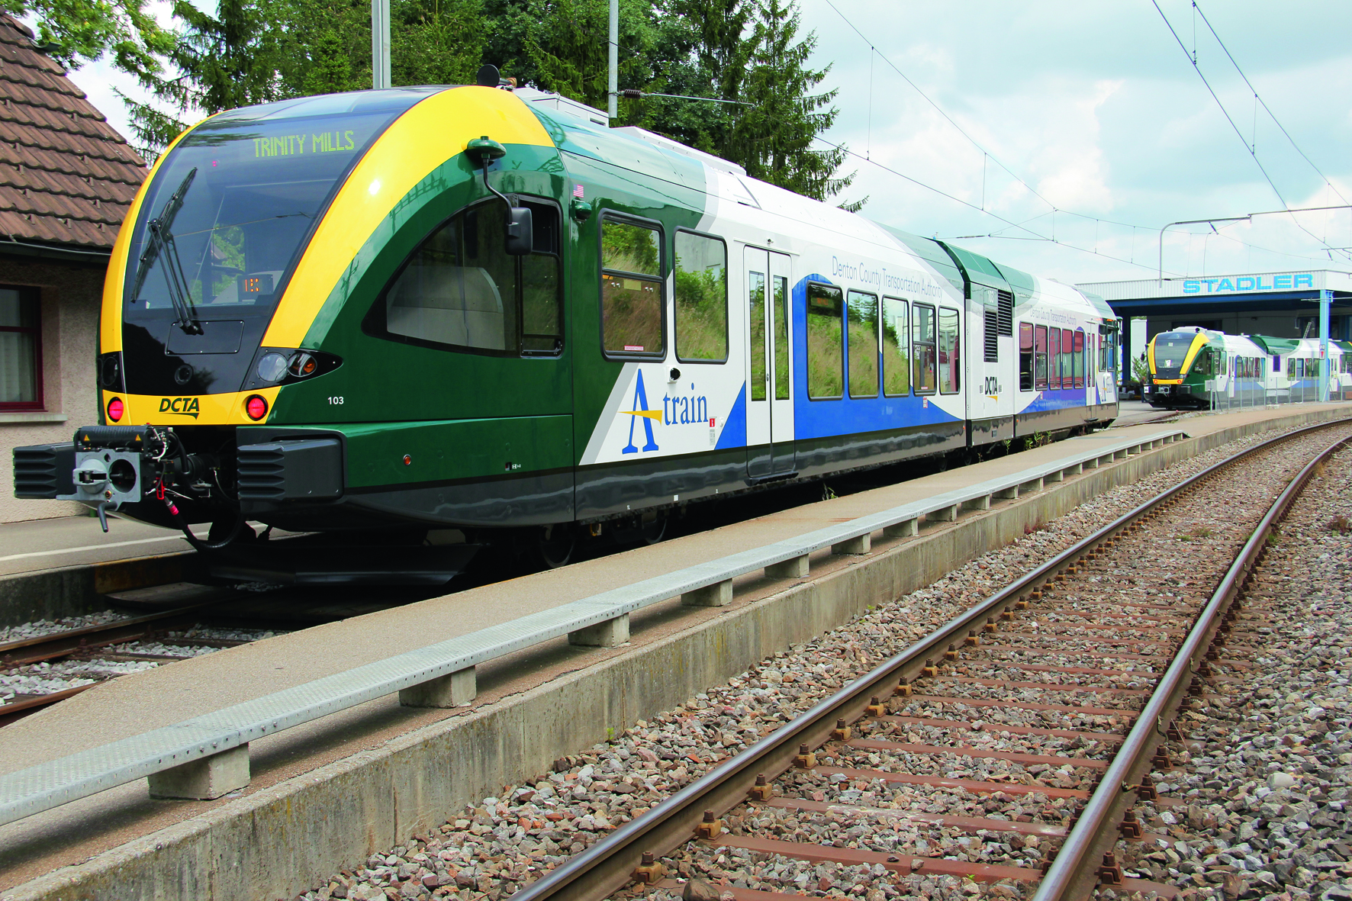
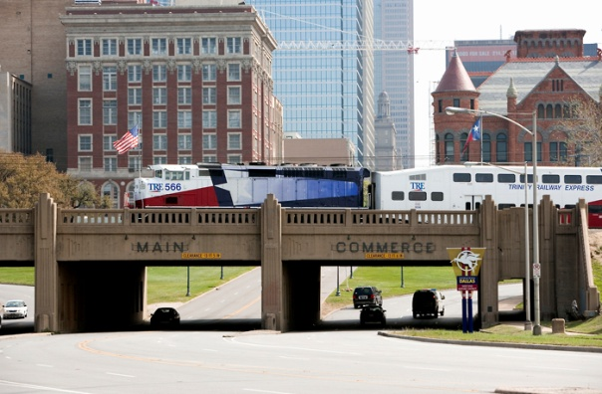
Regional Daily Ridership by Mode
99,495
1,367
106,882
2,821
7,830
2,670

Slide 8
DART Service Area
With DFW Regional Rail Network

Slide 9
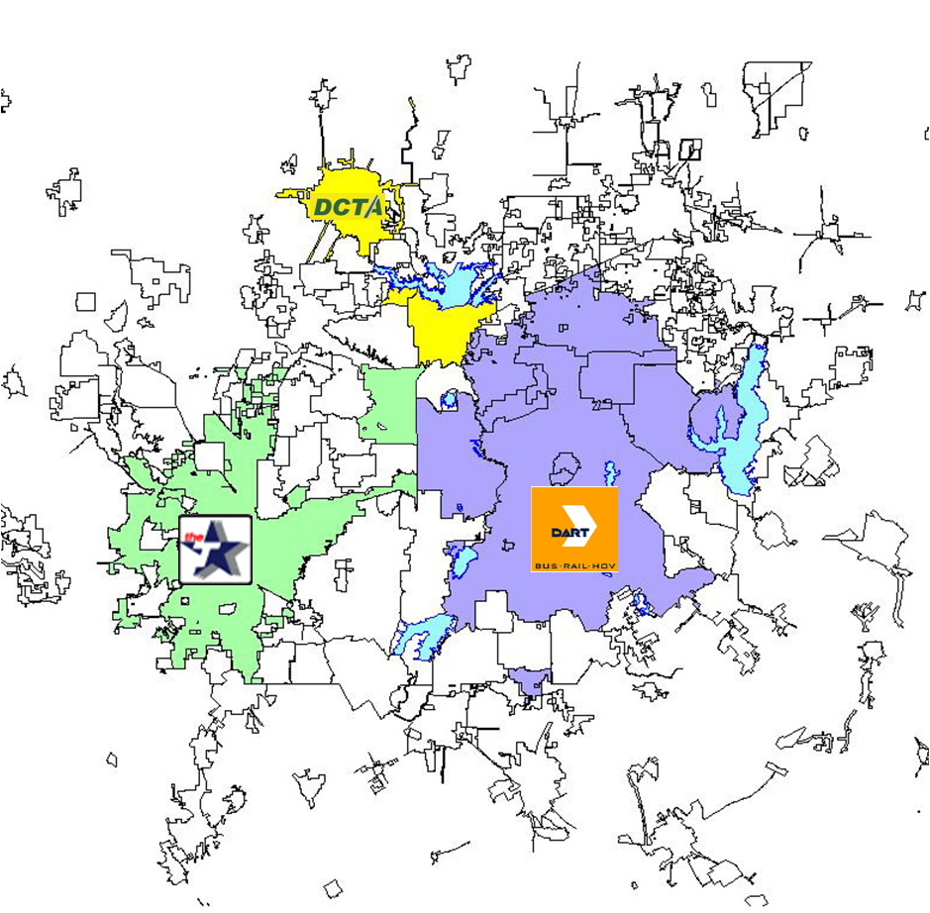
Transit Service Areas

Slide 10
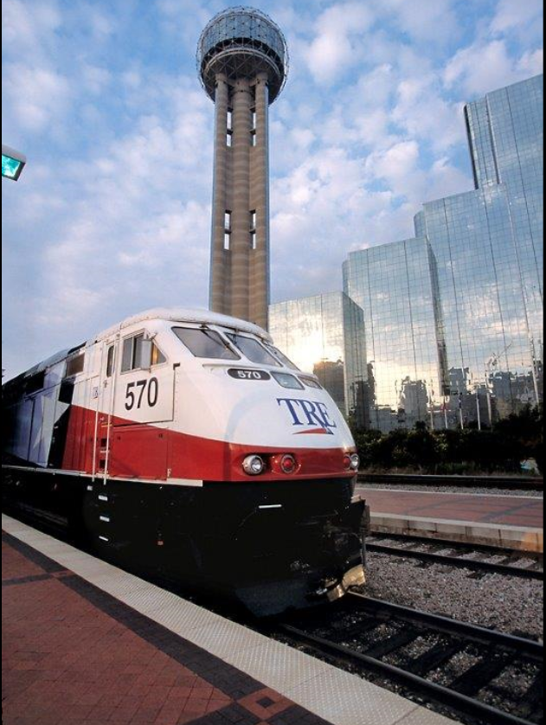
Trinity Railway Express
33.8 mile corridor between Dallas and Fort Worth
  68 trains Monday through Thursday
  70 trains on Friday
  42 trains on Saturday
  No Sunday service
Number of stations: 10
Parking: 3,230 spaces
Freight traffic
  Average 22 freight moves per day

Slide 11
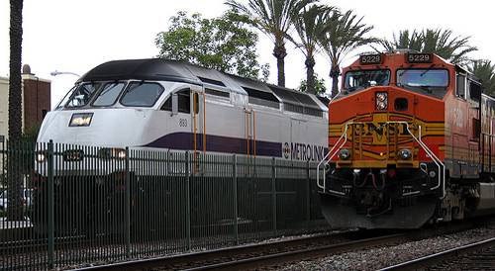
Regional Rail in North Texas
DART regional leadership: working the FWTA, Class 1 railroads and Amtrak
DART owns 250 miles of heavy rail corridor across North Texas
Shared Services
  Facilities
  Personnel
  Overhead, insurance and other expenses
  Technology
  Positive Train Control implement

Slide 12
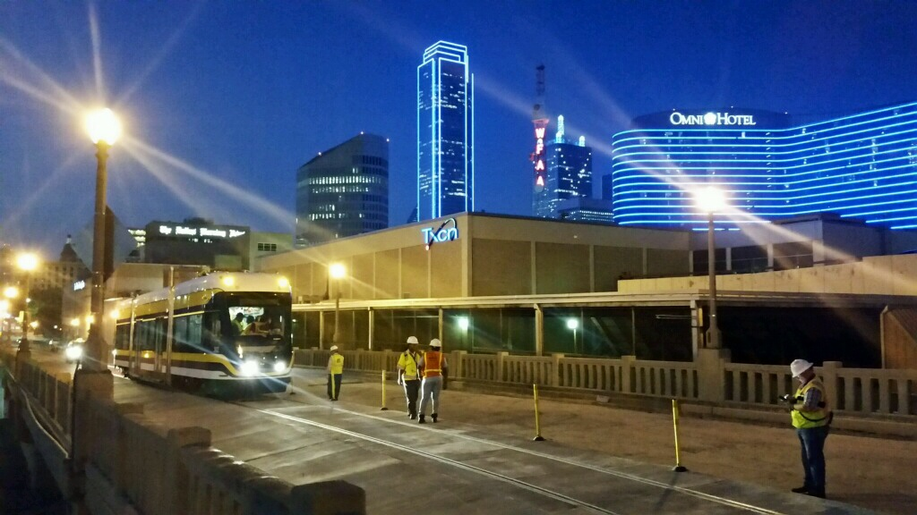
Upcoming Capital Projects
Red and Blue Line Platform Extensions
Dallas CBD Second Light Rail Alignment (D2)
Dallas Central Streetcar Link
Cotton Belt

Slide 13
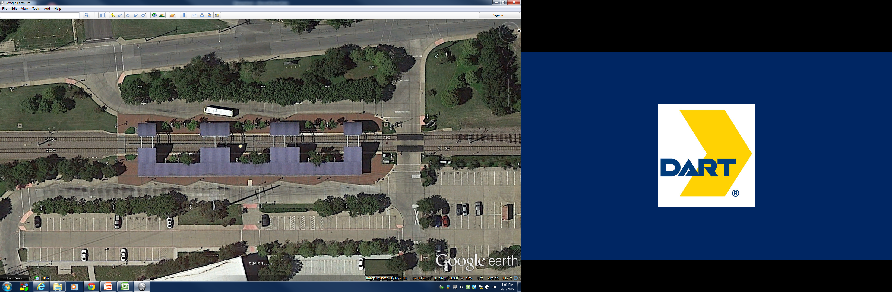
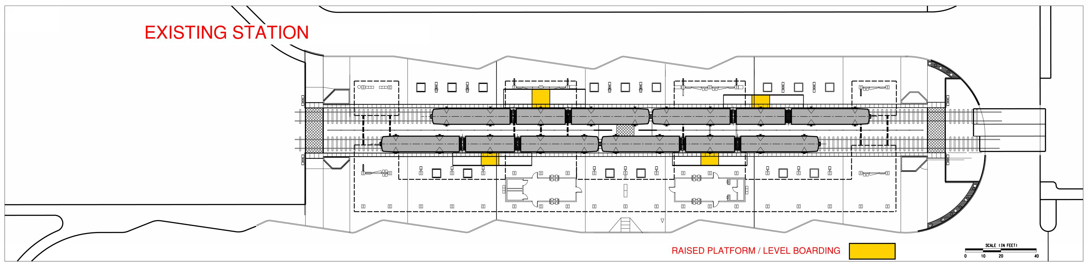
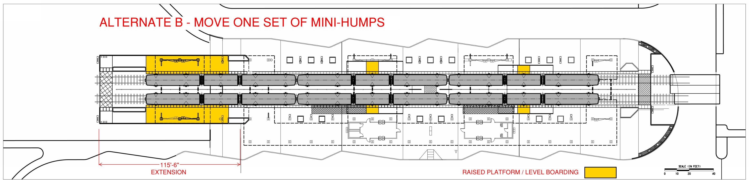
Upcoming Capital Projects
Platform Extension
Comprehensive Professional Services (CPS) for design solicitation completed.
  Architects, Engineers, Systems, QA
Construction Management/General Contractor(CM/GC) - 1 Solicitation/ 5 Lots by geographic location in summer 2017
30% Design completed by GPC
Platform Extension at 28 stations
Allows 3-car trains at each station
Increases passenger capacity by 33%
Minimizes passenger disruption
Operational flexibility
Existing Station
Existing Station
Platform Extension Concept Plan

Slide 14
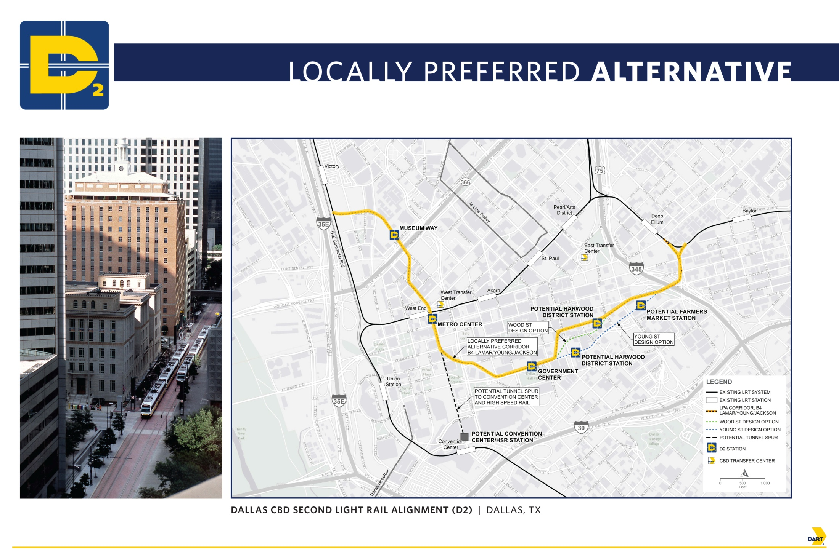
Upcoming Capital Projects
D2 – Dallas CBD Second Light Rail Alignment
2.4 mile light rail corridor, 4 stations (1 below grade)
Project Delivery Method
  Design-Build
Current Work Efforts
  Subsurface Investigation
  Building Foundation Plans Collected from City of Dallas; individual buildings.
  Research of City of Dallas Utilities (water, storm/drainage)
  Franchise Utilities (ONCOR, AT&T, Atmos, etcetera)
Environmental (SDEIS)
  Field Analysis/Data Collection
  Noise/Vibration: Ambient Levels Measured
  Historic Resources: Field Verification
  Traffic: City of Dallas supplied intersection models

Slide 15
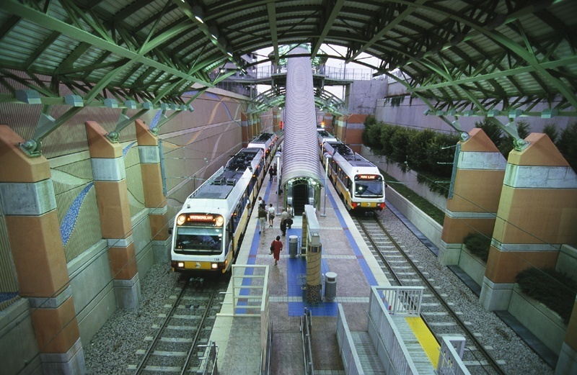
Upcoming Capital Projects
D2 Project Status
Currently in FTA Project Development (PD)
  FTA Capital Investment Grant (CIG) Core Capacity program
Project refinement as subway
Refined Locally Preferred Alternative decision by June 2017
Reinitiate 30% Preliminary Engineering (PE) and Supplemental Draft EIS in summer 2017

Slide 16
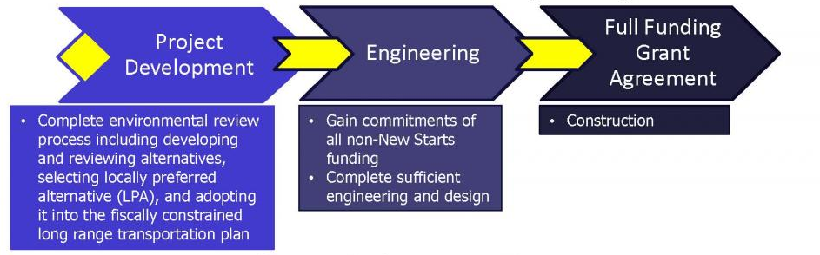
Upcoming Capital Projects
Capital Funding for D2 Subway
DART Financial Plan
  $1.3B in YOE dollars
  Assumes a 50% FTA Core Capacity Capital Investment Grant

Slide 17
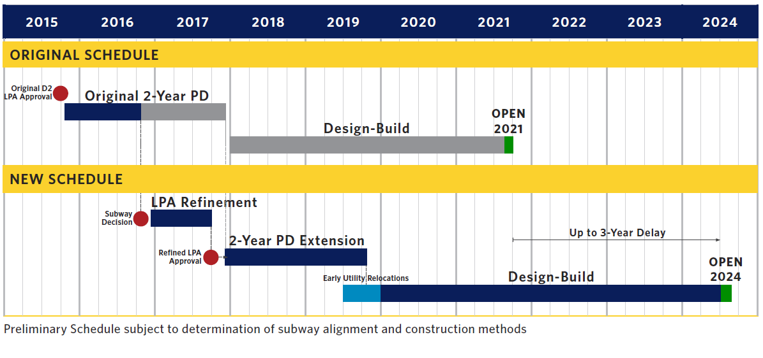
Upcoming Capital Projects
D2 Schedule

Slide 18
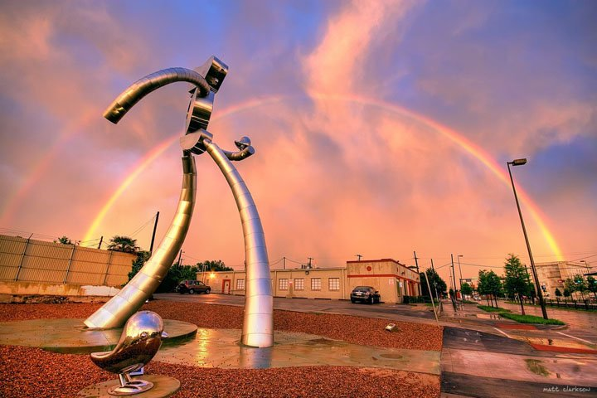
Upcoming Capital Projects
Cotton Belt
26 Miles, 11 Stations, Regional rail, Single track with passing sidings
Single track with passing tracks; double track stations
  Future expansion to double track
  30 Minute peak headways
    Future 20 minute peak headways
    Regional Rail Vehicle
    Betterments along the residential areas of corridor

Slide 19
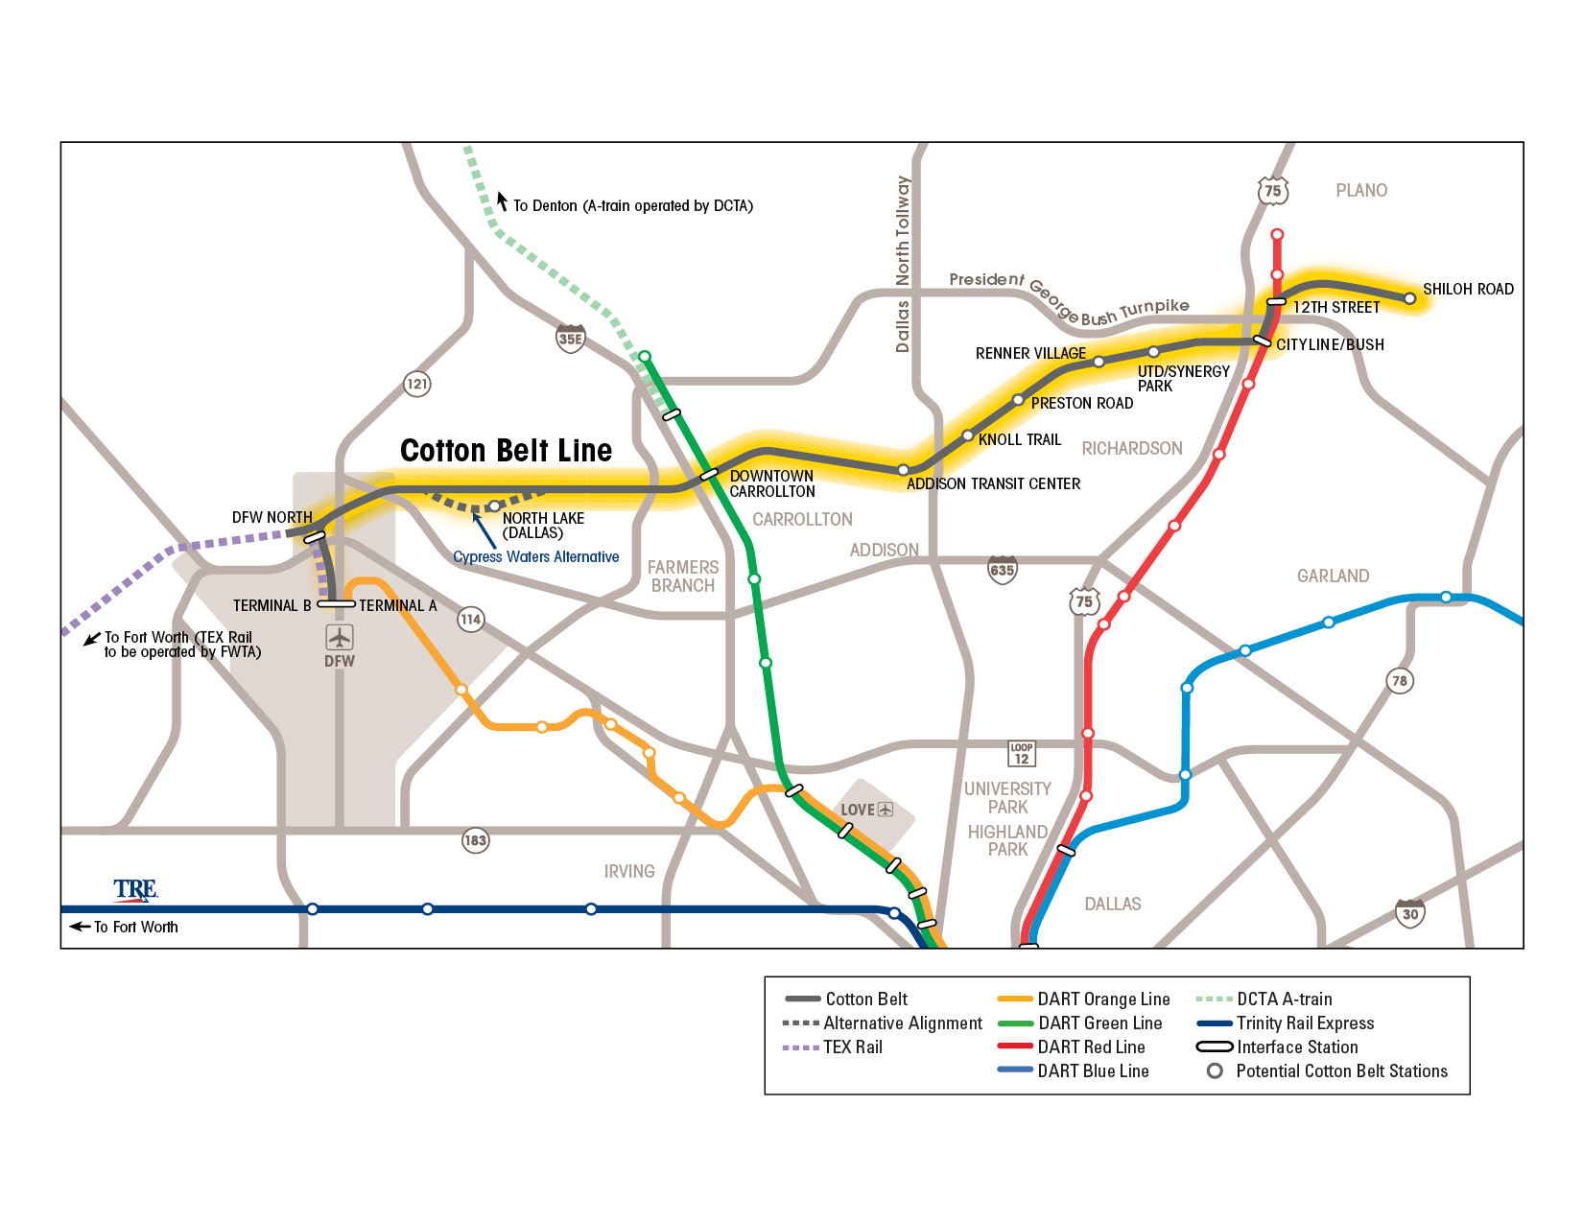

Slide 20
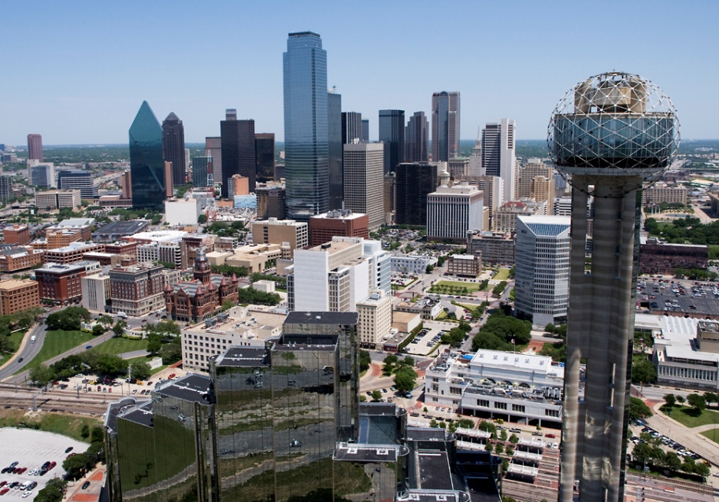
Upcoming Capital Projects
Cotton Belt
The Cotton Belt was included in the FY 2017 Financial Plan with service beginning in 2022.
Project to be funded primarily through Railroad Rehabilitation Improvement Financing (RRIF) Program
  Through FRA/Build America Bureau

Slide 21
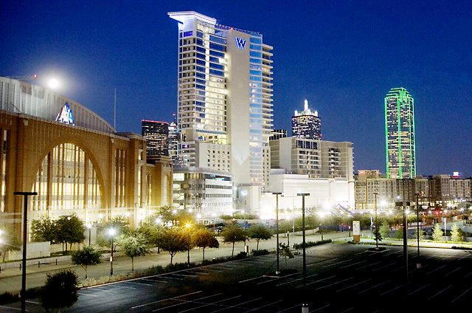
Upcoming Capital Projects
Cotton Belt
One Department of Transportation (DOT) Meeting (FTA/FRA/FAA)
  FTA will remain lead agency
    Original 2010 Notice of intent to prepare Environmental Impact Study (EIS) can be used
    FRA and FAA will be Cooperating Agencies on the EIS and will issue separate Records of Decision (ROD)
    Bi-weekly One DOT meetings to discuss issues pertinent to each agency as we advance EIS

Slide 22
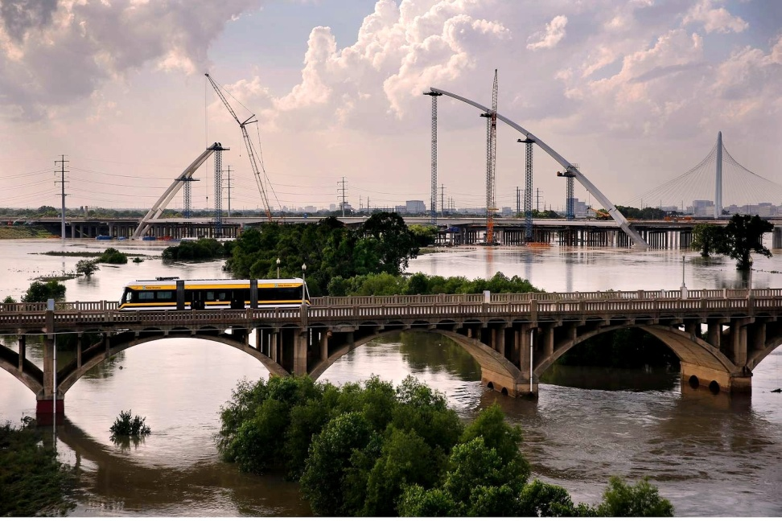
Upcoming Capital Projects
Cotton Belt
One DOT coordination
RRIF Loan pre-application
Coordination with cities
Developing enhanced public outreach
Early action items on engineering issues
  Focus on interconnectivity with TEX Rail

Slide 23
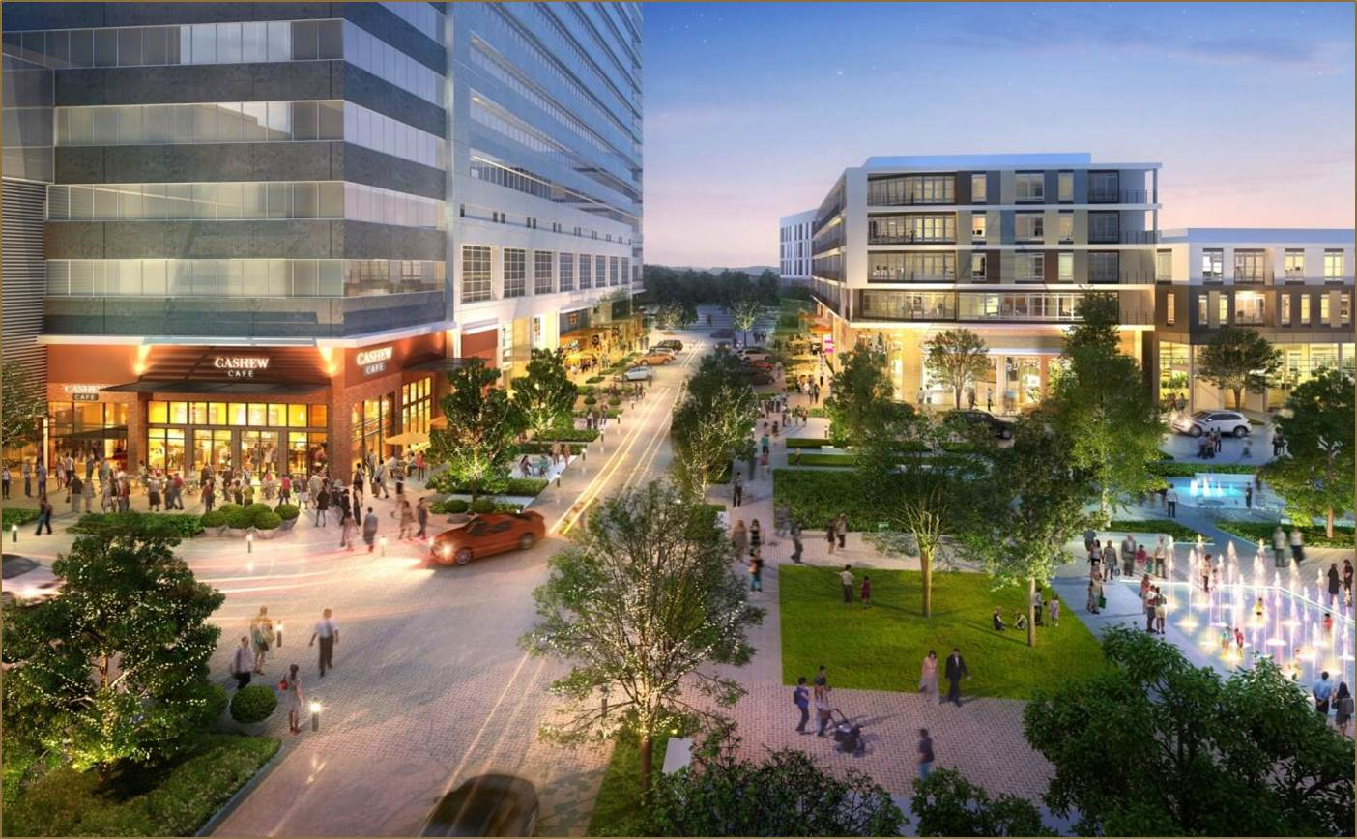
Upcoming Capital Projects
Cotton Belt
Finalizing Communications Plan and will present to committee and stakeholders
Public meetings to be scheduled
  Dates will be provided when finalized
  Area Focus Group meetings in the spring
    DFW/Cypress Waters, Carrollton/Addison, North Dallas, Richardson/Plano

Slide 24
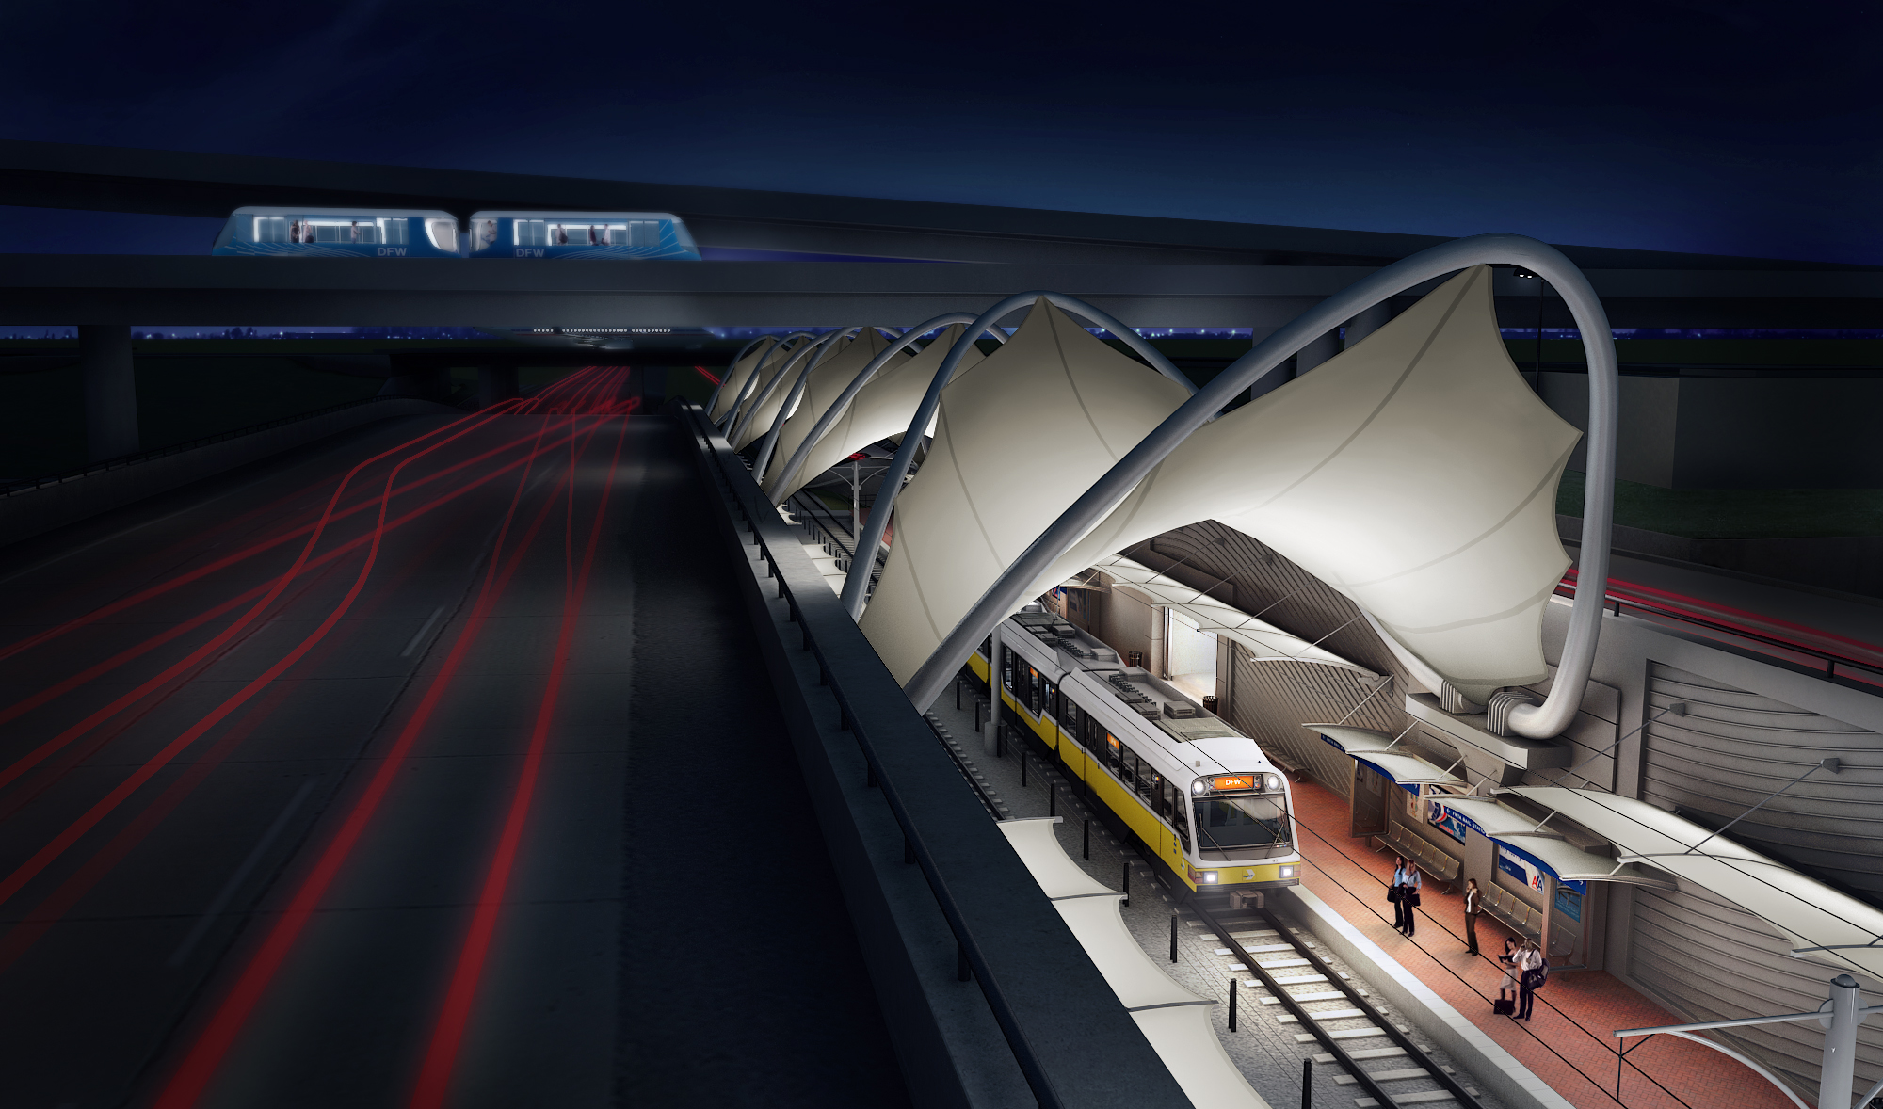
Upcoming Capital Projects
Cotton Belt
Communications Plan outlines:
  Bi-weekly One DOT coordination meetings
  Early coordination with FWTA/DFW Airport
  Regular city staff coordination
  Quarterly city briefings
  Monthly DFW Airport staff meetings
  Other agencies/organizations as needed

Slide 25
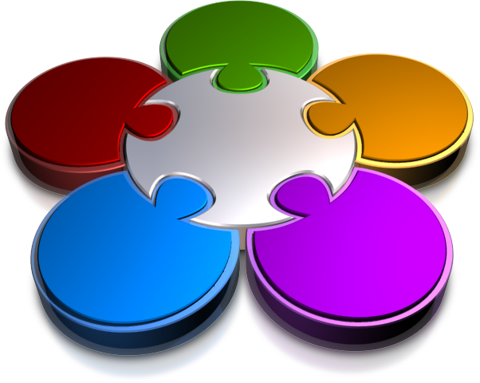
Agency Initiative
Culture Change
5-Star Service Program
Pillars of 5-Star Services
  Culture Change
  Image and Brand
  Center of Excellence
  Improved Services
  High Performance and Recognition
Accountability
Promoting culture change
Create an extraordinary customer experience every day with colleagues, riders, partners and the community
Image and
Brand
Center of
Excellence
5 Star Program
High Performance
and Recognition
Improved Services

Slide 26
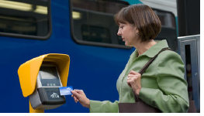
Agency Initiatives
Prepaid Payment Card and Retail Network (PPCRN) -Smartcard
Comprehensive Fare Payment System
Contactless smartcards installed on all buses and at all rail stations
Customers will be able to load value onto the card obtained at a retail merchant location or DART facility and present the card at validators as they travel throughout the system

Slide 27
Agency Initiatives
PayNearMe MT, Inc. (PNM)
RFP issued in November 2015
Approximately 900 retail outlets within the DART Services Area
Provides an additional 400-500 retail outlets with inclusion of The “T” and DCTA
Provides bill paying services such as utilities and rent payments for cash customers in all 7-11 stores in the US
Partners with 7-11 and Greyhound to provide payment and bus ticketing services
PNM Partners – Blackhawk Network, the largest provider of gift card distribution services to grocery stores in the US, and Fidelity Express, the fifth largest supplier of products to convenience stores in the US.

Slide 28
Agency Initiatives
IT Architecture – Use of Digital Communication Tools
Using digital communication tools assist DART in
  Communication and feedback of DART initiatives prior to launch
  Promoting of new DART products (GoPass, Brand Development, Openings of New Stations)
  Informing the public of real-time information (Schedule Changes, etc.)
Digital media informs the customers, advances the DART brand, elevates other communication platforms and gains customer insights as part of ridership development.
Customers choose their channels – we speak to them in their channel of choice

Slide 29
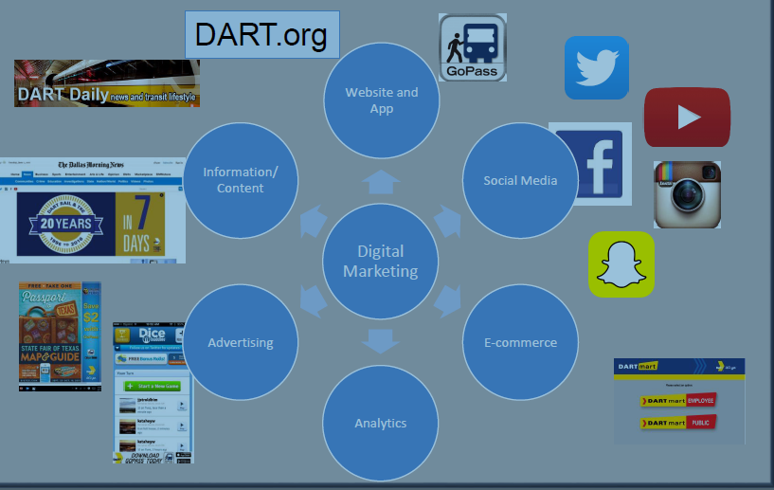
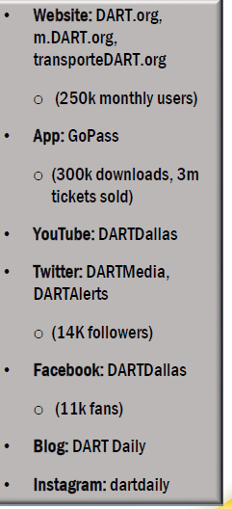
Agency Initiatives
DART Digital Communications Tool Kit

Slide 30
GoPass Mobile App
DART; The T; DCTA
Provides riders with a
“one –stop” solution
One single platform/One
single interface
Launched in September 2013

Slide 31
Last Mile Pilot Test With Uber

Slide 32
Questions?

