Slide 1


5
5 Star Service Update

Slide 2




5 Star Journey to Excellence
6

Slide 3


7
5 Star Service Program Concept

Slide 4
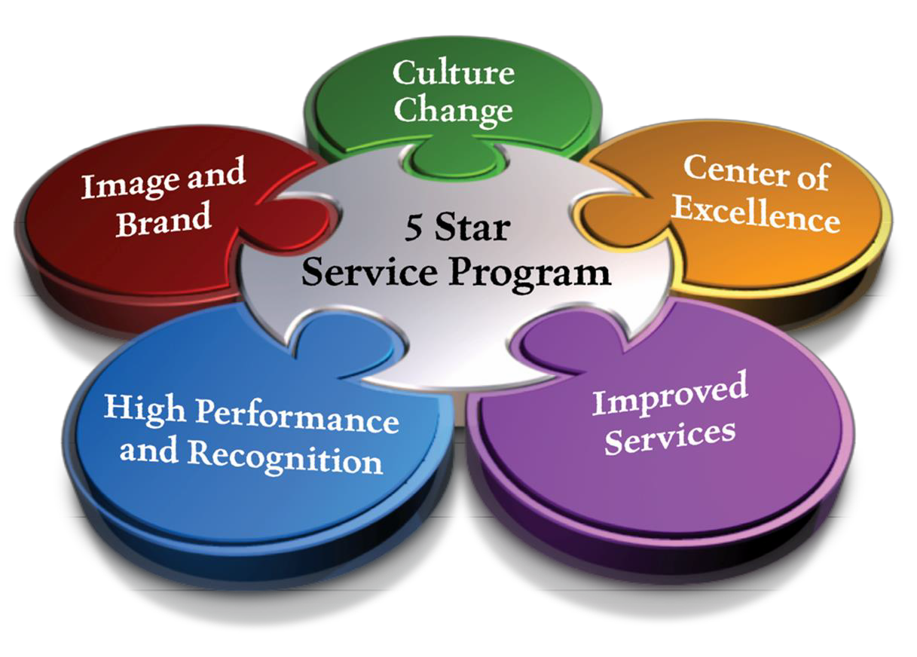

5 Star Pillars
8

Slide 5
Philosophy
A New Way of Thinking
A Cultural Transformation
Model the Way
WOW Experience
9

Slide 6
Leadership and Commitment
Leadership Support
Employee Buy-In
10

Slide 7


Journey
2022
2017
5 Year Benchmark
2012
11

Slide 8


A New Way of Thinking
12

Slide 9


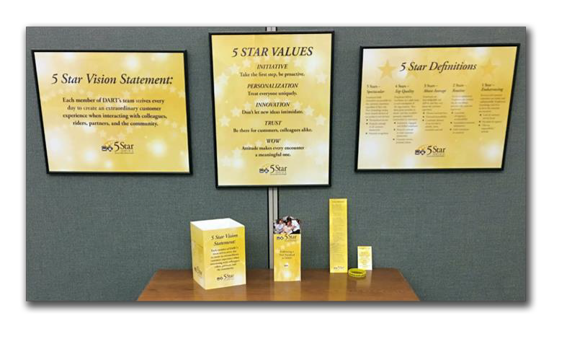

13
13
5 Star Vision Statement
5 Star Values
5 Star Definitions

Slide 10

5 Star Vision Statement
Each member of DART’s team strives every day to create an extraordinary customer experience when interacting with colleagues, riders, partners and the community.

Slide 11
5 Star Values
•
•
•
•
•
INITIATIVE - Take the first step, be proactive.
PERSONALIZATION -Treat everyone uniquely.
INNOVATION - Don’t let new ideas intimidate.
TRUST - Be there for customers, colleagues alike.
WOW - Attitude makes every encounter a
meaningful one.

Slide 12





5 Star Definitions
5 Stars – SPECTACULAR
4 Stars – TOP QUALITY
3 Stars – ABOVE AVERAGE
2 Stars – ROUTINE
1 Star – EMBARASSING

Slide 13
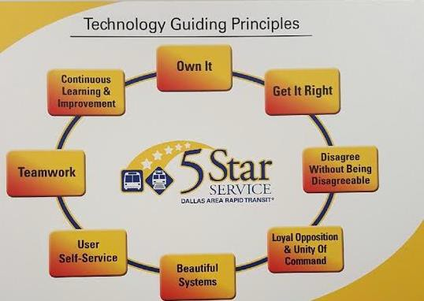
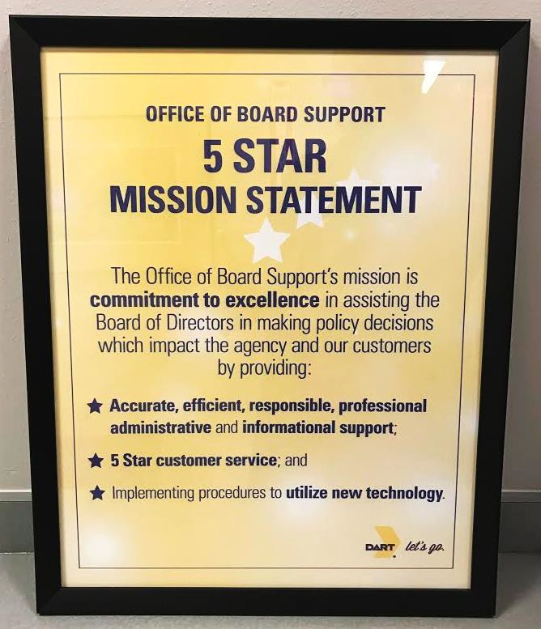
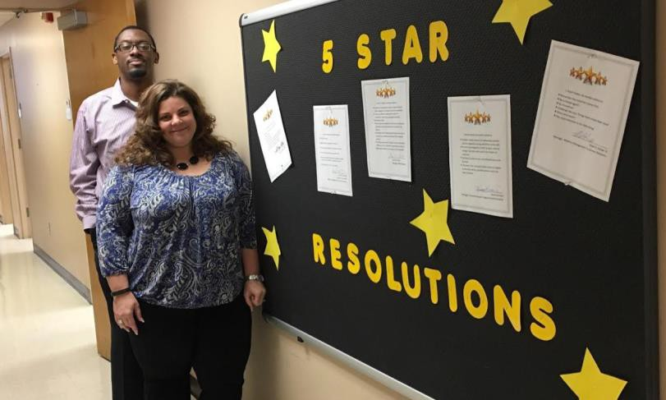
5 Star Vision Statement by Department

Slide 14


18
Transformation

Slide 15
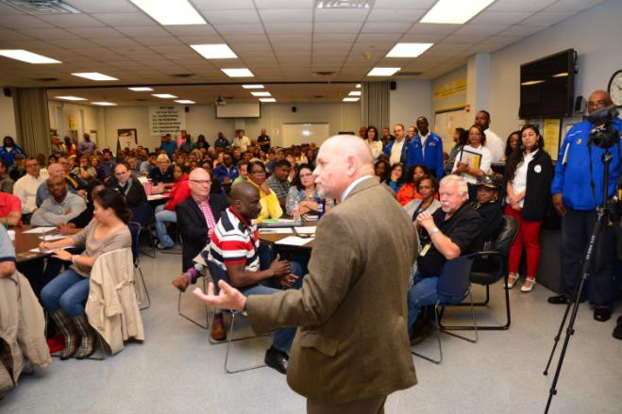
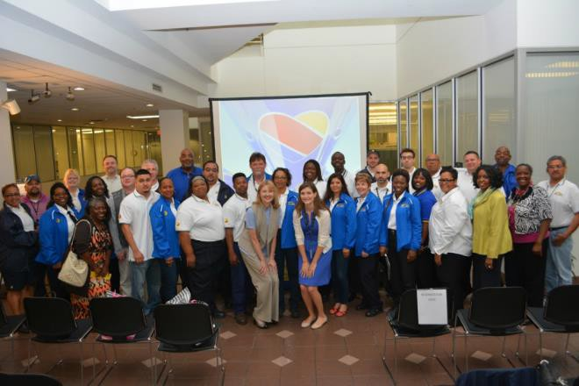
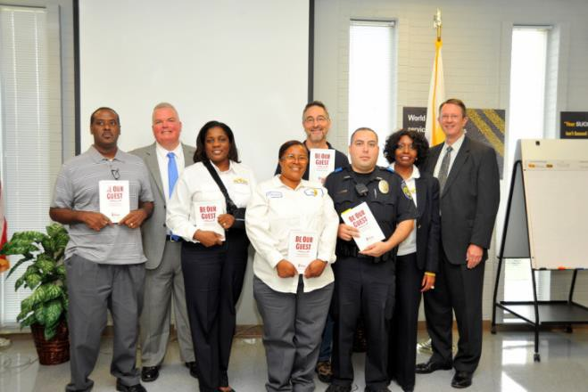
Culture Change Series
19

Slide 16


Culture Change
29

Slide 17
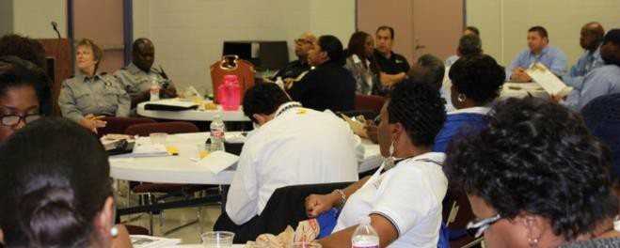
Training

Slide 18

Person of Character
Puts People First
Skilled Communicator
Compassionate Collaborator
Has Foresight
Systems Thinker
Leads with Moral Authority
Competency Strengths of the Maintenance Team
Pillar II: Puts People First
➢Express genuine care and concern for others
Engage our staff, avail ourselves to employees
Prepare for succession – training & mentoring
Celebrate milestones
Pillar III: Skilled Communicator
➢Influences others with assertiveness and persuasion vs. power and position
Typically solution oriented, focusing on a common goal (egos are checked)
Authentic, showing care by listening & showing respect

Slide 19
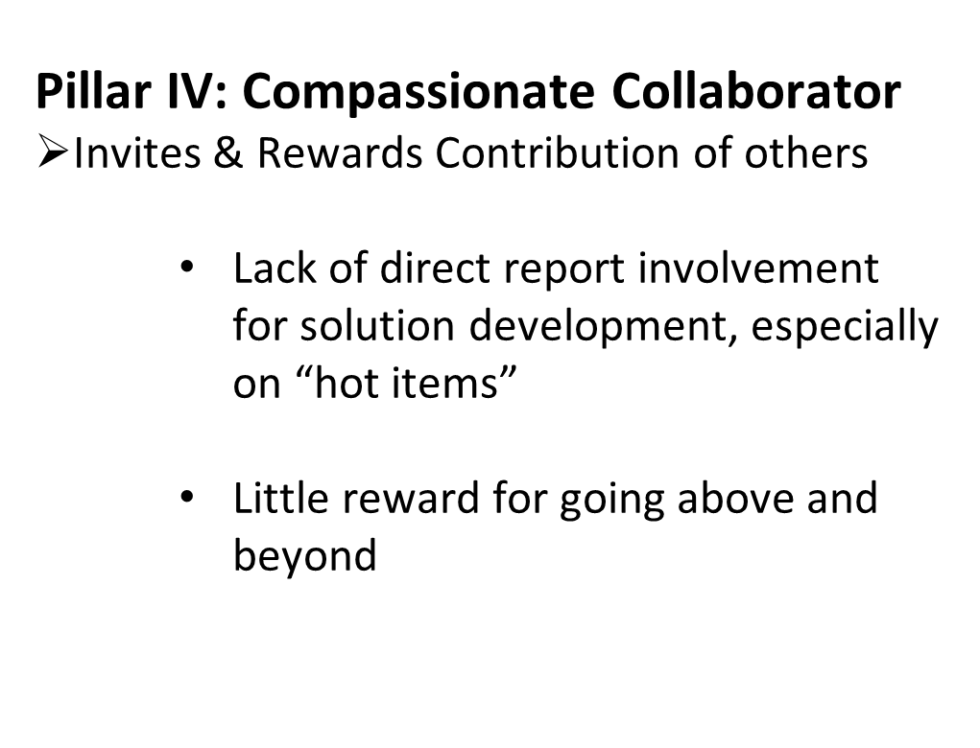
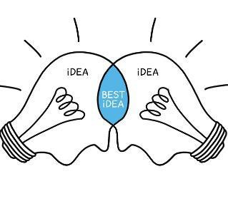
Person of Character
Puts People First
Skilled Communicator
Compassionate Collaborator
Has Foresight
Systems Thinker
Leads with Moral Authority
Competency Strengths of the Maintenance Team

Slide 20
Person of Character
Puts People First
Skilled Communicator
Compassionate Collaborator
Has Foresight
Systems Thinker
Leads with Moral Authority
Competency Strengths of the Police Team
Pillar I: Person of Character – 3.69 Pillar II: Puts People First – 3.53
Pillar VII: Leads with Moral Authority – 3.56
Team members see them as being trustworthy and having integrity. Team members believe they are authentic and strive to serve everyone and not just themselves.

Slide 21
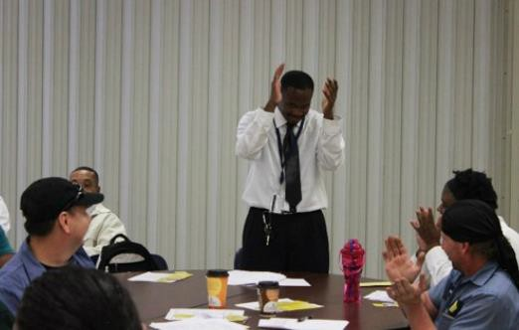
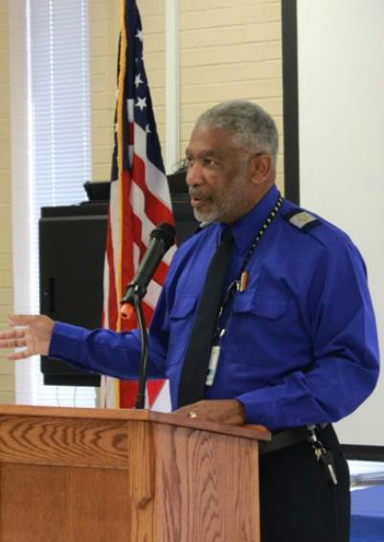
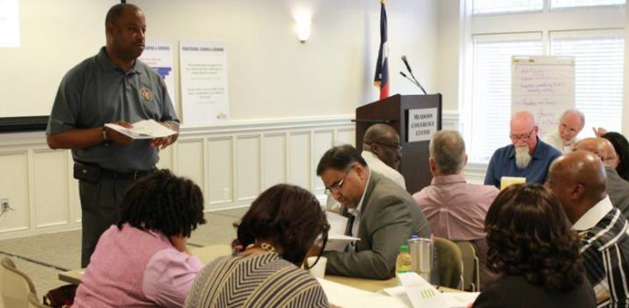
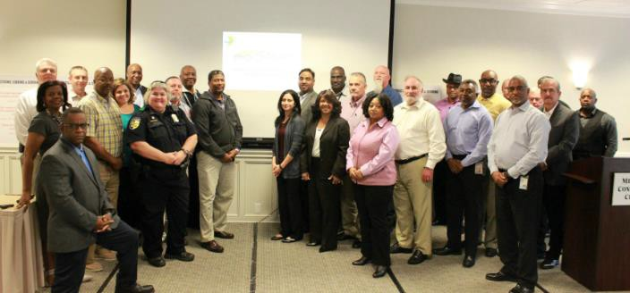
Culture Change
Orientation
Behavior
Competencies
High Performance Teams
Practice, Leading, and Serving (PLS)

Slide 22

26
Modeling the Way

Slide 23

5 Star In Action

Slide 24
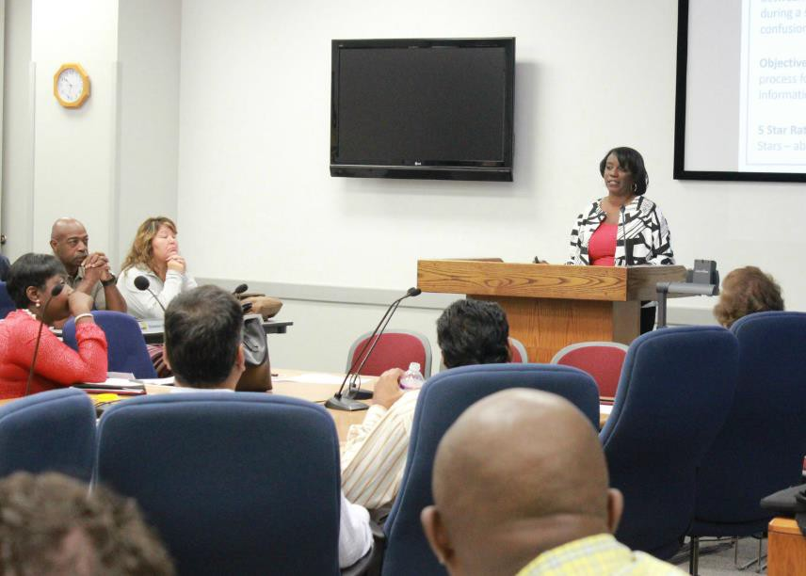
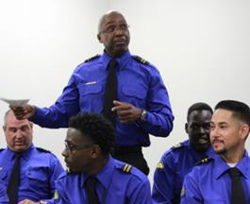
Employees Leading

Slide 25
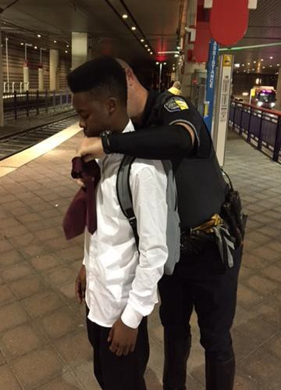
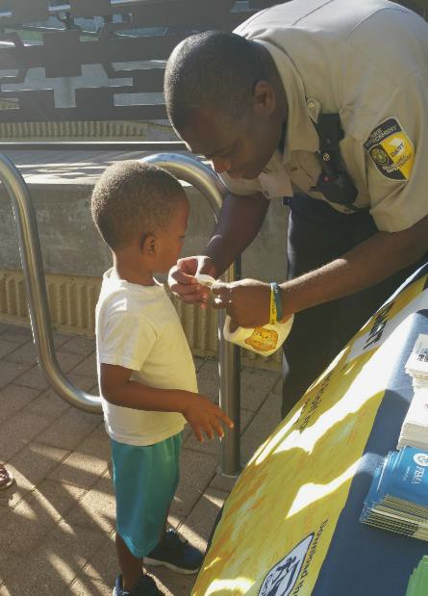
Employees Serving

Slide 26
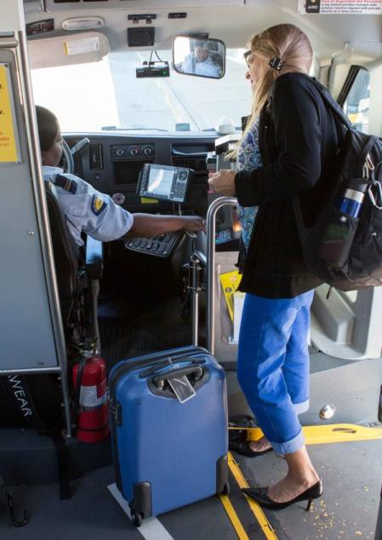
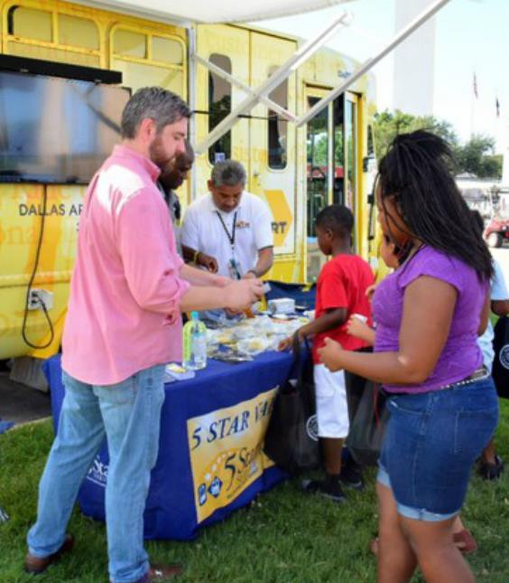
How We Serve
30

Slide 27
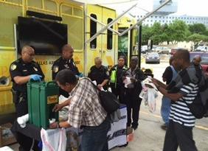
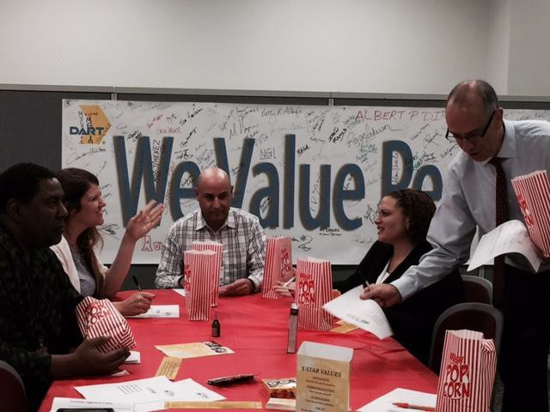
Who We Serve

Slide 28

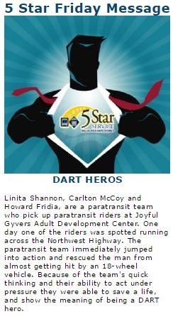
Communication

Slide 29
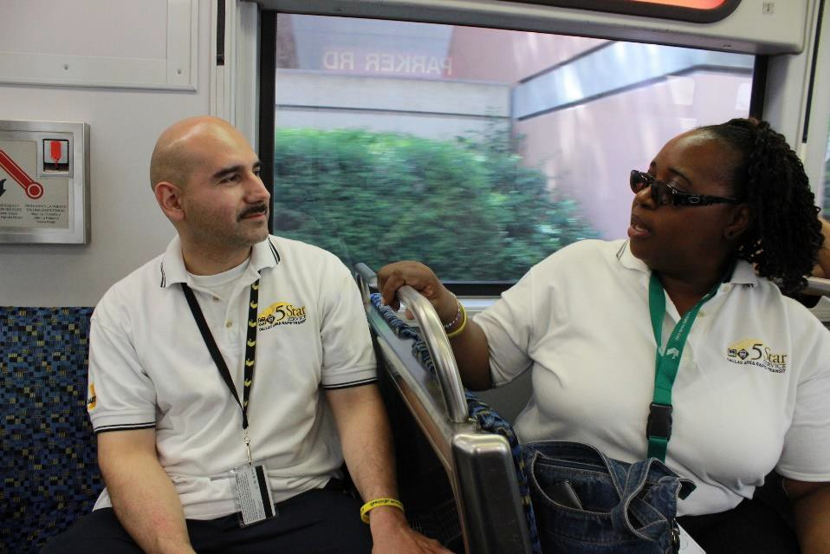
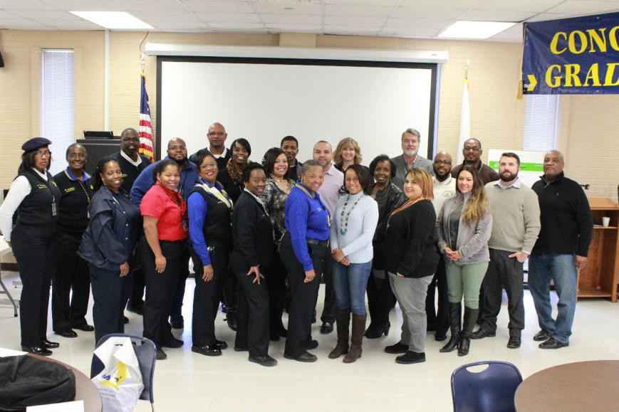
Communication

Slide 30
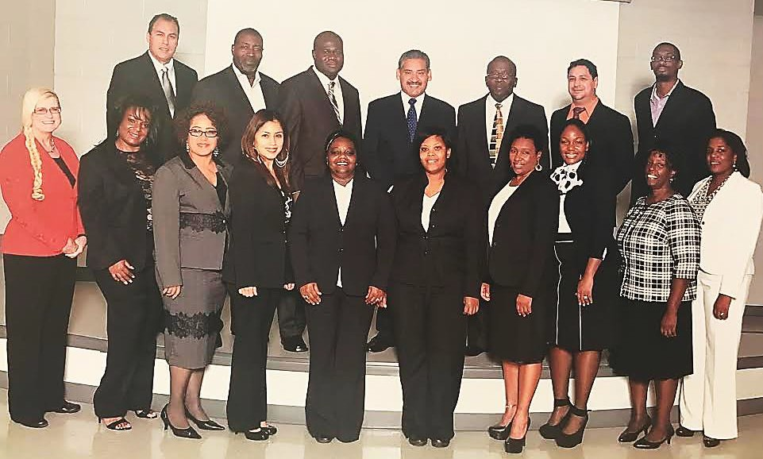
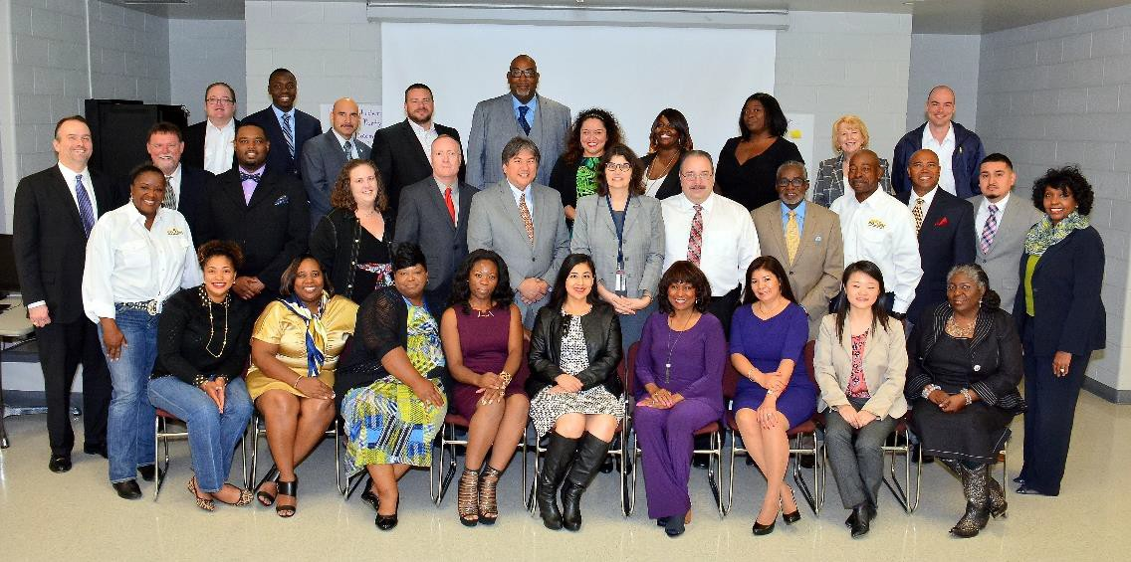
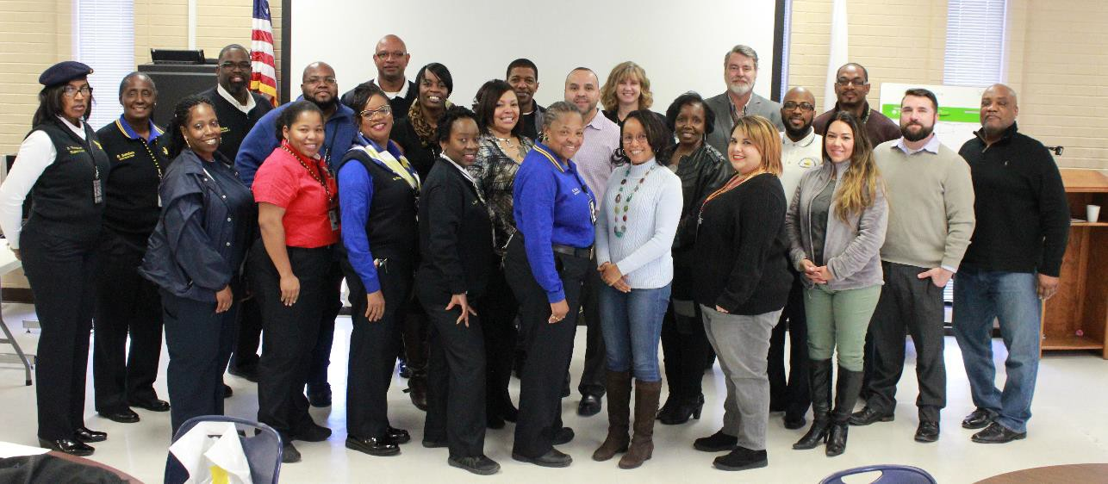
Communication

Slide 31

35
Engagement

Slide 32
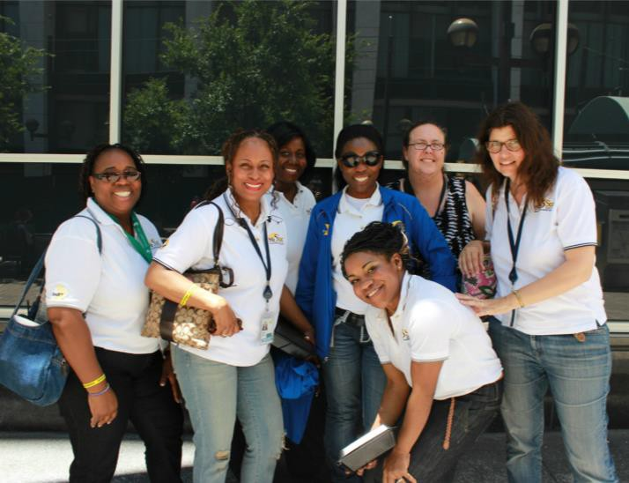
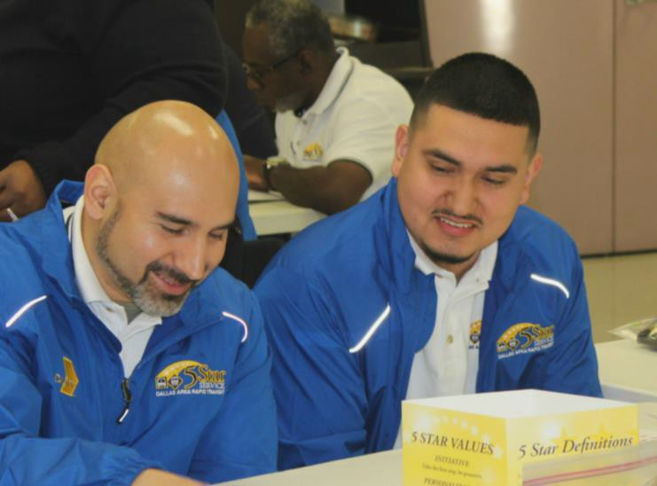
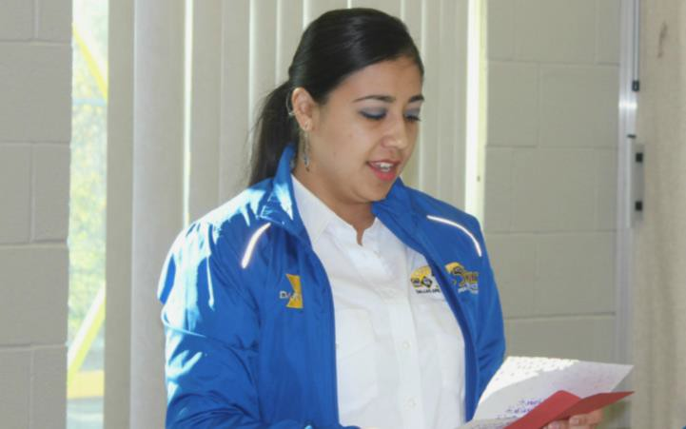
Customer Experience Officers (CEO)

Slide 33
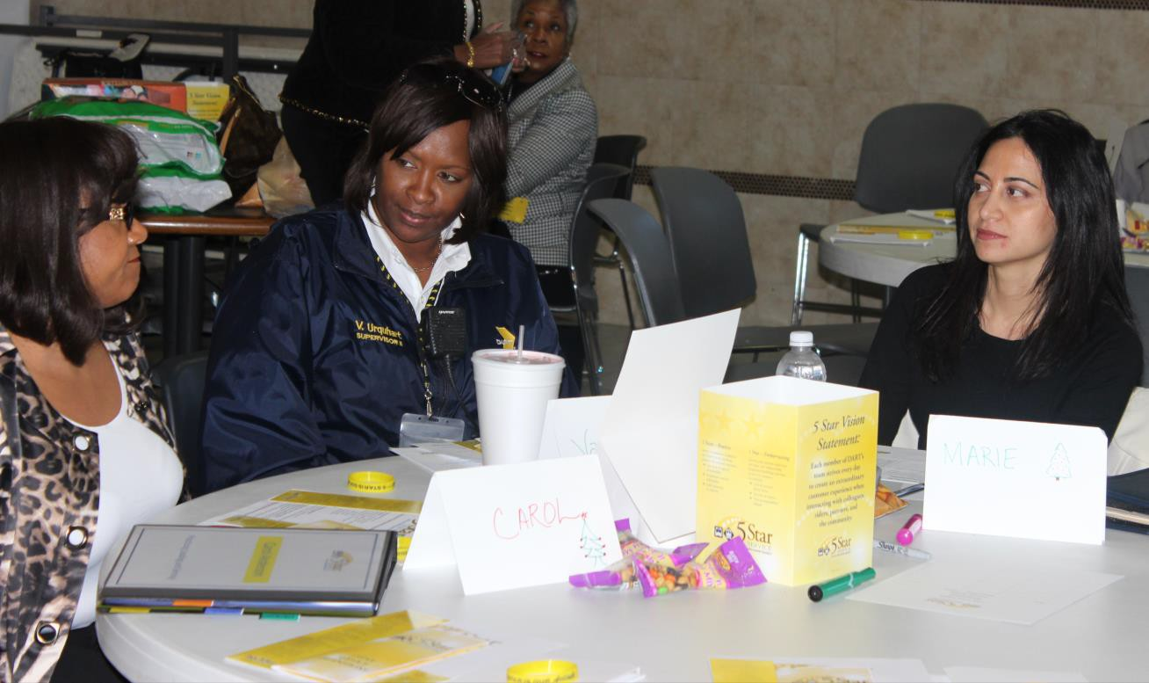
Continuous Improvement Teams (CIT)

Slide 34
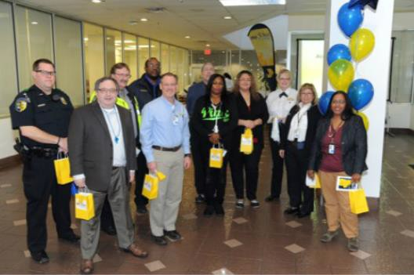
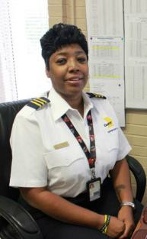
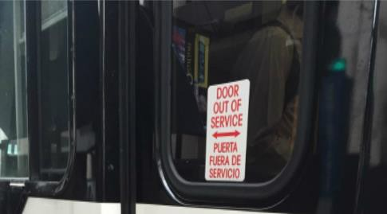
5 Star Suggestions

Slide 35
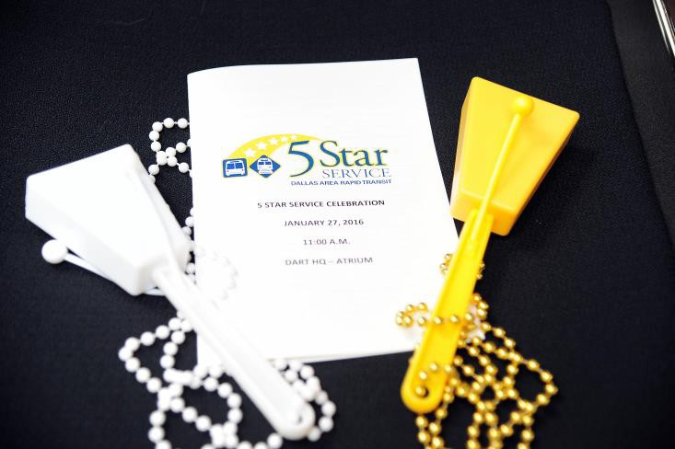
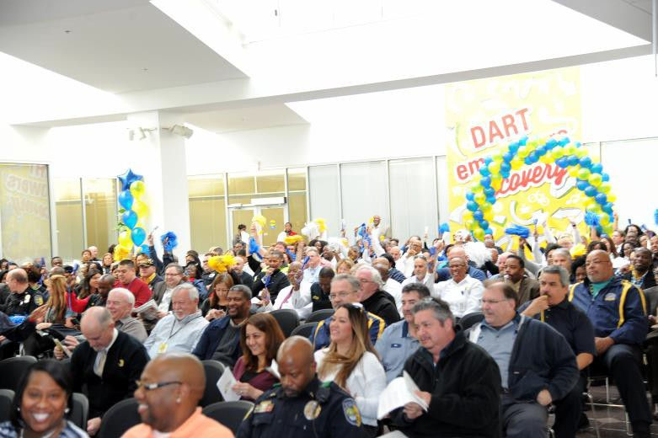
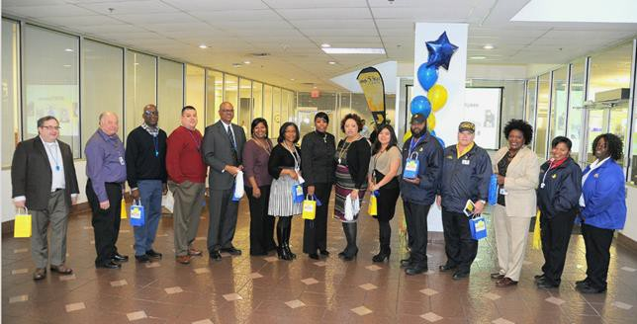
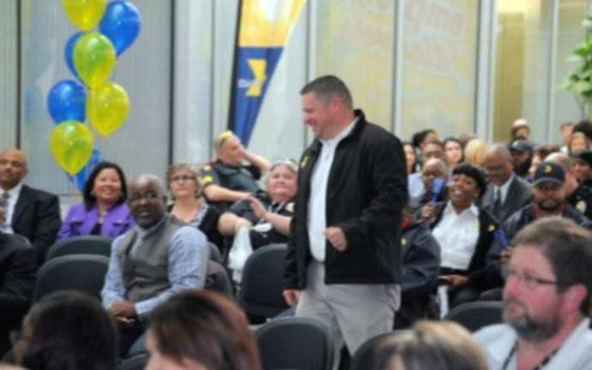
Celebration

Slide 36
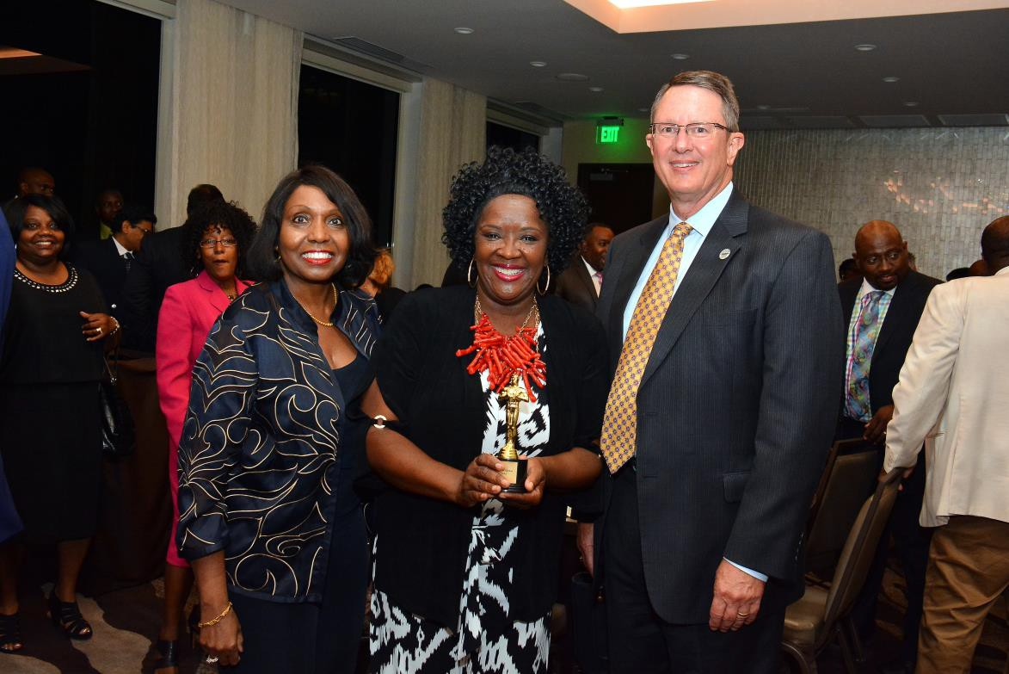
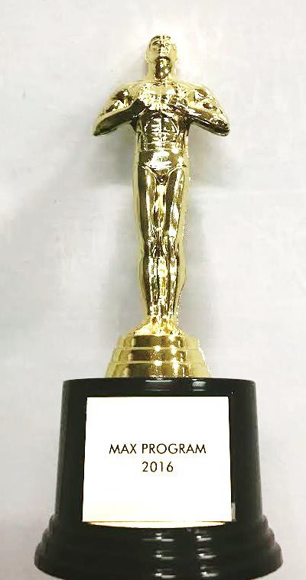
Celebration
40

Slide 37

41
The How of WOW

Slide 38

5 Star Results By The Numbers 2016
Reduced Customer Complaints – Down to 37 per 100,000
Bus Pass-Ups – Decrease 8% in 2016 – 52% Decrease since 2014
Bus On-Time Performance – 0.06% increase
Bus Accidents were reduced by 6%
Light Rail Passenger Delays – Reduced 7%
Elevator/Escalator Mean Time Between Failures improved to 1500 from 815 in 2015
401 New employees completed 5 Star Orientation
588 Front-line employees received 5-Star Customer Service Training
5 Continuous Improvement Teams were completed
38 Customer Experience Officers graduated and completed 23 projects
500+ Employees worked on various 5 Star initiatives
15 Candidates were accepted into the new Succession Planning Program
225 Light Rail Vehicle Operators received Field Diagnostic Skills Training
758 Supervisors and Managers received both soft-skills and Bus/Rail cross training
638 New Customer Experience follow-up calls by Travel Ambassadors
Customers In Action (quality assurance rides by customers rose from 458 in 2015 to 927 this year

Slide 39
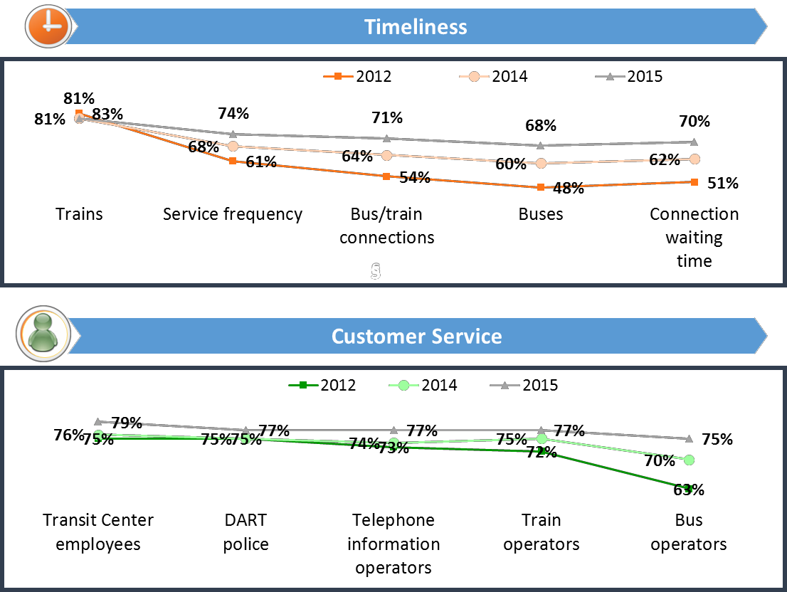
Customer Surveys
Safety/Security & Cleanliness

Slide 40
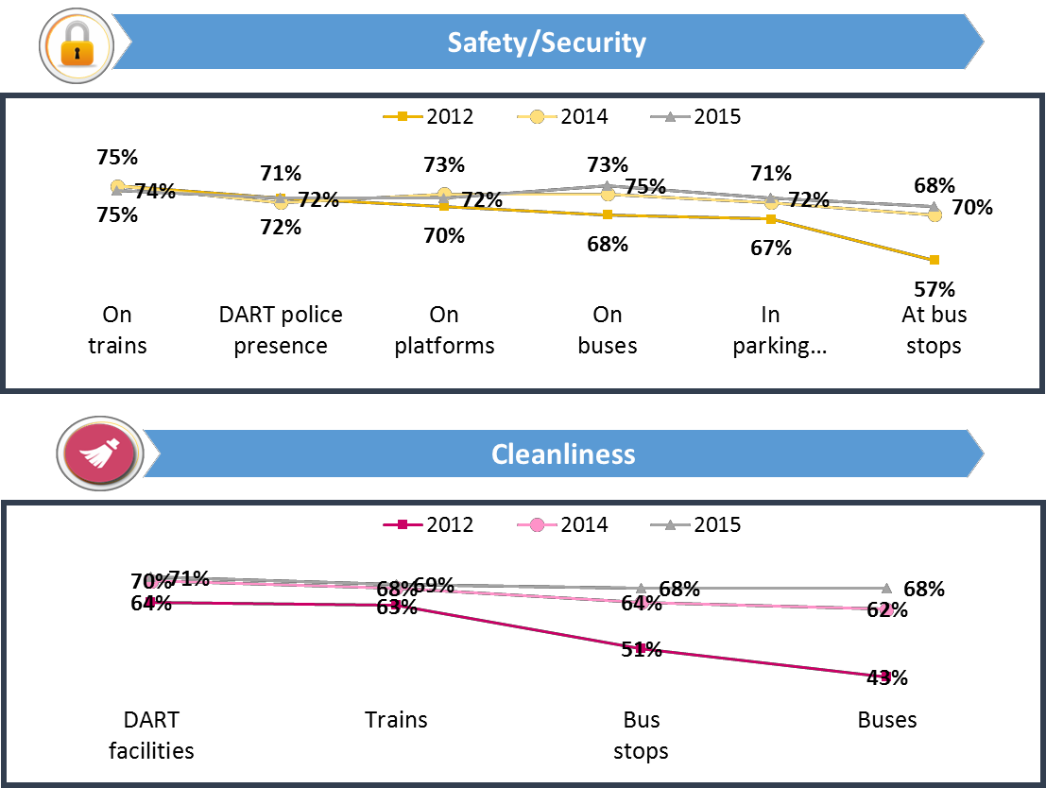
Customer Surveys
Safety/Security & Cleanliness

Slide 41


The Journey Continues…

Slide 42

46
END

Slide 43
Concluding Remarks
47

Slide 44

48
ADJOURN

