Slide 1
Dallas Streetcar & TOD - Bishop Arts
COMPTO Conference
July 9, 2016
Dallas, Texas
Evelio Hernandez, PE
Director of Streetcar
Dallas Area Rapid Transit
Email: ehernandez4@dart.org
MAX Program
June 21, 2017
Dallas, Texas
Evelio Hernandez, PE
Assistant Vice President
Streetcar/Systems Engineering
Dallas Area Rapid Transit
Email: ehernandez4@dart.org

Slide 2
Unique Partnership
Stakeholders:
North Central Texas Council of Governments: Federal Grantee
City of Dallas: Project Owner
DART: Owner’s Technical Representative
Federal Transit Administration (Federal Partner)
TxDOT (State Partner)

Slide 3
Dallas Streetcar System Map
Union Station to Oak Cliff (Starter System)- 1.6 miles April 2015
Colorado/Beckley to Zang/Davis (South Extension)- .75 miles August 2016
Union Station to Omni Convention Center Hotel Loop (North Extension)- Future

Slide 4
Streetcar Alignment System
1.6 miles Starter System
-1 mile off-wire operation dedicated single track bi-directional operation
-4 stops
0.75 miles Southern Extension
-on wire operation
-double track
-2 stops
Street running with some transit signals
Two 500Kw traction power substations

Slide 5
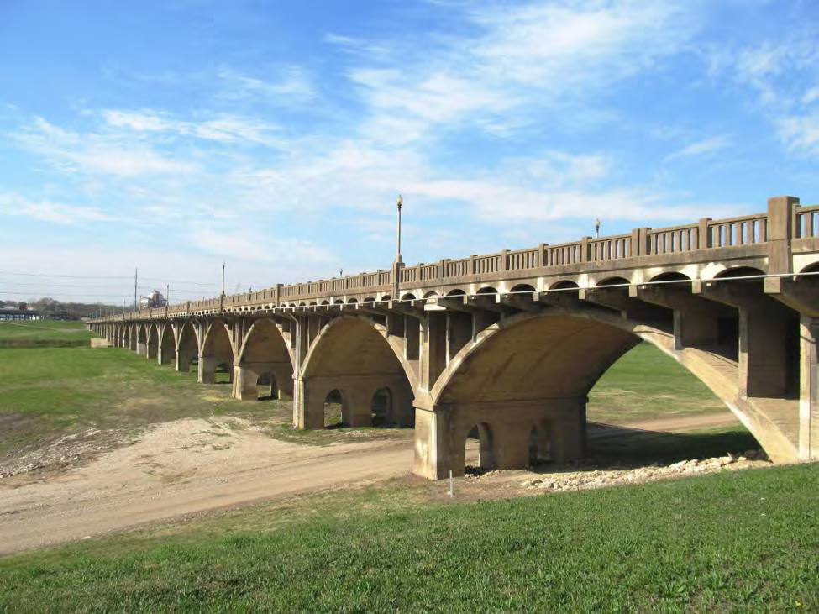
Houston Street Viaduct Bridge
Historic bridge
100 years old
One mile long
National Register of Historic Places
Bridge Deck Rehabilitation

Slide 6
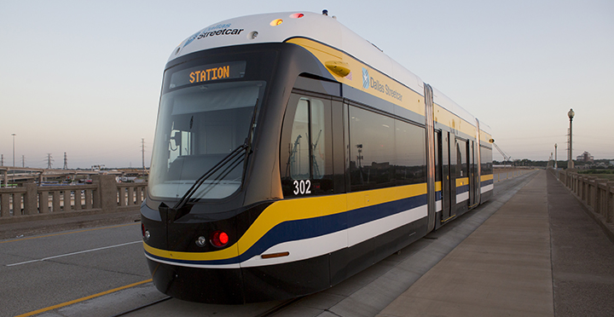
BROOKVILLE Liberty Streetcar
First off-wire capable streetcar manufactured in the US
Designed and manufactured in Pennsylvania
Awarded ‘Technical Innovation of the Year’ at LRTA Global Light Rail Awards

Slide 7
Streetcar Vehicle
4 Streetcar vehicles in operation
-2 in service; 2 spare
Top speed: 40 MPH
Level Boarding
34 passenger seats
65’-6” long
Weight: 83,000 lbs
CCTV
Automatic Passenger Counters

Slide 8
Integration With Light Rail
Integration with:
-Maintenance Facility
-Operators
-Maintainers
-Controllers
-Transit Police

Slide 9
Energy Storage System:
Components
Four Main Components:
Batteries
Battery Management System
Chiller System
Train Operator’s Display

Slide 10
Energy Storage System: Batteries
North Central Texas Council of Governments: Federal Grantee
City of Dallas: Project Owner
Redundant battery trays mounted underneath the carbody
Provides propulsion power and auxiliary loads
Each tray contains 30 batteries.
Each tray has a capacity of 300 Vmin and 492 Vmax and is rated at 84.1 kWh.

Slide 11
Energy Storage System: Batteries
Lithium Ion (Li) battery technology.
Tray is watertight, sealed, corrosion resistant enclosure.
Vibration isolators are used to prevent equipment damage.
Desiccant bags are used to absorb moisture.
Spare trays are charged in the shop. ESS charger requires a 240VAC, 20A.

Slide 12
Energy Storage System: Battery Management System
Battery Management System is integrated in the battery modules.
Provides ground fault protections.
Regulates the charging and discharging of the batteries.
Monitors battery status, cell temperature, cell voltage, state of charge and health of cells.

Slide 13
Energy Storage System: Chiller System
Cools the ESS Batteries
Two chillers, roof mounted
Cold plates are mounted under the batteries for heat transfer
Maintain a battery temperature of 95 degrees or less

Slide 14
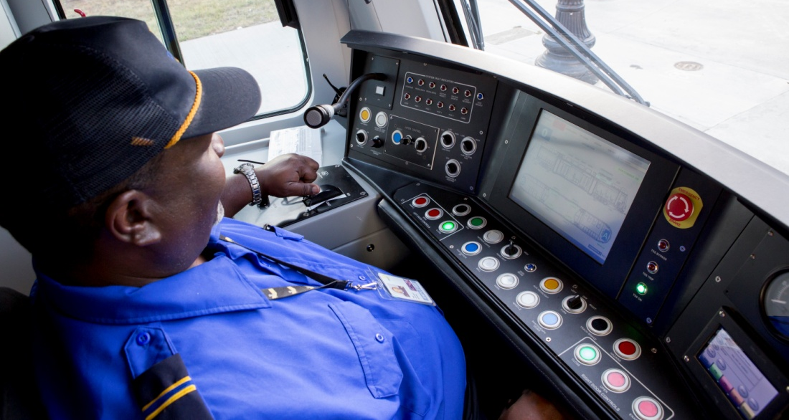
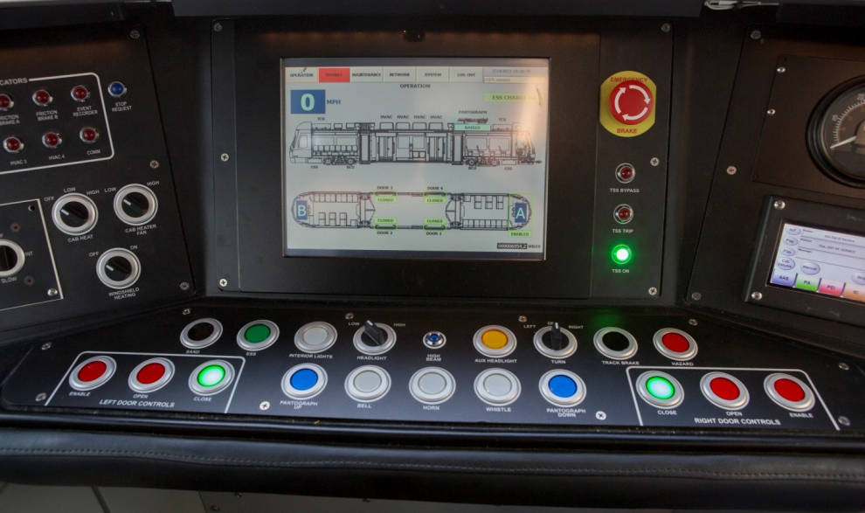
Energy Storage System: Train Operator’s Display
Train Operator’s Display (TOD) provides visibility of the system
Logic-coded vehicle control unit (VCU) ensures ample power for off-wire runs, providing visual cue for the operator- OK, Not OK
Pantograph lowers in <10 seconds activated via pushbutton switches, ESS is activated via pushbutton switch

Slide 15
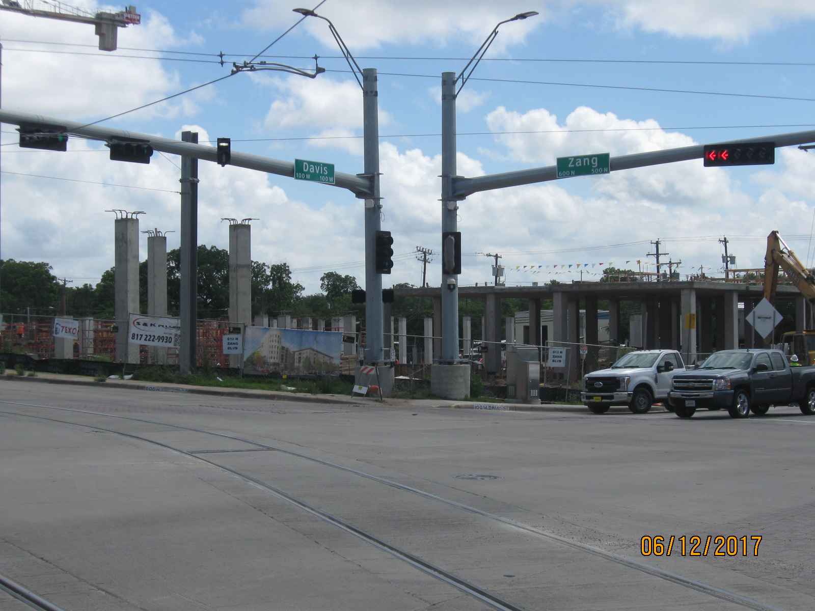
Bishop Arts District

Slide 16
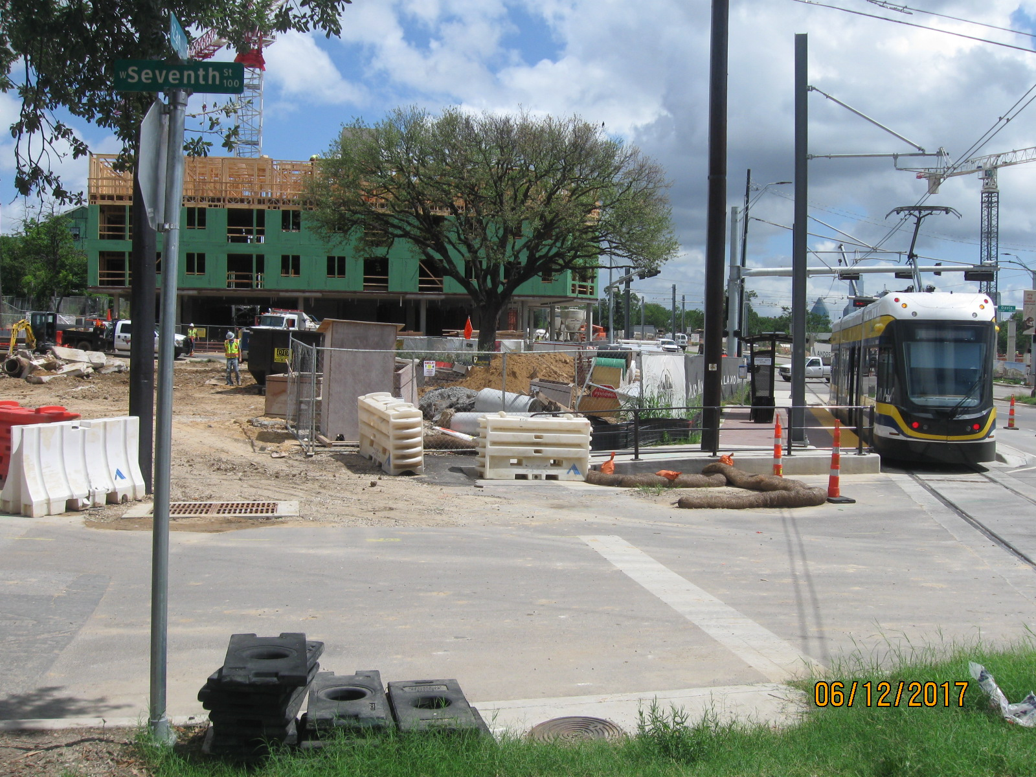
Bishop Arts District

Slide 17
Bishop Art District

Slide 18
Bishop Arts District

Slide 19
Dallas Streetcar
QUESTIONS?

