Slide 1

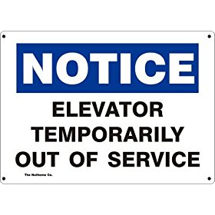
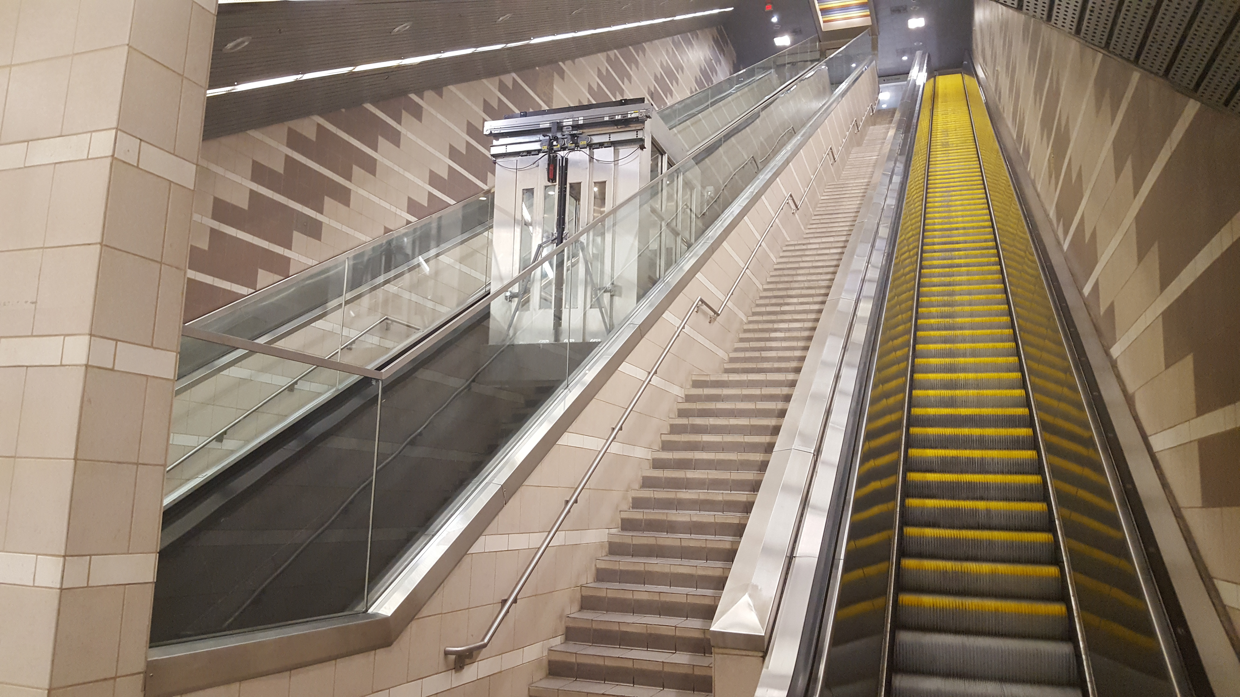
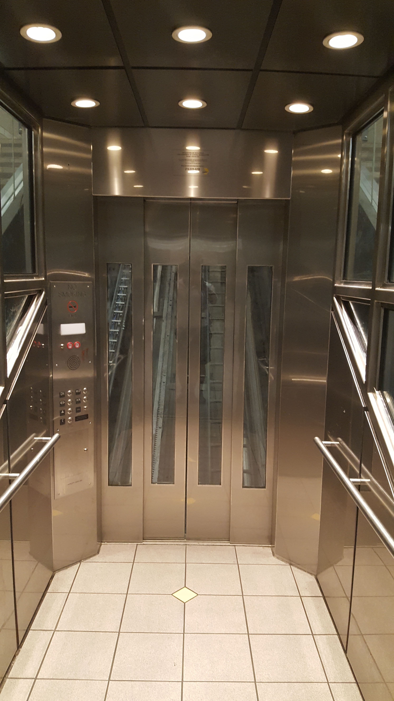
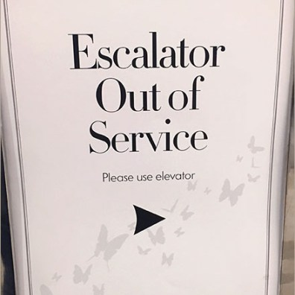
DART Elevator - Escalator
Reliability Failure Notification

Slide 2
Problem/Failure Statement
Elevators - Escalators
Aging Lift Equipment
Inability to monitor lifting device operations at LRT Stations remotely
Contractor Poor Performance – Contractor’s inability to keep Lift equipment working in the most efficient manner
Poor communication to customers, no station signage, media relations lacked communication with customers when lift equipment was out of service
High volume of Customer complaints
Burden on Bus Operations having to provide bus bridge due to lift equipment being out of service

Slide 3
Objective
Improve equipment reliability
Improve Contractors accountability for repair performance on all DART Lift Equipment
Improve Communication with our External/Internal Customers
Reduce Customer complaints
Reduce need for bus bridge

Slide 4
Improved Strategies
Installation of new On-line Remote Monitoring (ORM) Software on lift equipment that monitors critical functions
Utilization of Visual Message Boards (VMB) at LRT Stations, signage put in place to help improve communication to customers. Notification sent to Media Relations who sends out messages via social media to public
Utilize Alternative Duty Personnel “Ambassadors” at stations, specifically where equipment is down or a bus bridge is in place (LA Metro)
Award of Performance contract with incentives and liquidated damages (Marta)
Notes:
Award of Performance – Should the contractor meet all the goals established in the contract there is a monetary reward ; Maintenance identified stations with critical pieces of equipment (City Place Elevators/Inclinators; Mockingbird elevator and Market Center elevators) and if the units were out of service for more than 24 hours the contractor would be charge 173 per hour until the unit was back in service (this was done at least twice during the contract term);

Slide 5
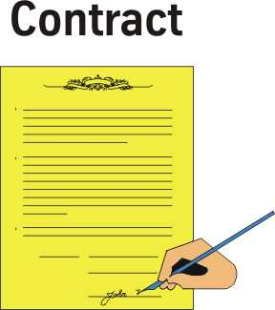
Awarded Performance Contract with Incentives and Liquidated Damages (Marta)
Should the contractor meet all the goals established in the contract there is a monetary reward; Maintenance identified stations with critical pieces of equipment at our (City Place Elevators/Inclinators; Mockingbird elevator and Market Center elevators) and if the units were out of service for more than 24 hours the contractor would be charge $173 per hour until the unit is back in service (done twice during this contract term)

Slide 6
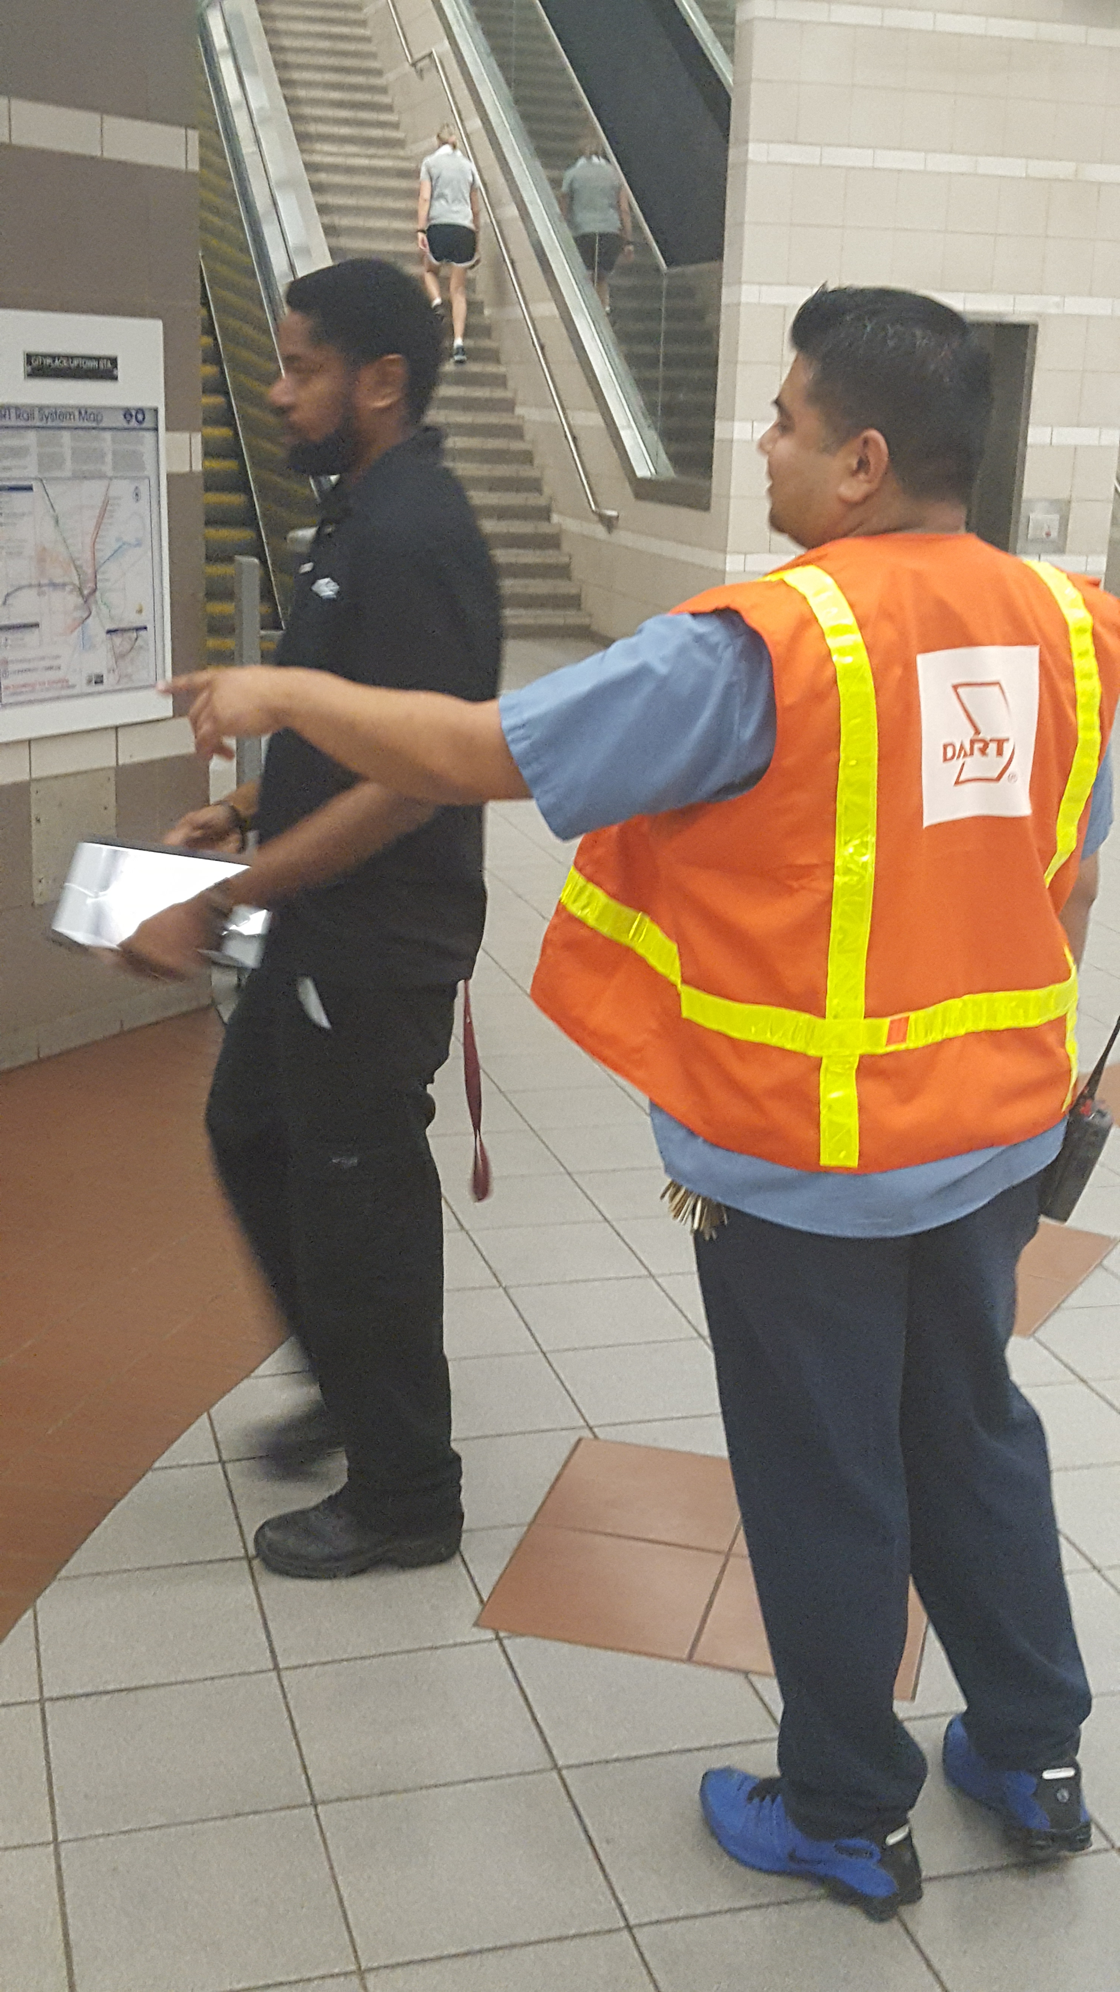
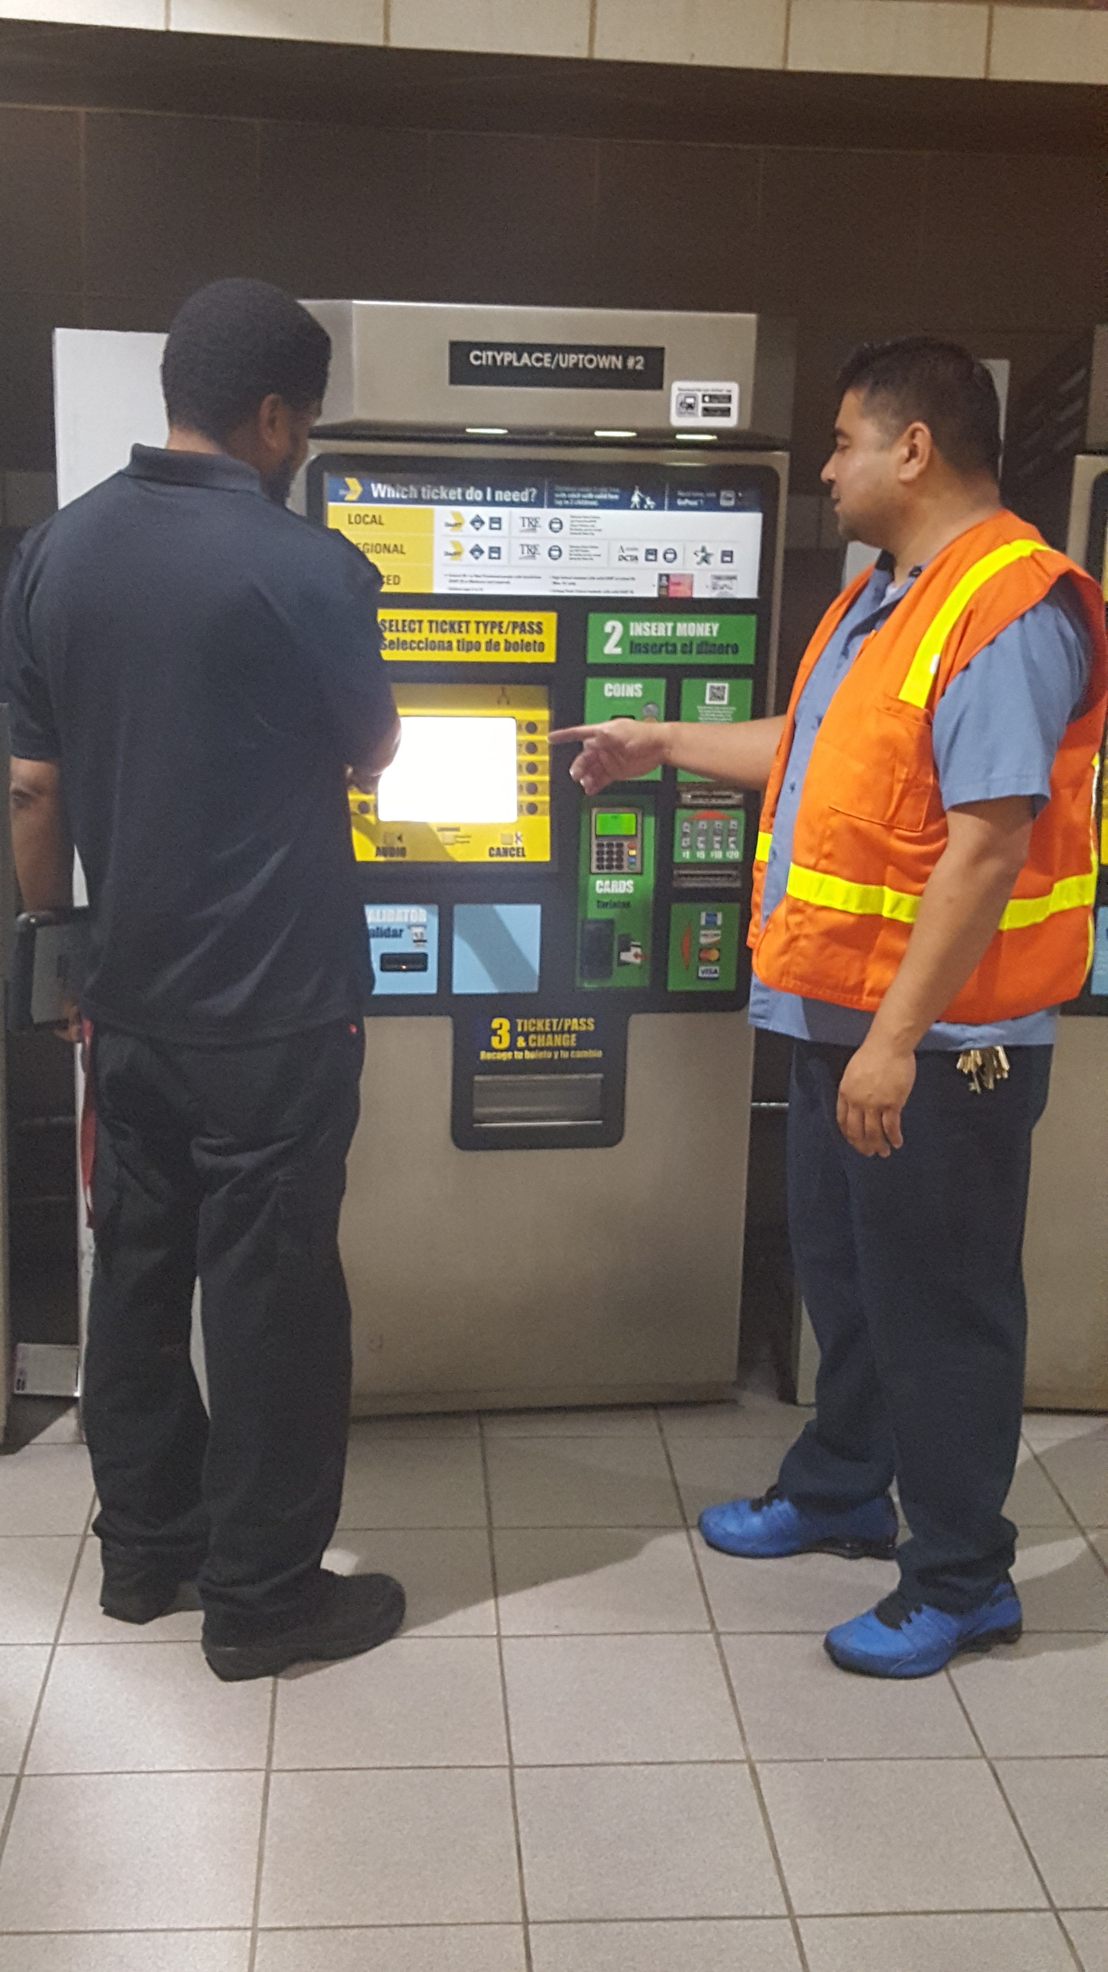
Utilize Alternative Duty Personnel “Ambassadors” at stations, specifically were equipment is down or a bus bridge is in place (LA Metro)
Picture of Ambassador
Picture of Ambassador

Slide 7
Progress Evaluation
On-line monitoring system provides data that tracks component failure which reduces maintenance repair time. Data is also used for predictive maintenance practices which means proactive preventative maintenance before equipment goes down
Development of monthly matrix for the Contractor to meet and/or exceed the goals set in the contract. Goals are: Mean Time Between Failures (MTBF) of 814 hours; Mean Time To Repairs (MTTR) 3.73 hours; and Entrapment goal of 1.75
Capital projects on Elevators/Escalators - Installing new electronic controls, new pumps, rehab of cabs, and major overhaul of escalators. Projects will add twenty (20) more years to the life cycle of equipment
Complaints reduced by 57%
Bus Bridges reduced by 85%

Slide 8
Continued Progress Evaluation
To give an idea of the challenges that we were up against when the contract was first awarded included:
FY14 -Mean Time to Repair stood at 12.45 hours. New contract goal is 3.73 Hours. In FY17 - Mean Time to Repair stands at 1.17 hours
FY14 -Mean Time Between Failures stood at 1663 hours. New contract goal is 814 hours. In FY17 Mean Time Between Failures stands at _{1070 hours}
FY14 –Entrapments stood at 2.33. New contract goal is 1.75. In FY17 –Entrapments stands at 1.75
The key to this success has been cross-functional teamwork in improving contractor performance. Remote monitoring of equipment, and better communication to customers
FY14- 5 Star Program – Star Level 2
FY17- 5 Star Program – Star Level 4
We are on the right path to 5 Star service!

Slide 9
Team Members
Terrance Keltner
Brenda Sadberry
Julie Nelson (CEO/Max Class 2015)
James Carroll (CEO/Max Class 2015)
Peter Dickenscheid
***(CEO Customer Experience Officer)

Slide 10
Questions?

