Slide 1
East Dallas Safety Awareness Campaign
Notes:
2013 Customer Experience Officer (CEO) Project (Part of 5 Star initiative)
R. Reed
J. Carranza
D. Battiest
William Brown
Vickers
E. Barron
B. Clayborne
Overview:
Hazardous Bus Lot Conditions for Pedestrian Traffic
Safety Board Highlighting Service Area Concerns
Safety Violations Weekly Updates Targeting Accident Reductions
Excessive Costs Due to Rim and Tire Damage

Slide 2
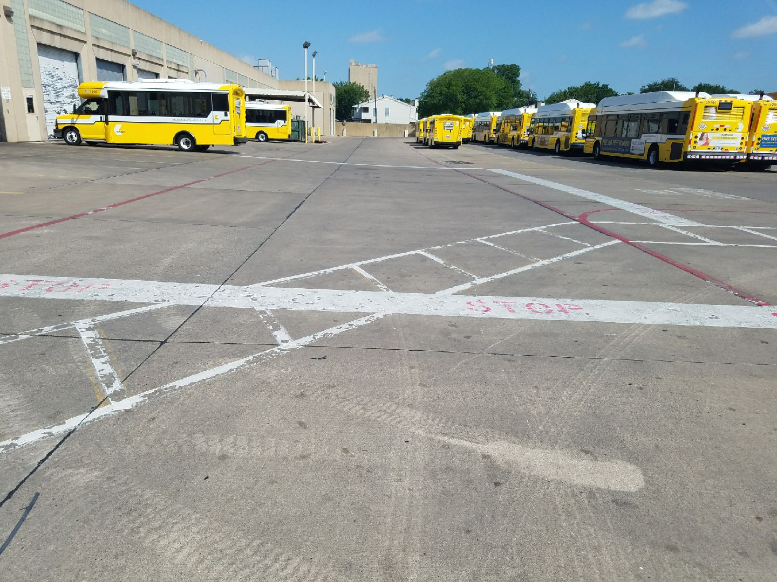
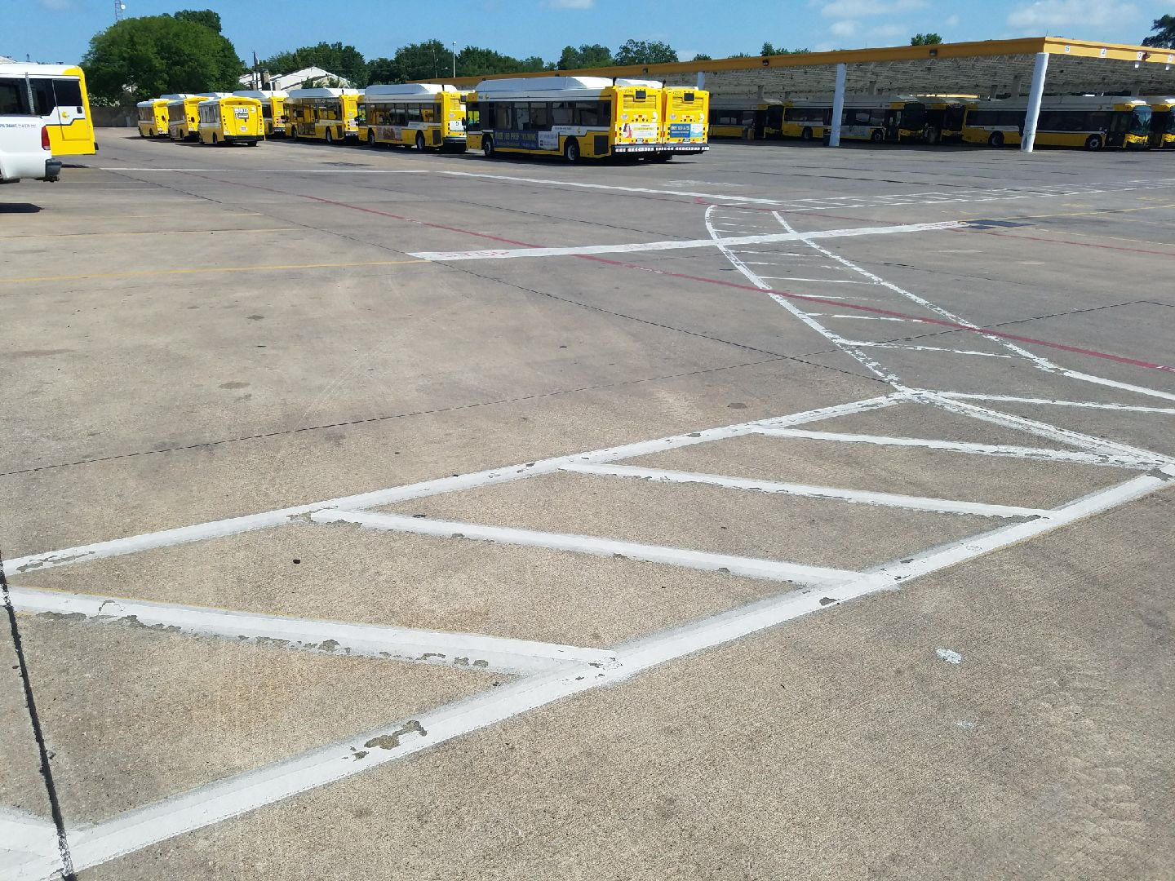
Hazardous Bus Lot Conditions for Pedestrian Traffic
Notes:
To provide a safer environment for all pedestrian traffic on the bus lot (Maintenance & Transportation), designated walkways were painted and 10 mph speed limit signs were posted
Future recommendations:
Add reflectors for better visability

Slide 3
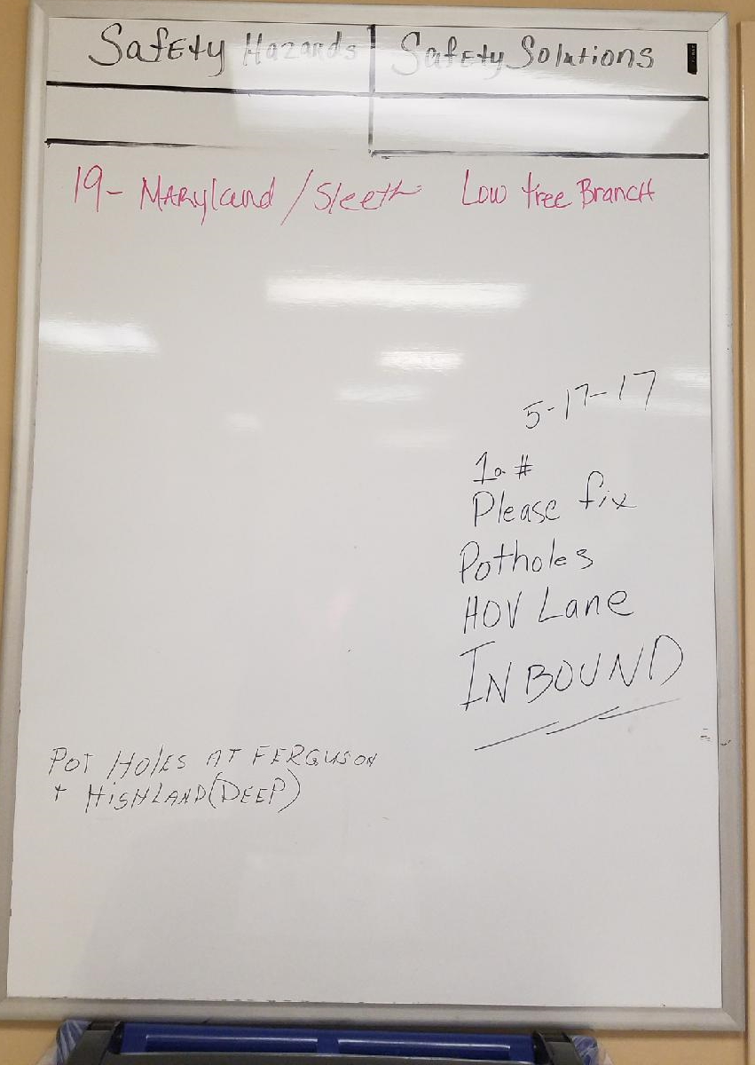
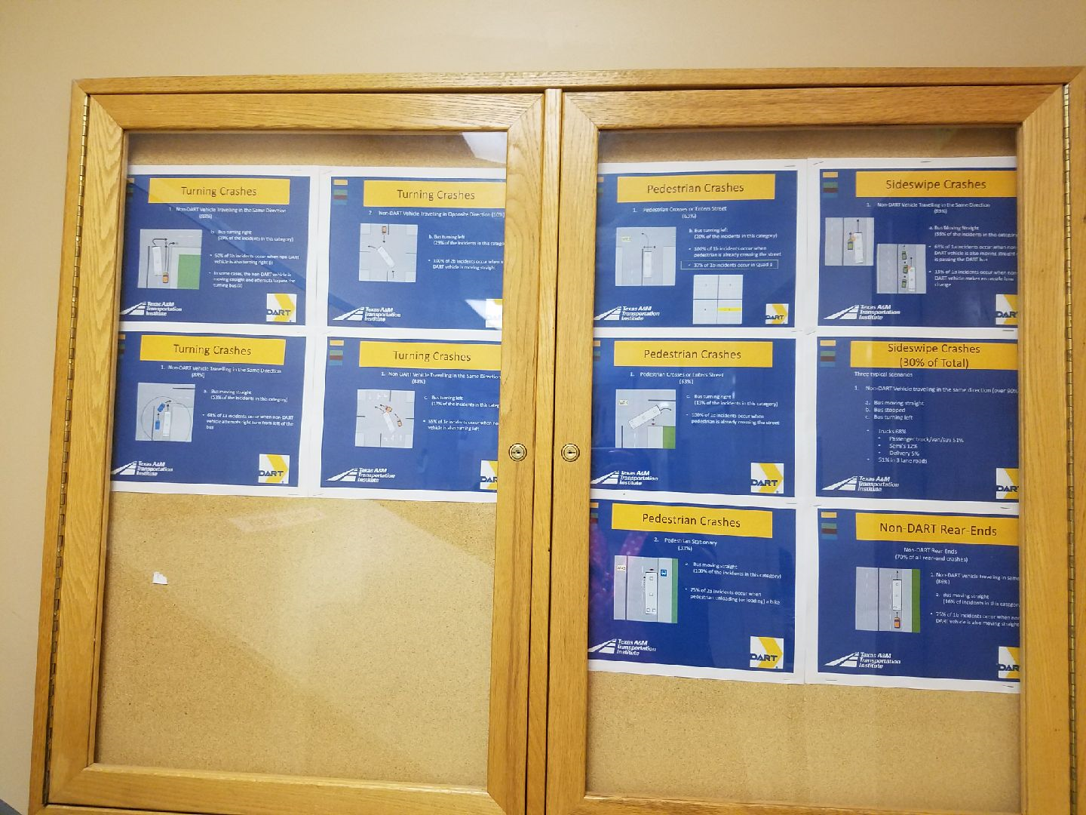
Conduct a Pilot Safety Board Highlighting Service Area Concerns
Notes:
Inside the division:
We added Safety Board
Left Board:
Highlighted and awareness of correct turns and sideways for Bus Operators to use as a reference point
Right Board:
Share any area of concerns such as intersections, problem and solutions to share with Safety Specialist

Slide 4
Safety Violations Weekly Updates Targeting Accident Reductions
Divisional Weekly Safety Violations Publicized
Notes:
Safety board provided by the Safety Specialist to showcase the # of safety violations and reduce:
Backing up without authorization
Speeding
Incomplete stops at stop signs
Driving with less than 2 hands on the wheel
Using cell device when bus is in operation
Not using seatbelt properly

Slide 5
Excessive Costs Due to Tire and Rim Damage
Bruton at Jim Miller
Elm at Ervay
Highland at Jim Miller
Pearl at Elm
…is an ongoing concern.
Notes:
In 2014 we had a high volume of tire and rim Damage
I went out with Safety Specialist and took pictures of how the rim looked

Slide 6
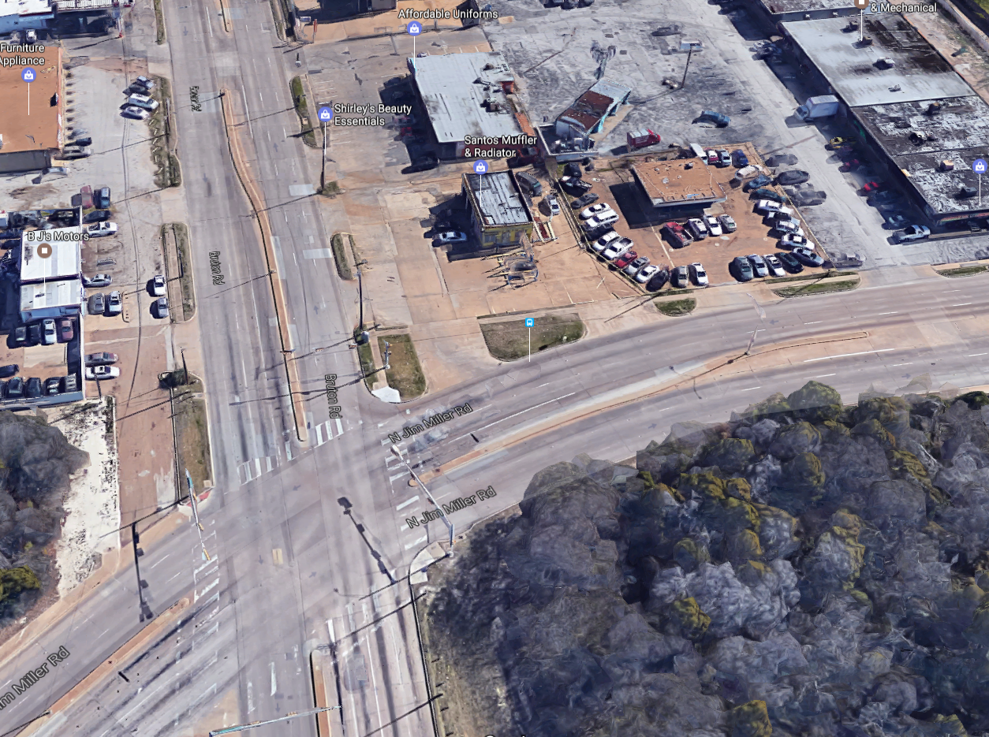
High Frequency Locations for Rim Damage Were Revealed
Notes:
Bruton and Jim Miller
3 of us went out, myself, Safety Specialist, and Tony Williams (ATU Rep)
identified intersections such as this one
Bruton and Jim Miller
Collected data to determine how the rims were being damaged on the bus and brought back the information to the Bus Operators

Slide 7
Reduction in Rim and Tire Cost Graph
FY 2016 Rims and Tire Costs
FY 2017 Rims and Tire Costs
Notes:
Enrique Overview

Slide 8
Best Practices Implemented
MARTA Q-Bus:
Program to ensure that MARTA has a quality product that is:
Reliable and safe
Ensure on-time performance
Maintain like-new appearance
Q Bus Inspector inspects alongside the operator
Inspect before service
Inspect after service
Notes:
2015 I was apart of the MAX program and my best practices came from MARTA, Atlanta, GA
Program to ensure that MARTA has a quality product that is:
Reliable and safe
Ensure on-time performance
Maintain like-new appearance
Q Bus Inspector inspects alongside the operator
Inspect before service
Inspect after service
This led to internal pilot program which lasted 2 weeks and this led to a Continuous Improvement Team (CIT) project

Slide 9
Pilot Programs
Background:
Prior to development of the Continuous Improvement Team (CIT) there were two trials at the East Dallas Division
1st Trial:
Required Bus Operators to turn in defect issues to both Maintenance (defect card) and Transportation (paper)
2nd Trial:
Increased supervision at the pull out and pull in

Slide 10
Results
Trial Results:
The trial ran for two weeks and required seven people;
Both trials reduced unreported damage to buses while in service;
However, the volume of manual paperwork was excessive and required significant additional staff support;
The trials clearly demonstrated the need to identify an automated process that results in a digital record of the pre-trip inspection.

Slide 11
Actions
CIT Actions:
Review Maintenance & Transportation SOP’s related to pre-trip, relief and post-trip vehicle inspection and defect reporting. Identify and close any noted gaps.
Develop and implement “Bus Exterior Cosmetic Assessment Guide” SOP, which standardizes the process for acceptable bus appearance.
Initiate a pilot program with Zonar Systems on the 7 D-Link buses.

Slide 12
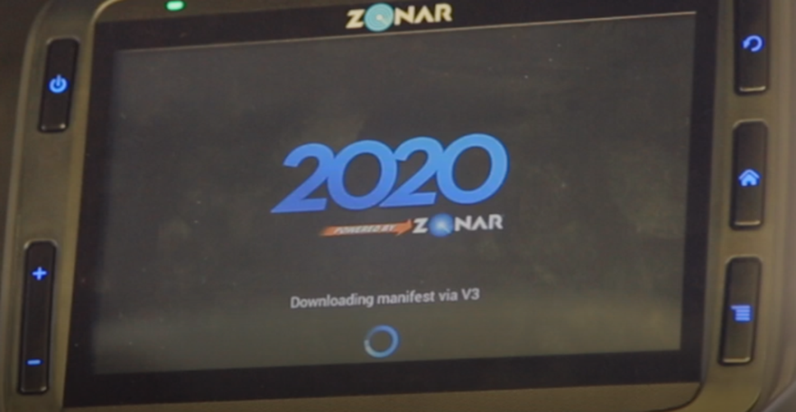
CIT Recommendations
Zonar System Pilot
7 D-Link buses
Installation of Zonar Equipment
Train Bus Operators and Admin Users
Went live on 5/12/17
Zonar Pilot will be for 60 days
Notes:
Pilot is being conducted at the SOC garage on our Dlink route on 7 buses.
RFID tags are placed inside and outside the bus
Bus Operators scan using a hand held device called the 2020

Slide 13
Next Steps
Weekly conference calls between DART and Zonar Systems during 60 day pilot program;
Daily monitoring of reports produced by Zonar Systems to ensure completion of vehicle inspections and reporting of vehicle damage and defects;
Identify resource requirements for management of Zonar System with a fleet wide deployment; identify potential savings.

