Slide 3
D2 Project Status
Currently in FTA Project Development (PD)
FTA Capital Investment Grant (CIG)
Core Capacity program
Project refinement as subway see newsletter update
Refined Locally Preferred Alternative decision by August 2017
30% Preliminary Engineering (PE) and Supplemental Draft EIS in summer 2019

Slide 4
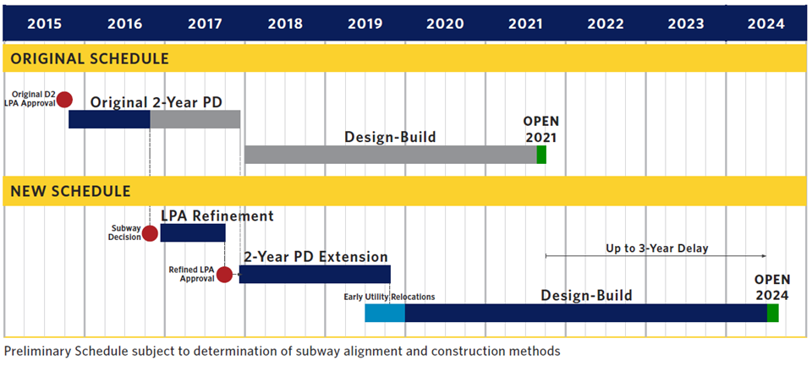
D2 Schedule

Slide 6
Capital Funding for D2 Subway
•DART Financial Plan
–$1.3B in YOE dollars
–Assumes a 50% FTA Core Capacity Capital
Investment Grant

Slide 7
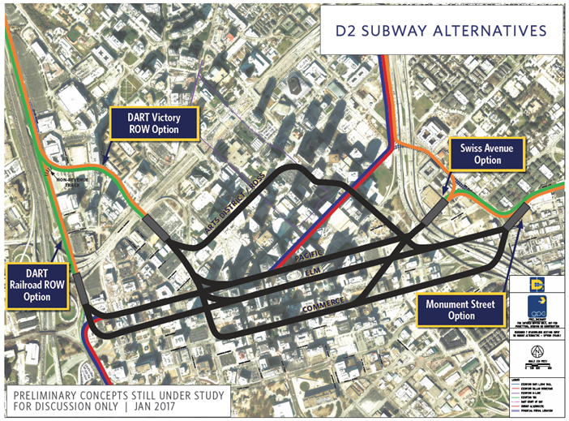
Primary Corridors Review (January)

Slide 8
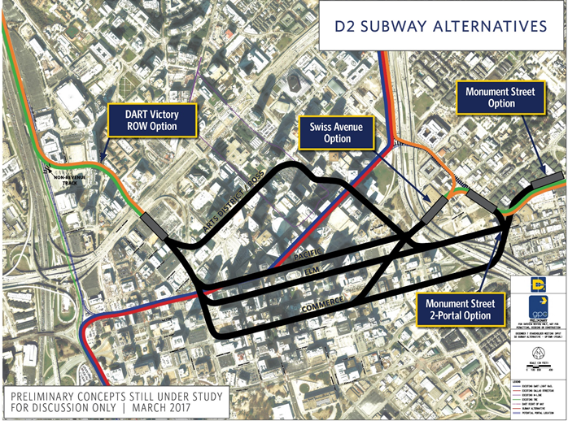
Primary Corridors Review (March) Advanced to Screening Evaluation

Slide 9
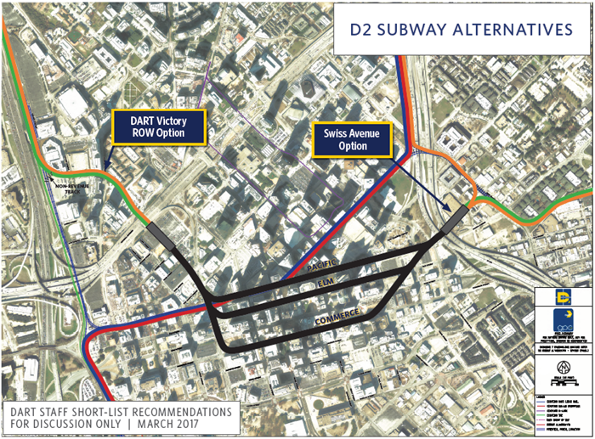
Short-List of Alternatives

Slide 10
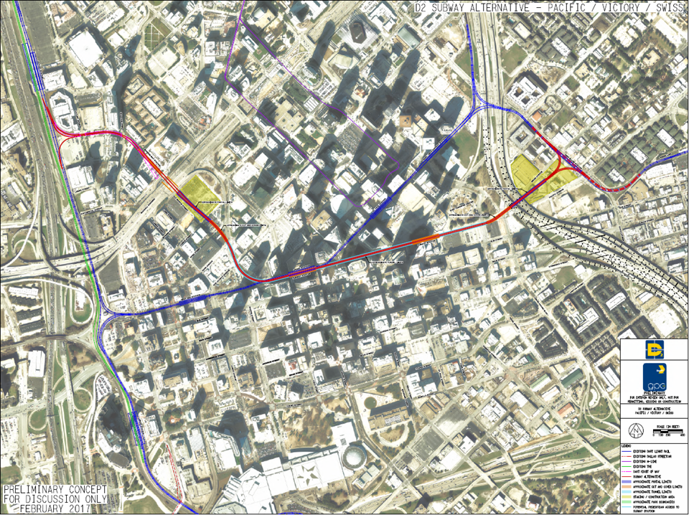
Pacific Alternative via Victory-Swiss

Slide 12
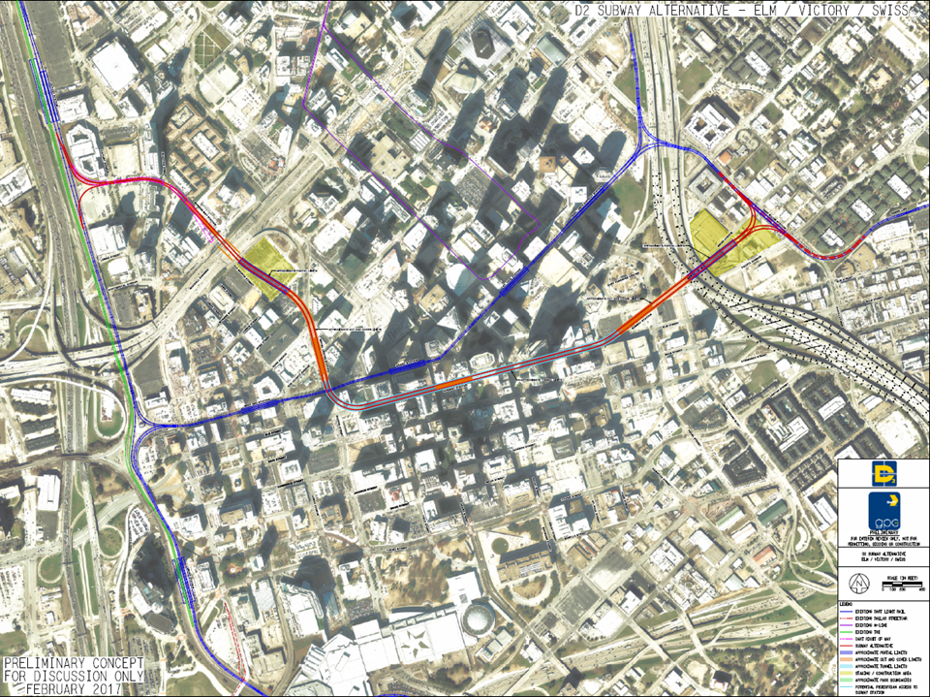
Elm Alternative via Victory-Swiss

Slide 14
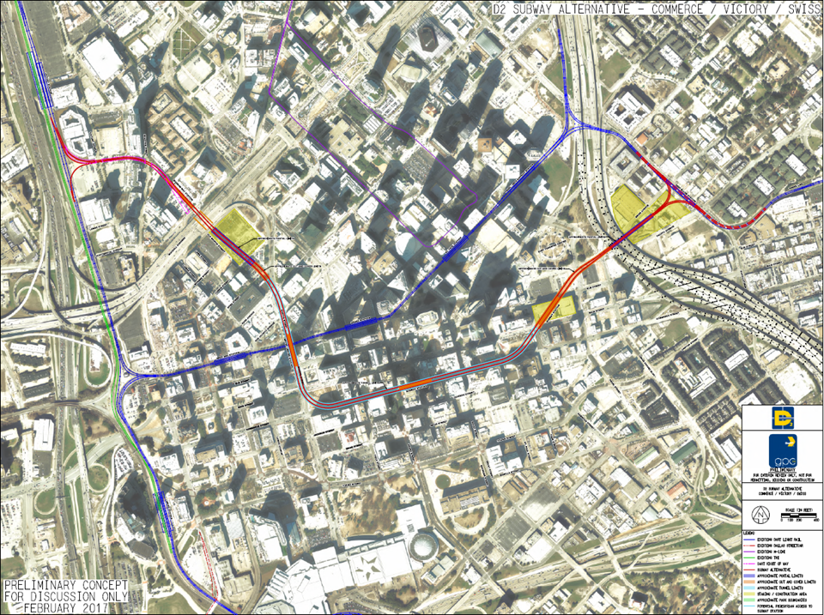
Commerce Alternative via Victory-Swiss

Slide 23
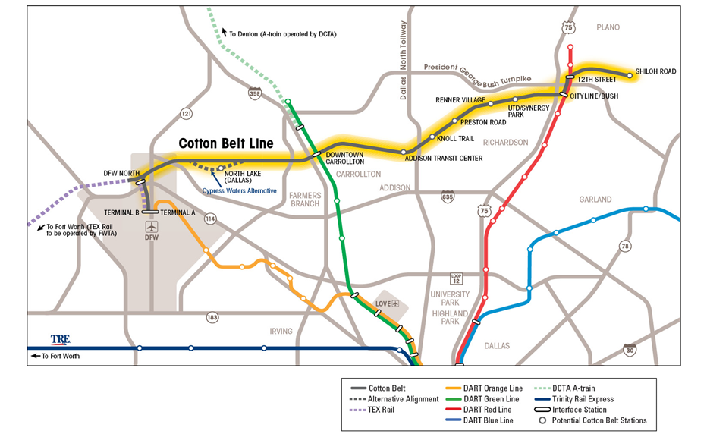

Slide 25
RRIF Loan Status
Pre-Application submitted on February 27, 2017
April 5, 2017 Email from Build America Bureau
- All comments have been addressed to date
- No significant issues

Slide 26
Cotton Belt Potential Funding Sources
Source | Funding (000s)
RRIF Loan | $908,000
FTA (CMAQ or STPMM) | 100,000
FTA (Formula) | 3,300
FTA (CMAQ) | 36,000
Local * | 87,700
Total | $1,135,000
*Anticipated local sources may include a combination of the following:
-DART cash contribution
-City of Plano (tax increment financing)
-City of Richardson (tax increment financing)
-City of Addison (cash contribution)
-City of Coppell (equivalent of 3/8 cent sales tax)
-Fare revenue
-Naming rights, advertising
-Other value capture sources

Slide 27
Environmental Activities
Data collection update: Ongoing
- Information requests (Community Facilities, Schools, Parks,etc.)
sent to all cities
- Cities preparing response
Field Recognizance/Testing
- Noise/Vibration Data Collection: Complete
- Surveying: Ongoing
- Utilities: Ongoing
- Historic Resources: Ongoing
- Environmental Resources: Ongoing

Slide 28
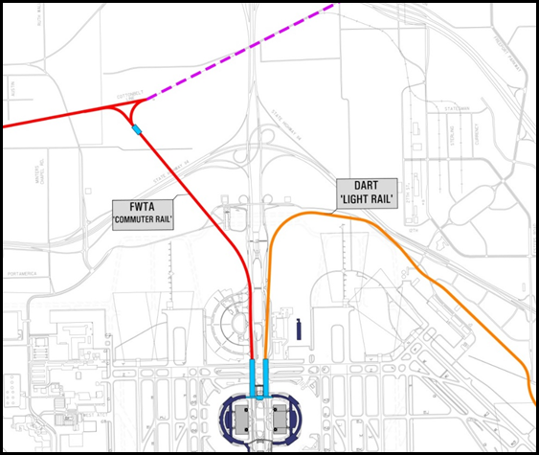
DFW Terminal Stations

Slide 29
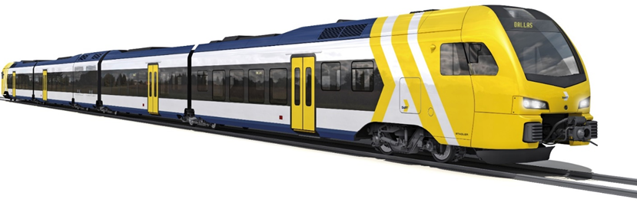
Regional Rail Vehicle
Compatible with TEX Rail (FLIRT)
Tier 4 EPA Emissions Standards

Slide 30
Project Schedule
May 2017: Public Meetings
November 2017: Publish DEIS
January 2018: Public Hearing
March 2018: FEIS/ROD

