Slide 1
Comprehensive Payments System Update
DART’s Fare Collection Initiative
Presented by Finance

Slide 2
Agenda
CPS Project Update
Account-Based System
Mobile Ticketing (GoPass 2.0)
Farebox Decision
Sandbox MOD Grant Project
Overall Project Schedule
Fareboxes

Slide 3
CPS Project Update

Slide 4
Project Status Update
Design Reviews Completed:
Conceptual Design Review (CDR)
Preliminary Design Review (PDR)
Supplemental Design Review (SDR)
Final Design Review (FDR)
Device Evaluation, Selection, and Installation Documentation:
Evaluated validator devices from Vix, Genfare, and Arcontia
Selected Vix devices
Reviewed DART bus fleet and rail platforms to create placement plan and approve installation documentation

Slide 5
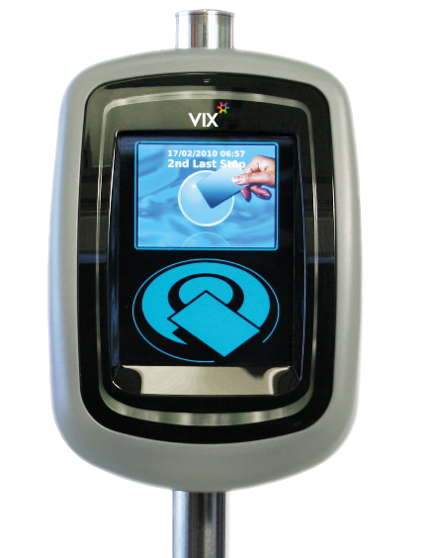
DART
Bus Fleet
Vix On-board Validators:
Installed on all NABI buses;
Installed on all New Flyer buses;
Installed on most ARBOC buses; and
Will be installed on all Proterra buses as buses are received.
Bus Modems:
Replacing existing Rocket modems with Sierra wireless modems before Pilot II scheduled for February 2018.

Slide 6
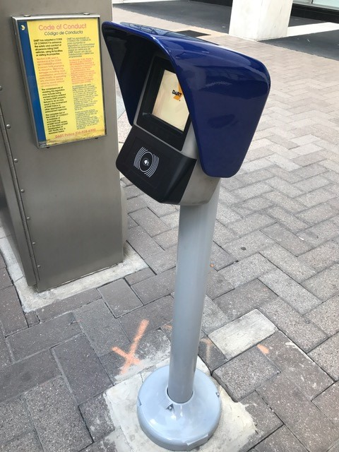
DART Rail Platforms
All DART rail platforms have civil works completed to include:
New POE (Power over Ethernet) modems located in each TVM;
New communications equipment added to support additional number of platform devices;
Vix validator pole and base cover fully installed;
Poles secured and covered until installation begins;
Platform validators scheduled to be complete by late summer 2017.

Slide 7
Third-Party Integration
Trapeze – Integration required on-board the bus from the IVLU (Integrated Vehicle Logic Unit) to the validator.
Seattle Web Group (SWG) – Development and integration of web portals for customer and corporate account management.
PayNearMe – Integration required for retail distribution and card network solution.
Plum Voice/Trachmar – Integration required for IVR and customer service personnel in call center.

Slide 8
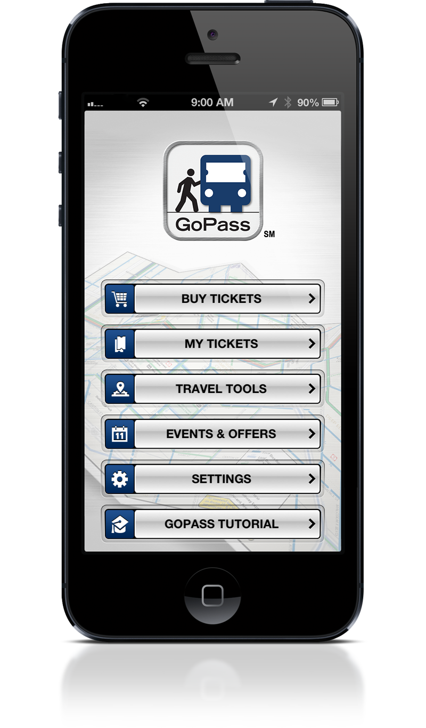
Upgrading Mobile Ticketing Platform
6

Slide 9
GoPass Downloads
GoPass is now up to 716,350 downloads (as of June 17, 2017)
Since the launch we are averaging over 518 downloads daily
55.90% of the downloads are being generated by Android; 44.10% iOS

Slide 10
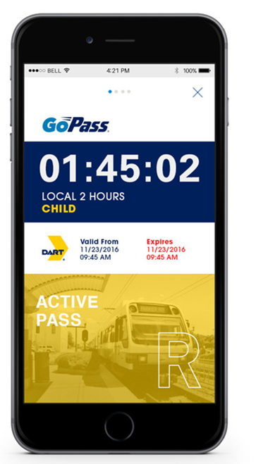
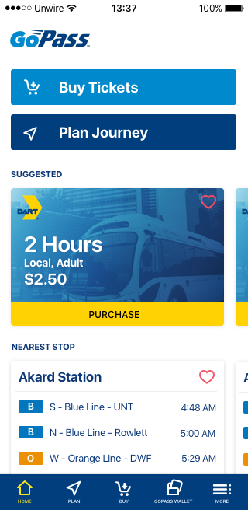
Next Generation of GoPass
Vendor: Unwire (Copenhagen);
Provides base mobile ticketing functionality with the addition of a fresh, customer-centric, feature rich application;
Will support the Sandbox Mobility on Demand initiative.

Slide 11
GoPass 2.0
New Functionality Requirements
Update screens and menus;
Purchase ticket on website and push to phone;
Reduced price student ticket registration;
Address verification system (zip code) to enhance security;
Cash to mobile capability.
Add system map
Real-time trip planning;
Multi-agency upgrade format;
Tighten integration with Uber, Lyft, taxi and other rideshare programs such as intelligent carpooling and micro-transit.

Slide 12
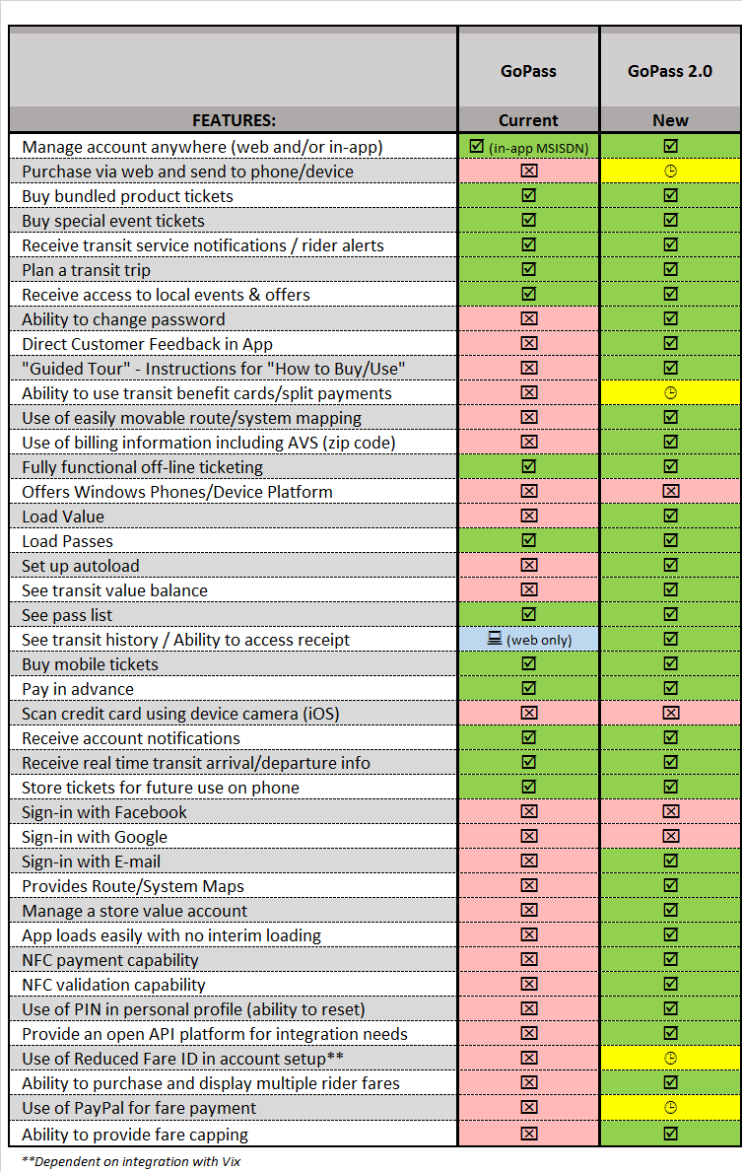
Additional Mobile Functionality
DART conducted side-by-side mobile functionality research among app providers;
Researched app functions that were customer-centric and provided a more robust and feature rich app.

Slide 13
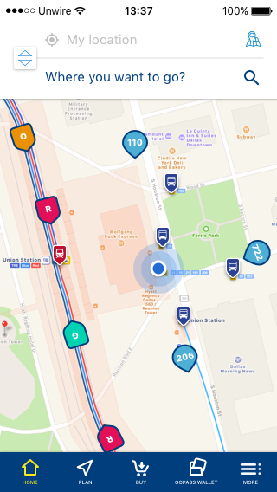
GoPass 2.0 “New Look”

Slide 14
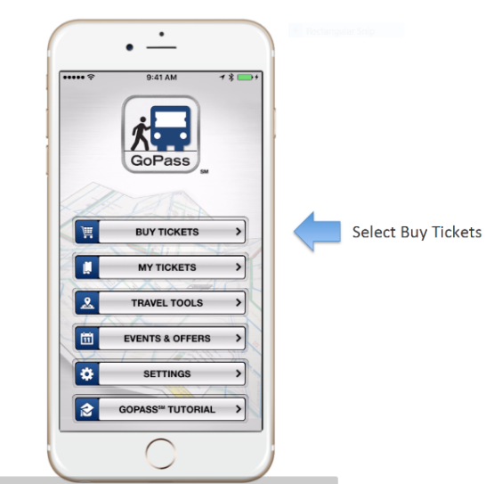
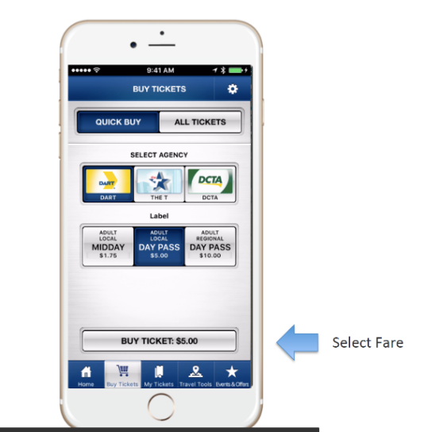
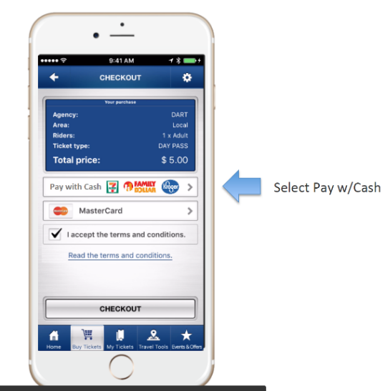
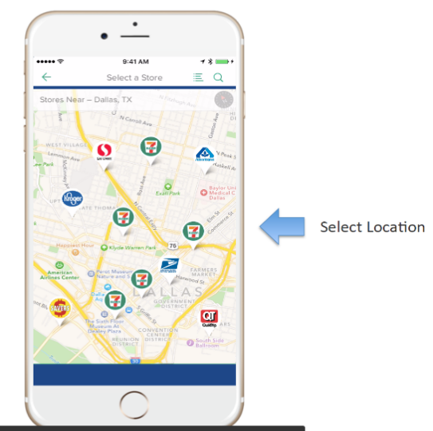
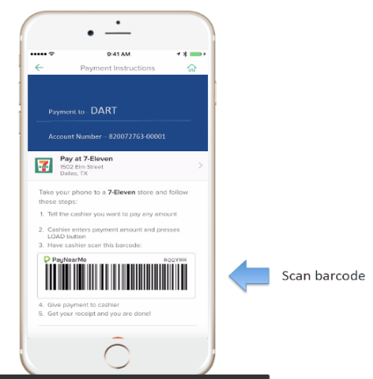
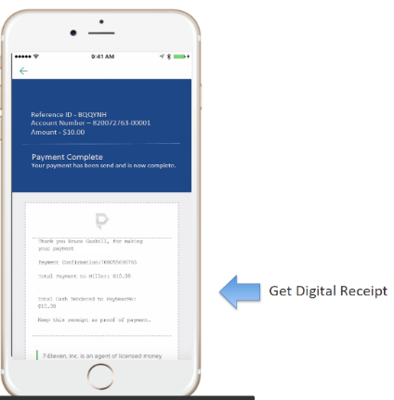
PayNearMe Mobile Integration with Retail Network

Slide 15
Fareboxes

Slide 16
Farebox Decision
Smaller footprint
Roll feed, thermal printing;
Electronic bill and coin validation;
Tamper resistant locks;
Moveable/adjustable operator keypad;
Cashbox tracking without battery.
Odyssey Genfare
Proven Technology Cost per unit $7,510 includes installation

Slide 17
Sandbox MOD Project

Slide 18
MOD Overarching
Goals
Reduce the overwhelming dependency on the single occupant automobile within the North Texas region.
Provide single interface solution to aggregate public and third party mobility providers
Deliver a “one-touch,” single payment transaction for customers to interface with DART’s GoPass app and identify “door-to-door” transit solutions
Develop a clearinghouse portal facilitating revenue settlement for multiple third-party transportation providers
Integrate equitable MOD options to DART’s portfolio of public transit options including comparable access for the unbanked, disabled, low income, and smartphone challenged customers
Lower the cost and expand the reach of public transportation to provide high quality, first and/or last mile services

Slide 19
Technology Strategy
Update GoPass’ Software Development Kit (SDK) to leverage APIs of key mobility on demand providers including taxi, TNCs, bike and car share services
Upgrade GoPass’ trip planning feature to allow customers to choose transportation modes based on time, cost and overall travel preference
Integrate DoubleMap on demand app technology for pairing customers with DART and/or other public demand responsive providers as an additional option for first and/or last mile travel
Leverage DART’s account-based back office provided by Vix Technology to function as a clearinghouse portal facilitating revenue settlement for multiple third-party transportation providers
Leverage GoPass to allow multiple payment options to include bank cards, NFC (Apple Pay, Android Pay and Samsung Pay), and “cash to mobile” through PayNearMe integration and other emerging payment options

Slide 20
MOD Project Map
Pending
Service Providers
Sponsors
Get Me
DART
VIX
DART
Uber
Sand Box LGC
Settlement
Lyft
USDOT
Taxi
Allies
Unwire
$
MV On-Call
Toyota
Pay Near Me
Bike Share
Corporations
Double Map
API DATA
CARMA
Cities
Go Pass
DART Public TNC
Other/ COG
Intelligent Carpool
DART
DCTA
The T
Vanpool
DART
DCTA
The T
DART
DCTA
The T

Slide 21
Mobility On Demand – Southern Sector Pilot Area Options

Slide 22
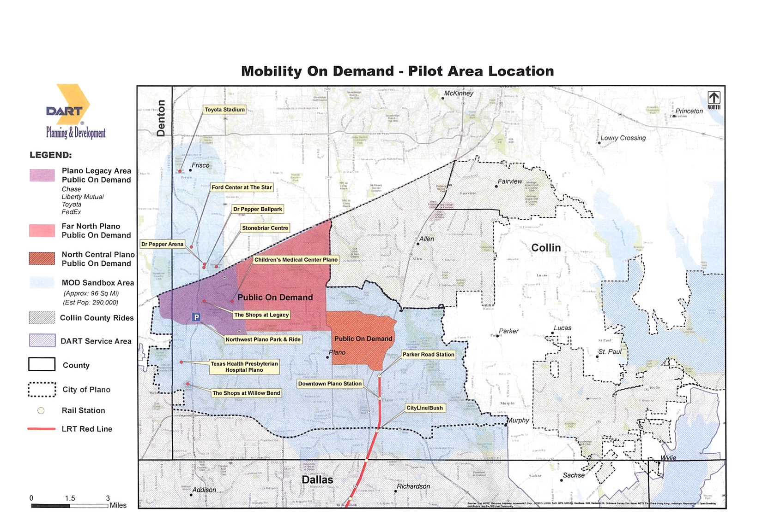

Slide 23
Project Schedule

Slide 24
Key Project Dates
2017
2018
Aug Oct Nov Feb Apr Aug Sep
Farebox
Soft Launch
Pending Pilot
GoPass 2.0
Pilot 1
Pilot 2
Official Launch
Field Demo
Vendor Legend
Genfare
Unwire & PayNearMe
VIX & PayNearMe
Sandbox MOD

Slide 25
Questions?

