Slide 1
Understanding and increasing transit ridership in our new mobility future
Dr. Kari Watkins
Associate Professor
Georgia Tech

Slide 2
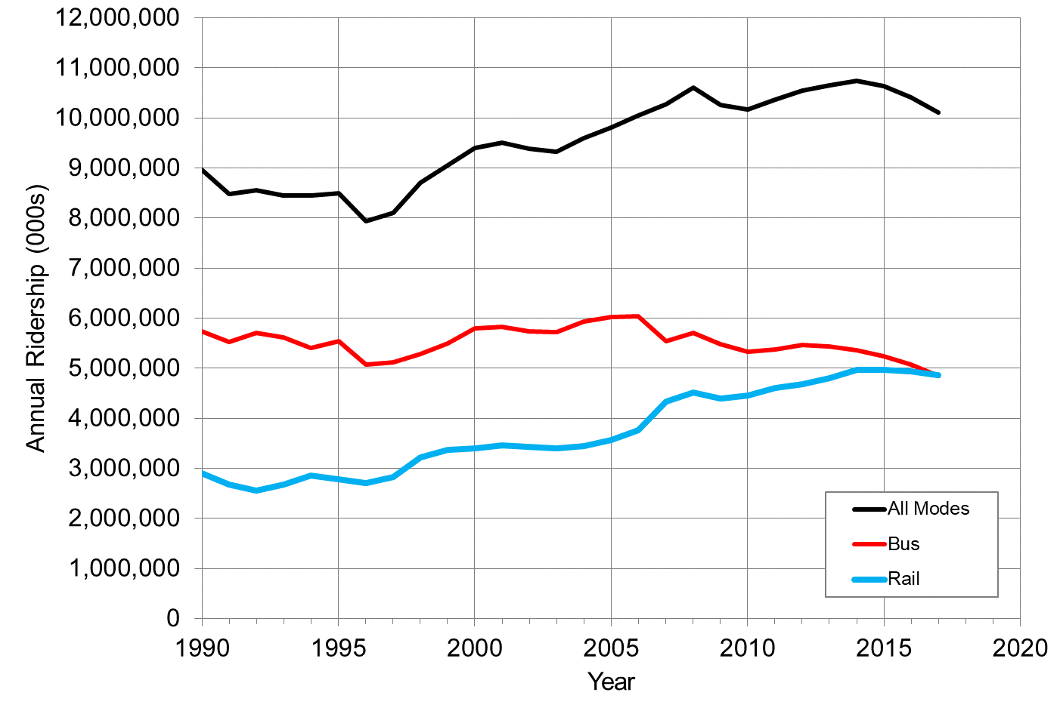
Change in US Transit Ridership

Slide 3
Normalized Change in MARTA and Peer Agency Ridership

Slide 4
Traditional Causes of Ridership Change
Historically, most vital factor affecting ridership is the amount of service provided.
In past few years, many agencies have increased service without associated ridership increases.
Transit ridership is cyclical and tied to economic factors
Low unemployment increases ridership
High gas prices increases ridership
Ridership also tied to built environment factors
Higher housing and employment density increases ridership
Low cost parking decreases ridership
Shifts in housing and demographics are not favoring transit access
Growing suburbs
Gentrification in urban cores
Notes:
Traditional causes of transit ridership increases and declines
We have long understood that public transit ridership is affected by traditional economic factors, such as population and employment change (recession, gentrification, residential location), gas prices, and auto ownership. Many external factors affecting transit ridership are well established within the literature. The level of employment has a mixed effect on ridership, and while greater employment generates more trips from commuting and consuming, it also leads to private vehicle purchase (Hendrickson, 1986; Liu, 1993). The overall effect of employment, however, has been found to be positive (Gomez-Ibanez, 1996). While gas prices have been found to have little impact on transit ridership, parking availability is an important determinant (Sale, 1976; Dueker, 1998). Transit ridership is highly correlated to housing and workplace density, although this variable has a relationship with many other ridership factors (Pushkarev and Zupan, 1977; Spillar and Rutherford 1998; TCRP Report 95, 2004).
Transit ridership is also impacted by many internal factors that are largely under the control of the transit operator, such as the amount of service being provided (frequency, coverage, span, availability), the cost of service (fares) and the quality of that service (speed, reliability, comfort). There is a consensus in the literature that the primordial factor for transit ridership is the service levels. Vehicle revenue hours have been found to explain up to 95% of the variation in transit ridership (Boisjoly et al. Dill et al, 2013, Kyte et al 1988, Taylor et al. 2009, Liu, 1993; Gomez-Ibanez, 1996; Kohn, 2000; TCRP Report 95 2004). Although sensitivity to fare can vary widely within the customer base, modest changes in fares have been found to greatly affect ridership (Liu, 1993; Kohn, 2000).
The recent decline in transit ridership is particularly worrisome because traditional factors of ridership do not seem to be involved. According to data from the National Transit Database, transit agencies have increased bus service (vehicle revenue miles) by five percent between 2012 and 2017. Our analysis from TCRP study J-11 found that transit agencies had to increase service by 9% during that period to expect unlinked passenger trips to remain unchanged. Meanwhile, urban population in the United States is at its highest point in recorded history (Census, 2012) and urban core areas have grown in population every year since 2006 (Frey, 2018). While a study from the University of South Florida (Driscoll et al. 2018) pointed out that transit-oriented regions are losing population and car-oriented regions are gaining population, our deeper dive analysis from TCRP J-11 found that population change and ridership change were entirely uncorrelated for bus and somewhat correlated for rail. The health of the economy should also be encouraging people to make more transit trips. In 2017, unemployment levels in the United States were at their lowest level since the recession in 2009.

Slide 5
New Competition for Ridership
Increasingly people are making less traditional trips
Telecommuting increasing (less monthly transit passes)
Flex work schedules
Delivery services to stores and restaurants
There is more competition from new modes
Bikeshare
Carshare
Shared mobility services
Evidence that Uber and Lyft replace transit trips, particularly outside of peak hours
Also evidence that Uber and Lyft complement transit, particularly for rail systems
Notes:
However, recent changes to how people travel are impacting ridership in significant ways. Telework, flex work schedules, and online shopping are becoming more prevalent and impacting the demand for travel or the times we do it. According to a Gallup poll, 43% of Americans reported working remotely at least sometimes, a 4% increase since 2012 (Gallup 2017). Telecommuters also reported working remotely more often; 75% reported working from home more than once a week from 66% in 2012. This trend may affect commuters' decisions to purchase monthly passes in favor of more flexible options (Habib 2017). Delivery services such as Amazon and GrubHub have made shopping and dining delivery possible (Suel et al. 2018). Total vehicle miles traveled are now at their highest point in history (Davis 2017).
A potential contributing factor to the decreasing transit ridership is the economic displacement of low-income earners from dense urban-centers to the suburbs (Florida, 2017). While cities are becoming denser, their populations are becoming whiter, have higher-incomes, and more cars. Despite some trends that were temporarily going in the opposite direction, suburbs have outpaced urban cores in growth rate (Frey, 2018). A study from Tri-Met staff in Portland, OR, identified low-income migration as a major factor of transit ridership decline (Mills and Steele, 2017). Increasing auto ownership especially among lower-income households has been found to have a significant effect on falling transit ridership in the Southern California region (Manville et al., 2018). Parking benefits have been shown to decrease transit use in (Bruno et al. 2017, Dong et al. 2016, Block-Schachter & Attanucci 2008).
Several studies on the impact of carsharing on transit have been conducted with mixed results. Households that utilize carsharing have been shown to use transit less than before joining carsharing (Martin and Shaheen, 2011), and zero-car households that utilize carsharing have been shown to use transit less than zero-car households in general (Sioui et al., 2012). A study combining 15 reports, however, described car sharing members’ transit usage increase between 13.5 to 54% after joining carsharing (Shaheen, Cohen, Chung, 2009).
Although competition from other modes has always been prevalent, new modes such as TNCs, bikeshare and electric scooters are providing new options for travelers and new competition for transit. The impact of new mobility services on traditional transit has been the subject of much speculation. Some see these new services as competitors that simply skim choice riders from the transit system, while others believe that offering as many mobility options as possible enables individuals to choose a car-free or car-lite life. Several studies using data prior to 2016 have found that TNCs had either a mixed relationship to transit ridership or no statistically significant relationship (Boisjoly et al. 2018, Hall et al. 2018). Other studies have found that bus usage decreases while rail increases as a result of TNCs (Clewlow and Mishra 2017) and that TNCs may replace or support transit differently for different trip purposes (Feigon & Murphy, 2016).
Recent work on the effect of TNCs in San Francisco is clearer. Using stop-level APC data and a unique data set scraped from the user interfaces of Uber and Lyft, researchers have shown that TNCs are responsible for a net reduction of 10-20% in MUNI bus ridership (Mucci 2017). The effect of a shift from transit to TNC is increased congestion, and between 2010 and 2016, congestion, as measured by vehicle hours of delay, increased by 60% in San Francisco, with two-thirds of that increase attributable to TNCs (Erhardt et al). Understanding and managing the interactions between fleet vehicles and transit will become even more important going forward as companies continue to invest in self-driving car technology.

Slide 6
Ongoing Research
MARTA (finishing summer)
Understanding Transit Ridership Decline
STRIDE A-2 (finishing summer)
Changing Access to Public Transportation and the Potential for Increased Travel
TCRP A-43 (just beginning)
Recent Decline in Public Transportation Ridership: Analysis, Causes, Responses
Notes:
This therefore begs the question of how agencies should address these factors, including modifying service to accommodate changes in the transportation system. Strategies can be operational in nature, such as route and network restructuring. They can be technological, such as new fare technologies or real-time information. They can involve new service types, such as demand-responsive transit. They can even involve new communication and marketing campaigns. Some of these strategies are discussed below.
Many recent service-related efforts to increase transit ridership have consisted in restructuring bus networks to prioritize service concentration over coverage (Houston, Omaha, Austin Columbus). Called the “hottest trend in transit” by Governing Magazine at the end of 2017, bus network restructuring is being considered by transit agencies across the nation. LA’s Metro, Dallas’s DART, Philadelphia’s SEPTA, and DC’s WMATA are planning similar bus network redesigns (Hymon 2017, Schmitt 2017, Laughlin 2017, Powers 2017). In November 2017, Streetsblog USA wrote that, “Transit ridership is falling everywhere – but not in cities that redesigned their bus networks” (Schmitt, 2017). However, many of these bus network redesigns were accompanied by net increases in bus operating budgets that may explain the ridership mitigation or increases more than the restricting itself.
Technology changes can improve transit ridership as well. A study by Brakewood, Macfarlane, and Watkins (2015) examined bus ridership changes in New York City in response to the gradual availability of real-time bus information. The study revealed a median ridership increase of 2.3%, with higher increases on the largest routes. Additionally, many transit agencies are investing in new fare payment systems to improve the rider experience, particularly for tech-savvy riders who are already using their smartphones to pay for many other goods and services. While mobile ticketing and other new payment technologies are likely to have positive ridership impacts, there has been limited prior research specifically studying the effects of new payment systems.
To provide greater transit access in low-density neighborhoods, a new strategy consists in using demand-responsive transit. Research has shown that in low-density areas, demand-responsive transit can service short trips faster (Qiu et al. 2015) and at a lower cost than fixed routes (Edwards and Watkins, 2013). Several transit agencies have implemented demand-responsive service either to reach the first-and-last-mile or to connect origins and destinations directly (Becker et al. 2013, Westervelt et al. 2018, Bliss 2017). There still lacks, however, quantitative research to assess the service and ridership implications of the programs.
Given the rapidity of the ridership change, it is important that the strategies considered be both sufficient in scale to offset the recent declines, and forward-looking to anticipate new technology and changes coming over the next several years. This suggests the consideration of strategies that involve broader partnerships with cities and other stakeholders, such as a large-scale re-thinking of how urban right-of-way is allocated between cars, transit and non-motorized modes; introducing congestion pricing to both manage congestion and increase transit use; or introducing self-driving buses as a means to cost-effectively increase the service provided. The implication for this project is that we must not limit ourselves to an empirical evaluation of existing strategies.

Slide 7
Broader Research Questions
1. Service Allocation
What is the relationship between ridership and frequency?
2. Gentrification
Does economic displacement explain the ridership decline?
3. Transportation Network Companies
What impacts do the TNC’s have on the ridership decline?

Slide 8
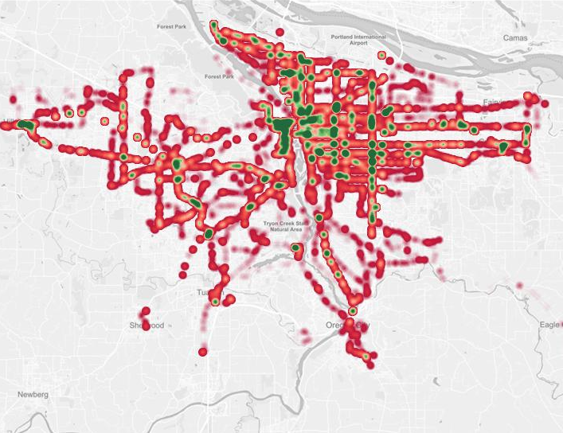
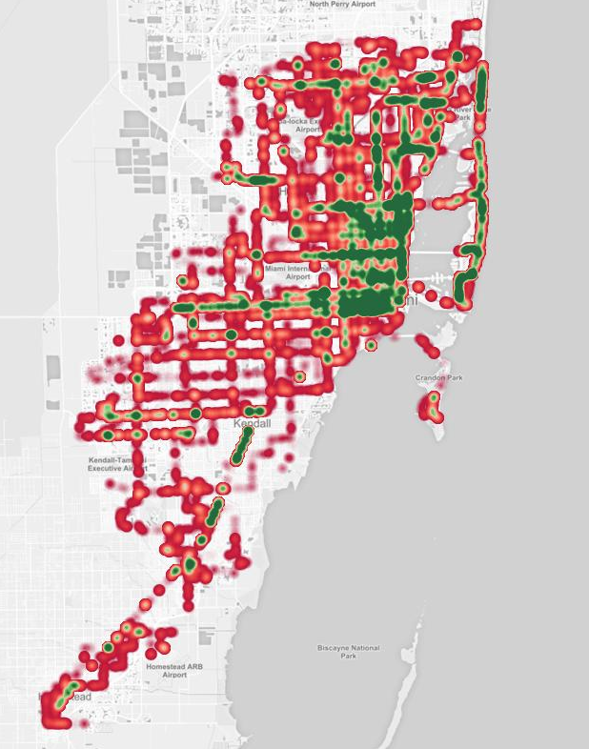
Case Studies
Trimet
– Portland, OR
Miami Dade Transit
– Miami, FL
Metro Transit
– Minneapolis/St-Paul, MN
MARTA
– Atlanta, GA

Slide 9
Data Sources
APC Automatic Passenger Counters 2012/13 – 2017 | GTFS General Transit Feed Specification 2012/13 - 2017 | LEHD Longitudinal Employer-HH Dynamics 2011-2015 | ZTRAX Zillow Transaction & Assessment Data 2012-2017
Lasers on vehicle doors Typically connected to GPS 30M – 1B Records Used mainly for planning & scheduling, not system-wide ridership counts | Standardized format for transit schedules Historical data available openly through 3rd parties | Number of jobs and workers by demographic Available yearly by Block Provided by Census Bureau | Housing Selling Price at Block Group level

Slide 10
Research Conclusions Thus Far
Traditional factors still explain ridership
Service and population are still significant for dedicated and mixed ROW
Don’t explain ridership change as well
Dedicated ROW explained by service and somewhat by population
Mixed ROW
Losing ridership in mid-sized cities without service increases (8 – 10%)
No relationship in large metros
No relationship between population and ridership change
New factors may explain ridership change
Gentrification is part of the story
More research needed on TNCs

Slide 11
In the meantime, what are transit agencies to do?
When I say “Future of Transportation”, what do you think of?
How do you think we are planning to get around in 20 years?

Slide 12
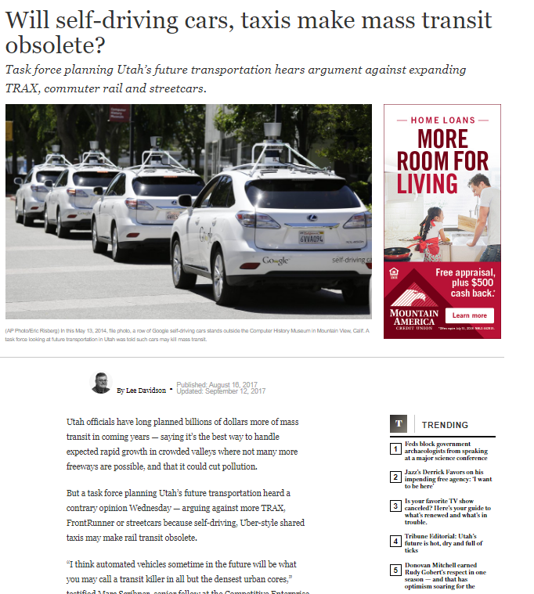
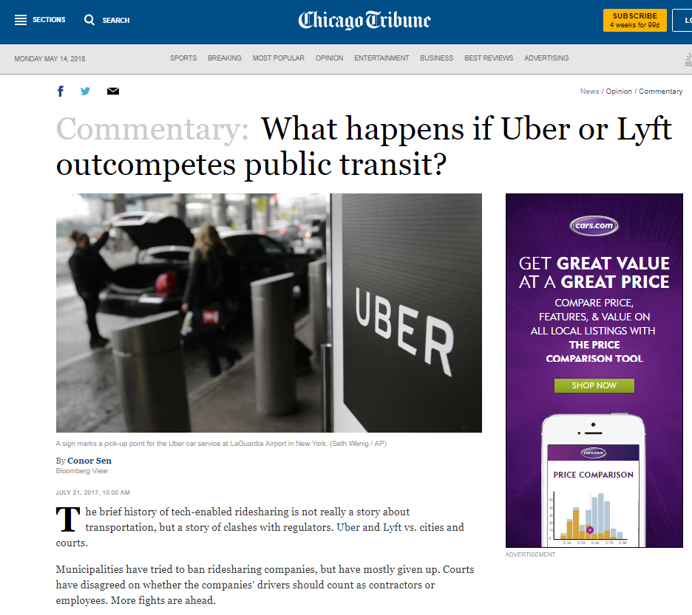
Solutions:
Self-driving cars
TNC’s (Uber and Lyft)
Notes:
Both of these contemporary transportation concepts allow car drivers to overcome the biggest individual negative aspect to their mode - the stress and time involved in paying attention to the road ahead – something that has long been used to attract new riders to transit.

Slide 13
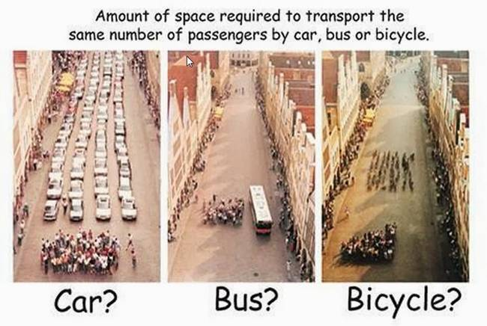
Space
Notes:
Image source:
City of Muenster Planning Office, 2001.

Slide 14
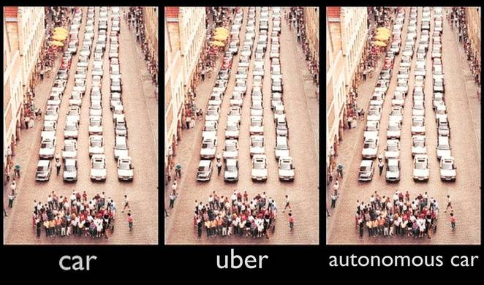
Future of Transport

Slide 15
How can we ensure a livable and effective future transportation system?

Slide 16
All I really need to know I learned in Kindergarten
Share everything.
Play fair.
Don't hit people.
Put things back where you found them.
CLEAN UP YOUR OWN MESS.
Don't take things that aren't yours.
Say you're SORRY when you HURT somebody.
Wash your hands before you eat.
Flush.
Warm cookies and cold milk are good for you.
Live a balanced life - learn some and drink some and draw some and paint some and sing and dance and play and work everyday some.
Take a nap every afternoon.
When you go out into the world, watch out for traffic, hold hands, and stick together.
Be aware of wonder. Remember the little seed in the Styrofoam cup: The roots go down and the plant goes up and nobody really knows how or why, but we are all like that.
Goldfish and hamster and white mice and even the little seed in the Styrofoam cup - they all die. So do we.
And then remember the Dick-and-Jane books and the first word you learned - the biggest word of all – LOOK.
Notes:
Do you remember the book “Everything I need to know I learned in Kindergarten” by Robert Fulghum
** go through some items **

Slide 17
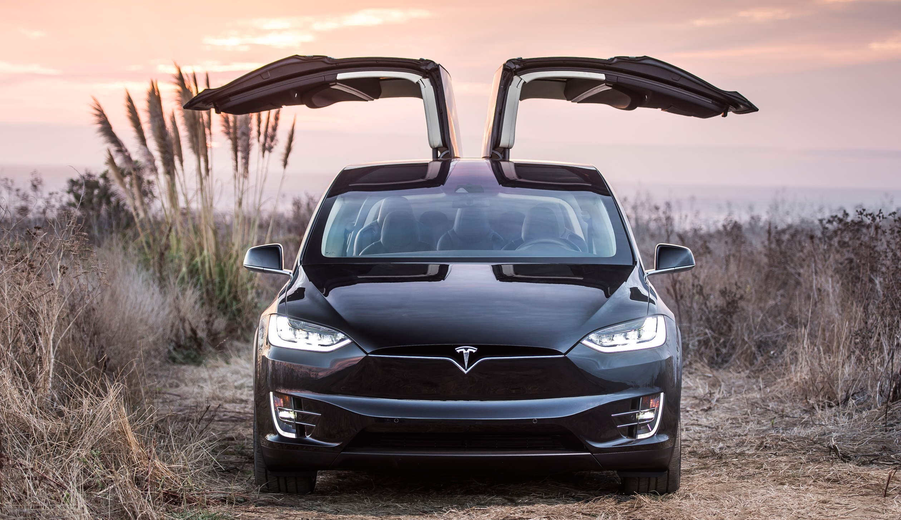
Possible Autonomous Futures
Personal autonomous vehicle ownership
Typical driver only able to afford one vehicle - sized to maximize usefulness
Zero-occupant trips
Single occupant ride-hailing
Circling to wait for pick-ups
Passengerless delivery trips
Increased travel demand
Dinner in Chattanooga?
Shared usage of mobility services

Slide 18
Future of Public Transport
If travel is a utility, then mobility must be a service
Spatial priority must be given to collective transportation modes
Focus first on service, then on technology
“Scientia potentia est” - knowledge is power

Slide 19
Future of Public Transport
If travel is a utility, then mobility must be a service
Seamless travel with collective transportation as the backbone
Best of high capacity public transportation for the bulk of travel distances
Travel collectively = system efficiency
Localized services for short trips and first-mile, last-mile connectivity
Individual needs for origin to destination
Mobility must be transformed to be seen more like a high quality utility
Connection from one service to another must be efficient and pleasant
Good information and minimal delay

Slide 20
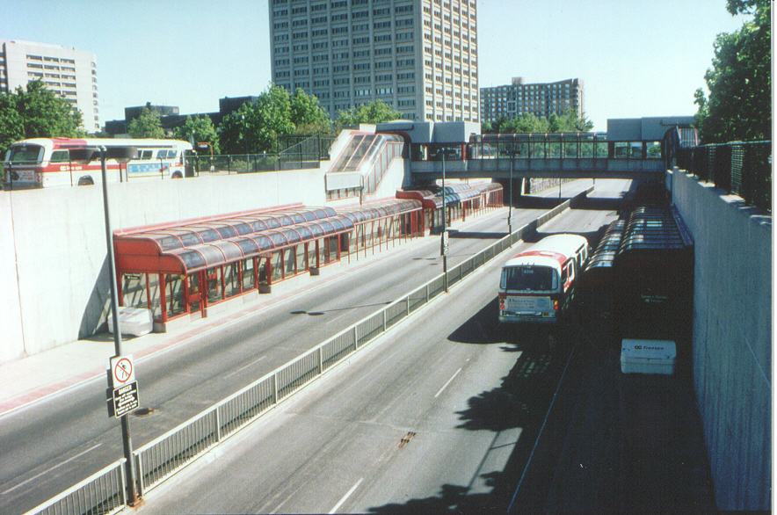
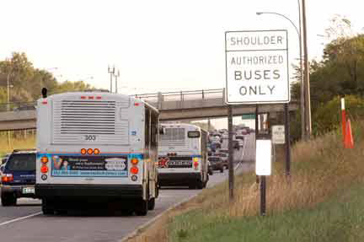
Future of Public Transport
Spatial priority must be given to collective transportation modes
Transit + carpooling mixed with general traffic = no incentive to share
Exclusive right-of-way to collective transportation modes
HOV lanes, transit lanes, BRT must become the norm
Heavy rail versus bus has never been about steel vs rubber wheels
Spatial allocation for collective modes much more important with driverless vehicles

Slide 21
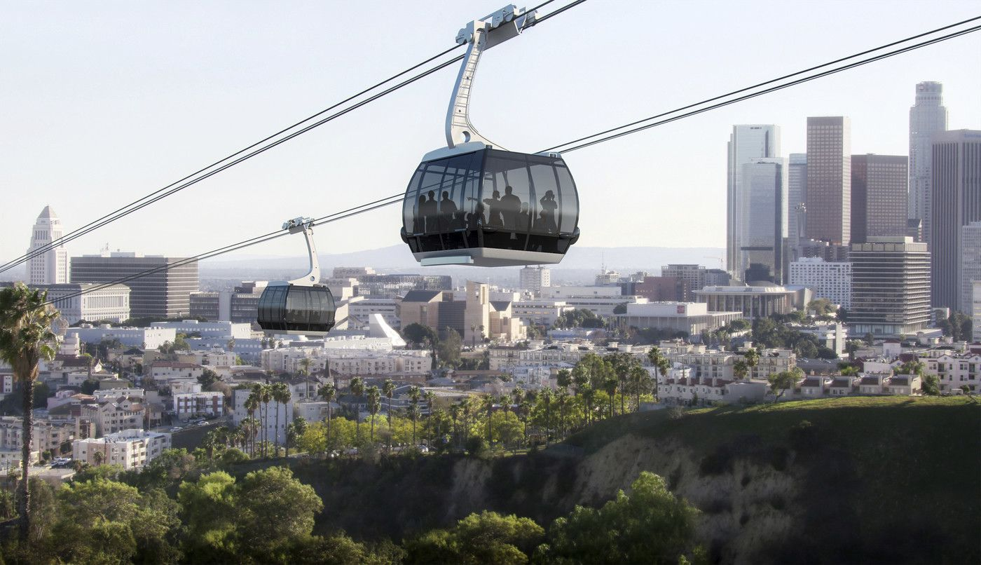
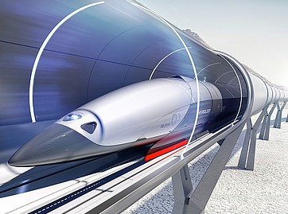
Future of Public Transport
Focus first on service, then on technology
Streetcar? Gondola? Hyperloop? Don’t chase technology
First create a connected, accessible transit network
Link major nodes with frequent service
Minimize number of modal transfers

Slide 22
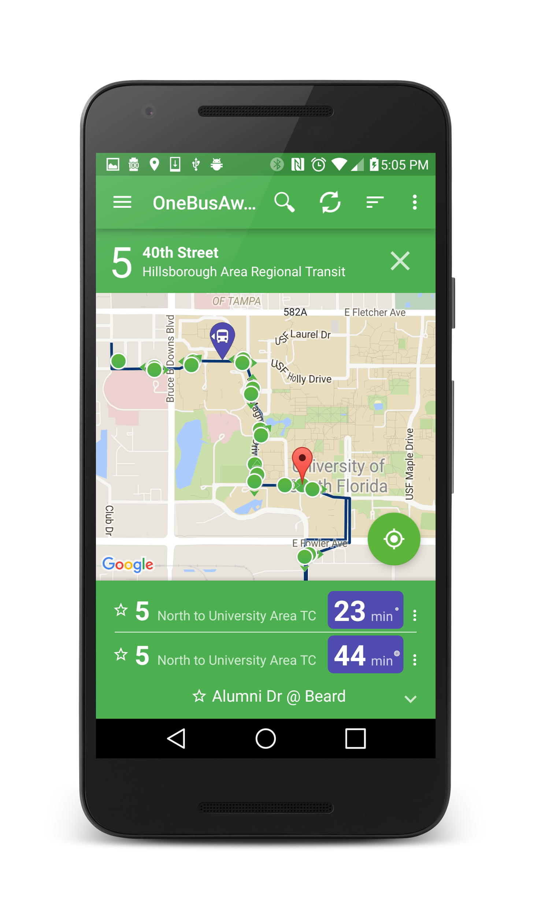
Future of Public Transport
“Scientia potentia est” - knowledge is power
Use of technology and data to improve transit services has been far too slow for transit to compete
Information intense society
Inform customers in real-time
Open data kept updated
Service disruption alerts
Customer feedback mechanisms

Slide 23
Future of Public Transport
Transit as backbone of mobility
Spatial priority to transit mode
Well-connected accessible network
Up-to-date real-time personalized information

Slide 24
What is OneBusAway?
What? Suite of tools that provides real-time bus/train tracking information
Open source software
API for developers
Free to riders
Why? Make riding public transit easier by providing good information in usable formats
Research to evaluate the impacts

Slide 25
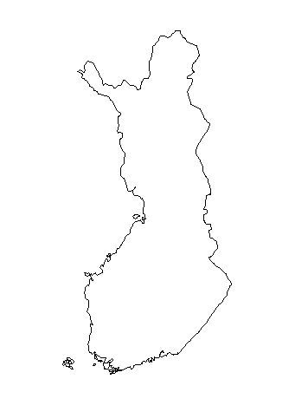
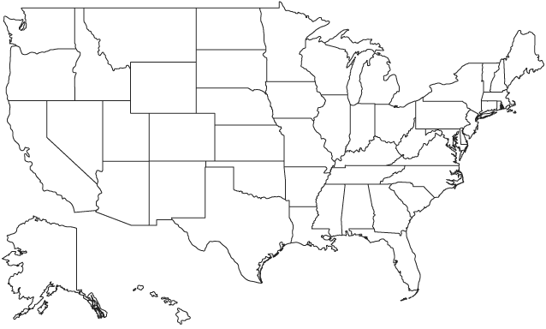
Where is OneBusAway?
Seattle, WA:
Original deployment 2008
Lappeenranta , Finland:
Beta
York, ON:
2015
Rouge
Valley, OR:
2015
New York, NY:
Adapted for the MTA
(Bus Time)
San Joaquin, CA:
Beta
Washington, DC:
2016
Atlanta, GA:
2013
San Diego, CA:
2016
Sroda Wielkopolska, Poland:
Launched May 2016
Tampa, FL:
2013

Slide 26
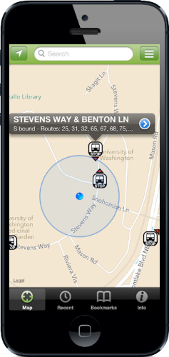
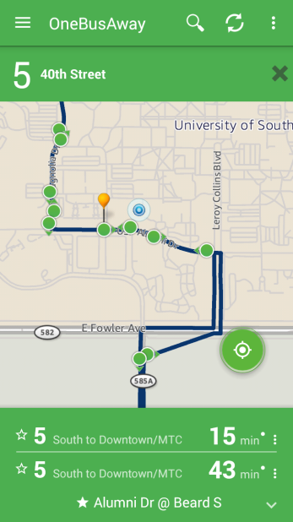
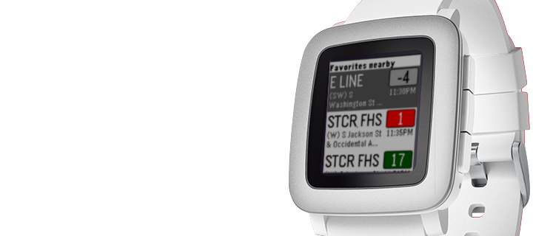
Mobile Apps and More
Android
iPhone
Support user location, route, stop contextual /personalized information
All OPEN-SOURCE!

Slide 27
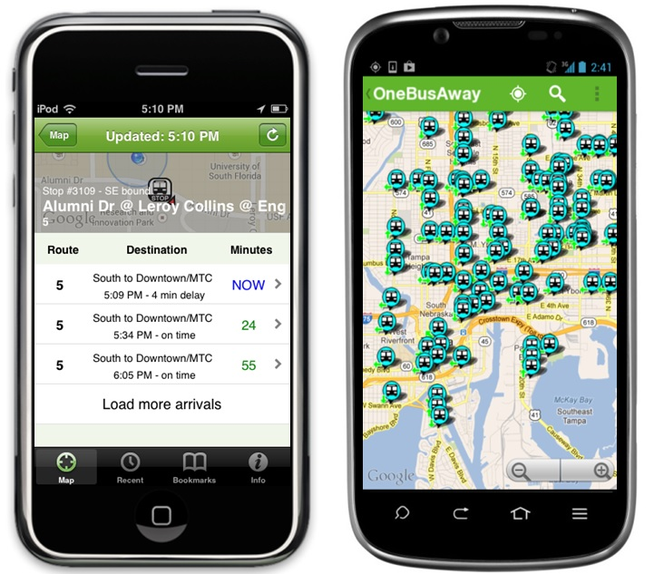
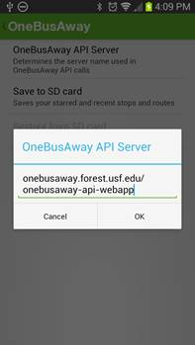
Ridership Impacts - Tampa
Before-After Control Group Research Design
Limiting the Treatment: iPhone & Android Apps
Motivation: HART provided USF & Georgia Tech special access to real-time data
Recruitment: HART website/email list (Incentive of 1 day bus pass)
Measurement: Web-based surveys
Group Assignment: Random number generator
Treatment: OneBusAway
Notes:
Highlight setting change on the right side of the screen

Slide 28
Ridership Impacts - Tampa
Significant improvements in the waiting experience
Decreases in self-reported usual wait times
Increases in satisfaction with wait times and reliability
Little evidence supporting a change in transit trips
Approx. 1/3 of RTI users stated they ride the bus more frequently, perhaps because of:
Affirmation bias of respondents
Scale of measurement (trips per week)
Only riders within sphere of transit agency
Notes:
Evidence supporting changes in the number of transit trips associated with real-time information is limited.
First, it is possible that the “revealed” questions suffered from measurement error and did not capture sufficient levels of detail. For example, the use of trips per week to measure transit travel frequency could be insufficient if a person only makes one or two additional trips per month attributable to RTI. A more reliable way to measure this would be to record trips over an extended period of time (e.g. have respondents report their number of trips per week for all the weeks over the study period). Similarly, a five-point Likert scale for satisfaction may not be sufficiently refined to capture a small increase in satisfaction associated with using RTI.
A second plausible explanation is bias on behalf of the survey respondents when answering the stated questions. The survey methods literature has shown that respondents often have a social desirability bias and will provide an affirmative response that may not align with their actual behavior

Slide 29
Ridership Impacts - New York City
#3. November 2012: Bronx Launch
#4. October 2013: Manhattan Launch
#5. March 2014:
Queens + Brooklyn Launch
#2. February 2012: Staten Island Launch
#1. February 2011: Brooklyn Pilot (B63)
Notes:
Explain bus time, search by route, intersection, etc.
MTA simultaneously launched multiple interfaces and released real-time data openly
The borough-by-borough launch allows us to analyze ridership on routes in Staten Island, the Bronx and Manhattan before and after Bus Time. It also allows for comparison with routes that do not have Bus Time in Queens and Brooklyn.
This roll out by borough – allows us to compare before-after on routes with real-time; also control boroughs (queens & brooklyn)

Slide 30
Ridership Impacts – New York City
Method
Comparison of multiple panel regression techniques in a well-suited natural experiment
Conclusions
Average increase of ~115 rides per route per weekday (median of 1.6%), similar to previous Chicago study
Average increase of ~338 rides per weekday on the largest quartile of routes (median of 2.3%)
Limitations
Short Timescale
Aggregate Analysis
Notes:
Likely need more months in Manhattan
Staten island has different demographics

Slide 31
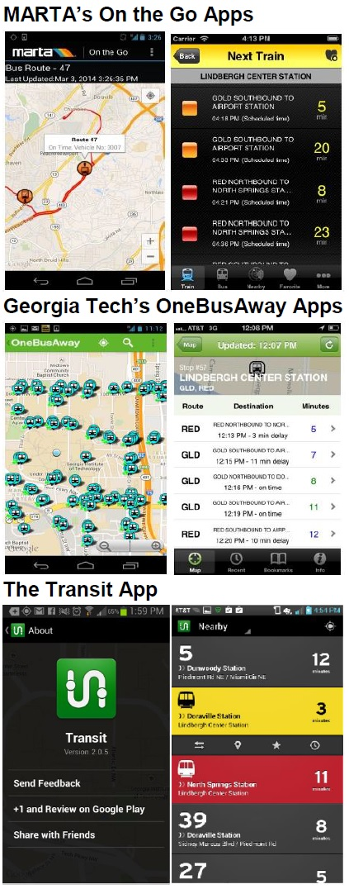
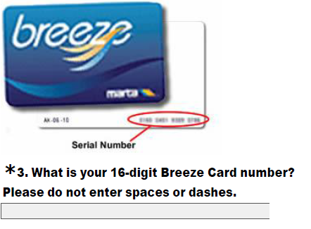
Ridership Impacts - Atlanta
Data Collection
Web-based survey conducted first week of May 2014
Recruitment
Both real-time information (RTI) users and non-users
Matching with Smart Cards
669 participants entered survey software
538 provided a 16 digit smart card number
494 matched usable, active smart cards
Notes:
No Personal Information in the Survey: Georgia Tech cannot collect any personally identifiable information (e.g. email address, home address) along with requesting a study participant’s smartcard number.
→ Only one survey since there is no way to contact study participants for a post-wave
Aggregate Data: MARTA will aggregate the smart card trip histories for each individual in the study to the number of trips per mode per day.
→ Controls for transit service changes and transfers done by MARTA

Slide 32
Ridership Impacts - Atlanta
Has using an app with real-time information changed the NUMBERS OF TRIPS that you take on MARTA TRAINS?*
Has using an app with real-time information changed the amount of time you spend WAITING for MARTA TRAINS?**
Has using an app with real-time information changed how SATISFIED you are with MARTA TRAIN service?

Slide 33
Using Real-time - Unstable Headway Dynamics
Bus 3
Bus 2
Bus 1
Bus 3
Bus 2
Bus 3
Bus 2
Passenger waiting
Bus stop
Notes:
Talk about the instability parameter

Slide 34
The Route and the Terminal Station(s)
Bus being held at terminal station
Bus running the route
T
Buses are held at one or several terminal stations
Notes:
The objective is to send buses from the terminal station with low headway mean and variance. The problem is that running time is random.
Change text

Slide 35
What is Transit Clock?
What? Transit Clock records the real-time and historical movements of vehicles to predict arrival and departure times.
Provides predictions in GTFS realtime and SIRI format
Schedule adherence reports
Prediction analysis reports
3rd Party predictions analysis
Web interface
API for developers
Auto assigns vehicles to trips based on GPS data
Why?
To produce accurate arrival predictions to be displayed to passengers
To provide reporting on performance of transit systems and existing real-time infrastructure
35

Slide 36
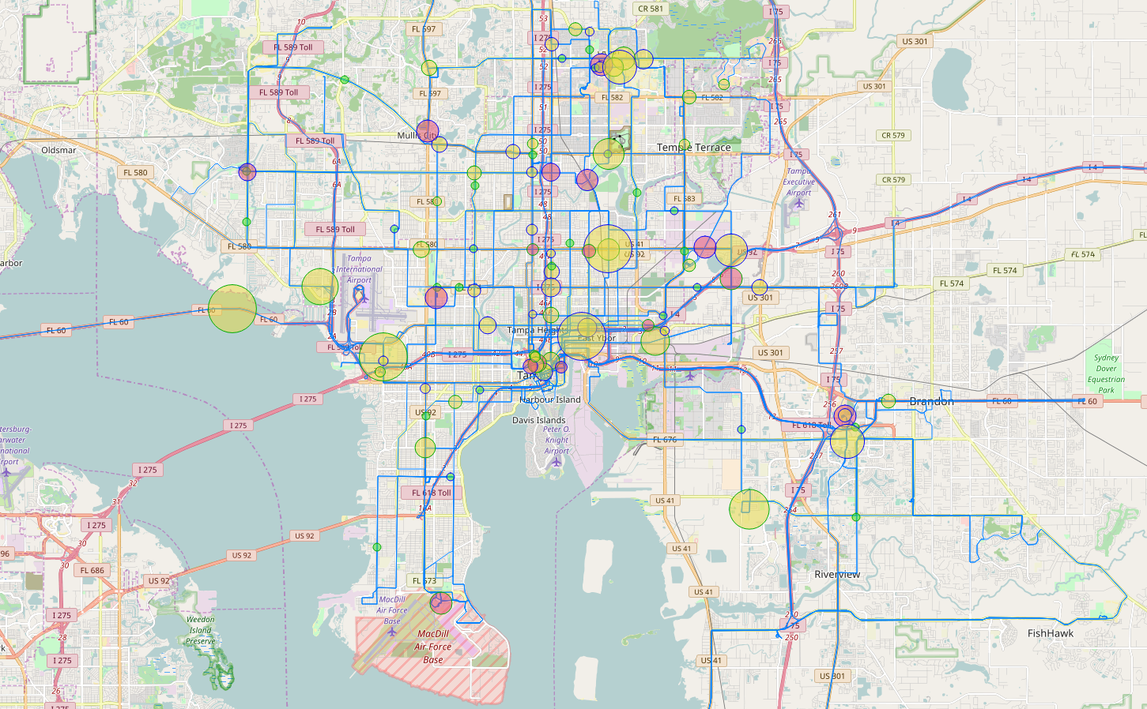
Transit Clock: Real-time Schedule Adherence

Slide 37
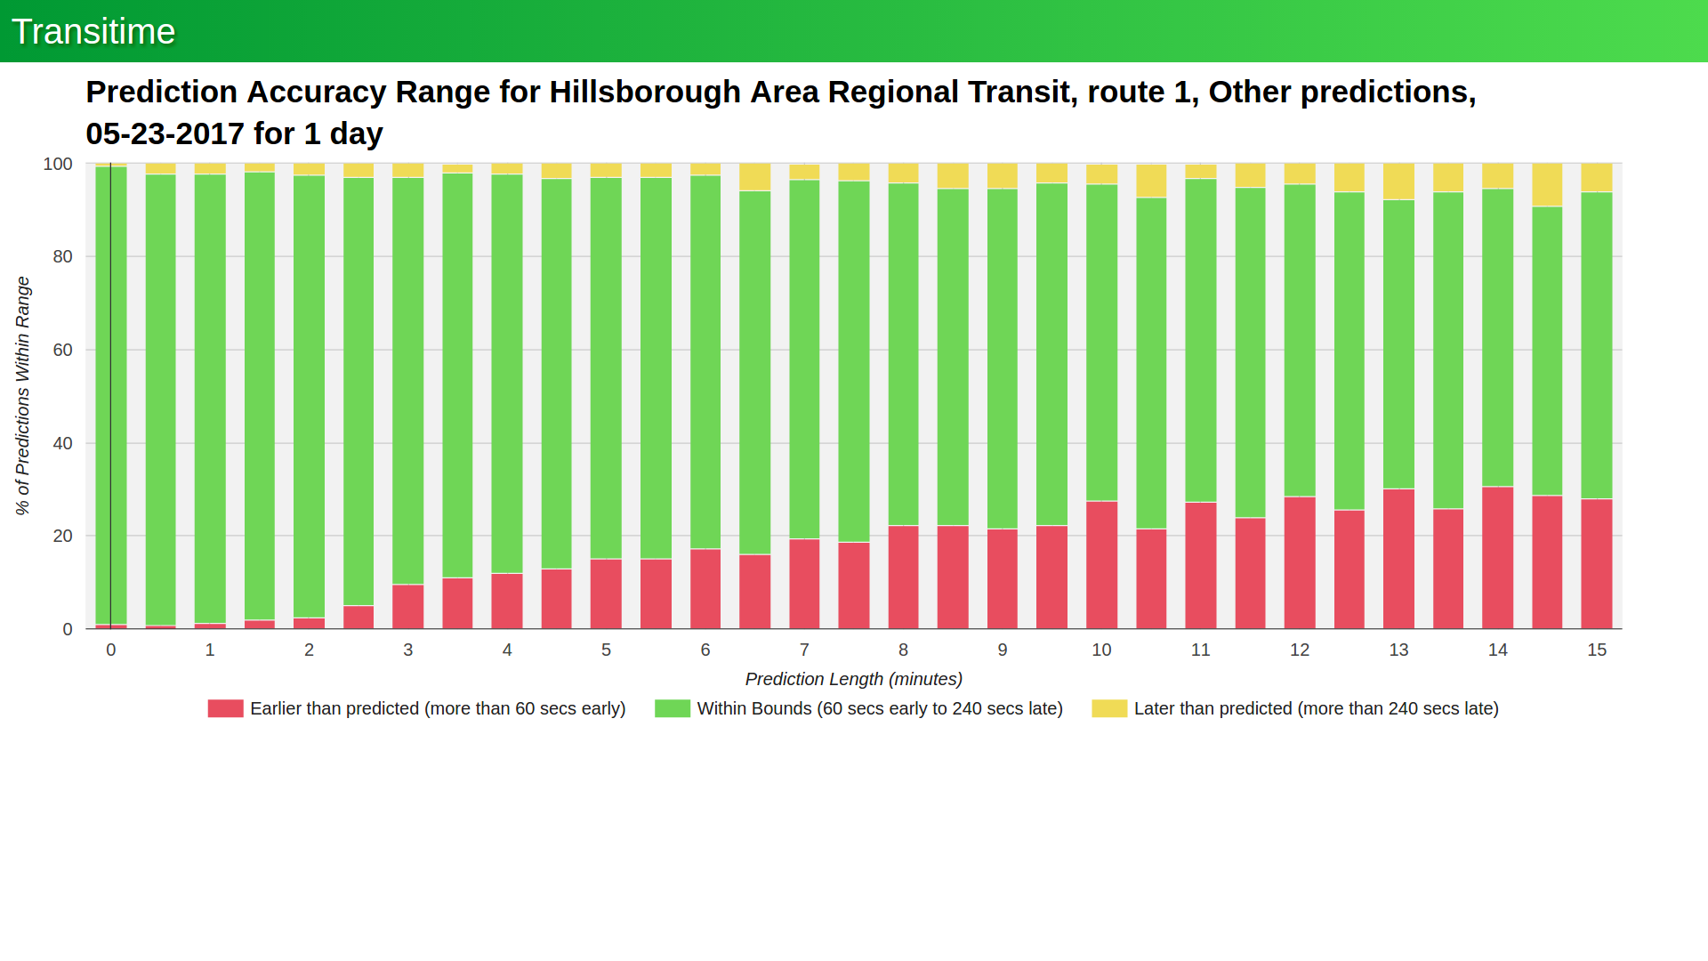
Transit Clock: Prediction Analysis
Notes:
Route 2 is

Slide 38
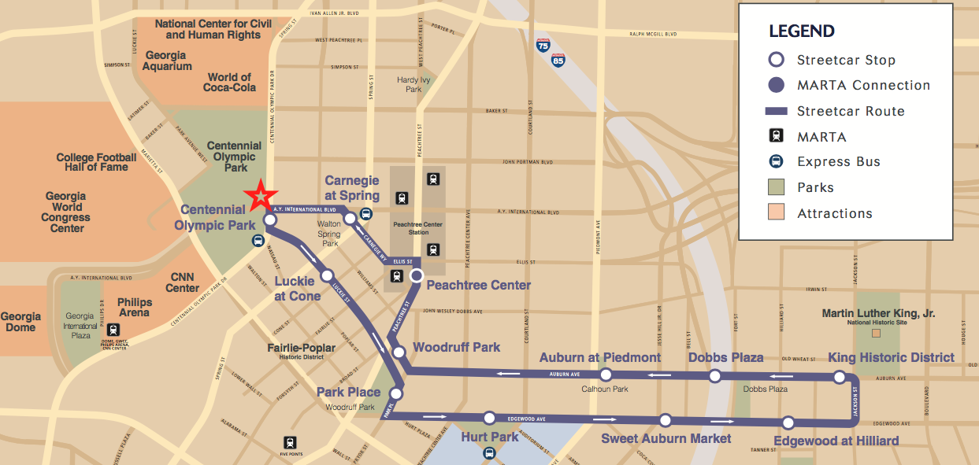
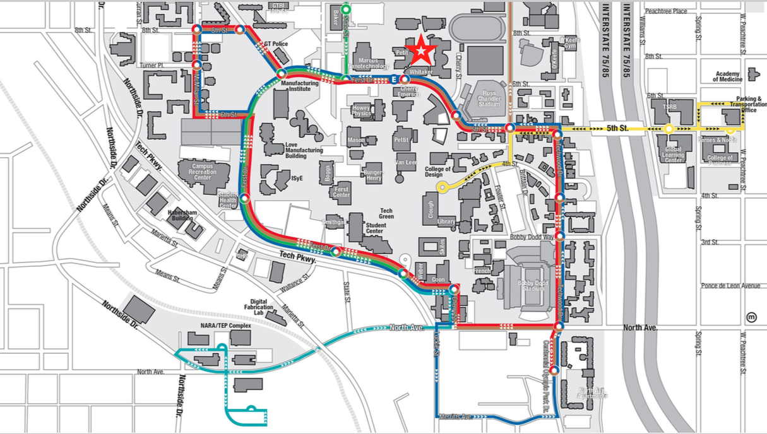
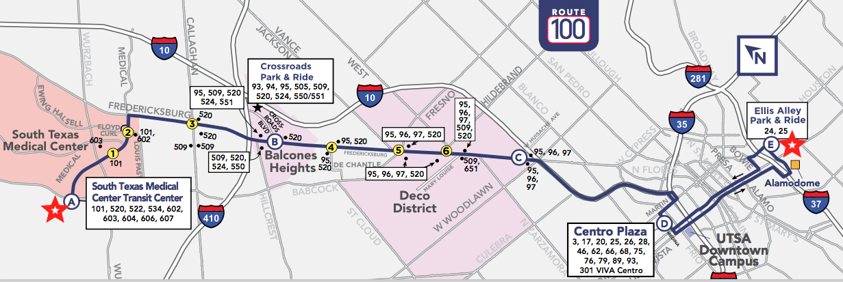
Transit Clock Trials on VIA, Atlanta Streetcar, GTech Trolley

Slide 39
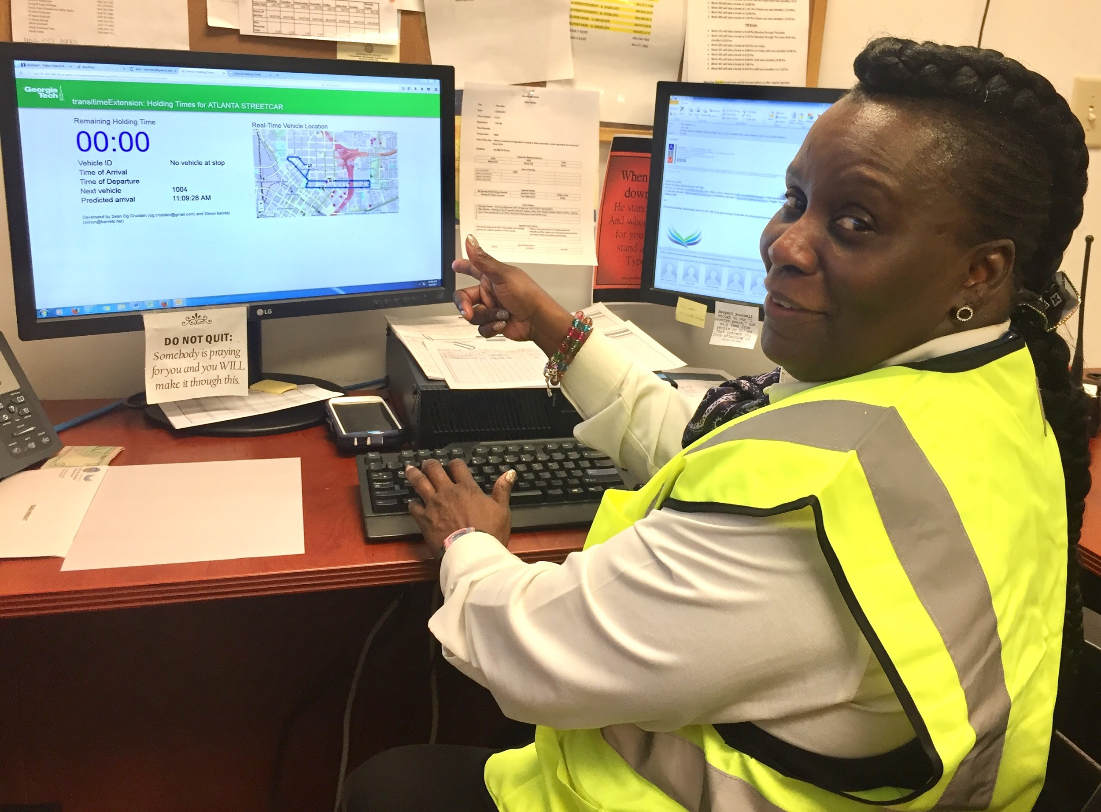
Transit Clock Trials on VIA, Atlanta Streetcar, GTech Trolley

Slide 40
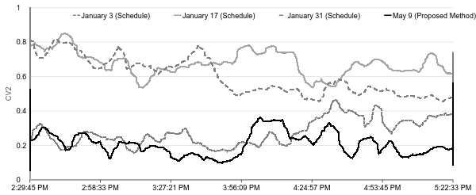
Transit Clock: Route Level Stability
Notes:
Headway Coecient of Variation (CV2) throughout the route between 2:30 and 5:30 under the schedule (January 3, 17, and 31) and under the proposed method (May 9).
Other methods were applied were applied at 4 controls points
Ours was applied at only 2 due to limited man power
If vehicles were equiped with tablets, we could get better results.

Slide 41
Shared Code = Open Source
Open source products exist in many spheres
WordPress blogging platform
Web browsers Mozilla and Firefox
Postgres, MySql, Tomcat.
Definition for open source:
“Software with source code that anyone can inspect, modify and enhance.”
Any agency can use without license fee and adapt for specific needs

Slide 42
Future of Public Transport
Transit as backbone of mobility
Spatial priority to transit mode
Well-connected accessible network
Up-to-date real-time personalized information

Slide 43
Transit must take the lead
Transit filled with civil servants and equity advocates being mindful of public resources
Public transit being called on to position itself for the future
Collective mobility is the backbone to future of transportation

Slide 44
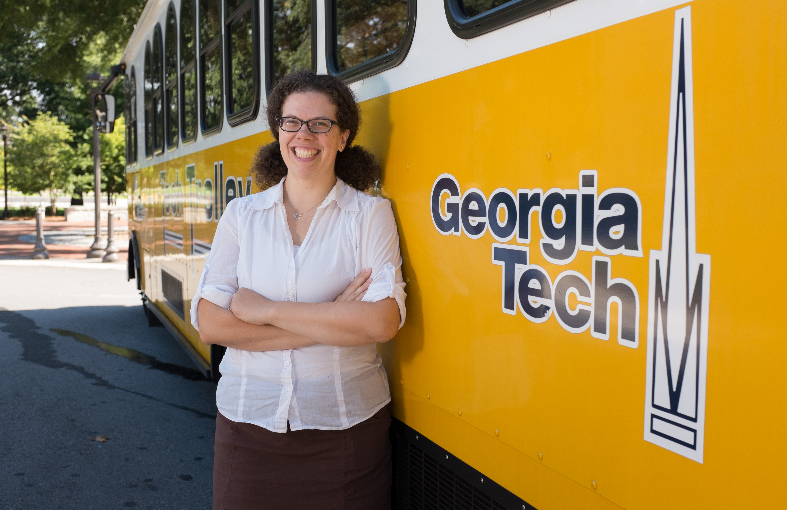
Thank You!
Dr. Kari Watkins
Frederick Law Olmsted Associate Professor
Civil & Environmental Engineering
kari.watkins@ce.gatech.edu
@transitmom

