Slide 1
Step to the Mic Effective Presentation Skills
Delana Glenn – Eno Facilitator

Slide 2
Presentation Skills Overview
Throughout your career you will be called upon to make presentations to staff, managers, executives, and constituents
With/without visuals or handouts
1 person/larger group
With advance notice/on the fly
to peers/to executives
How do you ensure a consistent, effective message no matter the circumstances
Presentation Skills
1. OUTCOME(S)
2. AUDIENCE
3. CONTENT
4. DELIVERY
5. PRACTICE

Slide 3
Talking Points
Today’s Session will cover;
Outcomes - What s your desired outcome(s), what do you want to accomplish with this presentation
Audience – Understand your Audience, preferred styles for receiving information
Content – selecting and organizing your content to make your case
Delivery - delivering the message so that the audience received and understands
Practice – practicing, rehearsing the presentation so there are no surprises
Business Pitch
Presentation Skills
1. OUTCOME(S)
2. AUDIENCE
3. CONTENT
4. DELIVERY
5. PRACTICE

Slide 4
Desired Outcomes
Start at the finish
At the end of our session today, participants will plan at least one improvement to an existing presentation
During EnoMAX week 4, participants will deliver an effective simulated Business Pitch
Presentation Skills
1. OUTCOME(S)
2. AUDIENCE
3. CONTENT
4. DELIVERY
5. PRACTICE
Notes:
Invitation/Request clearly
No destination meander/wander

Slide 5
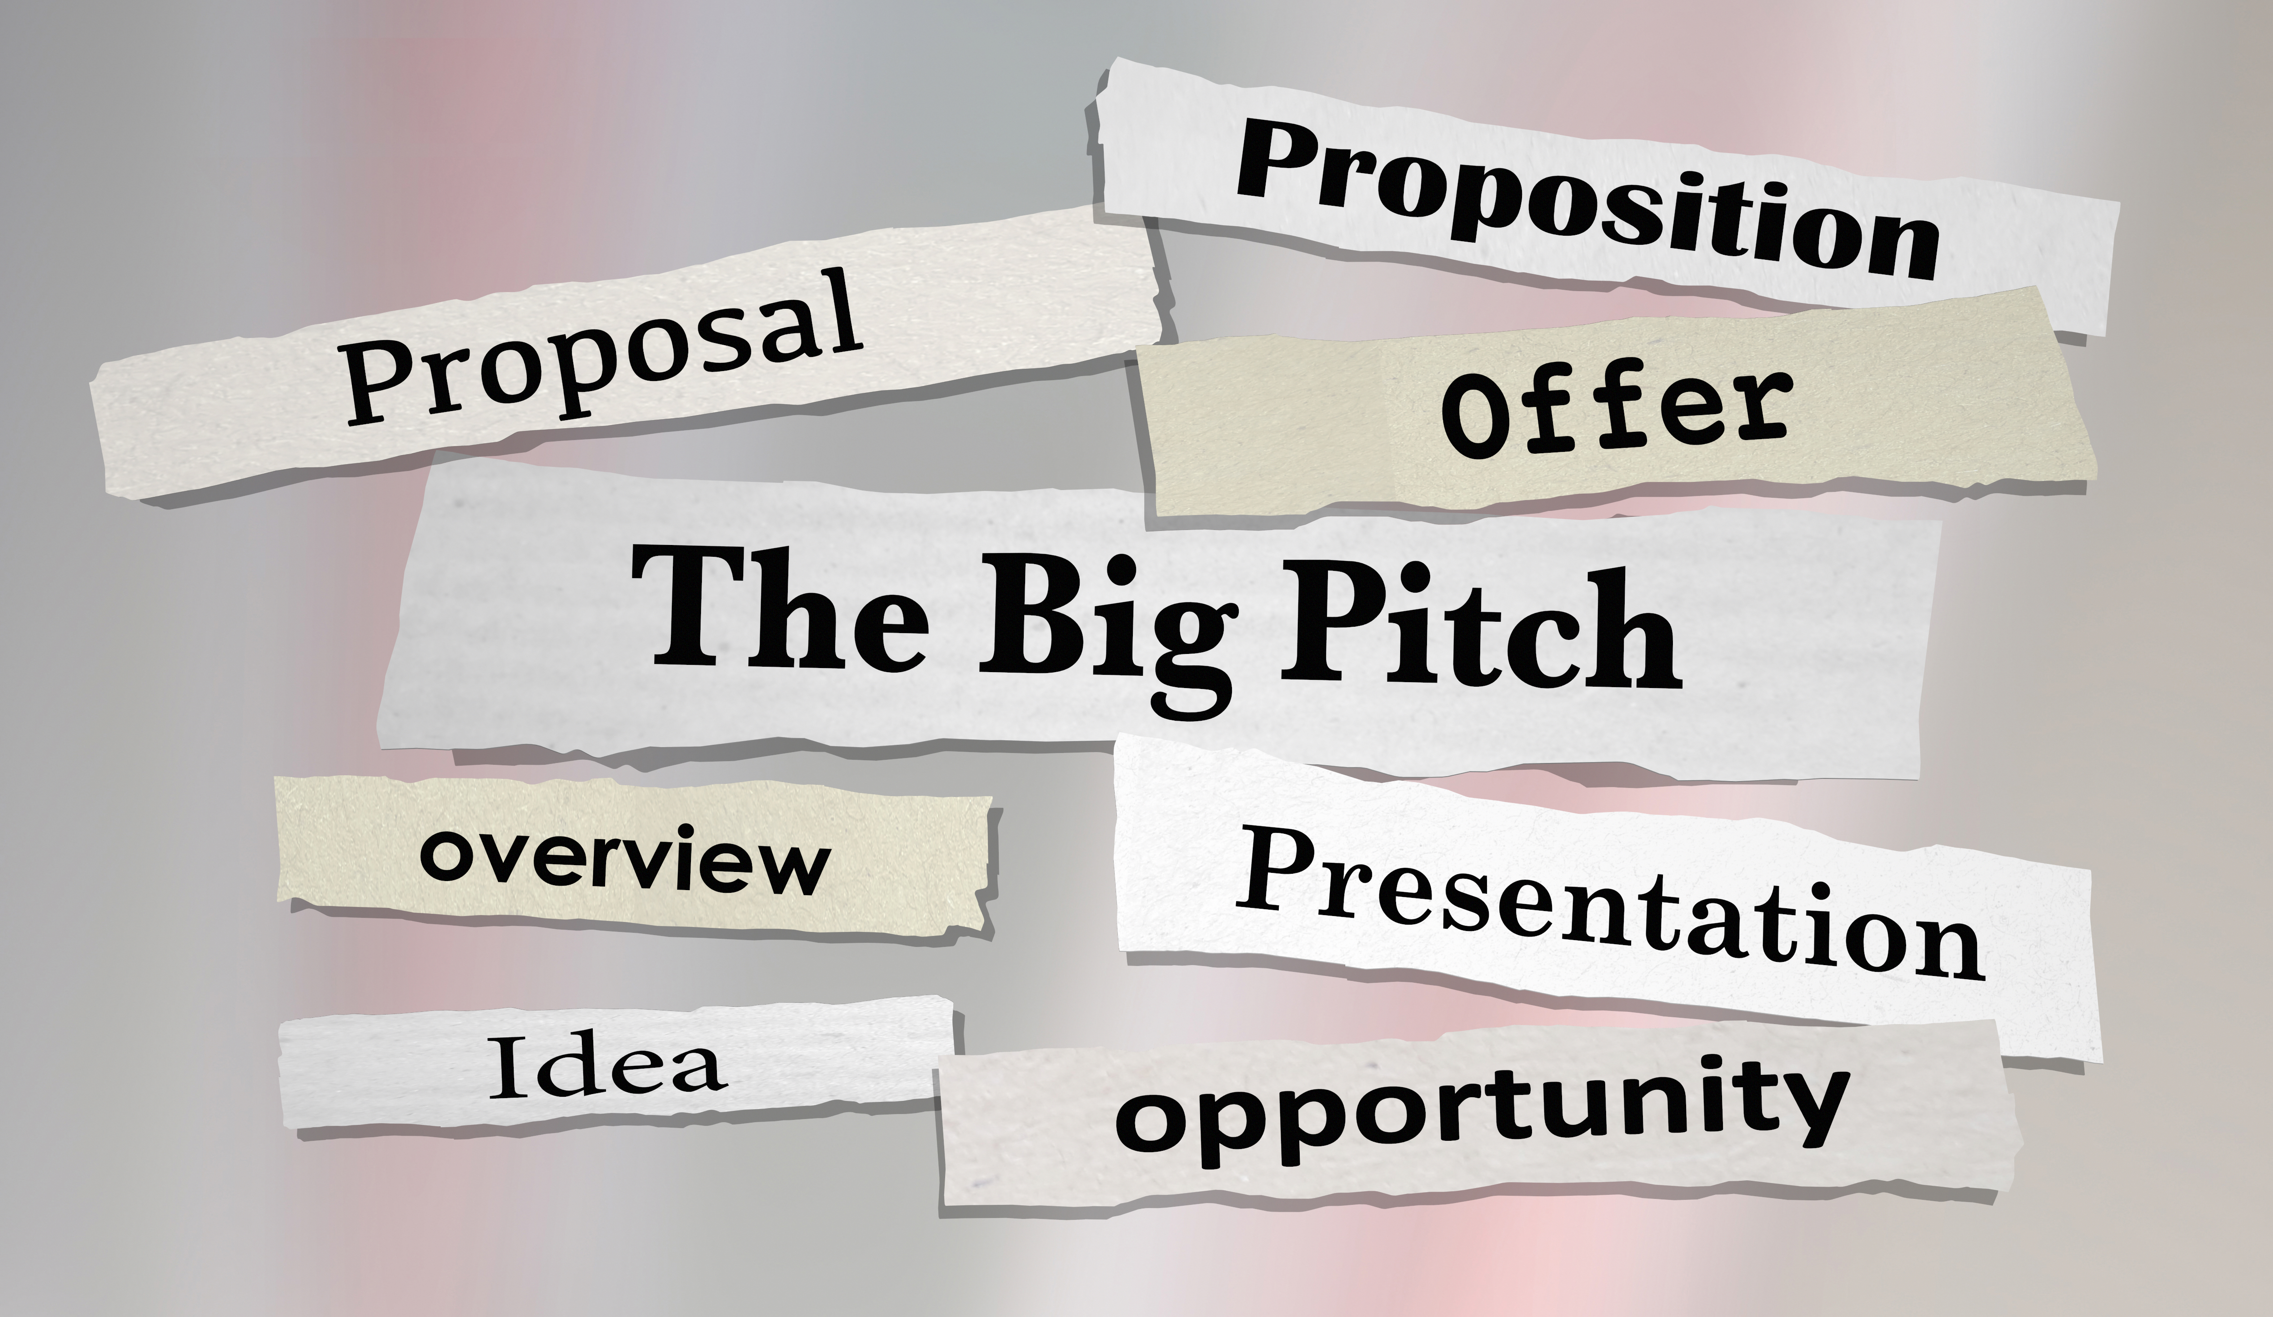
Desired Outcomes
Potential Outcomes
Educate
Decision
Entertain
Influence
Inform
Motivate
Persuade
Report
Presentation Skills
1. OUTCOME(S)
2. AUDIENCE
3. CONTENT
4. DELIVERY
5. PRACTICE

Slide 6
Know Your Audience
It is not all about ME
Who is your audience and stakeholder(s)
Adapt the story to the audience
Speak the language of the audience
An effective presentation makes the best use of the relationship between the presenter and the audience.
Presentation Skills
1. OUTCOME(S)
2. AUDIENCE
3. CONTENT
4. DELIVERY
5. PRACTICE

Slide 7
audience

Slide 8
Select Content
Tell ‘em ³
Tell them what you are going to tell them
Recommendation (which makes the status quo unappealing) to correct the Problem Statement, and Situational Analysis
Tell them
Situational Analysis (why the status quo is unappealing), List of Options (there are various ways we can fix it)
Tell them what you told them
This recommendation will correct the Problem Statement, better than any of the other options available and leave us with an appealing future
Rhetorical devices of Repetition and Storytelling
Presentation Skills
1. OUTCOME(S)
2. AUDIENCE
3. CONTENT
4. DELIVERY
5. PRACTICE

Slide 9
Selecting and Organizing Content
Select and Sequence information
Agenda
Historical
Chronological
Impact highest to lowest
Logical structure
Present (Status Quo is unappealing) ➤ New appealing Future (shiny new car)
Problem Statement
Opportunity Statement
Absenteeism
Overtime
Hiring
employees
Situational Analysis
Options
Attrition
YOY
Time to train
Status Quo
Hire 3/2 classes
Adjust jobs
Evaluate Options
Recommendations
Cost
Service
Overtime Reduction
Green Light
Presentation Skills
1. OUTCOME(S)
2. AUDIENCE
3. CONTENT
4. DELIVERY
5. PRACTICE

Slide 10
Selecting and Organizing Content
As you develop content stay focused on your desired outcome and your audience
Present (Status Quo is unappealing)
Cutting jobs, running trains with short crews, annulling trains, customer overcrowding, revenue not collected
New appealing Future (shiny new car)
Adequately staffed trains, customer satisfaction zooms, all revenue collected
Desired Outcome
Greenlight hiring of 3 Conductor and 2 Engineer classes
My Audience
CEO, Operations Vice President, Transportation Department Head, HR Department Head, Training Director
Content (Problem Statement)
There are not enough positions on the T&E Roster to cover all the existing Conductor and Engineer assignments because of increasing attrition, planned and unplanned absences. I want to accelerate 3 Conductor classes and 2 Engineer classes to start in the next 6 months.
Presentation Skills
1. OUTCOME(S)
2. AUDIENCE
3. CONTENT
4. DELIVERY
5. PRACTICE

Slide 11
Selecting and Organizing Content
The Survey Says…
People remember the first thing they hear
The last thing that is said
Sensory rich messages
recollection of sounds, tastes, smells and body feelings
People tend to forget numbers, names, details and sequences of events
unless they are visual
Presentation Skills
1. OUTCOME(S)
2. AUDIENCE
3. CONTENT
4. DELIVERY
5. PRACTICE

Slide 12
Delivering the Message
7 Things Steve Jobs Can Teach Us About Delivering a Powerful Presentation
Take a page from Jobs, who not only acted excited, but sprinkled in words like "cool" or "amazing", and once said "it looks pretty doggone gorgeous" with a huge smile after revealing a new iPhone.
Most speakers make the mistake of solely focusing on the topic ahead, and leaving their personality out of it. Like Jobs, you eventually want to exude passion from every pore instead. For some baby steps, you can include a few reasons you're so excited about something when presenting it. You shouldn't be afraid to be confident and say why you think your great product is so "amazing" or "awesome.”
(inc.com, May 6, 2016, Elle Kaplan)
Presentation Skills
1. OUTCOME(S)
2. AUDIENCE
3. CONTENT
4. DELIVERY
5. PRACTICE

Slide 13
Delivering the Message
Personal Style
Verbal Language
Body Language
Personality
Standing Still
Standing/Sitting
Managing the Environment
Set the room
Assign seats
Attire
Presentation Skills
1. OUTCOME(S)
2. AUDIENCE
3. CONTENT
4. DELIVERY
5. PRACTICE

Slide 14
Delivering the Message
Examples of Effective Speaking Tools
Tone of Voice
Cadence
Word Selection
Body Language
Hand Gestures
Posture
Movement
Facial Expressions
Breath
Passion translates and infects others
Presentation Skills
1. OUTCOME(S)
2. AUDIENCE
3. CONTENT
4. DELIVERY
5. PRACTICE

Slide 15
Delivering the Message
Anxiety and Fear
Fear of public speaking is very high on peoples lists of anxieties
Attitude is 90% of speaking
Most motivating emotion is enthusiasm so get excited
Think positive thoughts and imagine it’s over
Find your Comfort Zone
Practice makes perfect
During your presentation
Make sure to take breathes, don’t rush
Have water available, you may get dry mouth
Have handouts to read to break up talking
Wear your power colors to increase your confidence
Find a friendly face in the audience
Plan to RELAX
Presentation Skills
1. OUTCOME(S)
2. AUDIENCE
3. CONTENT
4. DELIVERY
5. PRACTICE

Slide 16
Putting it Together
Audience
Your audience assessment should include any information on how your audience members take in information
Content
People need visual and auditory cues to remember your messages
Delivery
Be comfortable with your personal style, body language, verbal language and environment
powerful storytelling, solid content, an emotional connection and obsessive preparation
Presentation Skills
1. OUTCOME(S)
2. AUDIENCE
3. CONTENT
4. DELIVERY
5. PRACTICE

Slide 17
Rehearsal
Look in a Mirror while practicing
Record your presentation and listen
Gather a small audience of family or friends
Get in front of the mic as much as possible
Presentation Skills
1. OUTCOME(S)
2. AUDIENCE
3. CONTENT
4. DELIVERY
5. PRACTICE

Slide 18
Business Pitch
The Business Pitch presentation simulation in Charlotte will be 5-7 minutes to a mock CEO, Eno staff member and your peers from your agency team. This is meant as practice. You will receive feedback on both the content and delivery of your Pitch.
Your actual Business Pitch to your CEO/Executive Team varies by Agency. Check with your facilitator for specific details.
Your Business Case Worksheet will provide both information and structure to your presentation.
Loose Format for Business Pitch
Start at the finish (Desired Outcome) - I am recommending that we implement this business solution and here is why…
Current state (problem statement and situation analysis) vs. Future state (proposed recommendation)
List all options considered - I looked at multiple ways to address this problem…
Briefly describe how you evaluated all options and criteria used - Evaluated each option for customer impact, operational feasibility and cost (both long and short) bought me to my final recommendation
Final Recommendation – The final recommendation is…
Brief description, Cost, Time to implement. Integration with operation, Customer benefit, Risks, Risk of not implementing
Ask - With your approval to proceed I can begin specification design meetings with appropriate departments and staff to target full implementation by date…
Presentation Skills
1. OUTCOME(S)
2. AUDIENCE
3. CONTENT
4. DELIVERY
5. PRACTICE

Slide 19
Business Pitch
Managing the Presentation
Set-up room before the presentation if at all possible
Timing
Don’t run out of time
Save time for questions
Be intentional about the order of your content
Start at the finish
Have your one page Executive Summary available as a take away
Spread attention (eye contact) around the room
Presentation Skills
1. OUTCOME(S)
2. AUDIENCE
3. CONTENT
4. DELIVERY
5. PRACTICE

Slide 20
Presentation Skills
1. OUTCOME(S)
2. AUDIENCE
3. CONTENT
4. DELIVERY
5. PRACTICE

Slide 21
Summary Outcomes
At the end of our session today, participants will plan at least one improvement to an existing presentation
During EnoMAX week 4, participants will deliver an effective simulated Business Pitch
Anyone have a new tool in their Presentation Tool Kit?
Presentation Skills
1. OUTCOME(S)
2. AUDIENCE
3. CONTENT
4. DELIVERY
5. PRACTICE

Slide 22
The Finish
Maybe not a Desired Outcome, but still an effective finish to the race, she won.
Presentation Skills
1. OUTCOME(S)
2. AUDIENCE
3. CONTENT
4. DELIVERY
5. PRACTICE

Slide 23
MIC DROP
Thank You

