Slide 1
MARTA’s Environmental Management System (EMS)
3 Years In…
And, Still Growing Strong

Slide 2
Executive Order 13148: “Greening the Government through Leadership in Environmental Management”
Signed by President Bill Clinton April 21, 2000
Implementation of EMS is mandated in EO 13148
FTA began offering training for Transit agencies in 2012

Slide 3
Why MARTA Based our EMS Program on ISO 14001:2015
Internationally agreed standard that sets out the requirements for EMS
Helps organizations improve their environmental performance through a systematic approach
More efficient use of resources and reduction of waste

Slide 4
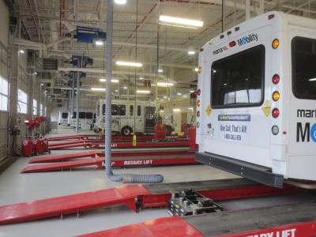
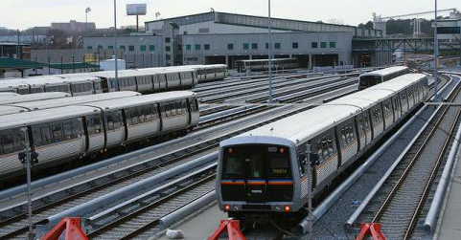
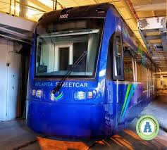
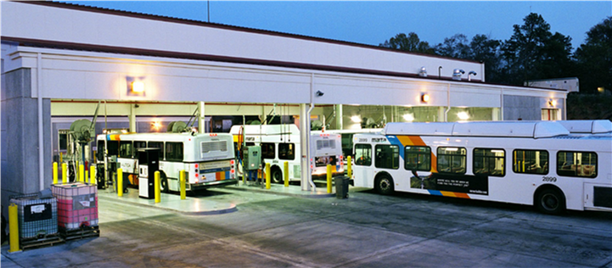
ISO 14001:2015 Certified Facilities
Headquarters
Armour Yard
Laredo
Brady Mobility
South Yard
IOC
Streetcar

Slide 5
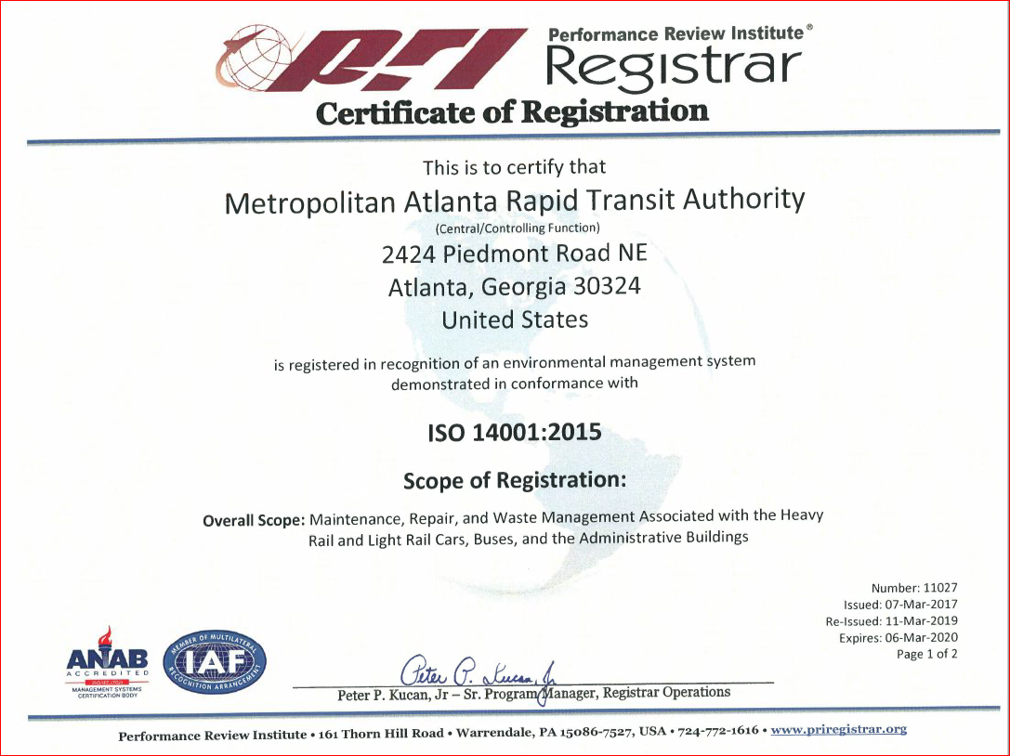
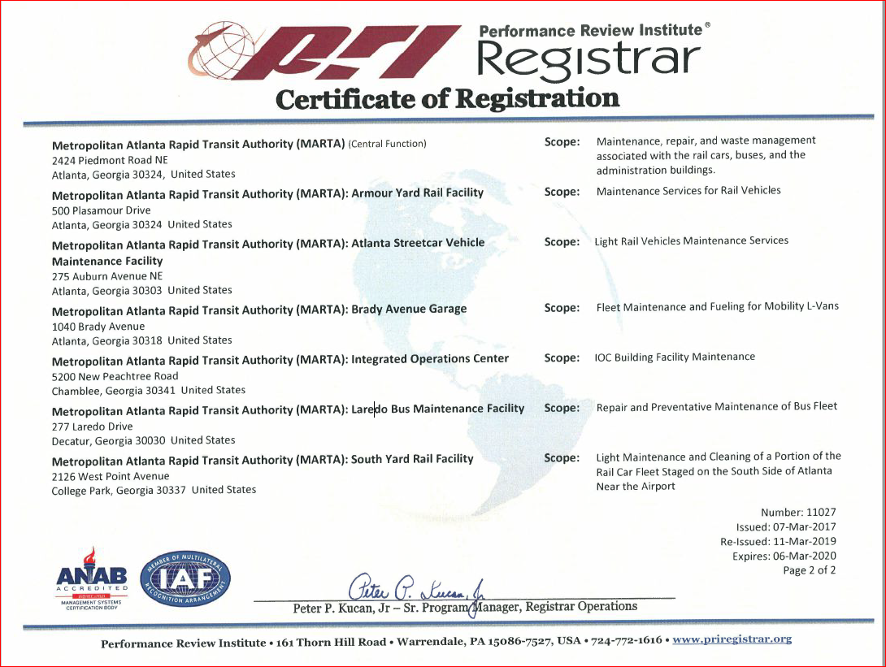
We are nationally recognized as one of the first transit agencies to be a ISO 14001:2015 certified multi-site organization.

Slide 6
Environmental Management System
ISO 14001:2015 Framework

Slide 7
MARTA’s Environmental Policy

Slide 8
Components of an EMS
Oversee compliance requirements
Manage Environmental risks
(financial, public, & legal)
Avoid costs / fines associate with legal requirements
Ensure environmental stewardship and sustainability
Identify and mitigate impacts to the environment
Manage our waste cradle to grave
Communicate requirements among all departments and management levels
Educate MARTA staff and contractors

Slide 9
EMS External Initiatives
APTA established an EMS Working Group in January 2019 (Sustainability sub-committee)
MARTA EMS Program Manager is serving as the Chair
Members from transit agencies across North America

Slide 10
Thank You

