Slide 1

Energy Savings
Performance Contract
June 2019
Notes:
Update on the progress of our ESCO project.

Slide 2
Case for Change
MARTA has improved its financial performance and realized cost savings in many areas
However;
Internal infrastructure upgrades compete with modernization of core business operations
Execution of multiple projects can be very expensive and long
Notes:
Cost savings – fewer paper checks with more direct deposits;

Slide 3
Energy Savings
Performance Contract
An ESPC is a contract between an agency and an energy service company (ESCO)
Public agencies can procure energy and water savings, renewable energy solutions and facility improvements with no up-front capital costs
ESPC streamlines multiple projects into one to gain efficiencies in cost and schedule
MARTA’s ESPC was developed as a tax-exempt capital lease agreement
Notes:
The cycle on the right side is a general explanation of how the cost and payments work. Since we are a tax exempt agency we will perform just a little differently. Instead of the ESCO being the borrower, MARTA will be the borrower.
a comprehensive EPC project results in roughly a 20% reduction in energy use/costs and lasts approximately 17 years

Slide 4
A tax-exempt capital lease is a simple transaction conducted between 3 parties . . .
MARTA
1
Lease/Purchase
Agreement
Rental
Payments
Use Of Leased Property
With Option to Purchase
Vendor(s)
3
1
Lender
2
MARTA & Lender enter into a separate lease-purchase agreement
Lender pays Vendor(s)
MARTA pays Lender over the finance term
With MARTA as the borrower, lower cost tax-exempt financing is available.
Notes:
MARTA will enter into a tax-exempt lease purchase agreement with the lender. Project costs are paid out to vendors during the implementation period by the lender once MARTA signs off on completion of construction milestones. After construction completion MARTA will make installment payments to the lender which will be less than or equal to the project’s savings. This method is a common public sector financing alternative that allows repayment from operating expense dollars rather than capital expense dollars. More specifically, this type of financing mechanism allows MARTA to draw on dollars saved from future utility bills to pay for new, energy efficient equipment today.

Slide 5
ESPC Contracting Process
Dec 2015
Owner decides to utilize ESPC for energy efficiency project
Complete energy system survey
Assess program viability
Owner develops Request for Proposal (RFP) for ESCO selection, evaluates proposals and selects ESCO
Develop & issue RFP
Pre-bid walkthrough
Owner issues contract to ESCO to conduct investment grade energy audit (IGEA) and develop implementation proposal
Negotiate IGEA and project development agreement with ESCO
Finalize ESPC Contract and arrange financing
Review bids and select
Baseline utility bills
Perform Facility audit
Review IGA & implementation proposal and select ECMs to implement
Negotiate contract
Final Implementation Plan
Secure financing
Issue ESPC Contract to ESCO
Implement Energy Conservation measures (ECMs) and monitor success through Measurement and Verification (M&V)
Install ECMs
Independently Commission installation
Monitor systems either through ESCO & independently verify
Feb
2016
Feb 2016
Dec 2016
Dec 2016
Aug 2017
Aug 2017
Mar 2018
Mar 2018
Aug 2020
Notes:
Two-part approval process: audit and construction:
Dec. 2016 - Received Board approval to enter in a contract with an ESCO to conduct an audit (Audit Approval)
Feb. 2017 - Began an authority-wide, comprehensive audit to identify savings opportunities
Oct. 2017 – Board awarded a full energy savings performance contract for construction (Construction Project Approval)
Nov. 2017 – Entered into a tax exempt lease agreement with Pinnacle Public Financing, inc.
April 2018 – Issued a contract to Schneider for final design and construction
Currently developing systems drawings and other administrative submittals to begin work in the next couple months

Slide 6
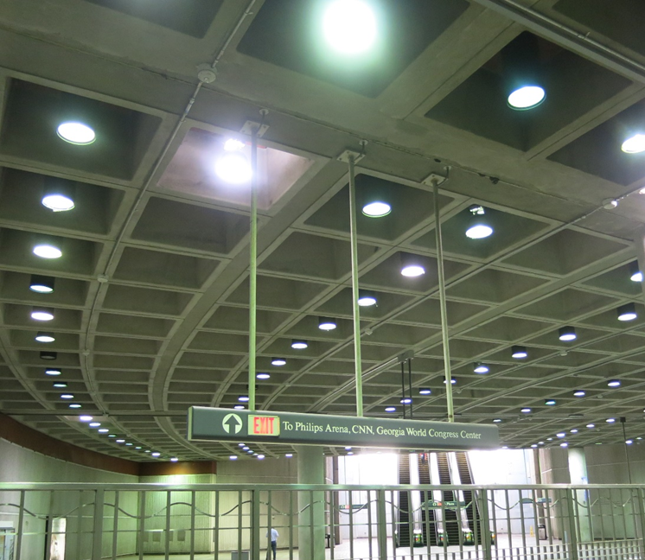
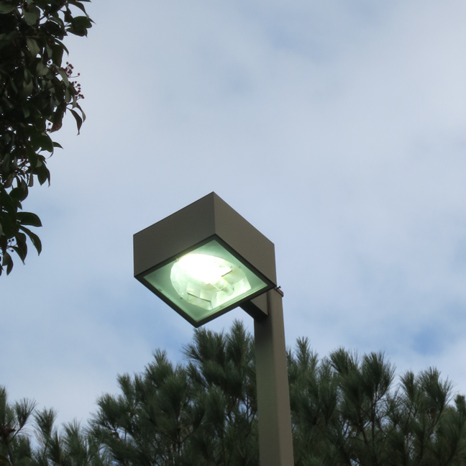
Energy System Survey
Metal halide lights
Exterior lights on in daylight
Notes:
Conducted walkthrough facility audit of sampling of facilities and initial utility baseline in DEC 2015
Spend $16 million a year in utility expenses, (mostly electric 92%)
Identified 67 potential energy and water conservation measures
Estimate $23 million project for facility ECMs
Lighting $12M
HVAC, Fans & Building Energy System Controls $6M
Escalators $4M
Water efficiency and others $1M
Additional $13M in Solar PV with Roof Rehabilitation
Potential savings estimate of $5.8M a year - a simple payback of 6 year
Estimated of what may be …..Lighting $12M
Opportunity: Retrofit with LED at Dome Station
Exterior lights on at 2:30 PM; Arts Center Station: Exterior lights on in daylight Opportunity: Photocell control
Lights on in unoccupied storage rooms
; opportunity for occupancy sensor

Slide 7
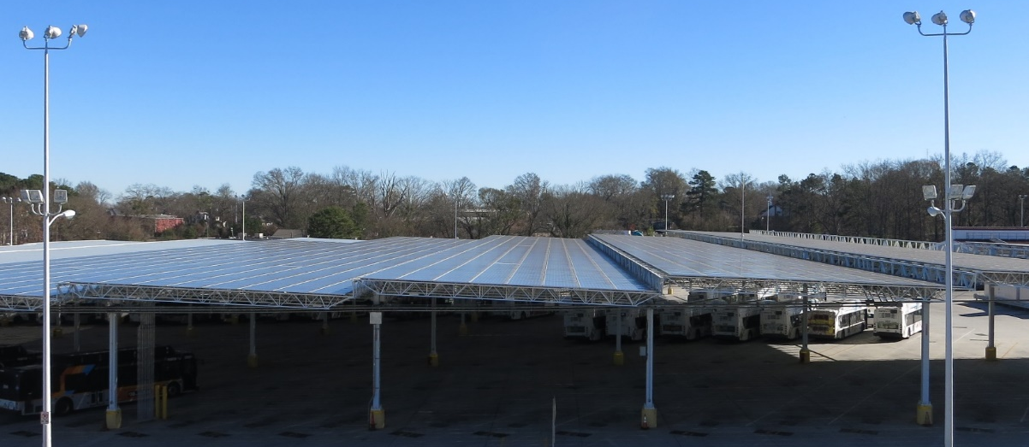
Energy System Survey
1,200 kW solar canopy at Laredo Bus Facility
Notes:
Opportunity: Solar PV rooftop array at other buildings
Additional $13M in Solar PV with Roof Rehabilitation
Currently, the major contributor to MARTA’s renewable energy is the solar PV parking canopy at the Laredo Bus Garage. This large 1.2 megawatt (MW) solar array was funded in 2009 and installed in 2011 and consists of over 4,800 panels. The shaded parking structure provides an added benefit of reduced idling time needed for drivers to cool the buses prior to running routes.
The solar panels at Laredo are currently only occupying half of the parking structure that was installed, meaning that adding additional capacity would be more cost effective on a $/watt basis than installing a new system where the mounting structure would add to the total cost. However, the system is already providing almost 3 times the amount of power that is required by the facility itself during the day. As a Qualifying Facility (QF) for Georgia Power, the excess power generated beyond what the building needs is sold back at a very low rate of $0.03-$0.04/kWh (varies), which is the avoided cost for the utility. In contrast, power for this site is purchased (on the RTP Day Ahead/Power & Light rate) at a blended rate of about $0.077/kWh. With the real-time pricing rate at Laredo, the cost per kWh when solar is at peak production is actually even higher. Therefore, expanding the production capacity at Laredo is not the most cost effective long term solution for additional solar production unless a different buy-back rate could be negotiated.
A better option would be to install a new system at a site where 100% of the energy produced goes towards offsetting the electric bill each month.

Slide 8
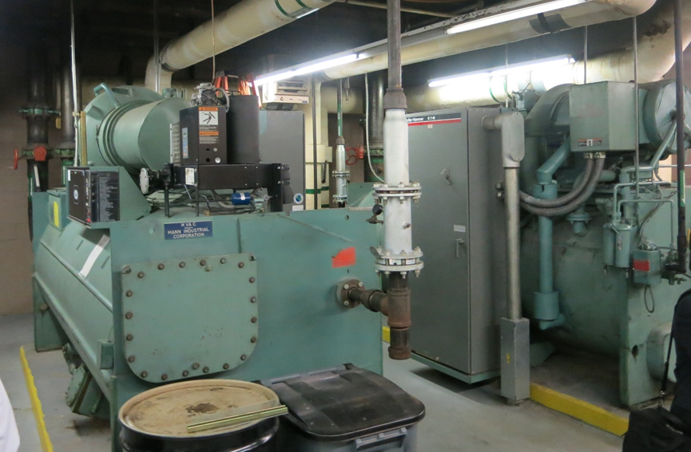
Energy System Survey
Chillers are at end of their useful life
Notes:
HVAC, Fans & Building Energy System Controls $6M
Opportunity: Retrofit with high efficiency chiller

Slide 9
ESPC Contracting Process
Dec 2015
Owner decides to utilize ESPC for energy efficiency project
Complete energy system survey
Assess program viability
Owner develops Request for Proposal (RFP) for ESCO selection, evaluates proposals and selects ESCO
Develop & issue RFP
Pre-bid walkthrough
Owner issues contract to ESCO to conduct investment grade energy audit (IGEA) and develop implementation proposal
Negotiate IGEA and project development agreement with ESCO
Finalize ESPC Contract and arrange financing
Review bids and select
Baseline utility bills
Perform Facility audit
Review IGA & implementation proposal and select ECMs to implement
Negotiate contract
Final Implementation Plan
Secure financing
Issue ESPC Contract to ESCO
Implement Energy Conservation measures (ECMs) and monitor success through Measurement and Verification (M&V)
Install ECMs
Independently Commission installation
Monitor systems either through ESCO & independently verify
Feb
2016
Feb 2016
Dec 2016
Dec 2016
Aug 2017
Aug 2017
Mar 2018
Mar 2018
Aug 2020
Notes:
Two-part approval process: audit and construction:
Dec. 2016 - Received Board approval to enter in a contract with an ESCO to conduct an audit (Audit Approval)
Feb. 2017 - Began an authority-wide, comprehensive audit to identify savings opportunities
Oct. 2017 – Board awarded a full energy savings performance contract for construction (Construction Project Approval)
Nov. 2017 – Entered into a tax exempt lease agreement with Pinnacle Public Financing, inc.
April 2018 – Issued a contract to Schneider for final design and construction
Currently developing systems drawings and other administrative submittals to begin work in the next couple months

Slide 10


Investment Grade Audit Results
Older, high-flow domestic water fixtures
Older, high-flow domestic water fixtures
Aging, inefficient lighting systems
Hot spots in HQ Data Center
Hot spots in HQ Data Center
HVAC systems near end of useful life
HVAC systems near end of useful life
Heating and cooling difficult to optimize = poor occupant comfort
Heating and cooling difficult to optimize = poor occupant comfort
Notes:
Aging, inefficient lighting systems
HVAC systems at end of useful life
Lack of a common, centralized Building Automation System (BAS) to manage HVAC equipment across large support facilities effectively
Inefficient high-flow domestic water fixtures
HQ Data Center experiences hot spots and issues with cooling
Regenerative braking energy lost in the rail system

Slide 11
Energy & Water Conservation Measures Considered, not Implemented
Data Center Upgrades
Traction Power Energy Recovery System
Renewable Energy - Solar Photovoltaic (PV) Arrays
On-Demand NEW Cleaning Chemical Generation
Non-Chemical and High Efficiency Cooling Tower Treatment
Notes:
Data Center:
IT operations consume ever increasing amounts of energy as we adopt more and more technology. Advances in components and design have led to much smaller footprints and space required to house the equipment. This results in rooms with small areas of high density heat rejection requirements. Often the low-density areas are over-cooled and the high-density areas are under-cooled. In addition, the density variations often result in much of the cooling air bypassing the cooling load and mixing with the hot air in the return path to the cooling units, resulting in low operating efficiency and extra costs.
The proposed upgrades to the data center on the 5th floor of the Headquarters building are designed to improve the air flow around critical server equipment, reducing hot spots and increasing the lifespan of the equipment, as well as significantly reducing the energy consumption and utility costs associated with cooling these critical systems.
ERS:
As MARTA’s largest consumer of electric energy, the rail system is being investigated for savings potential. There is interest in improving the efficiency of the rail system through an energy recovery system to capture additional power from the regenerative braking of the trains. Currently, the older energy recovery technology that is in place involves linking all substation catenaries to allow the regenerative power to flow directly to other trains present on the rail system. Because the catenaries of all substations are linked, the energy recovery is limited and depends on:
1) Physical size of the rail network
2) Density of trains on the rail system at a given time
3) Train schedules, or frequency
This type of system limits how much of the regenerative braking energy from one train can be re-used by nearby accelerating or cruising trains due to the effective distance between them. A significant amount of this energy is currently being dissipated along the rail when there isn’t a train close enough to use it. Current estimates indicate that the current system can only recover up to 50% of the braking energy. It is likely that only 40-45% is currently being recovered.
PV Arrays:
MARTA has expressed interest in continuing to invest in renewable energy solutions throughout the system. On-site solar photovoltaic (PV) power generation is an alternative answer to the increasing demand for purchased energy. Moreover, solar PV uses a clean renewable energy source without emission impact on the environment. Most of Georgia ranks in the middle of solar power production potential in the US. In addition to offsetting electrical costs, solar panels provide clear market identification as an entity promoting good environmental stewardship. These items are very difficult to quantify; however, they provide significant value to the overall organizational image.
Several locations were considered for a new solar PV array, including rail stations with large open parking lots, bus garage facilities with large parking areas, as well as headquarters and general maintenance sites. The rail stations were excluded because they are powered from the large totalized Traction Power electric account
NEW:
Neutral Electrolyzed Water: Sustainable, cost-effective commercial cleaning chemical production is centered on the production of Neutral Electrolyzed Water (NEW). NEW is generated through the electrochemical reaction between salt, water, and electricity. NEW has been proven to be non-toxic, non-corrosive, organic, ecologically and environmentally friendly, and more effective than traditional sanitizers and chemical cleaning products.
On-Demand On-Site NEW Generators: NEW generators enable facilities to eliminate the need to purchase toxic cleaning chemicals, reduce chemical transportation requirements, and improve a facility’s health and safety. NEW generators create two chemical streams from salt, water, and electricity. The first solution produces a pH neutral, high ORP (Oxidation Reduction Potential) sanitizer which is proven to be more effective than traditional sanitizers such as sodium hypochlorite. The second solution produces a high pH, low ORP chemical degreaser and surface cleaner. Both chemical streams are non-toxic, non-corrosive, and more cost efficient than traditional cleaning solutions.
Cooling Tower Treatment:
Cooling Tower Water Treatment: Cooling towers create an environment where air and coolant water are in direct contact and evaporative cooling can take place. This process uses the same water repeatedly to generate cooling and as the water evaporates and the cooling water becomes more concentrated with minerals and debris, the water is drained into the sewer. Because cooling tower water is exposed to the environment, it can become a breeding ground for bacteria and microorganisms. Also, after several cycles of concentration, the coolant water can become scale forming and damage plumbing and mechanical equipment. Water treatment for cooling towers such as the one recently replaced at Headquarters is vital in preventing mechanical corrosion and damage, increasing cooling efficiency, and controlling biological growth.
Non-Chemical and High Efficiency Cooling Tower Treatment: Various nonchemical and on-site generation water treatment solutions provide increased cycles of concentration, allowing for significant water savings, constant water chemistry monitoring, increased cooling tower performance and efficiency, and a reduction in chemical costs. These water treatment systems involve a wide array of electrochemical water treatment technologies and several on-site chemical generators commonly used in other water treatment industries such as commercial pool and aquatic water treatment and commercial agriculture. Non-chemical and high efficiency water treatment solutions can be developed and incorporated into a turnkey water treatment program to greatly reduce utility usage within a HVAC water treatment program and prevent large volumes of toxic chemicals from entering the environment.
This measure has been excluded due to the hardness of the water used for makeup for the cooling tower at Headquarters and the annual expense of the existing chemical water treatment. This measure is not expected to be as effective at eliminating the water treatment chemicals as it would in other areas with harder water. In addition, the monthly water treatment chemical costs at Headquarters and the Annex combined were determined to be $383 through Claude Paul Chemicals. The return on investment for this measure was not beneficial to the project, nor did it allow for all chemical water treatment to be eliminated due to the Annex being excluded from this project.

Slide 12
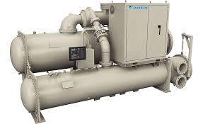
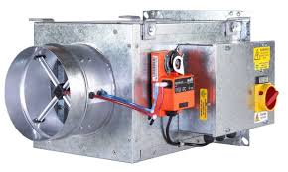
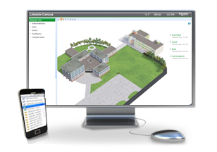
Energy and Water Conservation Measures Adopted
Electric sub-meters
21 Rail Stations
Mechanical system upgrades
4 Rail Stations
12 Support Facilities
11 Train Control Rooms
LED lighting upgrades
38 Rail Stations
17 Support Facilities
15 Gap Breaker Stations
24 Traction Power Substations
Water conservation measures
15 Support Facilities
Building Automation System
14 Support Facilities
Notes:
MARTA has chosen to implement 5 different energy and water conservation measures as part of the ESCO project.
LED lighting upgrades will improve the look of facilities, reduce replacement intervals and increase safety while significantly reducing energy. (38 Rail Stations, 17 Support Facilities, 15 Gap Breaker Stations, 24 Traction Power Substations ).
Lighting retrofit savings are based on the pre- and post- system wattages, along with the assumed lighting run hours. A 5% burnout rate was applied to the existing fixture wattage.
Mechanical system upgrades include replacing chillers, air handling unit units, and pumps with more efficient, reliable technology to improve comfort, air quality, and controllability. (4 Rail Stations,12 Support Facilities, 11 Train Control Rooms)
Mechanical equipment replacement savings are driven by an improvement in cooling efficiency
New low-flow domestic water fixtures will conserve water and prevent vandalism. (38 Rail Stations,15 Support Facilities)
Water retrofit savings for toilets and faucets are based on number of uses per year for each fixture type, the number of minutes used per person for faucets and showers, and the water and thermal energy saved from using less water.
A Building Automation System (BAS) will control HVAC schedules and temperatures for multiple support facilities from a single centralized system. (14 Support Facilities)
Building automation system controls will allow equipment to shut down or setback temperature setpoints during off hours. Other energy saving control strategies can also be programmed.
Electric sub-meters at facilities and rail yards will allow more accurate monitoring of consumption and identify underperforming facilities. (21 Rail Stations)

Slide 13
Investment Grade Audit Results
Notes:
Schneider Electric’s Certified Energy Managers conducted an Investment Grade Audit at 13 support facilities, 38 rail stations, 9 parking garages and 37 rail support buildings, totaling almost 7.9M square feet. The annual utility expenditures for electricity, natural gas, and water services at the facilities for the last three years are shown here. Traction Power account makes up 76% of the overall costs for the MARTA sites audited.
The “activities” in the utility baseline costs include lighting, heating and air conditioning, and fan systems as well as domestic water consumption. The consumption “trend" has stayed fairly consistent for the past 5 years. Cost has actually gone down some on the electricity and gas as those rates have gone down a bit. The water rate is rising; so we see a rising cost trend there.
The annual utility costs have been estimated with a 3% escalation rate included in the calculations.

Slide 14
Financial Overview
Project Savings
13.5%
Reduction in energy expenditures
$3,784,975
Projected annual cost savings
(Energy + O&M)
$64.3 Million
Total savings impact over a 17 years
Project Value
$36.2 Million
Funding Mechanisms
Tax Exempt Lease Purchase
19 year loan through a lease purchase @ 2.92%
Notes:
Annual Estimated Savings:
$ 2,065,606 (Buildings Energy) +
$ 1,719,369 (annualized O&M Savings) =
Total projected average annual savings = $3,784,975
(Annualized – year to year the number will be diff.)
Project value is the cost of the implementation (materials and labor) = $36,167.998.00

Slide 15
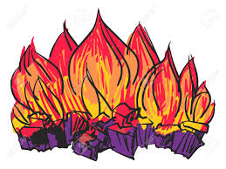

Financial and Environmental Impacts
This project will ultimately lower utility costs by over 13.5%, address deferred maintenance and improve occupancy comfort while offsetting costs with over $64 Million in projected savings!
The projected annual energy savings of $3.8M is equal to
3,787 passenger vehicles removed from the road per year
OR
19,134,597 pounds of coal burned per year

Slide 16
Project Accomplishments
  Sustainability Goals Supported
  Substantial reduction in operating costs
  Reduce MARTA environmental impact
  Operations Goals Supported
  Improve reliability of systems
  Upgrade aging equipment
  Improve operations visibility into remote systems
  Financial Goals Supported
  Improvements made on a budget friendly basis
  Future repair and replacement costs averted

Slide 17
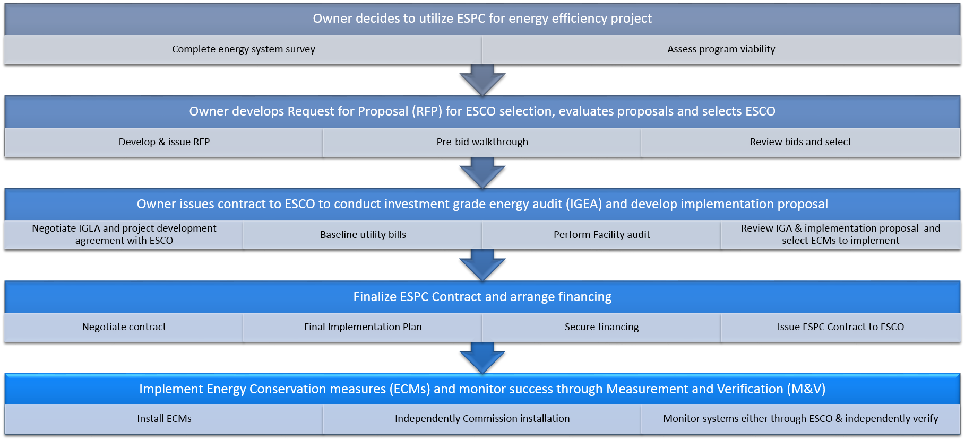
CURRENT STATE
Notes:
Commissioning – equipment testing and start up

Slide 18
Thank you

