Slide 1

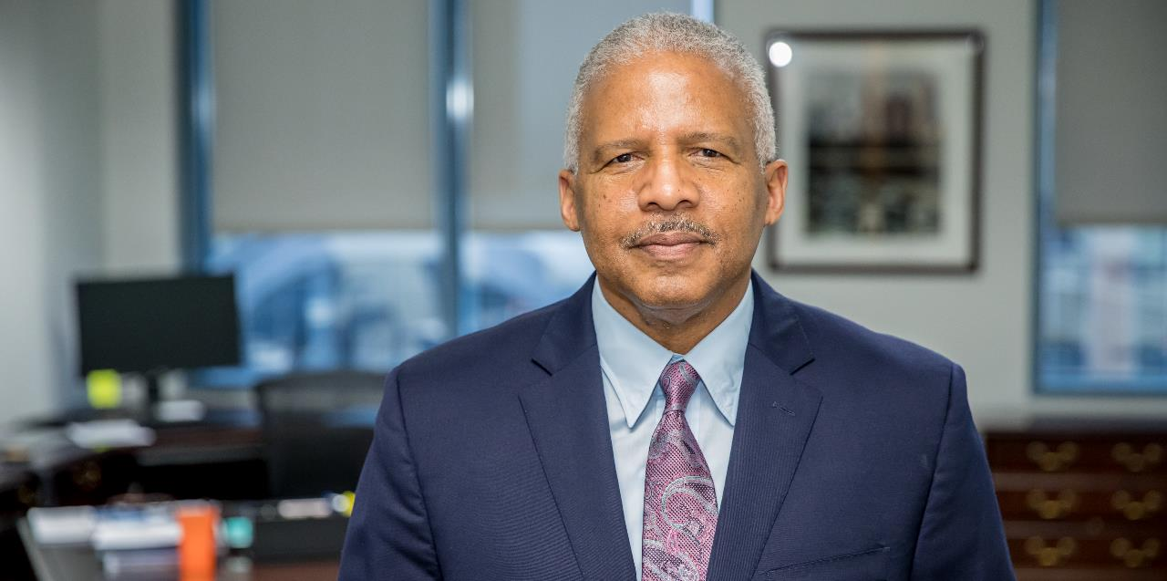

Multi-Agency exchange Program (MAX)
Franklin Rucker, Chief of Capital Programs, Expansion, and Innovation

Slide 2

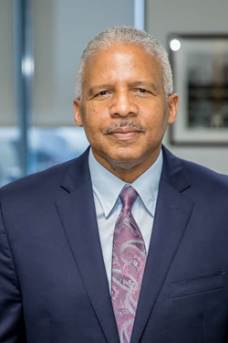

About Frank Rucker
Professional engineer with 37 years of experience
  Assistant General Manager/Program Executive, Hartsfield-Jackson International Airport
  Deputy Program Manager for the expansion of the Abu Dhabi International Airport in the United Arab Emirates
Joined MARTA February 2019
Responsible for planning, design, construction of the Authority’s expansion and state of good repair projects

Slide 3

Organizational Structure

Slide 4
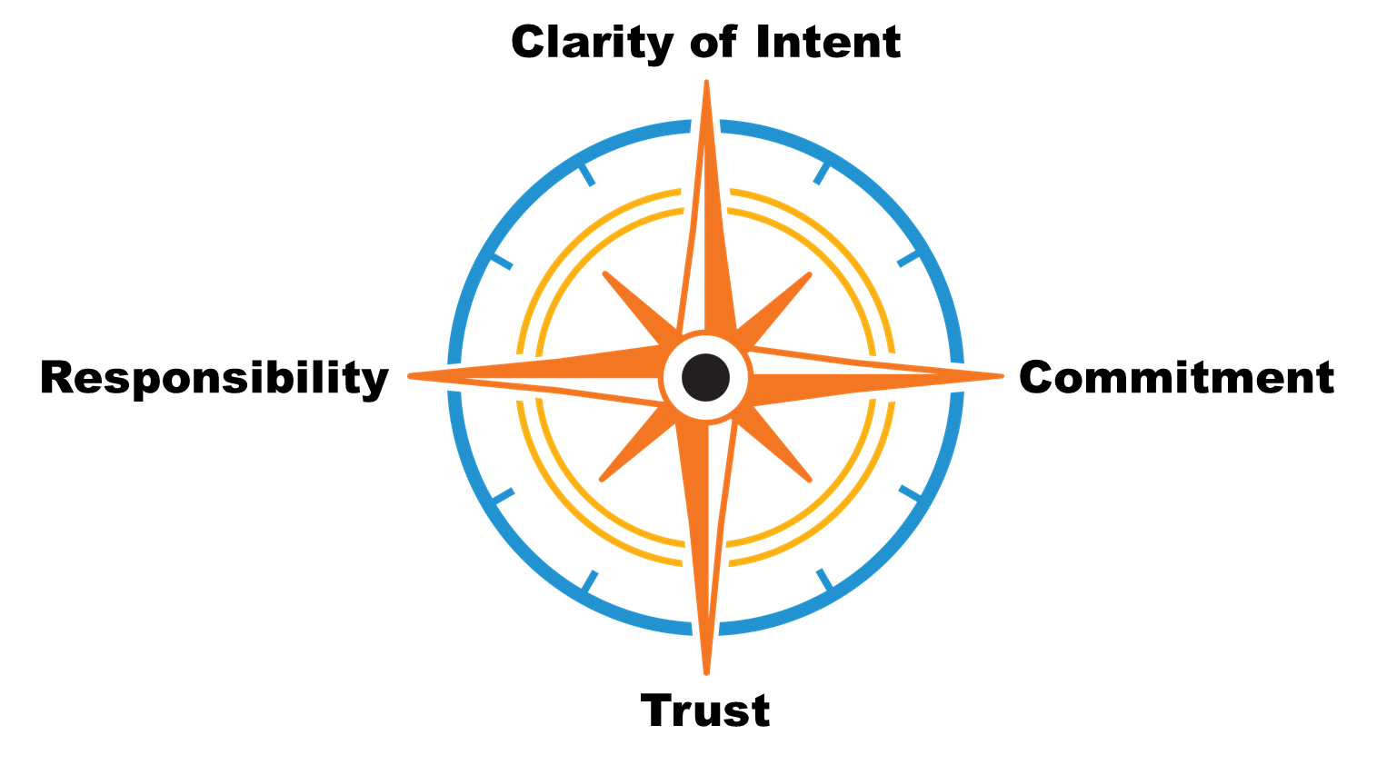
Agenda
  Objective
    State of Good Repair
    MARTA Capital Program
    CPMO
  Delivery Culture
    Integrity Compass
      Responsibility
      Clarity of Intent
      Commitment
      Trust

Slide 5

State of Good Repair
System infrastructure repair & upgrades
  Track
  Traction power
  Station rehabilitation
Station rehabilitation
Bus maintenance facilities
  Clayton County
  Existing facilities rehabilitation
Job Order Contractor (JOC)
A/E design
$300M-$400M

Slide 6
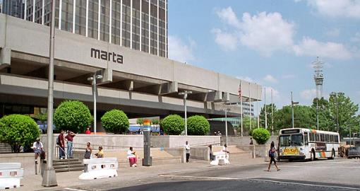
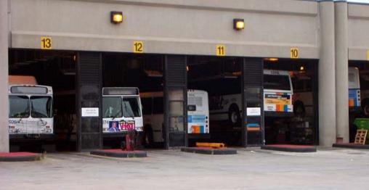
State of Good Repair
  Station rehabilitation
  Bus maintenance facilities
    Clayton County
    Existing facilities rehabilitation
    Job Order Contractor (JOC)
    A/E design
    Traction power

Slide 7
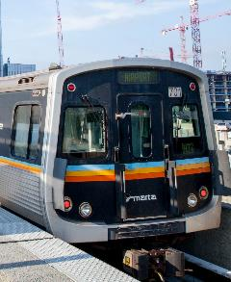
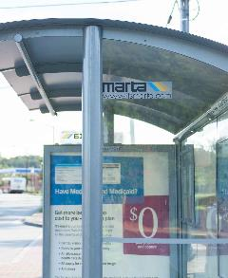
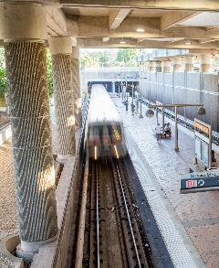
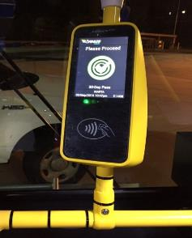
Other Projects
Railcars
Bus Shelters
System Upgrades
Technology
    Entire fleet, some dating to 1979, will be replaced over next decade with more comfortable cars
    Agency adding shelters with seating at bus stops
    Up to 1,000 new shelters expected in next 5 years
    Tunnel ventilation system
    Escalator/elevator revamp
    Public address system
    Clean diesel/CNG buses
    Free Wi-Fi on all buses
    and trains; expansion underway to all stations
Notes:
MARTA has a lot of exciting initiatives underway beyond transit expansion. Here’s a closer look at a few of the upgrades in store for our riders. These enhancements fall under MARTA’s capital program:
Railcars
MARTA is looking to replace its entire fleet of railcars, including some that date to 1979, an effort that will cost $700 million to $1 billion. In the coming years, MARTA will add new, modern cars, which will be easier to load and unload and more comfortable for passengers. The new fleet may include more charging stations, live graphic displays and maps.
BUS Shelters
MARTA is adding many new shelters, along with seating and digital information at many bus stops within the City of Atlanta.
System UPGRADES
Tunnel ventilation system
Tunnel ventilation is a critical infrastructure component in all subway transit environments, and MARTA has identified the renovation and renewal of its aging system as important to maintain optimal functionality and state of good repair. MARTA’s TVs includes a network of fans and dampers that effectively control and direct air flow during normal rail operations and in emergency situations.
Elevators/escalators
In 2017, MARTA launched an ongoing initiative to overhaul our vertical transportation system, including our elevators and escalators. We have 116 escalators and 111 elevators to modernize under our 10-year plan. The entire MARTA portfolio of vertical transportation equipment includes a total of 150 escalators and 115 elevators. A number of elevators and escalators have been completed or are in progress.
Public address system
MARTA is installing an audible delivery system in 38 stations. Benefits include compliance with ADA requirements (i.e. synchronized audio and visual messaging); real-time bus and train information; and safety and security alerts communicated systemwide.
Clean diesel and compressed natural gas (CNG) buses
New Gillig clean diesel and compressed natural gas buses will replace older buses. The 30-foot buses will be used on community circulator routes.
TECHNOLOGY
Wi-Fi
MARTA now has free Wi-Fi Lite on all buses and trains. We are expanding our Wi-Fi and cellular services to our stations. Currently, only Five Points, Peachtree Center and Dome Stations have Wi-Fi.

Slide 8
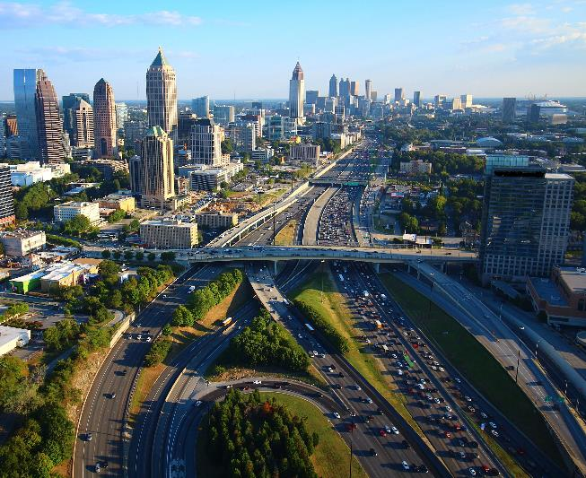
What Factors Drive Transit Growth?
Regional Population
Population in 2000: 4 million
Population today: 6 million
Projected population in 20 years: 8-9 million
Transit Studies
DeKalb County: Transit Master Plan underway
Fulton County: Transit Master Plan completed
Public Support and Funding
City of Atlanta: Sales tax passed in 2016
Clayton County: Sales tax passed in 2014
Notes:
Forty years ago, had we not invested in transit, the region would look dramatically different in terms of density, mobility, economic growth and quality of life.
MARTA’s current system amounts to a roughly $6 billion infrastructure investment that continues to pay dividends.
There’s a fundamental link between transit and the densification we’re experiencing in key areas of metro Atlanta. These key areas include downtown, Midtown, Buckhead and Perimeter.
And yet, there’s still the availability of development along MARTA rail corridors.

Slide 9
Objective – MARTA Capital Program
Next 40 Years
  Expansion = $5B+
  SOGR = $6B (20yr)
    (State of Good Repair @ $300M/yr)
How to Deliver?
Centralized PMO

Slide 10
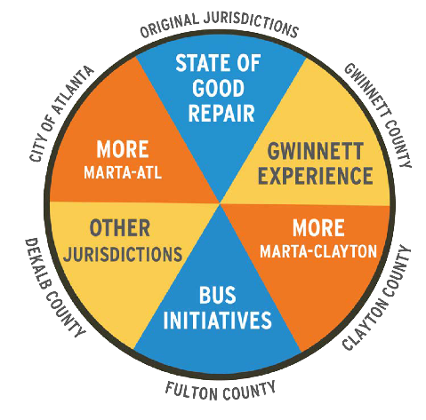
MARTA Tomorrow
System expansion
Heavy Rail Transit (HRT)
Light Rail Transit (LRT)
Bus Rapid Transit (BRT)
  Arterial Rapid Transit (ART)
  Commuter rail
  New facilities
  Facility enhancements
$600M+

Slide 11
More MARTA Atlanta
What Is It?
Largest transit investment in Atlanta in 40+ years
Partnership between MARTA and City of Atlanta
16-project program approved Oct. 4, 2018
How Is It Funded?
Half-cent sales tax passed by Atlanta voters in 2016
What Is Included?
Light Rail Transit (LRT)
Bus Rapid Transit (BRT)
Arterial Rapid Transit (ART)
2 new transit centers
More frequent local bus service
Station enhancements
What’s Next?
Approval of project sequencing expected in summer 2019
Notes:
The funding
The tax will generate approximately $2.7B over 40 years.
Federal and private funds will be sought to advance and expand key projects
The benefits
Supports population growth and the City of Atlanta’s vision for that growth, and it will:
Provide service to 126 Atlanta neighborhoods.
Increase access to more than 350,000 jobs
Connect to 77 medical facilities, 83 grocery stores and 115 schools in Atlanta
List of projects
BeltLine Northeast LRT
BeltLine Southwest LRT
Campbellton Rd LRT
Clifton Corridor LRT
Crosstown Downtown East Extension
Crosstown Downtown West Extension
Capitol Ave BRT (Summerhill)
North Ave – Donald L. Hollowell Pkwy BRT
Northside Dr BRT
Peachtree Rd ART
Cleveland Ave ART
Metropolitan Pkwy ART
Frequent local bus service
Greenbriar Transit Center
Moores Mill Transit Center
MARTA station enhancements
The approval in October 2018
MARTA Board of Directors’ unanimous vote based on:
Public input
Technical data
Performance measures

Slide 12
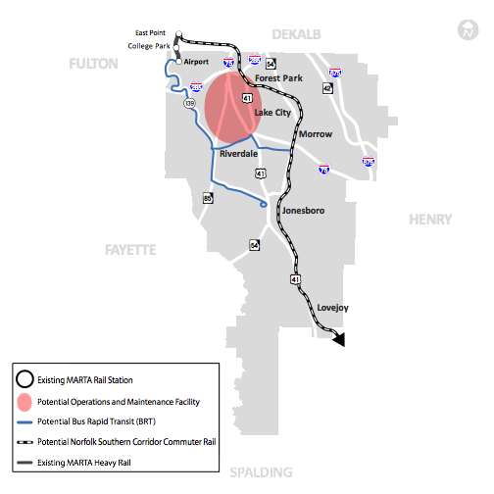
Clayton County Transit Initiative
What Is It?
A suite of transit investments designed to improve mobility,
provide greater access to jobs, and drive economic development
How Is It Funded?
In 2014, Clayton County voters approved referendum to join MARTA
1-cent tax yields about $48 million annually for transit expansion
What Are the Current Services?
8 bus routes, 1 circulator, amenities
What Are the Proposed Services?
Commuter rail alternative in the Norfolk Southern (NS) railroad
Arterial-based, Bus Rapid Transit (BRT) alternative for
corridors (SR 85/SR 139) on the county’s western side
Park-and-ride lots
Operations and maintenance facility
Station/stop amenities
Notes:
The funding
On July 5, 2014, the Clayton County Board of Commissioners approved a contract with MARTA to extend service to the county, financed by a 1 percent sales tax.
On November 4, 2014, Clayton County residents approved the 1% sales tax to join MARTA and on March 21, 2015 MARTA began bus services to Clayton County. The contract also includes provisions for future rail transit to Clayton County by 2025.
The benefits
Greater access to jobs
Improved mobility
Alternatives to congested auto travel
Environmental improvements
Economic development
Connections to major employment centers across the region
Current services:
• Route 193 | Jonesboro/Morrow
• Route 195 | Forest Parkway
• Route 191 | Riverdale/Airport
• Route 55 | Jonesboro Rd
• Route 15 | Candler Rd
• Route 196 | Upper Riverdale
• Route 192 | Old Dixie/Tara Blvd
• Route 194 | Conley Rd/Mt. Zion
• 1 circulator … Route 800 | Lovejoy
• Amenities
Proposed services
Commuter rail alternative in the Norfolk Southern (NS) railroad corridor on the eastern side of the county
Arterial-based, Bus Rapid Transit (BRT) alternative for corridors (SR 85/SR 139) on the western side of the county
Operations and Maintenance Facility
Park and ride lots
Station/Stop Amenities

Slide 13
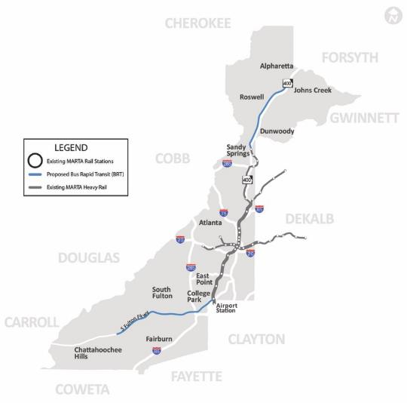
Fulton County Transit Master Plan
What Is It?
A proposal to address county’s future transportation needs
A referendum is possible in 2019
How Would It Be Funded?
A 0.2-cent sales tax, which could potentially generate
$28 million annually for transit expansion outside of Atlanta
What Are the Current Services?
South Fulton: 14 local bus routes, 1 Xpress bus route
and 2 MARTA rail stations
North Fulton: 7 local bus routes, 1 Xpress bus route,
2 MARTA rail stations, and 2 peak-hour-only bus routes
What Are the Proposed Services?
Bus Rapid Transit (BRT) to Ga. 400, Holcomb Bridge Road/Highway 92, Roosevelt Highway (Highway 29),
and South Fulton Parkway
Notes:
The benefits
After months of planning and community input, the transit plan seeks to:
Provide greater access to employment centers and destinations
Provide faster, more reliable transportation
Spur economic development and investment
Enhance transportation options and access
Establish a framework for greater regional connectivity
The priorities
Within the Fulton County Transit Master Plan, three critical, short-term initiatives have been established:
Last-mile connectivity
Bus-stop enhancement program
Rail station enhancement program
More on BRT services
Proposed BRT along South Fulton Parkway in dedicated transit lanes between SR 92/Campbellton Road and College Park or Airport MARTA rail stations
Proposed BRT along the Georgia 400 corridor – North Springs MARTA station to Old Milton Parkway – in coordination with MARTA and GDOT’s managed lane system

Slide 14
DeKalb County Transit Master Plan
What Is It?
The DeKalb Transit Master Plan will expand transit options
Project underway and scheduled for completion this summer
How Would It Be Funded?
A potential sales tax, as part of a future referendum, could generate approximately $60 million
What Are the Current Services?
46 bus routes, 2 park-and-rides, 10 rail stations
What Are the Proposed Services?
Heavy Rail Transit
Light Rail Transit
Bus Rapid Transit
Arterial Rapid Transit
Notes:
What are the proposed plan’s benefits?
• Addresses mobility challenges for DeKalb County transit users
• Enhance future development opportunities throughout DeKalb County
• Improves quality of life for DeKalb County residents

Slide 15
General Project Durations
KICK-OFF TO OPERATIONS*
*These benchmarks vary by project and are subject to change.
They include planning, environmental, design, construction, and startup activities.
Up to 10 years Light rail transit (LRT)
Up to 7 years Bus rapid transit (BRT)
Up to 4 years Arterial rapid transit (ART)
Up to 5 years Station enhancements
Up to 6 years Transit centers
Planning
1-2 years
Environmental Review
2 years
Final Design
1-2 years
Construction
4-5 years
Operations
Notes:
GETTING STARTED
Establish Transit on BeltLine Working Group
-Led by MARTA, with reps from the City and ABI, to begin our work to bring on a P3 consultant.
BRT Study Trip
With a delegation to be determined by the Mayor’s Office and City Council. We are ready to plan and lead this trip once the delegation is identified. Potential site visits could be Cleveland, Los Angeles or Pittsburgh. Want to ensure that the policymakers are fully educated on the elements of a successful BRT system so that the investments made are fully worthwhile.
Capitol Ave/Summerhill BRT Alignment Modification
MARTA Planning Department will coordinate a series of stakeholder meetings to determine a modified alignment that will be submitted to the FTA for consideration on the $12.5 million TIGER Grant that was awarded in spring 2018. Aware that Councilmember Smith has concerns about the current plan for the BRT line to run all the way to Midtown station.
Campbellton Road Economic Dev/Transit Study
We want to work with Renew Atlanta on this study to ensure that transit supports a unified development plan or the full corridor.
Five Points Station Renovation Task Force
Five Points needs to be overhauled. It’s the central station, flagship and crossroads of the MARTA system. The area around Five Points is seeing significant new investment and redevelopment from WRS, Newport and CIM. We’d like to form a Task Force with reps from the Mayor, City Council, Atlanta City Design, Central Atlanta Progress and the private developers who are investing near the station so that we can unite behind a shared vision for the new Five Points, leverage private funding to support the $65 million MARTA has budgeted and get to work right away on this essential station.
Inman Park/Reynoldstown Pedestrian Bridge
This is a great example of re-thinking station access for pedestrians to increase ridership and improve the customer experience.

Slide 16
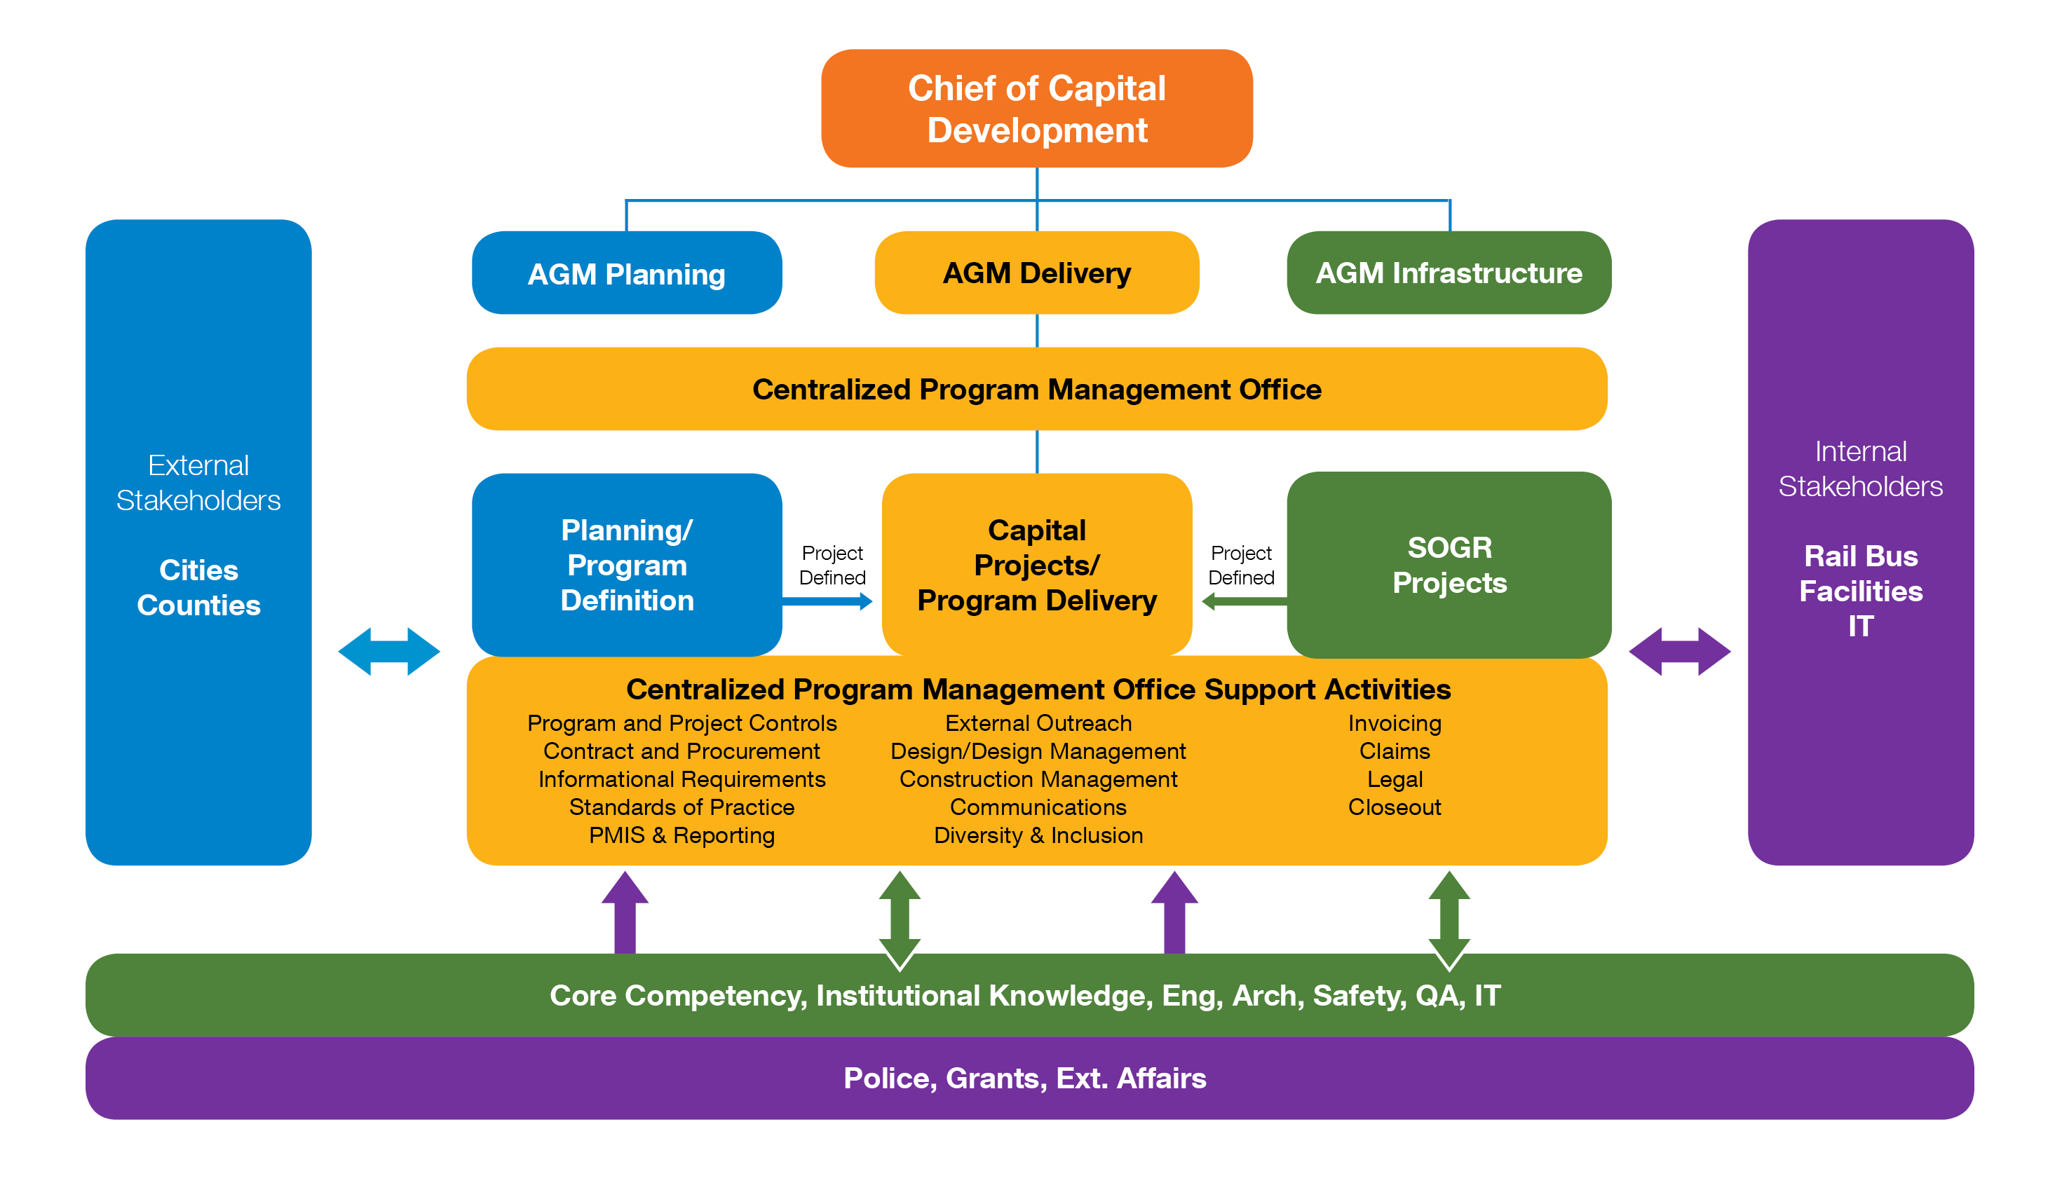
Centralized Project Management Office

Slide 17

Delivery Culture
(Integrity Compass)
Clarity of Intent
Responsibility
Commitment
Trust

Slide 18
Delivery Culture
(Integrity Compass)
TRUST
Clarity of Intent
Governance
Processes/Procedures
Change Management (CRB)
Responsibility
Commitment
Roles/Responsibilities
Organization
Master Schedule
Budgets
Score Cards
Trust
Culture

Slide 19

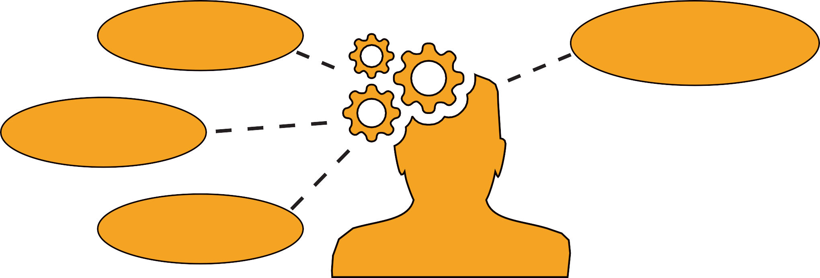
Building a Delivery Culture – B/F/A
DO IT
SOLVE IT
OWN IT
SEE IT
THE LINE
CURRENT
CULTURE
WAIT & SEE
CONFUSION / TELL ME WHAT TO DO
COVER YOUR TAIL
IT’S NOT MY JOB
FINGER POINTING
IGNORE /
DENY

Slide 20
Delivery Culture
(Integrity Compass)
RESPONSIBILITY
Clarity of Intent
Responsibility
Commitment
Roles/Responsibilities
Organization
Trust

Slide 21

Roles/Responsibility & Organization
Program Support - Program Management Attributes
QUALITY
Quality Management, Compliance Management
COMMERCIAL/CONTRACTS
Procurement, Commercial Terms Development, Contract Administration, Change, Claims Avoidance
PROCUREMENT
Project Delivery Analysis, Alternative Delivery Advisory,
Procurement Services
DIVERSITY & INCLUSION
  Establishment of DBE Goals, Outreach
FUNDING/FINANCE
Feasibility Analysis, Value Assessment, Economic Analysis, Financial Tracking
PROJECT CONTROLS
Budget, Schedule, Documents Management, Life-cycle Costing, Reporting,
IT Support, Risk

Slide 22
Roles/Responsibility & Organization
PM/CM Management – Program Management Attributes
MANAGEMENT
  Strategic Planning, Policy, GR, Dispute Management, Training, Facilitation
DESIGN
Design Management of On-call Consultants
CONSTRUCTION
Construction Services, Constructability, Value Engineering
COMMUNICATIONS
Public Relations
OPERATIONAL READINESS / OPS & MAINTENANCE
Performance Requirements, Asset Management, Optimization Analysis
SAFETY
  Establish Program Safety Requirements, Compliance
OTHER SUPPORT SERVICES
Utilities, Right of Way, Third-Party Agreements, Environmental, Permitting

Slide 23
Delivery Culture
(Integrity Compass)
CLARITY OF INTENT
Clarity of Intent
Governance
Processes/Procedures
Change Management (CRB)
Responsibility
Commitment
Roles/Responsibilities
Organization
Trust

Slide 24
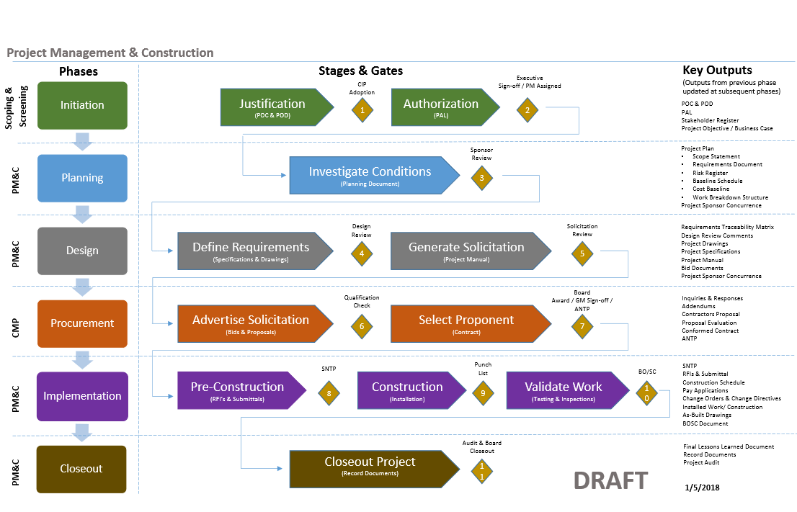
Governance
Governance/ Stage Gate Process (Example)
Governance/ Stage Gate Process
CIP Adoption
Executive Sign-off
Sponsor Review
Design Review
Solicitation Review
Qualification Check
Board Award
NTP
Punch List
Substantial Completion
Closeout

Slide 25
Delivery Culture
(Integrity Compass)
COMMITMENT
Clarity of Intent
Governance
Processes/Procedures
Change Management (CRB)
Responsibility
Commitment
Roles/Responsibilities
Organization
Master Schedule
Cost Management
Score Cards
Efficiency Tools
Trust
Culture

Slide 26
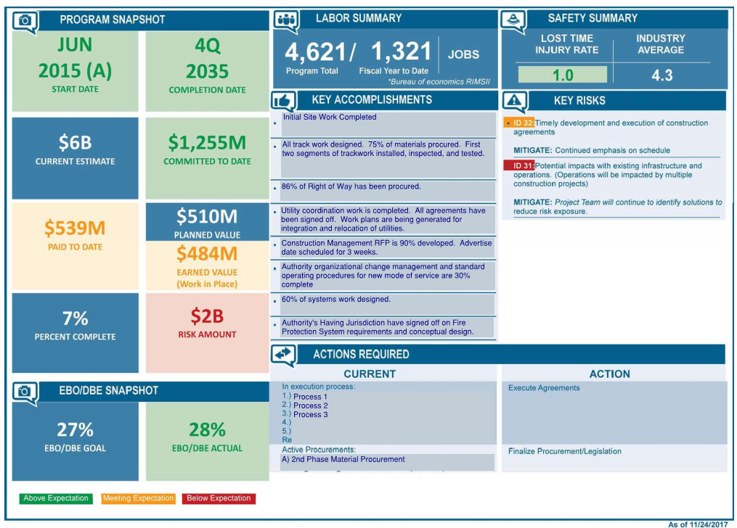
Reporting (Score Cards)

Slide 27
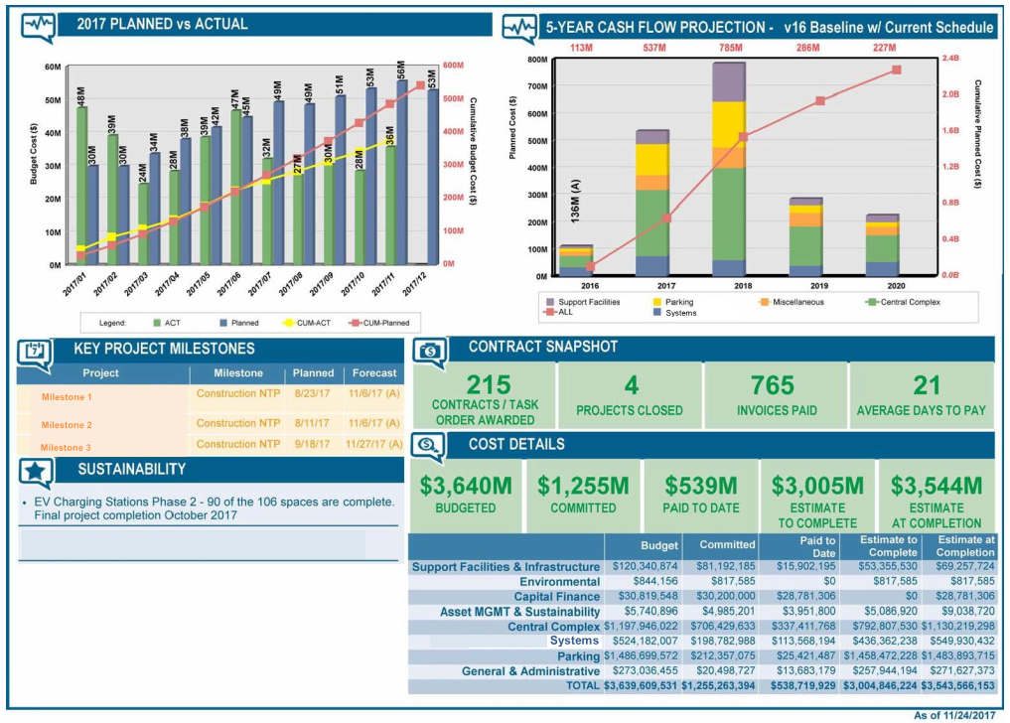
Reporting (Score Cards)

Slide 28
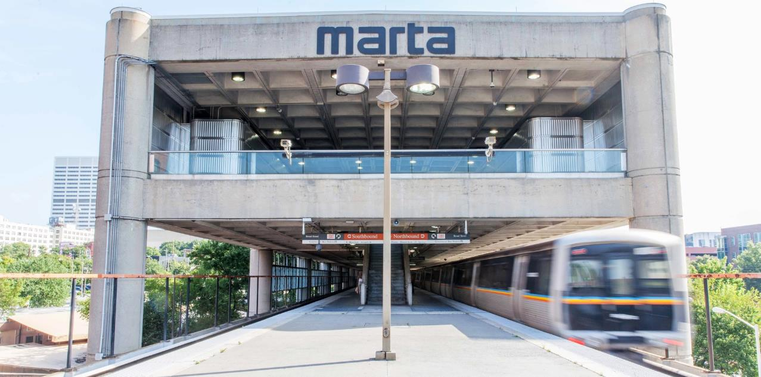
THANK YOU!
Monday, June 10, 2019

