Slide 1
The bus operator’s task force
Luz Borrero, Chief Administration Officer
June 6, 2019

Slide 2
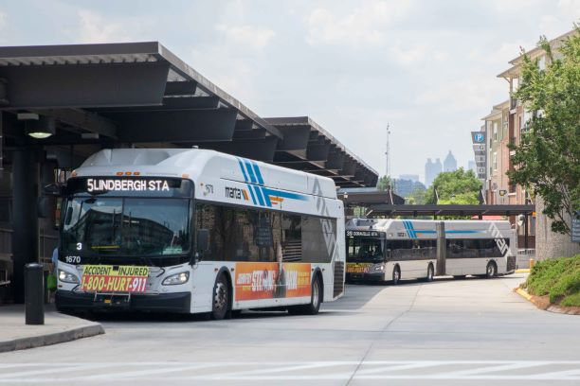
Bus Routes and Bus Ridership at a Glance
Bus Routes
Weekday: 110
Saturday: 104
Sunday: 103
Bus Ridership
Bus Transit Annual Ridership: 57,460,309 (2018 NTD)
Paratransit Annual Ridership: 687,537 (2018 NTD)
Annual Miles (Bus) – 30,791,099 (FY2018)

Slide 3
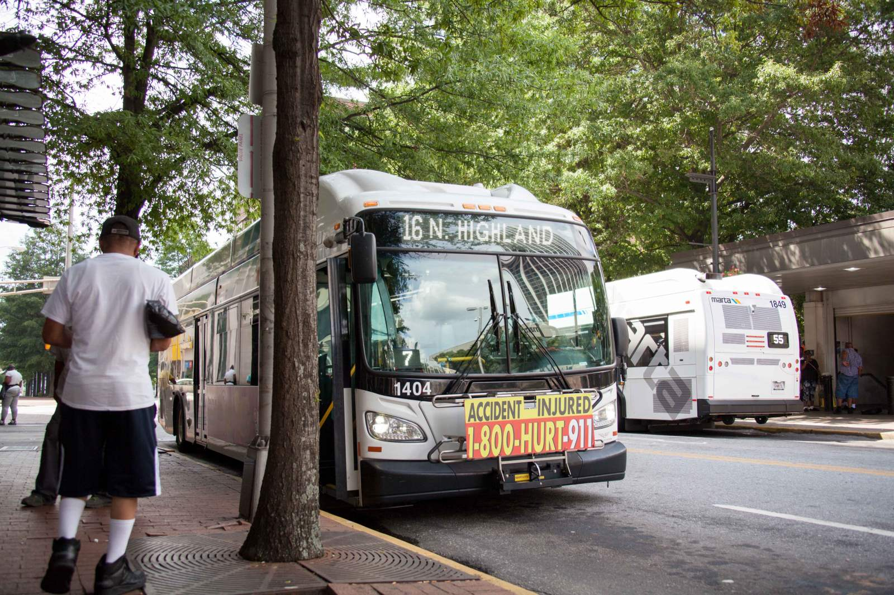
The Issue: Large number of Bus Operators vacancies grew over time
Vacancies (3-18-2019)
  129 Full-Time
  83 Part-Time
  212 total
  Projected Vacancies (5 -11-2019)
  (Includes turnover of 13.5% full time and 40.86% part-time, and considers training schedule)
  95 full-time
  93 part-time
  188 total
Budgeted
  1,327 Full-Time Budgeted
  121 Part-Time Budgeted
  36 overfill
  1,484 total
Actual (3 -18-2019)
  1,198 Full-Time
  38 Part-Time
  0 Overfill
  1,236 total
In Training thru April 26, 2019
  68 – 4 graduating classes
To close the gap over four months needed to hire an average of 80 bus operators per month!

Slide 4
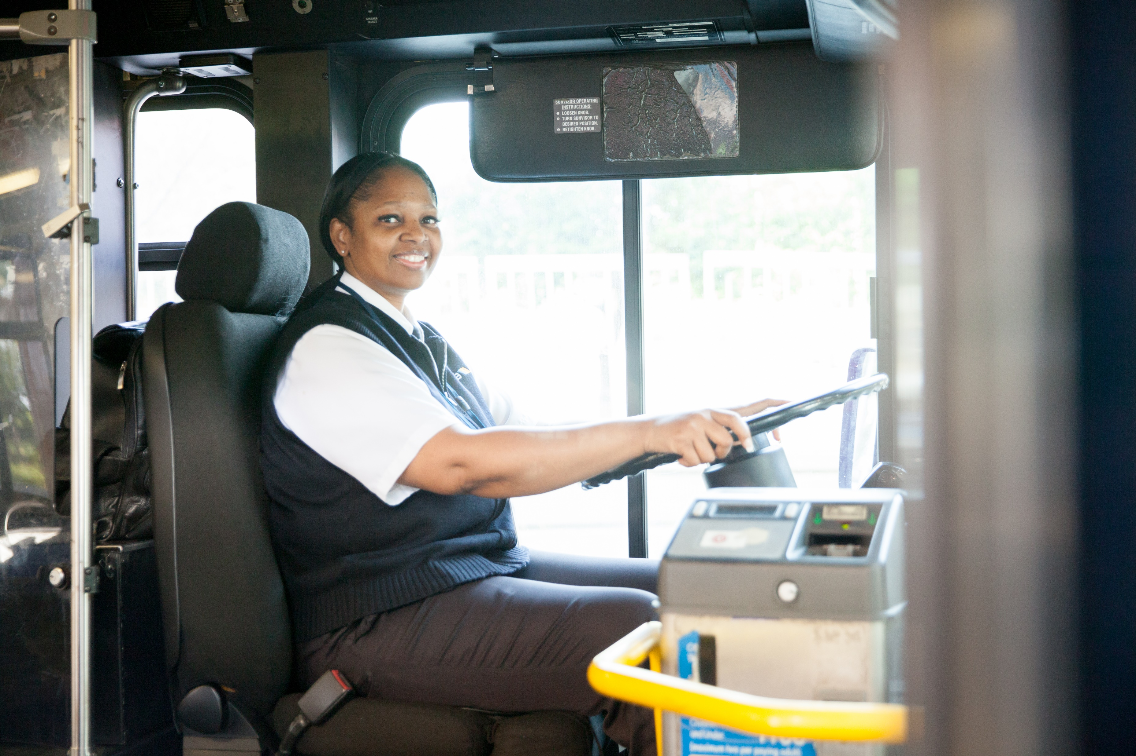
The Solution approach: establish a cross-functional
Task Force
A team of 25 employees working to address the issues impacting MARTA’s ability to recruit, hire, support and retain Bus Operators to meet its service needs.
This initiative will serve as a precursor to a culture change effort centered around customer’s needs and undergirded by a core set of values:
the principles of integrity.

Slide 5
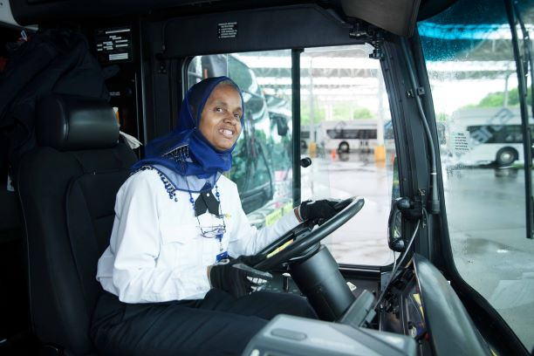
A team of 25 staff members from 10 different departments and offices was organized in subcommittees. Each subcommittee worked to formulate and implement short-term, mid-term and long-term solutions.
Objective
Participating representatives from:
Human Resources
Facilities
Planning
Finance
Capital Programs
Information Technology
Research & Analysis
Rail Operations
Safety
Bus Operations
Marketing and Communications
Customer Service and
External Relations

Slide 6
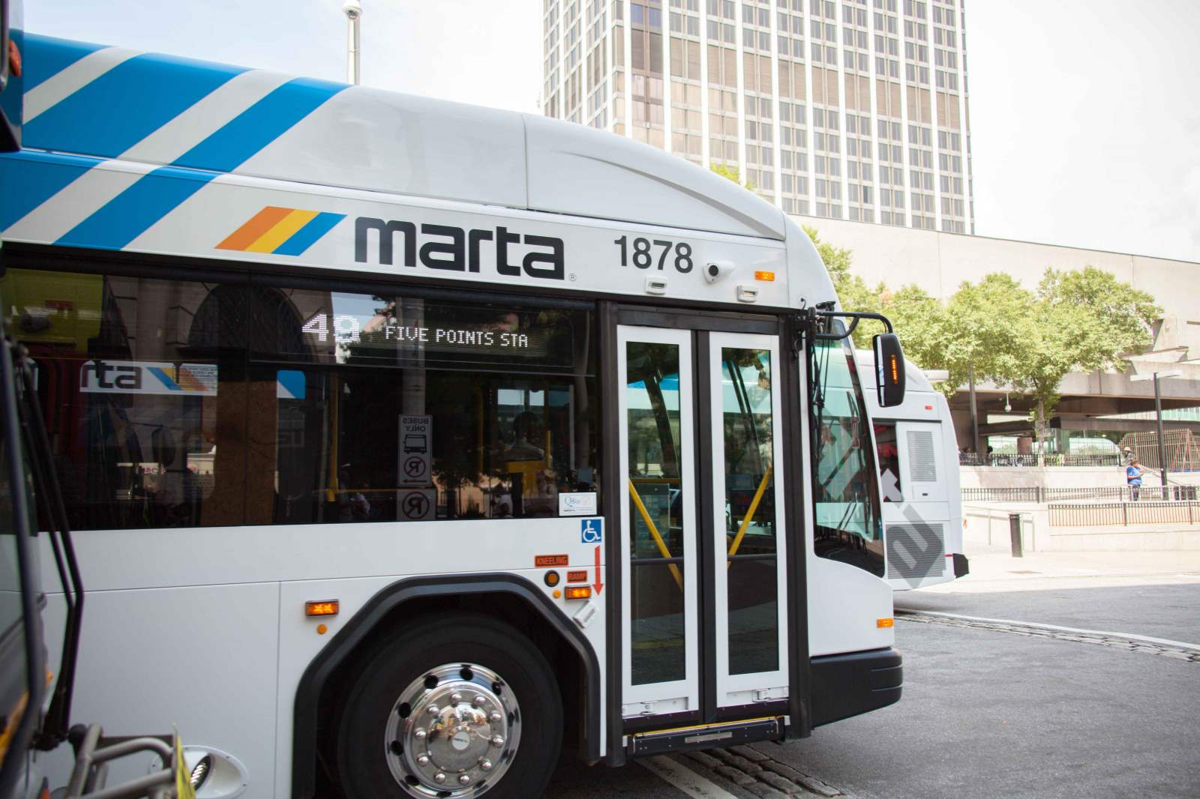
Objectives
Increase MARTA’s pool of qualified Bus Operators and hire and train sufficient operators to meet our needs
Streamline business processes to enable efficient recruitment, hiring, training and support of Bus Operators
Improve the working environment for Bus Operators to increase morale and retention rates
Expand partnerships with community organizations, business partners and WorkSource Development Agencies to broaden the pool of candidates
Promote MARTA as a desirable place to work and increase awareness of MARTA as a provider of career opportunities within and outside Bus Operations

Slide 7
High Level Workflow
Recruiting
Hiring
Training
Placement
Supervision
Development
Retention
Increase
staff,
expand marketing
and enhance sourcing
Streamline
processes expand hiring teams and review technology
tools
Redefine
and expand customer interface training elements
Review mark-up process and route selection
process
Review and re-align span of control and develop training for supervisors
Create career path and develop support program including mentoring
Improve working conditions and reduce turnover rates

Slide 8
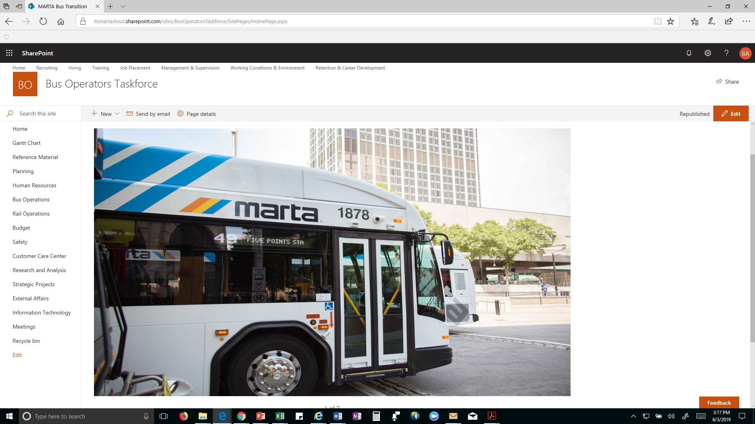
share point site was created to facilitate document sharing and reporting
Published vacancies forecasting tool
And progress reports for each subcommittee

Slide 9
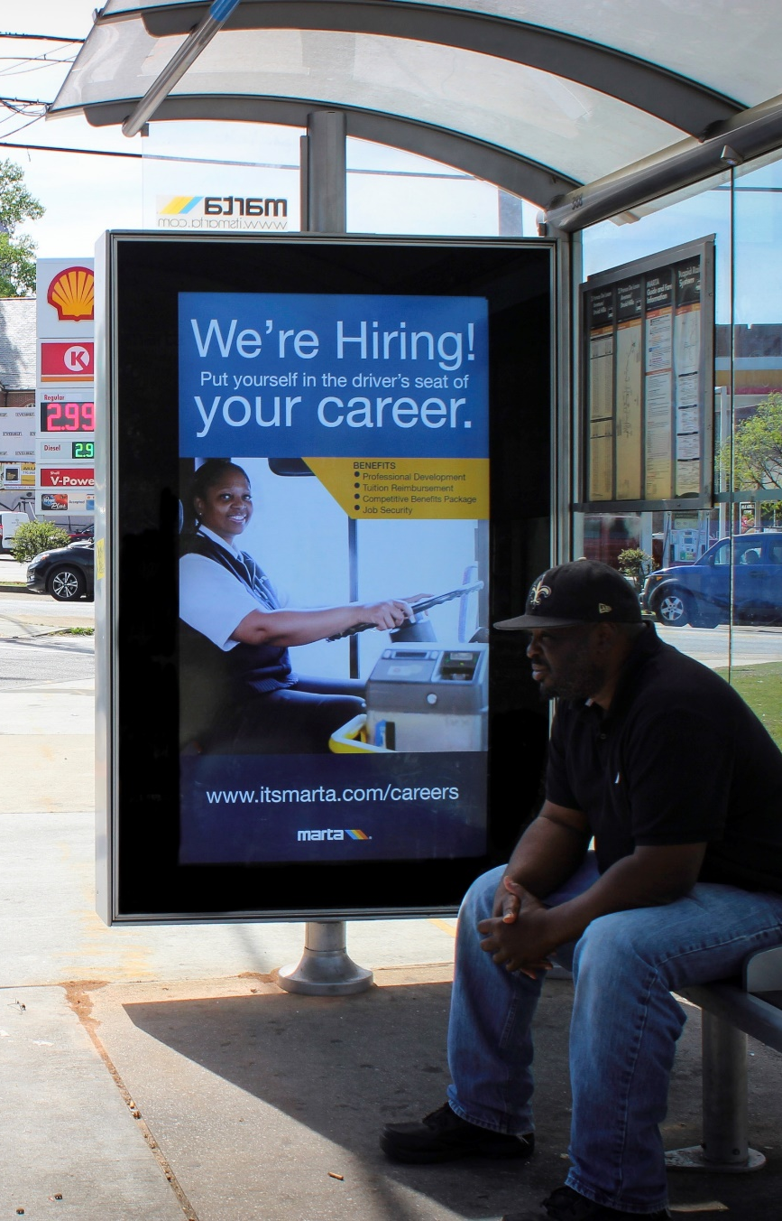
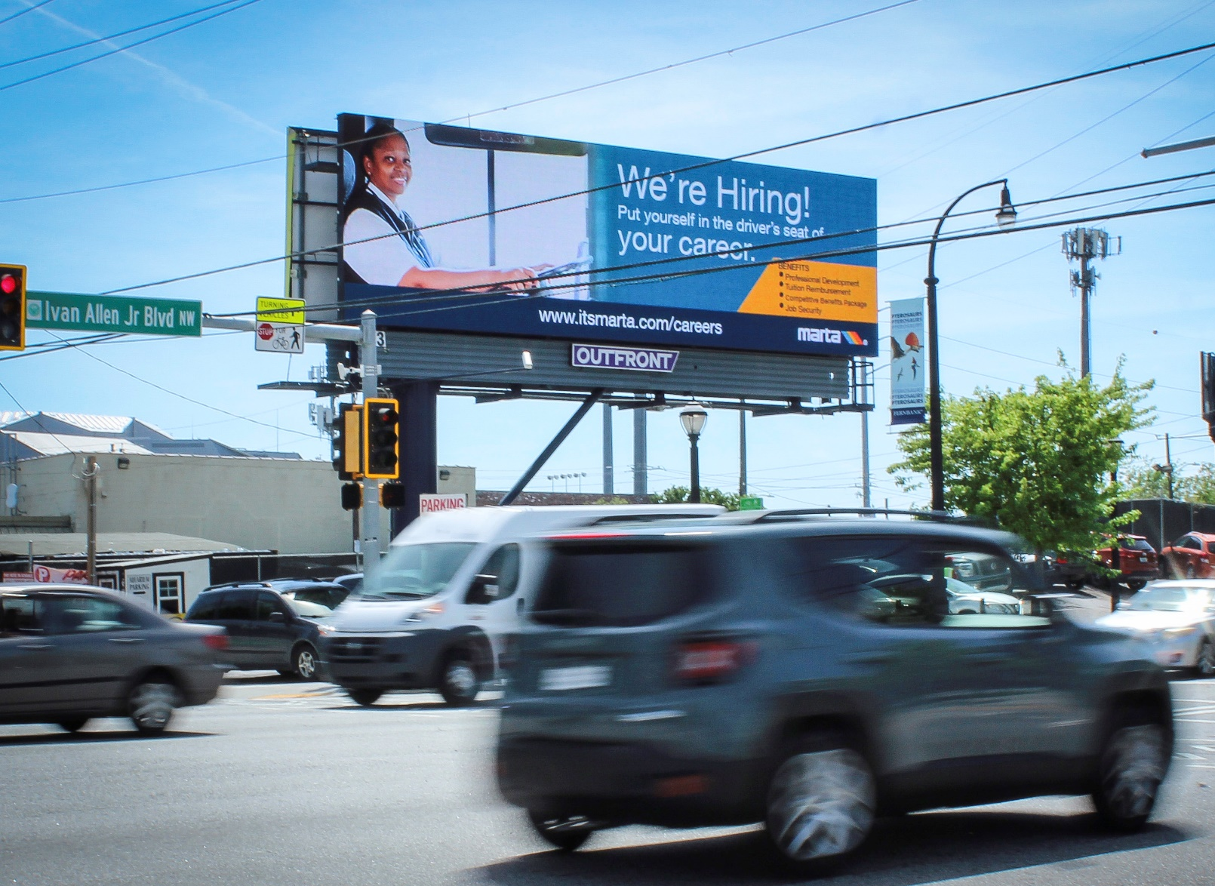
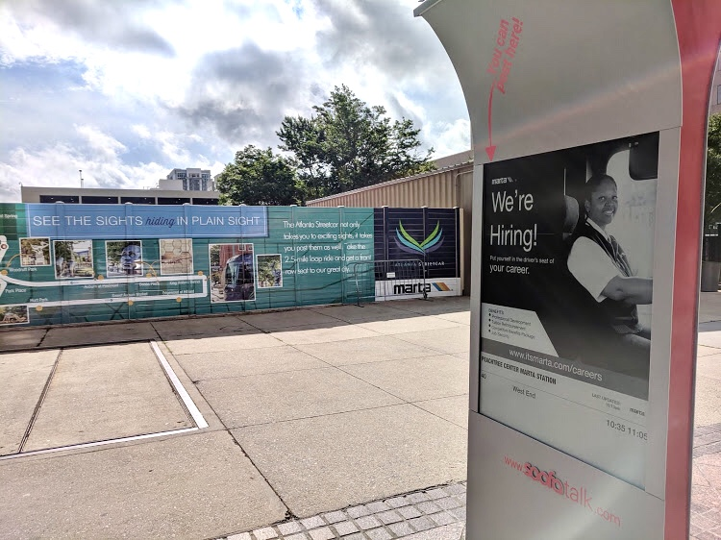
Marketing Tactics – External Marketing
Leverage relationships with Outfront Media and City of Atlanta (Soofa Signs) to disseminate the hiring message throughout Atlanta in high traffic volume areas
Digital Bus Shelters (10)
Digital Soofa Signs (27)
Digital Billboards (4)

Slide 10

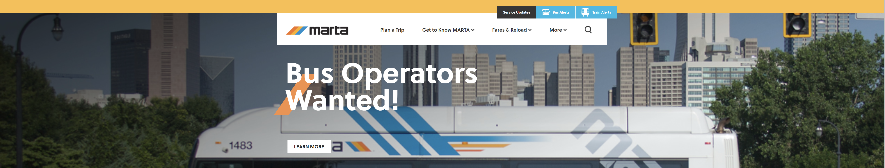
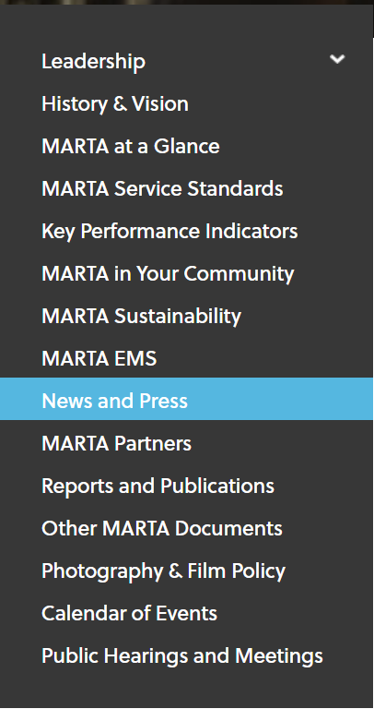
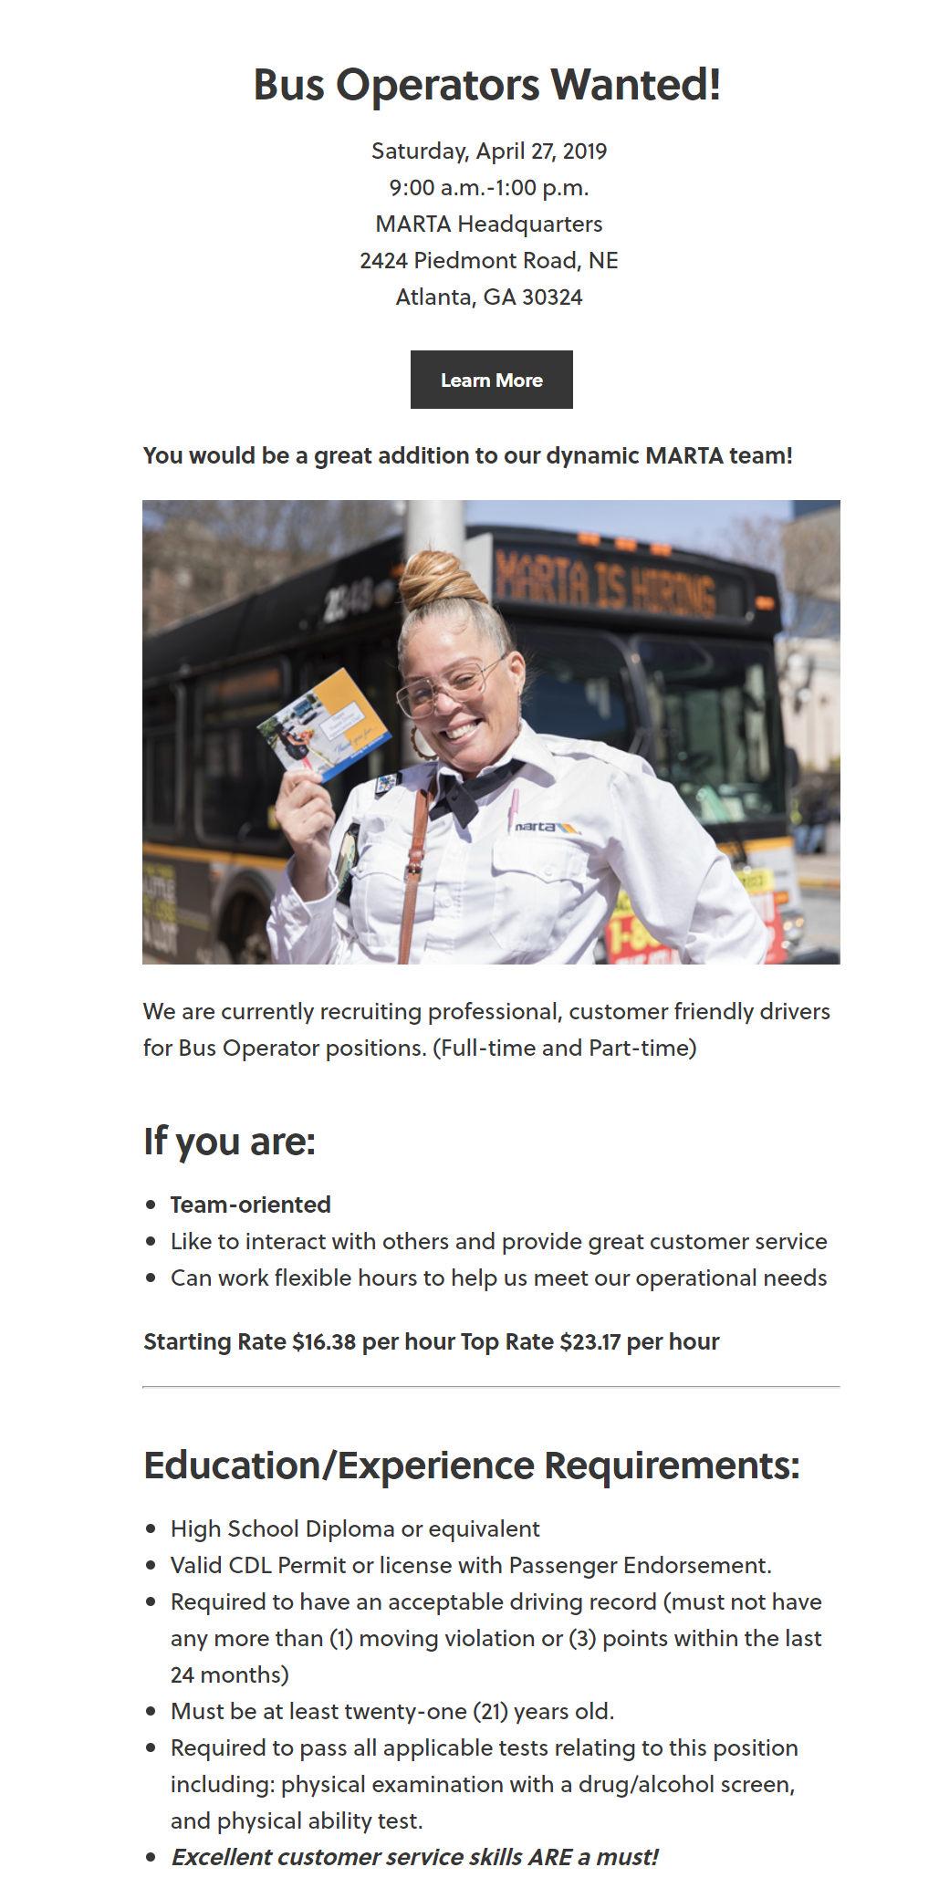
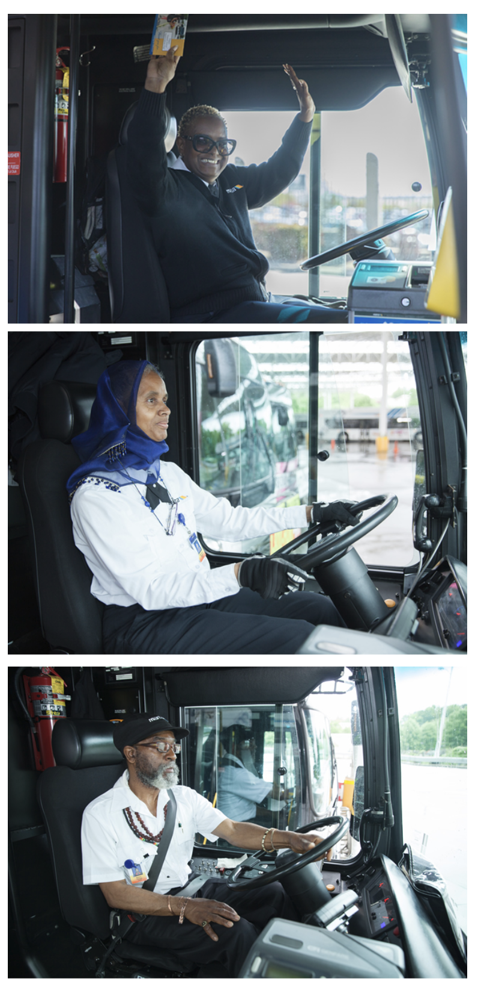

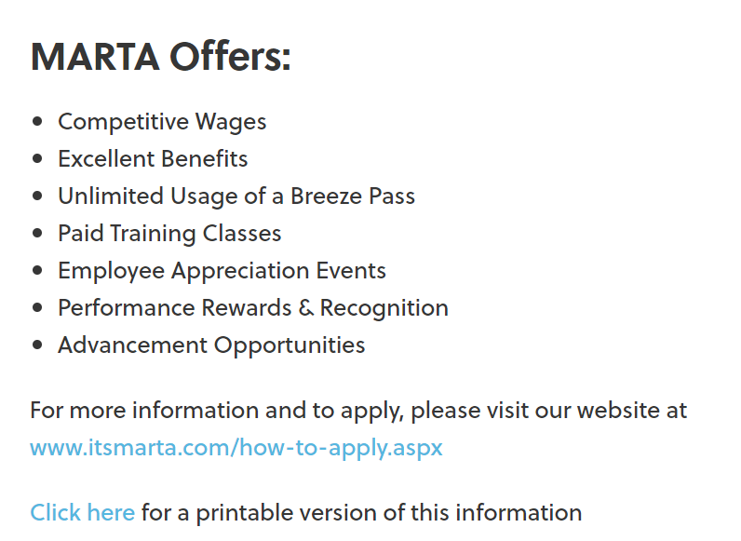
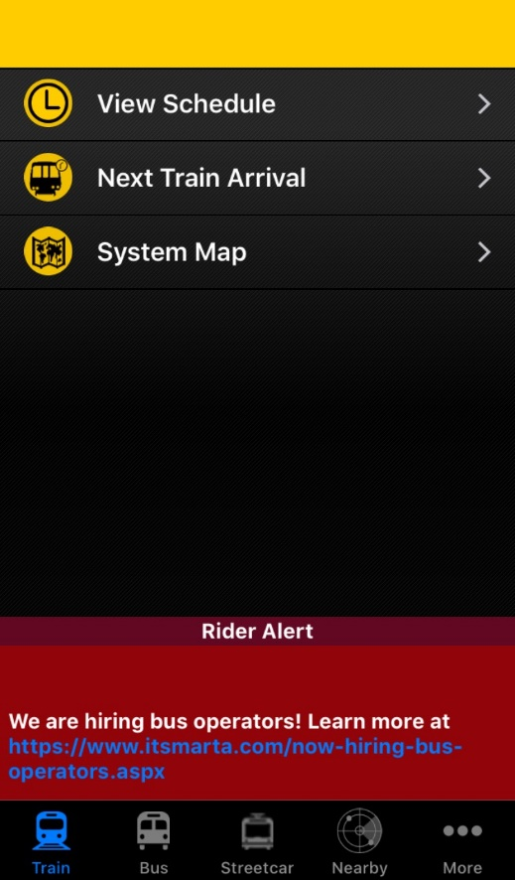
Utilized digital inventory to educate potential candidates through internal channels.
Banner on itsmarta.com
Splash page on itsmarta.com
MARTA On the Go App Rider Alert
Launched a social media ad campaign on April 24th through our social media channels to gain visibility online.
Marketing Tactics – Internal Digital Promotions

Slide 11
Environment Subcommittee has launched execution plan
Short Term Tasks:
Deep Cleaning
Comment cards were distributed, responses received and processed
Deep cleaning of Hamilton, Laredo and Perry Garages has been completed
Additional maintenance and cleaning is underway to ensure that all facilities are properly addressed
Mid-Term Tasks:
Refurbishment of Garages
Funding approved and procurement of appliances was completed (coffee makers, microwaves, commercial refrigerators, televisions, ice machines)
Funding approved and procurement of furniture is in progress
Operators selected the color choices (three) for painting walls and baseboards. Flooring to be installed in during the summer and fall as Facilities’ resources allow.
Technology is reviewing how electronic boards may be used in garages (i.e. how many are currently available, content management)
Breakroom refreshes and Policy Development
A plan for adjusting restroom policy (moving towards employee only restrooms at stations) has been initiated and is under discussion wit the C-Team.

Slide 12
Efforts to improve Retention, career development and job placement
Studying operator’s kiosks installation
selection process under way
considering installation of operators bulleting boards
pushed job referrals program
Developing plan to provide tablets to operators
Creating the Business case
Developing Costs analysis and training requirements
Execution Time line
Training program implementation
Job placement opportunities
Automation of pick process
Automation of route quality assurance form
Enhancing Supervisors, superintendents and generals training
Developing program concept
Obtaining feedback and internal consensus
aligning the resources and requirements

Slide 13
Recruitment and hiring initiatives are yielding results
Enhanced Candidates sourcing approach
Expanded Partnerships
Increased recruitment fairs
pushed job referrals program
Pool of interviewers was expanded
broaden the participation of interviewers
created faster follow-up process
Made full use of Indeed sourcing tool
Processed 150 Applicants in April
On queue to process 183 applicants from Indeed and 104 from Oracle in may
Shortened timeline for hiring
after analysis of impact eliminated assessments
working to streamlined application process
Diminish follow-up times
Increased awareness and advertising
Created Web site banner
Placed advertising in buses, trains and garages
pushed job referrals program

Slide 14
Conducted 10 Focus Group Meetings with Operators, Mechanics, Supervisors and Superintendents
Ensuring that those most impacted by the process have a voice and input on the solutions considered
Recording and cross-referencing perceptions and validating needs
Relaying on direct experience
Validating most critical issues
Prioritizing appropriately and formulating solutions that take those who are most impacted into consideration

Slide 15

New Hires
January 2019
  Full Time - 31
February 2019
  Full Time - 31
  Part Time - 3
March 2019
  Full Time - 29
  Part Time - 4
April 2019
  Full Time - 62
  Part Time – 6
May 2019
  Full Time - 60
  Part Time - 4
Referrals Program
January | 7
February | 7
March | 9
April | 32
May | 11
Applicants on pipeline: 183 from Indeed and 104 from Oracle

Slide 16
hiring is trending up but not yet at target level

Slide 17

MAY’s Candidate Interview Results

Slide 18
Slow but steady Progress
Graduating Classes
Vacancies full-time
4-13 | 4-27 | 5-11 | 5-25 | 6-8
26 | 18 | 28 | 32 | 40
4-13 | 4-27 | 5-11 | 5-25 | 6-8
112 | 115 | 119 | 113 | 98
Operators Available part-time
Operators Available full-time
4-13 | 4-27 | 5-11 | 5-25 | 6-8
44 | 46 | 45 | 47 | 47
4-13 | 4-27 | 5-11 | 5-25 | 6-8
1,215 | 1,212 | 1,208 | 1,214 | 1,229
Operators Needed: 1,327

Slide 19



Thank you!!

