Slide 1
Service Development
Cesar Ochoa
August 22, 2017
Notes:
Previously know as the Scheduling Department
Service Development - consists of Service Planning & Scheduling and System Support.
Closely associated with:
Special Services and
Bus Stop Program.
Doug and I have over 40 years of transportation experience.

Slide 2
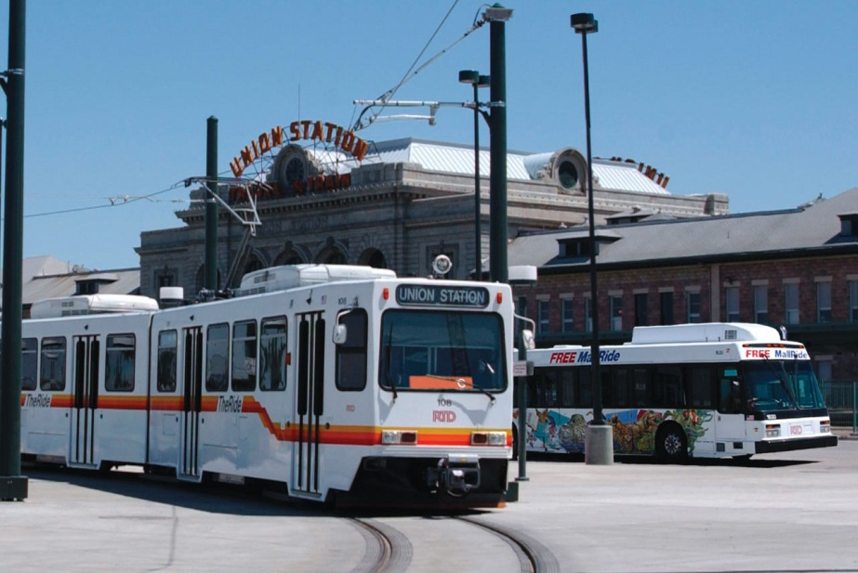
Service Development
Develops,
Reviews,
Maintains
Bus
Light Rail
plans and schedules
Notes:
RTD is actually a successor to the Denver Tramway Company
From 1886 – 1971
CCD 1971 – 1974
This means we are actually the maintainers of very old routes.
On average Service Development creates one new route/year

Slide 3
Service Development
Major tasks:
Explores and develops new and improved services including
Restructured network; sub-regional, corridor, and community transit plans.
Integrates with
Marketing,
Systems Planning,
Facilities Planning.
Evaluates service performance vs. RTD Standards and proposes changes.
Develops and implements three service changes/yr.
Maintains and Develops tools for:
planning,
analysis,
scheduling,
runcutting,
geographic information systems,
ridership monitoring and analysis
performance evaluation.
Notes:
We do a good deal of research
We coordinate with more than 50 municipalities and transportation organizations.
We work internally with Engineering, Long Range Planning, as well as Marketing.
Using our Service Standards we’re better able to evaluate proposals:
Unfortunately our most common response is “no”.
Our three service changes add stability for our customers, but slow our responsiveness.
We also work with our software vendors to improve their product, so that we can do the same with ours.

Slide 4
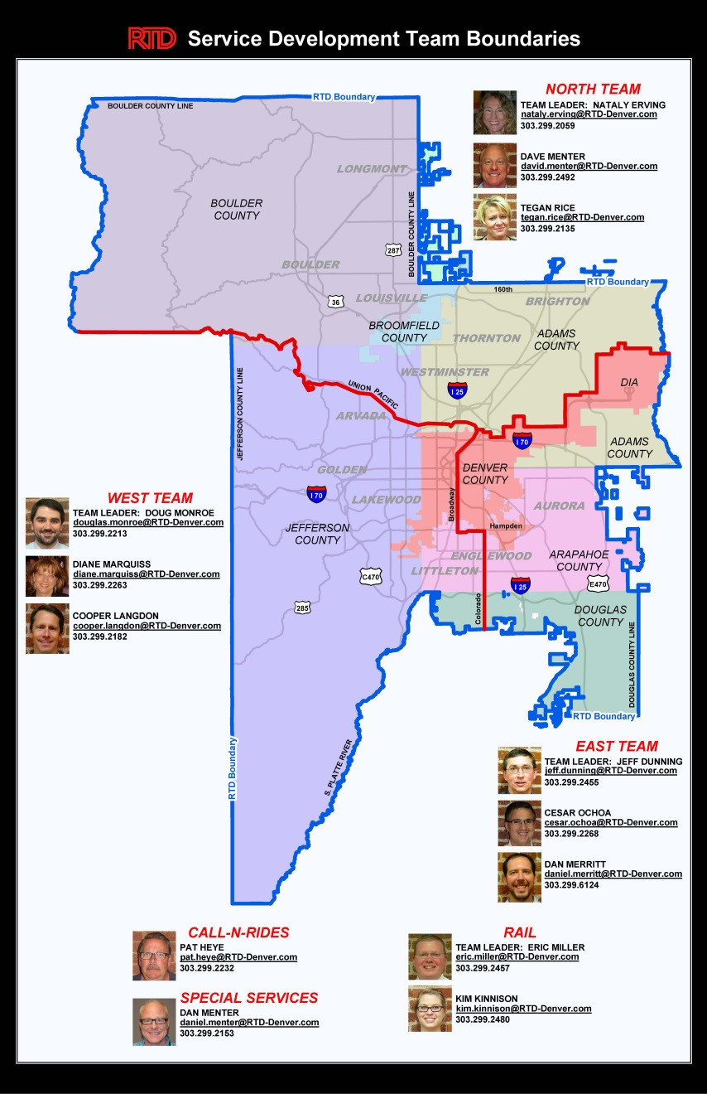
Service Planning & Scheduling
Service Area
2,340 sq. mi.
Teams
North
East
West
Rail
Special Services
Notes:
With 2,340 square miles it makes the most sense to divide the district into 5 Teams:
It’s the only way we can get to know
Where routes overlap we share.
Only Special Services needs a little explanation:
BroncoRide
RockiesRide
RunRide
Special Service Orders
They also get help from The Rail for special events.
This diagram with our phone numbers is available on the HUB,
Search for Content and type in “Team Map”.
Because of the large area, we need all the help we can get.

Slide 5
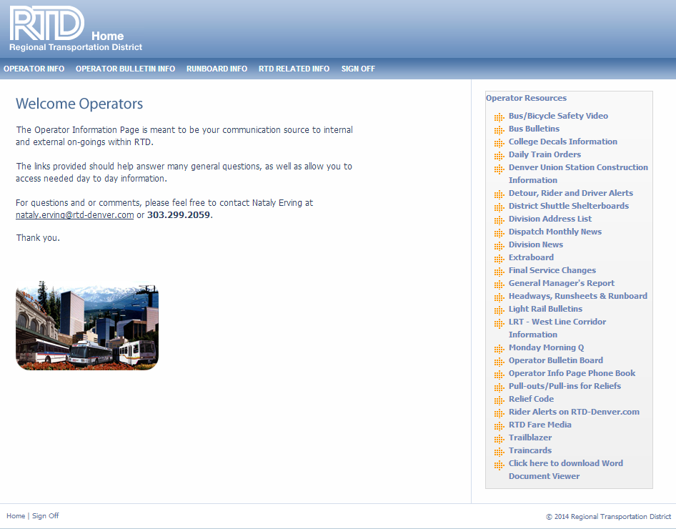
Gathering Information
Market Research
Origin & Destination Studies
Surveys
Customer Input
TIC/Customer Service
service.changes@rtd-denver.com
Public Hearings
Local Governments
Operators
Operator Input Sessions
Reports from operators
Operator Bulletin Board
Notes:
So we have a number of ways to get information.
Story of Chambers connecting to Parker Rd.
So all these different areas help us to find our mistakes, oversights, and “Opportunities”.
Alternatively you can use Trailblazer and the Admin Assistant will route you through to the right person.
So once we get the suggestions, how do we research the ideas?

Slide 6
Gathering Information
Performance Data
APC – Automatic Passenger Counters
Boardings & Alightings (and locations)
AVL – Automatic Vehicle Location
On-time performance
Farebox
Service Monitors
Notes:
APC measure infrared - light blobs of heat.
Woman and two children get on the bus, but they fall asleep and she carries them both off the bus, APC shows two extra people at the end of the trip.
A rotisserie chicken in a shopping cart cools off, similar effect.

Slide 7
Guiding Principles
Service Design & Evaluation
Service Standards
Cost-effectiveness
Title VI
Effect on the overall network
Transit dependent markets
Availability of alternative services
Respond to demographic changes where service is/not offered
Notes:
Title VI of the 1964 Civil Rights Act prohibits discrimination … for any program or activity that receives Federal funds.
Highlight Cherry Hills Village in this picture vs. Montbello.

Slide 8
Family of Services
CBD Local
Local, Limited routes - Central business District.
Urban Local
Local, Limited routes - high residential/employment density.
Suburban Local
Local, Limited routes - low to medium density suburban areas.
Express/Regional
Long-haul routes - outlying residential/employment centers.
Call-n-Ride
Door-to-PnR - poor access suburban areas.
SkyRide service
Suburban PnR/Station-to/from-Airport w/ poor or no rail service.
Rail
High density corridors
Notes:
Wide Family of Services
Designed for different density levels
Some Suburbs only have Call-n-Ride

Slide 9
Service Evaluation
Performance
Ridership
On-time performance
Financial
Service Standards
Notes:
Except for the Railroads, all other forms of transportation are subsidized.
In 1995 the U.S. Congress Office of Technology Assesment studied 6 other studies and found that gasoline was subsidized between $2.86 – $7.08/gallon.
That’s $4.57 - $11.32/gallon subsidy in 2017 dollars.
So all RTD routes are subsidized. We’re aiming to break even.

Slide 10
Service Standards
 | Subsidy Per Boarding |  |  | Boardings Per Hour
Service Class | Average | 10% | 25% | Average | 10% | 25%
 |  | Min | Min |  | Min | Min
CBD Local | 3.66 | 5.7 | 4.73 | 32.6 | 17 | 24.5
Urban Local | 3.86 | 8.49 | 6.28 | 28.9 | 17.4 | 22.9
Suburban Local | 7.18 | 13.26 | 10.36 | 17.7 | 6.5 | 11.8
Express | 2.81 | 6.81 | 4.91 | 50.9 | 24.4 | 37
Regional | 5.17 | 11.5 | 8.48 | 25.1 | 17.3 | 21
SkyRide | 2.89 | 6.47 | 4.76 | 30.1 | 17.2 | 23.4
Call-n-Ride | 19.26 | 33.25 | 26.59 | 4 | 2 | 2.9
Mall | 0.91 |  |  | 210.6
Rail | 5.94 | 7.56 | 6.79 | 112.9 | 67.1 | 88.9
Access-a-Ride | 42.92 |  |  | 1.5
Vanpool | 0.55 |  |  | 4.6
System | 4.53 |  |  | 31.9
System 2014 | 4.44 |  |  | 33.3
Notes:
So while these numbers describe our 2014 subsidies/Customer…a picture…
If a Route is in either of the 10% categories or both 25% categories…
Note:
Central Business District subsidy
Mall Shuttle $0.91 subsidy – no fare
Access-A-Ride
Vanpool has a low subsidy/passengers because of the “volunteer” driver.
System is actually System 2015 up $0.09 from 2014.

Slide 11
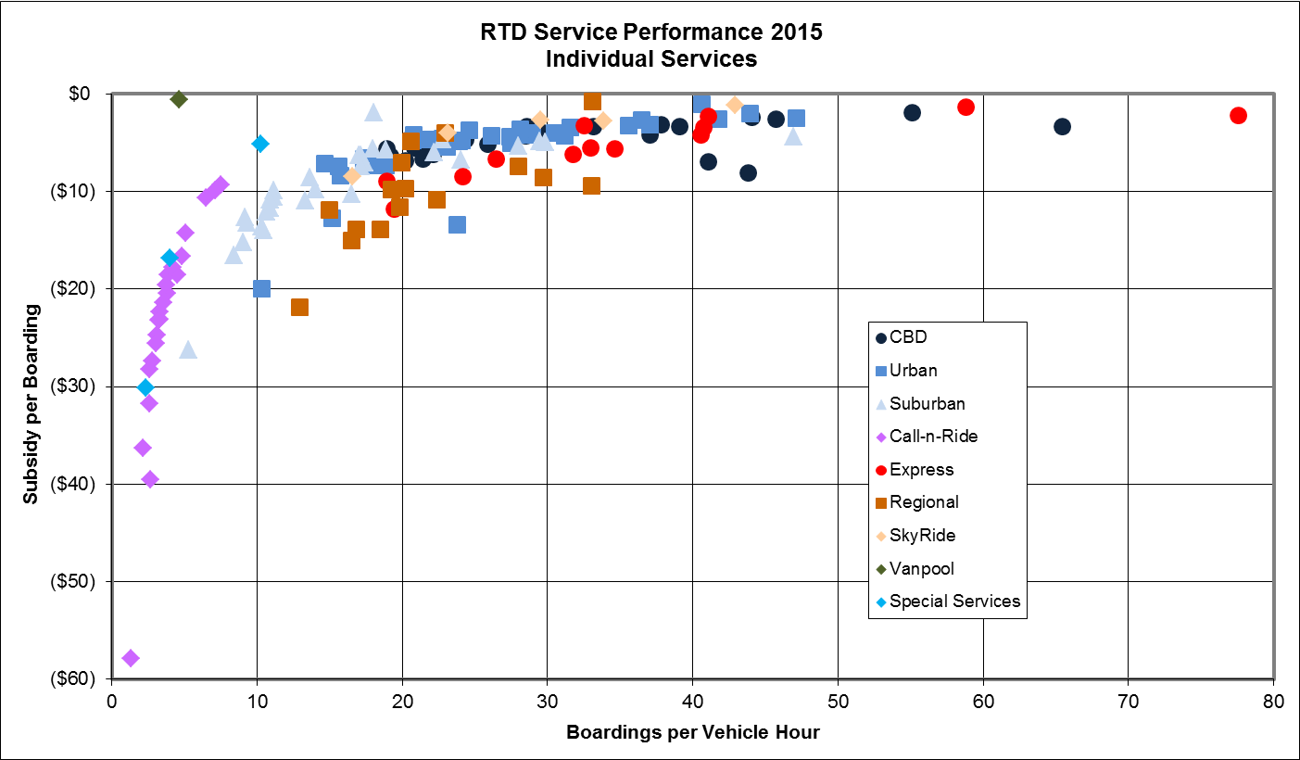
Notes:
So please remember subsidy per boarding customer is in addition to what is put in the farebox.
There is a negative inverse squared relationship between density and productivity.
As this graph shows RTD almost breaks even on a couple of Routes.

Slide 12
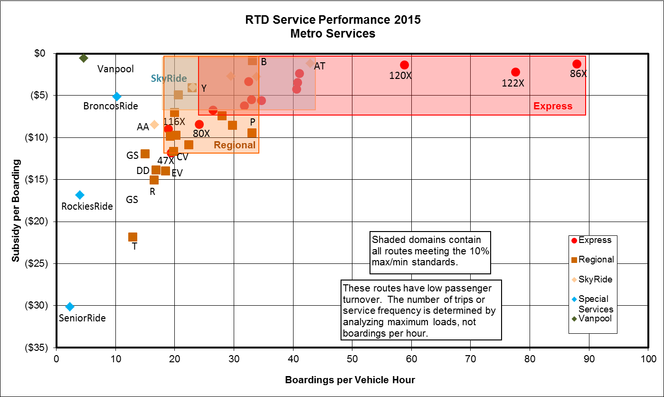
Notes:
Some noteworthy elements:
Those routes that fall out of the 10% and 25% range of their category are vulnerable for termination.

Slide 13
Service Standards
Boardings by service hour
Subisdy per boarding
Frequency
 | Boardings Per Hour
Frequency | Route | Segment-Period
60 - 30 minutes | Minimum for Class | -
15 minutes | 25 - 39 | 35+
10 minutes | 40+ | 45+
Notes:
What is the appropriate level/frequency of service?
By setting a standard in advance we don’t have to guess.
We can also defend ourselves against Municipalities that ask for more than ridership can justify.
Eliminates the Chicken & Egg Problem
“If You Build It, They Will Come” Is sometimes true…

Slide 14
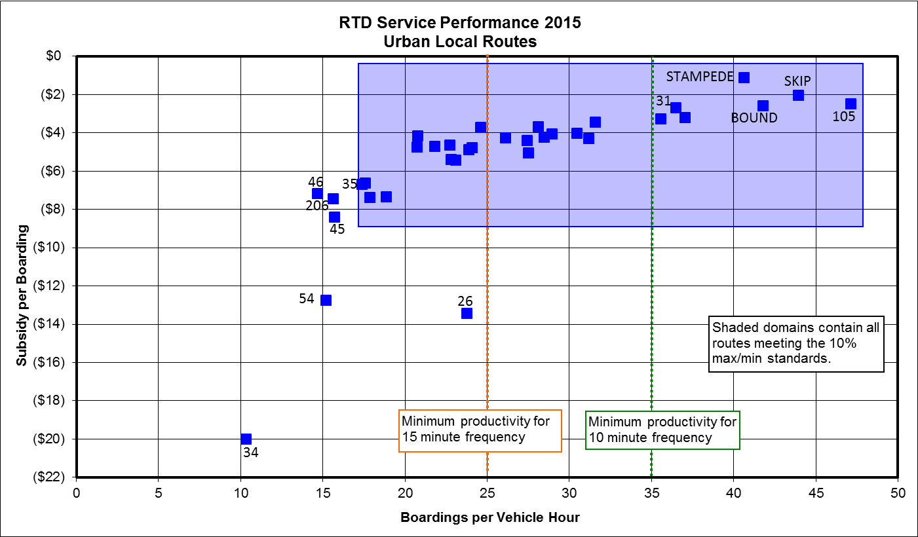
Notes:
This shows how our Service Standards serve as a defensive tool when municipalities ask for an increase in frequency where none is deserved.
Additionally one can see outlying routes that either were changed or soon will be.

Slide 15
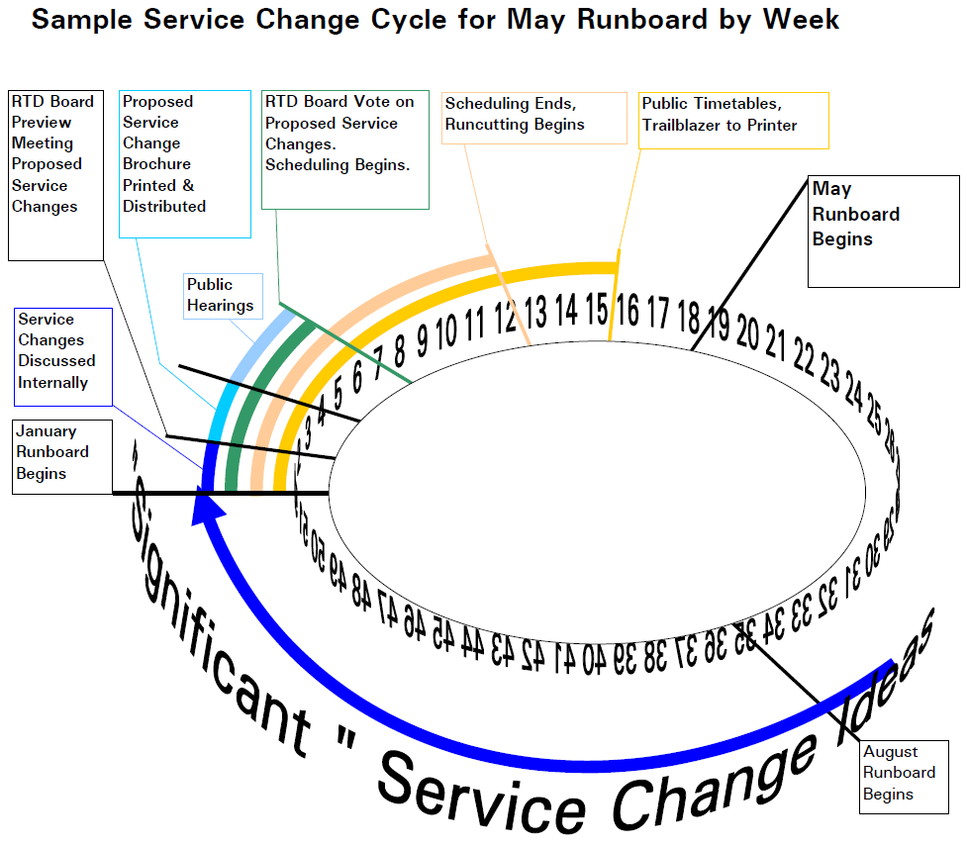
Service Change Process
Notes:
This graphic shows the time constraints that impact “Significant” service changes. It’s actually Major
The Federal Transit Administration (FTA) allows each Transit Agency to define “Major”.
These must have public hearings.
RTD interprets “Significant” changing 5% or more of a route or schedule.
The Collective Bargaining Agreement requires that:
10 Operators vote/hour or 100 Operators/Day.
900 Operators = 9 workdays, plus 1 day for Relief runs and two days for part-timers = 12 Days or 2.5 weeks. Two weeks are added for buffer in case of a re-vote. So that’s 4.5 weeks.
Three workdays before the vote the runs must be posted so that’s 5 weeks.
5 days before the runs are posted, the Runboard Committee must get the work.
So 6 weeks before the runboard starts the runcut must be finished.
3 Weeks before that schedules must be finished.
1 Week before that the Board votes to approve changes.
10 days before that are public hearings.
2 Weeks before the brochures are published and distributed
1 Week before the brochures are sent to the printer.
1 Week before the Board Approves taking the proposed changes to the public.
1 Week before Senior Staff Approves taking the proposed changes to the board.
1 Week before Service Development approves the proposed changes.
1 Week before the Teams hand in their proposed changes to their Manager.
18 x 3 = 54 weeks; The summer gets 2 week less for Scheduling & Runcutting.

Slide 16
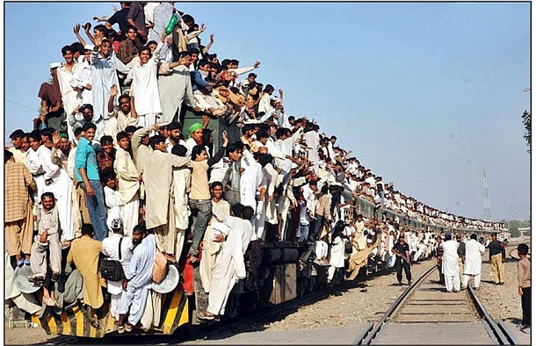
Service Planning
Routing
Frequency
Peak
Base
Weekend
Span of Service
Equipment
Cost/Budget
Operators
Notes:
These are some of the variables used in balancing our choices.
Three legged Stool.

Slide 17
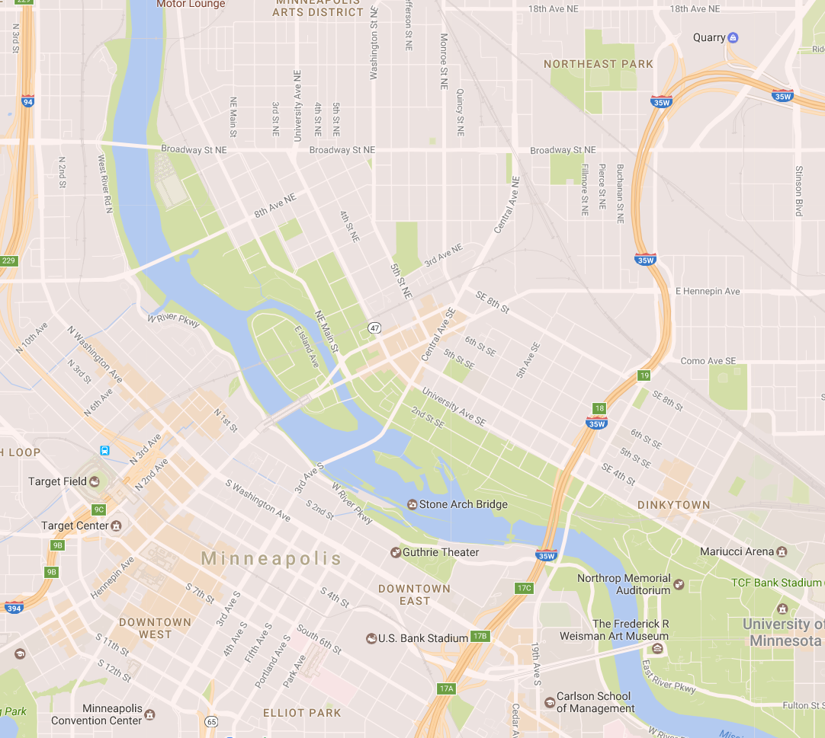
Notes:
Ok so taking a fictional route in Minneapolis.
Imagine if we looked at this route from the side.
Now what if we added a timeline across the bottom.
Then we would get a common route planning tool called a string diagram.

Slide 18
 | 6:00 |  |  |  |  |  | 7:00 |  |  |  |  |  | 8:00 |  |  |  |  |  | 9:00 |  |  |  |  |  | 10:00 |  |  |  |  |  | 11:00 |  |  |  |  |  | 12:00
Notes:
So this simplified version of a string diagram shows three different blocks making an hour headway.

Slide 19
 | 6:00 |  |  |  |  |  | 7:00 |  |  |  |  |  | 8:00 |  |  |  |  |  | 9:00 |  |  |  |  |  | 10:00 |  |  |  |  |  | 11:00 |  |  |  |  |  | 12:00
Notes:
So displaying this in three different colors, helps us see the blocks more easily.
So how many buses does it take to run this service? Would you say 3?
Well experienced Bus and Train Operators would say 4. Can you see why?
Well perhaps the next slide will help you.

Slide 20
 | 6:00 |  |  |  |  |  | 7:00 |  |  |  |  |  | 8:00 |  |  |  |  |  | 9:00 |  |  |  |  |  | 10:00 |  |  |  |  |  | 11:00 |  |  |  |  |  | 12:00
Notes:
Ok, so let’s just look at one block.
See any problem?
(Click) How about now?

Slide 21
 | 6:00 |  |  |  |  |  | 7:00 |  |  |  |  |  | 8:00 |  |  |  |  |  | 9:00 |  |  |  |  |  | 10:00 |  |  |  |  |  | 11:00 |  |  |  |  |  | 12:00
Notes:
Ok, so now if we add some recovery, how many colors do you see?
Yes, this would take a minimum of four vehicles.
“Well”, you might say, “that sounds fine.”
Ok, but how much does that translate to in dollars?

Slide 22
How Much is an All-Day Bus?
1 All-Day Bus = 12 Hours/Day
Weekdays/Year = 255 Days/Year
1 All-Day Bus = 3,060 Hours/Year
Cost/Hour = $50 / Hour
1 All-Day Bus = $153,000 / Year
How Much are 4 All-Day Buses?
1 All-Day Bus = $153,000 / Year
x4
$612,000 / Year
Notes:
So an all-day bus operates for 12 hours.
There are 255 weekdays/year
At $50/Hour, 1 all-day bus is over $150,000.
So four all-day buses/year is over $600,000 each year.
Of course there all alternatives…

Slide 23
 | 6:00 |  |  |  |  |  | 7:00 |  |  |  |  |  | 8:00 |  |  |  |  |  | 9:00 |  |  |  |  |  | 10:00 |  |  |  |  |  | 11:00 |  |  |  |  |  | 12:00
Notes:
Now what if we shortened the Route, what might that do?

Slide 24
 | 6:00 |  |  |  |  |  | 7:00 |  |  |  |  |  | 8:00 |  |  |  |  |  | 9:00 |  |  |  |  |  | 10:00 |  |  |  |  |  | 11:00 |  |  |  |  |  | 12:00
Notes:
Now what if we shortened the Route, Might that save a bus?
Well if we shift the trips…

Slide 25
 | 6:00 |  |  |  |  |  | 7:00 |  |  |  |  |  | 8:00 |  |  |  |  |  | 9:00 |  |  |  |  |  | 10:00 |  |  |  |  |  | 11:00 |  |  |  |  |  | 12:00
Notes:
Hook the trips together…

Slide 26
 | 6:00 |  |  |  |  |  | 7:00 |  |  |  |  |  | 8:00 |  |  |  |  |  | 9:00 |  |  |  |  |  | 10:00 |  |  |  |  |  | 11:00 |  |  |  |  |  | 12:00
Notes:
And add some color, we see that we do indeed save a vehicle.
Looking carefully, we’ll see these two blocks are hovering at just around 10% recovery.
That’s not recommended.
But wait there’s more. If you act now, you can actually save another route that’s even in more trouble…

Slide 27
 | 6:00 |  |  |  |  |  | 7:00 |  |  |  |  |  | 8:00 |  |  |  |  |  | 9:00 |  |  |  |  |  | 10:00 |  |  |  |  |  | 11:00 |  |  |  |  |  | 12:00
Notes:
Here we have another route with no recovery.
Poor Route – Poor Customers – Poor Driver!
If only there were something someone could do?

Slide 28
 | 6:00 |  |  |  |  |  | 7:00 |  |  |  |  |  | 8:00 |  |  |  |  |  | 9:00 |  |  |  |  |  | 10:00 |  |  |  |  |  | 11:00 |  |  |  |  |  | 12:00
Notes:
First we’ll add some color.
Then we’ll add some new hooks, and we find
Every 2nd trip gets a 36 minute recovery.
So 4 hours is 240 minutes – 72 minutes of recovery is 168 minutes So that’s around 40% recovery.
But many Operators would say, big deal, the routes are still all screwed up. Well we’d contend that most routes have at least one rough spot, but there’s a reason for that…

Slide 29
How Many Running Times?
Rail 8
SkyRide 5
Local/Limited 110
Regional +16
Total Routes 139
Directions/Route x2
Total Directions 278
Patterns/Dir. x5
Total Patterns 1,390
Time Points/Pattern x10
Total Timepoints 13,900
Running Time Breaks/Timepoint x5
Total Running Times 69,500/ 34,750 17,375
Service Planner/Schedulers 11
Running Times/Service Planner 6,319 3,160 1,580
Notes:
We are swimming under an ocean of Running Times.
There’s another thing to consider There’s a bell curve for Bus Operator driving styles.
There was this Driver named John…
There’s something else to consider
According to Governing Magazine Monday traffic is 25% better than average, and Friday is 6% worse than average.
We’ve discussed writing the schedules by day of week, and perhaps eventually by day of year, but trying to design bus-train meets with different running times by time of day and day of week, not to mention communicating different times to the customers, well there’s obvious limitations.
But if we look at how many running times each Service Planner/Scheduler has to maintain, it amazing we are doing this well.
In fact we are purchasing new scheduling software to speed up our maintance.

Slide 30
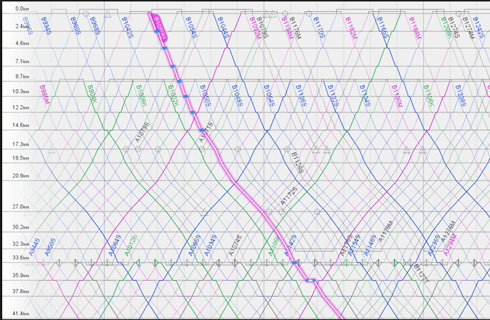
Scheduling
Frequency
Running Time
Recovery
Blocking & Interlining
Notes:
So here we have an actual string diagram for a rail line.
This graph demonstrates
Frequency - distance between the lines horizontally
Running Time – slope of the lines
Recovery – by the distances at the top/bottom of the lines
Blocking – Color of lines and hooks at the top/bottom
Interlining – none which is also seen at the top/bottom of lines.

Slide 31
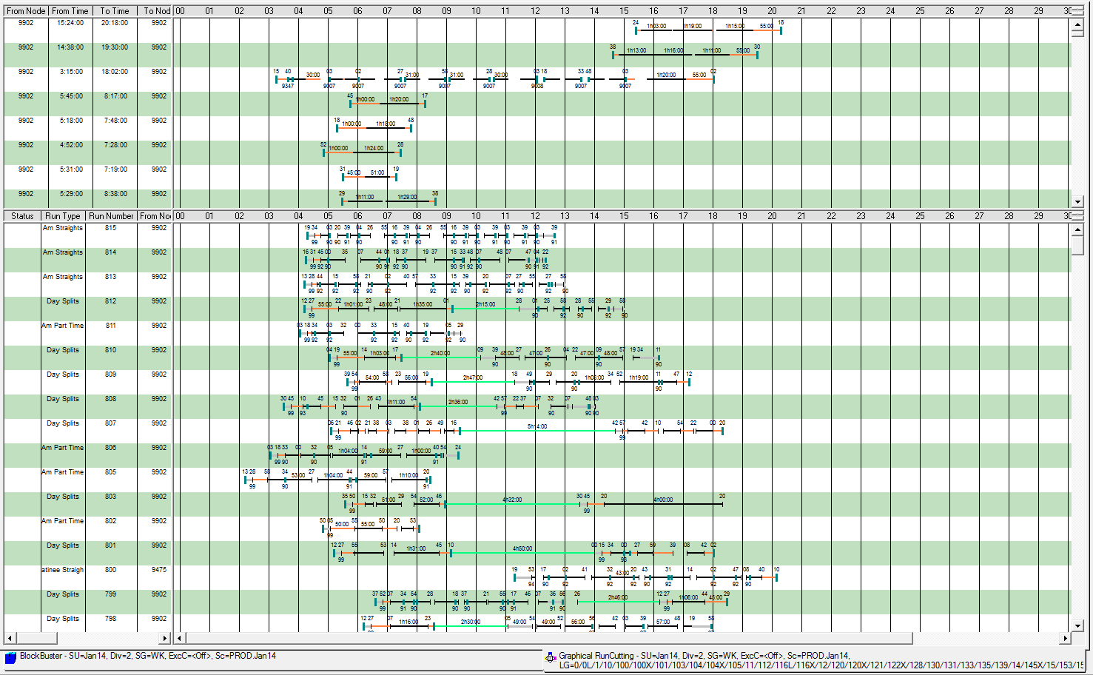
Runcutting
Divides service into workable pieces
Rules defined in Collective Bargaining Agreement
Notes:
Then there’s runcutting.
So if we have a bus that’s out on the street for 20 hours, and a school tripper that’s out for only 1 hour how would they get cut.
Obviously the 1 hour piece will need to get combined with another run to make a split.
But the 20 hour piece

Slide 32
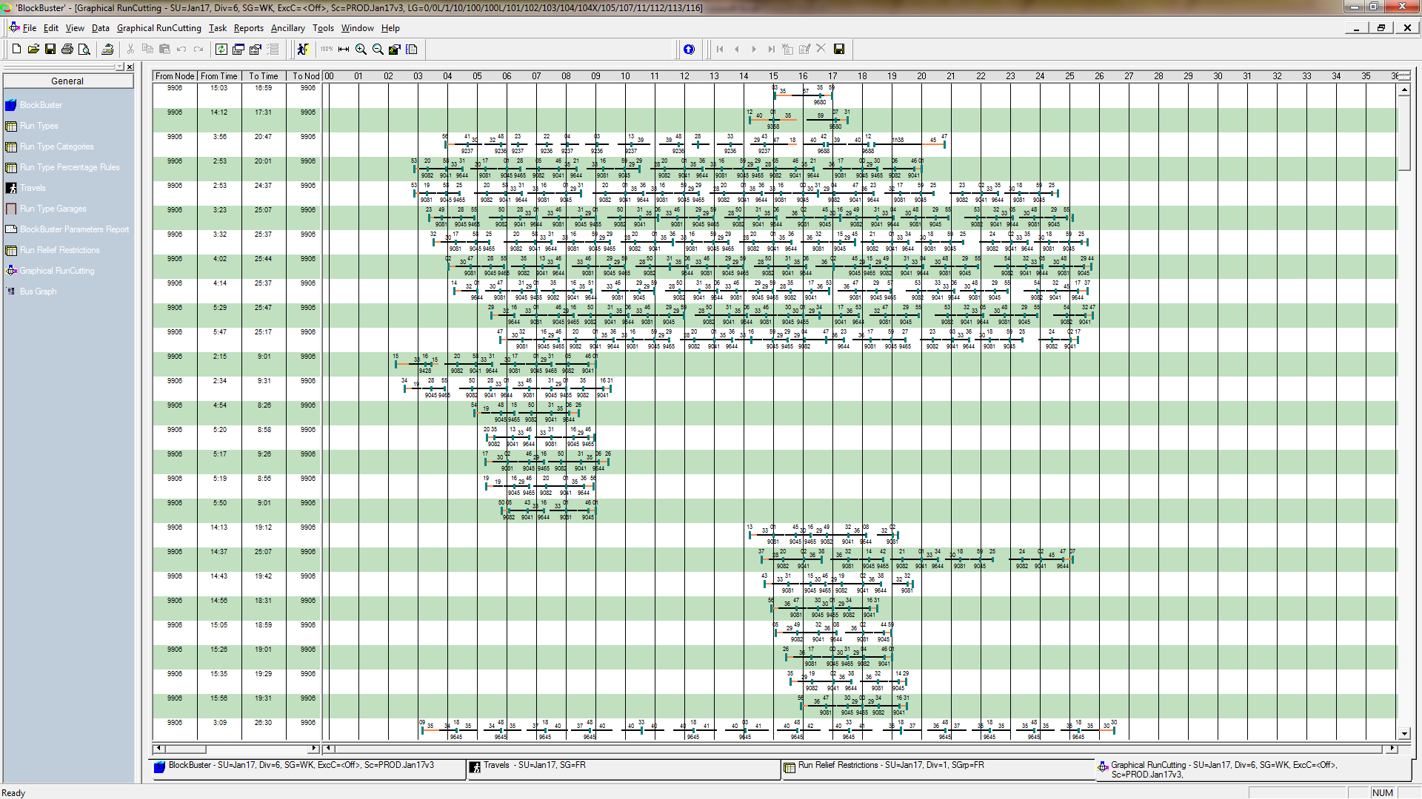
Runcutting
Divides service into workable pieces
Rules defined in Collective Bargaining Agreement
May 2017 Runcuts
Wk Sa Su
LRT 115 85 79
PL 348 160 125
Bo 135 40 33
EM 279 144 128
Total 877 429 362
Potential Combinations = 1 – 3 Googol
Notes:
Here we see that on each blocks there are a finite amount of opportunities when/where we can make relief.
Of course we have an obligation to do follow the Collective Bargaining agreement.
But we are also tasked with spending tax payer money wisely.
So with over 1 Googol possible runcut solutions
1 followed by 100 zeros
We need a computer to even begin to look at as many combinations as possible.
We currently check for 11 quality control items.
But we average 25 final cuts/garage, so that’s over 20,000 runs for Wk alone.
So we’re limited as to checking the quality of the runcuts.

Slide 33
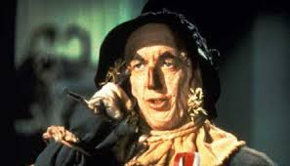
Review
140 Routes.
Numerous areas of input.
1 Weekday bus = $150k/yr.
4-Month Turnaround for “Major” (5%) Route changes.
2015 Average Subsidy/Passenger = $4.53/Passenger.
11,000 Running Times/Service Planner.
2 Googol Possible Runcutting Solutions.
Over 20,000 Weekday Runs to proof.
Notes:
So Lots of Routes that we inherited
Numerous ways to study them APC, CAD/AVL, Service Monitors, Operator Comments
Just one all-day bus is pretty expensive
There is a limit to how quickly we can make Major changes.
As long as roadways and airlines are subsidized so will transit, but we can aspire to break even
Currently Service Planner/Schedulers have a good deal of Running times to monitor
The sheer volume of runcut possibilities means computerized runcutting necessary
With over 20K solutions to proof, limited abilities to judge quality.

Slide 34
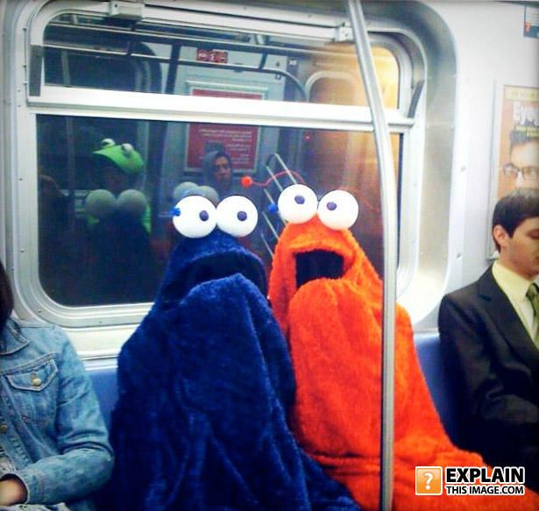
Questions?

